Slide 1
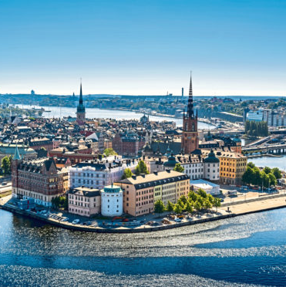
Registered Voters Income for year 1910, 1912-14, 1916-18
Name: Inelda Shinko Rama
Course: statistical analysis II
Student id: 21362991

Slide 2
Summary
The original data examine the rise and mobilizational dynamics of social democracy employing data reported by the Swedish authorities on the distribution of voting eligibility, turnout and partisan vote in local elections during the 1910s at a high level of disaggregation.
The data set used is (“3ab_replication.csv”, “2ab_replication.csv”, "local-national-tot_mes_replication.csv") which has 11 variables and 234 observations, 13 variables and 156 observations and respectively.
This analysis focuses the following groups: such as Party lab(that is, Conservative, Liberal and Socialist) and Party2(that is Eligible and Turnout).

Slide 3
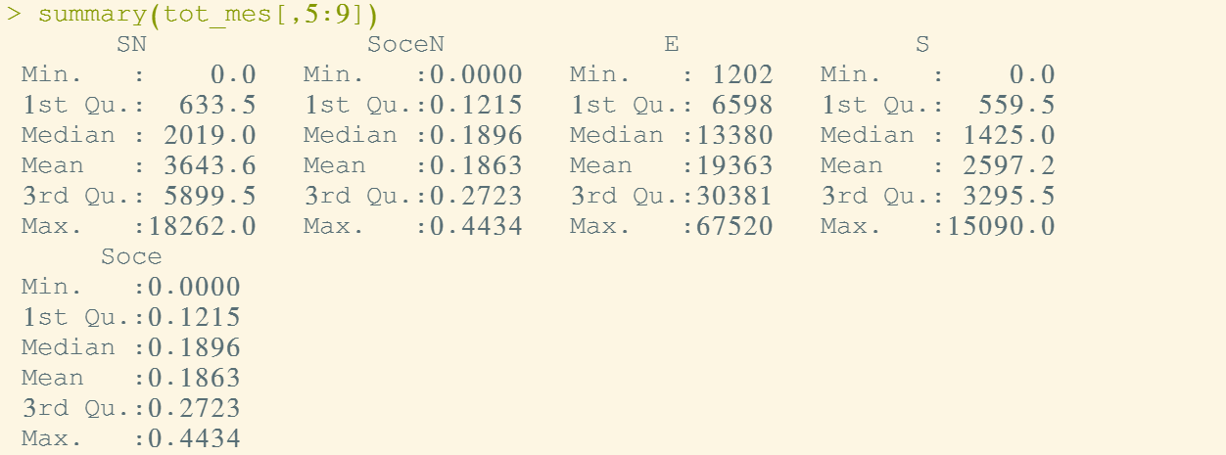
Results
I run the summary for the data local-national to determine the mean and standard deviation for numeric variables.
From the results SN has a mean of 3643.6. The maximum value is 18262.0 and the minimum is 0.0

Slide 4
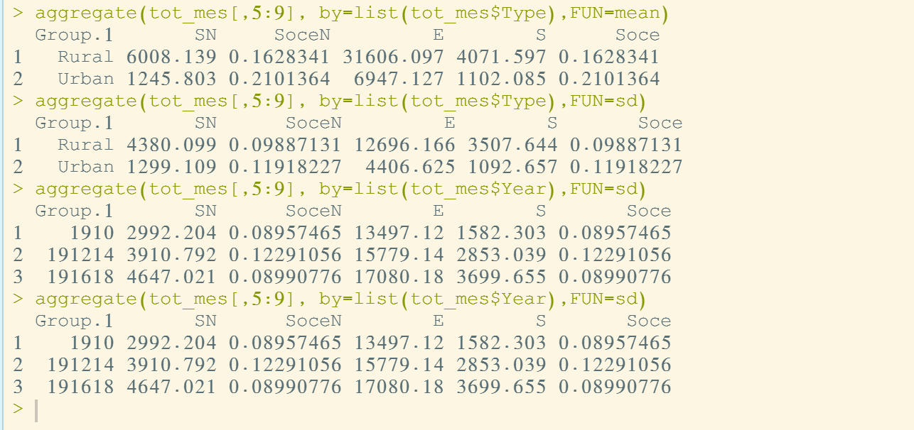
Continued…
Also, I did aggregation (mean and standard deviation) by grouping the results according to Type(rural and urban) and Year (that is, 1910, 1912-14, 1916-18). From the results, it’s clear rural has the highest average of SN, E, S, while urban dominates the SoceN and Soce.

Slide 5
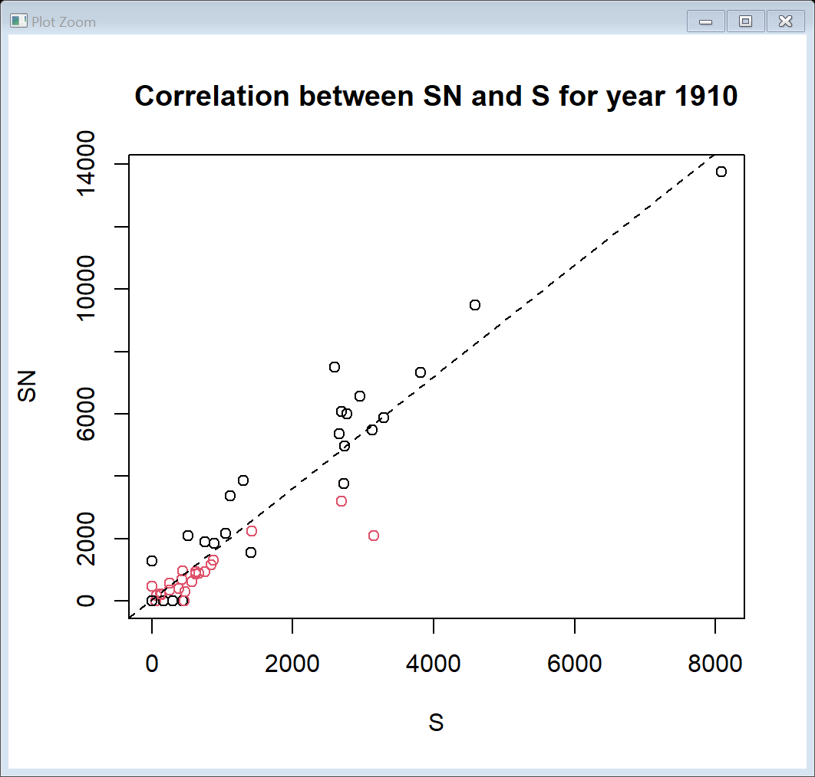
Continued…
Created a correlation plot for the different variables within the data set. The plot examines the correlation between variable SN and S. For the year 1910, it’s observed the data point are close to the linear line, thus the data has a normal distribution.

Slide 6
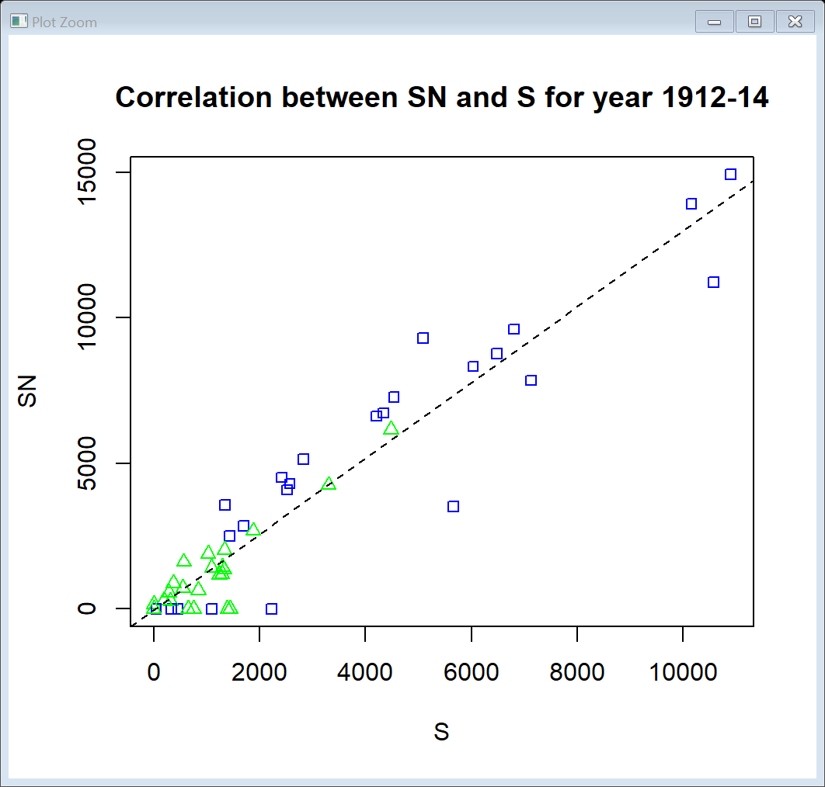
Continued…..
For the year 1912-14, the correlation between SN and S for different location (rural and urban) is as shown.
It’s observed the data point are close to the linear line, thus the data has a normal distribution.

Slide 7
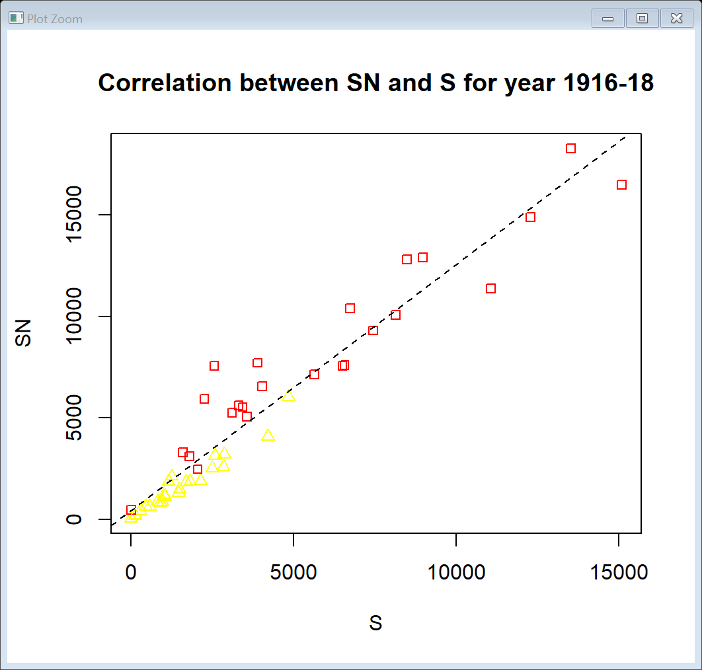
Continued…..
For the year 1916-18, the correlation between SN and S for different location (rural and urban) is as shown.
It’s observed the data point are close to the linear line, thus the data has a normal distribution.

Slide 8
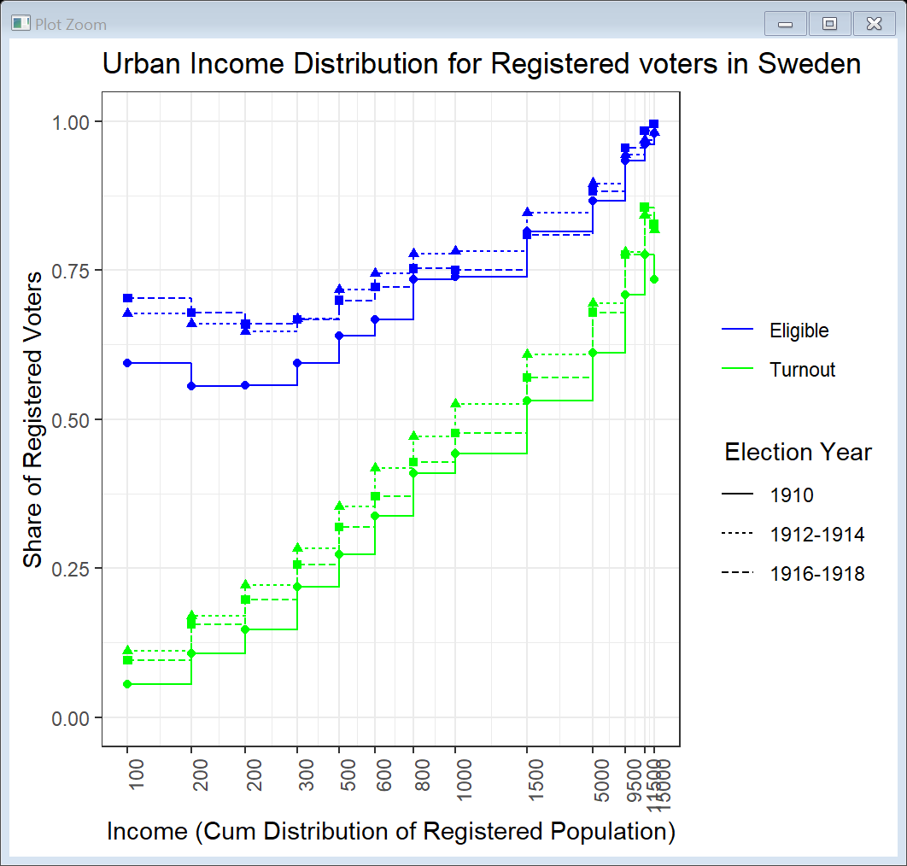
Results
This plot examines the eligible and turnout for urban voters inn different election years from the data 3ab_replication and 2ab_replication.
From the plot it’s evident that the income distribution of eligible voters was higher than the turnout.
Between year 1912-14, the income was high for eligible voters compared to other years.

Slide 9
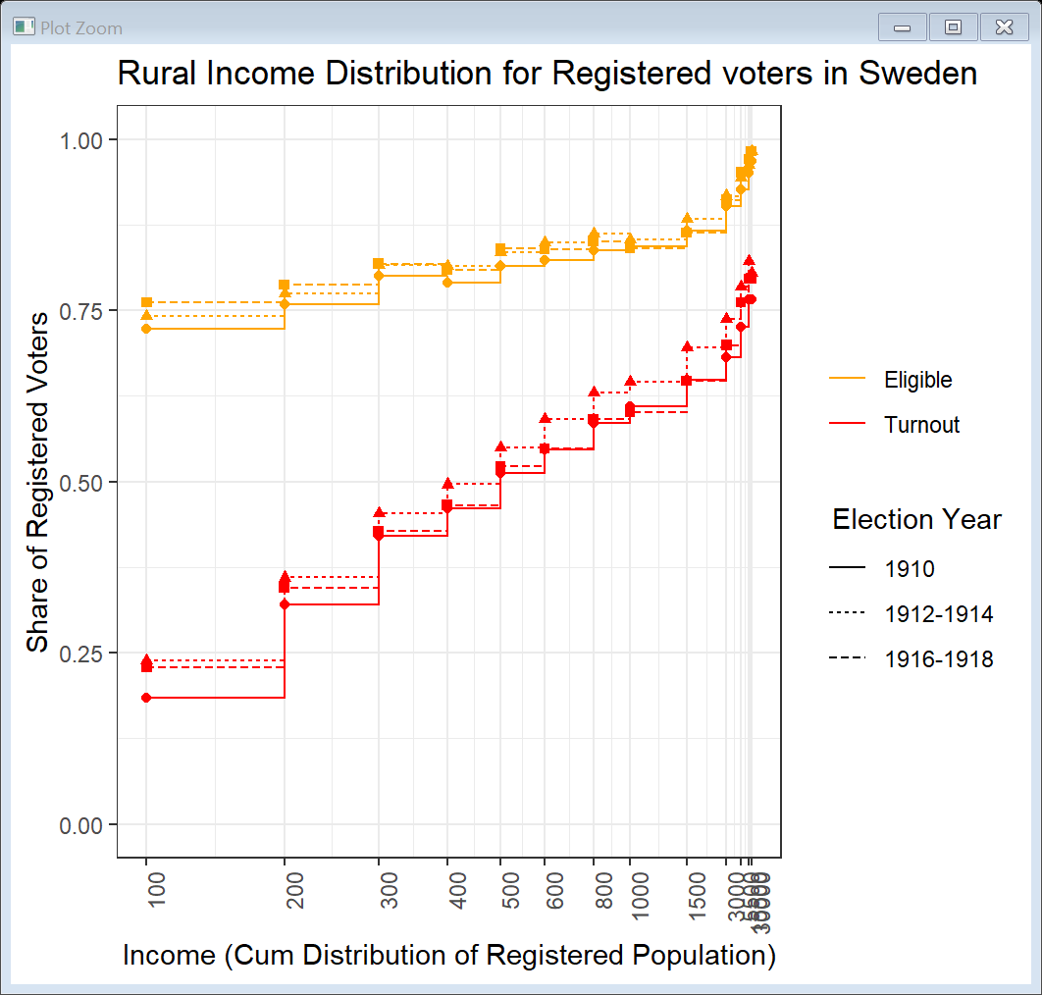
Continued…
This plot examines the eligible and turnout for rural voters in different election years.
From the plot it’s evident that the income distribution of eligible voters was higher than the turnout.
Between year 1912-14, the income was high for eligible voters compared to other years.

Slide 10
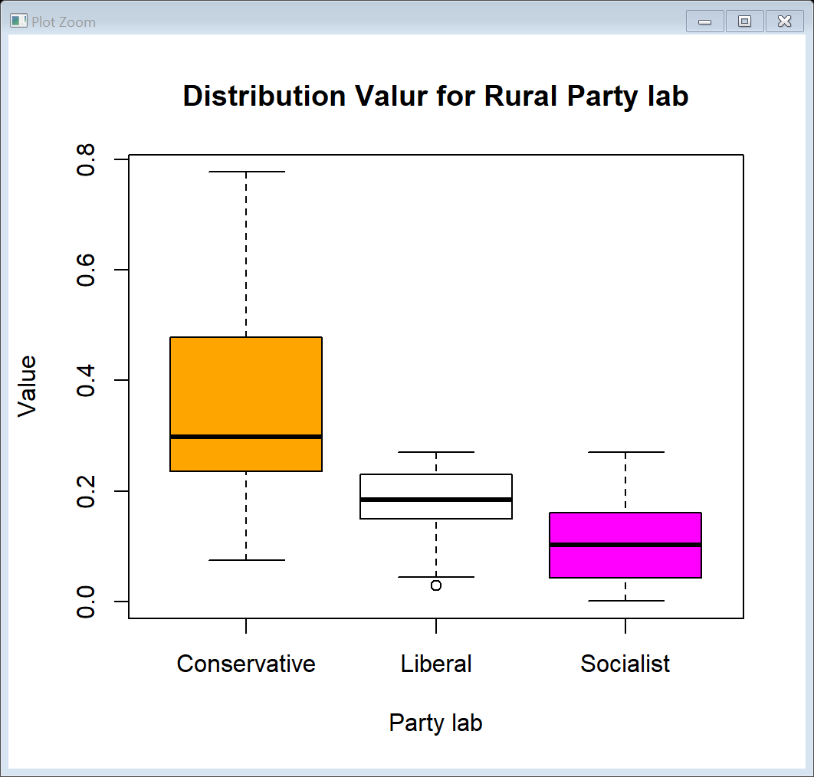
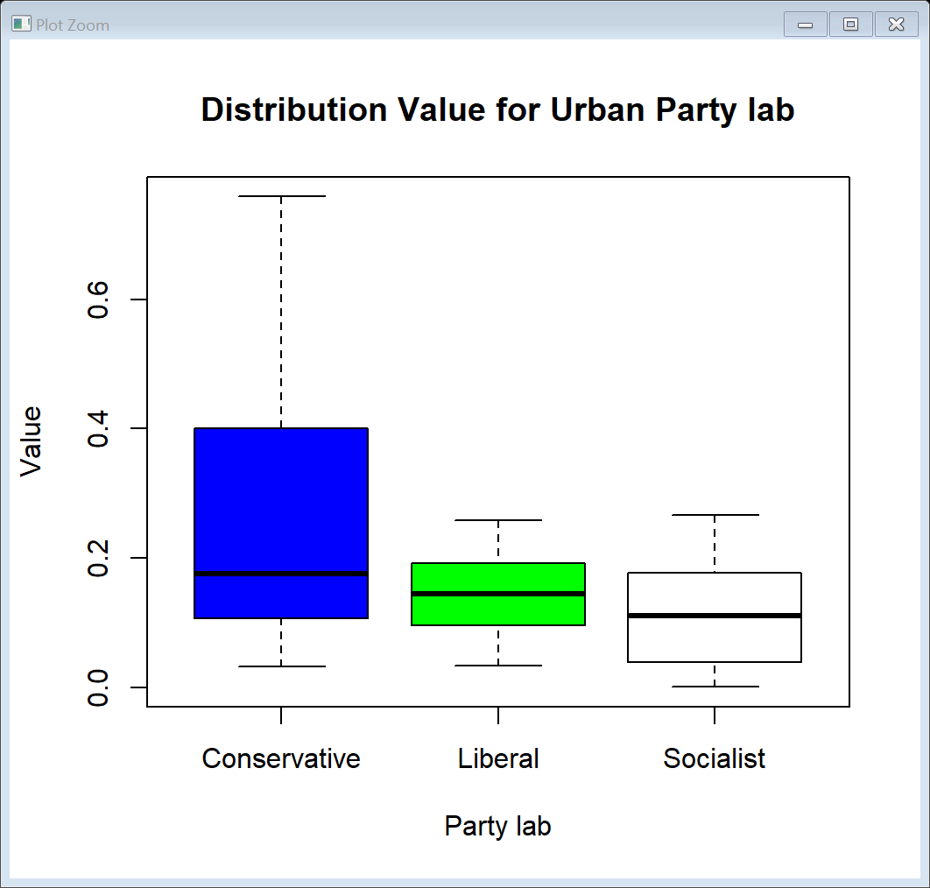
Continued…
The plot below shows that mean of value for conservative voters is relatively higher compared to Liberal and socialist.
The plot above shows that the mean of value for conservative voters is higher compared to Liberal and socialist.

Slide 11
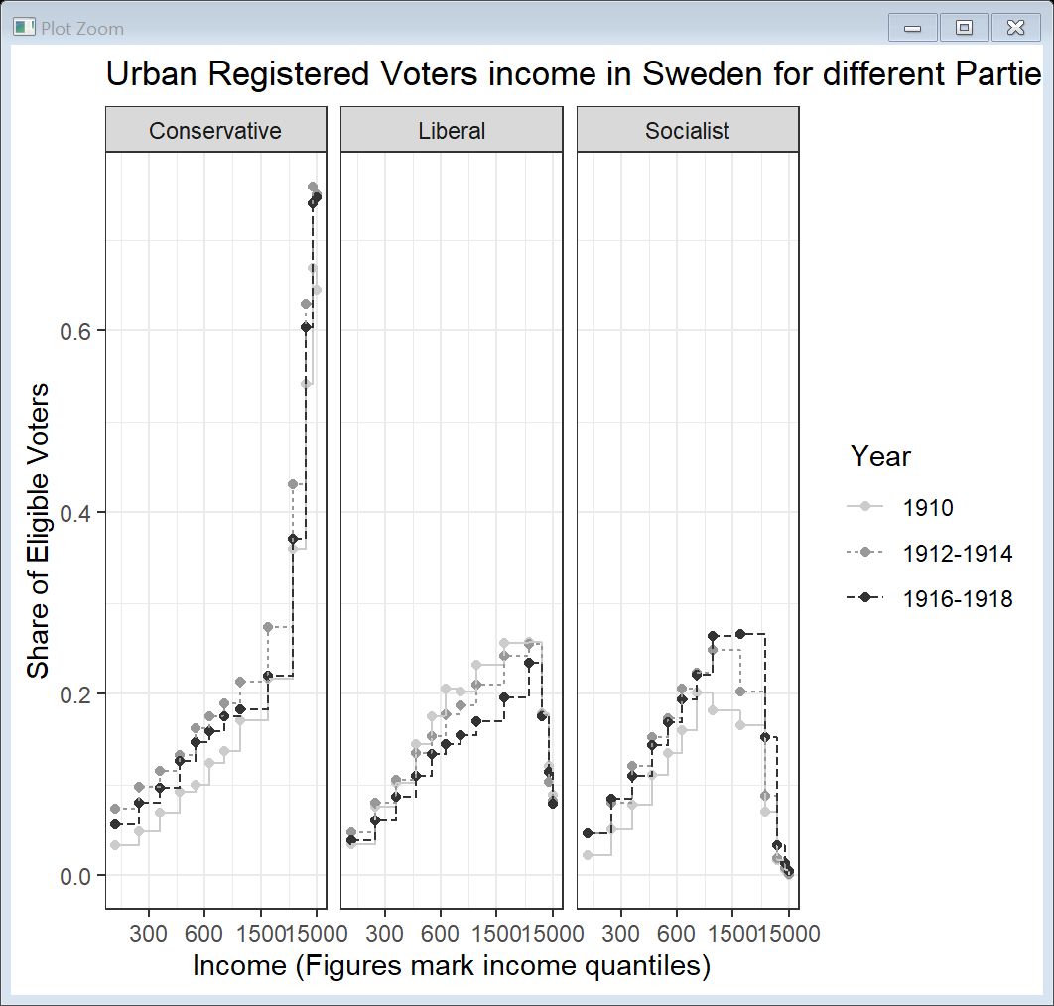
Continued…
This plot examines the income distribution for different parties during election years.
From the plot it’s evident that the income distribution for rural Conservative voters is higher compared to other Liberal and Socialist.

Slide 12
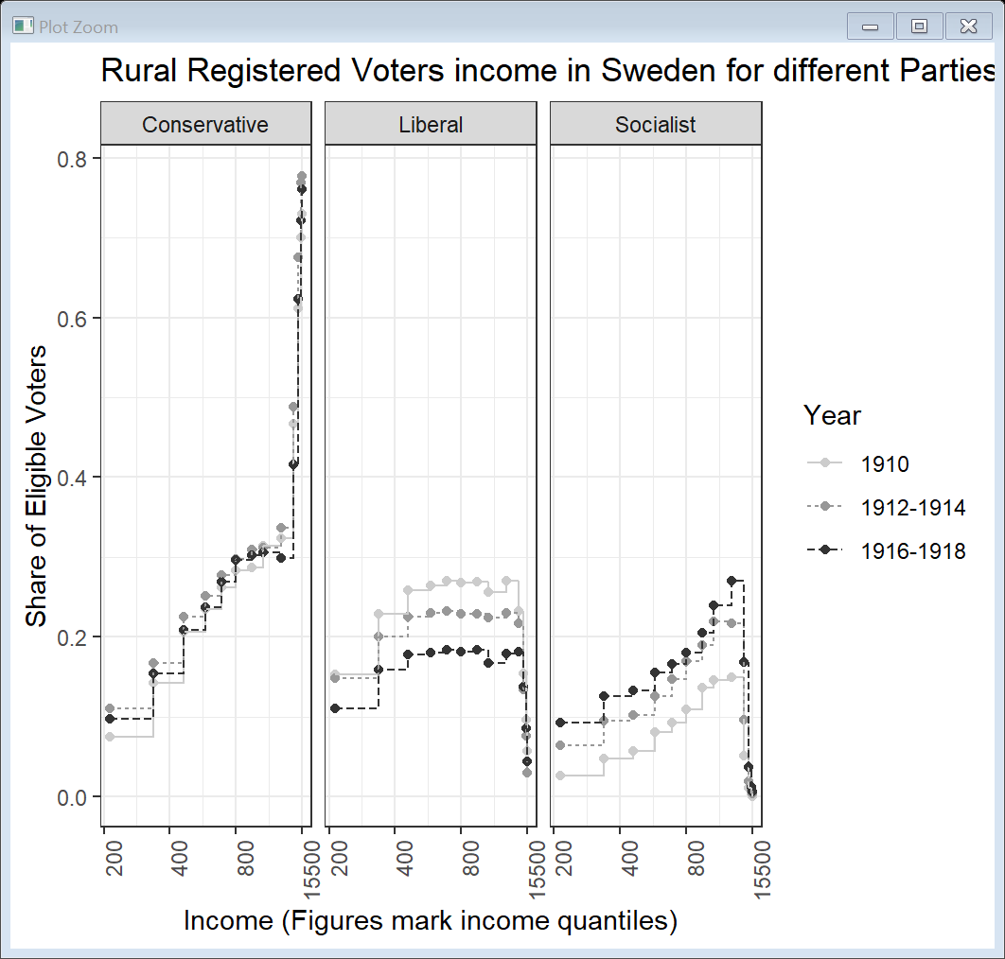
Continued…
This plot examines the income distribution for different parties during election years.
From the plot it’s evident that the income distribution for rural Conservative voters is higher compared to other Liberal and Socialist.

Slide 13

Link to dataset
https://dataverse.harvard.edu/dataset.xhtml?persistentId=doi:10.7910/DVN/TEI3YZ

