Slide 1
Securing User Browsing: Comparing Browsers and Extensions Effectiveness against XSS Attacks
Team-member names:
Anmol Singhal
Ishit Vasoya

Slide 2

Introduction
Idea: Conducting XSS attacks on vulnerable website on 6 different browser under three conditions:
With extension to mitigate XSS
Without extension to mitigate XSS
With Content Security Policy
Goal : To tell which browser is the safest with which configuration to mitigate XSS attack.

Slide 3
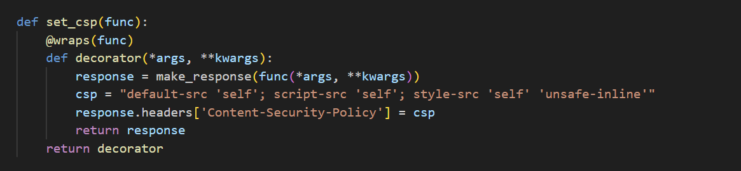
Content security policy

Slide 4
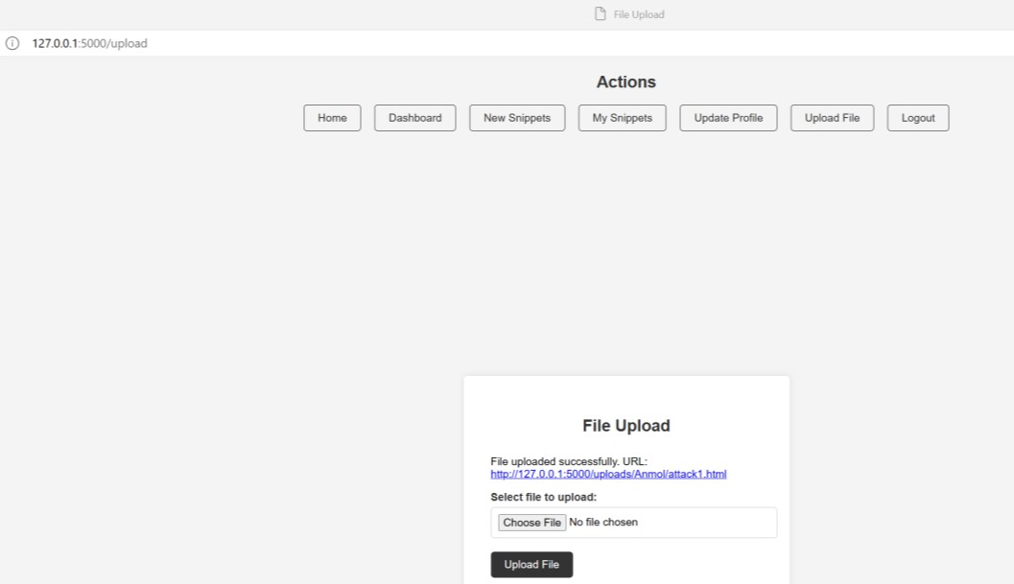
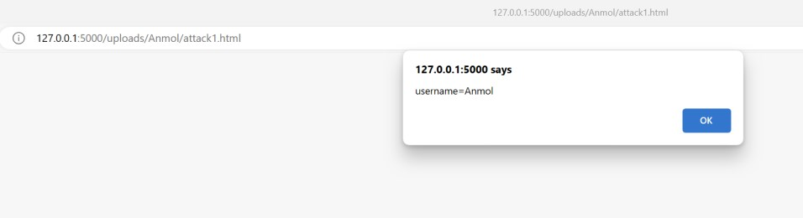
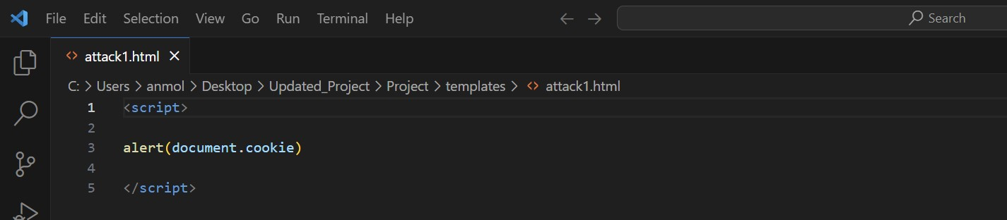
Attacks
Attacks: This is a vulnerable website; it has 5 vulnerabilities in it which we can exploit to do XSS attacks. Below is the description of all the attacks one by one.
Attack1: File Upload: Once the file uploads it gives a URL, when we click this URL, it opens the file and malicious script is executed on the user’s system.
Attack1.html is the file we will use for each file upload attack throughout the experiments.

Slide 5
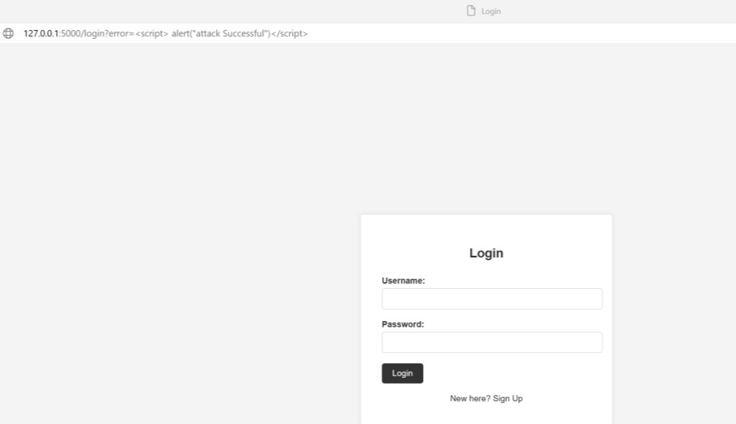
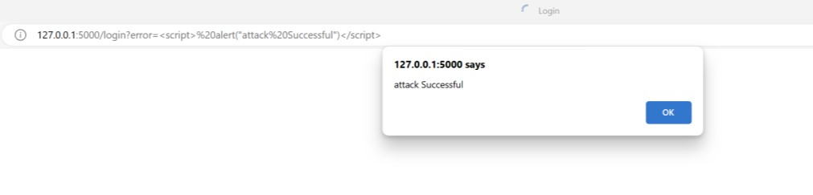
Attacks
Attack2: URL: If you go to login page and add this script? error=<script>alert ("Attack Happened”) </script> in the URL or any other script where the current text of URL ends, and press enter the malicious script will be executed.

Slide 6
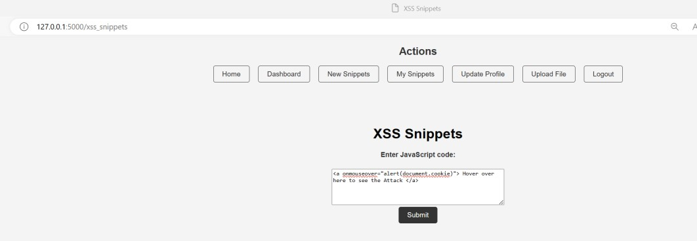
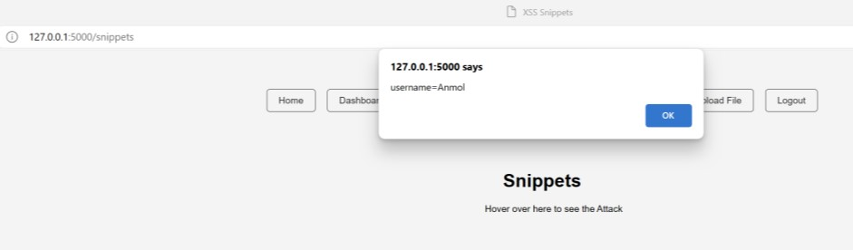
Attacks
Attack3: Snippets: If you go to new snippets page and add script like <a onmouseover="alert(document.cookie)"> Hover around here...</a> in the text box, or any other script, and press submit, Post this if we go to my snippet page and hover on the text we will the malicious script is executed.

Slide 7
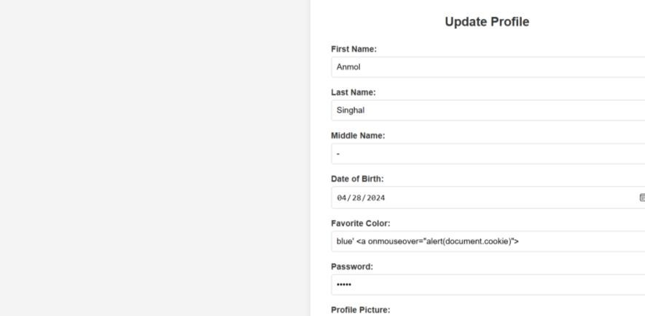
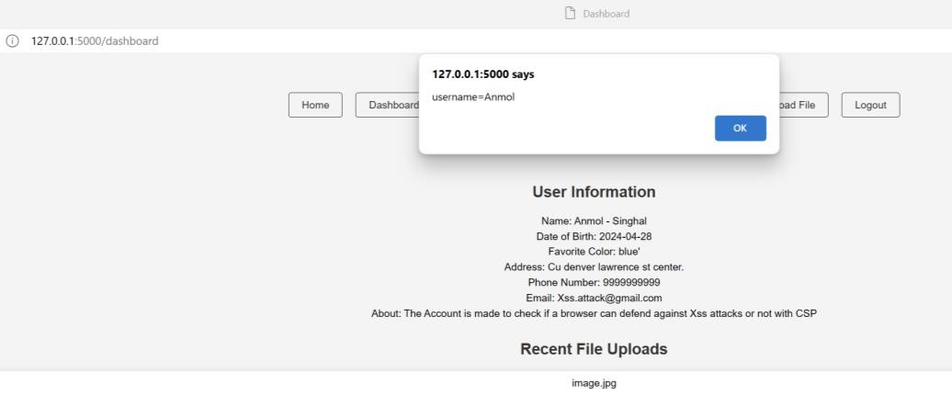
Attacks
Attack4: Text Box: If you go to update profile page and add script in the favorite color text box after writing the color blue' <a onmouseover="alert(document.cookie)"> and click on update and then go to dashboard.html page and Hover around where the favorite color blue is written, we will the malicious script is executed.

Slide 8
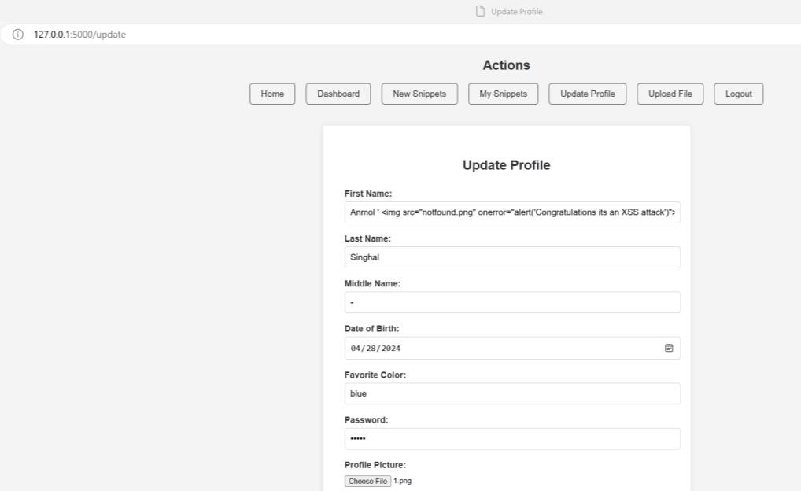
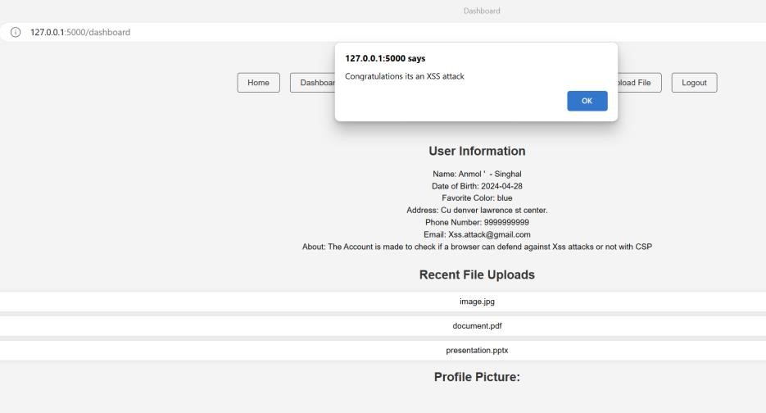
Attacks
Attack5: Image: If you go to update profile page and add script in the First name text box after writing the name '<img src="notfound.png" onerror="alert('Congratulations, XSS attack')" and put any other image in profile picture make sure that the notfound.png does not exist click on update and then go to dashboard.html page and when you open the page there will be an error and you will see the malicious script is executed.

Slide 9
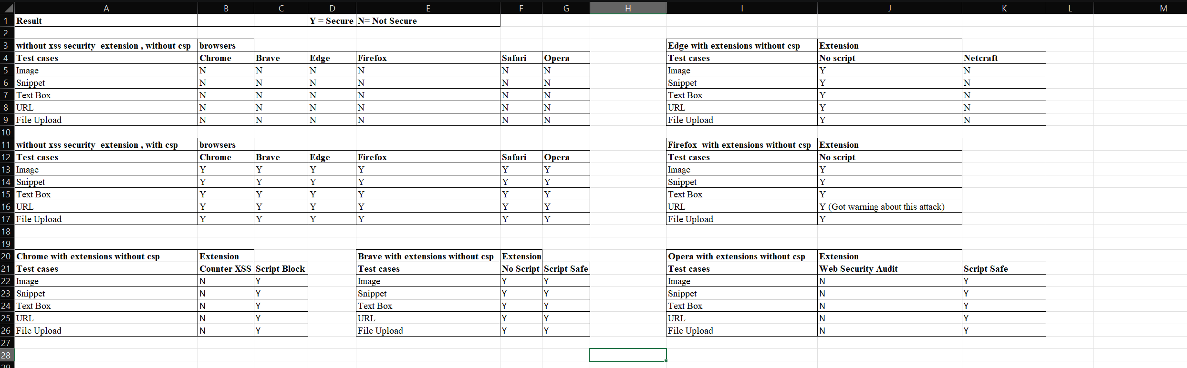
Results

Slide 10
Results
1. Without extensions and CSP, none of the six browsers were secure against even simple attacks.
2. With CSP, all attacks were mitigated by all browsers, making the website safe.
3. Netcraft, Web Security Audit, and CounterXSS, which claim to mitigate JavaScript code, did not work against attacks, even against the attacks with clear <script> tag.
4. NoScript, supported by most browsers, mitigated all attacks on Brave, Edge, and Firefox. However, on Firefox, the URL
attack showed a special warning, making NoScript work best on Firefox.
5. Chrome's ScriptBlock and Brave's NoScript and ScriptSafe performed well.
6. Safari iOS claims to be the most secure browser, but without extensions and CSP, all attacks were successful, refuting its security claims. Moreover, available extensions were limited and paid.

