Slide 1

INFORMATION THEORY MINI PROJECT
Image Entropy Analyzer
From pixel distributions
to statistical uncertainty
Information Theory Mini Project
Ishita Sahu
Synthetic test image
Python · Streamlit · Reproducible experiments
ISHITA SAHU / IMAGE ENTROPY ANALYZER
01
Notes:
Approximate speaking time: 20 seconds.
My project turns an uploaded image into a probability distribution and uses Shannon entropy to describe uncertainty in its pixel values. I will show the mathematical model, how the Python modules implement it, and what controlled experiments tell us. The landscape shown here was generated for testing; it is not a photograph.

Slide 2

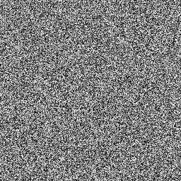
INFORMATION THEORY MINI PROJECT
What can a pixel distribution tell us?
Problem
Images look different; we need a precise statistical comparison.
Motivation
Counts and probabilities make uncertainty measurable.
Constant → predictable
Noise → nearly balanced counts
Research question
How does the intensity distribution change entropy?
ISHITA SAHU / IMAGE ENTROPY ANALYZER
02
Notes:
Approximate speaking time: 30 seconds.
Looking at an image tells us about its appearance, but not a numerical uncertainty. I choose a narrow question: if I sample a pixel location, how uncertain is its intensity? A constant image is predictable. Random noise spreads the counts much more evenly. These examples motivate the model, without treating entropy as a quality score.

Slide 3
INFORMATION THEORY MINI PROJECT
Objectives we can check
Measure and explain grayscale intensity uncertainty.
Compute
Compare
Histogram → probabilities → entropy
RGB channels and multiple images
Interpret
Verify and export
Fixed maximum, normalization and deficit
Known inputs, measured results and CSV
ISHITA SAHU / IMAGE ENTROPY ANALYZER
03
Notes:
Approximate speaking time: 25 seconds.
The main objective is to connect Information Theory to decoded image data. I can check each stage: counts must equal the pixel count, probabilities must sum to one, known distributions must give known entropy, and the exported values must match the analysis. The interface supports both exploration and explanation.

Slide 4
INFORMATION THEORY MINI PROJECT
Shannon entropy: average surprise
H(X) = −Σ pᵢ log₂(pᵢ)
Symbol | Meaning
X | Intensity at a uniformly selected pixel location
pᵢ = nᵢ / N | Count of intensity i divided by total pixels
Σ over pᵢ > 0 | Average weighted surprise; zero bins contribute 0
log₂ | Base 2 gives bits per grayscale pixel sample
[1] Shannon (1948), A Mathematical Theory of Communication · Full references: slide 16
04
Notes:
Approximate speaking time: 45 seconds.
X is the intensity at a uniformly selected pixel location. For each occurring intensity, I divide its count by the total pixels to obtain p. Minus log base two of p is that outcome’s surprise. Multiplying by p and adding gives average surprise. The implementation excludes zero entries so it never takes log of zero. The result concerns this marginal model, rather than the joint information in an entire image.

Slide 5

INFORMATION THEORY MINI PROJECT
An image becomes 256 intensity counts
One occupied level
Four equal-frequency levels
256 nearly balanced levels
8-bit grayscale: i ∈ {0,…,255} pᵢ = count(i) / N
Brightness range and probability balance are different properties.
Implementation: image_utils.grayscale_array → entropy.calculate_histogram → calculate_probabilities
05
Notes:
Approximate speaking time: 30 seconds.
Pillow converts the decoded image to 8-bit grayscale, so the alphabet has 256 values. NumPy counts how often each one occurs, then divides by the total. The four-band image spans black to white but has only four levels. That illustrates why a broad intensity range does not itself imply entropy near eight. Balance and support size both matter.

Slide 6
INFORMATION THEORY MINI PROJECT
Architecture: reuse one numerical analyzer
Upload bytes
Decode + EXIF
Grayscale array
app.py
image_utils.py
image_utils.py
Plots + CSV
Hnorm + deficit
Counts → p → H
app.py
entropy.py
entropy.py
RGB branch: loaded image → three 2D arrays → same analyze_image()
Comparison: repeat the grayscale pipeline for each uploaded file.
ISHITA SAHU / IMAGE ENTROPY ANALYZER
06
Notes:
Approximate speaking time: 40 seconds.
app.py owns the interface, image_utils.py owns decoding and representation, and entropy.py owns the calculations. Data moves from bytes to a Pillow image, then a two-dimensional uint8 array, then a result dictionary. The RGB branch starts from the loaded colour image. Each channel reuses exactly the same analyzer. Comparison repeats the main grayscale pipeline, so it is a consistent method across files.

Slide 7
INFORMATION THEORY MINI PROJECT
Methodology: count, normalize, summarize
Stage | Actual operation | Reason
Preprocess | EXIF transpose; convert("L") | Analyze a consistent 8-bit representation
Count | bincount(image.ravel(), minlength=256) | One frequency for every legal intensity
Normalize | p = histogram / histogram.sum() | Turn counts into empirical probabilities
Summarize | H = −sum(p[p>0] × log₂(p[p>0])) | Compute mean surprise without log₂(0)
Hmax = 8 Hnorm = H/8 R = 100(1 − Hnorm)%
R is an entropy deficit, not a measured compression saving.
ISHITA SAHU / IMAGE ENTROPY ANALYZER
07
Notes:
Approximate speaking time: 40 seconds.
The histogram is built once from the validated samples. Dividing by its total makes the probabilities sum to one. Entropy uses the positive bins. The maximum is fixed at eight, even when only a few values occur. Normalized entropy is clipped to zero through one in the helper. The redundancy label means the deficit relative to that eight-bit reference; no compressor is run and it is not a guaranteed saving.

Slide 8
INFORMATION THEORY MINI PROJECT
Implementation and technology stack
Library | Role in this project
Python | Module structure, functions and control flow
Streamlit | Uploads, tabs, caching, tables and downloads
Pillow | Decode bytes, correct EXIF, grayscale/RGB conversion
NumPy | Arrays, counting, probabilities and log₂
Matplotlib | Histogram, probability and entropy comparison plots
Pandas | Result DataFrames and CSV text
Project files
app.py
entropy.py
image_utils.py
requirements.txt
README.md
ISHITA SAHU / IMAGE ENTROPY ANALYZER
08
Notes:
Approximate speaking time: 30 seconds.
All six libraries shown are confirmed in the requirements or source. Streamlit runs the script as an interactive application. The cached function covers image loading and main grayscale analysis, while RGB and plots can be recomputed. Keeping entropy.py independent of the browser made it possible to test tiny arrays directly. The requirements are unpinned; the experiment manifest records the versions actually used.

Slide 9
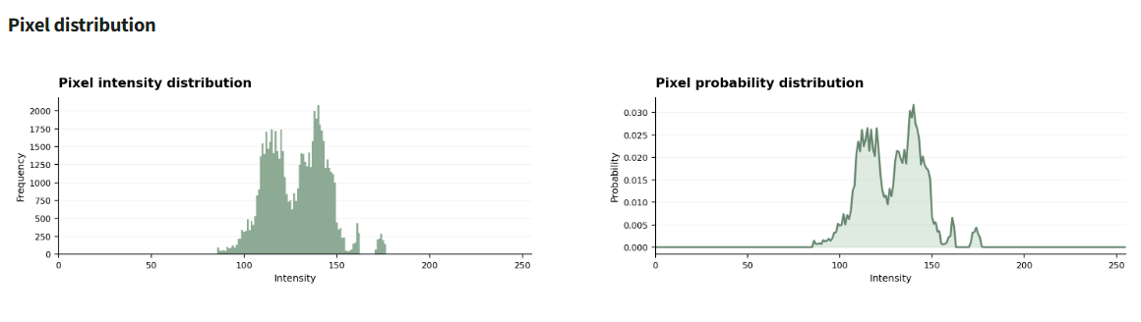
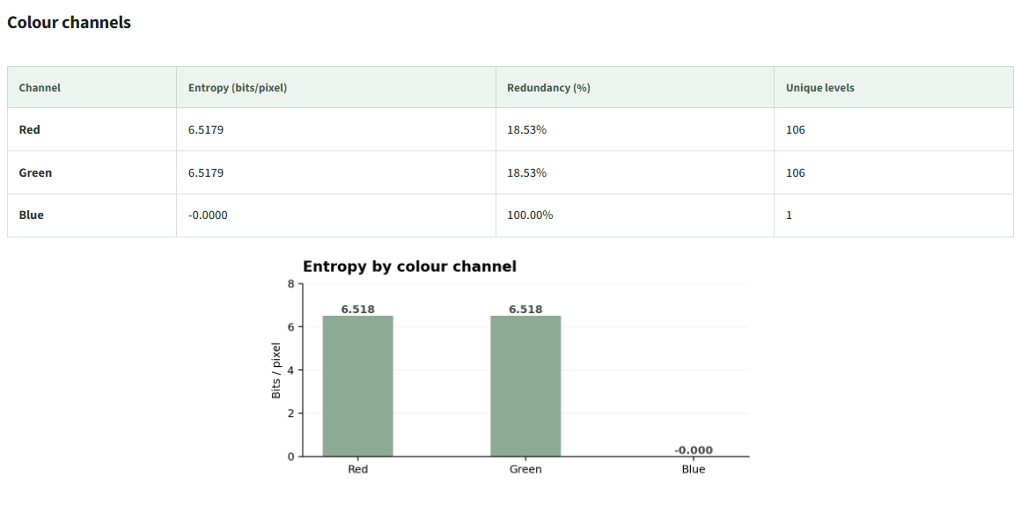
INFORMATION THEORY MINI PROJECT
Application walkthrough: actual running interface
R = G ≈ 6.518; B = 0
Upload → original / grayscale preview → metrics → distributions → independent RGB analysis
Genuine Streamlit screenshots · Synthetic colour_demo.png · Full captures retained in documentation/assets/
09
Notes:
Approximate speaking time: 40 seconds.
These screenshots come from the actual app running locally. The uploaded colour demonstration has red and green channels with identical distributions and a constant blue channel. Its main grayscale entropy is 5.881063, which differs from the red and green values of 6.517914 because grayscale conversion mixes samples before counting. The two distribution plots show counts and probabilities. Both CSV download buttons and invalid-input handling were exercised in a real browser.

Slide 10
INFORMATION THEORY MINI PROJECT
Worked example: [0, 0, 0, 255]
Intensity | Frequency | Probability
0 | 3 | 0.75
255 | 1 | 0.25
H = −(0.75 log₂ 0.75
+ 0.25 log₂ 0.25)
= 0.811278 bits/pixel
Hmax = 8 Hnorm = 0.101410
R = 89.8590% entropy deficit Unique levels = 2
The fixed 8-bit maximum is different from the 1-bit maximum on a two-level support.
ISHITA SAHU / IMAGE ENTROPY ANALYZER
10
Notes:
Approximate speaking time: 45 seconds.
There are four pixels. Intensity zero occurs three times and 255 occurs once, giving probabilities three quarters and one quarter. Their surprise values are about 0.415 bits and two bits. Weighting gives 0.311278 plus 0.5, or 0.811278. Divide by eight for normalized entropy and take its complement times one hundred for the deficit. There are two unique levels. The code still uses eight as its maximum reference.

Slide 11
INFORMATION THEORY MINI PROJECT
Experimental results: synthetic test images
Image | H | Hnorm | R (%) | Levels
Constant | 0.0000 | 0.0000 | 100.0000 | 1
Four levels | 2.0000 | 0.2500 | 75.0000 | 4
Landscape | 6.5179 | 0.8147 | 18.5261 | 106
Noise | 7.9968 | 0.9996 | 0.0403 | 256
Entropy (bits/pixel)
Known cases match theory: 0 bits and 2 bits.
Landscape: unequal counts. Noise: nearly uniform, slightly below 8.
Measured with unchanged entropy.py · 256 × 256 PNG inputs · Seed 20261020 · experiment_results.csv
11
Notes:
Approximate speaking time: 40 seconds.
All four images are synthetic and have the same dimensions. The constant and four-level cases match their exact expected values. The procedural landscape has 106 occupied levels with unequal probabilities. Finite seeded noise uses all levels with counts close to equal, giving just under eight. The table and editable chart use genuine outputs from the project analyzer, not illustrative values. These four cases are demonstrations, not a statistical survey of natural images.

Slide 12
INFORMATION THEORY MINI PROJECT
Applications: useful measurements, careful claims
Demonstrated now
Potential with added validation
Inspect intensity statistics and channel distributions.
Texture / scene characterization
Noise and preprocessing studies
Compression-model experiments
Features for computer vision
Controlled experiments
Compare synthetic content and export measured results.
Teaching
Connect array operations with Information Theory.
ISHITA SAHU / IMAGE ENTROPY ANALYZER
12
Notes:
Approximate speaking time: 25 seconds.
The current tool directly supports image statistics and teaching. It also gives a starting point for controlled processing studies. More ambitious uses require additions and evidence: scene characterization needs spatial features and labels, vision needs a validated downstream model, and compression analysis needs a specified coder with actual byte measurements. I distinguish those possibilities from implemented features.

Slide 13
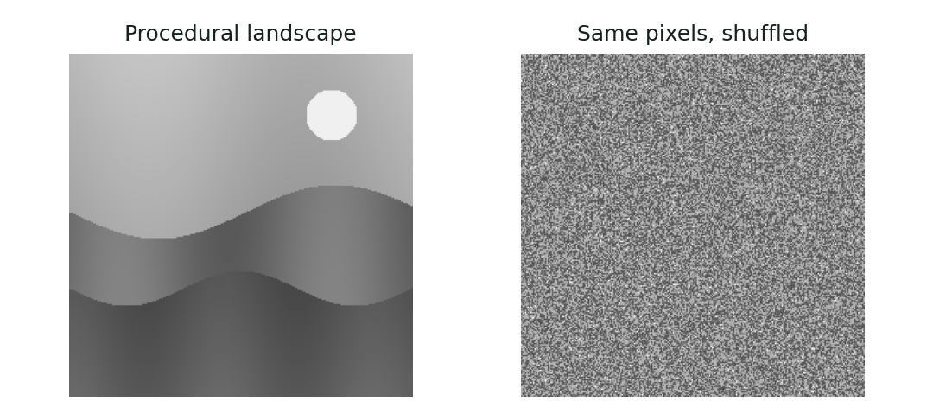
INFORMATION THEORY MINI PROJECT
Limitation: positions are invisible to the histogram
Same counts.
Same H = 6.517914.
Different appearance.
No spatial dependence or joint RGB model.
Entropy is not visual quality, compressed file size or compression ratio.
ISHITA SAHU / IMAGE ENTROPY ANALYZER
13
Notes:
Approximate speaking time: 35 seconds.
This is the strongest limitation demonstration. I shuffled the landscape pixels and verified exactly identical histograms and entropy. Their arrangement has changed but the model cannot see that. The same issue applies to separate channel entropies: dependence between channels is missing. Representation and finite-sample choices also affect results. File size is metadata, not an entropy calculation.

Slide 14
INFORMATION THEORY MINI PROJECT
Future scope: small, testable extensions
1 Region comparison
Isolate sky, edges and textured areas rather than mixing the whole image.
2 Controlled noise and preprocessing sweeps
Measure sensitivity using fixed seeds and repeated trials.
3 Local maps and neighboring-pixel entropy
Study where uncertainty occurs and what adjacency predicts.
4 Verified lossless coding experiments
Compare actual bytes and decoding fidelity with the selected source model.
ISHITA SAHU / IMAGE ENTROPY ANALYZER
14
Notes:
Approximate speaking time: 25 seconds.
I would begin with region comparison or a controlled noise sweep because they are manageable and easy to validate. Local maps would show variation across a scene, with window size explicitly recorded. Neighbor-pair statistics could test prediction beyond a marginal histogram. Finally, a real lossless-coding experiment must verify decoded samples and count overhead. Each extension answers a specific question.

Slide 15
INFORMATION THEORY MINI PROJECT
Conclusion: a transparent statistical pipeline
Implemented
Upload → preprocess → distributions → metrics → plots / CSV
Verified
Known cases, seeded experiments, browser workflow and exports
Learned
The source model determines what entropy can legitimately describe.
Measure precisely. Interpret within the model.
ISHITA SAHU / IMAGE ENTROPY ANALYZER
15
Notes:
Approximate speaking time: 20 seconds.
The project implements an end-to-end measurement pipeline with understandable intermediate evidence. Known-input checks support the arithmetic and the browser run supports the interface behavior. The main lesson is to state the source model clearly: uncertainty in image-wide intensity values is useful, but it is not a complete description of an image or a compressor.

Slide 16
INFORMATION THEORY MINI PROJECT
References and reproducibility
[1] Shannon, 1948 · A Mathematical Theory of Communication
https://www.princeton.edu/~wbialek/rome/refs/shannon_48.pdf
[2] Pillow · Image conversion and EXIF orientation
https://pillow.readthedocs.io/en/stable/reference/Image.html
[3] NumPy · bincount
https://numpy.org/doc/stable/reference/generated/numpy.bincount.html
[4] Streamlit · cache_data
https://docs.streamlit.io/develop/api-reference/caching-and-state/st.cache_data
Local evidence: inspected source; experiments.py; experiment_results.csv;
experiment_manifest.json; browser CSV downloads and actual screenshots.
ISHITA SAHU / IMAGE ENTROPY ANALYZER
16
Notes:
Approximate speaking time: 10 seconds.
These are the primary theoretical and official library references. The guide includes additional official links for EXIF, CSV and plotting. More importantly, the implementation claims are grounded in our inspected local files, and every experimental number can be reproduced using the saved script and image files. The repository address is verified from git origin.

Slide 17
INFORMATION THEORY MINI PROJECT
Questions are welcome
Thank you.
Ishita Sahu · Information Theory Mini Project
github.com/Ishita-2210/image-entropy-analyzer
ISHITA SAHU / IMAGE ENTROPY ANALYZER
17
Notes:
Approximate speaking time: 5 seconds.
Thank you. I am happy to explain the numerical example, trace a function in the code, or discuss why the shuffled-image result exposes the limits of this model.

