Slide 1

A compound data type:
[0]
[2.3, 4.5]
[5, "Hello", "there", 9.8]
[]
Use len() to get the length of a list
>>> names = [“Ben", “Chen", “Yaqin"]
>>> len(names)
3

Slide 2

>>> names[0]
‘Ben'
>>> names[1]
‘Chen'
>>> names[2]
‘Yaqin'
>>> names[3]
Traceback (most recent call last):
File "<stdin>", line 1, in <module>
IndexError: list index out of range
>>> names[-1]
‘Yaqin'
>>> names[-2]
‘Chen'
>>> names[-3]
‘Ben'
[0] is the first item.
[1] is the second item
...
Out of range values
raise an exception
Negative values
go backwards from
the last element.

Slide 3

>>> smiles = "C(=N)(N)N.C(=O)(O)O"
>>> smiles[0]
'C'
>>> smiles[1]
'('
>>> smiles[-1]
'O'
>>> smiles[1:5]
'(=N)'
>>> smiles[10:-4]
'C(=O)'
Use “slice” notation to
get a substring

Slide 4

smiles = "C(=N)(N)N.C(=O)(O)O"
>>> smiles.find("(O)")
15
>>> smiles.find(".")
9
>>> smiles.find(".", 10)
-1
>>> smiles.split(".")
['C(=N)(N)N', 'C(=O)(O)O']
>>>
Use “find” to find the
start of a substring.
Start looking at position 10.
Find returns -1 if it couldn’t
find a match.
Split the string into parts
with “.” as the delimiter

Slide 5

if "Br" in “Brother”:
print "contains brother“
email_address = “clin”
if "@" not in email_address:
email_address += "@brandeis.edu“

Slide 6
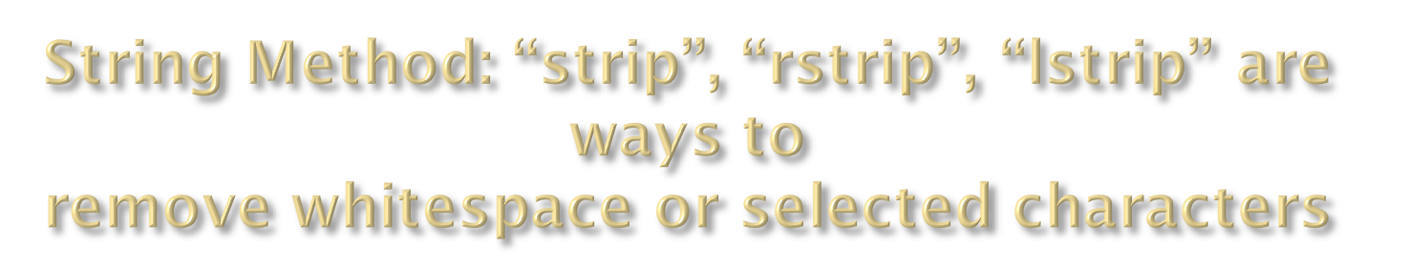
>>> line = " # This is a comment line \n"
>>> line.strip()
'# This is a comment line'
>>> line.rstrip()
' # This is a comment line'
>>> line.rstrip("\n")
' # This is a comment line '
>>>

Slide 7

email.startswith(“c") endswith(“u”)
True/False
>>> "%s@brandeis.edu" % "clin"
'clin@brandeis.edu'
>>> names = [“Ben", “Chen", “Yaqin"]
>>> ", ".join(names)
‘Ben, Chen, Yaqin‘
>>> “chen".upper()
‘CHEN'

Slide 8

>>> s = "andrew"
>>> s[0] = "A"
Traceback (most recent call last):
File "<stdin>", line 1, in <module>
TypeError: 'str' object does not support item assignment
>>> s = "A" + s[1:]
>>> s
'Andrew‘
Strings are read only

Slide 9

\n -> newline
\t -> tab
\\ -> backslash
...
But Windows uses backslash for directories!
filename = "M:\nickel_project\reactive.smi" # DANGER!
filename = "M:\\nickel_project\\reactive.smi" # Better!
filename = "M:/nickel_project/reactive.smi" # Usually works

Slide 10

append an element
remove an element
sort by default order
reverse the elements in a list
insert an element at some
specified position.
(Slower than .append())
>>> ids = ["9pti", "2plv", "1crn"]
>>> ids.append("1alm")
>>> ids
['9pti', '2plv', '1crn', '1alm']
>>>ids.extend(L)
Extend the list by appending all the items in the given list; equivalent to a[len(a):] = L.
>>> del ids[0]
>>> ids
['2plv', '1crn', '1alm']
>>> ids.sort()
>>> ids
['1alm', '1crn', '2plv']
>>> ids.reverse()
>>> ids
['2plv', '1crn', '1alm']
>>> ids.insert(0, "9pti")
>>> ids
['9pti', '2plv', '1crn', '1alm']

Slide 11

>>> yellow = (255, 255, 0) # r, g, b
>>> one = (1,)
>>> yellow[0]
>>> yellow[1:]
(255, 0)
>>> yellow[0] = 0
Traceback (most recent call last):
File "<stdin>", line 1, in <module>
TypeError: 'tuple' object does not support item assignment
Very common in string interpolation:
>>> "%s lives in %s at latitude %.1f" % ("Andrew", "Sweden", 57.7056)
'Andrew lives in Sweden at latitude 57.7'

Slide 12

>>> names
['ben', 'chen', 'yaqin']
>>> gender = [0, 0, 1]
>>> zip(names, gender)
[('ben', 0), ('chen', 0), ('yaqin', 1)]

Slide 13

Dictionaries are lookup tables.
They map from a “key” to a “value”.
symbol_to_name = {
"H": "hydrogen",
"He": "helium",
"Li": "lithium",
"C": "carbon",
"O": "oxygen",
"N": "nitrogen"
}
Duplicate keys are not allowed
Duplicate values are just fine

Slide 14
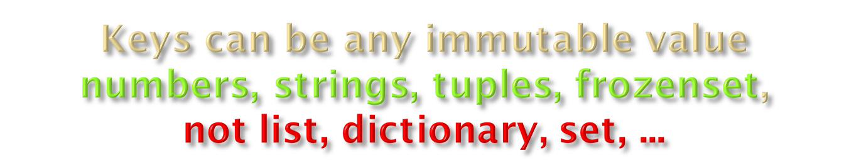
atomic_number_to_name = {
1: "hydrogen"
6: "carbon",
7: "nitrogen"
8: "oxygen",
}
nobel_prize_winners = {
(1979, "physics"): ["Glashow", "Salam", "Weinberg"],
(1962, "chemistry"): ["Hodgkin"],
(1984, "biology"): ["McClintock"],
}
A set is an unordered collection
with no duplicate elements.

Slide 15

Get the value for a given key
Test if the key exists
(“in” only checks the keys,
not the values.)
[] lookup failures raise an exception.
Use “.get()” if you want
to return a default value.
>>> symbol_to_name["C"]
'carbon'
>>> "O" in symbol_to_name, "U" in symbol_to_name
(True, False)
>>> "oxygen" in symbol_to_name
False
>>> symbol_to_name["P"]
Traceback (most recent call last):
File "<stdin>", line 1, in <module>
KeyError: 'P'
>>> symbol_to_name.get("P", "unknown")
'unknown'
>>> symbol_to_name.get("C", "unknown")
'carbon'

Slide 16

>>> symbol_to_name.keys()
['C', 'H', 'O', 'N', 'Li', 'He']
>>> symbol_to_name.values()
['carbon', 'hydrogen', 'oxygen', 'nitrogen', 'lithium', 'helium']
>>> symbol_to_name.update( {"P": "phosphorous", "S": "sulfur"} )
>>> symbol_to_name.items()
[('C', 'carbon'), ('H', 'hydrogen'), ('O', 'oxygen'), ('N', 'nitrogen'), ('P', 'phosphorous'), ('S', 'sulfur'), ('Li', 'lithium'), ('He', 'helium')]
>>> del symbol_to_name['C']
>>> symbol_to_name
{'H': 'hydrogen', 'O': 'oxygen', 'N': 'nitrogen', 'Li': 'lithium', 'He': 'helium'}

