Slide 1
PROBLEM
How might we test the state of autism in a child & tackle it through a therapy?

Slide 2
Autism?
Autism, or autism spectrum disorder (ASD), refers to a broad range of conditions characterized by challenges with social skills, repetitive behaviors, speech and nonverbal communication. Autism affects every 1 in every 40 children in the world.

Slide 3
SOLUTION
An AI-VR based application to help people with autism improve communication, social and other basic abilities required to live in a society.

Slide 4
WHY VIRTUAL REALITY?
Helps reduce cognitive Pressures.
2) Relax and feel less anxious.
3) Provides safe space tests on those key skills.
4) Being a safe space they can make mistakes, perform those skills over and
over and get used to it.

Slide 5
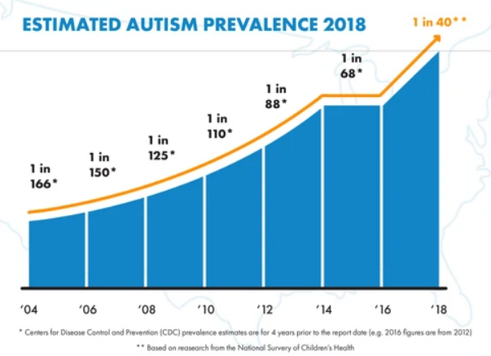
Published Work:
Effectiveness of Virtual Reality for Children and Adolescents with Autism Spectrum Disorder: An Evidence-Based Systematic Review.
(
STATISTICS
In 2018 the CDC reported that 1 in 40 children have been identified with ASD, this number is increasing at a rate of 15% every year.
1 in 500 or 0.20% or more than 2,160,000 people in India. Incidence Rate: Approx. 1 in 90,666 or 11,914 people in India. Incidence extrapolations for India for Autism: 11,914 per year, 250 per month, 57 per week, 8 per day, 1.4 per hour
https://harkla.co/blogs/special-needs/autism-statistics
http://www.rehabcouncil.nic.in/writereaddata/autism.pdf

Slide 6
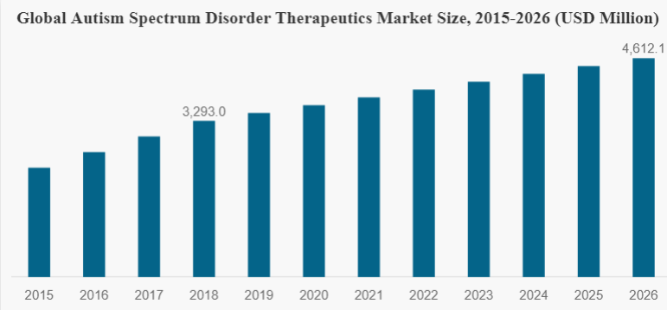
MARKET SIZE
The Global autistic spectrum disorder therapeutics market size was valued at US $ 3293.0 Million in 2018 and is projected to reach US $ 4612.1. Million by 2026.
https://www.fortunebusinessinsights.com/industry-reports/autism-spectrum-disorder-therapeutics-market-101207

Slide 7
NOVELTY
Published Work:
Effectiveness of Virtual Reality for Children and Adolescents with Autism Spectrum Disorder: An Evidence-Based Systematic Review.
(https://www.ncbi.nlm.nih.gov/pmc/articles/PMC6111797/)
2) Technologies as Support Tools for Persons with Autistic Spectrum Disorder:
A Systematic Review
(https://www.ncbi.nlm.nih.gov/pmc/articles/PMC4143832/)

Slide 8
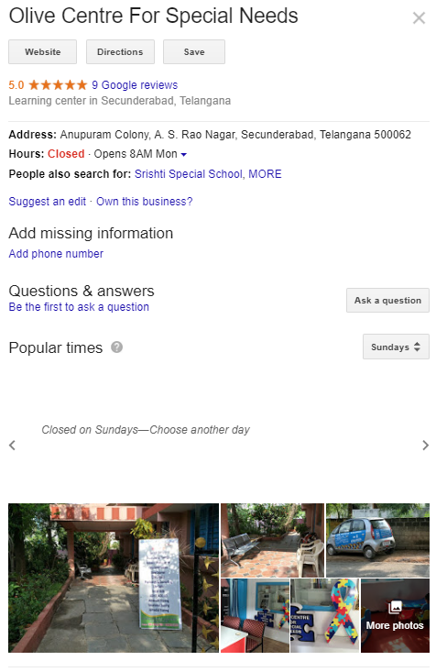

VALIDATION

Slide 9
THE TEAM
Karthik Epperla
Ishita Agarwal

