Slide 1
Intelligent Predictive Maintenance and Machine Failure Monitoring System
Hidden Markov Models on NASA C-MAPSS turbofan data
Unit 4 – Sequential Data · Industry-Oriented Project 1
Sai Ishita Chilukuri (RA2411003010608) · SRM Institute of Science and Technology, Kattankulatham

Slide 2
Problem and objective
• Machine sensors drift before a breakdown – but the drift is noisy and differs between machines
• Goal: infer the hidden health condition of each machine, detect deterioration early, show it on a dashboard
• Tasks: clean sensors → window features → train HMM → Forward-Backward & Viterbi → visualise fault-state evolution
• Metrics: fault recall, F1, log-likelihood, detection lead time
Hidden state z_t:
health condition
Observation x_t:
sensor features
Alert: P(Critical | past) ≥ τ
Predictive Maintenance with HMM · NASA C-MAPSS FD001 · educational prototype
2

Slide 3
Dataset and disclosures
• NASA C-MAPSS FD001: one operating condition, one fault mode (HPC degradation)
• Train: 100 engines run to failure (128–362 cycles). Test: 100 engines truncated, true RUL given
• Per cycle: 3 operating settings + 21 sensors
• RUL used for evaluation only – the HMM is unsupervised
SIMULATED data
(physics-based simulator, not real engines)
No access restrictions
(public NASA dataset)
Educational prototype –
not a production system
Predictive Maintenance with HMM · NASA C-MAPSS FD001 · educational prototype
3

Slide 4
Required workflow – followed end to end
Dataset
Pre-
processing
Sequence
construction
Model
formulation
Algorithm
implementation
Inference /
estimation
Evaluation
Visuali-
zation
Interpre-
tation
• Notebook sections 1–10 follow exactly this order
• Reproducible: fixed seed 42, data auto-download, executed notebook, scripts/train.py, 11 unit tests
Predictive Maintenance with HMM · NASA C-MAPSS FD001 · educational prototype
4

Slide 5
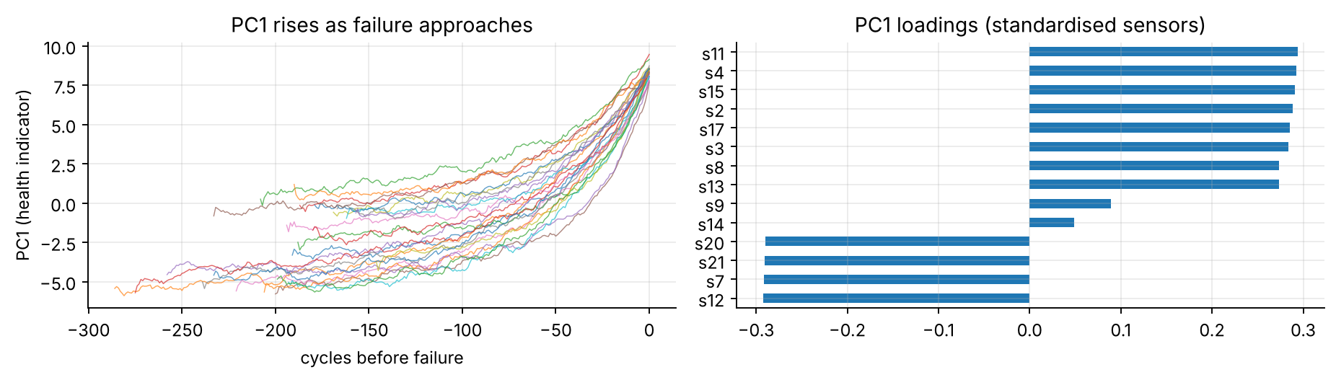
Preprocessing and sequence construction
• No missing values; 7 constant sensors dropped → 14 sensors
• Trailing 10-cycle mean (causal – no future data)
• Standardise + PCA to 3 components (97.1 % variance)
• PC1 rises as failure nears → health indicator
• One (T × 3) sequence per engine; split by engine: 70 fit / 30 validation + official test
Predictive Maintenance with HMM · NASA C-MAPSS FD001 · educational prototype
5

Slide 6
Model formulation: left-to-right Gaussian HMM
• States: Healthy → Early wear → Mild → Degrading → Severe → Critical (K = 6)
• Transitions only stay or advance; Critical is absorbing – wear never reverses
• Emission: x_t | state k ~ N(μ_k, diag σ²_k)
• Start distribution learned: engines start with different normal wear
• Training: Baum-Welch (EM), unsupervised init from time chunks – no RUL
• K chosen on validation fault-F1 (smallest K within 0.01 of best)
Healthy
Early
Mild
Degr.
Severe
Critical
→ each state moves to itself or the next one only
Predictive Maintenance with HMM · NASA C-MAPSS FD001 · educational prototype
6

Slide 7
Algorithms implemented from scratch – and verified
Algorithm (NumPy only) | Used for
Scaled Forward | Filtering, log-lik, causal alerts
Scaled Backward + FB | Smoothing, EM statistics
Viterbi (log domain) | Best state path
Baum-Welch (EM) | ML parameter estimation
Check vs hmmlearn | Result
Same parameters: log-lik | −38529.85125 = −38529.85125
Same parameters: Viterbi / γ | identical / 1e-14
Independent EM training: log-lik | −38529.85 vs −38529.85
Viterbi agreement (30 val. engines) | 100 %
Scaling matters: on a 2,880-step sequence the unscaled forward pass underflows to 0; the scaled one gives log-lik −21,645.
11 unit tests incl. brute-force checks over all state paths.
Compared against a reference implementation (hmmlearn) AND baselines (GMM, PC1 threshold).
Predictive Maintenance with HMM · NASA C-MAPSS FD001 · educational prototype
7

Slide 8
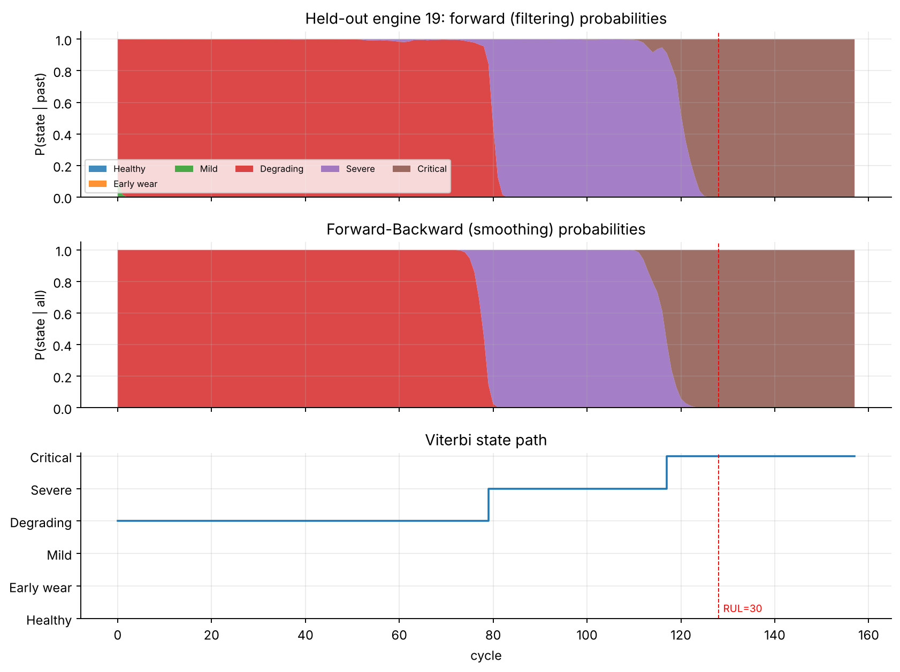
Inference on a held-out engine
• Forward (filtering): uses past only → used for alerts
• Forward-Backward (smoothing): uses whole sequence → retrospective
• Viterbi: single most probable state path
• Dashed line: true RUL = 30 (evaluation only)
Predictive Maintenance with HMM · NASA C-MAPSS FD001 · educational prototype
8

Slide 9
No data leakage – evaluation protocol
• Features are trailing/causal – unit test corrupts future cycles and checks the past is unchanged
• Engines are independent run-to-failure trajectories → engine-level 70/30 split; official test set evaluated once
• Scaler + PCA fitted on fit engines only
• Number of states K and alert threshold τ tuned on validation engines only
• Alerts use filtering posterior only; RUL never used in training
• Fault = RUL ≤ 30; alert is latched; lead time = true RUL at first alert
Predictive Maintenance with HMM · NASA C-MAPSS FD001 · educational prototype
9

Slide 10
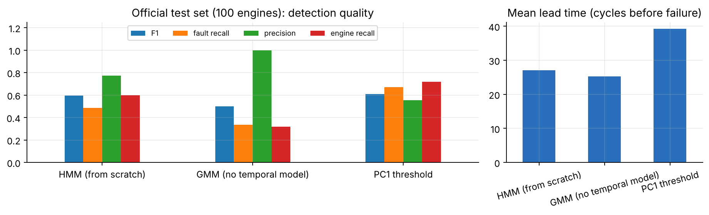
Results on the official test set (100 engines)
Method | Fault recall | Precision | F1 | Engine recall | Mean lead (cycles)
HMM (from scratch), K = 6 | 0.485 | 0.774 | 0.596 | 0.60 | 27.1
GMM (no temporal model) | 0.334 | 1.000 | 0.501 | 0.32 | 25.2
PC1 threshold | 0.672 | 0.556 | 0.608 | 0.72 | 39.2
• HMM clearly beats the non-temporal GMM
• F1 is NOT better than a tuned PC1 threshold – more precise, less sensitive
• Held-out log-lik/cycle: val −2.712, test −2.200
Predictive Maintenance with HMM · NASA C-MAPSS FD001 · educational prototype
10

Slide 11
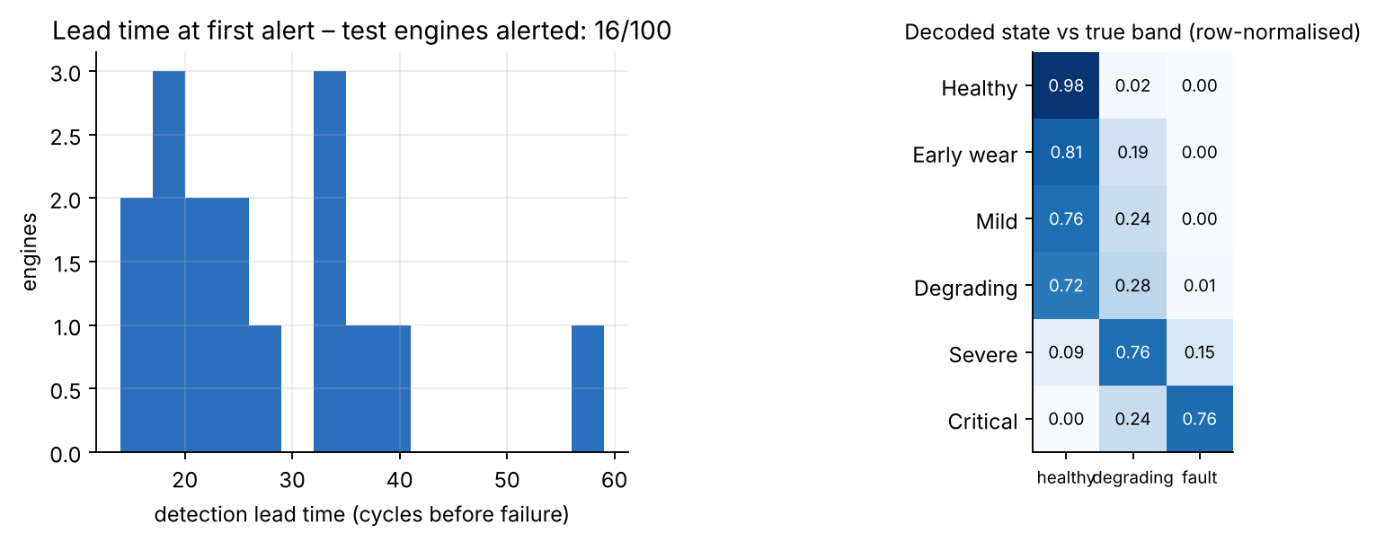
Lead time and decoded states
• 16 of 100 test engines alerted, on average 27 cycles before failure (median 23.5); no alert more than 100 cycles early
• Only 25 test engines end inside the fault zone → engine-level recall (15/25) rests on a small count
Predictive Maintenance with HMM · NASA C-MAPSS FD001 · educational prototype
11

Slide 12
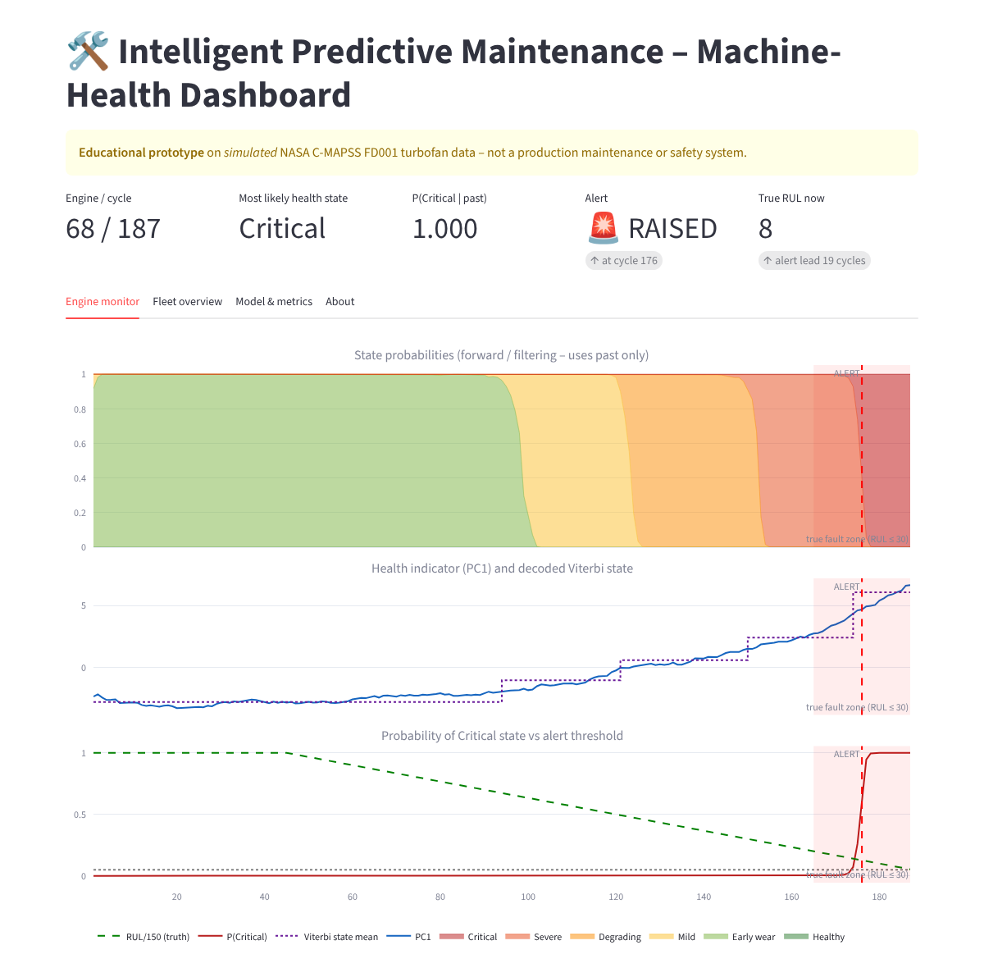
Working demonstration: Streamlit dashboard
• State probabilities, PC1 trend + Viterbi state, P(Critical) vs threshold, alert marker
• Replay slider: only the first t cycles are revealed → alerts are causal
• Adjustable threshold and persistence
• Fleet table: alert status, state now, lead time
• Model / metrics tab with transition matrix and test results
• Run: streamlit run app/streamlit_app.py
Predictive Maintenance with HMM · NASA C-MAPSS FD001 · educational prototype
12

Slide 13
Interpretation and limitations
• Decoded states form a wear ladder: mean PC1 −4.5 → +6.1, mean true RUL ≈168 → ≈15 cycles – found without RUL labels
• Early-warning alerts from the filtered probability give ≈27 cycles of notice on average
• HMM value = probabilistic state ladder (uncertainty, dwell times), not an F1 win over a simple threshold
Limitations
• Only FD001 (one condition, one fault mode)
• Simulated data
• K and τ depend on one 70/30 split (seed 42)
• F1 differences of 0.01–0.02 are within noise
• Educational prototype – not a production system
Predictive Maintenance with HMM · NASA C-MAPSS FD001 · educational prototype
13

Slide 14
Deliverables and conclusion
Required | Delivered
Reproducible Jupyter Notebook | notebooks/predictive_maintenance_hmm.ipynb (executed, seed 42)
Concise technical report | reports/Technical_Report.docx
Presentation | this deck
GitHub repository with README | README, src/, tests/, scripts/, artifacts/
Working demonstration | Streamlit dashboard (app/streamlit_app.py)
• Own HMM implementation (Forward, Backward, Forward-Backward, Viterbi, Baum-Welch) matches hmmlearn exactly
• Honest result: beats non-temporal GMM; comparable to a tuned threshold; adds interpretable health states
Predictive Maintenance with HMM · NASA C-MAPSS FD001 · educational prototype
14

