Slide 1
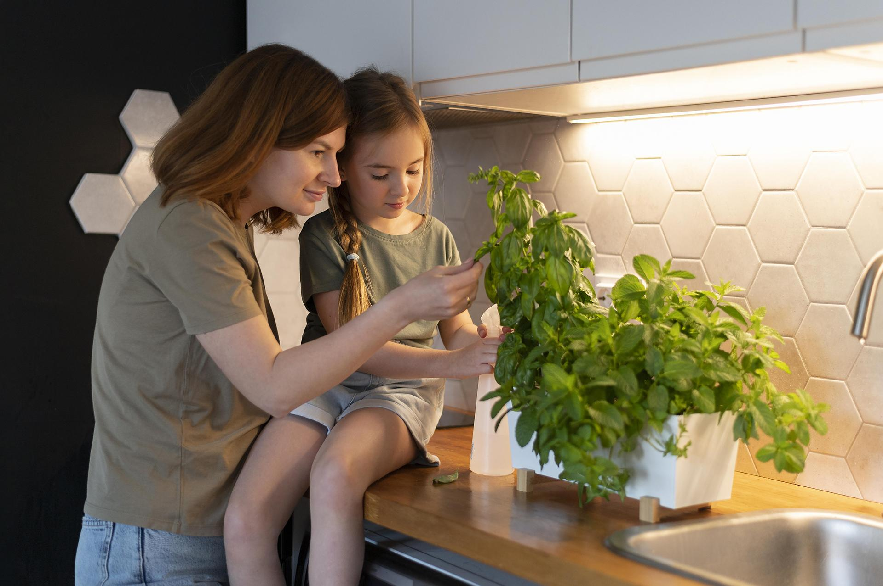
CSYE 6200
Daycare Project
Group 5
By-
Cyrus Dbritto - 002922815
Ayushi Patel - 002925618
Pinkle Soni- 002928259
Vaishnavi - 002776319
Ishita Sanjay Janwale - 002743825
Amisha- 002743313
Here is where
ur presentation begins

Slide 2
Table of contents
01
02
03
04
05
06
07
Modules and Technologies
Introduction
Registration
Student Immunization
Alert
Employee Review
Future enhancement

Slide 3
Introduction
01
Students from the age range of 6 to 60 months and over may enroll in daycare programs.
First, teachers and students must register.
According to state regulations, teachers are assigned to students.
Every year, registrations are renewed.
Students' immunization history is monitored on an annual basis.
Annual staff evaluations are kept on file.
Alerts are generated based on appropriate criteria.

Slide 4
Modules & Technologies
Technologies Used
Package Used
Swing
MySQL
Github
Netbeans IDE
JDBC
Swing
SQL Connector

Slide 5
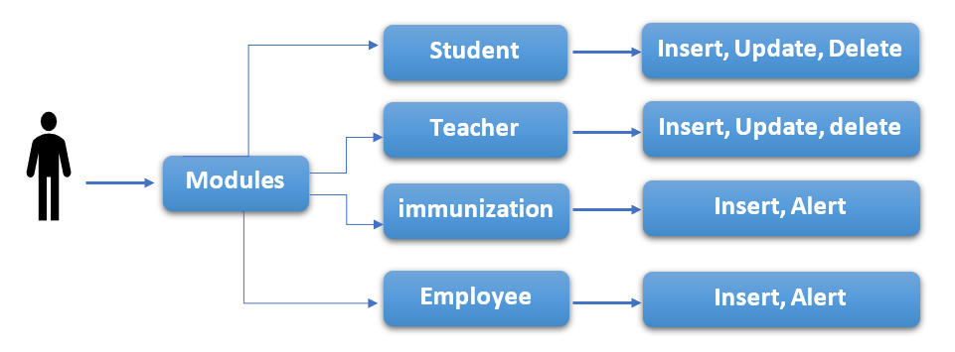
Flow Chart
USER

Slide 6
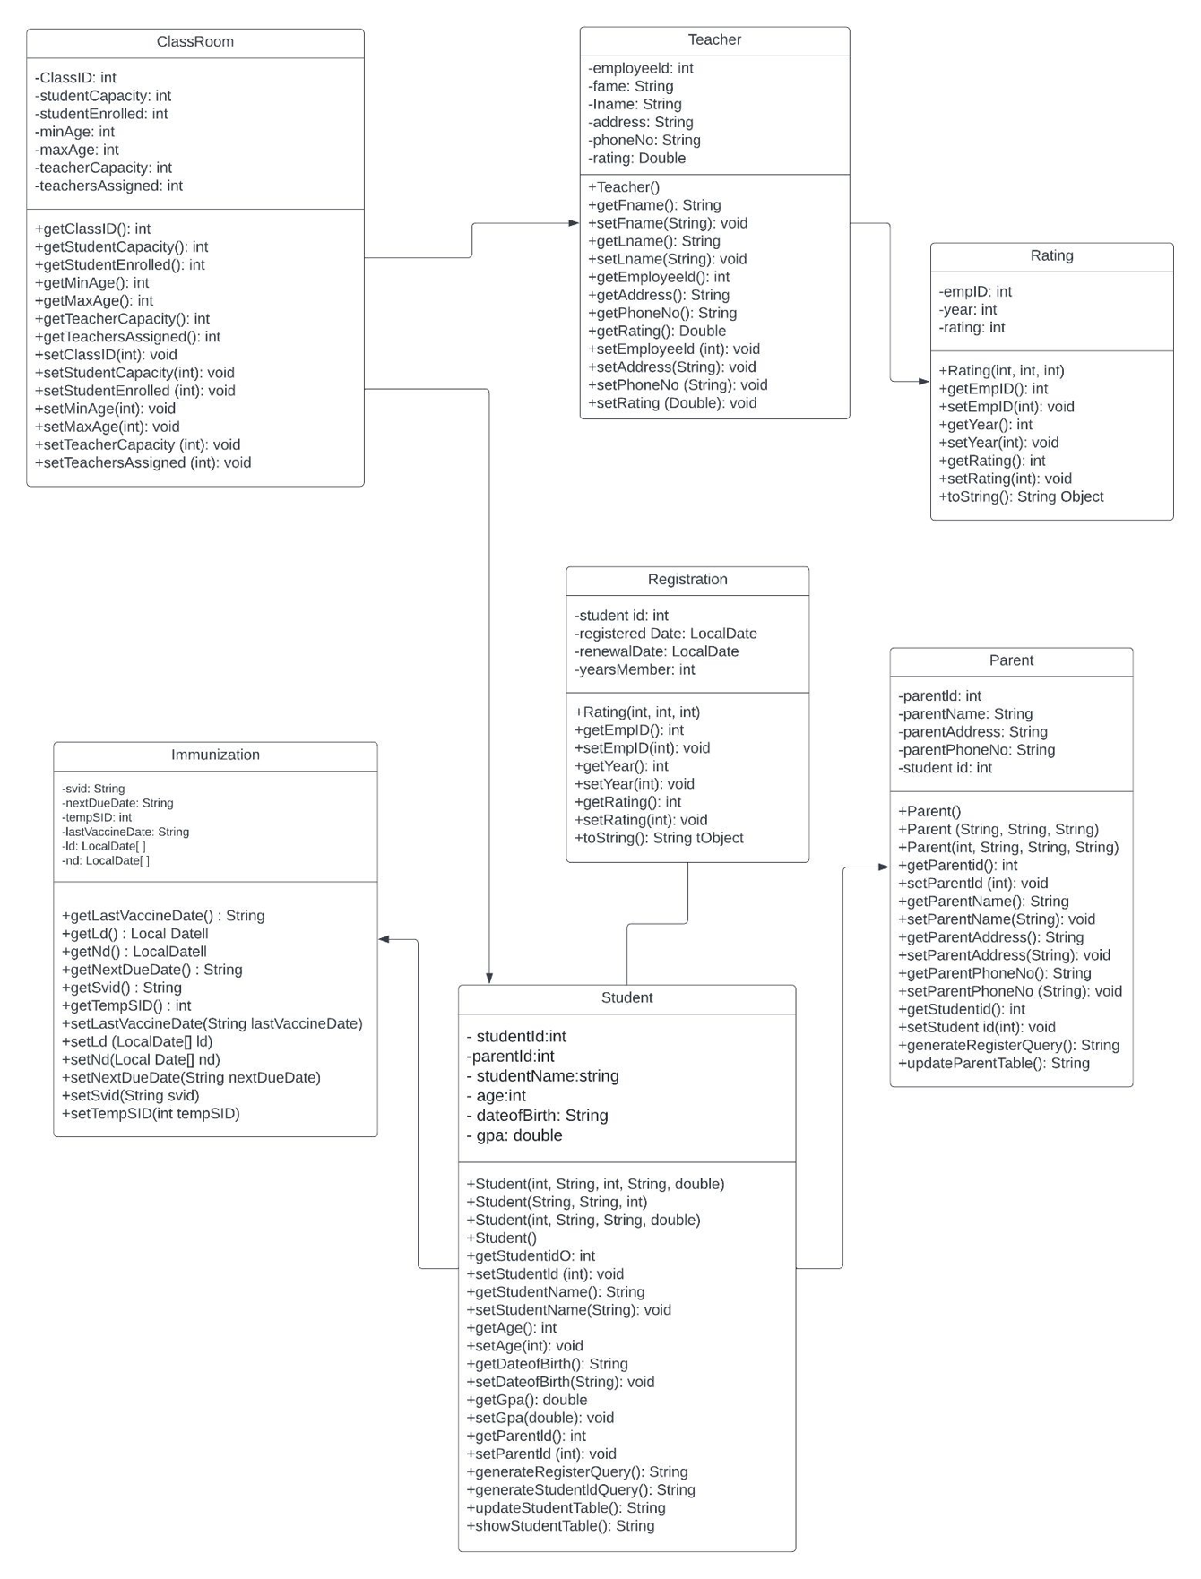
UML

Slide 7
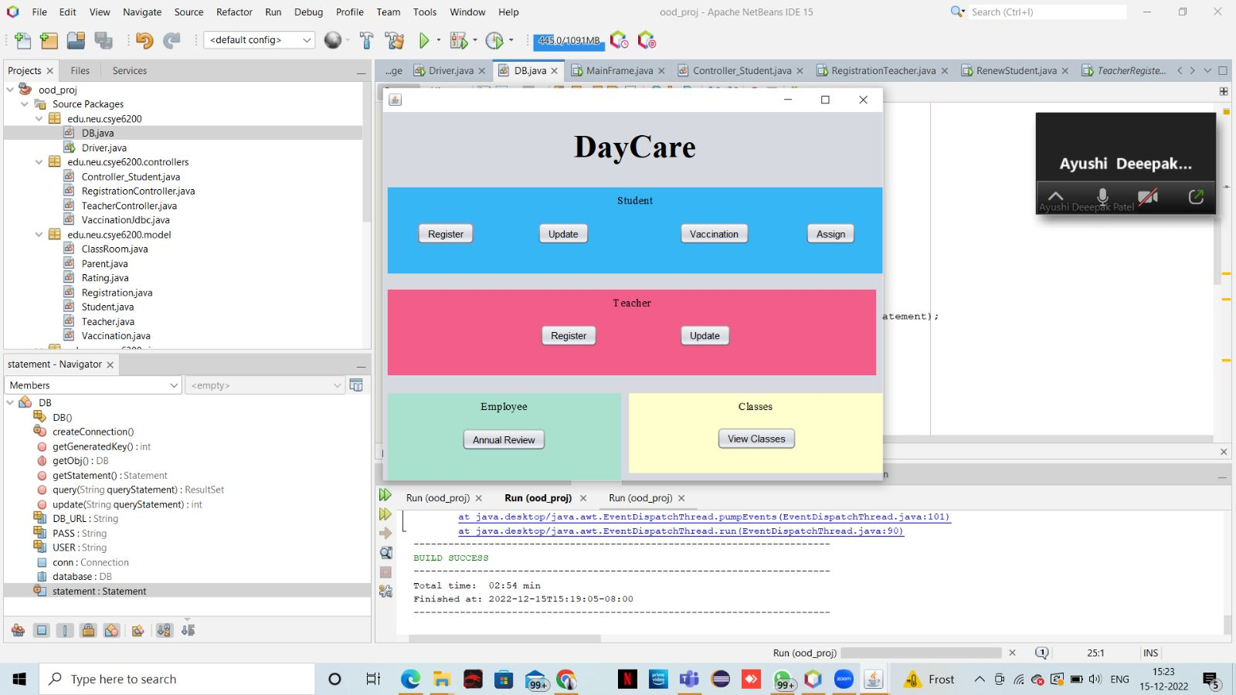
Main Frame

Slide 8
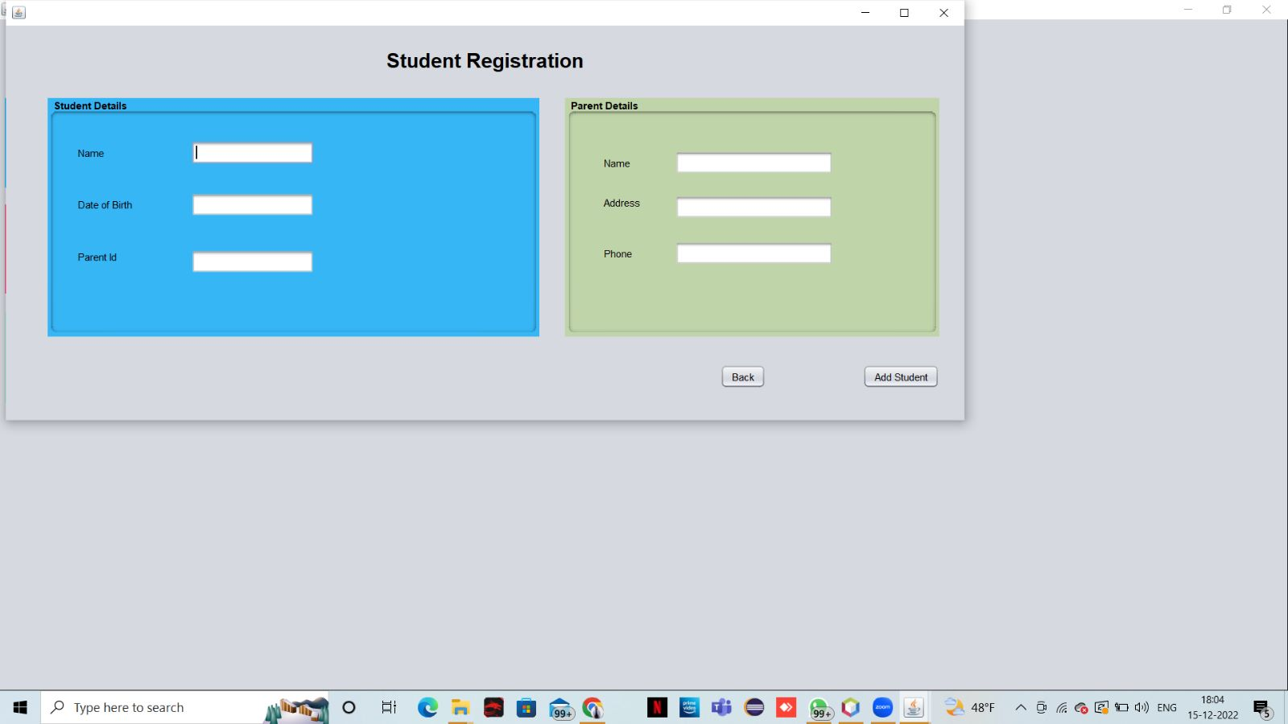
Student Registration
Student registration is implemented by obtaining the required attributes of students.
Student records can be updated and viewed as well

Slide 9
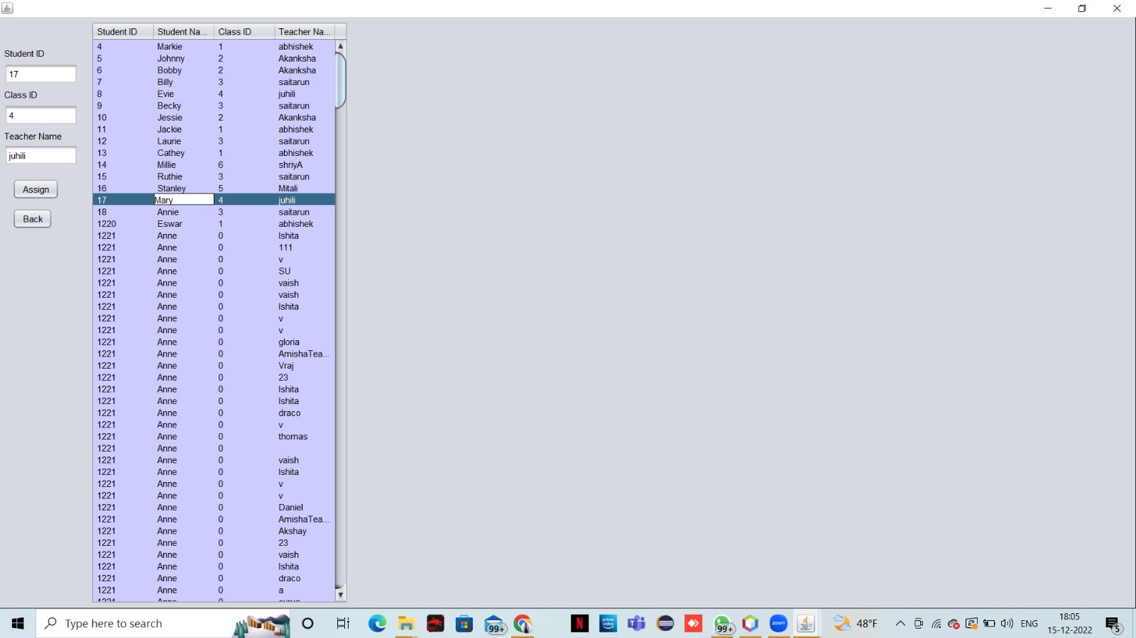
Student Update

Slide 10
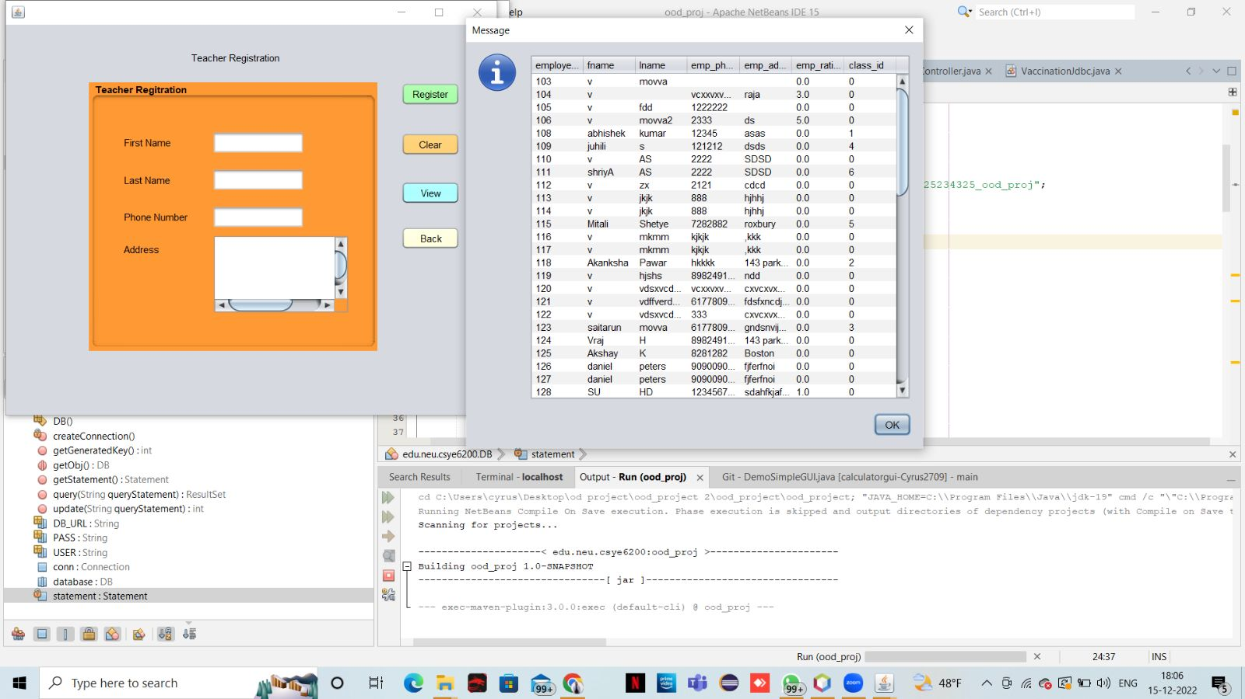
Teacher

Slide 11
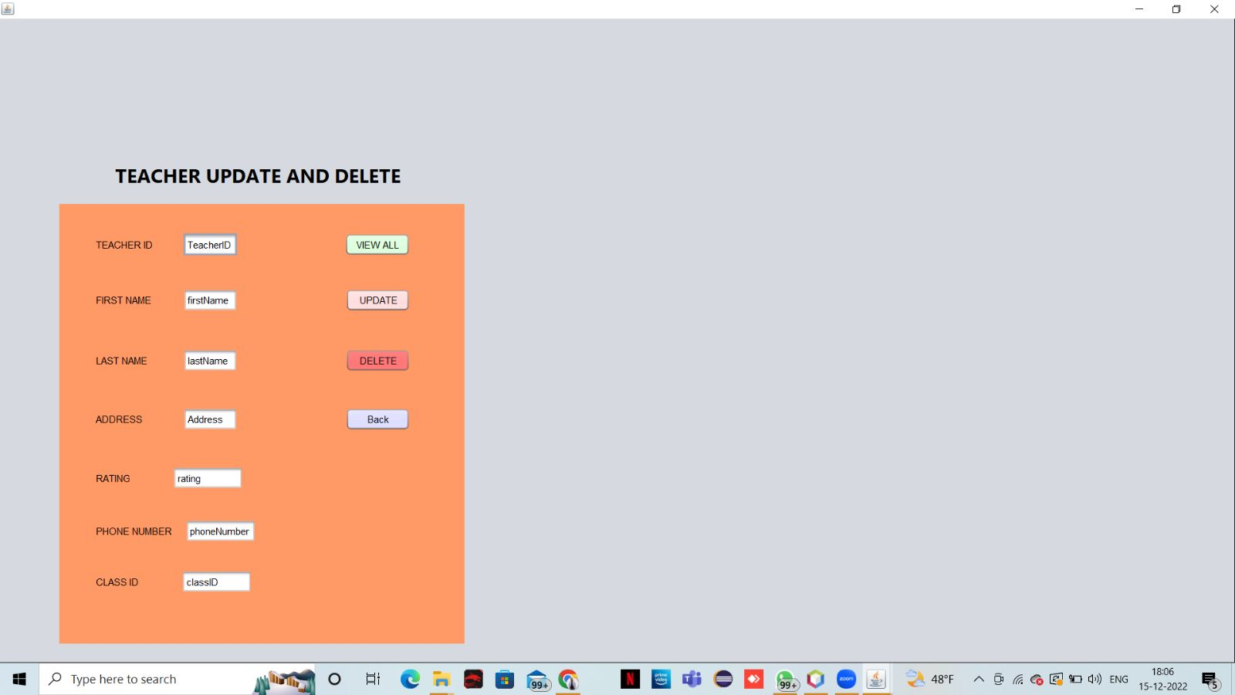
Teacher View

Slide 12
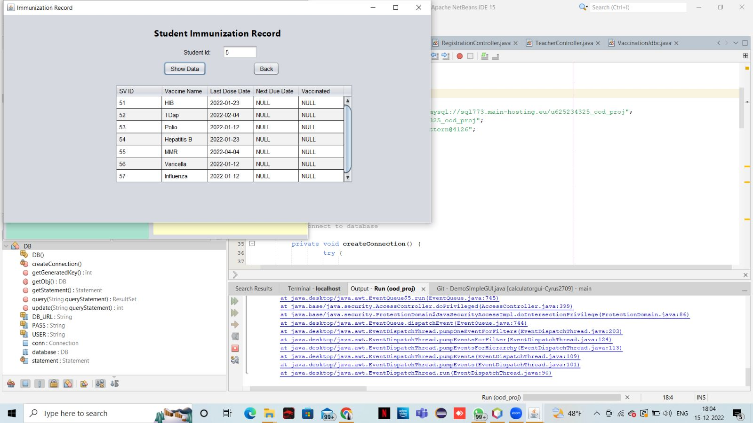
Student Vaccination

Slide 13
Assign Classroom

Slide 14
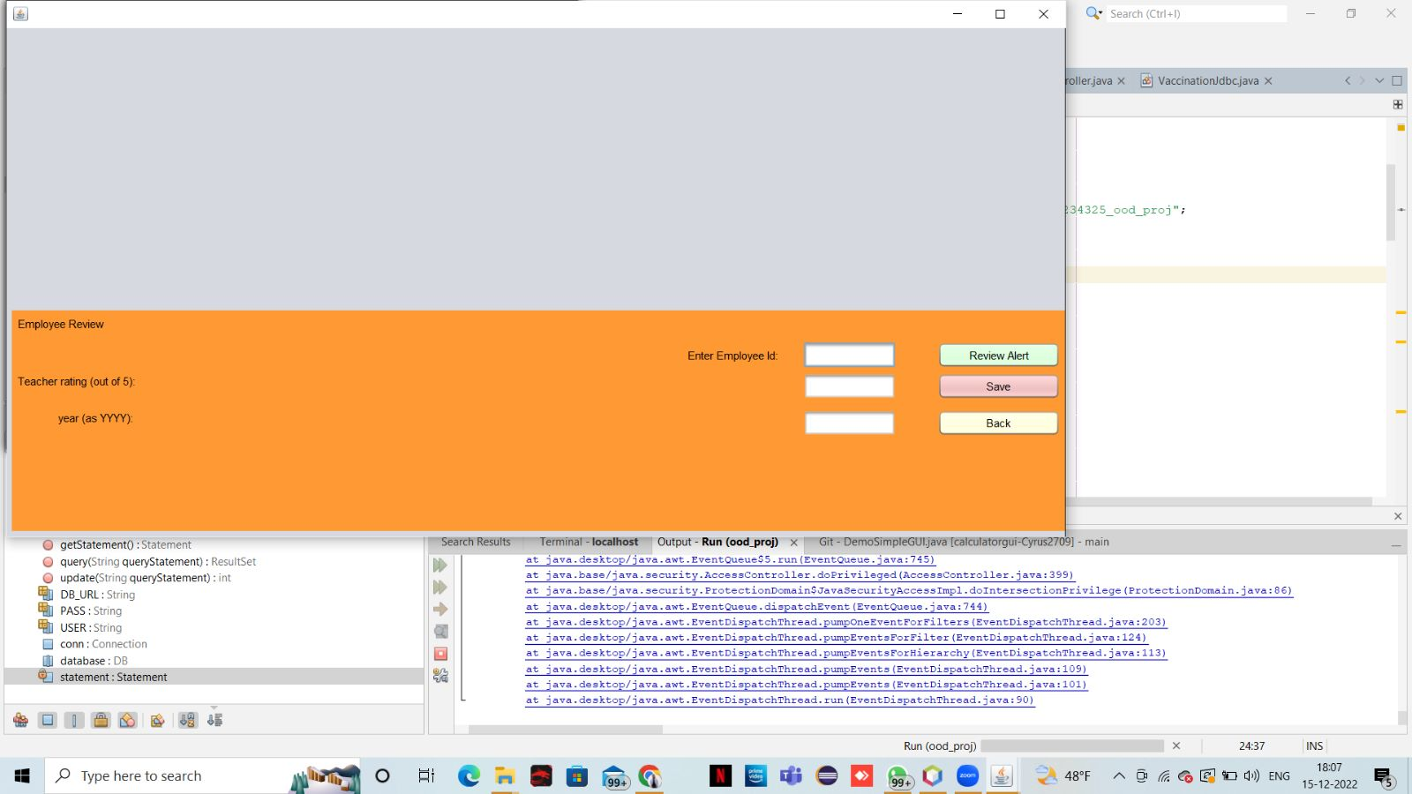
Employee Review

Slide 15
Future Enhancements
Make it Scalable
Improvise modules to handle latency
Implement C/CD for smooth operations and development
For better recommendations on immunizations, including the healthcare physician.
Real-time notifications can be added.
With emerging technologies like React Native and others, the UI can be more interactive and captivating.

Slide 16
Conclusion
We are using a database(MySQL) and JSwing to present an easy to use interface for children to be checked in and their information to be managed
This system will help in maintaining the records of the children enrolled along with their vaccination anniversaries in order to track their doses timely
Periodic alerts and notifications can keep immunization schedules in check and will avoid the children from missing out on their vaccinations
The user friendly interface will help the admit to record and maintain the data of students and employees (teachers) effectively

Slide 17
Contribution
Name | Contribution
Cyrus Dbrito | BE integration, Teacher J Table, Spring Boot, BE logic for persons
Ayushi Patel | Swing UI - classes pane, Testing(UI,BE) and Reporting
Pinkle Soni | Wireframing, Swing UI - vaccinations, spring integration, interaction
Ishita Sanjay Janwale | Immunization Backend Student J Table, Classroom, Backend
Vaishnavi Bhoito | Backend, BUG fixes, DB integration, alert notifications
Amisha | BE integration, Factory Patterns for Object Creation

Slide 18
THANK YOU

