Slide 1

Project Name: Programming Companion
Made by Amigos
Mentor : Aarhan Sir

Slide 2

CodeBud
A Google Chrome extension
that informs us everything
going on in the CP space!

Slide 3
What is CodeBud?
CodeBud is a coding companion extension for Competitive Programming.
Be upto date with all Competitive Programming Coding contests!
See all live and upcoming Programming Contests happening on a variety of popular platforms.
Such as CodeChef, CodeForces, LeetCode, AtCoder, HackerRank, HackerEarth.

Slide 4
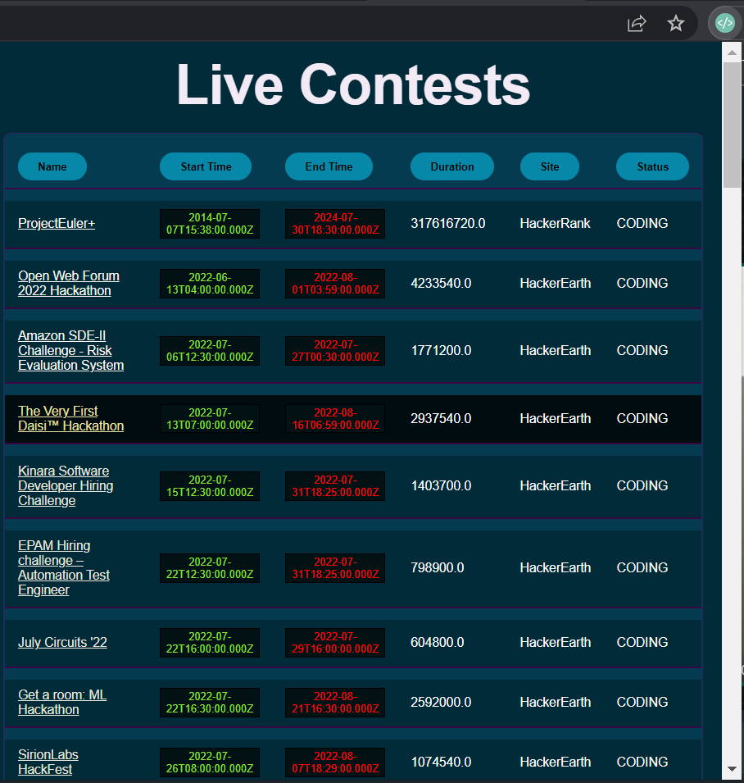
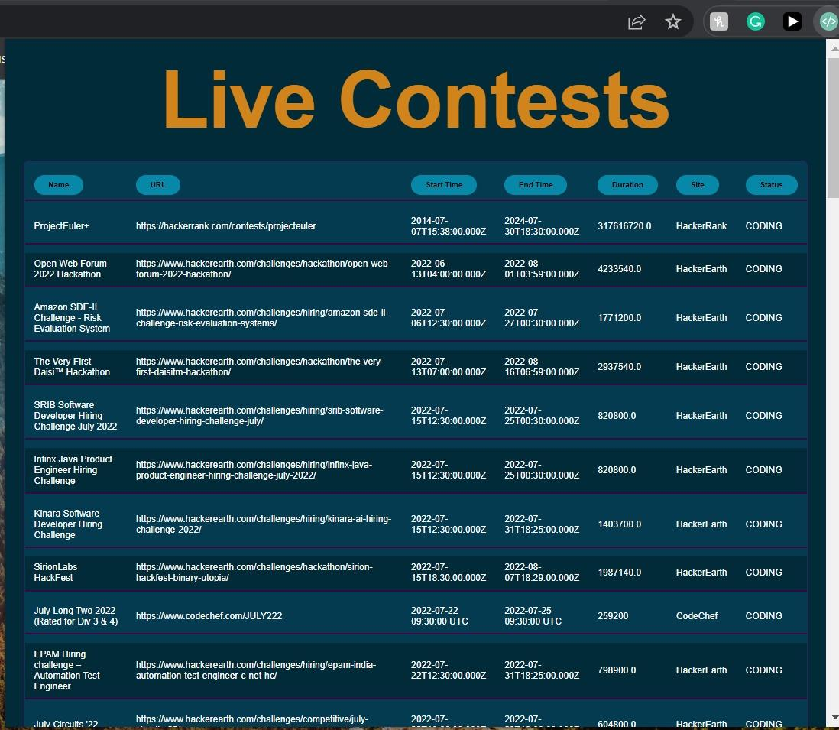


Slide 5
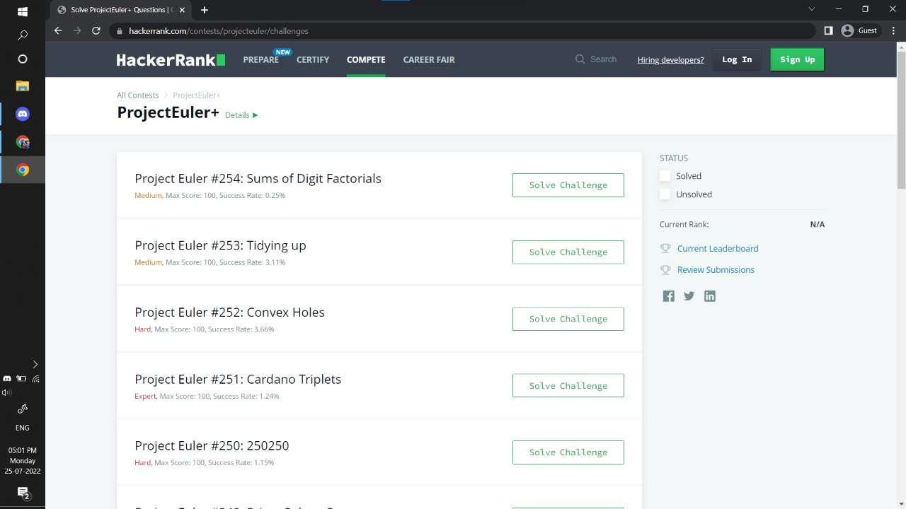

Slide 6



Technologies Used
01
02
03
HTML
CSS
JavaScript

Slide 7
What is HTML?
HTML stands for Hyper Text Markup Language.
HTML is the standard markup language for Web Pages.
Defines the structure & contents of a web page - where things go, how they’re laid out, & what’s on page.

Slide 8
What is CSS?
CSS stands for Cascading Style Sheets.
CSS describes how HTML elements are to be displayed.
Defines the styling/presentation of a web page and the elements on it.

Slide 9
What is JS?
JavaScript is the Programming Language for the Web.
JavaScript can update and change both HTML and CSS.
JavaScript can calculate, manipulate and validate data.

Slide 10
KEY FEATURES:
CodeBud
Your Programming Companion!
Visit a Coding Contest in one click, by clicking on the contest name.
Get access to all popular programming platforms , social platform and blogs in just one click.
Competition details- Start Time, End Time, URL, Status.
Simple chrome extension and easy to use.

Slide 11
Project Timeline
Week 1
Week 2
Week 3
Week 4
Learnt HTML
Working of various tags and elements
Learnt CSS
Added styling to the extension
Learnt JS
Basics of API fetching
Putting the project together

Slide 12
Future Additions
This project can be taken a step forward and add more useful features.
A | Subscription option
B | Add Your Friends option
C | Performance Analytics via graph or chart
D | Adding the contest timings to your calendar

Slide 13
Thankyou!

