Slide 1



Project Title
Jaypee University of Information Technology
Department of Computer Science and Engineering and Information Technology
Major Project - II (18B19CI891) | AY 2024-25
End-Term Evaluation | May 16-17, 2025.
Group No.:
Team Member (s)
Ishita Verma (211126)
Supervisor (s)
Name: Prof. Dr. Pardeep Kumar
Department: CSE & IT
Designation: Professor, SM-ACM

Slide 2
Outline
Introduction
Problem Statement
Objectives
Work Done (after Mid-Term Evaluation)
Project Design
Implementation
Experimental Results and Evaluation
Key Learnings
Future Work
Work Contribution and Attendance
Supervisor Interactions
References

Slide 3
Introduction
Efficient handling of Sales and Distribution (SD) processes is crucial for smooth business operations and timely customer service.
While SAP ERP provides standard modules, they may not meet the specific needs of businesses that require customized workflows and enhanced user interfaces.
There is a growing demand for tailored SAP applications that integrate user authentication, real-time order management, and automated document generation.
This project involves the development of a custom SAP solution using ABAP, Module Pool Programming, Smart Forms, and ALV Grids.
The system provides functionalities such as user registration/login, quotation creation, order placement, role-based access, and email notifications.
The objective is to automate and streamline the end-to-end SD process within SAP, ensuring better usability, process accuracy, and operational efficiency.

Slide 4
Problem Statement
Traditional SAP SD modules lack the customization needed for dynamic sales workflows in real-world scenarios.
Manual data entry and lack of role-based access can lead to inefficiencies and security concerns.
Existing solutions often do not provide integrated features like automated emails, Smart Forms, and user-specific dashboards.
There is a need for a unified, scalable SAP application that combines form generation, validation, and process automation.

Slide 5
Objectives
Design and develop a fully customized SAP module that manages the entire Sales and Distribution cycle—from customer registration and quotation generation to order processing and invoicing—using ABAP and module pool programming.
Implement user-specific login functionalities with role-based access, ensuring that customers and administrators have access only to relevant features and data, thereby enhancing both usability and security.
Automate key workflow actions such as order approval, status updates, and invoice dispatch by leveraging SAP Business Workflow (SWDD), business objects, and event-driven logic for seamless backend processing.
Create interactive and user-friendly GUI screens for real-time data entry, validation, and display using Screen Painter, enabling smoother user experiences and reducing data inconsistencies.
Integrate multiple SAP technologies (such as ALV grids, Smart Forms, and database tables) into a single, seamless system to improve operational efficiency, transparency, and decision-making.

Slide 6
Work Done (after Mid-Term Evaluation)
Developed custom SAP database tables to store customer, material, order, and quotation data, tailored specifically for the sales and distribution process.
Designed role-based login modules for both admin and customer users using module pool programming, ensuring secure and controlled access.
Created interactive screens using Screen Painter for registration, quotation requests, order processing, and invoice generation.
Automated the sales workflow using SAP Business Workflow (SWDD), integrating business objects and event triggers for real-time process handling.
Generated professional invoices through SAP Smart Forms and linked them dynamically to the order processing module.
Displayed structured data using ALV grids for admin users to view and manage customer records, quotations, and order histories.

Slide 7
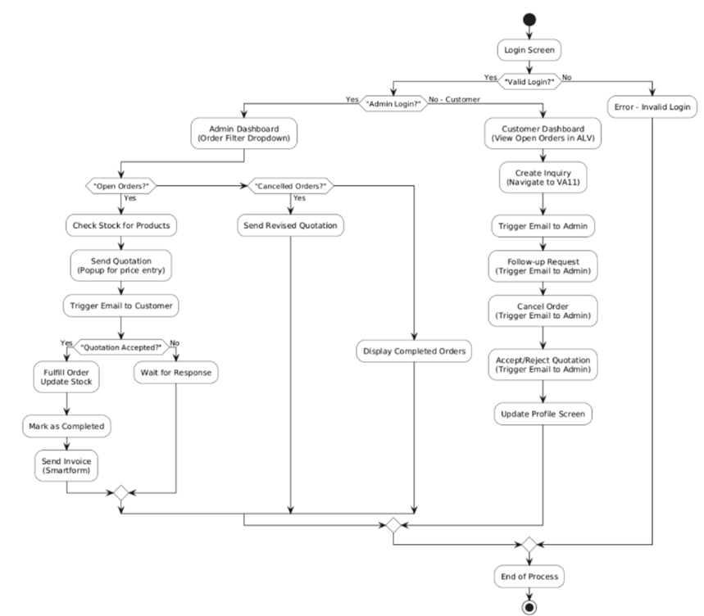
Project Design
Figure 1: Flowchart of the Project

Slide 8
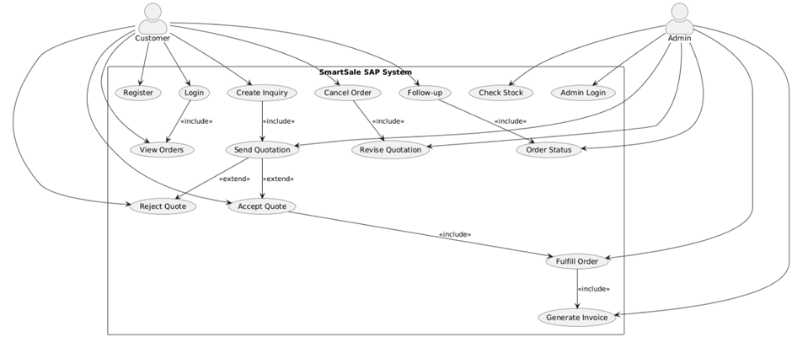
Project Design (cont…)
Figure 2: Use Case Diagram

Slide 9
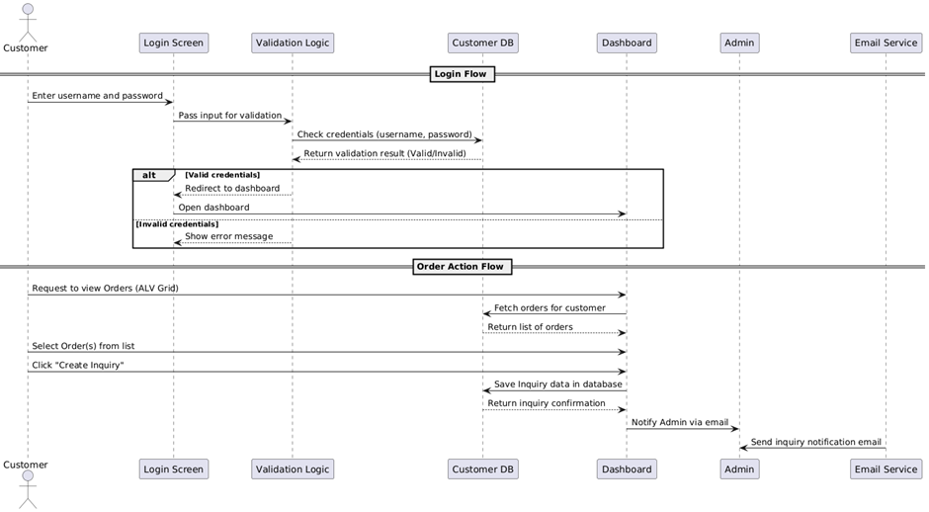
Project Design (cont…)
Figure 1: Use Case Diagram
Figure 3: Sequence Diagram

Slide 10
Implementation
Tools and Technologies Used:
SAP ABAP: Primary language for coding business logic, transaction codes, and customizing workflows.
SAP Module Pool Programming: Used for creating custom screens for user interaction, like login, order management, and invoice generation.
SAP Smart Forms: Used to design and generate dynamic business documents like invoices.
SAP Business Workflow (SWDD): Facilitates automation of tasks like order processing, invoice generation, and notifications.
Custom Tables Created:
ZCUSTOMER: Stores customer information including ID, encrypted password, security question, and answer for authentication.
ZPRODUCTS: Contains product details such as product ID, name, unit price, and available stock quantity.
ZORDERS: Maintains customer order headers including order ID, order date, order status (open/completed/canceled), and customer linkage.
ZINQUIRY: Logs customer inquiries for specific products and links them to the respective customers.
ZQUOTATION: Manages admin-generated quotations for orders, including total amount and customer decision (Accepted/Rejected).

Slide 11
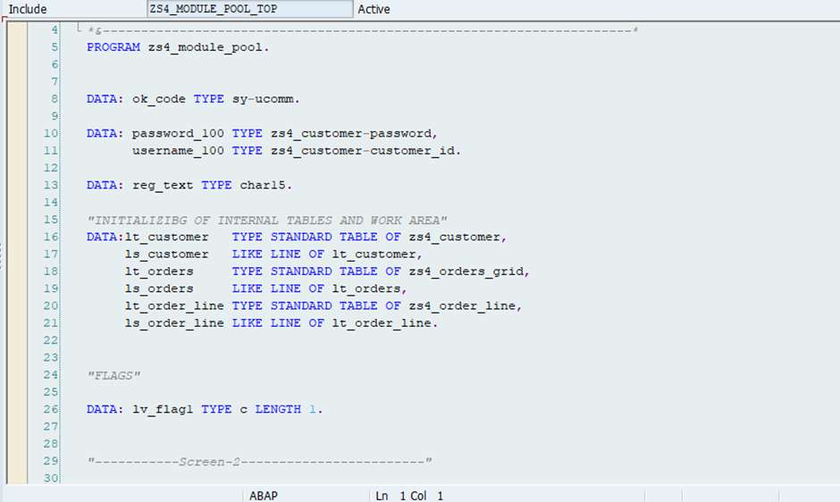
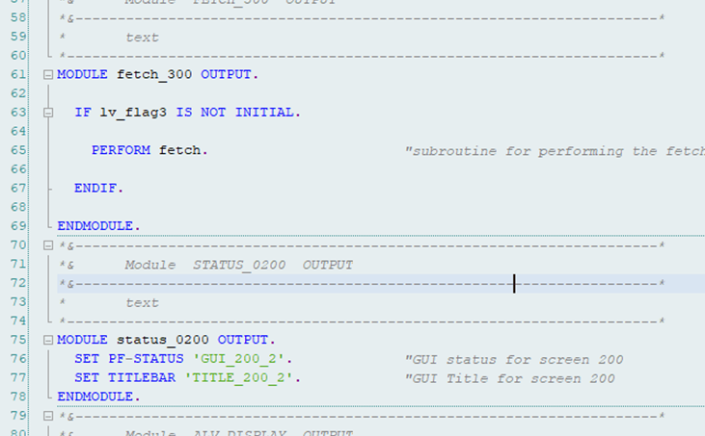
Implementation (cont…)
Login and Registration: Custom module pool screens enable both customers and admins to register and log in securely, with credentials stored in ZCUSTOMER and role-based redirection applied after authentication.
Customer Portal: Customers can view products from ZPRODUCTS, request quotations , track order status , and use buttons for follow-up, cancel order, and accept/reject quotation .
Admin Portal: Admins access a dashboard to manage inquiries, generate quotations, update order statuses (ZORDERS), and monitor overall customer activity.
Smart Forms Integration: Invoices for completed orders are generated automatically using SAP Smart Forms, offering formatted PDF outputs linked directly to order details.
Business Workflow Automation (SWDD): SAP Workflow automates admin notifications, order and quotation follow-ups, and invoice generation based on customer actions and order lifecycle.
Figure 4: Data Declaration
Figure 5: PBO Screen 1

Slide 12
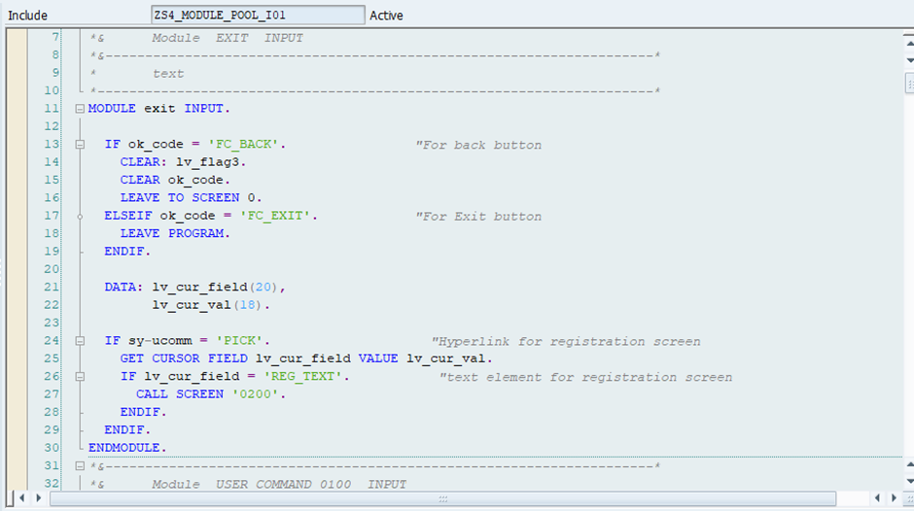
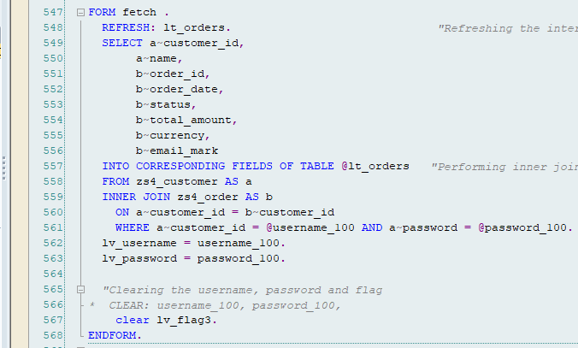
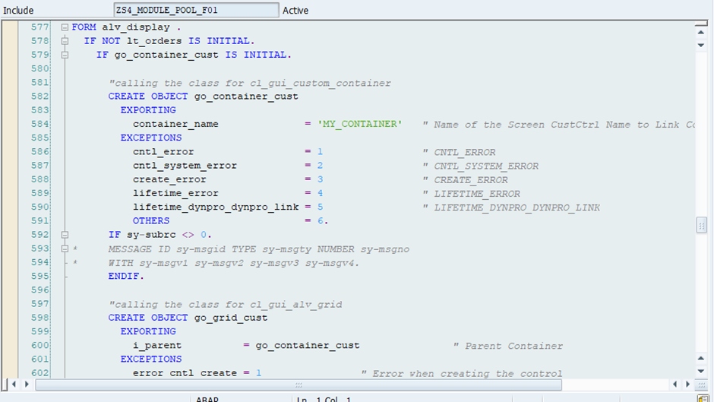
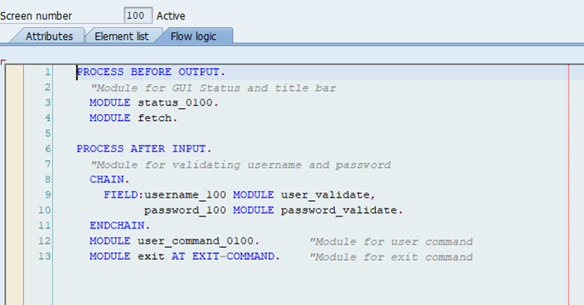
Implementation (cont…)
Figure 6: PAI (Process After Input) Module for Screen 1
Figure 7: Form-Routines Module for Fetching Data.
Figure 9: Screen 100
Figure 8: Form-Routines Module for ALV Display.

Slide 13
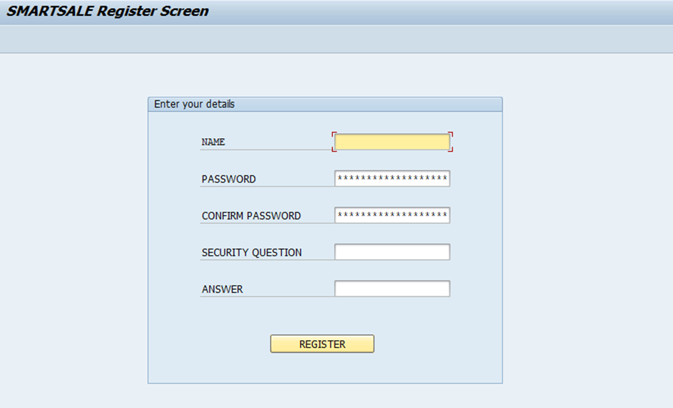
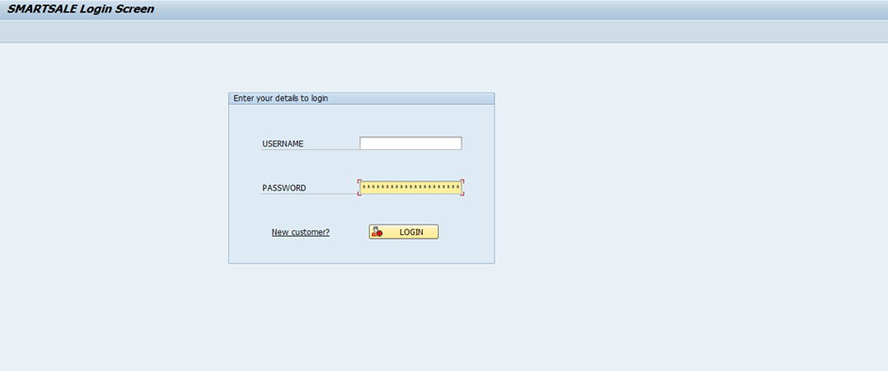
Experimental Results and Evaluation
Login and Registration: Secure role-based access successfully implemented for both customers and admins using custom module pool screens.
Customer Dashboard: Customers can view products, send inquiries, cancel orders, and track statuses; tested for functional accuracy and ease of use.
Admin Dashboard (ALV Grid: Admins manage orders, inquiries, and quotations efficiently with sorting and filtering via ALV Grid display.
Smart Forms: Auto-generated invoices and quotations with relevant order and customer data, ensuring accurate document handling.
Workflow Integration: Automated workflows built with SWDD and Business Object trigger quotation creation and order approval actions.
Figure 10: Project’s Login Screen
Figure 11: Customer Registration

Slide 14
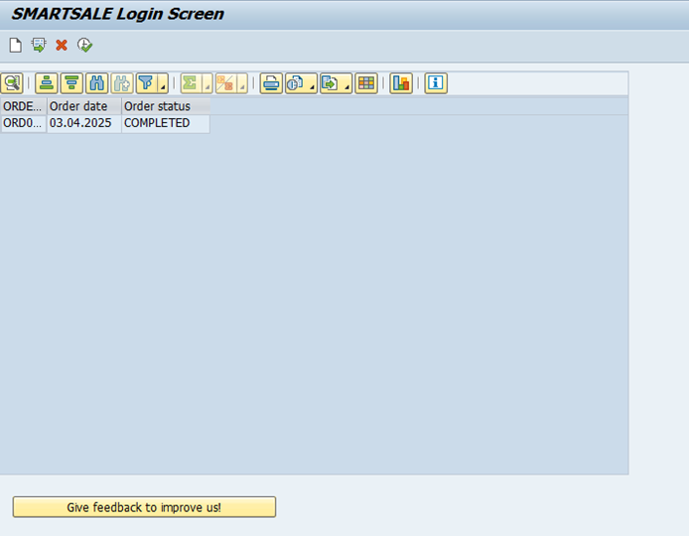
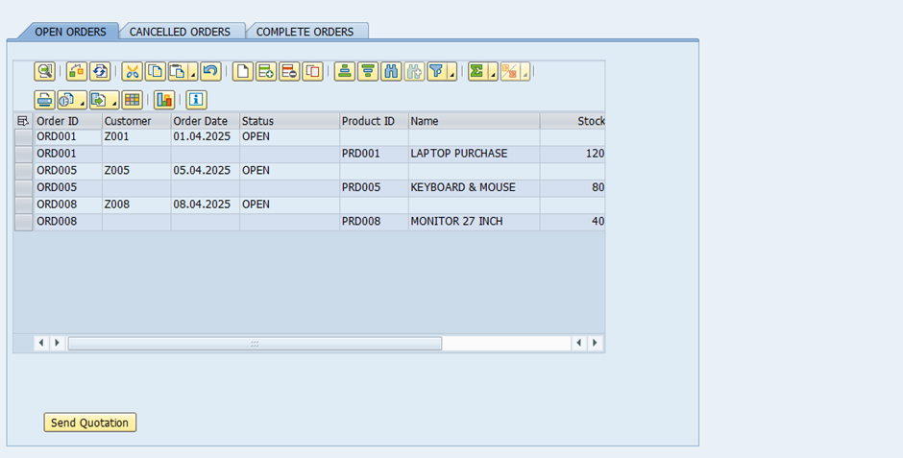
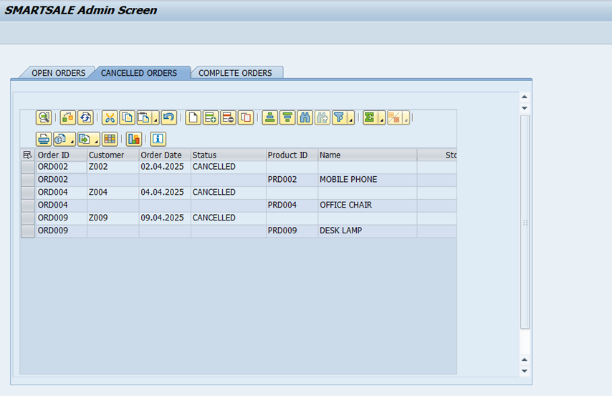
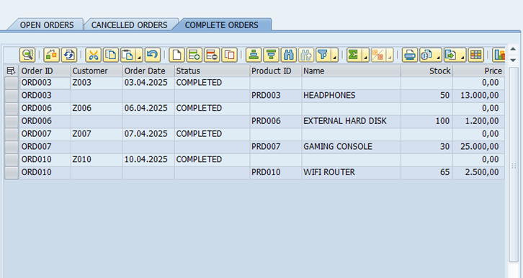
Experimental Results and Evaluation (cont…)
Figure 13: Admin Screen with Open Orders
Figure 12: Admin Screen with Open Orders
Figure 13: Admin Screen with Open Orders
Figure 14: Admin Screen with Cancelled Orders
Figure 15: Admin Screen with Completed Orders

Slide 15
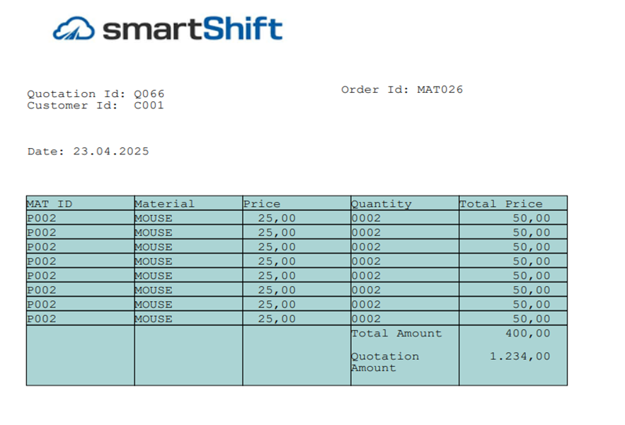
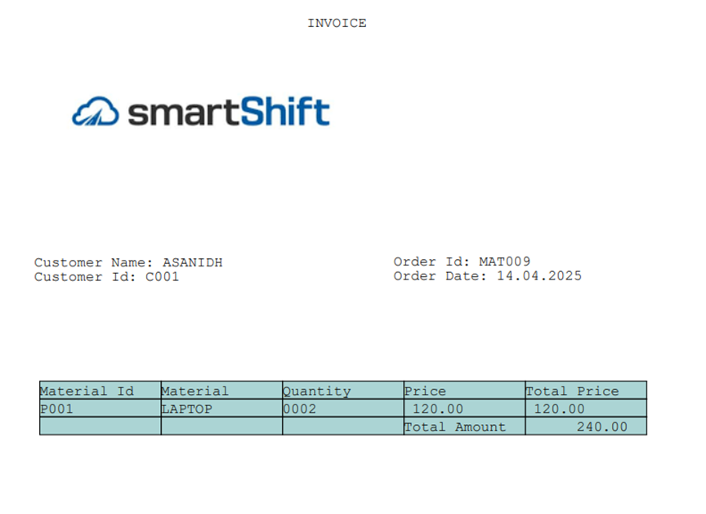
Experimental Results and Evaluation (cont…)
Figure 16: Smartforms Quotation Details
Figure 17: Smartforms Invoice Details

Slide 16
Key Learnings
Gained hands-on experience in SAP ABAP development, including Module Pool programming, Smart Forms, and ALV Grid integration.
Learned how to design and implement role-based portals and secure authentication using custom tables and logic.
Understood the end-to-end workflow automation process using SAP Business Workflow (SWDD) and business objects.
Developed the ability to build complete custom SAP solutions that align with real-world business processes in Sales and Distribution.
Improved debugging, modularization, and real-time data handling skills essential for enterprise-grade SAP applications.

Slide 17
Future Work
Integration with Email and SMS Gateways: Extend workflow notifications to include external communication via SAPconnect or third-party APIs.
Role-Based Dashboards: Enhance admin and customer dashboards with analytics, charts, and performance metrics for improved decision-making.
Mobile Accessibility: Develop a mobile-friendly version or integrate with SAP Fiori for better usability across devices.
Payment Gateway Integration: Implement secure payment processing for completed orders within the SAP environment.
Advanced Reporting: Incorporate SAP BI or custom reporting tools for sales trends, order tracking, and customer behavior analysis.

Slide 18
Work Contribution and Other Details
Roll No. |  | Start Date (dd/mm/2025) |  | Organization & Location | Work Mode (Online/Offline) | Work Nature (Tech./Non-Tech.) | Work Domain
211126 |  | 10/03/2025 |  | smartShift & Bangalore | Offline | Tech. | SAP ABAP
GitHub Repository URL: https://github.com/Ishita211126/SAP-Sales-and-Distribution-Automation-Framework
Work Contribution (provide week-wise work details)
Week 1 | 10/03/2025 to 15/03/2025 |  | Analyzed the project scope and finalized system requirements. Designed custom database tables for storing customer, product, inquiry, and quotation details using SE11. Defined appropriate primary keys, set up input validations, and established necessary foreign key relationships.
Week 2 | 17/03/2025 to 22/03/2025 |  | Developed the login and registration user interfaces using Screen Painter and Flow Logic. Implemented backend logic to verify user credentials and validate registration inputs. Introduced automated Customer ID generation during user registration.
Week 3 | 24/03/2025 to 29/03/2025 |  | Designed the customer dashboard using ALV Grid to display open orders. Explored ALV functionalities like field catalog configuration, layout settings, and row selection logic. Added integration to allow users to select orders and initiate the inquiry creation process.
Week 4 | 31/03/2025 to 05/04/2025 |  | Implemented functionality for Follow-Up and Cancel buttons using ALV row selection logic. Used internal tables to update order statuses in real-time within the database. Developed a custom function module to trigger workflow events based on user actions.

Slide 19
Work Contribution and Other Details (cont…)
Work Contribution (provide week-wise work details)
Week 5 | 07/04/2025 to 12/04/2025 | Built the admin dashboard with dropdown filters for managing order statuses (Open, Completed, Cancelled). Displayed hierarchical views for orders and corresponding line items. Added logic for validating stock availability and creating quotations via popup screens
Week 6 | 14/04/2025 to 19/04/2025 | Integrated SAP Smart Forms to generate PDF quotations. Configured functionality to send generated quotations to customers via email using the CL_BCS class.
Week 7 | 21/04/2025 to 26/04/2025 | Enabled customer actions to accept or reject quotations, with real-time status updates. Configured event-driven email notifications to alert the admin on customer actions. Designed the invoice Smart Form, linking it to finalized orders and enabling email delivery of final invoices.
Week 8 | 28/04/2025 to 03/05/2025 | Developed an additional screen (Screen 500) to allow customers to update their profile after login. Included validation for modifying details like name, password, and security answers. Updated changes directly in the ZCUSTOMER table after saving.
Week 9 | 05/05/2025 to 10/05/2025 | Conducted complete system testing to validate Smart Forms, email flows, and portal navigation. Debugged issues related to ALV operations, workflow triggers, and screen transitions.
Week 10 | 12/05/2025 to 13/05/2025 | Finalized the entire application workflow from customer inquiry to invoice generation. Captured relevant screenshots for documentation and project demo. Completed the project report, prepared the presentation, and recorded weekly contributions.

Slide 20
Supervisor Interactions (as mentioned in weekly log)
No. of Meetings with Supervisor: 10
Week No. | Duration | Remarks (as mentioned in the weekly log) | Incorporated (Yes/No)
1. | dd/mm/2025 to dd/mm/2025 | Defined custom tables and set up relationships between them Focused on mapping the project to the SD process flow Removed unnecessary fields for cleaner data structure | Yes
2. | dd/mm/2025 to dd/mm/2025 | Designed clean, SAP-style screens Added validation checks for login fields Replaced hardcoded credentials with dynamic checks | Yes
3. | dd/mm/2025 to dd/mm/2025 | Verified ALV data retrieval and selection functionality Used status codes to track order stages Handled cases where ALV datasets were empty | Yes
4. | dd/mm/2025 to dd/mm/2025 | Enabled workflows for Follow-Up and Cancel actions Logged events to support debugging Displayed user-friendly system messages | Yes
5. | dd/mm/2025 to dd/mm/2025 | Created dropdown filters for order status on admin side Checked product stock before creating quotations Used popups to simplify data entry | Yes

Slide 21
Supervisor Interactions (cont…)
Week No. | Duration | Remarks (as mentioned in the weekly log) | Incorporated (Yes/No)
6. | dd/mm/2025 to dd/mm/2025 | Built Smart Forms with flexible and aligned layouts Matched form fields accurately with order data Enabled PDF attachments in emails | Yes
7. | dd/mm/2025 to dd/mm/2025 | Developed Accept/Reject buttons for quotations Updated quotation and order statuses based on response Triggered invoice generation only after acceptance | Yes
8. | dd/mm/2025 to dd/mm/2025 | Added a new screen for updating customer profiles Implemented validation on all editable fields Blocked unauthorized users from making changes | Yes
9. | dd/mm/2025 to dd/mm/2025 | Conducted complete testing across modules Fixed bugs in navigation and workflows Documented all test results and system flows | Yes
10. | dd/mm/2025 to dd/mm/2025 | Finalized reports and presentation materials Verified screenshots and visuals for accuracy Completed logs of team contributions and activities | Yes

Slide 22
References (cont…)
[1] H. Frank and T. Allgaier, SAP S/4HANA Sales Certification Guide (C_TS462_2021): Application and Configuration Preparation, SAP Press, 2021
[2] A. Bose . Custom SAP Applications: Real-World Development Using ABAP, SAP Press, Boston, MA. 2020.
[3] C. C. Smith, Customizing SAP S/4HANA: Tools and Techniques for Tailoring the System to Meet Business Requirements, SAP Press, Boston, MA, USA, 2020.
[4] M. M. Raj, ABAP Development for SAP S/4HANA, Boston, MA, USA: SAP Press, Rheinwerk Publishing, 2021.
[5] B. Goerlich, SAP Smart Forms: Creating and Managing Forms in SAP ERP, Boston, MA, USA: SAP Press, Rheinwerk Publishing, 2017.
[6] P. Buley, Workflow for SAP S/4HANA: Business Process Automation with SAP Workflow, Boston, MA, USA: SAP Press, 2020.
[7] C. C. Smith, Customizing SAP S/4HANA: Tools and Techniques for Tailoring the System to Meet Business Requirements, Boston, MA, USA: SAP Press, 2020.

Slide 23
References
[8] SAP SE, "Working with the ALV Grid Control," SAP Help Portal. [Online]. Available
https://help.sap.com/doc/saphelp_snc70/7.0/enUS/4e/bd16291041389ee10000000a421937/content.htm
[9] SAP SE, "Module Pool Programming," SAP Help Portal. [Online].
Available:https://help.sap.com/docs/SUPPORT_CONTENT/wdabap/3362186650.html
[10] SAP SE, "Multiple Tabs in a Selection Screen in Module Pool Programming,"
SAP Help Portal.[Online].Available: https://help.sap.com/docs/SUPPORT_CONTENT/abap/3353523998.html
[11] R. D. Winter, ABAP Development for SAP Business Workflow, Boston, MA, USA: SAP Press, 2011.
[12] K. Krishnamoorthy, SAP Integration Suite: Managing APIs, Workflows, and Event-Based Processes, Boston, MA, USA: SAP Press, 2022.
[13] N. Ghosh and S. Goon, Workflow for SAP S/4HANA, Boston, MA, USA: SAP Press, Rheinwerk Publishing, 2022.

Slide 24
References (cont…)
[14] D. Mather, ABAP Development for SAP S/4HANA: ABAP Programming Model for SAP Fiori, Boston, MA, USA: SAP Press, 2020.
[15] SAP SE, "Properties of the ALV Grid Control," SAP Help Portal. [Online]. Available:
https://help.sap.com/doc/saphelp_snc70/7.0/enUS/4e/ba881e260e56a5e10000000a421937/content.htm\
[16] M. Missbach, M. Fenz, and B. Mühling, Securing SAP S/4HANA: Security Guide, Boston, MA, USA: SAP Press, 2021.
[17] B. U. Weinshel, SAP S/4HANA Sales: Business User Guide, Boston, MA, USA: SAP Press, 2022.
[18] M. Bader, SAP ABAP Advanced Cookbook, Birmingham, UK: Packt Publishing, 2015.

Slide 25

Thanks.

