Slide 1
Mini Project On Web Development Using Advanced Tools Submitted By: Ishita Srivastava University Roll No:2018845 B.Tech CSE Under the mentorship of Mr. Ramesh Singh Rawat Assistant Professor

Slide 2

Introduction
The process of creating a website is known as web design
The development of a website with an emphasis on various aesthetic elements like layout, user interface, and other visual imaginary is the primary focus of this procedure
When creating a web design, designers are obligated to consider the purpose and aesthetic appeal of the design as well as the type of audience they hope to reach

Slide 3
Methodology Tools Used: 1.HTML Hyper Text Markup Language is also known as HTML. The markup language is used to design web pages. Hypertext Markup Language (HTML) is a combination of the two languages. The link between web pages is defined by hypertext, and the text document within the tag that defines the structure of web pages is defined by markup language. The basic tags used in HTML :
<html>
<head>
<title>
<body>

Slide 4

2.CSS
Cascading Style Sheet
Inline: The inline CSS property can be found in the body section that is attached to the element
Internal or incorporated: The head section of the HTML file should contain the CSS ruleset, which means that the CSS is embedded within the HTML file
External: With the assistance of tag attributes, external CSS consists of a separate CSS file that only contains style properties

Slide 5
3.JavaScript The JavaScript actually makes the website interactive through the logical statements which tells that what will happen after something has been done on the website. It does not appear on the web page but its role is very crucial and central. JavaScript can be added to the HTML file in the following two ways:
Internal JavaScript
External JavaScript

Slide 6
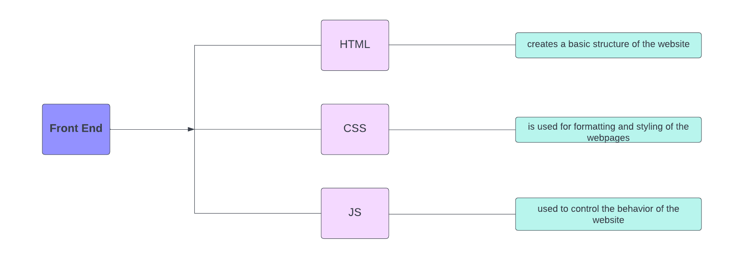
Flowchart

Slide 7
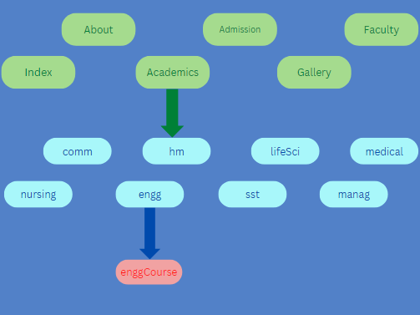
Result and Discussion The website is successfully employed with a plentiful of utilities making it ever interactive. The website can provide insights of the university . Users can interact with the website by navigating from one web page to another easily .
The structure of the website comes out to look like the below chart:

Slide 8
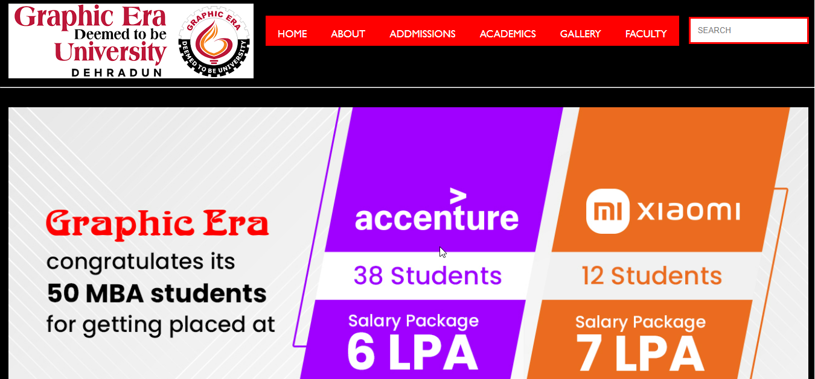
HOME PAGE

Slide 9

Skills Learned
During the process of designing a website, I have honed a number of skills, including computer skills, project management abilities, communication abilities, and design abilities
Analyses of these abilities are provided below: Skills in time management: By creating a website, I have learned how to manage my time by setting goals for the long and short term, creating a to-do list, breaking down difficult tasks into smaller ones, and scheduling group activities so that they can all be completed within the allotted time
Learning skills: By designing a website, I have learned about web designing tools that are html , css and javascript and now feel confident on using it for future purposes

Slide 10
Conclusion
The aforementioned report can be used to conclude that web design is a complicated process that necessitates systematic attention to numerous aspects
Examples of this include color contrast, text organization, font selection, page style, page size, graphics used, and consistency
The developer is responsible for organizing and analysing the user's statistics and background
Future Work
When it comes to connecting with customers online, a company's or business's website is the most important thing
A company's online image is its website
Every industry today recognizes the importance of maintaining a website and is working to design and build the best website for selling products or services online

Slide 11
References
[1] www.w3schools.com
[2] www.geeksforgeeks.com
[3] www.geu.ac.in
[4] Clark, Joe. Building Accessible Websites, New Riders Publishing, 2002.
[5] www.freecodecamp.org

