Slide 1

Automated Essay Grading
Natural Language Processing
Final Project

Slide 2
Introduction
Automated essay scoring (AES) is the use of specialized computer programs to assign grades to essays written in an educational setting. It is a method of educational assessment and an application of natural language processing. Its objective is to classify a large set of textual entities into a small number of discrete categories, corresponding to the possible grades—for example, the numbers 0 to 6. Therefore, it can be considered a problem of statistical classification.
The project aims to build an automated essay scoring system using a data set of 13000 essays from kaggle.com. These essays were divided into 8 different sets based on context. A variety of transformations are done on the dataset and features are extracted. Logistic regression as well as Ridge and lasso regression were performed on the dataset using various alpha values and the maximum score is calculated for each dataset. Spearman coefficient.

Slide 3
Related Work
ETS GRE e-rater
Checks for spelling, grammar, usage and discourse structure and quality
Detects responses that are off topic, anomalous or are not applicable.
It matches with the manual evaluation 98% of the time.
Mahana et. al – Stanford, 2012
Used features such as number of ‘Long’ words in an essay, bag of words etc.
Used Linear regression with Quadratic Kappa as an evaluation metric
Score: 0.73

Slide 4
Uniqueness and Analysis
Using Ridge and lasso regression instead of linear regression
Essay grading systems are essentially a statistical classification. We decided to use Linear Regression for this purpose. However Linear regression tends to have highly unregularized coefficient.
Combining models
Combining classification models using AdaBoostClassifiers
Combining regression models using truncated mean of the predictions of individual models

Slide 5
High Level Block Diagram
Data
Collection and analysis
Preprocessing
Features
Extraction of vectors
Identifying features
Training
Classification
Regression
Evaluation
Evaluate using metrics
Conclude on best fitting model

Slide 6
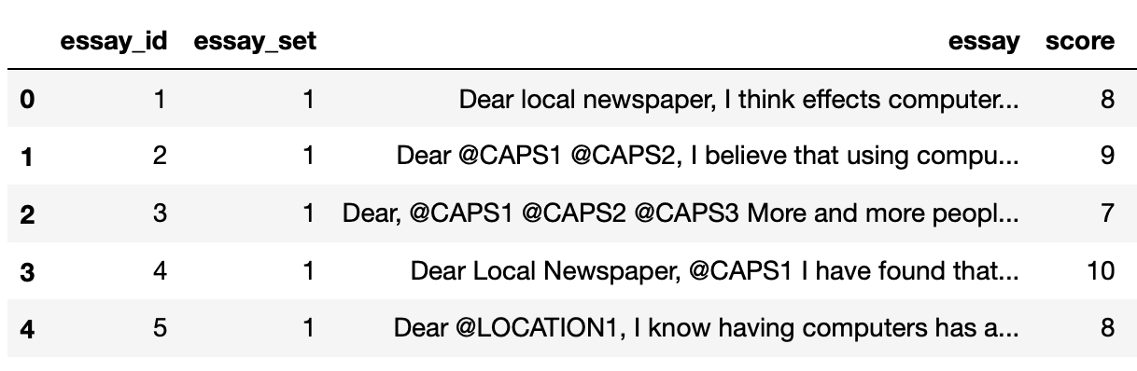
Dataset
Dataset consists of 12976 essays with scores manually obtained from human evaluation. The dataset is divided into 8 essay sets based on context. It is important to note that each essay set has a different scoring system.
The dataset initially looks like this:

Slide 7
Transforming the dataset - Essays
Lowercase
Converting all characters in the essay to lowercase
Valid words
Checking for all valid English words using wordnet
Special characters
Removing special characters and keeping only letters
Stop words
Removal of stop words using NLTK database

Slide 8
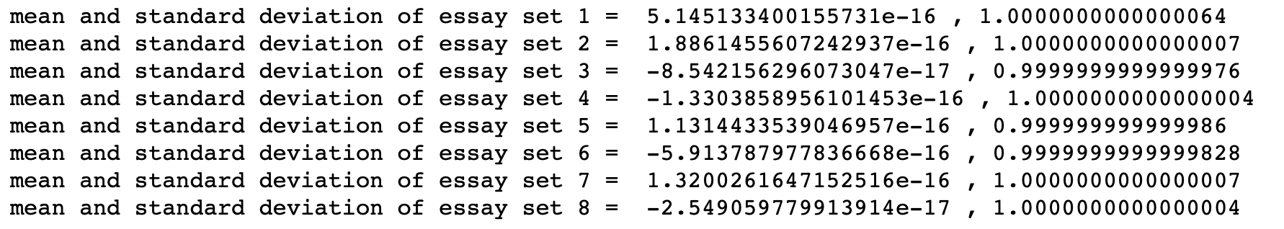
Transforming the data set - Scores
Each essay set has a different scoring system. The scores range from 1 to 60. Hence it is important to standardize the score. The score is standardized by the mean and standard deviation of each essay set.
After standardization:

Slide 9
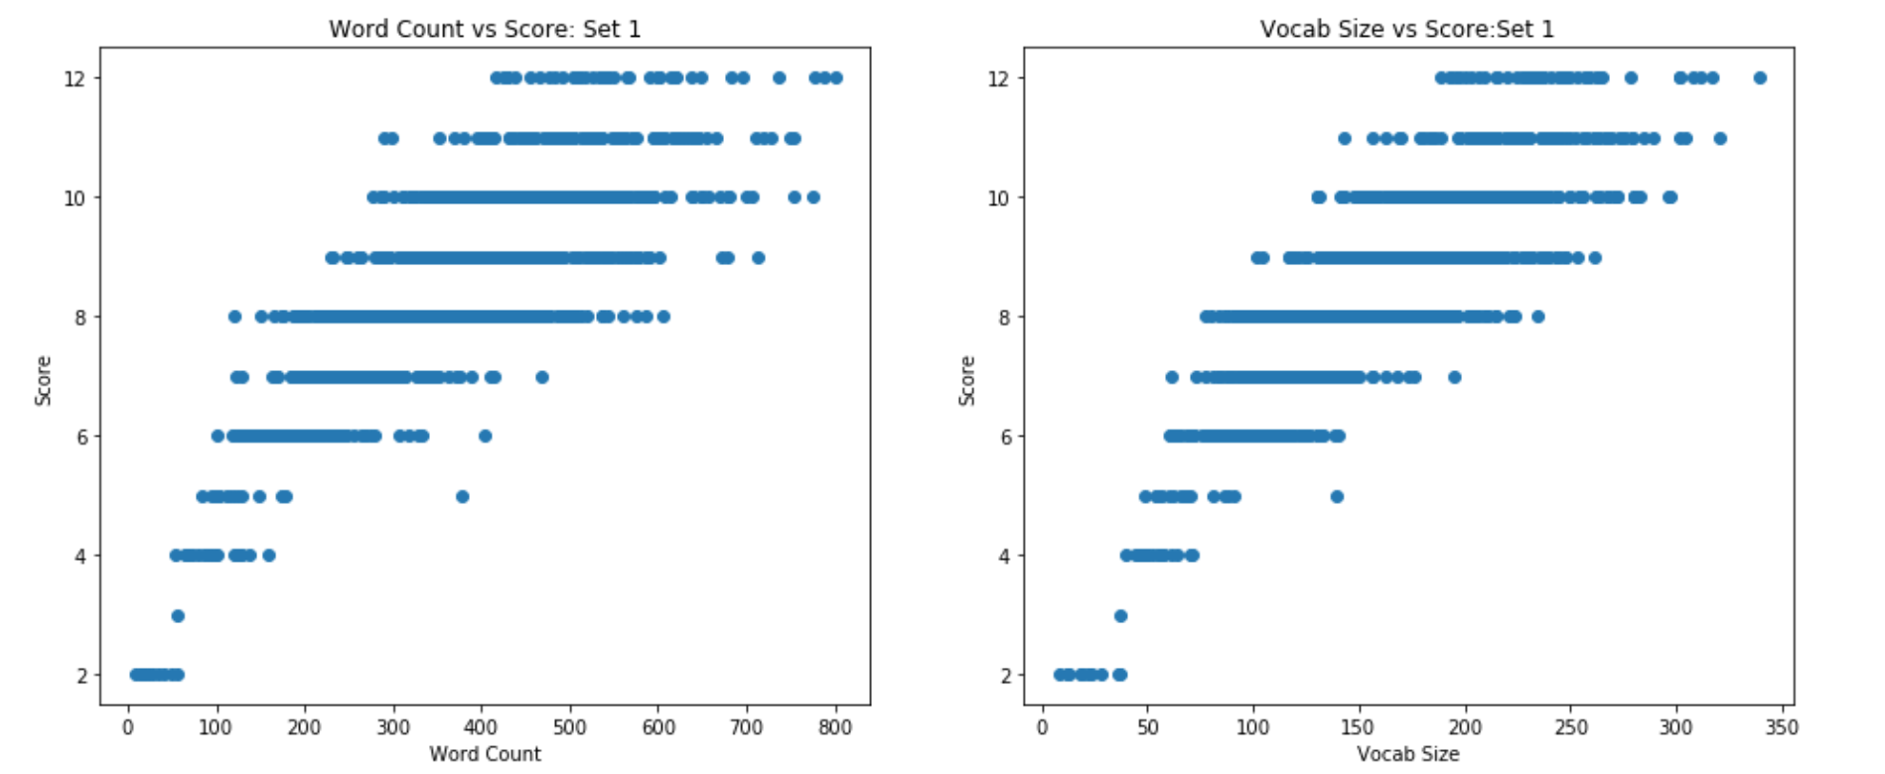
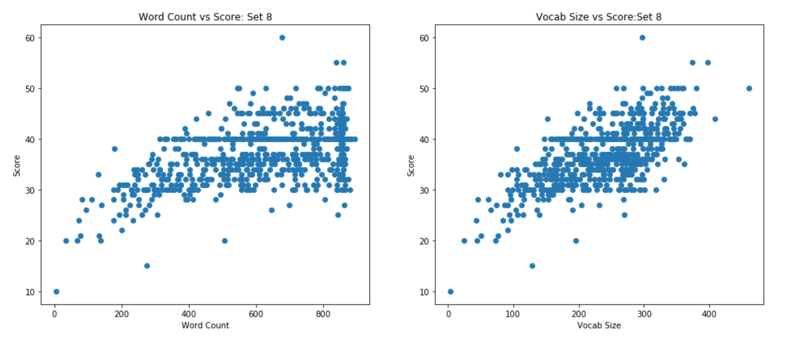
Analysis of the dataset
Plotting the word counts and the vocabulary sizes against the scores for each of the datasets helps us identify any underlying patterns of the dataset.
From the word counts vs. score scatterplots, we see that in general, there seems to be an upward, positive trend between the essay words counts and the score. For sets 1, 2, 4, 5, 6, and 7, the groups of essays for each score shift over to the right for the most part.

Slide 10
TFDIF Vectorizer
TFIDF essentially “vectorizes” the data. It generates a sparse matrix using term-frequency and inverse-document-frequency.
Alternative to this would be count vectorizer which gives equal importance to all words, whereas, TFIDF does not.
Output of the TFIDF vectorizer gives a matrix of dimension:
(12976, 43081)

Slide 11
Feature extraction
Apart from vectorizing the data, we decided to extract some features from the dataset and see how they perform as an independent entity.
The features we extracted were:
Sentence length
Unique words
Percentage of Misspelled words
Proportion of POS tags in each essay
{'ADJ': 0.105, 'ADP': 0.0823, 'ADV': 0.06, 'CONJ': 0.0422, 'DET': 0.087, 'NOUN': 0.22, 'NUM': 0.0084, 'PRT': 0.0478, 'PRON': 0.059, 'VERB': 0.208, '.': 0.0647, 'X': 0.00281}
Perplexity od each essay

Slide 12
Comparing vectors and features
We try to strike a comparison between modelling a machine learning algorithm with the TFIDF sparse matrix and the features.
We train our vectors and features on two different models and observe their combined score.

Slide 13
Models
Classification
After standardizing the scores of the essay sets, a binary target array was generated to aid with classification using logistic regression.
Evaluation metric: Accuracy = (True positive + True negative)/(Total Samples)
Regression
Ridge and lasso regression are used to predict the scores.
Evaluation metric Spearman coefficient. It is a robust measure of correlation between two distributions.

Slide 14
Results
MODEL | ACCURACY |  | SPEARMAN COEFFICIENT
 | VECTORS | FEATURES | VECTORS | FEATURES
Logistic regression | 71.1% | 67.5% | N/A | N/A
Ridge regression | N/A | N/A | 0.648 | 0.101
Lasso Regression | N/A | N/A | nan | 0.103

Slide 15
Results – After Combining
MODEL | ACCURACY AFTER BOOSTING |  | SPEARMAN COEFFICIENT
 | VECTORS | FEATURES | VECTORS | FEATURES
Logistic regression | 0.704 | 0.674 | N/A | N/A
Ridge regression | N/A | N/A | 0.638
Lasso Regression | N/A | N/A

Slide 16
Learnings
Working of ridge and lasso regularization
The effect of different models on various metrics like accuracy and spearman coefficient
A clear understanding of the pipeline of processing data involving natural languages
Combining Models to increase accuracy

Slide 17
Unresolved challenges
The algorithm assumes a very mathematical and context-independent approach to the problem. This poses problems such as the algorithm's inability to distinguish between quality and drivel. For example an essay with the word ‘the’ replaced with the word ‘animal’ gave a score of 6 out of 6.
Algorithm has not yet been able to come considerably close to human evaluation and cannot be used as a substitute, but an aide.
Combining models effectively to increase accuracy beyond 70%

Slide 18

Team
Dweepa Honnavalli
Ishita Bhandari
Rasya Ramesh

