Slide 1

SE 801: Final Presentation
Bengali Word Embedding and Next Word Prediction
Presented by
Ishita Sur Apan
Exam roll: 0932
Supervised By
Dr. Mohammad Shoyaib
Professor
Institute of Information Technology
University of Dhaka
05-04-2021

Slide 2
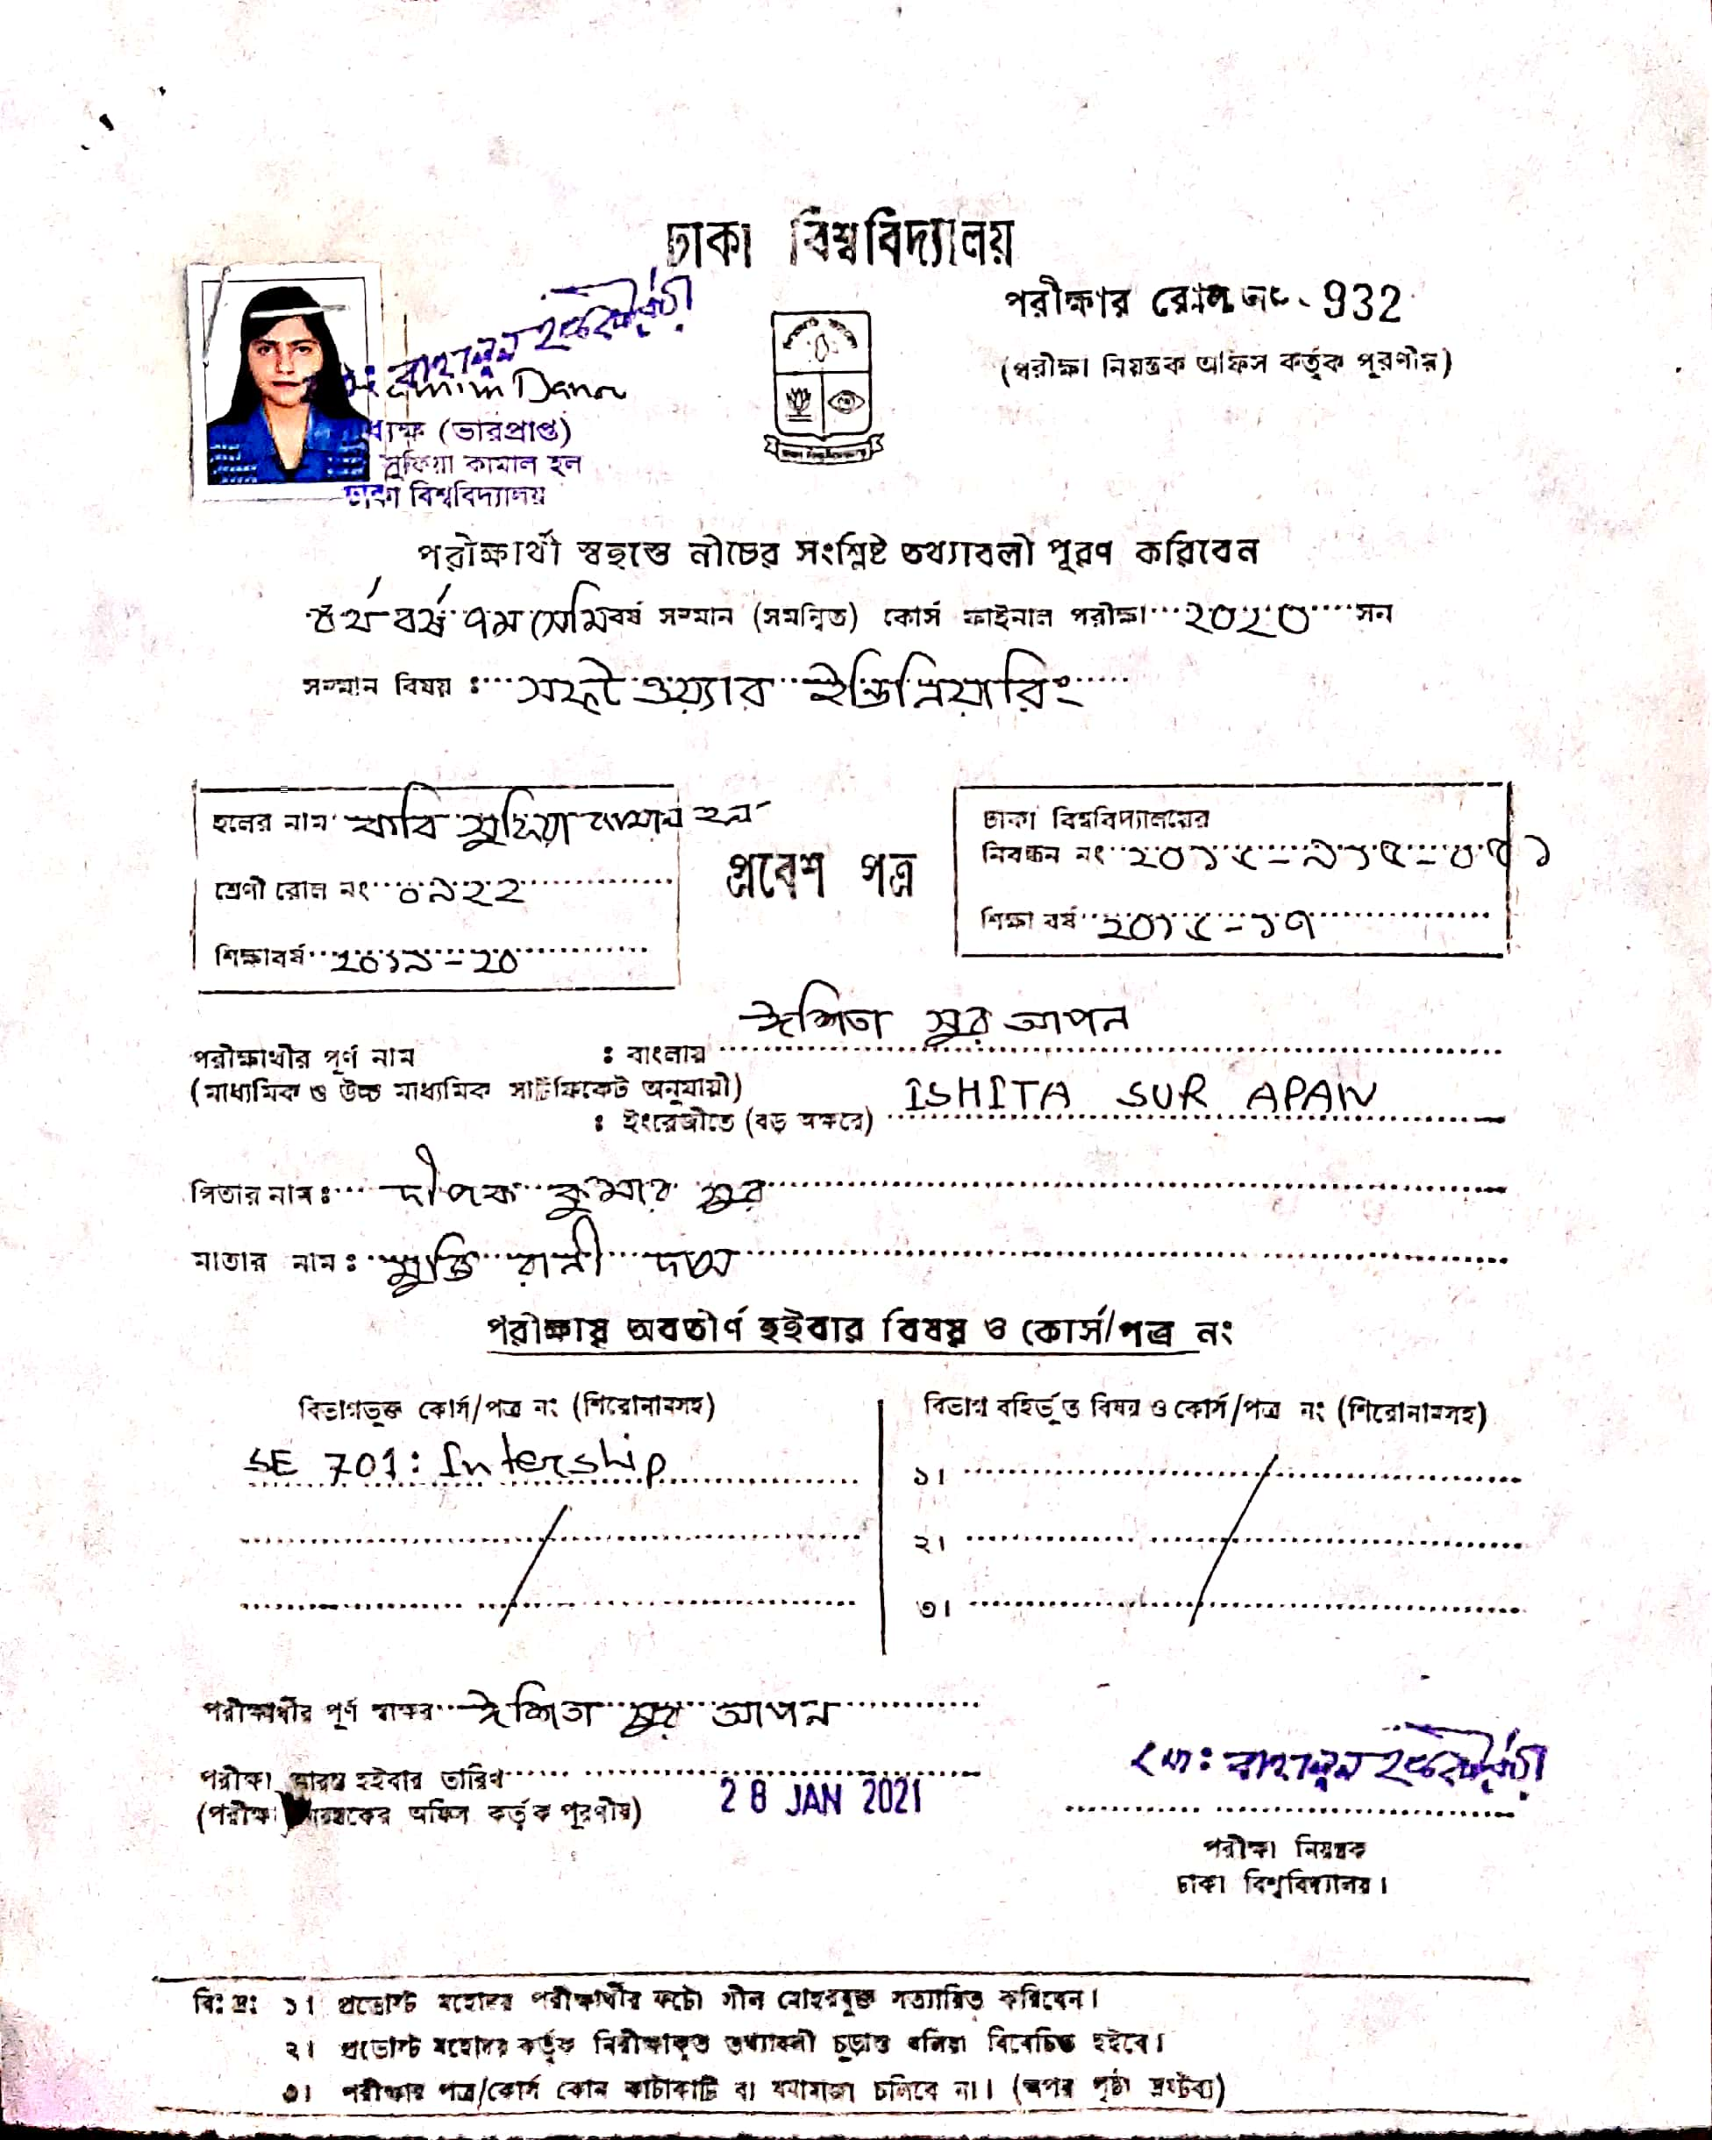

Slide 3
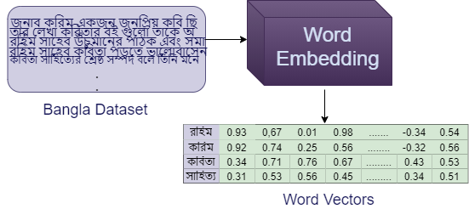
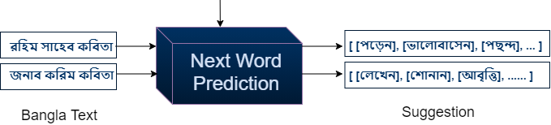

Bengali Word Embedding & Next Word Prediction
Deliverable
(4 Bengali embedding models, Source code)
Client: Technical users
Deliverable
(Web application, Chrome plugin)
Client: Non technical users

Slide 4
Methodology (At a glance)
Dataset Preparation
Google Chrome Plugin
Preprocessing
Web Application Development
Embedding Model Creation
Next Word Prediction

Slide 5







Dataset
Datasource
News portals
Prothom Alo, Kaler Kantho, Ittefak
Bengali websites
Banglapedia, Bengali wikipedia
Bengali bolg
Sachalayaton
Bengali Books
About dataset
10.2 million sentences
Total size 5 GB

Slide 6
Preprocessing
Remove unwanted characters and digits
Remove English words
Different approaches of preprocessing is required to find out Best embedding model
Remove punctuation
Extract sentences
Tokenize words
Save preprocessed files in pkl

Slide 7
Word Embeddings
Design embedding Model
Feed Corpus to the Model
Create and Save Model
Query Model
Word2Vec Skipgram
Word2Vec CBOW
FastText CBOW
FastText Skipgram

Slide 8
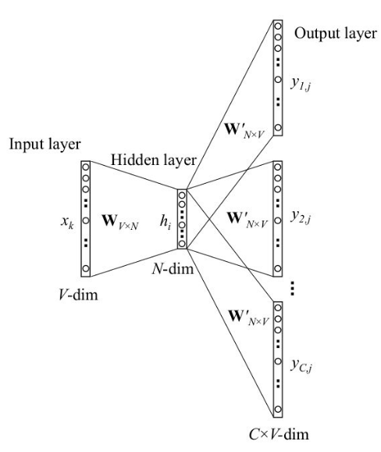
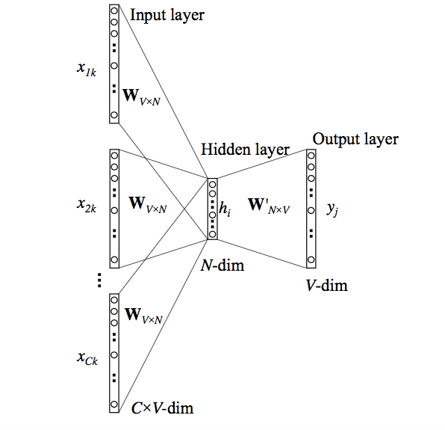
Sequence: [জাতীয় কবি কাজী নজরুল ইসলাম]
Context window size: 5
Target word: কাজী
SkipGram
CBOW
X (জাতীয়)
Y (জাতীয়)
X (কবি)
X (কাজী)
Y (কবি)
.
.
.
.
.
Y (কাজী)
.
.
.
.
.
Y (ইসলাম)
X (ইসলাম)

Slide 9
Word2Vec vs FastText
[জাতীয় কবি কাজী নজরুল ইসলাম]
Word2Vec
Treats each word an atomic entity
Generates a vector for each word
Cannot produce vector for out-of-vocabulary words
FastText
Extension of Word2Vec
Treats a word composed of its character ngrams
Mean of target word vector and its component ngram vectors
[“নজরুল”]
নজরুল → [-0.44, 0.957,.....,-0.013, 0.64 ]
জারুল → Error
[জাতীয় কবি কাজী নজরুল ইসলাম]
[“<নজ”, “জর ু”, “র ুল”, “ুল>”, “নজরুল”]
নজরুল → [-0.57, 0.9,.....,-0.001, 0.934 ]
জারুল → [-0.37, 0.84,.....,-0.012, 0.734 ]

Slide 10
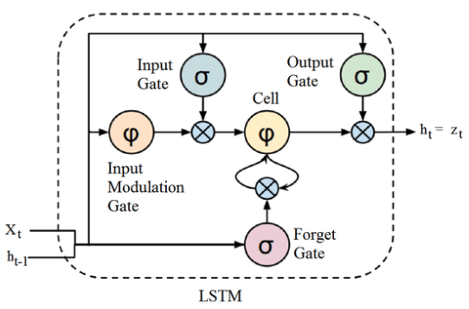
Long Short Term Memory
LSTM
Special kind of RNN
Input gate, output gate
Cell state, forget gate
Activation Function: SoftMax
Loss Function: Cross Entropy
Adam Optimizer
Metrics: Accuracy

Slide 11
Next Word Prediction
Take input Text
Build Model using LSTM
Use Embedding in input layer
Preprocess user input text
Generate Text
Suggest Next Word

Slide 12
Web Application and Plugin
Developing Frontend
Connecting with Backend
Build Plugin
Select Embedding model
Type Bengali Text
Google Chrome plugin
RESTful API
Get relevant suggestions
Use suggestions

Slide 13
Tools and Technology
Backend→ Python 3
Embedding
Word2Vec, FastText, CBOW, Skipgram
Gensim Library
Next Word Prediction
Algorithm: LSTM
Keras Library
Frontend→ Django
Web application
Html, Css, Bootstrap, Javascript
Web API
Django RESTful framework
Plugin
Google Chrome Extension

Slide 14
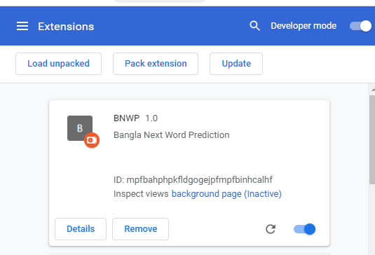
Demonstration(Chrome Extension)

Slide 15
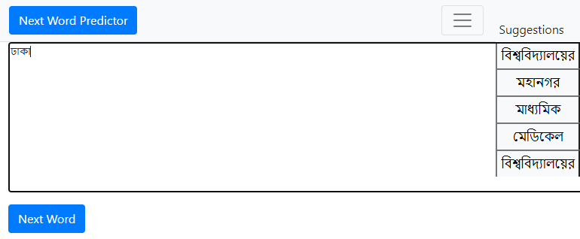
Demonstration(Web Application)

Slide 16
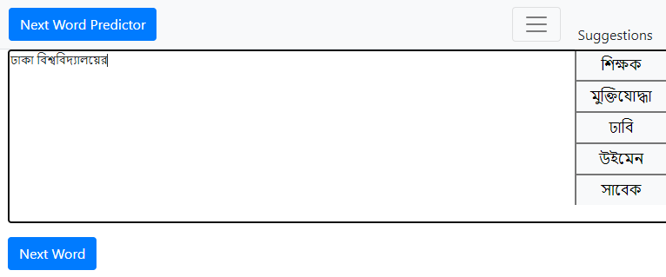
Demonstration(Web Application)

Slide 17
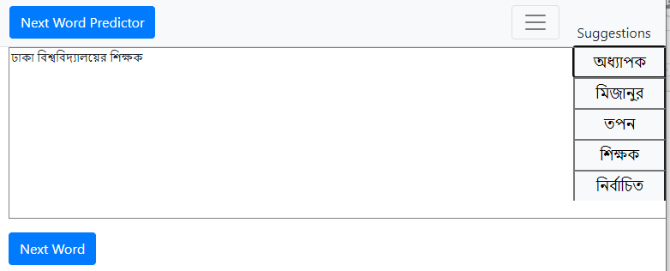
Demonstration(Web Application)

Slide 18
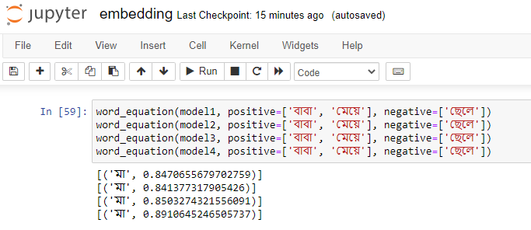
Demonstration(Embedding)
বাবা + মেয়ে - ছেলে
= মা

Slide 19
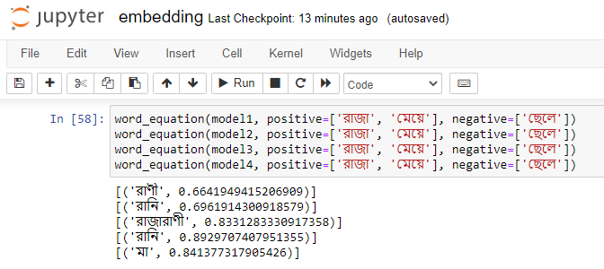
Demonstration(Embedding)
রাজা - ছেলে + মেয়ে
= রানি

Slide 20
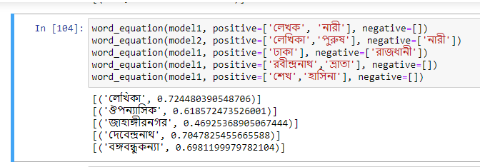
Demonstration(Embedding)

Slide 21
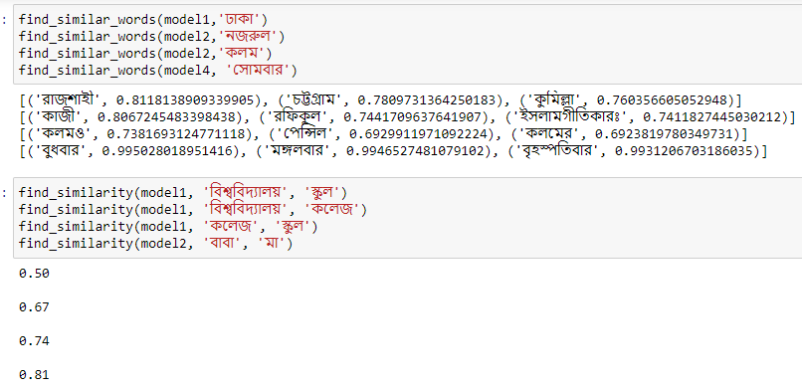
Demonstration(Embedding)

Slide 22



Slide 23
Word Embeddings
Different Approaches of Preprocessing
Without data cleaning
With data cleaning
Extract sentences regarding “ | ”
Extract sentences regarding “ | ”, “?” and “!”
Different Approaches of Algorithms
Word2Vec CBOW
Word2Vec Skipgram
FastText CBOW
FastText Skipgram
Preprocessing 1
Preprocessing 2
Preprocessing 3
Word2Vec CBOW
Word2Vec Skipgram
Word2Vec CBOW
Word2Vec Skipgram
Word2Vec CBOW
Word2Vec Skipgram
Fasttext skipgram
Fasttext CBOW
Fasttext skipgram
Fasttext CBOW
Fasttext skipgram
Fasttext CBOW

Slide 24
Methodology (Preprocessing)
Remove unwanted characters and digits
Why not Stemming?
Remove English words
Remove punctuation
Extract sentences
Stemming
আমাদের
আমা
Tokenize words
Save preprocessed files in pkl

Slide 25
Word Embeddings
Different Approaches of Preprocessing
Without data cleaning
With data cleaning
Extract sentences regarding “ | ”
Extract sentences regarding “ | ”, “?” and “!”
Different Approaches of Algorithms
Word2Vec CBOW
Word2Vec Skipgram
FastText CBOW
FastText Skipgram
Which Approach is better?
Trial and Error
Preprocessing 1
Preprocessing 2
Preprocessing 3
Depends on the task to be performed
Word2Vec CBOW
Word2Vec Skipgram
Word2Vec CBOW
Word2Vec Skipgram
Word2Vec CBOW
Word2Vec Skipgram
In this Project, the task is
Next Word Prediction
Fasttext skipgram
Fasttext CBOW
Fasttext skipgram
Fasttext CBOW
Fasttext skipgram
Fasttext CBOW

Slide 26
Word2Vec vs FastText
The key difference between FastText and Word2Vec is the use of n-grams.
Word2Vec→ Google, FastText → Facebook
Word2Vec is Faster to train
FastText works better for rare words
Fastext can create word vectors for out-of-vocabulary words

