Slide 1
Introduction to Web scraping in Python
Ishita Gopal
8th March
Notes:
https://www2.stat.duke.edu/courses/Fall19/sta199.001/slides/lec-slides/06a-web-scrape.html#28

Slide 2
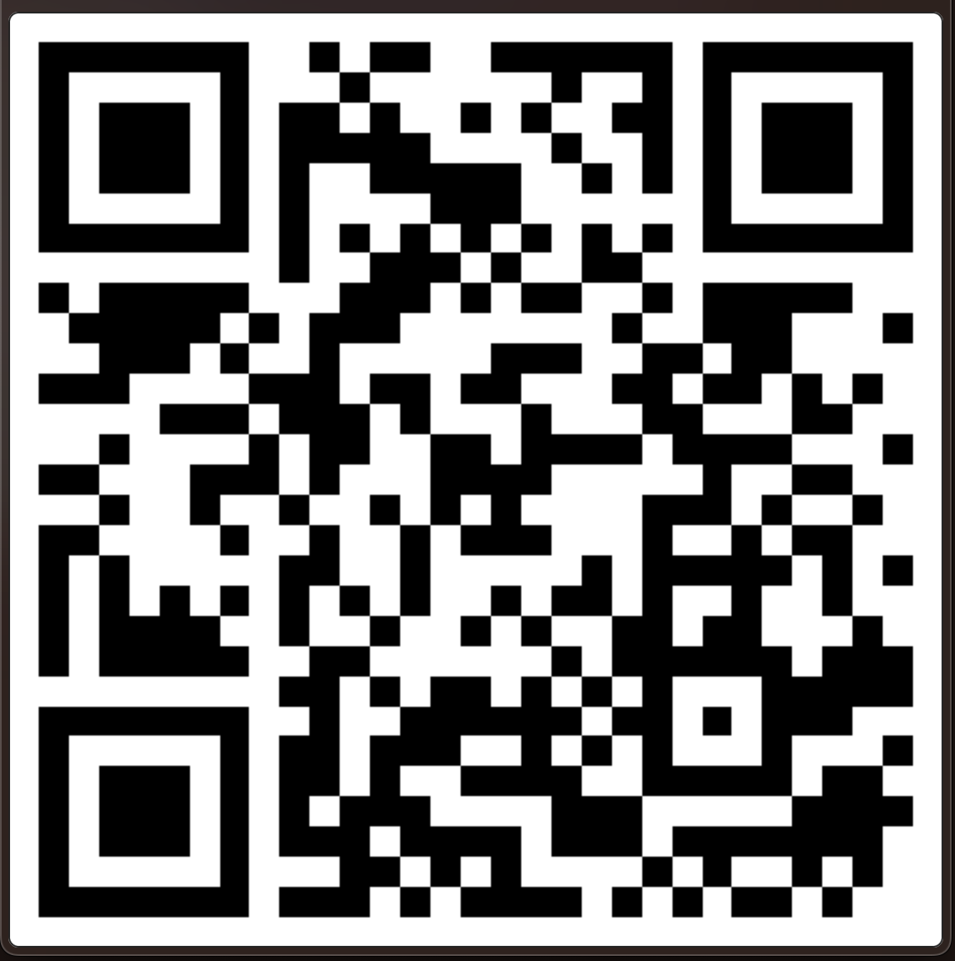
Welcome to the TRIADS Web scraping Workshop
Please fill out the pre-seminar survey:

Slide 3
Today
Why Web scraping ?
Webpage and HTML
Elements and Attributes in HTML
DOM
Code walkthrough and collect data

Slide 4
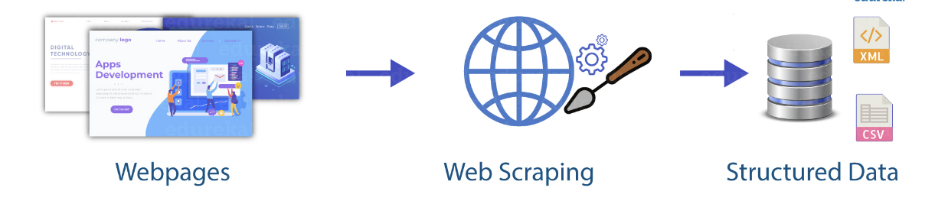
Scraping the web: what? why?
Increasing amount of data is available on the web.
These data are provided in an unstructured format: you can always copy & paste, but it's time-consuming and prone to errors.
Web scraping is the process of extracting this information automatically and transforming it into a structured dataset.

Slide 5
Two different scenarios:
Scraping: extract data from source code of website, with html parser (easy) or regular expression matching (less easy).
Web APIs (application programming interface): website offers a set of structured http requests that return JSON or XML files.
We will learn about the first one today!

Slide 6
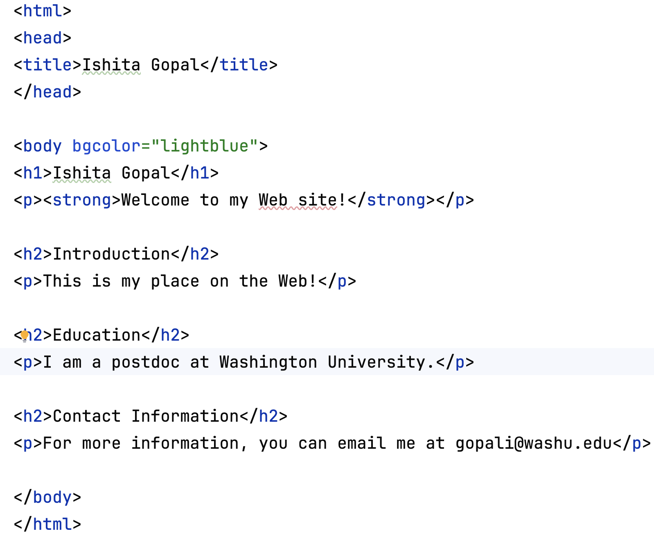
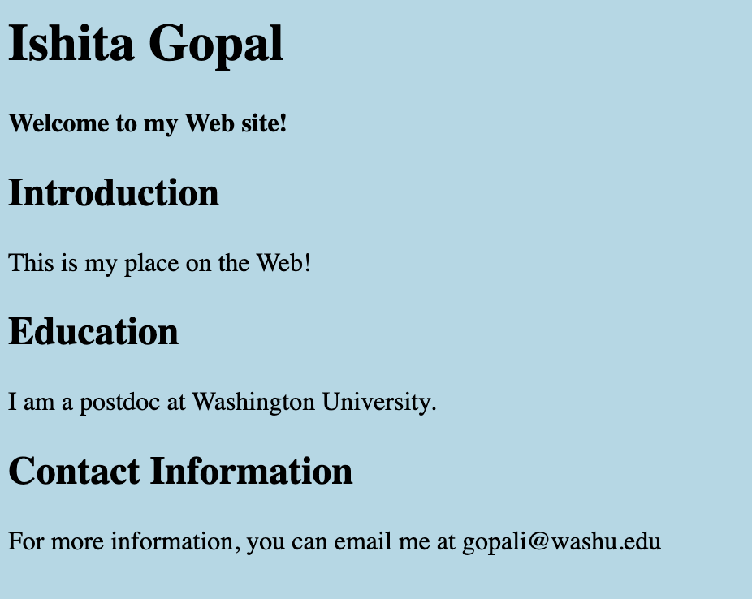
Hypertext Markup Language (HTML)?
It is a markup language used to create the content and basic structure of a web page.
It consists of elements (like headings, paragraphs, images, links, etc.) and attributes (additional information about elements).

Slide 7
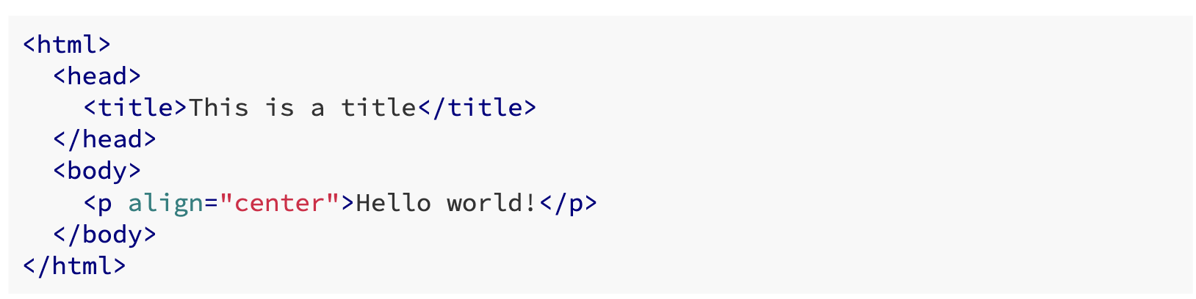
HTML
Is structured (hierarchical / tree based)
But not in a form useful for analysis (flat / tidy).
 | Attribute 1 | Attribute 2
Record 1
Record 2

Slide 8
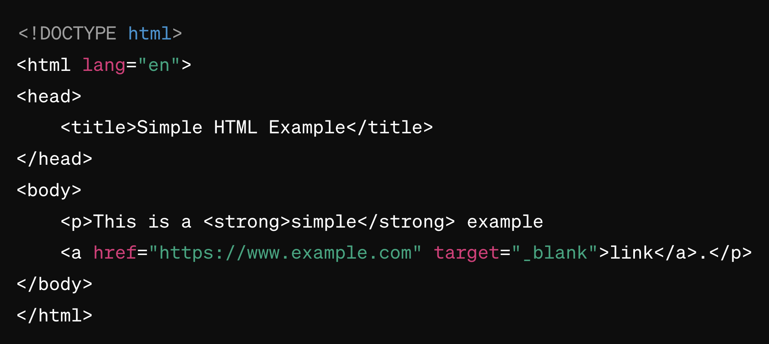
Components of HTML

Slide 9
HTML Elements:
Fundamental building block in HTML that defines the structure of a document.
Composed of a start tag, content, and an end tag.
Elements can contain other elements, forming a hierarchical structure (in the Document Object Model DOM).

Slide 10
HTML: Attributes
Provide additional information about HTML elements
Are added to the opening tag of the element
Consist of a name and a value, separated by an equals sign (=) and enclosed in double or single quotes.

Slide 11
Example
<a> is the anchor element (used for creating hyperlinks).
href and target are attributes of the <a> element.
"https://www.example.com" is the value assigned to the href attribute. It specifies the URL the link points to.
"_blank" is the value assigned to the target attribute. It specifies that the link should open in a new browser tab or window.

Slide 12
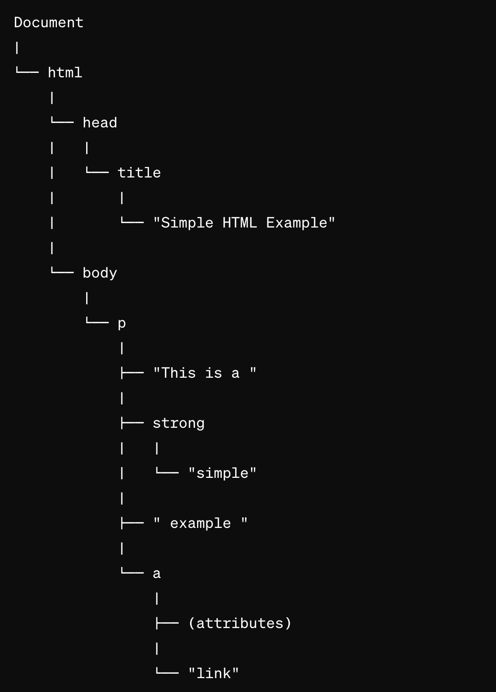
Document Object Model (DOM)
Programming interface that represents the structured document as a tree of objects.
Each HTML element becomes a "node" in the tree, and these nodes can be accessed using programming languages like Python.
Using Python, we will navigate such a DOM and extract data from a website today!

Slide 13
Let’s get started!
Google Collab Notebook: https://tinyurl.com/TRIADS-web-scraping

Slide 14
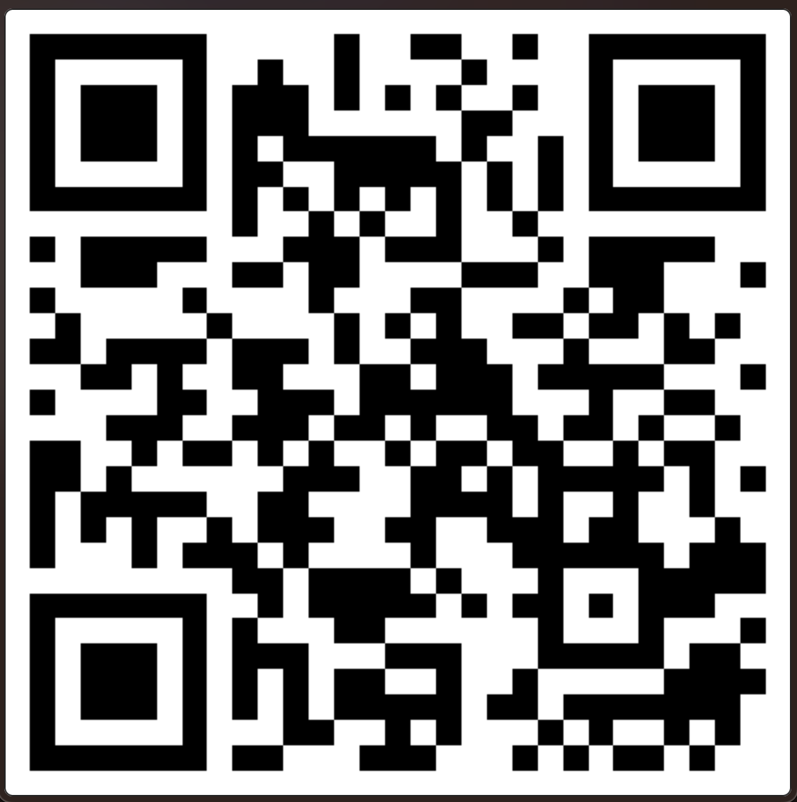
Please fill out the post-seminar survey:

