Slide 1

Day 1 - Introduction Introduction to Text Analysis in Python
TRIADS Training Series
Ishita Gopal
February 8, 2024

Slide 2
Today
Introduction
Course Logistics
Overview - Text Analysis
Lab - String Manipulation

Slide 3
Software
We will be using Python.
Python materials will be in notebooks and is provided through Google Colab.
Google Colab allows you to modify and run copies of the notebooks without worrying about installations on your own machines.
FYI, Google Colab provides free access to GPU and TPU computing, although it is overkill for this course, and we will not be using it.

Slide 4
What we will cover
Day 1: Overview of the goals and methods in text analysis, introduction to string manipulation.
Day 2: NLP “pipelines”. General concepts and practical application of NLP labeling tasks like part-of-speech tagging, named entity recognition, Basics of bag-of-words (with emphasis on CountVectorizer).
Day 3: Dictionary-based analysis (using tools like VADER), introduction to topic modeling methods (such as Latent Dirichlet Allocation or LDA)
Day 4: Text classification (using Naïve Bayes)

Slide 5
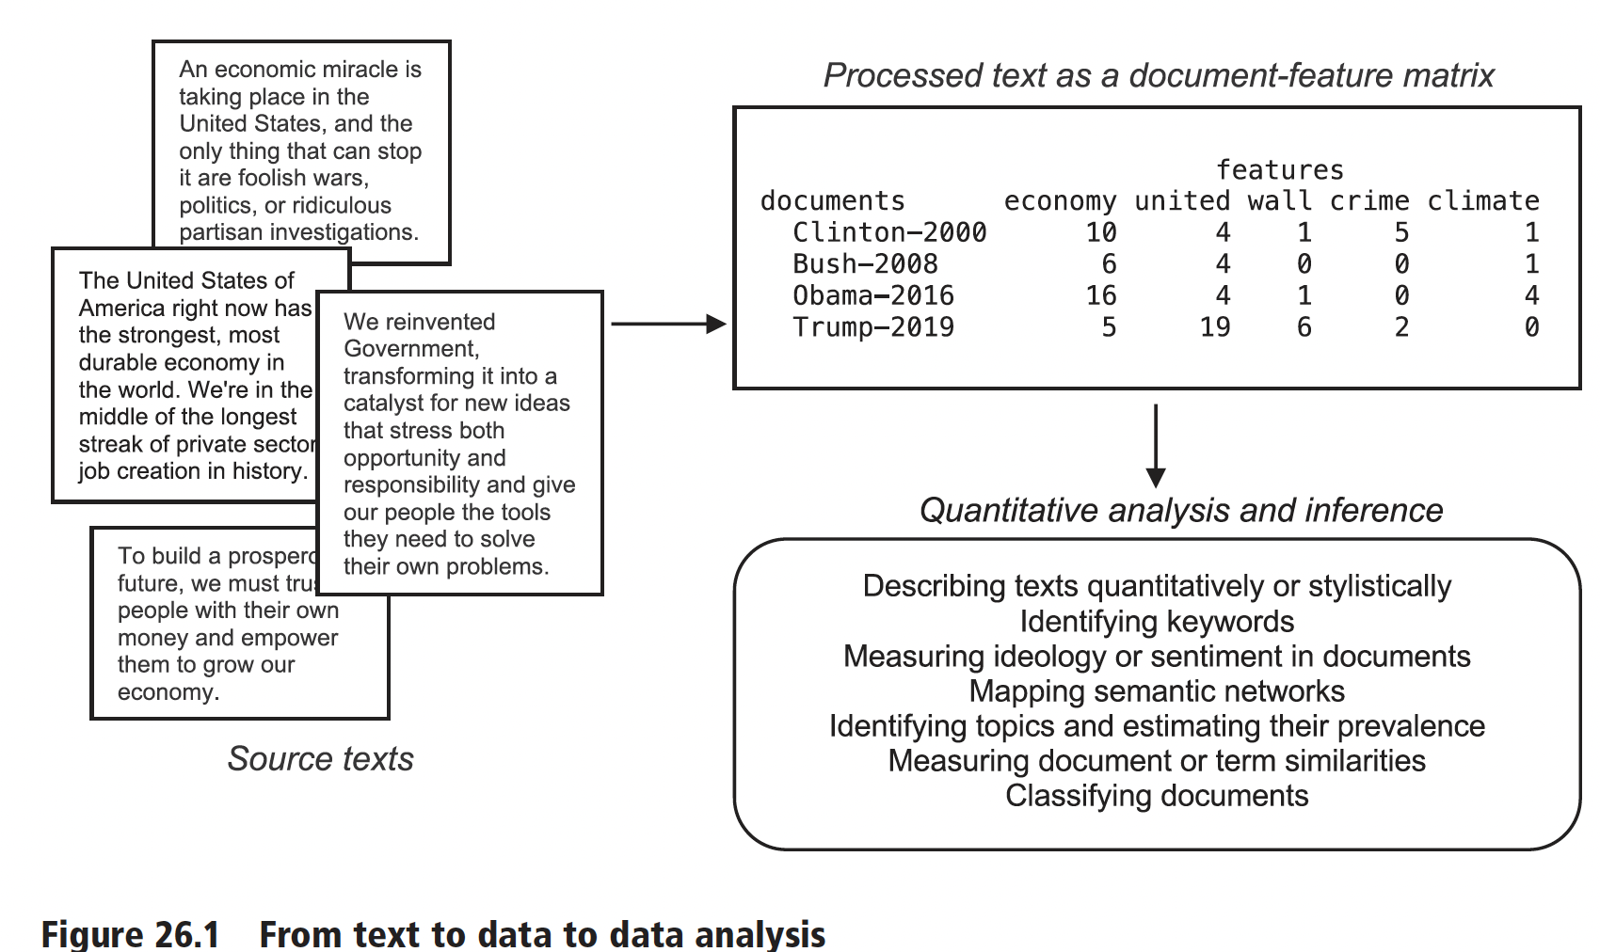
Source: Benoit. 2020

Slide 6
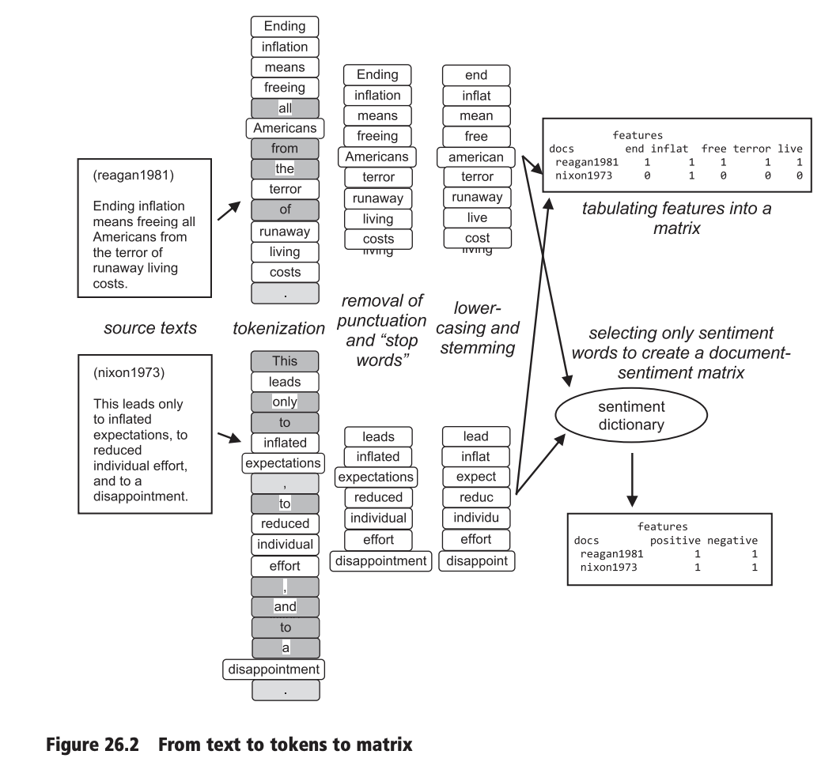
Typical text-as-data pipeline (1) divides the text into the units we might care about,
(2) throws out some we’re pretty sure we don’t care about, and
(3) combines units that we’re pretty sure should count as the same thing.
Source: Benoit. 2020

Slide 7
Dictionary Methods
Most basic - you have a list of words → have a dictionary that maps a predetermined category/score for each word → you have the computer count/add them up.
Very popular approach to sentiment analysis.
VADER
LIWC
Lexicoder
Source: Benoit. 2020

Slide 8
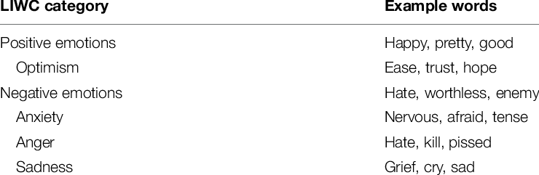
Source: Settanni and Marengo. 2015

Slide 9
Supervised Learning - Classification
We have labeled examples (documents) - training data.
Input text (which can be a speech, tweet, email etc.) is paired with corresponding output labels (negative sentiment, mentions of COVID, identification as spam email).
The task is to assign predefined categories or labels to input data.
Much more flexible than dictionaries.

Slide 10
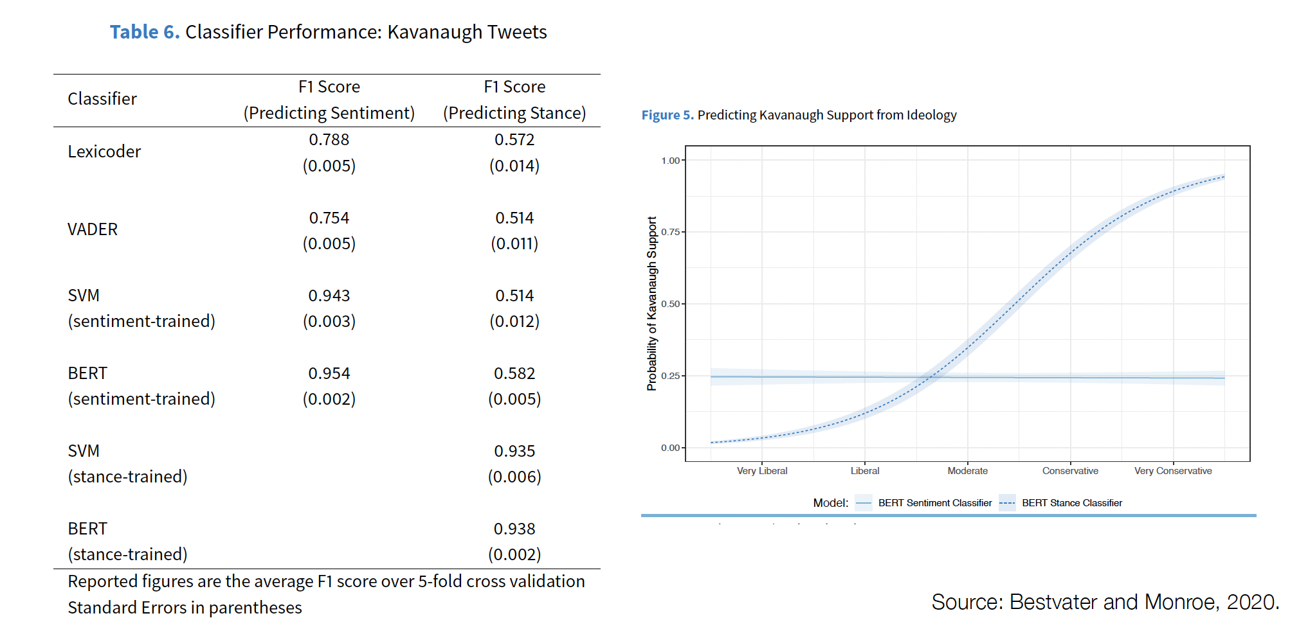
Sentiment refers to the emotional tone in a piece of text.
Stance relates to the author's position a topic.
In the article above, the authors classify 1) if the tweet was positive or negative 2) if the tweet supports or opposes Kavanaugh’s confirmation.
Notes:
In the Fall of 2018, Brett Kavanaugh was nominated to a seat on the U.S. Supreme Court. While the Senate was considering the nomination, a university professor, Christine Blasey Ford, stepped forward claiming that Kavanaugh had sexually assaulted her at a party when they were both teenagers. Ford agreed to testify to Congress in the confirmation hearings, which quickly became highly contentious and partisan. The hearings attracted a great deal of public attention on the national stage, and public discourse from this time reflects the high levels of (largely negative) emotions that defined the proceedings. Corpus of over 50 million tweets about Kavanaugh, the confirmation process, and the assault allegations

Slide 11
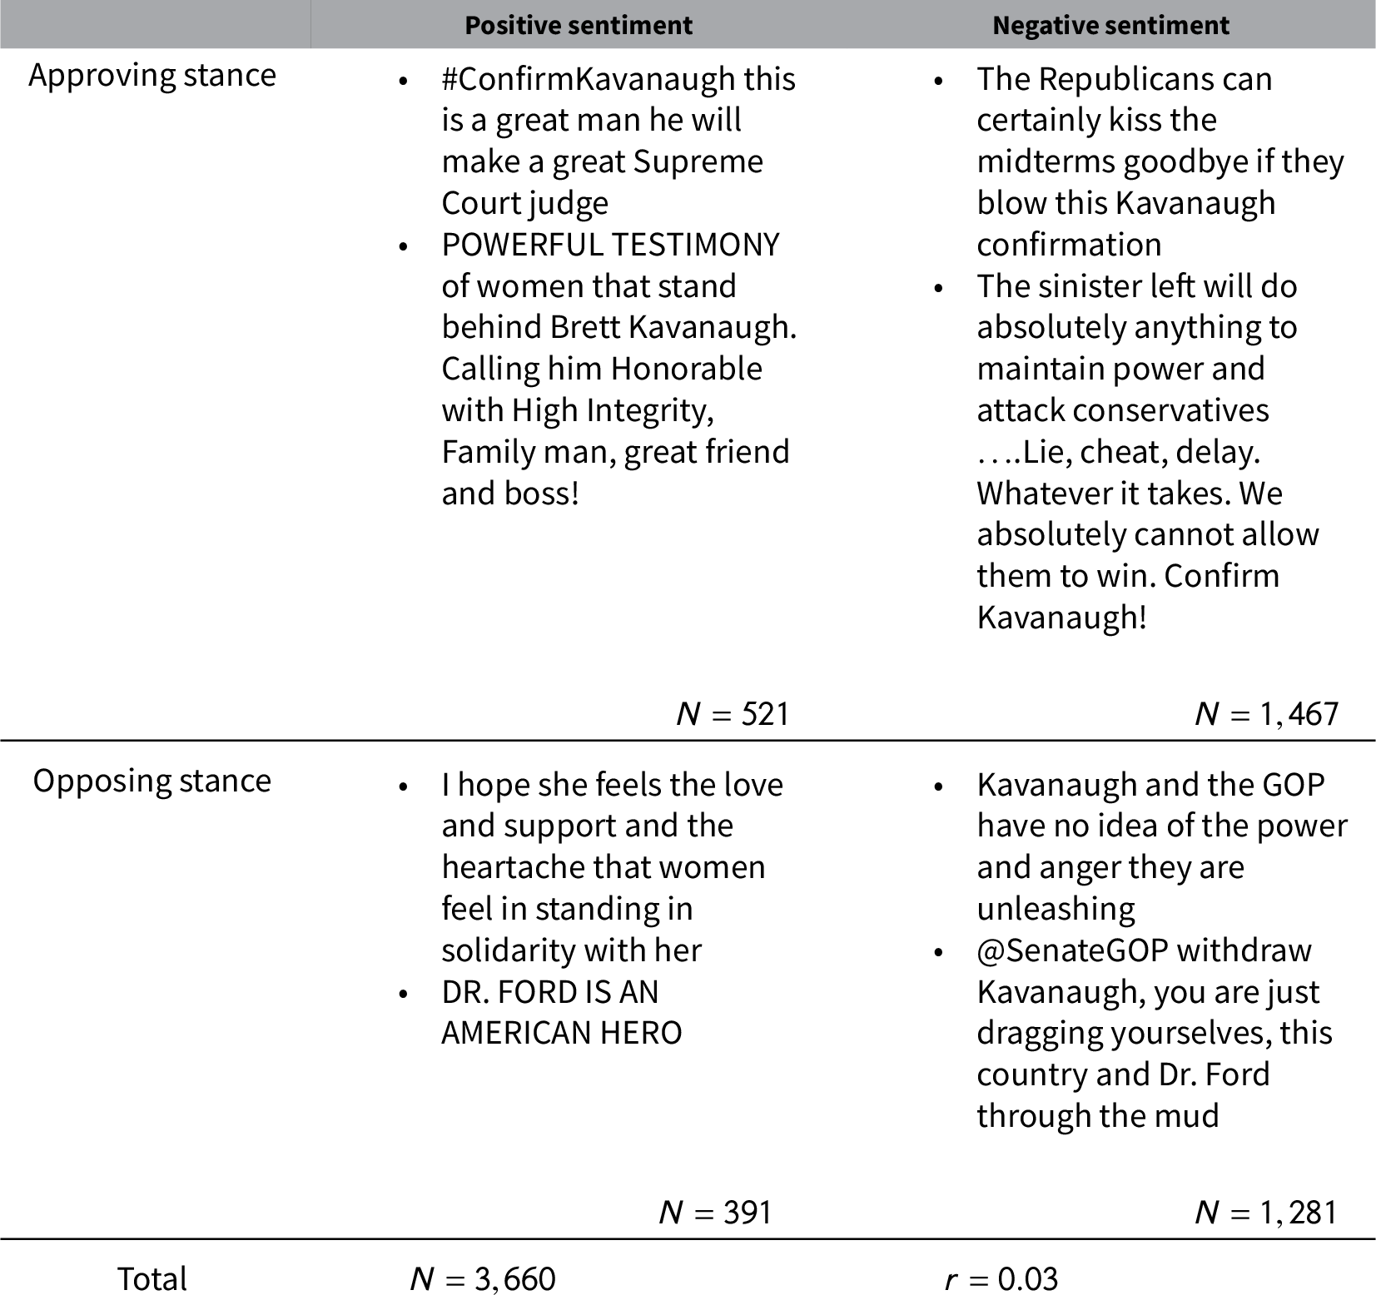
Source: Bestvater and Monroe. 2020

Slide 12
Unsupervised Learning
We don’t have labeled examples (documents) - no training data.
This is often used as an exploratory / discovery exercise or for theory testing.
Some of the main variants:
Clustering
Topic modeling
Word embeddings

Slide 13
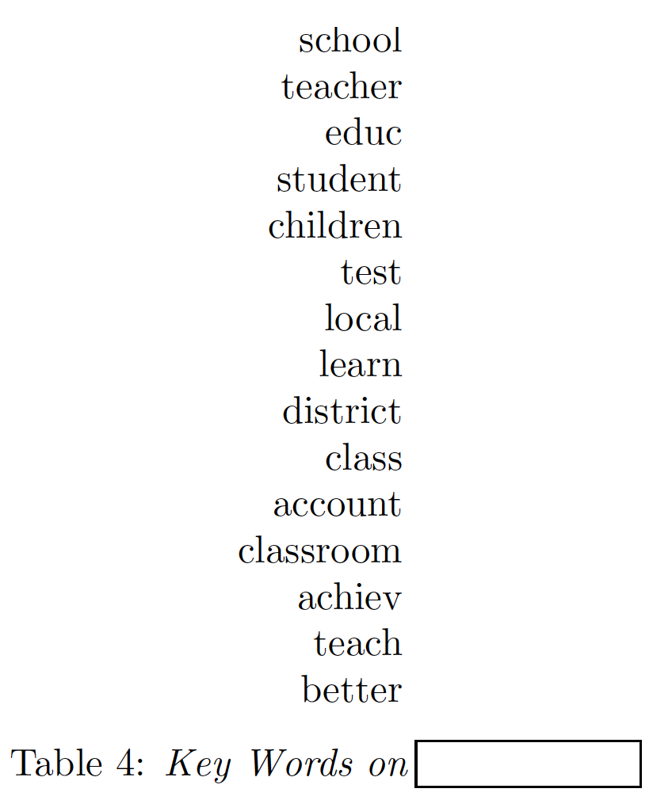
Unsupervised Learning - Topic Modeling
Unlike a classification problem, you don’t have pre-defined categories.
But one main output of a topic model is a measure of how words are associated with the topic.
When a topic model really works well, the appropriate label is obvious.
A model of speeches in the US Senate contained the topic to the right … what label would you give it?

Slide 14
Today
Basics of String Manipulation in Python:
Define a string
Strings and lists
String Manipulation
Concatenate
Format
Split
Substring Matching
Regular Expressions (if there is time!)

Slide 15
Google Colab notebook linked below: https://colab.research.google.com/drive/1RxcNLqLsAxl25CBdaRcdBtTFUKorCF1T?usp=sharing
Workshop folder is here: https://github.com/IshitaGopal/TRIADS_workshops
Slides and code are mostly from Burt L. Monroe’s Text as Data Course.

