Slide 1
Introduction to Web scraping in Python
Ishita Gopal
8th March
https://www2.stat.duke.edu/courses/Fall19/sta199.001/slides/lec-slides/06a-web-scrape.html#28

Slide 2
Scraping the web: what? why?
Increasing amount of data is available on the web.
These data are provided in an unstructured format: you can always copy&paste, but it's time-consuming and prone to errors.
Web scraping is the process of extracting this information automatically and transform it into a structured dataset.
Two different scenarios:
Screen scraping: extract data from source code of website, with html parser (easy) or regular expression matching (less easy).
Web APIs (application programming interface): website offers a set of structured http requests that return JSON or XML files.

Slide 3
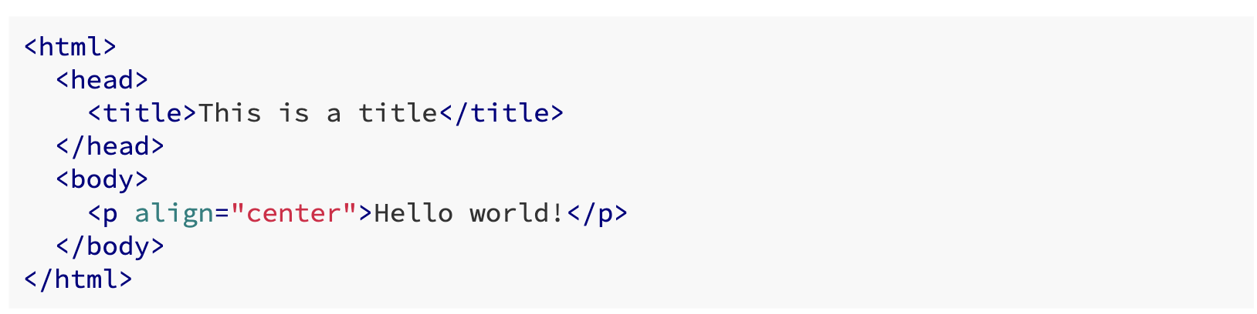
Hypertext Markup Language (HTML)
Most of the data on the web is still largely available as HTML - while it is structured (hierarchical / tree based) it often is not available in a form useful for analysis (flat / tidy).

Slide 4
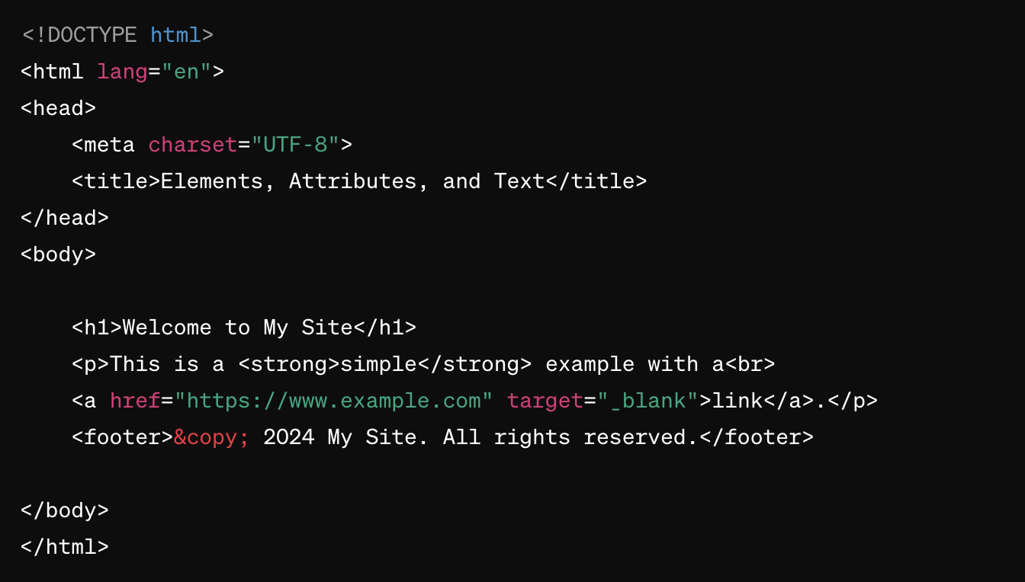
DOM
represents the structure of a document as a tree of objects, where each object corresponds to a part of the document, such as elements, attributes, and text.

Slide 5

An element is a fundamental building block in HTML that defines the structure of a document.
Elements are composed of a start tag, content, and an end tag.
For example, <p> is the start tag, and </p> is the end tag of a paragraph element.
Elements can contain other elements, forming a hierarchical structure in the Document Object Model (DOM).

Slide 6
This example demonstrates the integration of elements, attributes, and text within an HTML document. Each plays a distinct role in defining the structure, behavior, and content of the web page.

