Slide 1

Day 2 – Text to Bag of Words data Introduction to Text Analysis in Python
TRIADS Training Series
Ishita Gopal
February 10, 2024

Slide 2
Last Workshop:
Overview of text analysis pipelines
Examples of what dictionaries, supervised and unsupervised models can do and what their advantages/disadvantages are
Learnt to manipulate the basic unit of text – “strings” - in Python.

Slide 3
Today
Understand the document term matrix (DTM)
Get familiar with CountVectorizer in Python.
Learn to access and manipulate elements of a DTM.
Do word usage analysis using simple operations on DTMs.

Slide 4
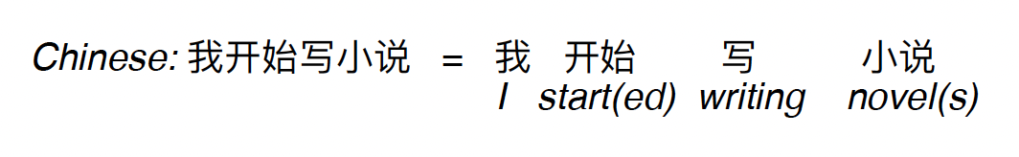
Corpus, Tokens & Vocabulary
Corpus: a digitized collection of text
Tokenization: is the division of text into tokens. This may mean "words" split on spaces and punctuation. But…
we may not wish to throw out punctuation (e.g.,"!!!"or "$" or #blessed)
not split on punctuation (e.g., D.C. or gopali@wustl.edu)
or not split on spaces (District of Columbia or Supreme Court)
Some languages don't have spaces.

Slide 5
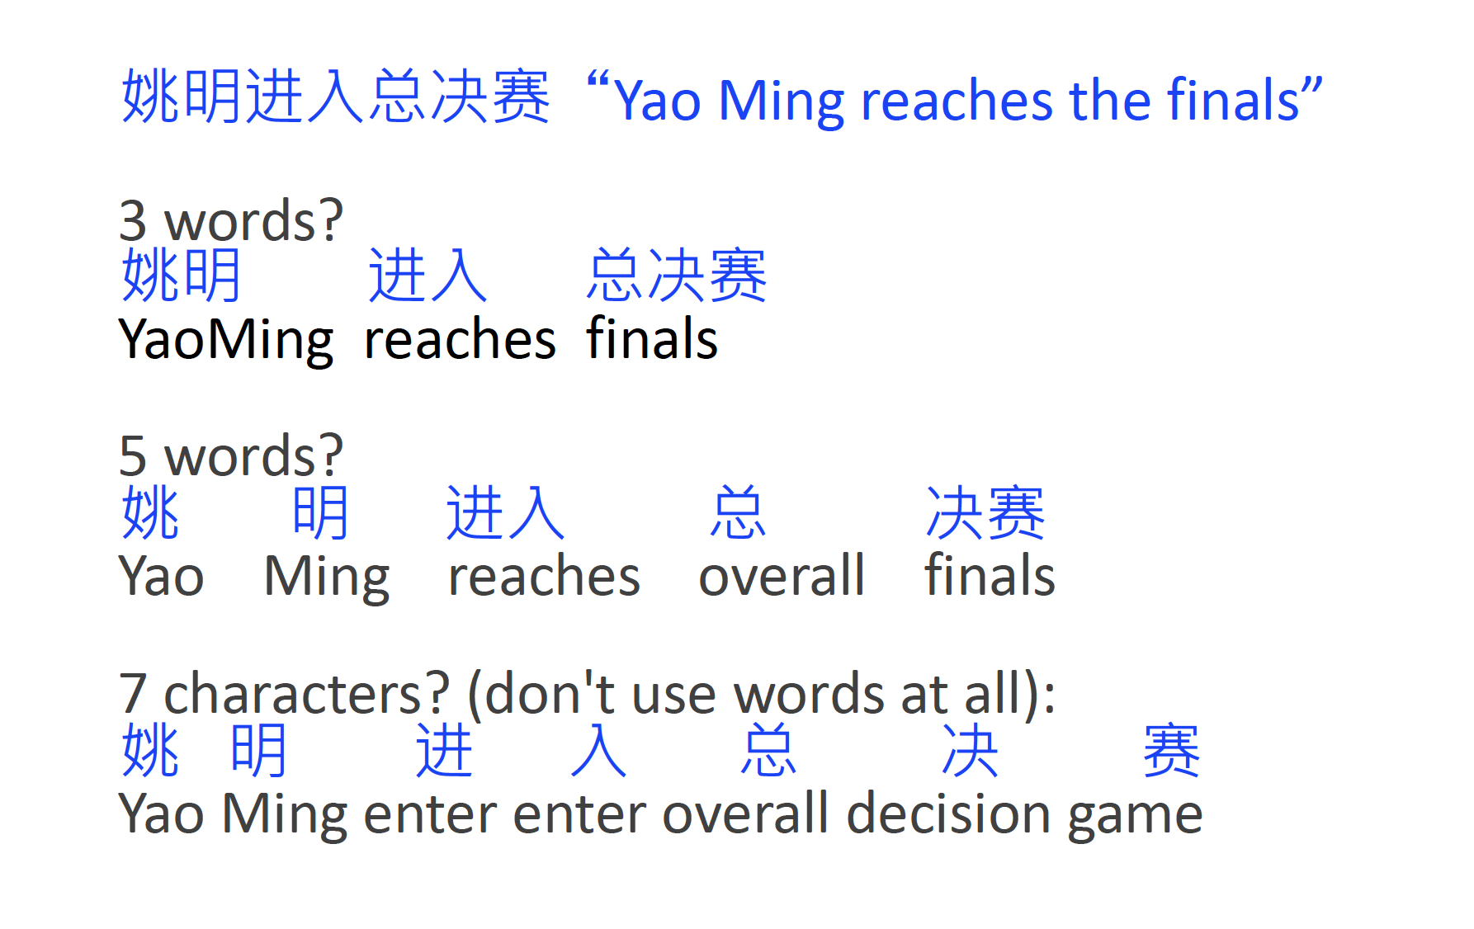
Source: Burt L. Monroe, TADA slides

Slide 6
Tokens and types are different.
Types are the unique tokens - constitute the vocabulary, V.

Slide 7
Text normalization (“Pre-processing”)
The process of putting tokens / textual features in a standard form. For example:
Case folding: typically converting all upper-case characters to lower case.
This and this become the same thing.
But..it may overdo it, conflating for example Trump and trump or US and us

Slide 8
Another text normalization thing…
Reducing words to their root form to handle variations.
Stemming involves removing prefixes or suffixes from words
Probably okay to stem running and runs becomes run
But…Porter Stemmer algorithm stems universal, university, and universe all to univers.
Lemmatization could be better but is computationally expensive. Reduces words to their base or dictionary form. Takes into consideration the larger context surrounding the word.

Slide 9
Part-of-speech tagging:
Assigning a part-of-speech label to a given token.
These are word-level classification problems, typically referred to as tagging or sequence labeling or annotation tasks.
Word-level tasks like part-of-speech tagging interact with sentence-level tasks for identifying grammatical / syntactical structure that ties words together, which are typically referred to as parsing.

Slide 10
Document Term Matrices
Workflow:
Step 1: Take the entire Corpus

Slide 11
Workflow:
Step 1: Take our entire Corpus
Step 2: Identify all the all the tokens (eg: words) in the corpus

Slide 12
Workflow:
Step 1: Take the entire Corpus
Step 2: Identify all the tokens (eg: words) in the corpus
Step 3: Do some preprocessing (lower case, remove stop words etc.)

Slide 13
Workflow:
Step 1: Take the entire Corpus
Step 2: Identify all the tokens (eg: words) in the corpus
Step 3: Do some preprocessing (lower case, remove stop words)
Step 4: Transform it into a mathematical matrix
each column represents a unique word that exists in the entire Corpus across all text documents
each row represents a unique text document

Slide 14
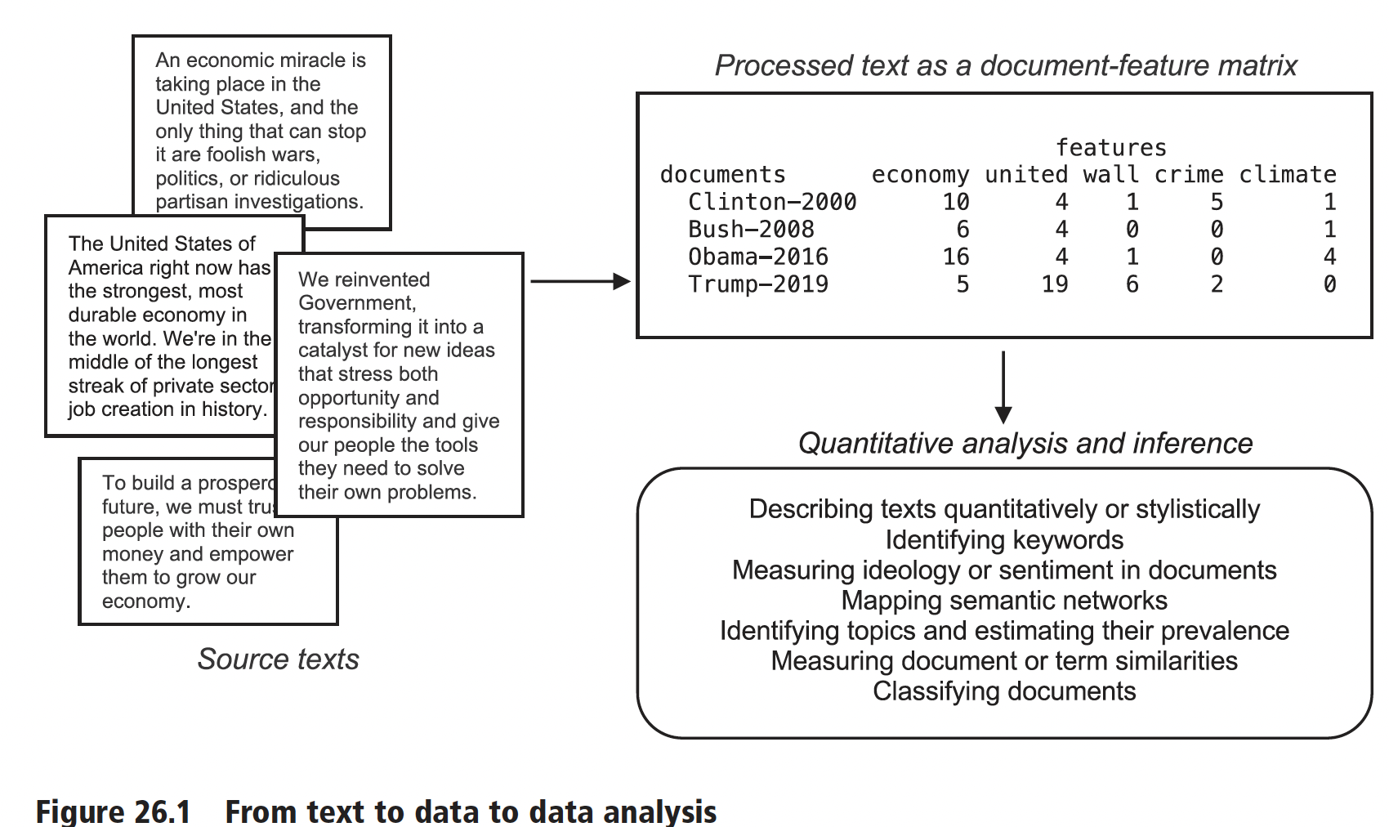
Source: Benoit. 2020

Slide 15
Python Lab Notebook:
https://colab.research.google.com/drive/1Ku1NDJ5dlnyeB_xcIaPPz8Wl4r-gp_7E?usp=sharing

