Slide 1

Day 4 – Introduction to Supervised Learning Introduction to Text Analysis in Python
TRIADS Training Series
Ishita Gopal
February 21, 2024

Slide 2
Last Time
Talked about dictionaries
It’s pitfalls
How to implement dictionary analysis in Python

Slide 3
To remind you about dictionaries:
Idea: set of predefined words with specific connotations that allows us to classify documents automatically and quickly
Common in opinion mining/sentiment analysis
Aim 1: categorize documents into a specific class.
This movie review is “positive”. This manifesto is “liberal”.
Aim 2: Measure the extent to which a document is associated with a category
This review “generally positive” with some negative elements.

Slide 4
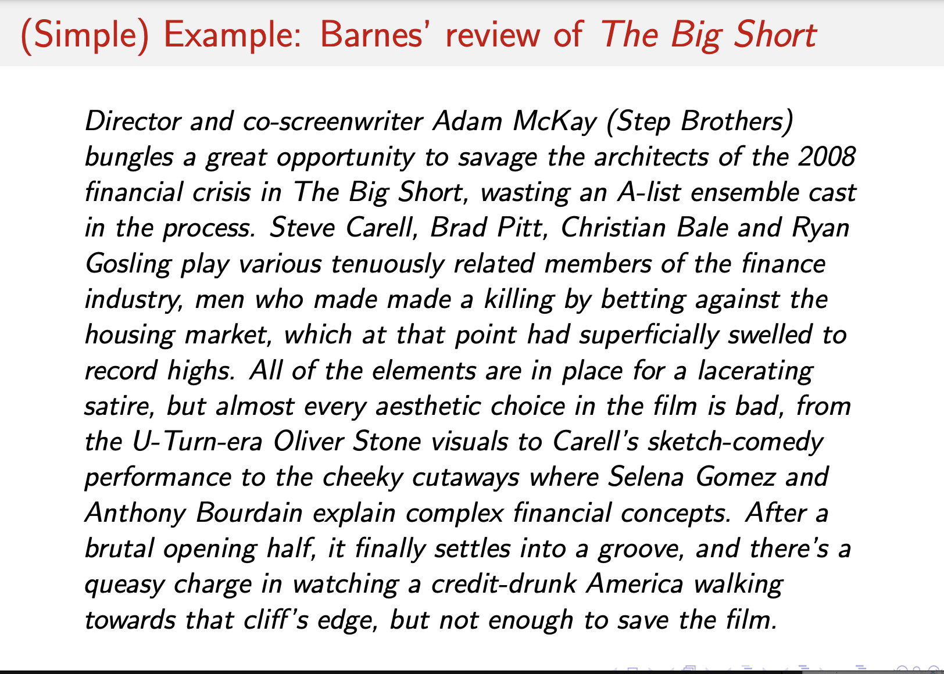
Source: Kevin Munger’s TAD PPT

Slide 5
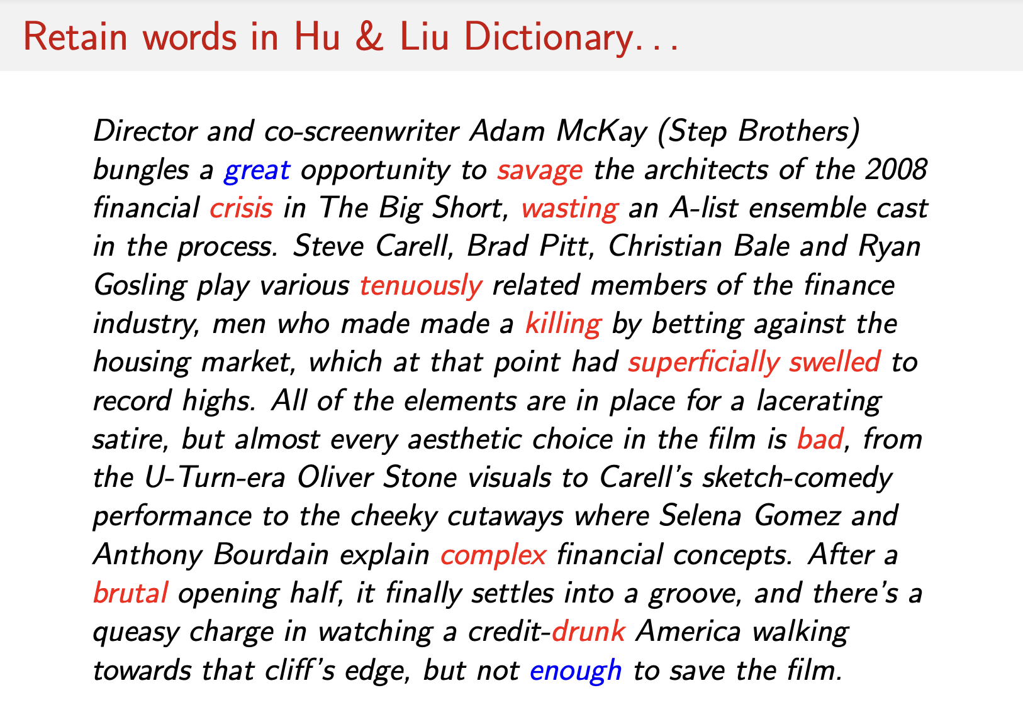
Source: Kevin Munger’s TAD PPT

Slide 6
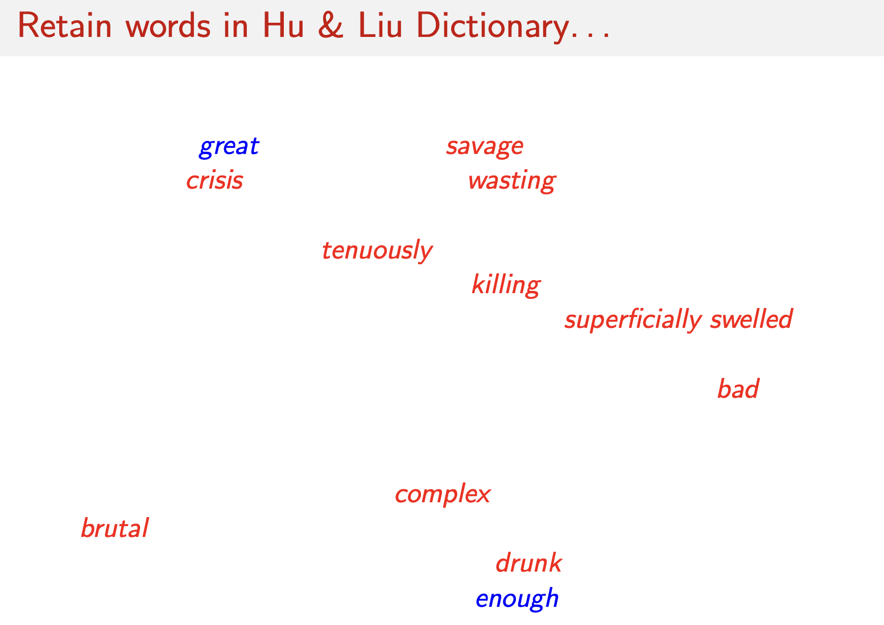
Source: Kevin Munger’s TAD PPT

Slide 7
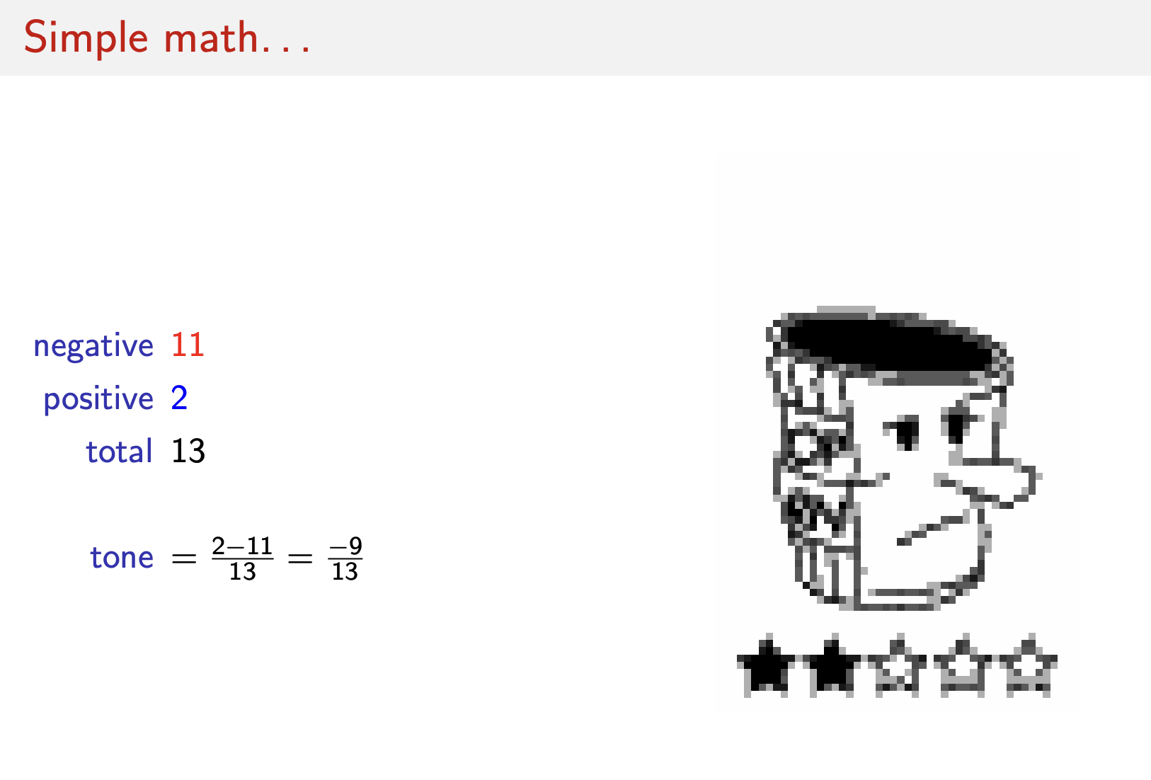
Source: Kevin Munger’s TAD PPT

Slide 8
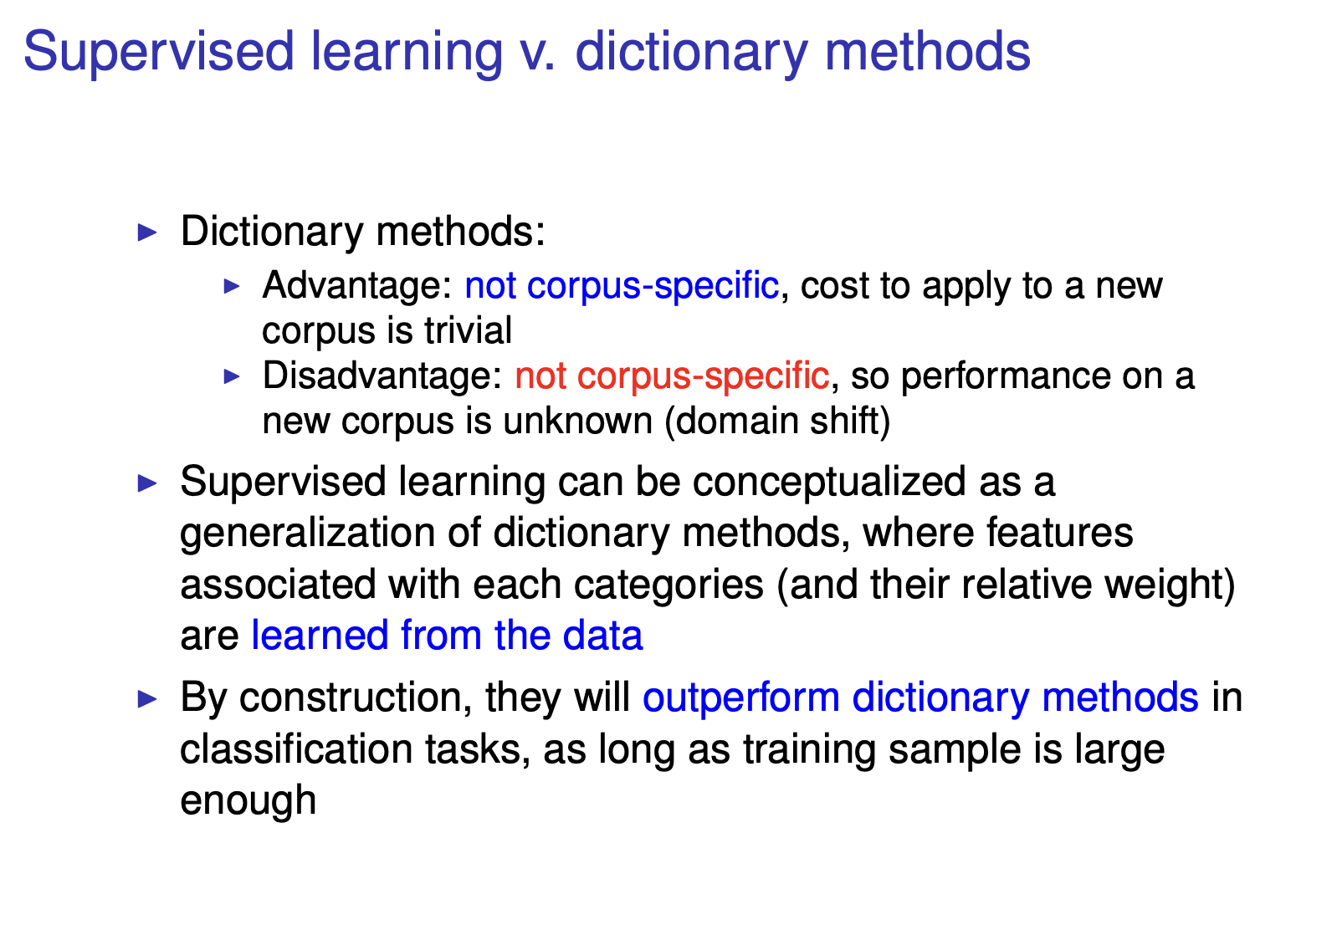
Source: Pablo Barbera’s QTA PPT

Slide 9
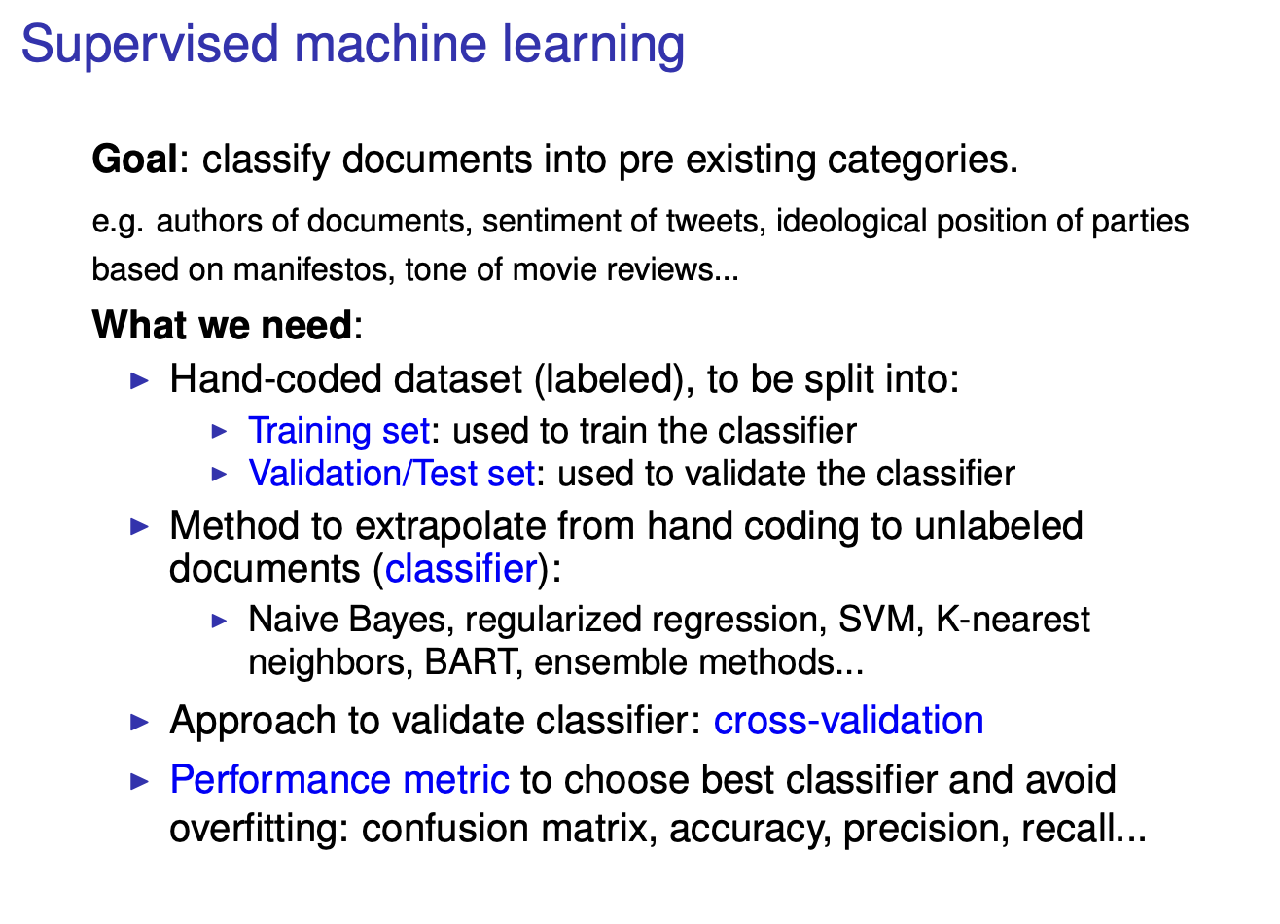
Source: Pablo Barbera’s QTA PPT

Slide 10
Say you want to classify 10,000 movie reviews into positive/negative:
Sample data and label it
say, 2000 out of the 10,000 reviews
Split it into train and test set
say, keep 1600 for training and 400 for testing
Training data→ Model → Use test data to measure performance
Test data is labeled data we did not train the model on
If satisfied with Model → use it to label unseen data

Slide 11
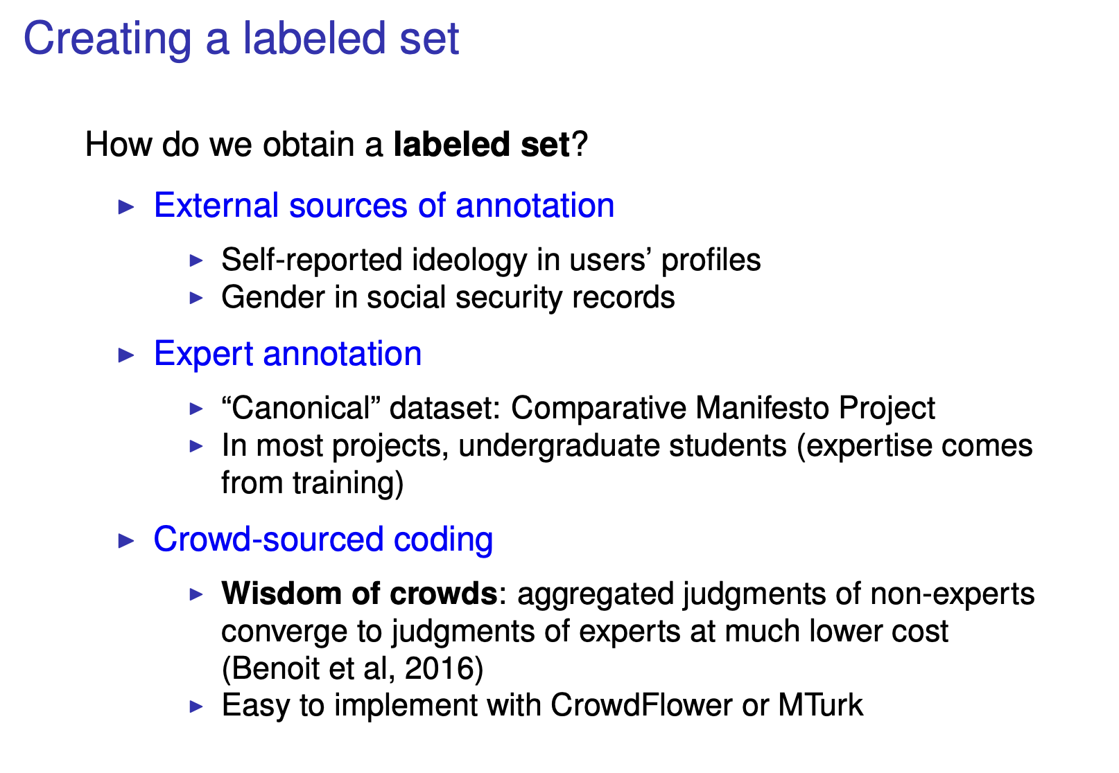
Source: Pablo Barbera’s QTA PPT

Slide 12
Let’s briefly look at how naïve bayes works:

Slide 13
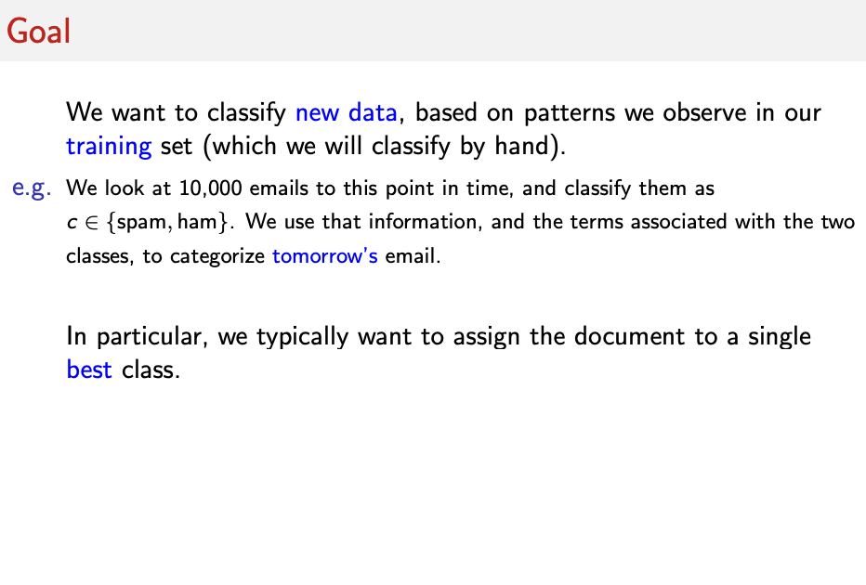
Source: Kevin Munger’s TAD PPT

Slide 14
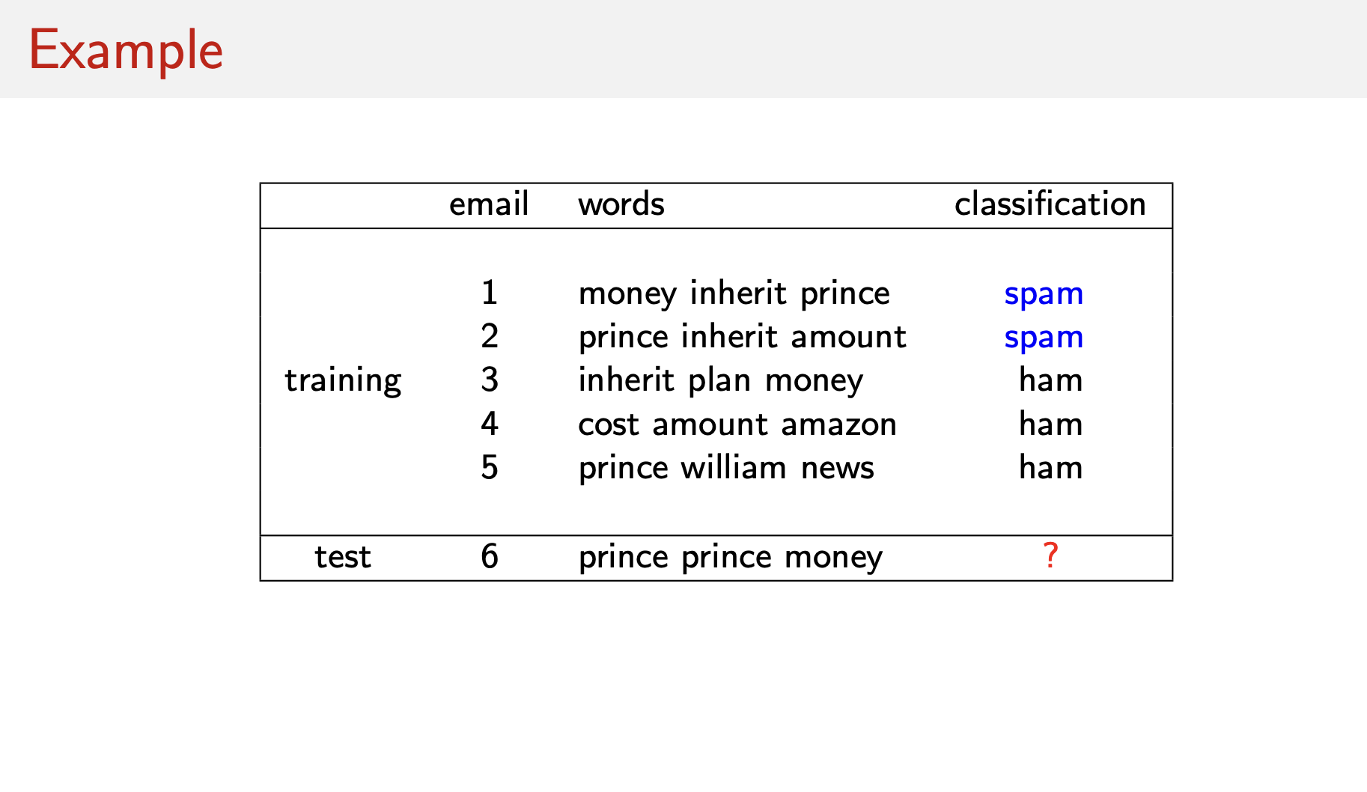
Source: Kevin Munger’s TAD PPT

Slide 15
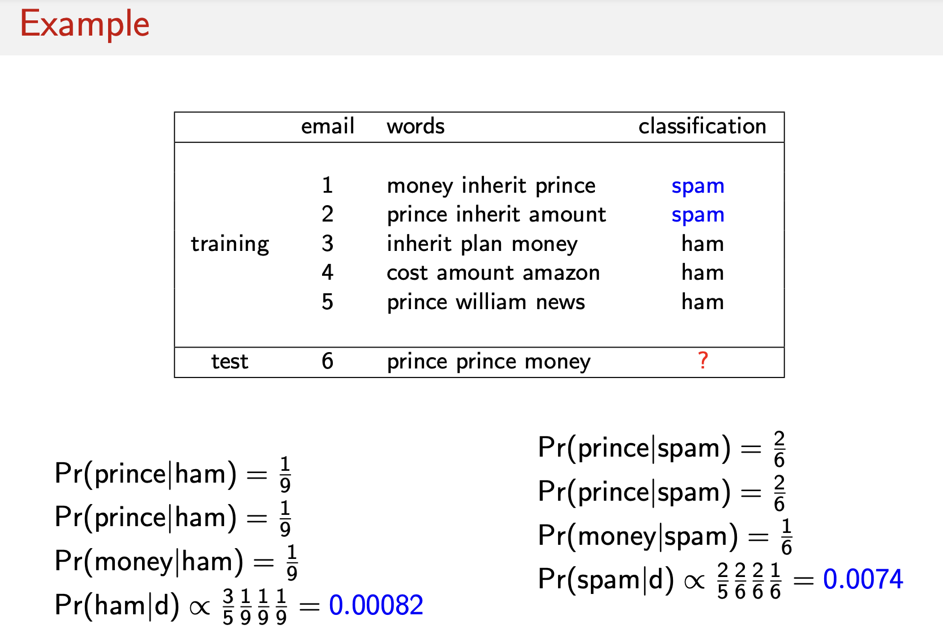
Source: Kevin Munger’s TAD PPT
Notes:
Every language has gra,mmar rules common phrases but naïve bayes ignores all that stuff. Treats language like a bag full of words and each message as a random selection of them.
Prob for each word given that we saw it in ham/spam
Prob we see prince given that we saw it in a ham/normal message = 1/9 (num times we see prince in ham/tot words)These prob are also called liklihoods.
Prior probability – initial guess that a message is a ham
Prortional to trhe prob that the message is normal given that it says prince prince money. Score it gets if the message is ham

Slide 16
Let’s implement the naïve bayes in Python.
https://colab.research.google.com/drive/14ZMpLiNp-rB33gXacP8Wdj_jcYNUUv68?usp=sharing
An easy to follow video on Naïve Bayes: https://www.youtube.com/watch?v=O2L2Uv9pdDA

Slide 17
