Slide 1
QUADCOPTER DRONE
DRONE = Dynamic · Remotely · Operated · Navigated · Equipment

Slide 2
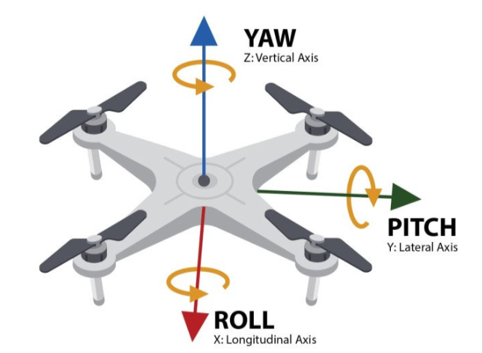
FLIGHT PHYSICS
KEY EQUATIONS
THE FOUR FORCES
L = W · cosθ
(Takeoff Condition)
Lift (L)
Generated by rotor rotation — acts upward, counters gravity.
F = D + W · sinθ
(Thrust Equation)
Weight (W)
T·v = D·v + v·W·sinθ
(Power Equation)
Gravitational pull — acts downward through centre of mass.
Thrust (T)
Forward/directional propulsion from motor & propeller.
Drag (D)
Air resistance — opposes the direction of motion.
FLIGHT CONDITIONS
W > L → Drone descends / falls
W < L → Drone rises / climbs
W = L → Drone hovers in place

Slide 3
DRONE TYPES & FRAMES
MULTIROTOR TYPES
FRAME TYPES
1. SINGLE COPTER 1 main rotor + tail rotor 2. TRI-COPTER 3 rotors — less stable 3. QUADCOPTER 4 rotors — most common for DIY builds 4. HEXACOPTER 6 rotors — heavier payload 5. OCTACOPTER
8 rotors — professional / cinematography
X-Frame
Standard layout. Arms diagonal. Agile & manouverable. Most common for racing & freestyle.
H-Frame
Arms parallel. Camera mount in front. Better for photography — stable hover.
Plastic Frame
Cheap, easy to replace. Unstable under vibration. Good for beginners.
Carbon Fiber (zig-zag)
Lighter & stronger. Reduces vibration significantly. Used in commercial/professional builds.
Balsa Wood
Low cost, high endurance. Absorbs vibration. Good for long-flight applications.

Slide 4
COMPONENTS
01
Frame
06
ESC ×4
Plastic / Carbon Fiber / Balsa Wood — X or H configuration
Electronic Speed Controller — converts FC signal to motor speed
02
Flight Controller
07
Power Dist. Board
K215 (Non-feedback) or Pixor — mounted at centre only
PDB — splits battery power to ESC and Flight Controller
03
Transmitter & Receiver
08
Propellers
2.4 GHz — pilot TX encodes input, RX decodes PWM signal
Matched CW+CCW pairs — attach directly to motor shaft
04
Battery
09
GPS Module
Lithium Polymer (LiPo) or Li-ion — 2200mAh = 2.2A (4S)
Navigation, Guidance & Control — position hold, RTH
05
BLDC Motors ×4
Brushless DC — 3-wire — CW ×2 and CCW ×2

Slide 5
MOTOR CONFIGURATION
WHY ALTERNATING DIRECTIONS?
X-FRAME DIAGRAM
In a quadcopter, two motors spin Clockwise (CW) and two spin Counter-Clockwise (CCW). Diagonal pairs share the same direction.
This cancels out the rotational torque reaction — without this balance, the drone would continuously spin on its yaw axis.
M1
M2
CW
CCW
FC
MOTOR POSITIONS (X-FRAME)
M1 — Front Right
CW (Clockwise)
M2 — Front Left
CCW (Counter-Clockwise)
M4
M3
CW
CCW
M3 — Rear Right
CCW (Counter-Clockwise)
M4 — Rear Left
CW (Clockwise)

Slide 6
WIRING GUIDE
1. Battery → Power Distribution Board (PDB)
Connect the LiPo battery to the PDB to supply power to the drone.
2. PDB → ESCs
Connect the four Electronic Speed Controllers (ESCs) to the PDB. The PDB distributes battery power to all ESCs.
3. ESCs → Motors
Each ESC connects to one brushless motor using three wires.
4. ESCs → Flight Controller
Connect the signal wire from each ESC to the Flight Controller (FC).The flight controller sends speed commands to the motors.
5. Receiver → Flight Controller
Connect the RC receiver to the Flight Controller. This allows the pilot to control the drone using the transmitter.
6. GPS → Flight Controller (Optional)
Connect the GPS module to the Flight Controller for features like:
Position hold
Navigation
Return-to-Home (RTH)

Slide 7
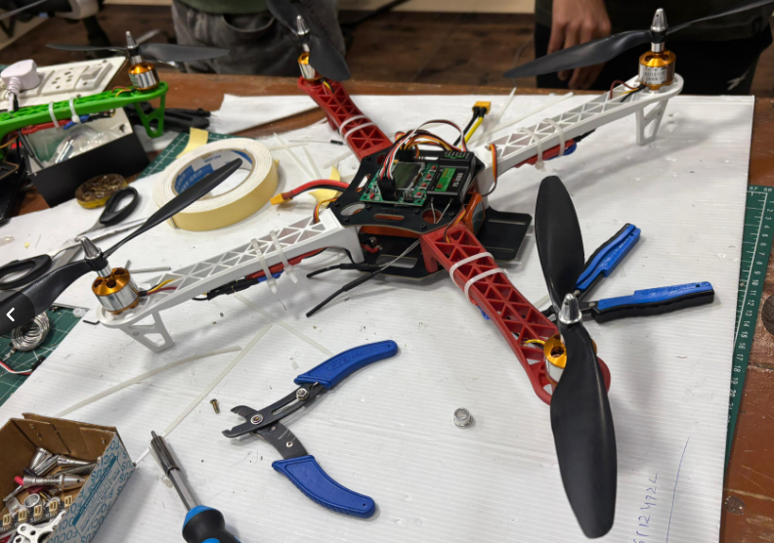
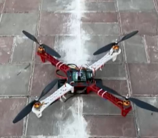
ESC CALIBRATION
Turn on transmitter with throttle at maximum
Connect LiPo battery
Wait for calibration beeps
Lower throttle to minimum
ESC stores max/min throttle value
DRONE IMAGES

Slide 8
THANK YOU

