Slide 1
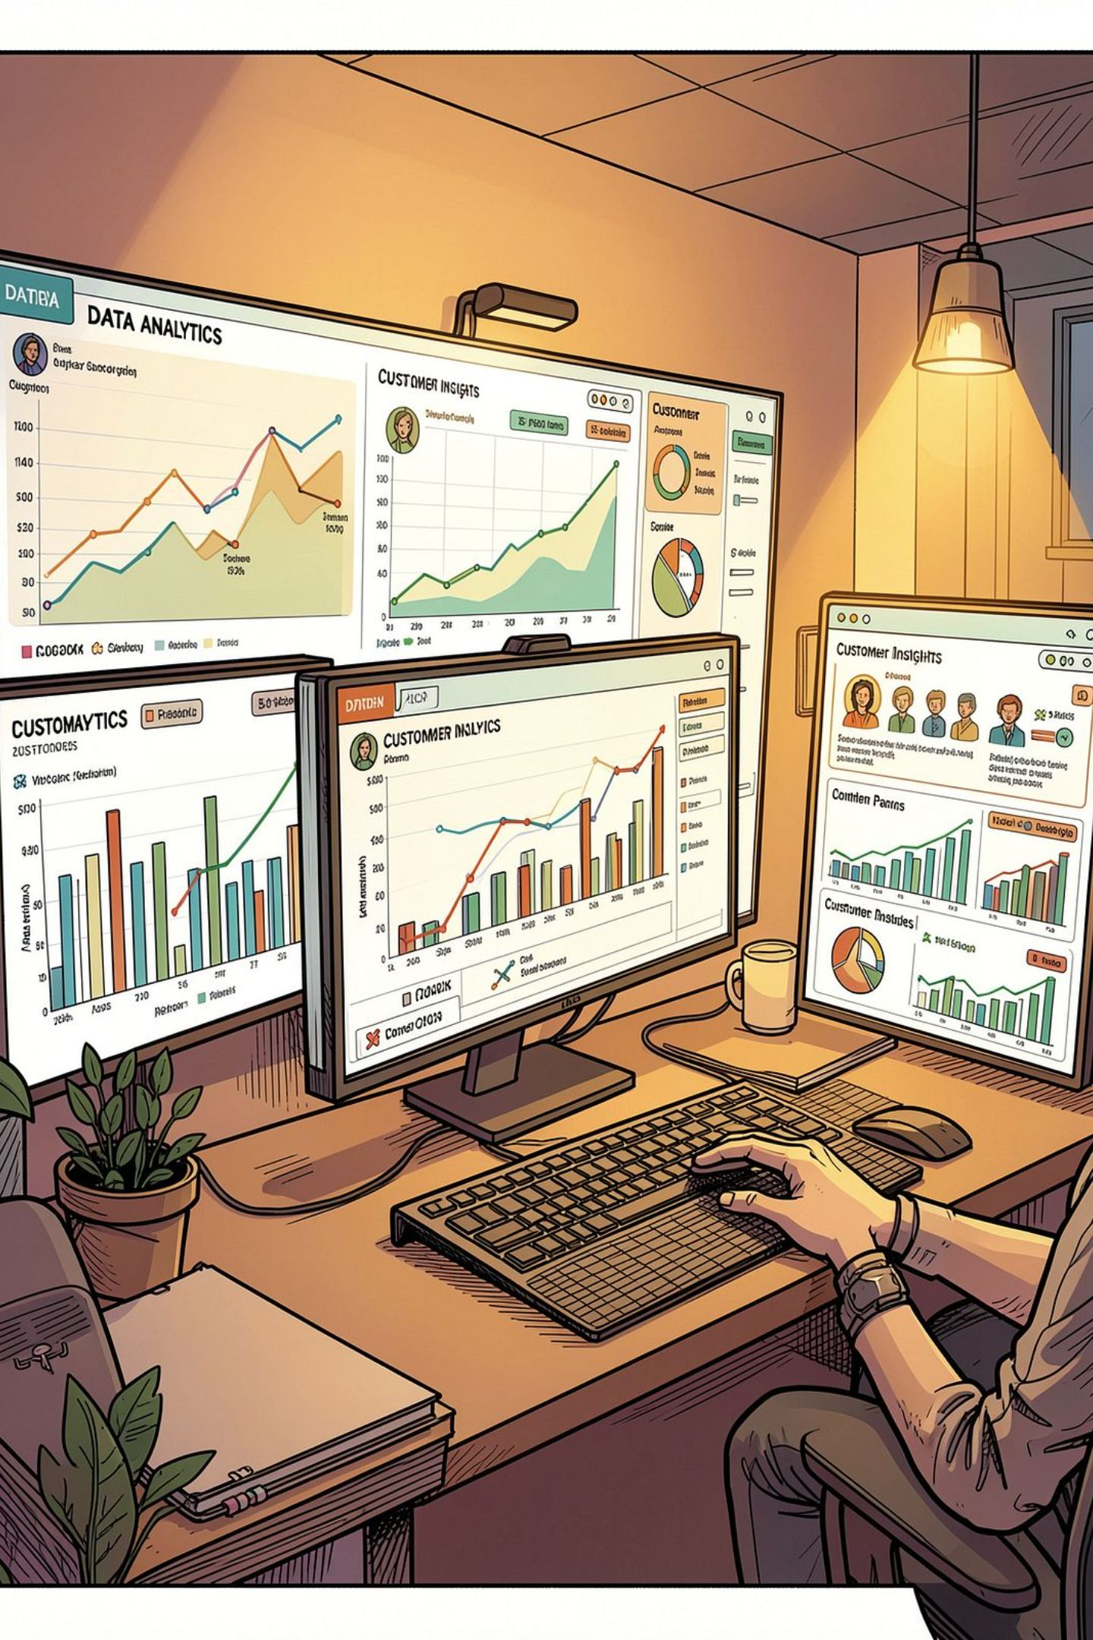
Customer Shopping Behavior Analysis
3,900 transactions · 18 features · Python · SQL · Power BI

Slide 2
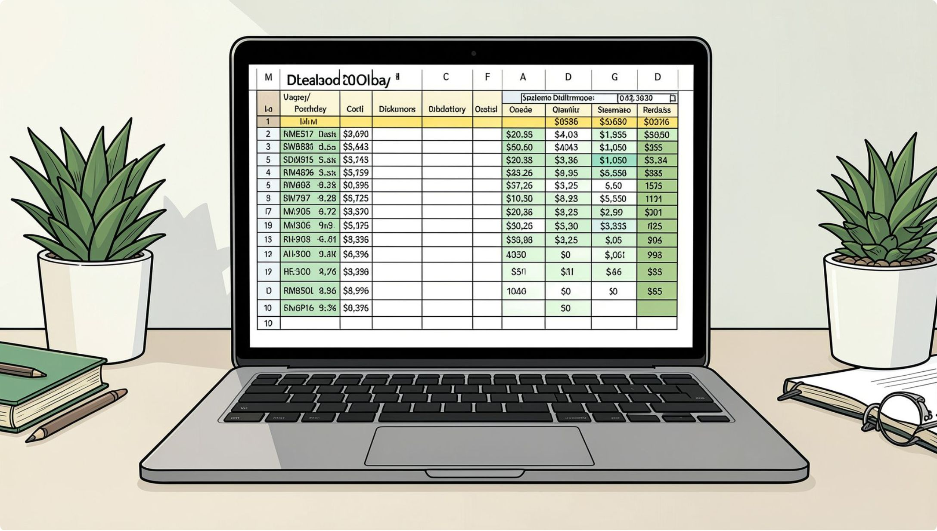
Dataset at a Glance
3,900
18
37
Transactions
Features
Missing Values
Review Rating column
Key Features
Demographics: Age, Gender, Location, Subscription
Purchases: Category, Amount, Season, Size, Color
Behavior: Discount, Frequency, Review Rating, Shipping

Slide 3





Data Preparation in Python
Load & Explore
pandas · df.info() · .describe()
Clean
Impute missing Review Ratings by category median
Engineer
age_group bins · purchase_frequency_days
Load to DB
PostgreSQL integration

Slide 4
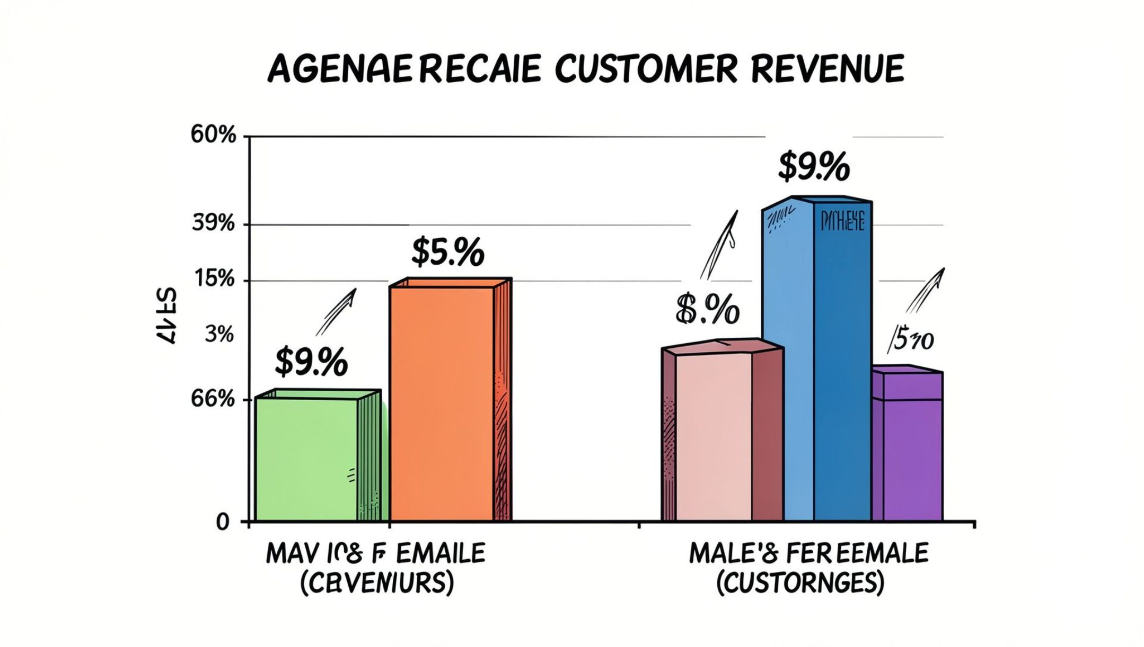
Revenue by Gender
Key Question
Compared total revenue generated by male vs. female customers.

Slide 5
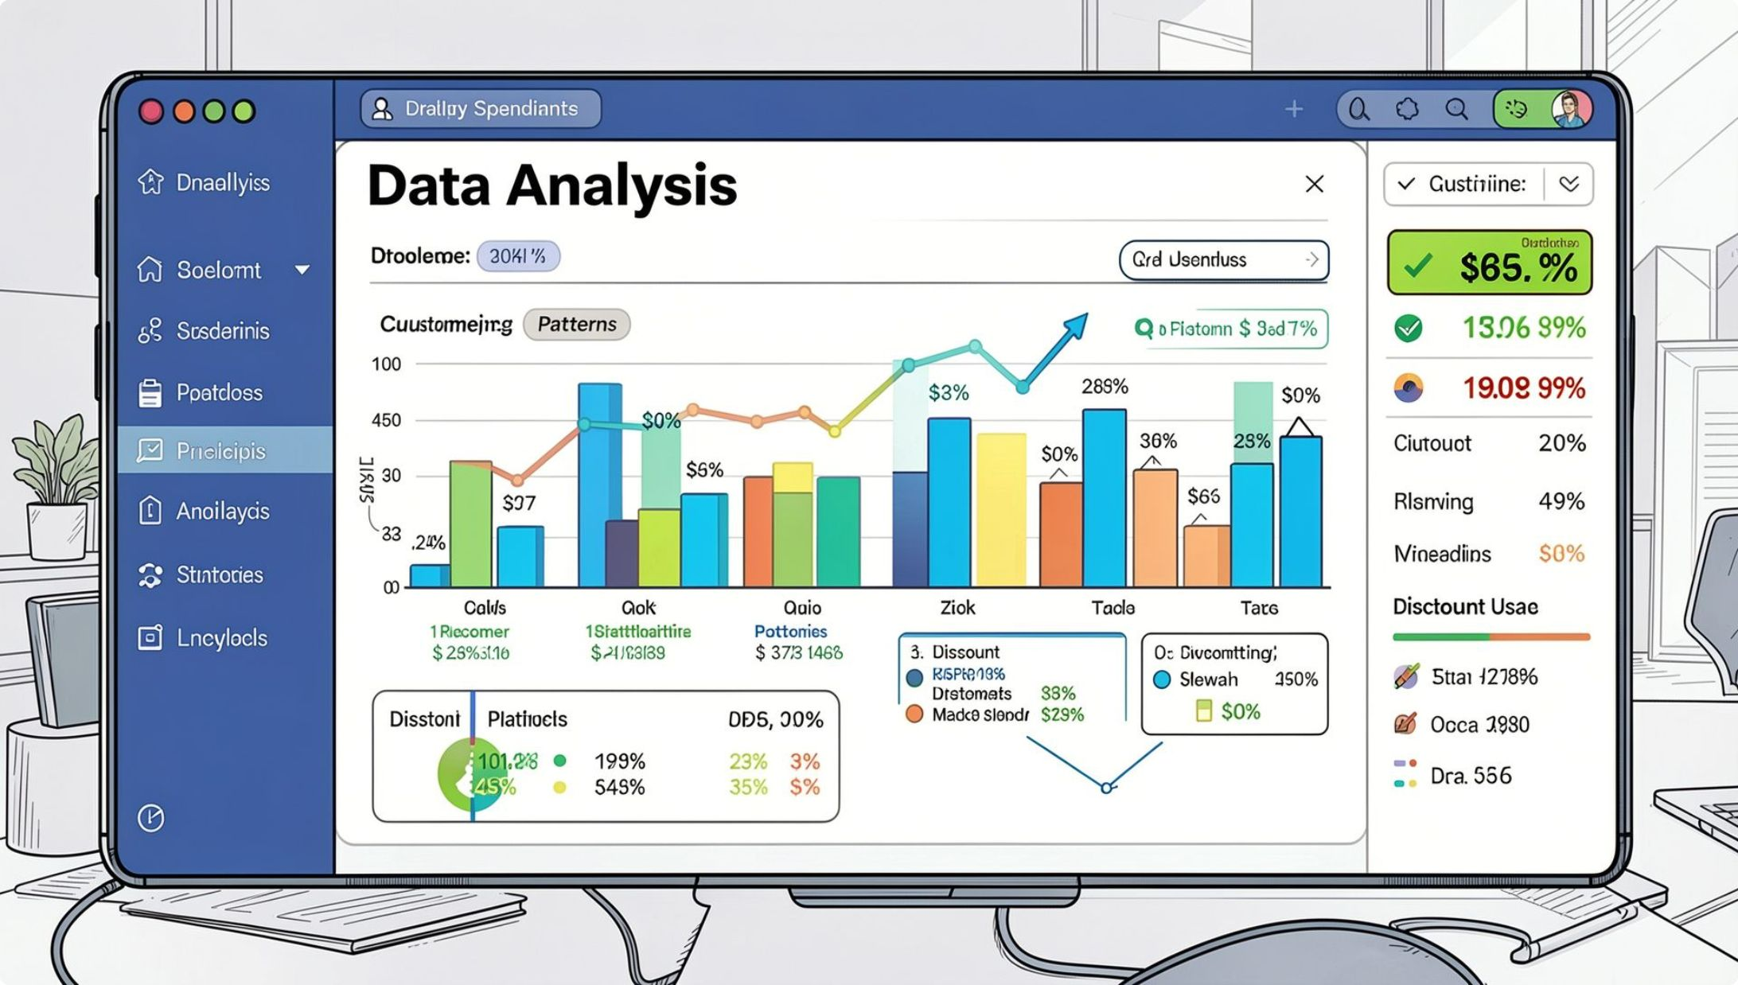
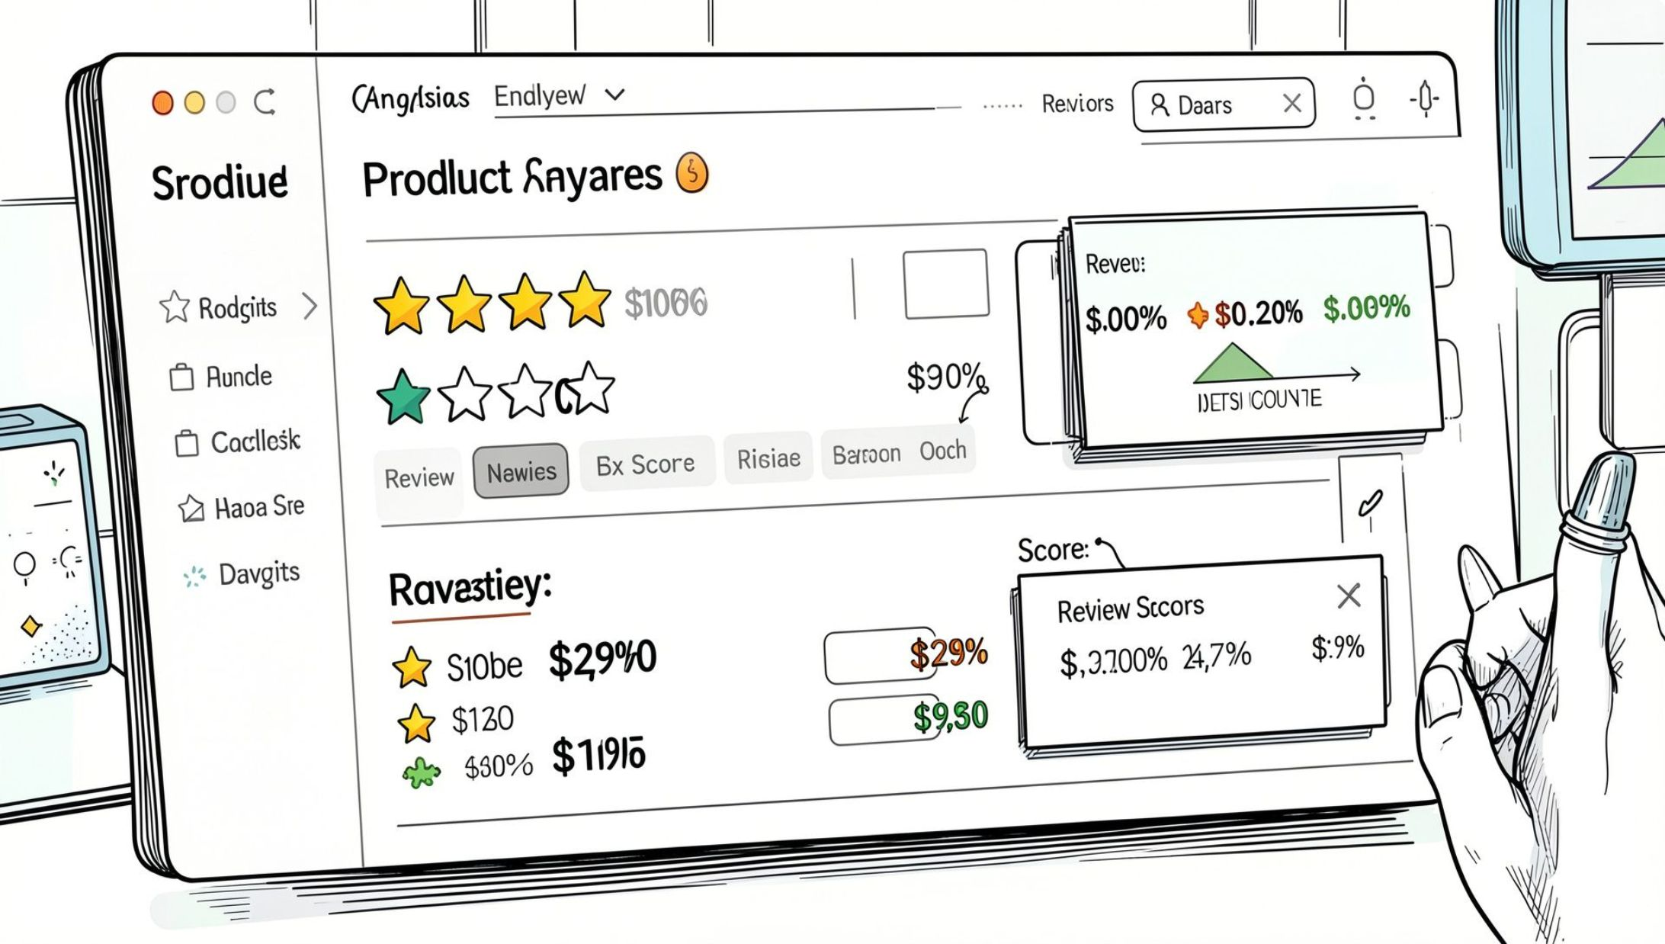
High-Spending Discount Users & Top-Rated Products
Discount Users
Customers who used discounts but spent above average purchase amount.
Top 5 by Rating
Products with the highest average review ratings identified via SQL.

Slide 6
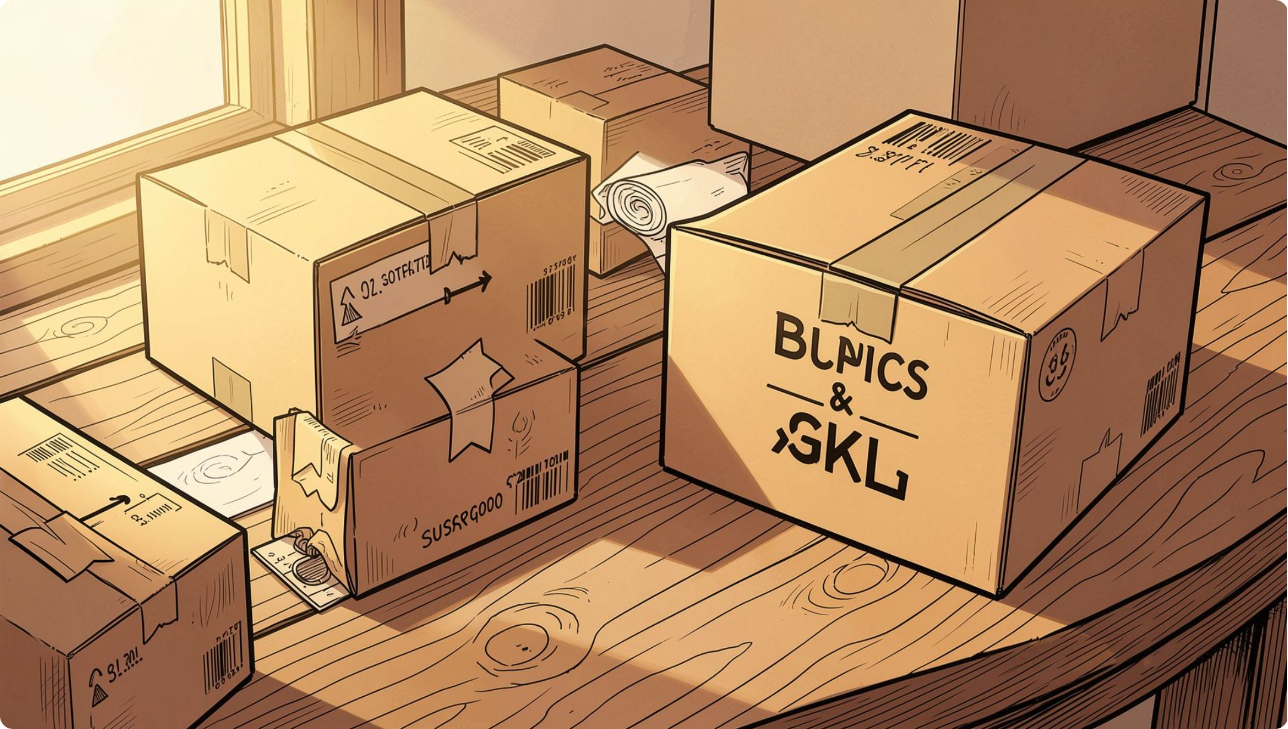
Shipping & Subscription Insights
Shipping Type
Compared average purchase amounts — Standard vs. Express shipping.
Subscribers vs. Non-Subscribers
Compared average spend and total revenue across subscription status.

Slide 7
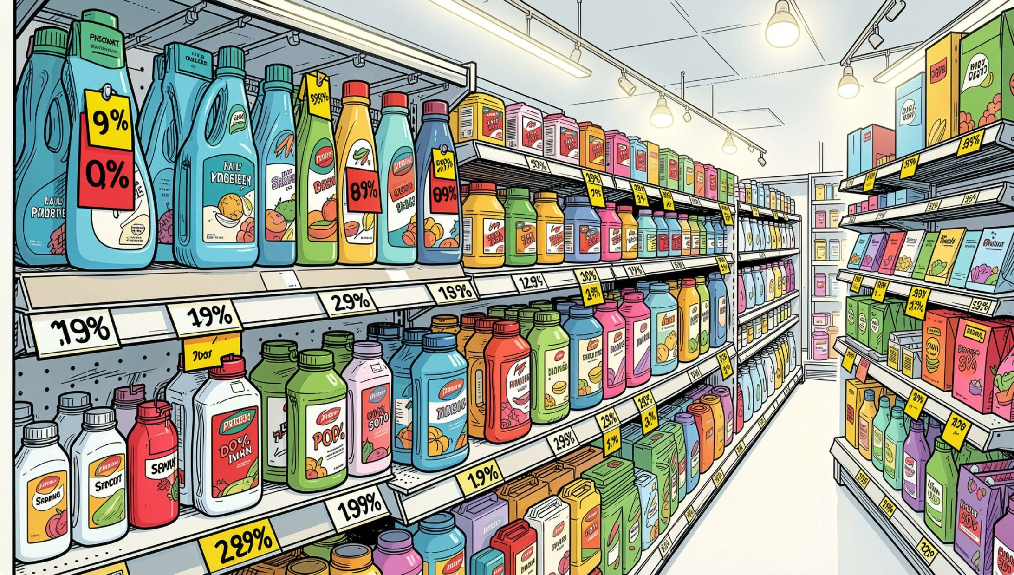
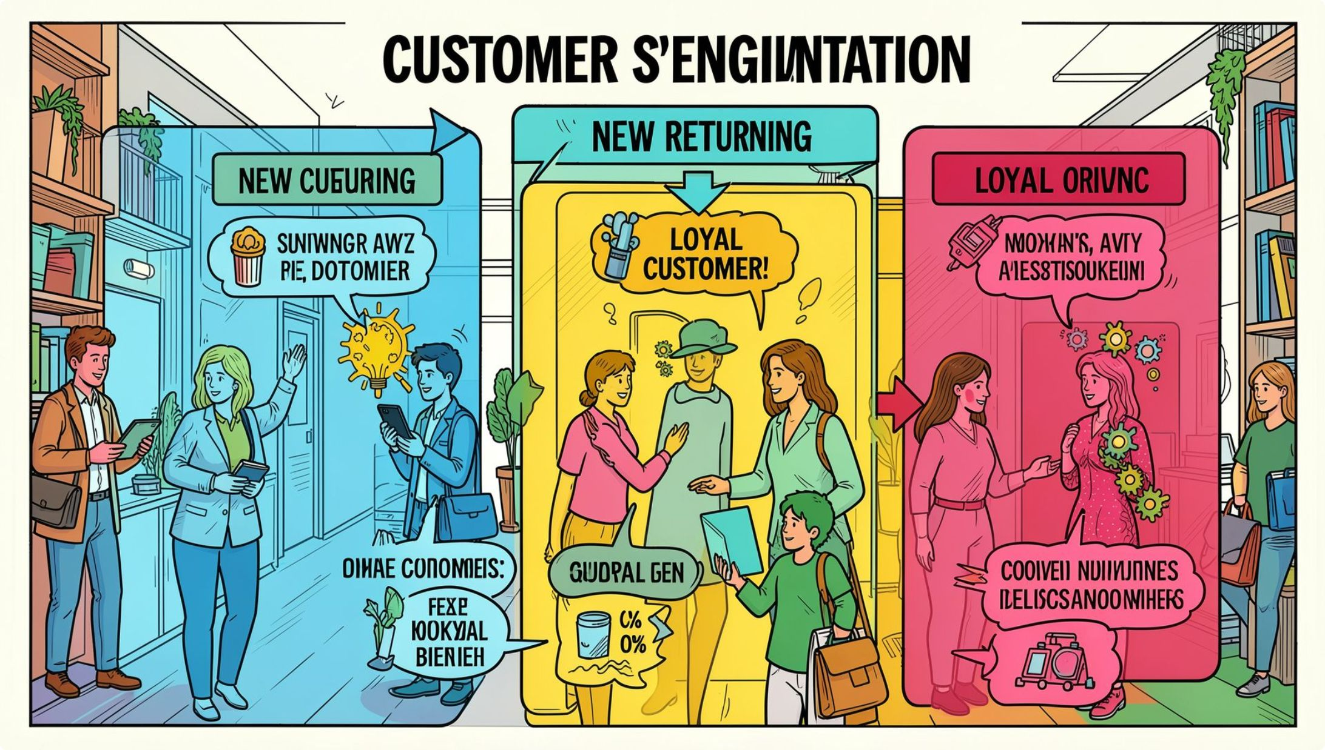
Discount-Dependent Products & Customer Segments
Top 5 Discount-Heavy Products
Highest % of discounted purchases per product.
3 Customer Segments
Classified by purchase history: New · Returning · Loyal

Slide 8
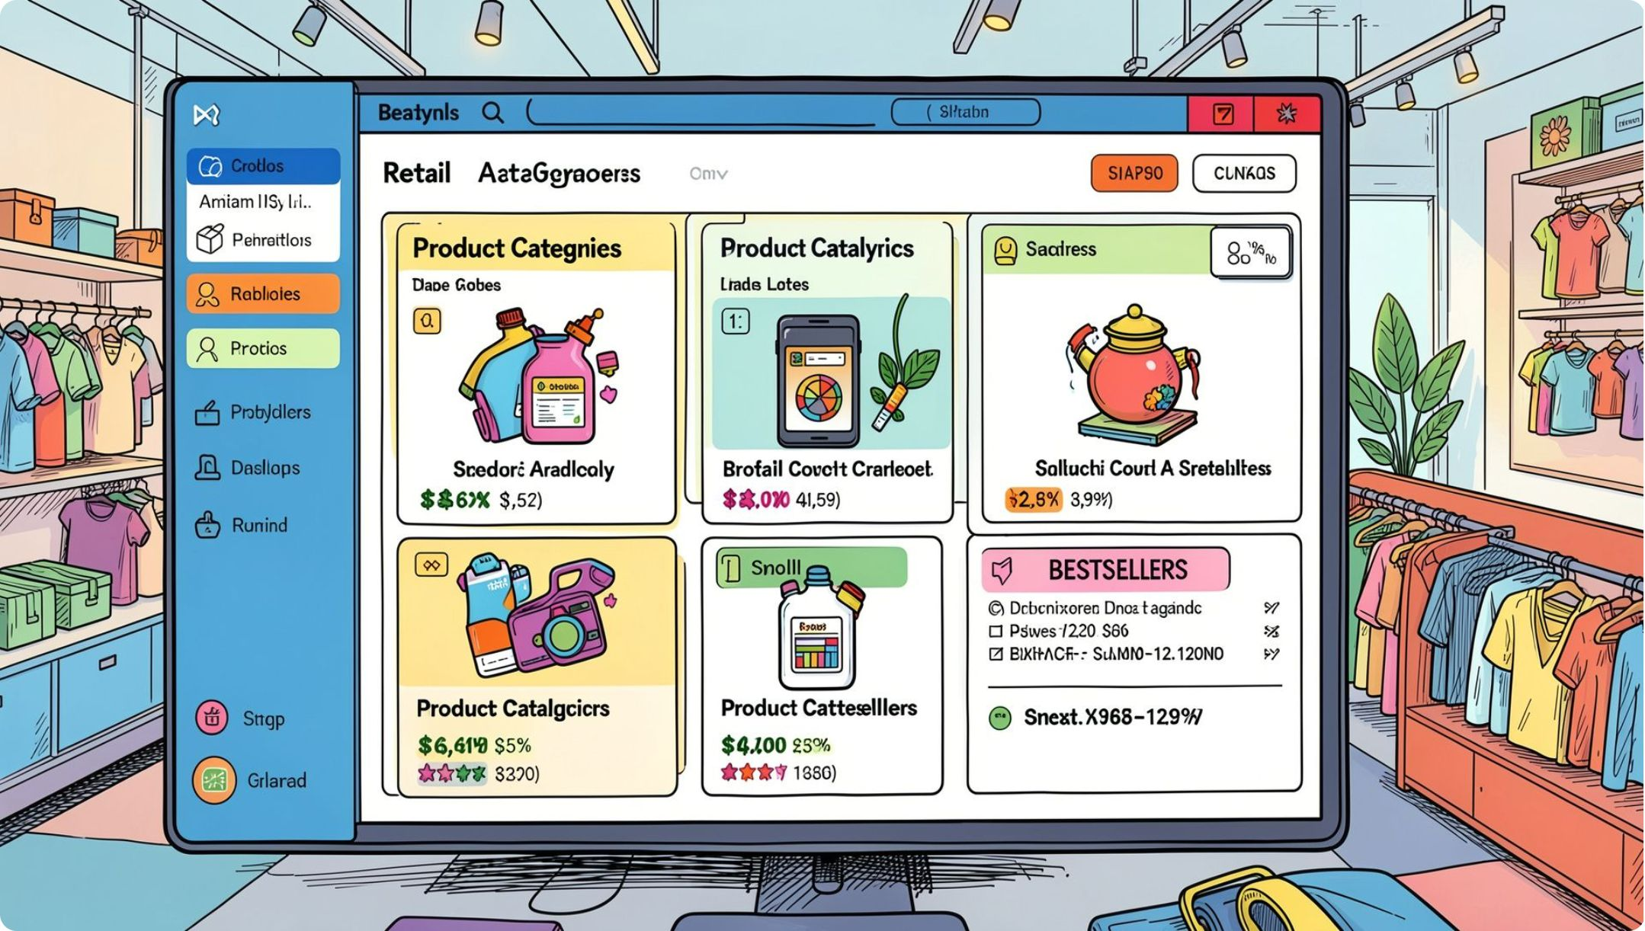
Product & Revenue Breakdowns
Top 3 Products per Category
Most purchased products within each category.
Revenue by Age Group
Total revenue contribution by age segment.
Repeat Buyers & Subscriptions
Customers with >5 purchases — more likely to subscribe?

Slide 9
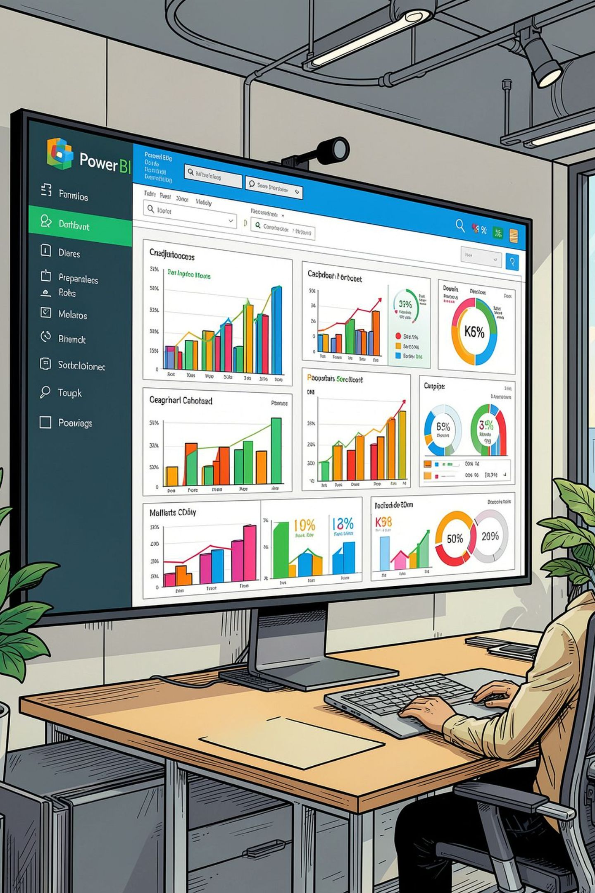
Power BI Dashboard
Interactive visual dashboard presenting all key insights — revenue, segments, ratings, and behavior patterns at a glance.

Slide 10

Business Recommendations
Boost Subscriptions
Promote exclusive subscriber benefits
Loyalty Programs
Reward repeat buyers → Loyal segment
Review Discounts
Balance sales lift with margin control
Targeted Marketing
Focus on high-revenue age groups & express shipping users

