Slide 1
CAPSTONE PROJECT GDP INDICATORS DATASET ANALYSIS Name : Ishita Jindal

Slide 2
About the dataset
Source: 15 CSV files containing GDP-related data.
Content: Includes various economic indicators by Inflation, GDP deflator (annual %), GDP growth (annual %), GDP per capita (current US$), GDP per capita growth (annual %), Gross savings (% of GDP)
Structure: Data organized into columns such as Country Name, Country code, Year, Indicator Name, Indicator Code, Region, Income Group, Value.
Purpose: Supports analysis of economic trends over time and across regions.

Slide 3

STEP-1 ETL Using Informatica

Slide 4
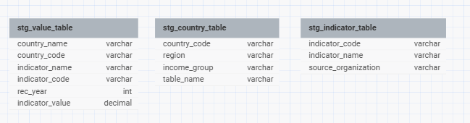
Staging Tables
Staging Table 1: stg_value_table
Purpose: Holds raw GDP data for initial examination.
Columns: Country code and name, Year, Indicator name and code, Value
Staging Table 2: stg_country_table
Purpose: Stores country-specific metadata.
Columns: Country code, Table Name, Region, Income Group.
Staging Table 3: stg_indicator_table
Purpose: Stores indicator-specific metadata.
Columns: Indicator code, Indicator Name, Source organization

Slide 5
Dimension Tables and Fact Table
1. DIM_COUNTRY:
Stores country information with columns for c_id, country_name, country_code, create_date, and update_date.
2. DIM_C_REGION:
Contains region data with r_id, region, create_date, and update_date.
3. DIM_INCOME:
Represents income levels with inc_id and income.
4. DIM_YEARS:
Holds year data with y_id and rec_year.
5. DIM_INDICATORS:
Stores economic indicator details with i_id, indicator_code, and indicator_name.
6. FACT_INDICATOR_VALUES:
Purpose: Stores detailed data about GDP indicators, linking each entry to corresponding dimension tables for contextual analysis.
Key Columns:
fact_id, country_id (Foreign Key), region_id (Foreign Key), income_id (Foreign Key), year_id (Foreign Key), indicator_id (Foreign Key), create_date & update_date
Relationships: Establishes connections with DIM_COUNTRY, DIM_C_REGION, DIM_INCOME, DIM_YEARS, and DIM_INDICATORS to enable multi-dimensional analysis.
Significance: Facilitates detailed analysis of GDP trends, comparison across regions, income levels, and over time.

Slide 6
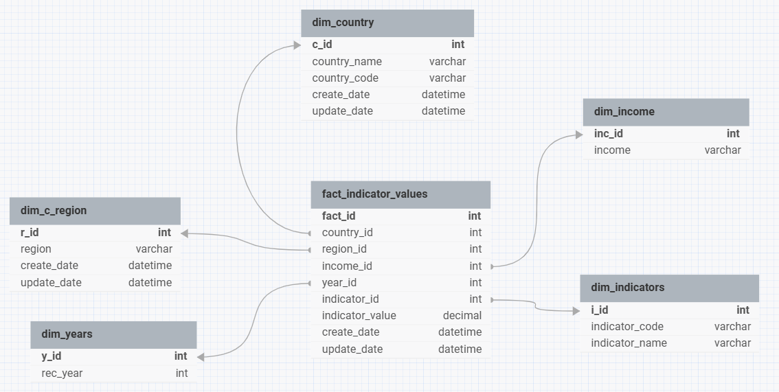

Slide 7

STEP-2 Data Analysis and Visualization

Slide 8
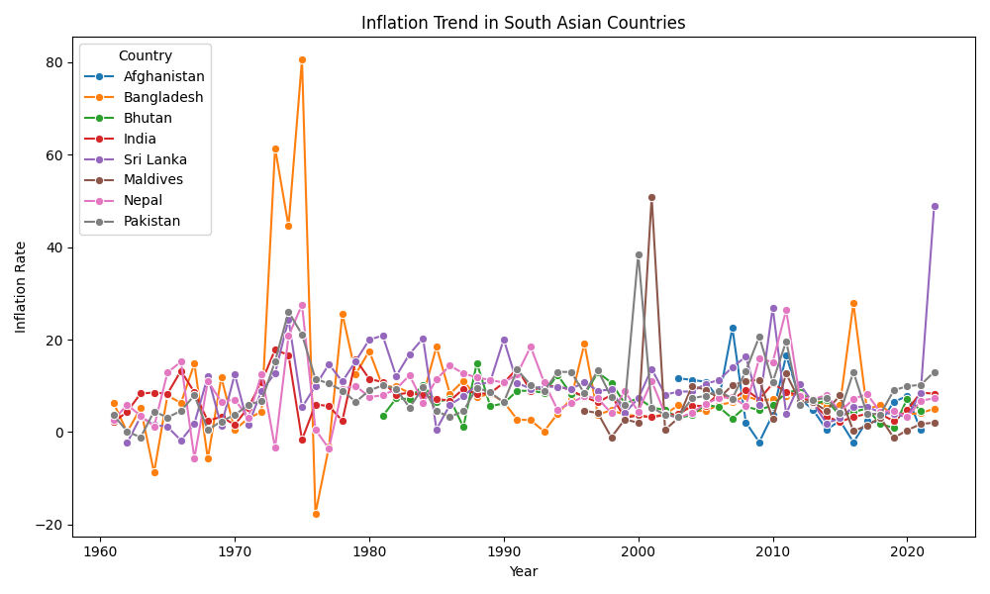
Inflation Trend in South Asian Countries
This plot shows the inflation trends over the years for various South Asian countries, providing insight into economic stability.
Some notable periods are:
1970s: A period of high inflation across most countries, likely influenced by global factors like the oil crisis.
1980s: Inflation rates generally declined in most countries, with some exceptions like Sri Lanka.
1990s: Inflation remained relatively low and stable in most countries.
2000s: Inflation rates remained low in most countries, with some fluctuations.
2010s: Inflation rates remained relatively low and stable in most countries, with some exceptions like Sri Lanka.
2020s: Inflation rates have increased in some countries, likely due to global factors like the COVID-19 pandemic and the war in Ukraine.

Slide 9
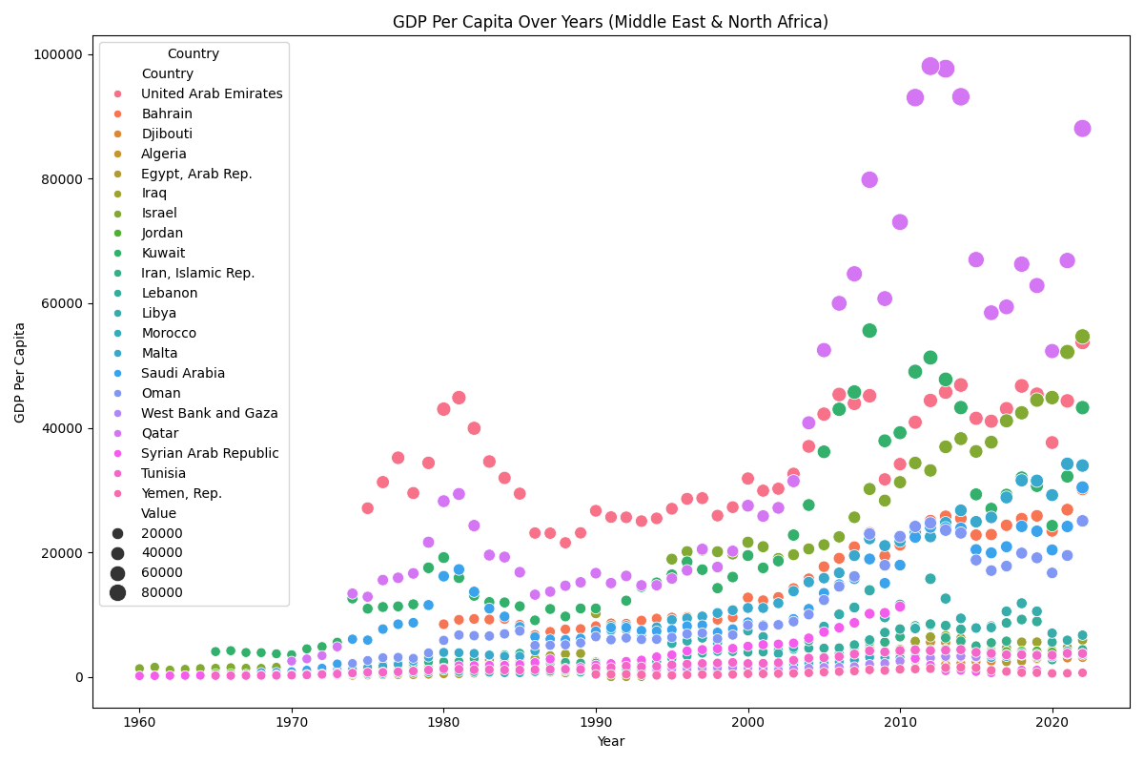
GDP Per Capita Over Years in Middle East & North Africa Region
The graph reveals significant divergence in GDP per capita trajectories across the Middle East and North Africa region. Some countries have experienced substantial growth over the years, while others have remained relatively stagnant or even declined.
Qatar stands out as a notable outlier, demonstrating exceptional GDP per capita growth, particularly in recent decades.
Several countries, including Yemen, Rep., Djibouti, and Syrian Arab Republic, have shown limited or no growth, and in some cases, a decline in GDP per capita.
The graph suggests a potential correlation between oil wealth and economic growth. Countries with significant oil reserves (like UAE, Qatar, Kuwait) tend to exhibit higher GDP per capita.

Slide 10
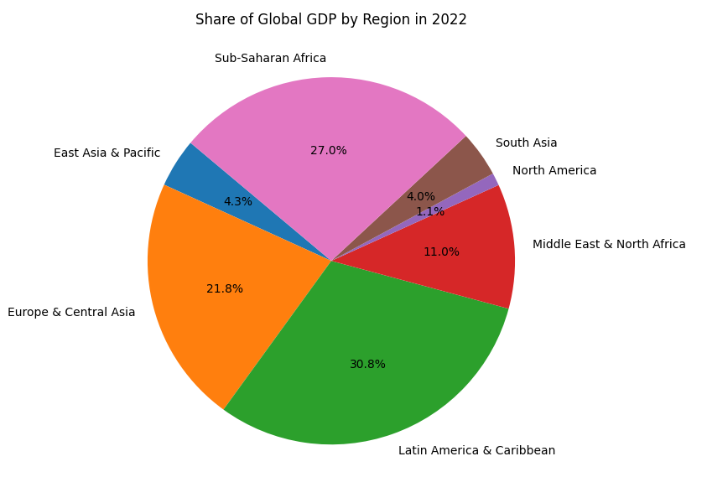
Share of Global GDP by Region in 2022
Uneven Distribution: The global GDP is not evenly distributed across regions. There are significant disparities in economic output between different parts of the world.
Dominance of Developed Regions: Developed regions like Europe & Central Asia, Latin America & Caribbean, and Sub-Saharan Africa hold a larger share of the global GDP compared to developing regions.
Regional Analysis can be:
Latin America & Caribbean has the largest share of global GDP at 30.8%, indicating a significant economic influence on the global stage.
Europe & Central Asia comes in second with a 21.8% share, also highlighting its substantial contribution to the global economy.
North America has the smallest share of global GDP at 1.1%, indicating significant economic challenges and disparities within the region.
Sub-Saharan Africa holds a substantial share of 27.0%, reflecting the economic growth and development of countries like China.

Slide 11
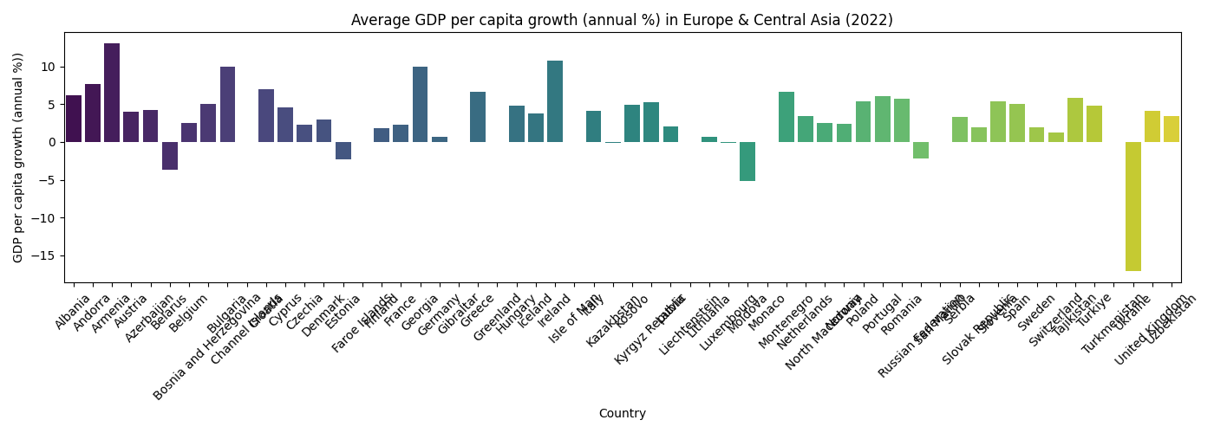
Average GDP per capita growth (annual %) in Europe & Central Asia(2022)
The graph reveals a significant divergence in economic performance across Europe and Central Asia in 2022. Some countries experienced substantial GDP per capita growth, while others faced contractions.
Top Performers: Iceland stands out as the top performer with a remarkable GDP per capita growth rate. Andorra and France also recorded strong positive growth.
Contracting Economies: Ukraine experienced a significant decline in GDP per capita.
Moderate Growth: A majority of the countries exhibited moderate growth rates, ranging from 0% to 5%

Slide 12
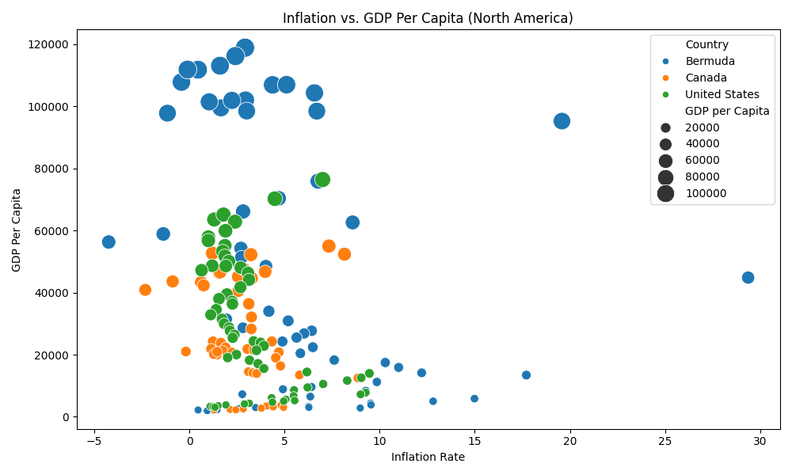
Inflation vs GDP Per Capita in North America Region
The data points are spread across a wide range of inflation rates and GDP per capita values. This indicates significant economic diversity among the countries in the region.
Bermuda stands out with both high inflation and high GDP per capita which can imply that Bermuda has a high cost of living.
Canada generally shows lower inflation rates compared to other countries.
There seems to be a slight tendency for countries with lower GDP per capita to experience lower inflation.
The economic structures of North American countries are diverse, with varying levels of industrialization, resource dependence, and service sectors. This can lead to different inflation drivers and economic growth patterns.

Slide 13

Significance and Use of this Dataset and Future Scope
Significance and Use:
Some notable Comprehensive Economic Analysis: The dataset combines GDP indicators with country, region, income levels, and year data to enable a holistic view of global economic trends.
Insights into Key Indicators: Supports detailed analysis of key economic indicators such as GDP growth, income distribution, and regional performance.
Policy Formulation: Helps policymakers, researchers, and organizations in creating strategies based on historical economic data and trends.
Future Scope:
Incorporating New Data Sources: Extend the dataset with additional economic indicators like population , unemployment rates, and trade balances.
Predictive Analytics: Integrate machine learning models for forecasting GDP trends and economic performance.

Slide 14
Thank You

