Slide 1
ETHEREUM VOLATILITY FORECASTING
STAT 429 - Time Series Analysis
Prof. Hyoeun Lee
Presenter: Ishita Singh

Slide 2
MOTIVATION
Crypto markets are highly volatile and trade 24/7.
Even a rough 1-week price view can help traders, analysts, and risk teams:
  plan entries/exits
  set stop-losses and position sizes
Goal: build a statistically sound, explainable forecasting pipeline.
Models used: ARIMA (trend), SARIMA (trend + weekly pattern), SARIMAX (trend + seasonality + predictors), GARCH (volatility).

Slide 3
OBJECTIVE
Problem:
  Can we reliably forecast Ethereum’s daily closing price for the next 7 days?
  Can we quantify the uncertainty/volatility around those forecasts?
Objectives:
  Clean and explore ETH price data.
  Check and enforce stationarity.
  Fit and compare several ARIMA and SARIMA models.
  Model time-varying volatility using GARCH.
  Evaluate accuracy with a fixed 7-day window and rolling windows.

Slide 4
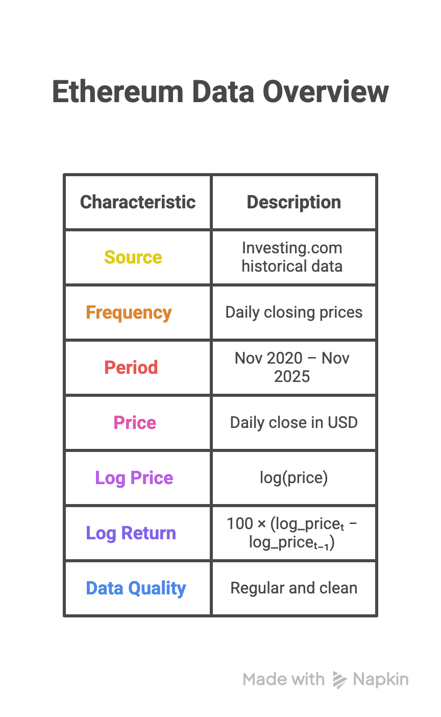

DATASET OVERVIEW

Slide 5
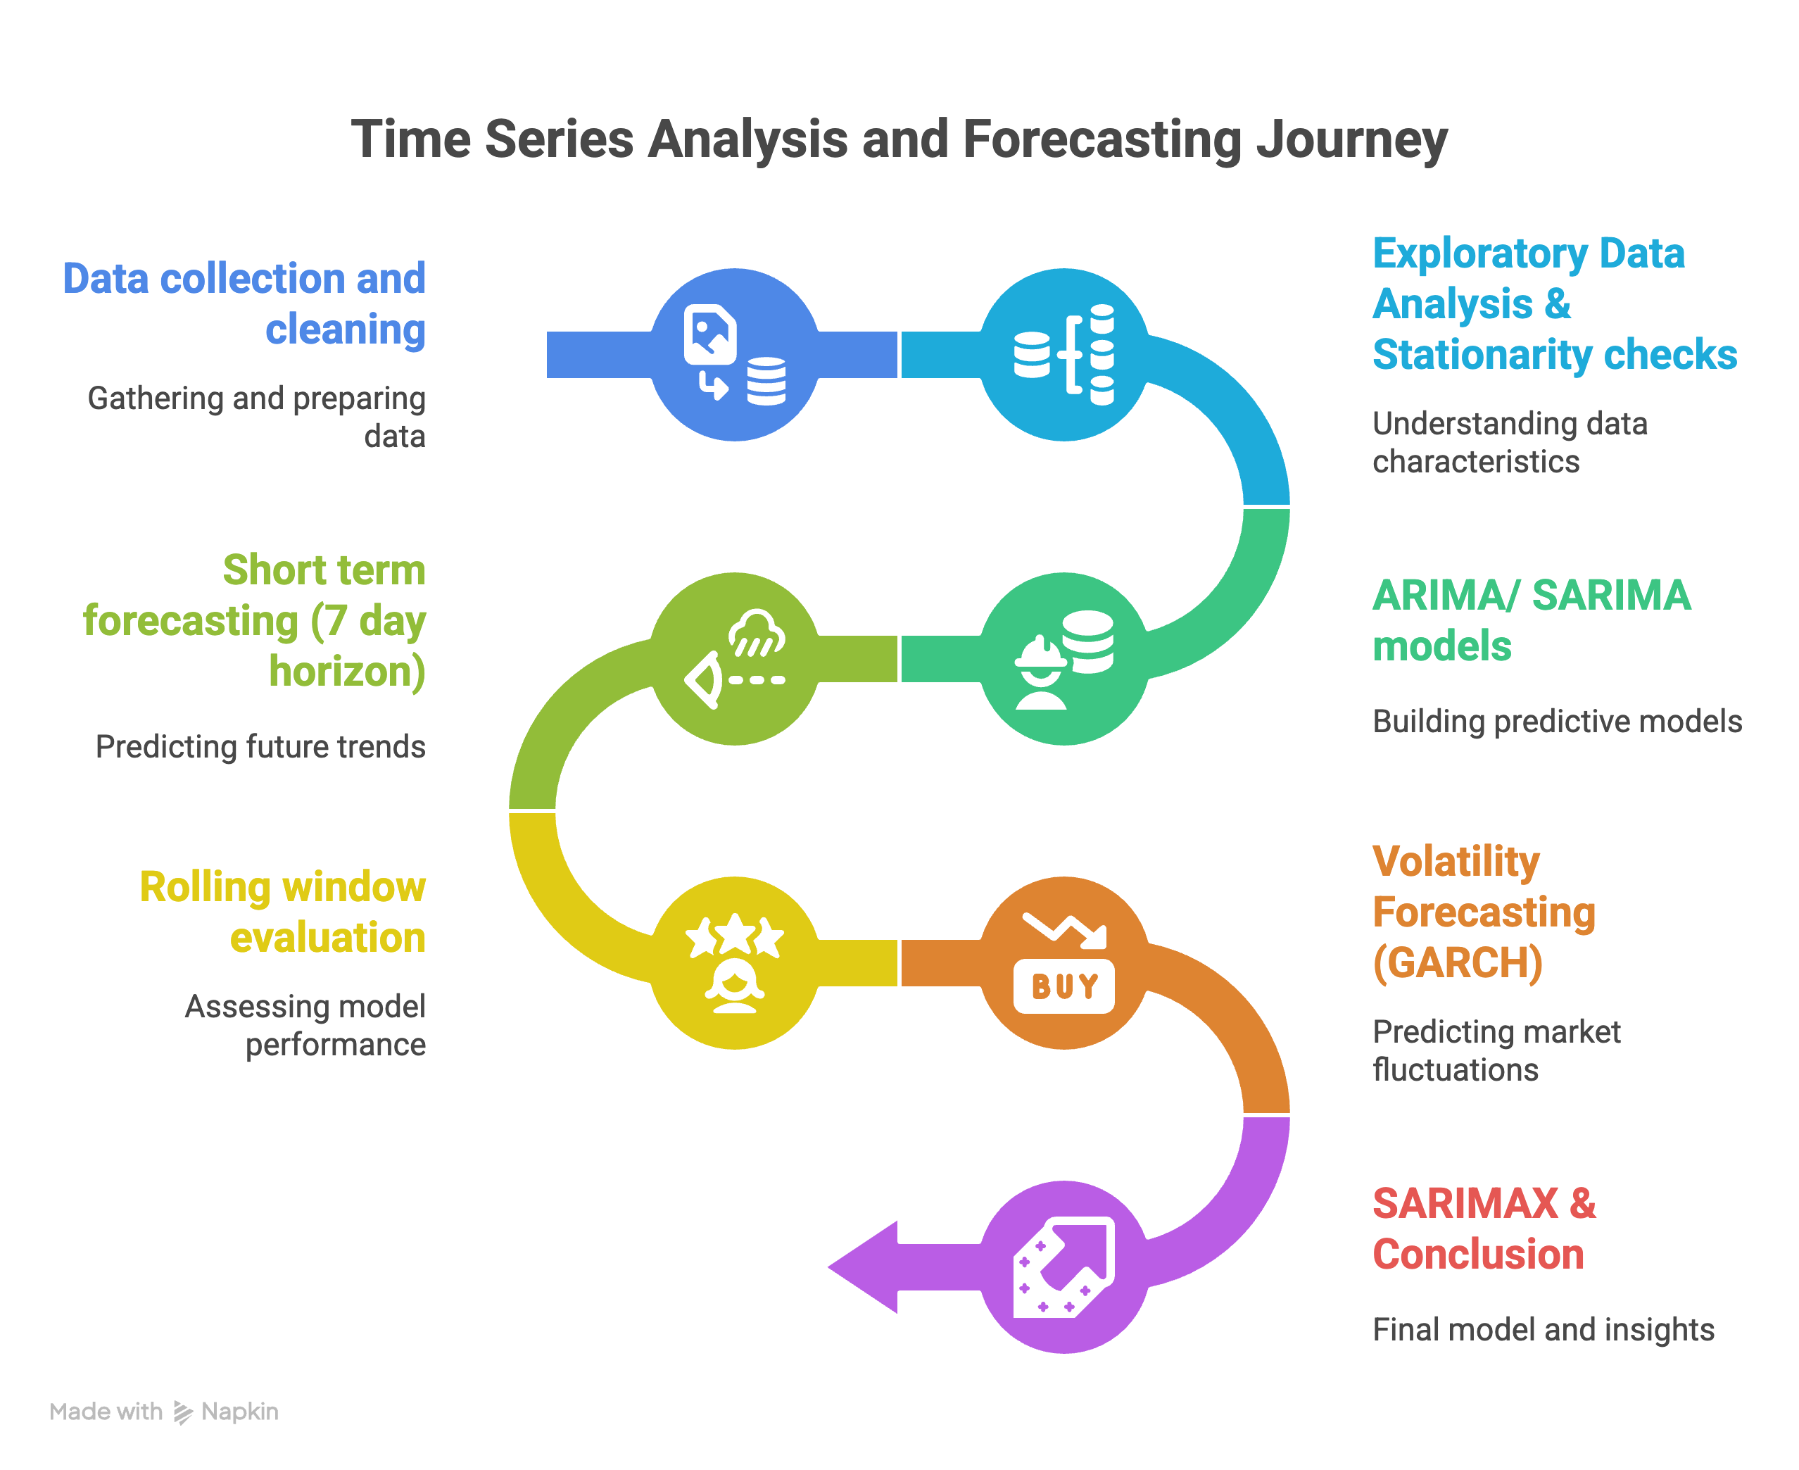
STATISTICAL PIPELINE

Slide 6
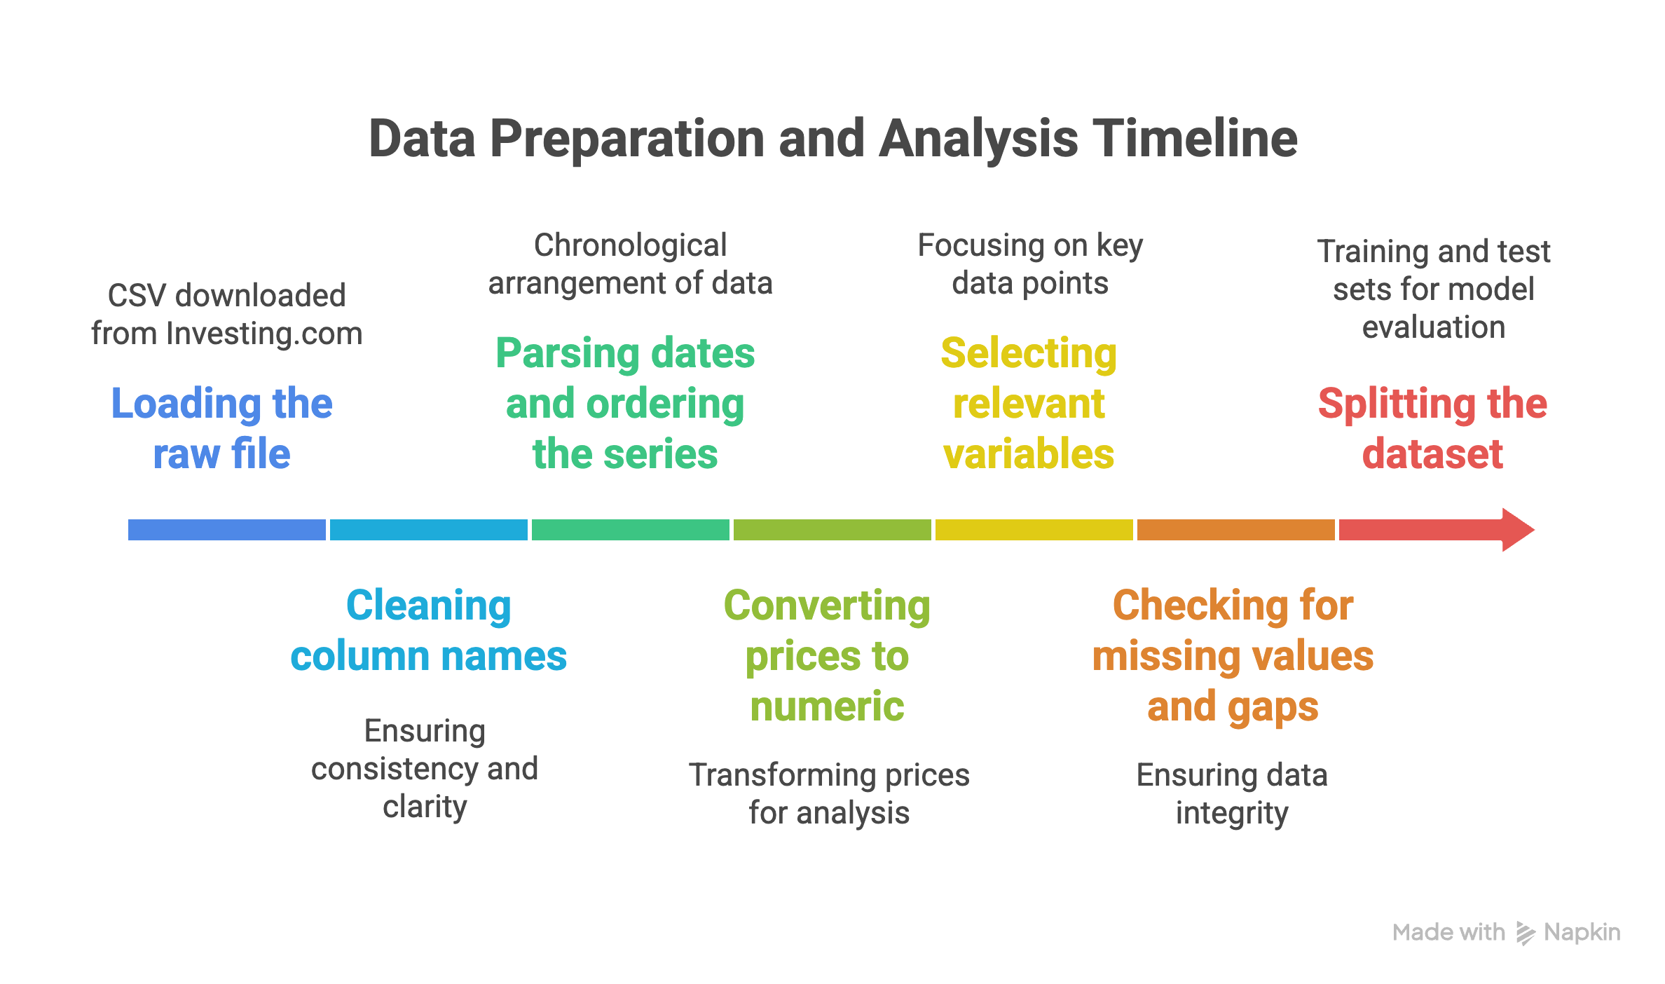
DATA PREPROCESSING

Slide 7
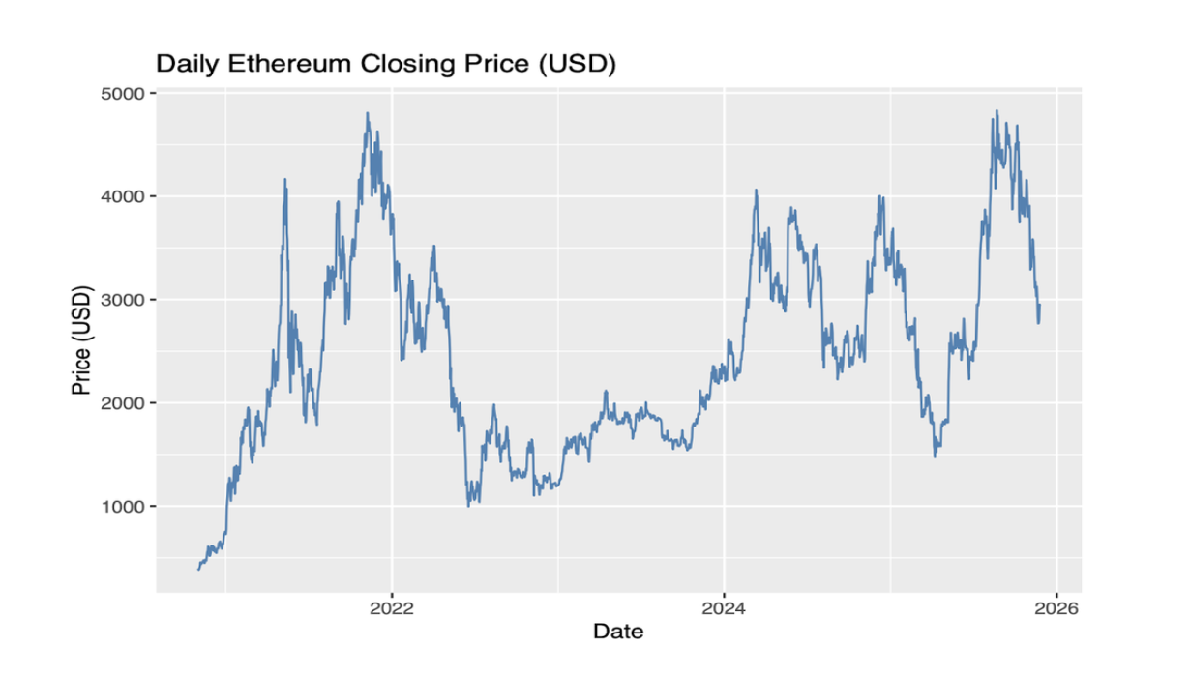
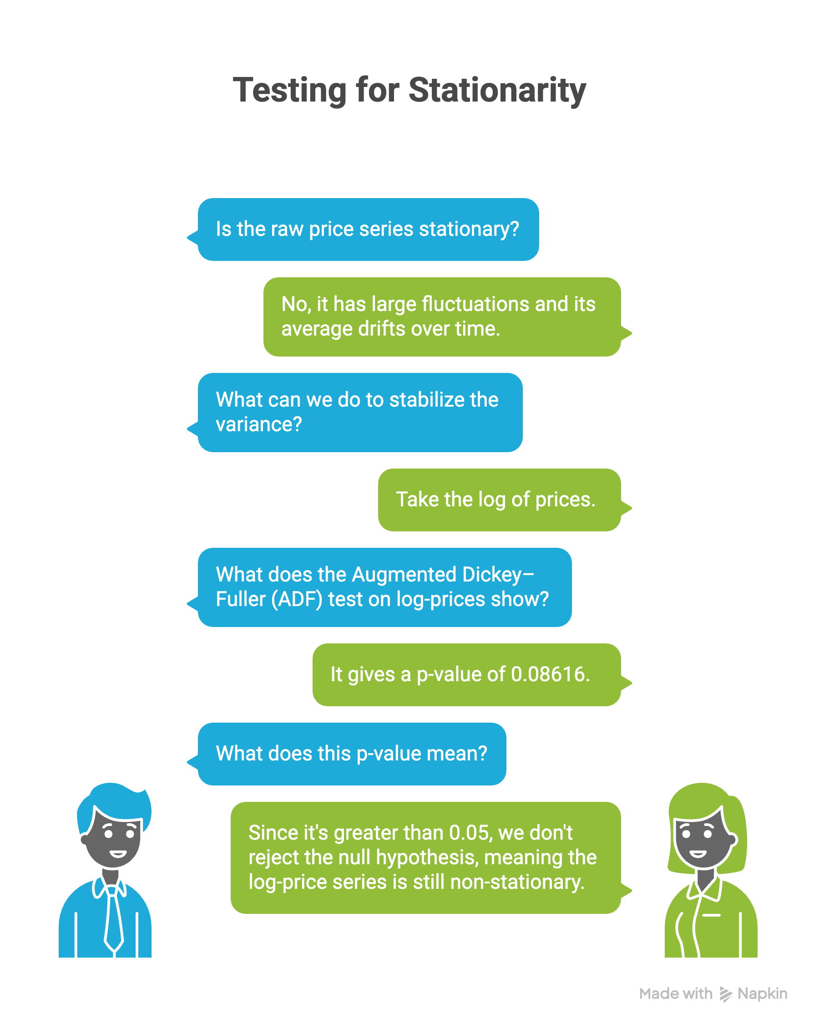
TIME SERIES PLOT

Slide 8
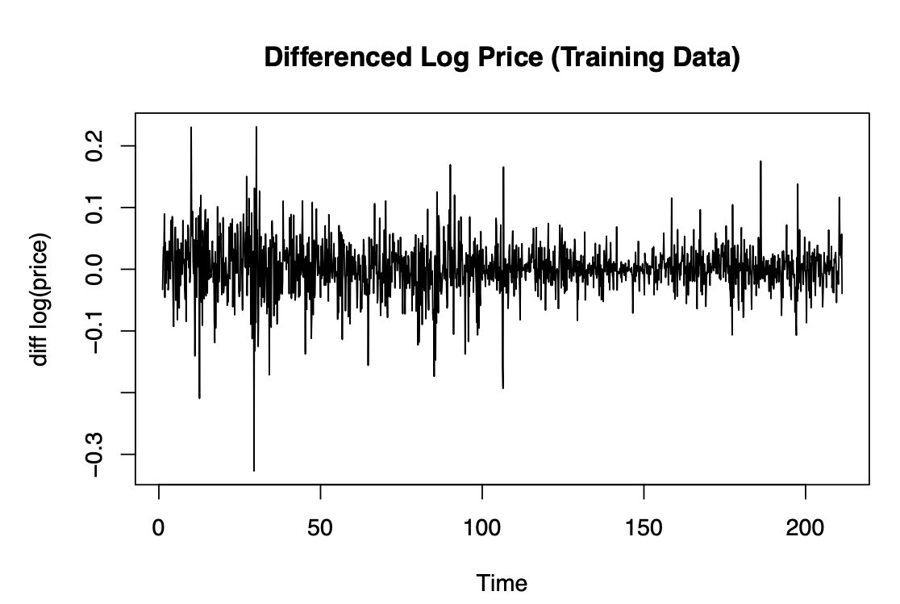
DIFFERENCING
Augmented Dickey–Fuller (ADF) test on log-prices gives p-value = 0.01.
Since this p-value is less than 0.05, we accept the null hypothesis so the differenced log-price series is stationary.

Slide 9
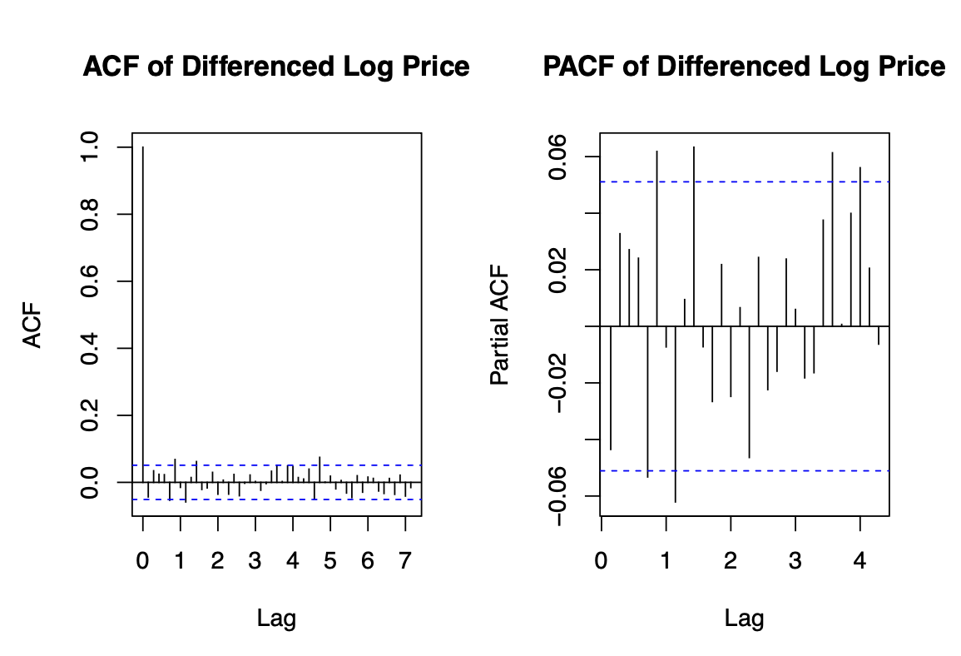
ACF AND PACF PLOT OF TIME SERIES
Differenced log price → check dependence.
ACF: big spike at lag 1, rest tiny → short-memory, MA-type.
PACF: only few small spikes → low-order AR/MA .
Confirms stationary differenced series → suitable for ARIMA modelling.

Slide 10
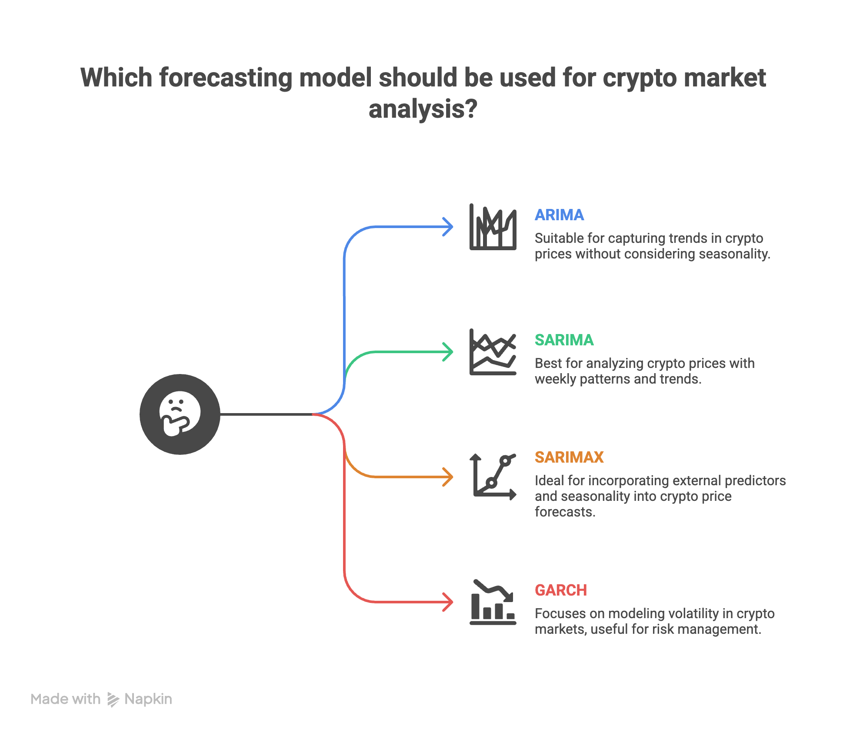

Slide 11
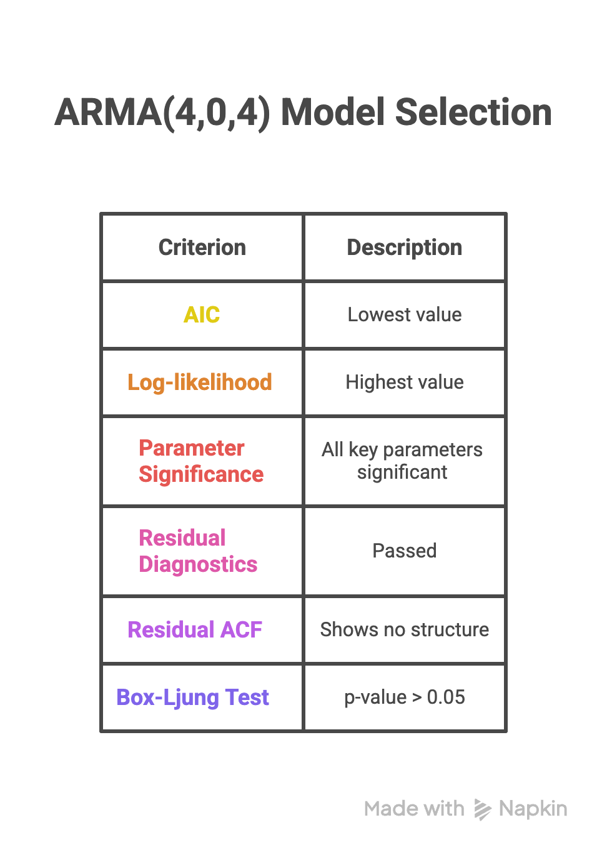
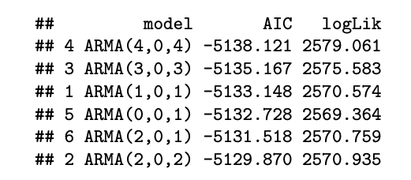
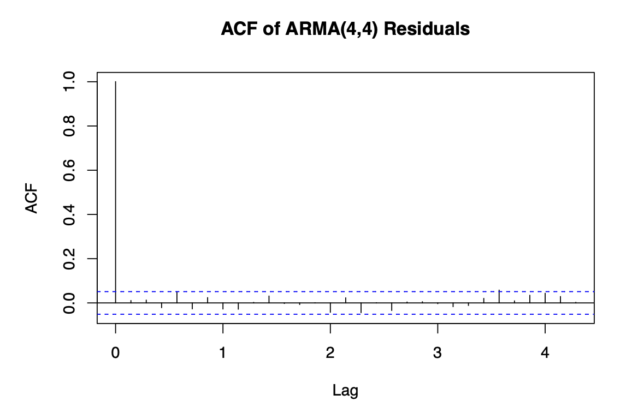
ARIMA MODELS

Slide 12
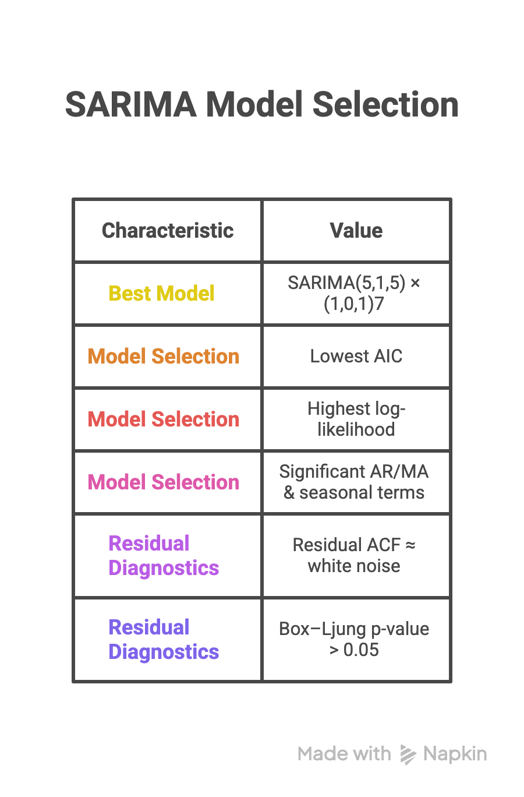
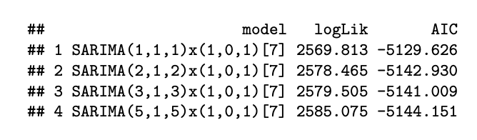
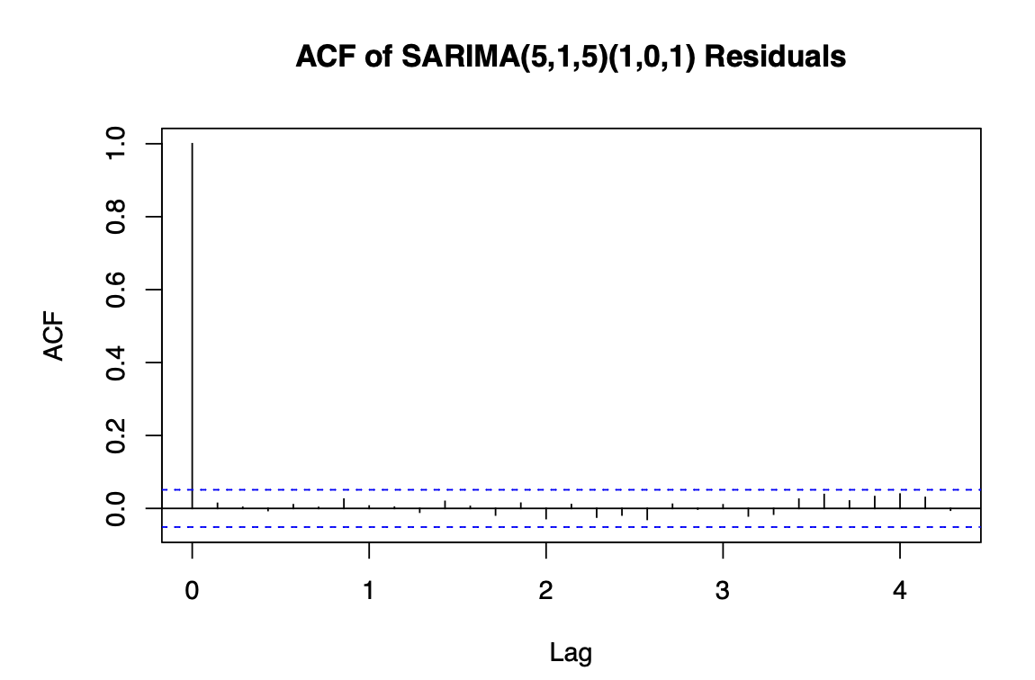
SARIMA MODELS

Slide 13
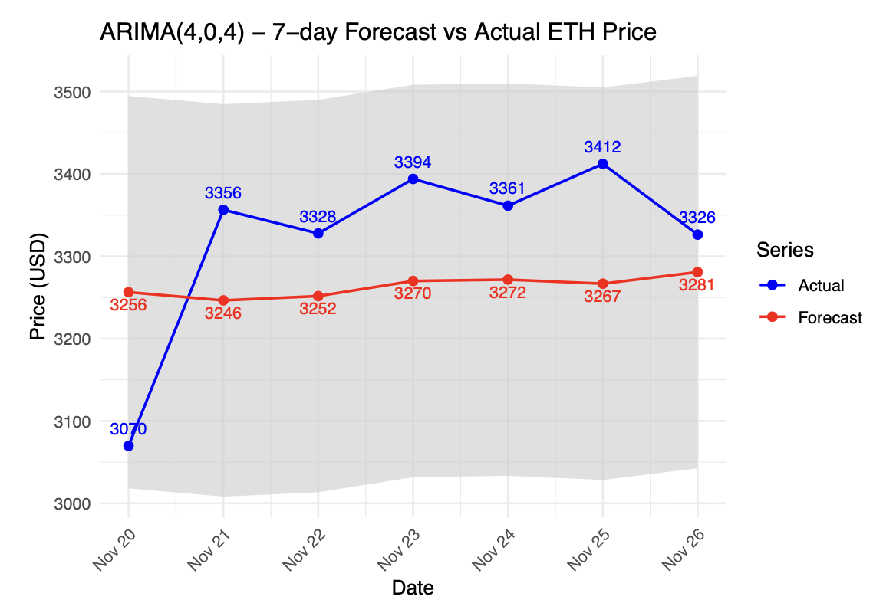
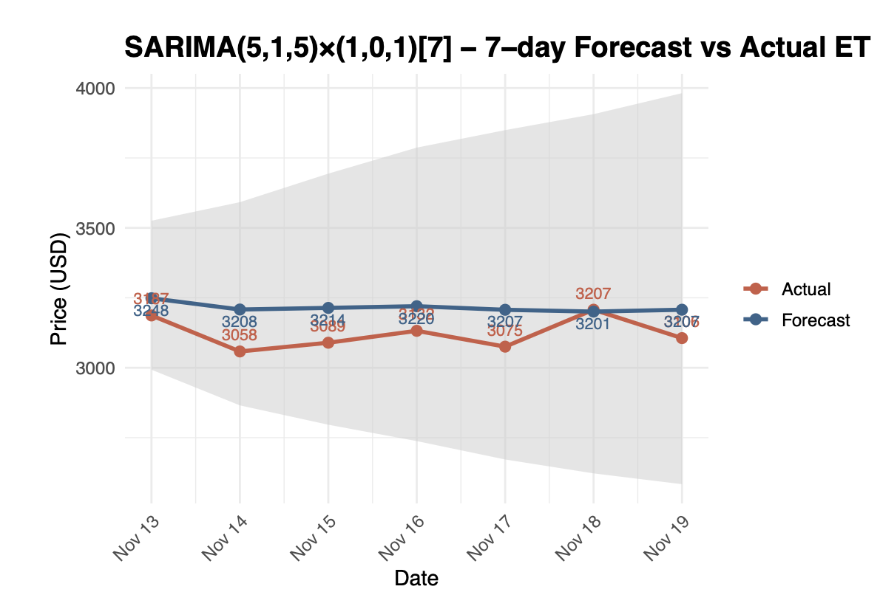
ARIMA/ SARIMA FORECASTS
ARIMA forecasts are smoother and miss some short-term movements, leading to slightly higher error.
SARIMA forecasts track the actual ETH prices more closely, especially around daily ups and downs.

Slide 14
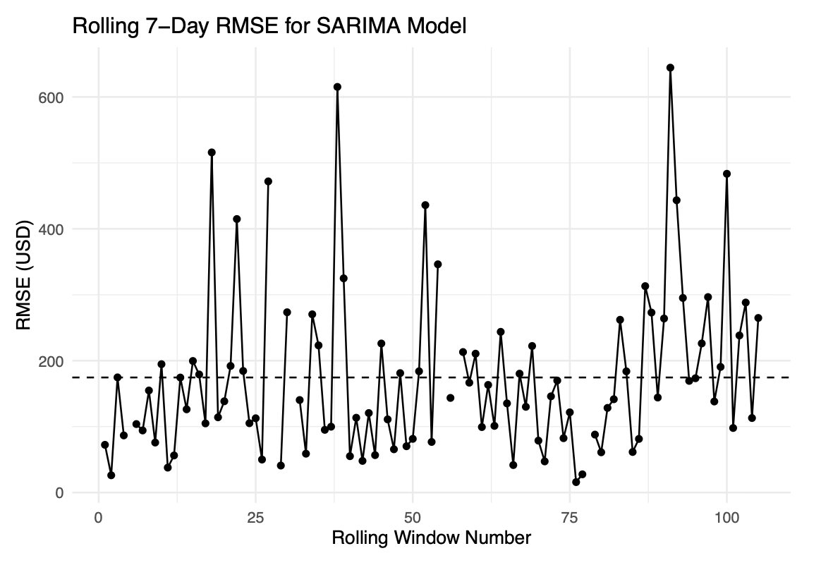
ROLLING WINDOW EVALUATION
Rolling 7-day RMSE for SARIMA best model (each point = one rolling window)
Dashed line ≈ average RMSE (~175 USD) across all windows
Most windows: errors in 100–250 USD range → reasonably stable performance
Few spikes > 400–600 USD → model struggles during sudden price jumps / high-volatility periods

Slide 15
GARCH MODEL
I fitted a basic GARCH(1,1) model on the daily log-returns to capture time-varying volatility.
The volatility parameters are highly significant and very persistent (α₁ + β₁ ≈ 0.99), meaning shocks to volatility fade slowly.
The GARCH(1,1) gives an RMSE of about 0.43 on log-price (≈ $1,330 on price), so it models volatility well but does not improve price forecasts over ARIMA/SARIMA.

Slide 16
SARIMAX
I extended the best SARIMA model to a SARIMAX by adding yesterday’s log-price as an extra regressor (lag-1 xt−1x_{t-1}xt−1 ).
The fitted model is SARIMAX(5,1,5) × (1,0,1)_7 with exogenous lag-1 log price, capturing both weekly seasonality and short-term dependence.
The exogenous coefficient on lag-1 log price is positive but not strongly significant, and the model shows a mild convergence warning, so the extra regressor does not add much new information.
The SARIMAX accuracy is RMSE ≈ 0.25 on log scale (≈ $675 on price), which is similar to but not clearly better than the SARIMA-only model.

Slide 17
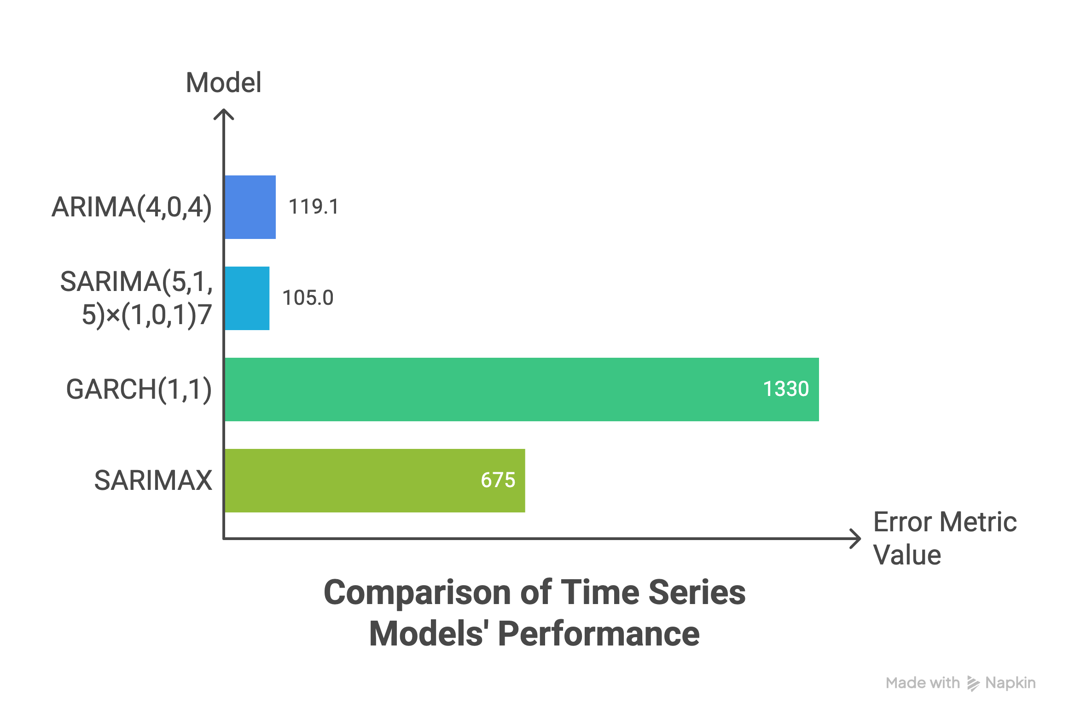
RESULTS

Slide 18
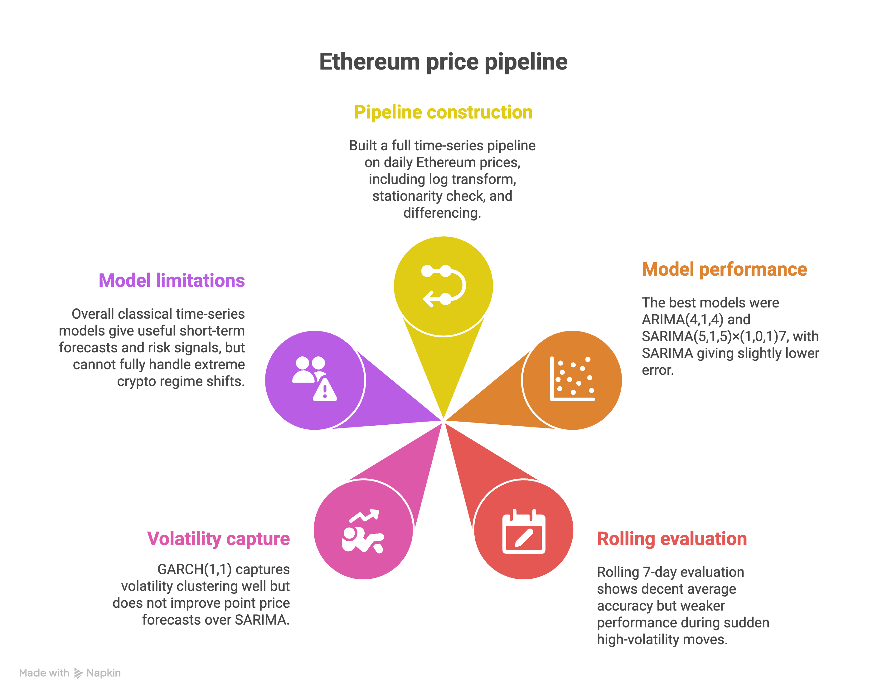
CONCLUSION

Slide 19
THANK YOU!

