Slide 1



"We are happier, healthier, wealthier and smarter around nature"
Nature
Society
Administration
Nature is the complex set of physical, geographic, biological, social, cultural and political conditions that surround an individual or organism that ultimately determines its form and the nature of its survival.
Focus Areas:
Air Quality
Water Conservation & Preservation
Land Usage
Waste management
Green coverage
River & Lakes
Biodiversity
GHG Emissions
Temperature & Humidity
Rainfall
Social sustainability is a process for creating sustainable successful places that promote wellbeing, by understanding what people need from the places they live and work. Social sustainability combines design of the physical realm with design of the social world.
Focus Areas:
City Planning
Holistic well-being
Transport
Education
Healthcare
Public Safety
Cultural Preservation
Employment Opportunity
Community engagement and participation
Aspects under Administration look at how society polices itself, focusing on internal controls and methods to preserve compliance with legislation, best practices, and policies.
Focus Areas:
Transparency and Accountability
Ethical Leadership
Disaster Management
Benefits:
Holistic Assessment of Sustainability
Informed Decision-Making
Enhanced Urban Planning
Promotion of Sustainable Practices
Increased Public Awareness
Long-term Sustainability Goals
Strategic Resource Allocation

Slide 2

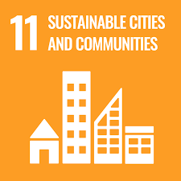

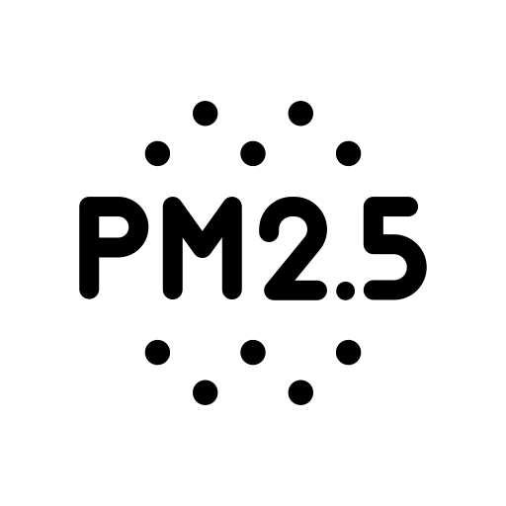

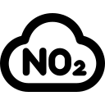
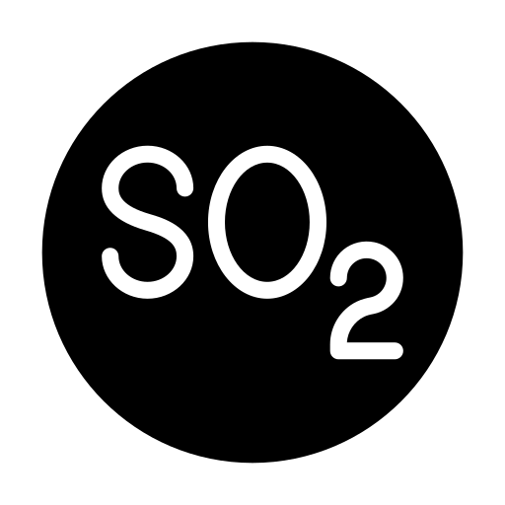


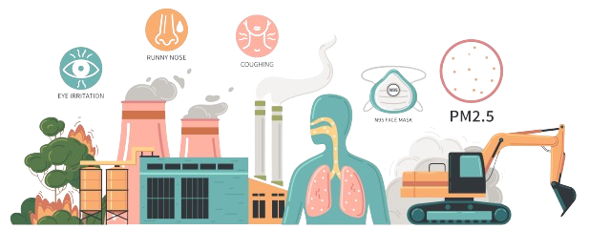


FRESH AIR, BRIGHT FUTURE: ELEVATING SUSTAINABILITY WITH EVERY BREATH
The World Health Organization estimates that air pollution is the single largest environmental health risk, killing up to 1 in 9 people globally.
What is Air Quality?
Air quality refers to the degree to which the air is suitable or clean enough for humans or the environment.
Track your city's air quality with our AQI score, a crucial step towards healthier living and sustainable urban development. Our comprehensive index empowers you to see the impact of clean air initiatives and guides strategic planning for a greener future.
Air quality index (AQI) is a metric developed to communicate levels of pollution over a given location. It is derived using the concentration levels of various pollutants.
By identifying high pollution areas, cities can take preventive measures to reduce exposure and health risks.
Improved air quality can lead to fewer pollution-related health problems, reducing the burden on healthcare systems and associated costs.
CALCULATION METHODOLOGY
Data collection through Sensors
Recommendations, Insights & monitoring
Enhances the city’s capability to respond to air quality emergencies, such as smog episodes, by providing critical data to guide response strategies.
Data cleaning
Score generation for Air Quality
Calculation using pollutant concentration
AQI ranging
Source
Wireframe

Slide 3
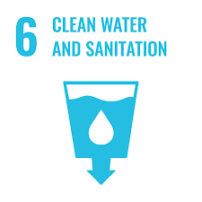





FLOWING FORWARD: WATER MANAGEMENT IN THE AGE OF SUSTAINABILITY
Challenges At Hand:
Estimates show that with current practices, the world will face a 40% shortfall between forecast demand and available supply of water by 2030.
Estimates indicate that over 40% of the world population live in water scarce areas, and approximately ¼ of world’s GDP is exposed to this challenge.
By 2040, an estimated one in four children will live in areas with extreme water shortages.
Incorporating water management into a city's sustainable development strategy is crucial for maintaining the health, safety, and economic vitality of urban areas. By ensuring a reliable water supply, protecting water quality, treating wastewater, and conserving water resources, cities can promote a sustainable and resilient future.
Water Management Index (WMI) is a comprehensive metric designed to evaluate and score a city's effectiveness in managing its water resources.
Benefits of Index:
Sources of water
Supply of water
Quality of water
Water usage management
The index aids in balancing the water needs of different sectors to ensure sustainable use.
Helps ensure that cities comply with national and international water management standards and regulations.
Water Management Index
It helps cities assess the quantity and quality of their water resources, highlighting areas where water scarcity, pollution, or overuse might pose risks.
It helps prioritize investments in water infrastructure and conservation programs along with strategic planning of the resources.
Source
Wireframe

Slide 4
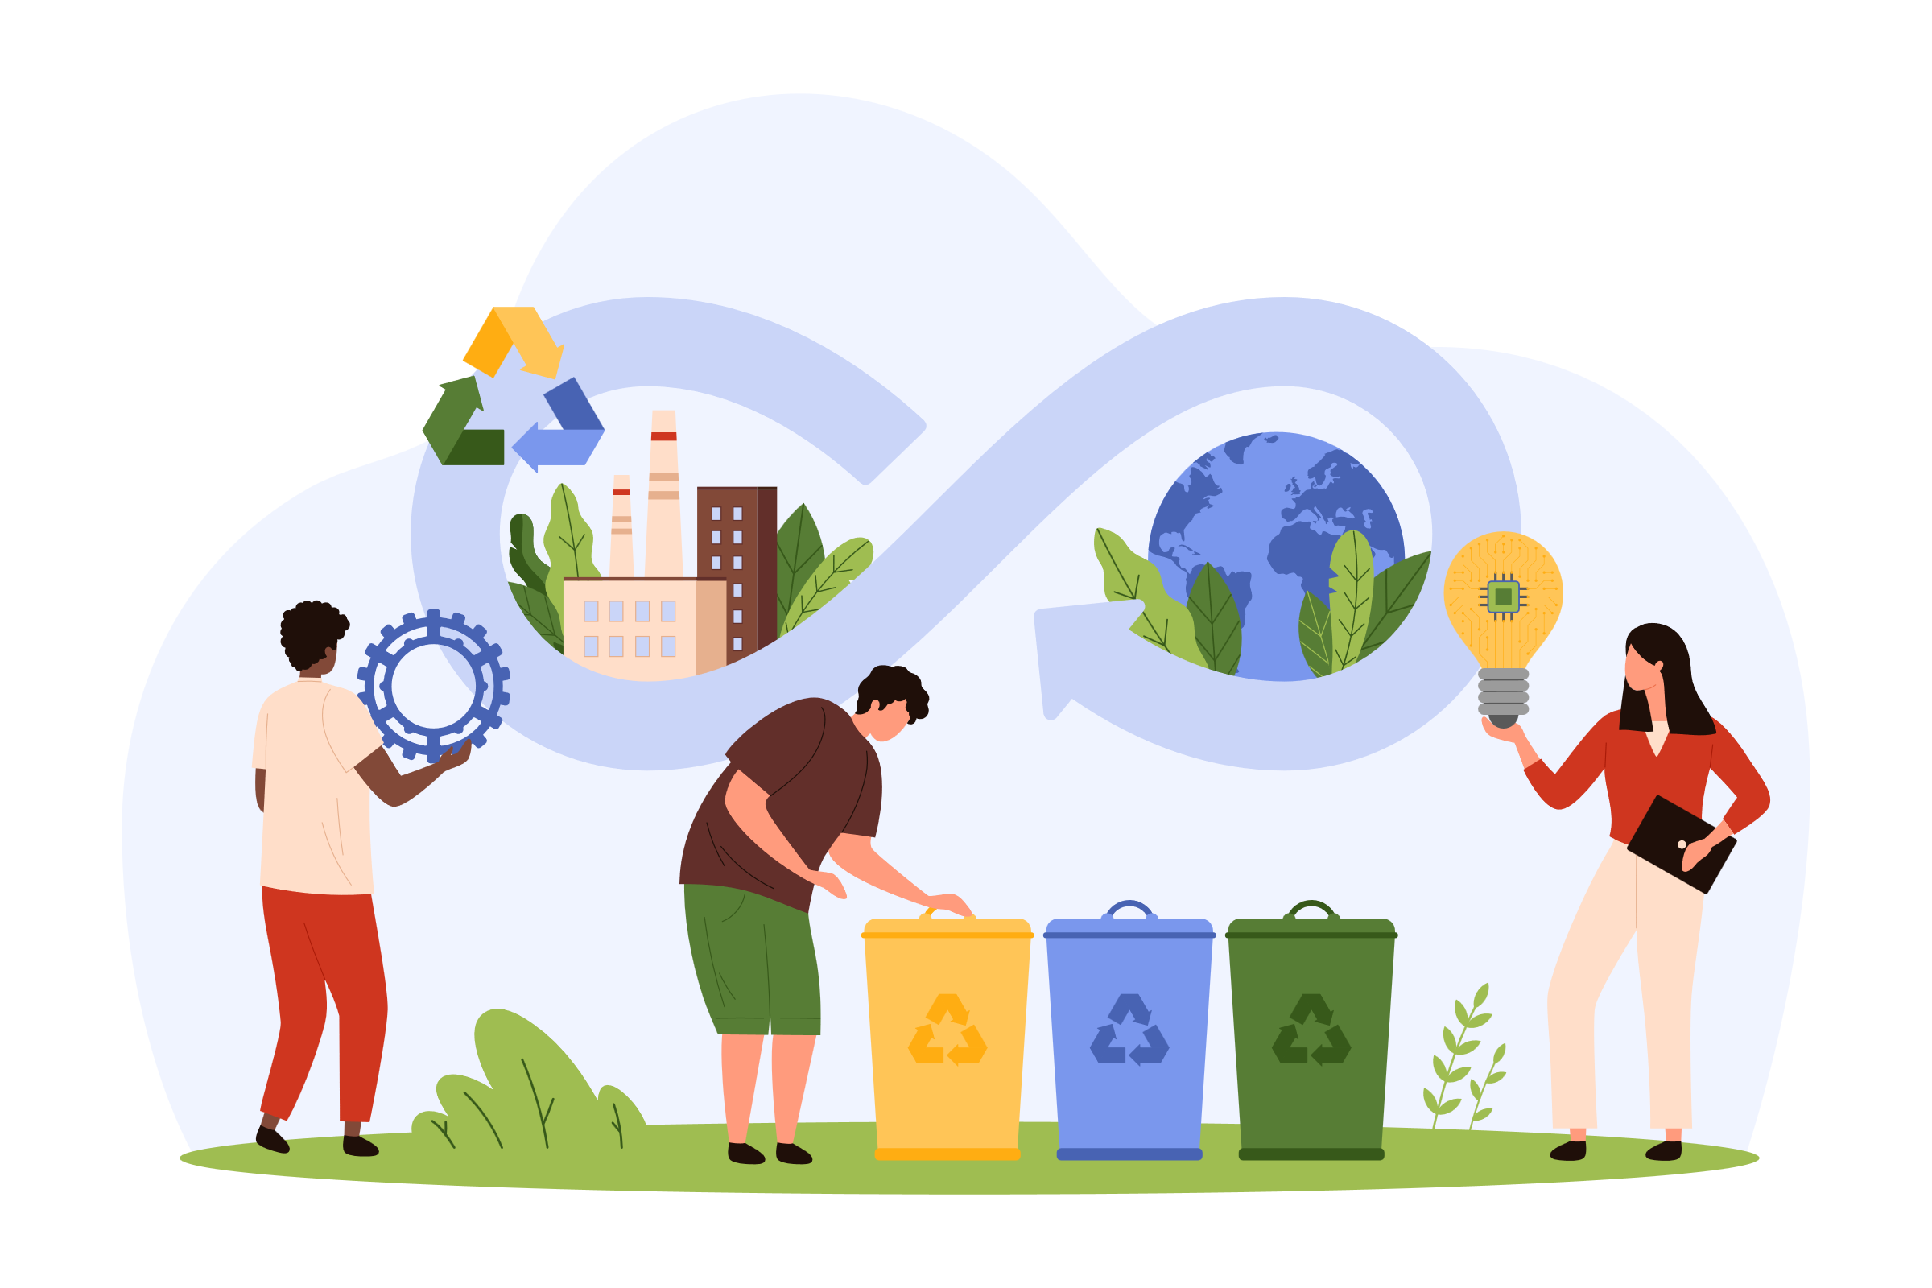




SUSTAINABLE WASTE SOLUTIONS: EVALUATING EFFICIENCY WITH WASTE MANAGEMENT INDEX
According to a report by TERI, India generates over
62 million tons (MT) of waste in a year. Only 43 MT of total waste generated gets collected, with 12 MT being treated before disposal, and the remaining 31 MT simply discarded in wasteyards.
The Waste Management Index (WMI) is a comprehensive metric to evaluate the effectiveness and efficiency of a city's waste management practices, based on key parameters such as waste generation, recycling, and processing rates.
The WMI aims to provide a holistic view of how well a city manages its waste, emphasizing sustainable practices and environmental impact reduction.
A cleaner environment resulting from effective waste management enhances the overall quality of life for residents.
Regular scoring allows cities to track their progress over time, facilitating continuous improvement in waste management practices.
Generation of waste
Collection
WMI helps cities track their progress towards achieving sustainability goals and international commitments
Waste Management Index
Processing of waste
Segregation
Highlighting areas for improvement encourages the adoption of innovative solutions and best practices.
Recycling of waste
Improved waste management practices lead to reduced pollution, enhancing air and water quality.
Source
Wireframe

Slide 5
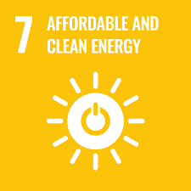


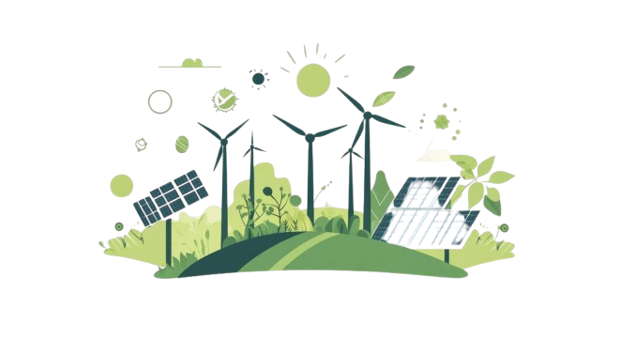
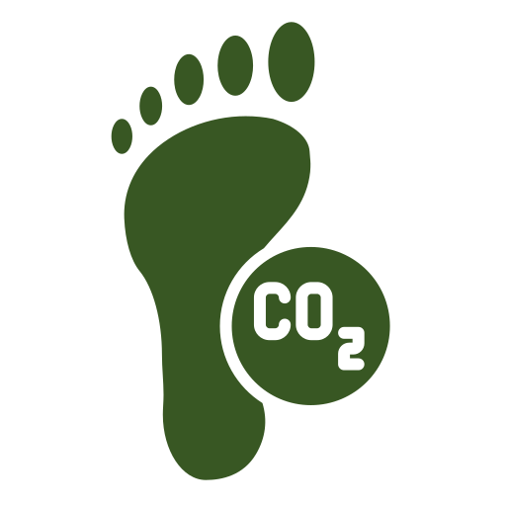

URBAN ENERGY REVOLUTION: STRATEGIC RENEWABLE ENERGY PLANNING
500 GW of Non-Fossil Fuel-Based Capacity by 2030: India aims to have 500 GW of installed capacity from renewable sources (solar, wind, biomass, and hydro) by 2030.
50% Energy from Renewable Sources by 2030: As part of its commitment at COP26, India plans to meet 50% of its energy demand from renewable energy sources by 2030.
Energy usage index (EUI) is a comprehensive metric developed to evaluate and quantify the energy consumption efficiency of a city.
It is typically expressed as the amount of energy consumed per unit area or per unit of output over a specified period, allowing for the comparison of energy performance across different timeframes.​
Boosts Energy Efficiency
Informs Policy Decisions
Total energy production and consumption
Renewable energy and Non- renewable energy proportion
Identifies and addresses inefficiencies to optimize energy consumption.
Guides data-driven strategies for energy-saving and renewable investments.
Energy Usage Percentage
Reduces Carbon Emissions
Promotes Sustainability
Energy Usage Index
Encourages efficient energy use and renewable adoption, lowering emissions.
Encourages the integration of sustainable practices in urban planning and development, fostering a greener city.
Source
Wireframe

Slide 6


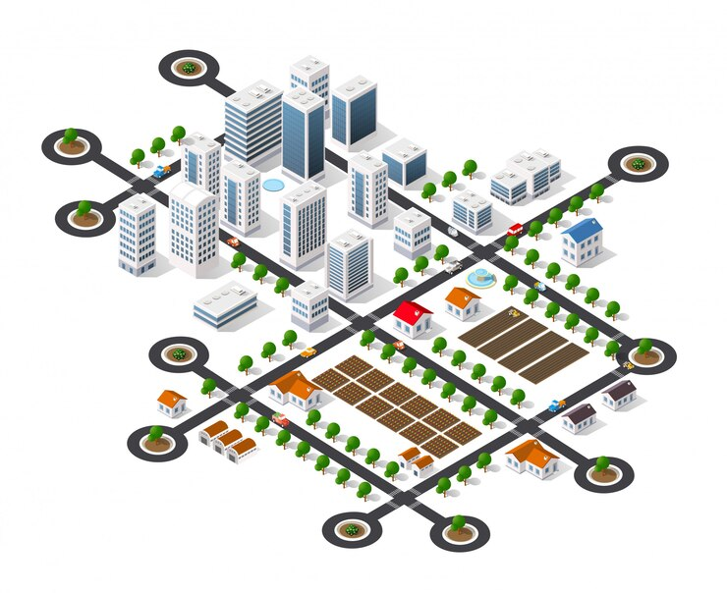


SUSTAINABLE LAND USE: BALANCING DEVELOPMENT AND CONSERVATION
​Urban areas in India cover approximately 3% of the total land area, but they are rapidly expanding.
The urban population is expected to grow from 34% in 2020 to 40% by 2031.​
The Land Usage Index (LUI) is a quantitative measure used to evaluate and analyze the distribution and intensity of land use of the city.
It assesses how different types of land are utilized and how they contribute to various aspects of land management, urban planning, and environmental sustainability.
Optimizing Land Allocation
Identifies mismatches between land allocation and usage for more efficient distribution. ​
Reducing Congestion
Helps balance development between overcrowded and underutilized areas
Residential
Transportation &
Communication
Public and
Semi-public
Land Usage Index
Commercial
Recreational
Sustainable Development
Promotes environmentally-friendly land use and resource efficiency.​
Enhancing Infrastructure
Guides infrastructure development to improve service delivery and quality of life.​
Industrial
Agriculture, Water Bodies & others
Source
Wireframe

Slide 7
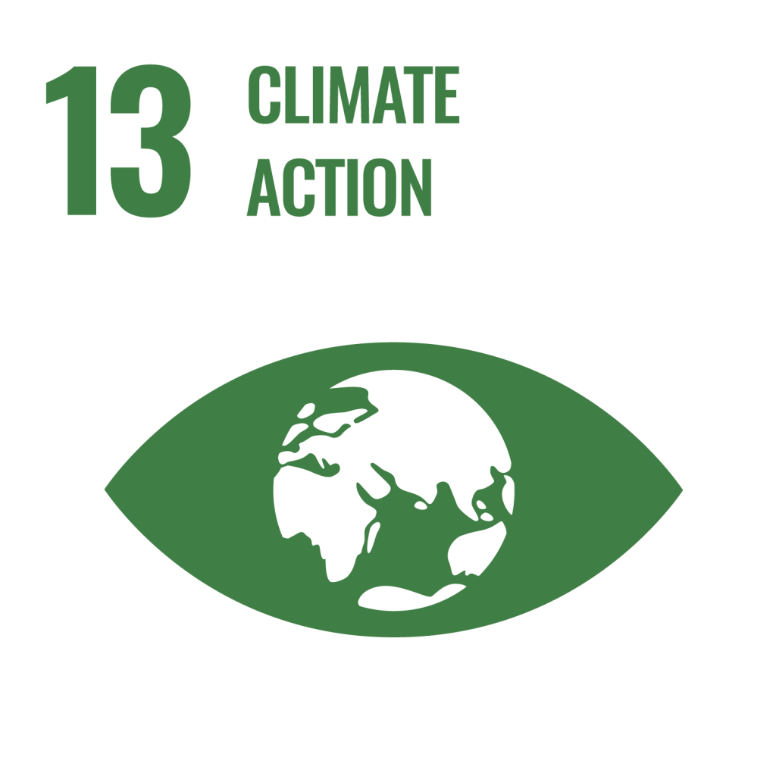




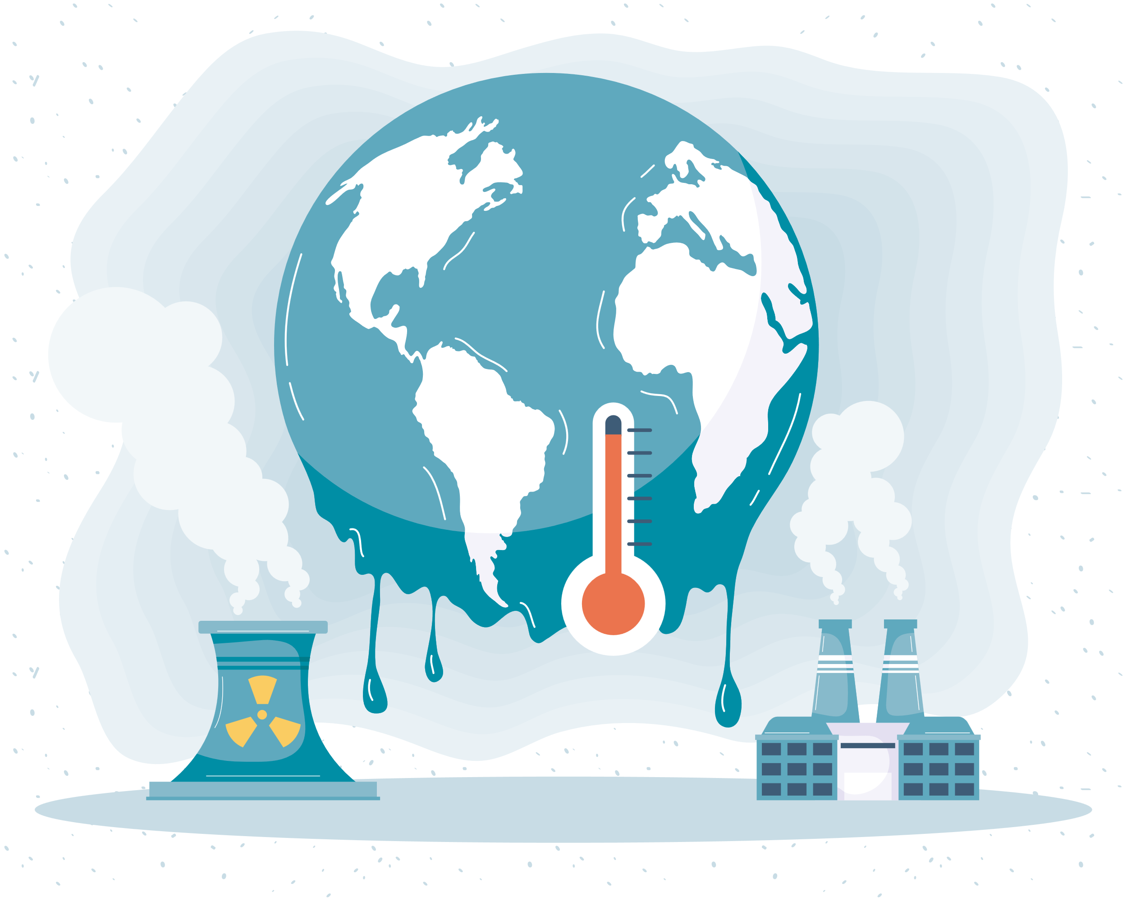




FROM AWARENESS TO ACTION: ADVANCING SUSTAINABILITY IN CLIMATE SOLUTIONS
Achieving Net Zero by 2070: India has committed to reaching net zero carbon emissions by 2070.
Aiming to achieve 500 GW of non-fossil fuel energy capacity by 2030.
India targets a 45% reduction in emissions intensity of its GDP by 2030.
The Emissions Management Index (EMI) is a metric designed to evaluate and monitor the effectiveness of practices and strategies in managing and reducing greenhouse gas (GHG) emissions.
It provides a comprehensive assessment of how well GHG emissions are controlled and managed, contributing to overall climate change mitigation efforts.​
Emissions
Temperature
Humidity
Rainfall
Comprehensive Emissions Monitoring: EMI offers detailed insights into GHG emissions, aiding targeted reduction strategies.
Progress Tracking: EMI enables cities to monitor emission reductions and benchmark their performance against similar regions.
GHG Emissions
Emissions
Management
Index
Past year
Progression over years
Present year
Holistic Climate Management: By integrating emissions with environmental factors (temperature, rainfall, humidity), it supports climate adaptation and management.
Informed Policy Decisions: EMI provides data-driven insights for effective decision-making, enhancing sustainability and resilience efforts.
Source
Wireframe

