Slide 1
Web Application Development 2
Group Project Design Specification: Group 7A

Slide 2
Group 7A: Overview – Find my Lecture
The objective of this Web Application is to help students find exact instances of a concept being referred to in recorded lectures, reading materials and slides provided for various modules.
Users will be able to perform keyword searches and get filtered results based on week number/professor name/module name
Users will also be able to create an account to highlight/star these instances and save it to their profile.
Professors will be able to upload study materials for the students to save/highlight

Slide 3

This is Hamish
USER PERSONA 1
He is a 20-year-old international student from Oman studying CS. Being a first gen university student, Hamish works hard to fund his education by working multiple part time jobs. As a result, he’s unable to spend the time catching up on every single lecture before live lectures. He prefers self studying using other materials but would love the option of reviewing recorded lectures if he finds something difficult/wants more insight into the professor’s approach about it. Not having to spend time watching videos but having the option to study efficiently using transcripts is something Hamish believes will improve his studies!

Slide 4
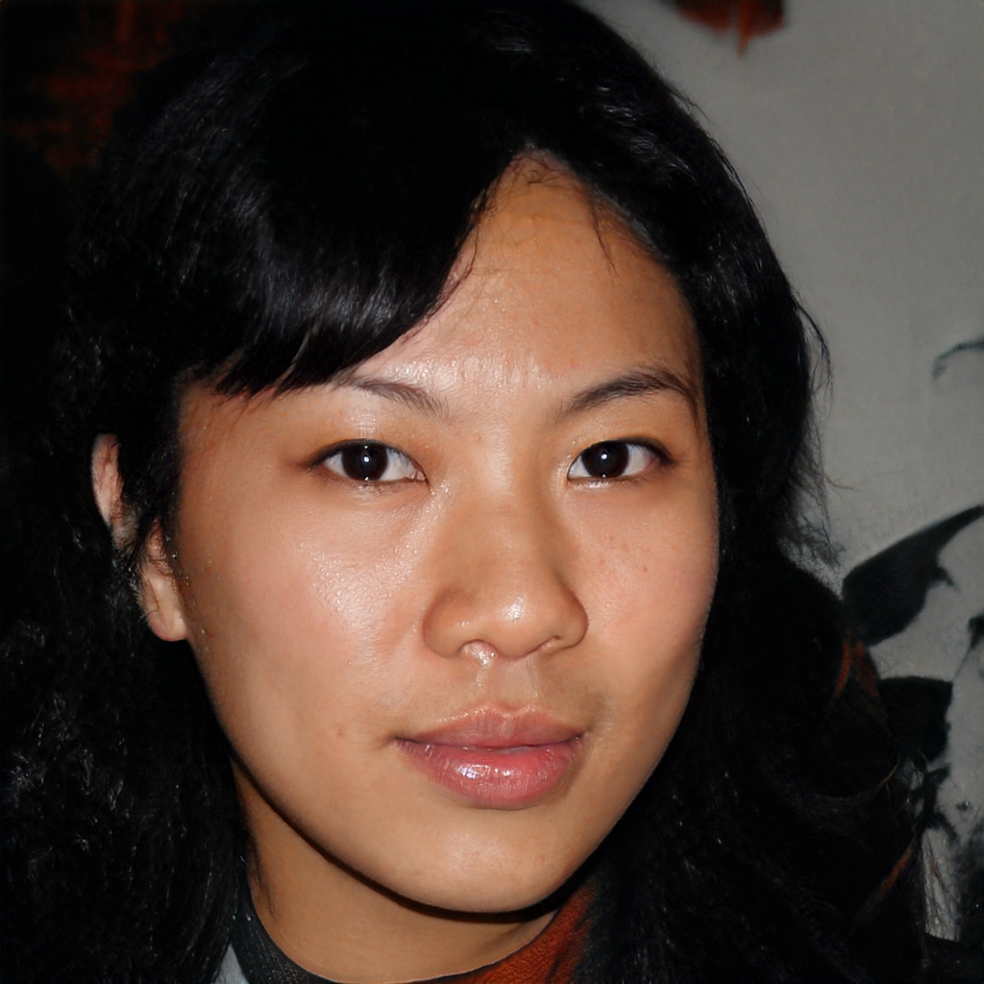
This is Mirabelle
USER PERSONA 2
She is a mature PHD Student who also works full time and has a family. Full time employment and familial commitments means that she can only focus on her PHD in curated free time. Since time is so precious for Mirabelle, Find my lecture will allow her to refer to material relevant to her focus of work for the day through keywords. Simply looking at instances of certain concepts being referred to would allow her to focus on being more efficient with her work.

Slide 5
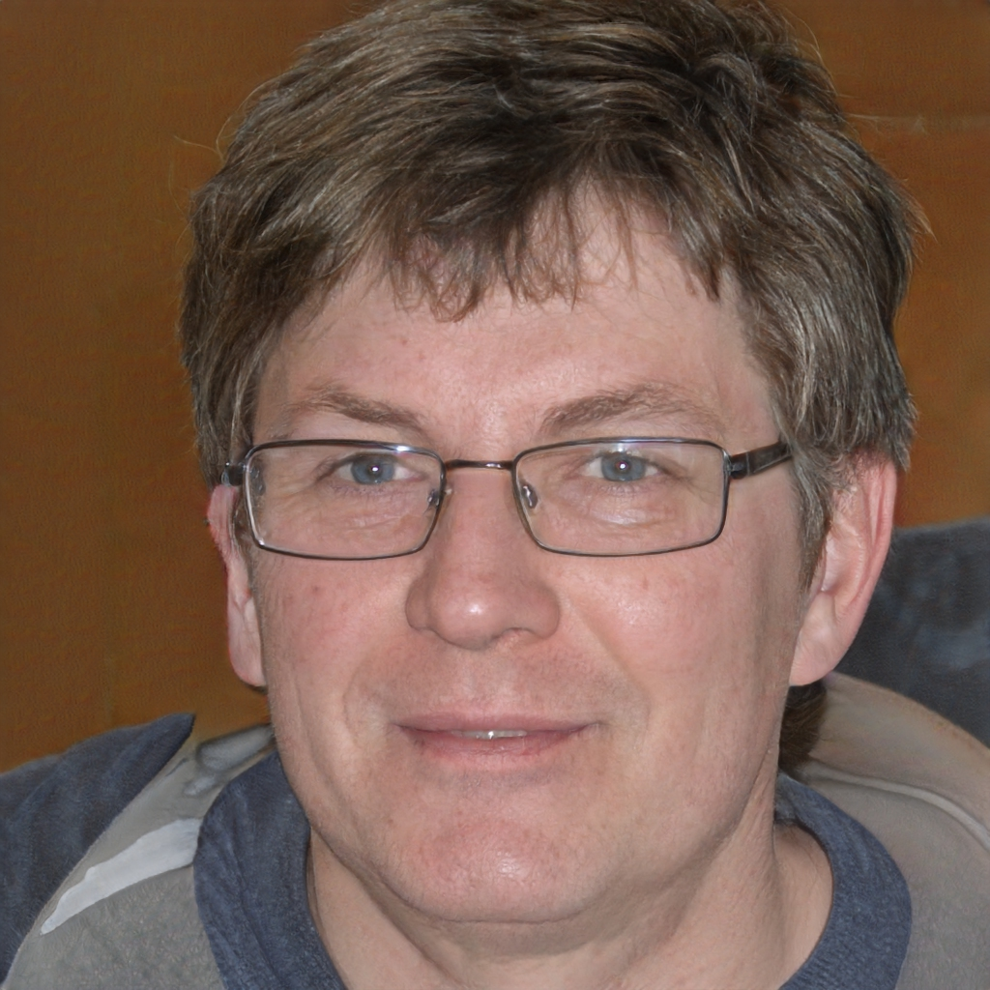
This is David
USER PERSONA 3
He is a professor with 12 years of working experience. He teaches a variety of students, everyone with their preferred method of learning. David really loves his students and would love to contribute in making studying an enjoyable process for every student. In addition to uploading study materials on students’ educational portal, he’d love to cater to this group of students for their convenience.

Slide 6
The Specification
The user is able to create/delete their account
The user is able to log in/out of their account
Professors with accounts and site admins can upload content (pdfs and links for lectures)
Students can view and filter the content uploaded
Students with accounts can save content and have their own instance to highlight
Students with accounts can view all saved content on their account page
Professors with accounts can view all uploaded content
User will be able to navigate through all pages that aren’t login restricted on all pages

Slide 7
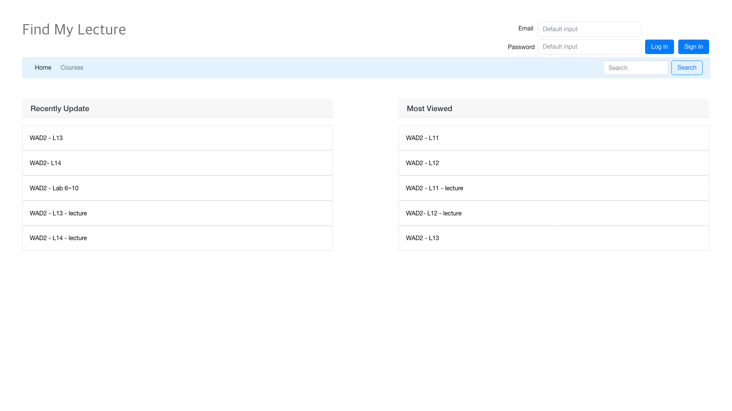
Wireframe – Index (Home)

Slide 8
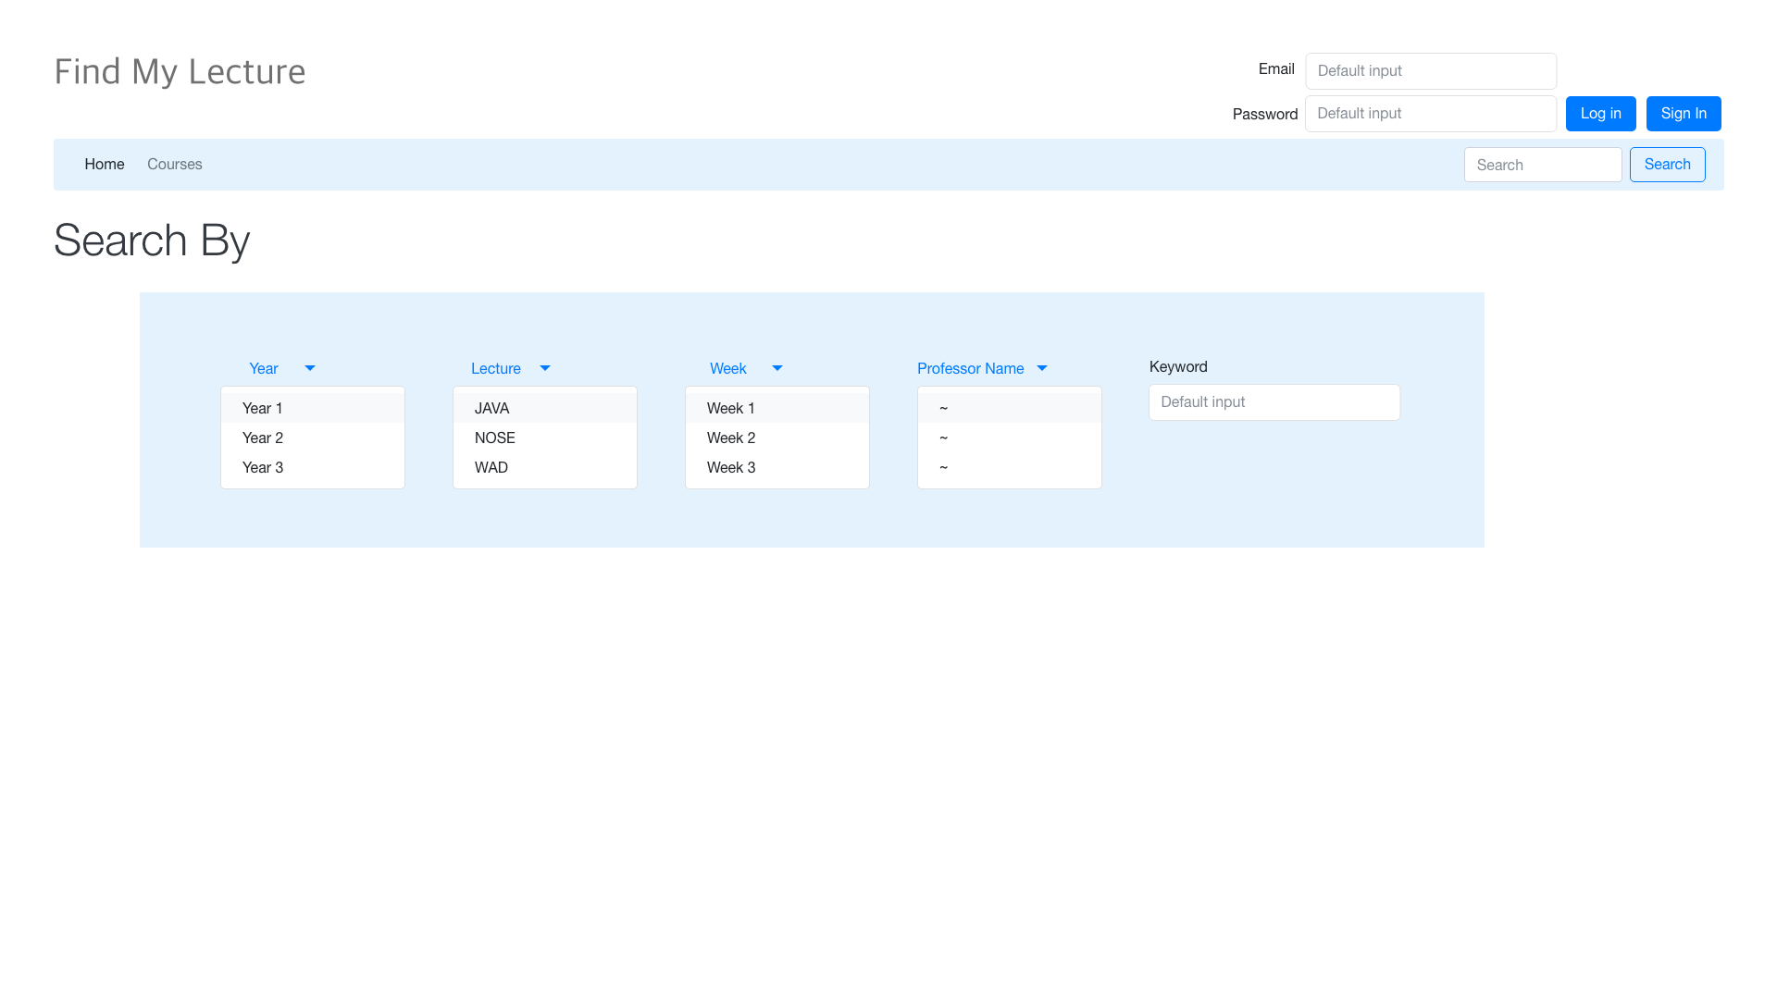
Wireframe – Search

Slide 9
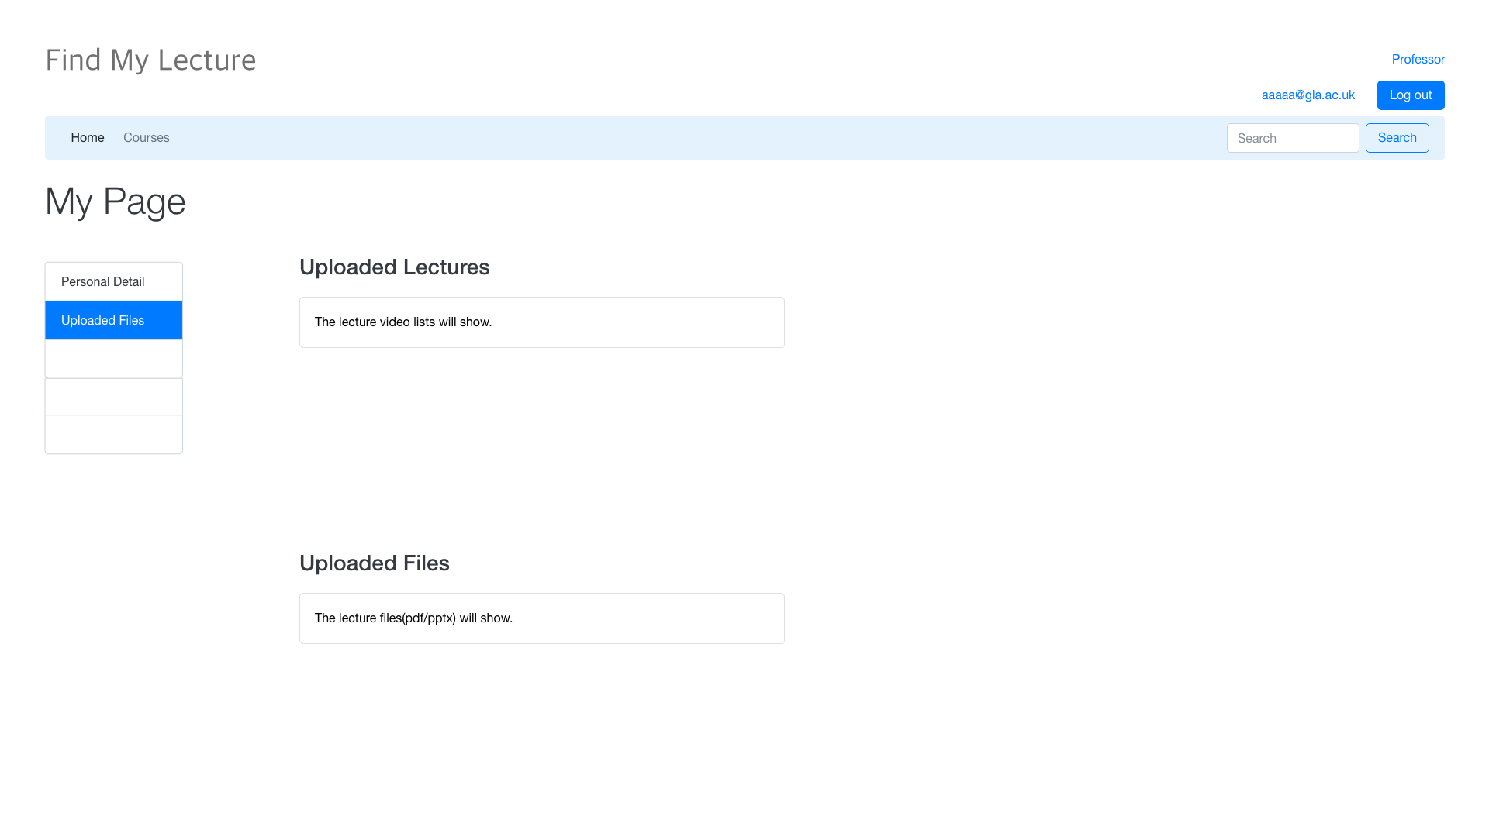
Wireframe – My Page (Professor)

Slide 10

Wireframe – My Page (Student)

Slide 11
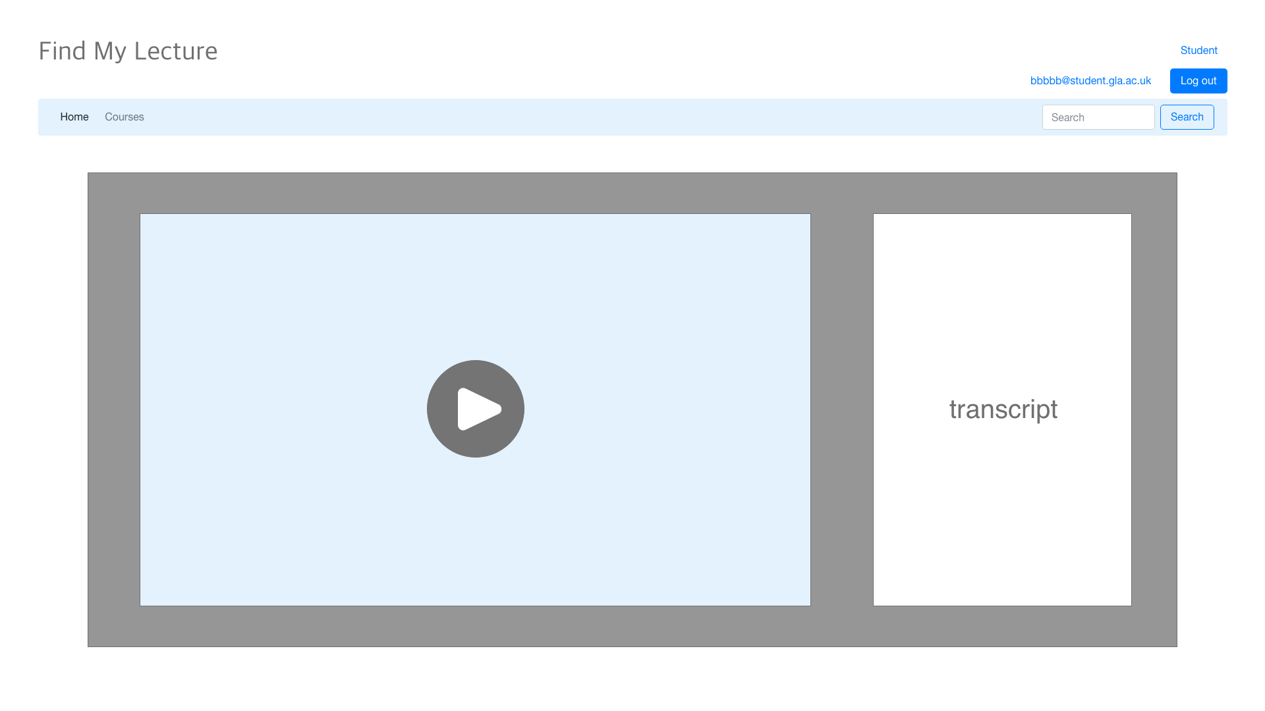
Wireframe – Lecture (Video)

Slide 12
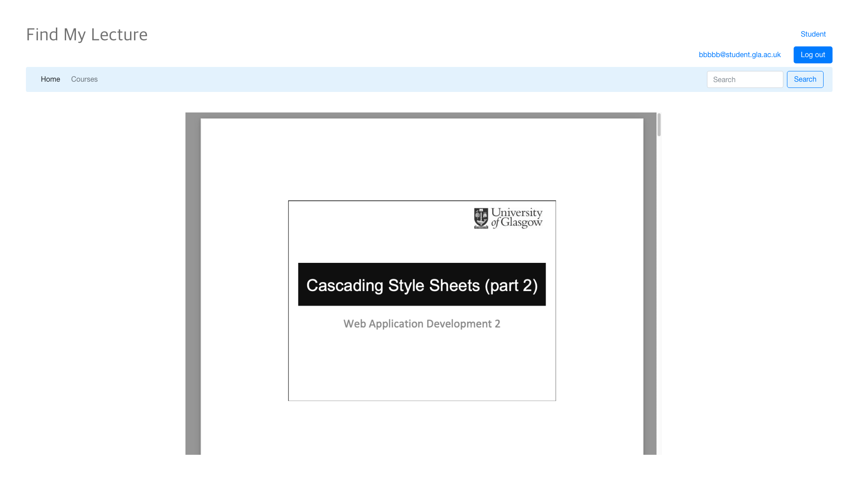
Wireframe – Lecture (PDF)

Slide 13
System Architecture
Moodle/Google
Search API
Search Query
Result
If not cached, retrieve
Request
URL
Client
Middleware
Response
Web Pages
If cached, retrieve
SQL Query
Data
Database
User

Slide 14
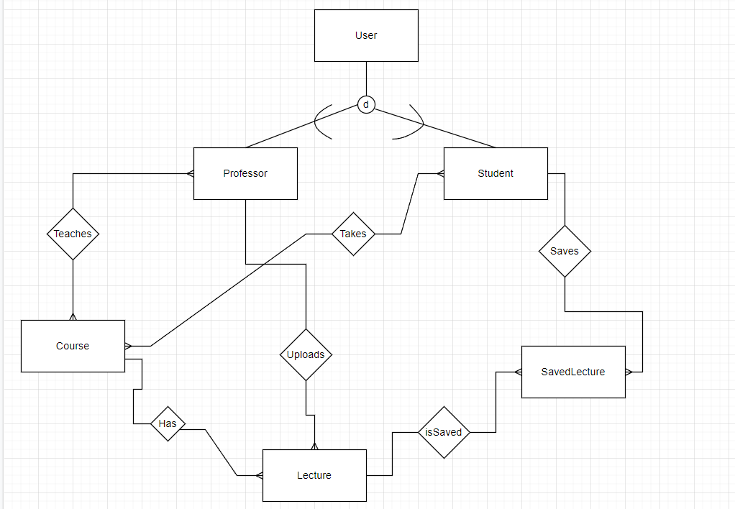
ER Diagram (Compressed Chen Notation)

Slide 15
ER Diagram (Expansion)
User
Course
Field | Type
user_ID | IntegerField
First_name | CharField(30)
Last_name | CharField(150)
Email | CharField(200)
Field | Type
Course_ID | IntegerField
courseName | CharField(50)
Professor
Lecture
Field | Type
professor_ID* | IntegerField
Field | Type
Lecture_ID | IntegerField
videoURL | CharField(150)
slideShowURL | CharField(150)
Course_ID* | IntegerField
Professor_ID* | IntegerField, can be null if this lecture was pulled from Moodle (not uploaded manually)
Student
Field | Type
student_ID* | IntegerField
SavedLecture
Field | Type
Lecture_ID | IntegerField
User_ID* | IntegerField

Slide 16
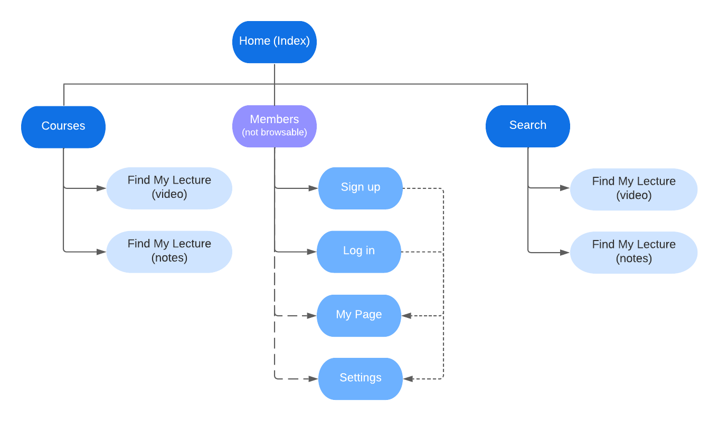
Site Map

Slide 17
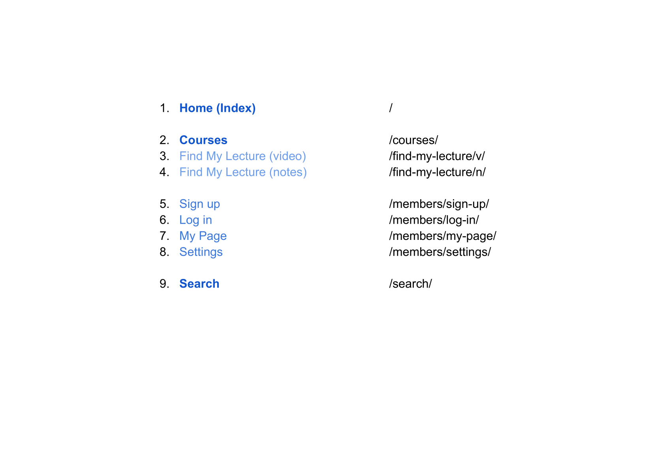
Site URLs

