Slide 1
Gluon NLP

Slide 2
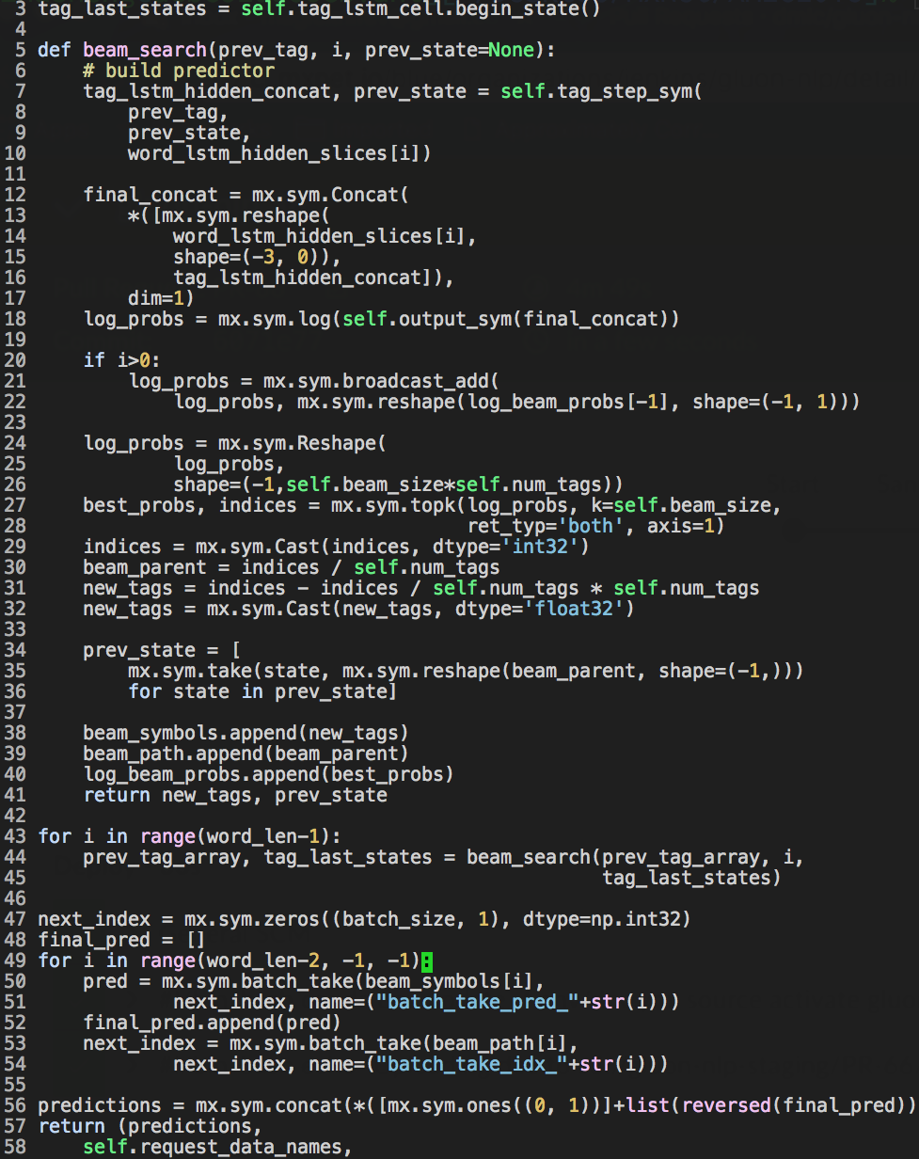
Common myth1
I will write clean and reusable code when I’m prototyping this time.
Variant:
- I will write clean and reusable code next time.
hard-coded score func?
func & script?
Notes:
share common myths among myself and my colleagues
last year keyphrase extraction
no need to read
a weird combination of function and script that does the job
cannot customize score function
later project cannot reuse, end up 3 copies

Slide 3
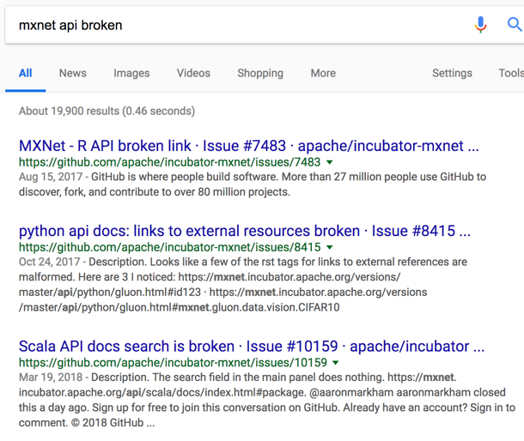
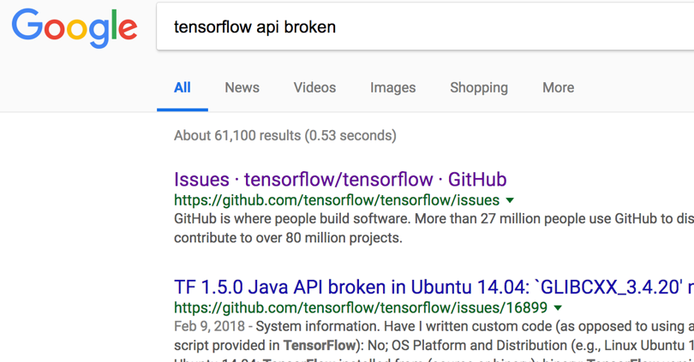
Common myth2
My code will still run next year.
Sometimes, it’s not our fault.

Slide 4
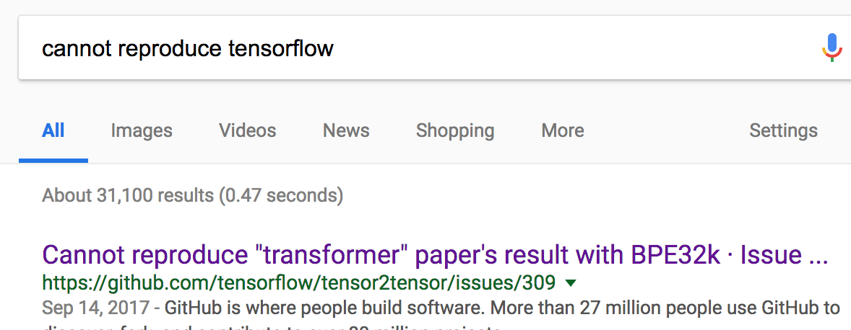
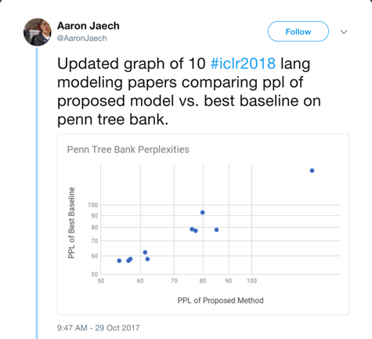
Common myth3
I will finish setting up the baseline model this afternoon.
Again, it may not be our fault.
Notes:
so many toolkits and examples out there, how hard?
REALLY started looking, you find
utterly confusing situation in research

Slide 5
GluonNLP Goals

Slide 6
GluonNLP Goals
Problem 1: prototype code is not reusable without copying.
Solution 1: carefully designed API for versatile needs.
Problem 2: code may break due to API changes.
Solution 2: integrated testing for examples.
Problem 3: setting up baseline for NLP tasks is hard.
Solution 3: implementation for state-of-the-art models.

Slide 7
GluonNLP Goals
Designed for engineers and researchers
Enable fast prototyping for NLP application and research

Slide 8
Features

Slide 9
Pre-trained Embedding Evaluation
Intrinsic evaluation:
Similarity
Analogy (Syntactic, Semantic)

Slide 10
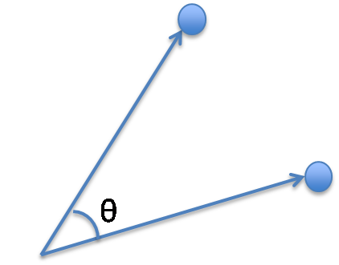
Similarity

Slide 11
Analogy
Syntactic: Went - Go = Thought - Think

Slide 12
Analogy
Semantic: Woman - Man = Queen - King

Slide 13
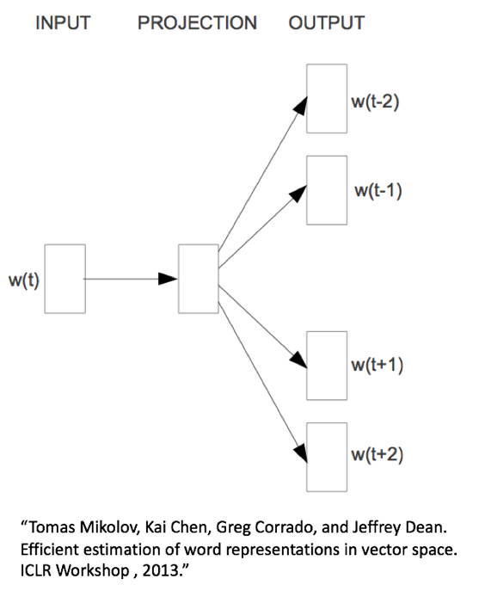
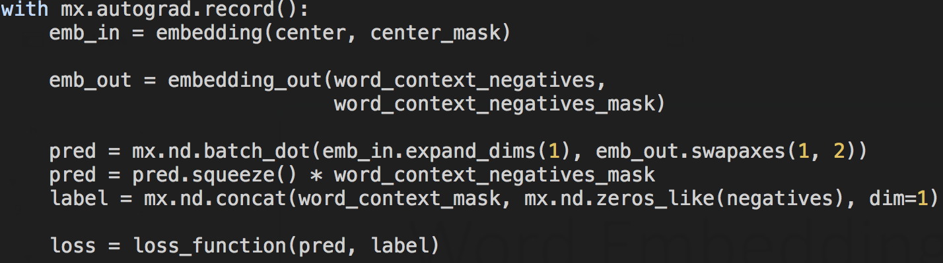
Word Embedding Training
Skip-gram
Given a center word, predict surrounding words

Slide 14
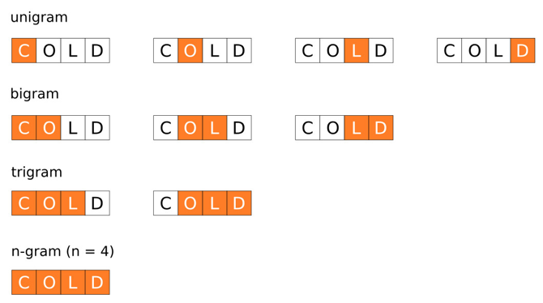
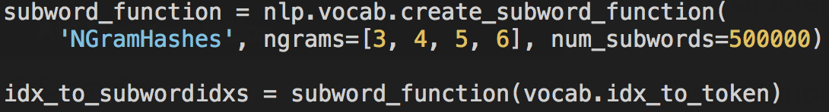
Word Embedding Training
FastText
(Unknown) word:
the sum of char-n-gram.

Slide 15
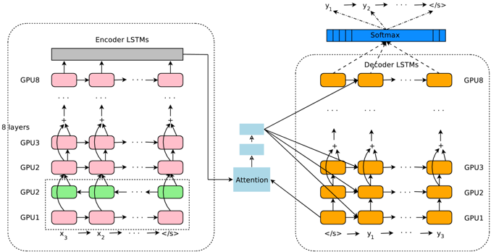
Google Neural Machine Translation
http://gluon-nlp.mxnet.io/master/scripts/index.html#machine-translation
Our implementation:
BLEU 26.22 on IWSLT2015, 10 epochs, Beam Size=10
Tensorflow/nmt:
BLEU 26.10 on IWSLT2015, Beam Size=10
Encoder: Bidireciontal LSTM + LSTM + Residual
Decoder: LSTM + Residual + MLP Attention

Slide 16
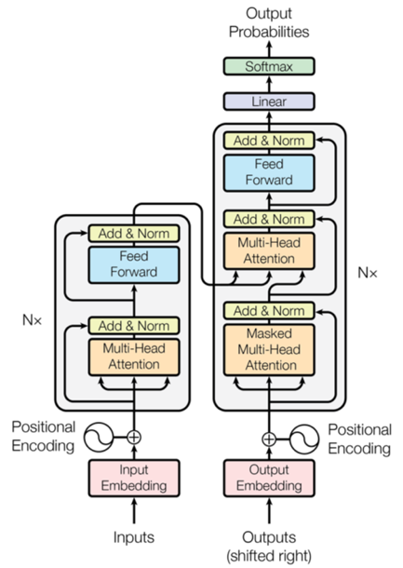
Transformer
http://gluon-nlp.mxnet.io/master/scripts/index.html#machine-translation
Our implementation:
BLEU 26.81 on WMT2014en_de, 40 epochs
Tensorflow/t2t:
BLEU 26.55 on WMT2014en_de

Slide 17
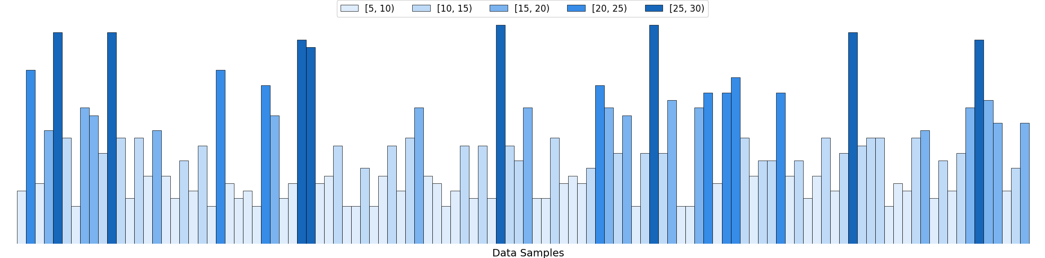
Bucketing
How to generate the mini-batches?

Slide 18
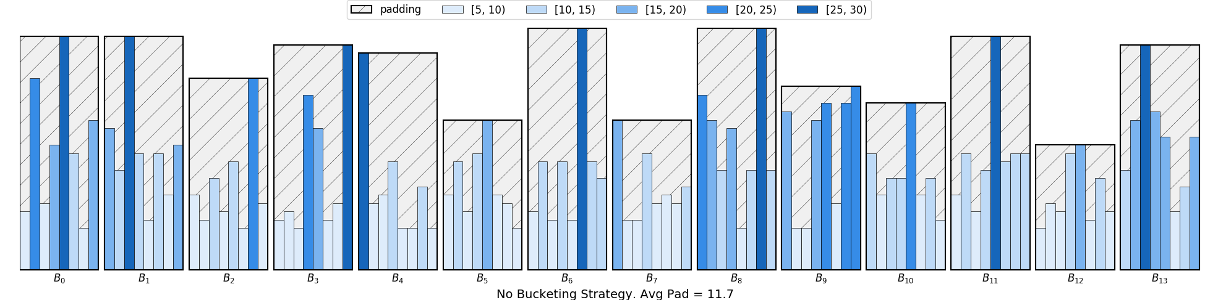
No Bucketing + Directly Pad the Samples
Average Padding = 11.7
Be Frugal! Use Bucketing.

Slide 19
Two Bucketing Strategies
Sorted Bucketing Strategy
Fixed Bucketing Strategy
GluonNLP is the first package that supports both strategies.

Slide 20
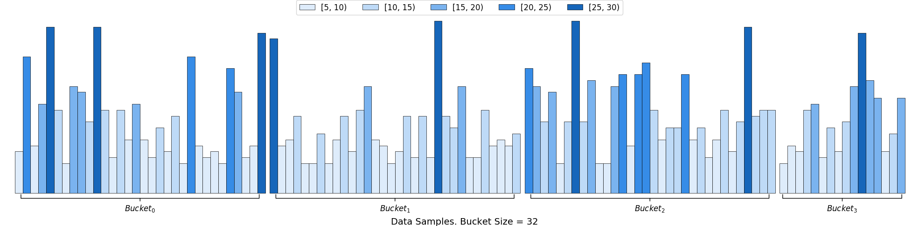
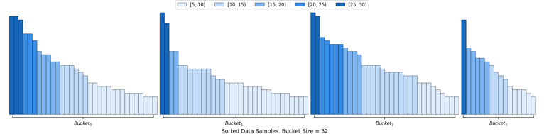
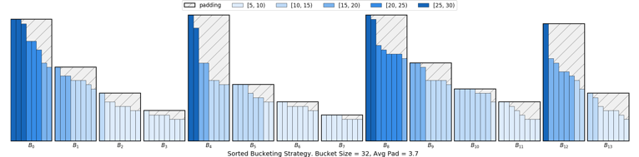
Sorted Bucketing
Average Padding = 3.7

Slide 21
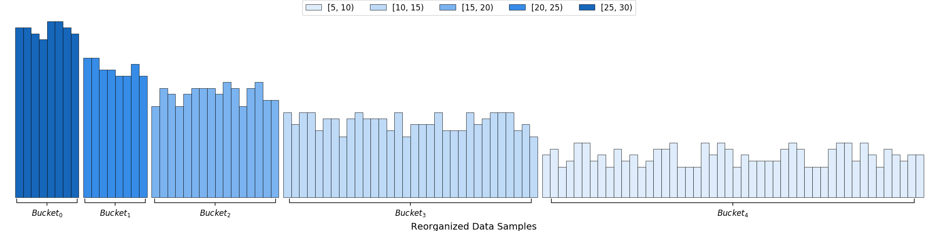

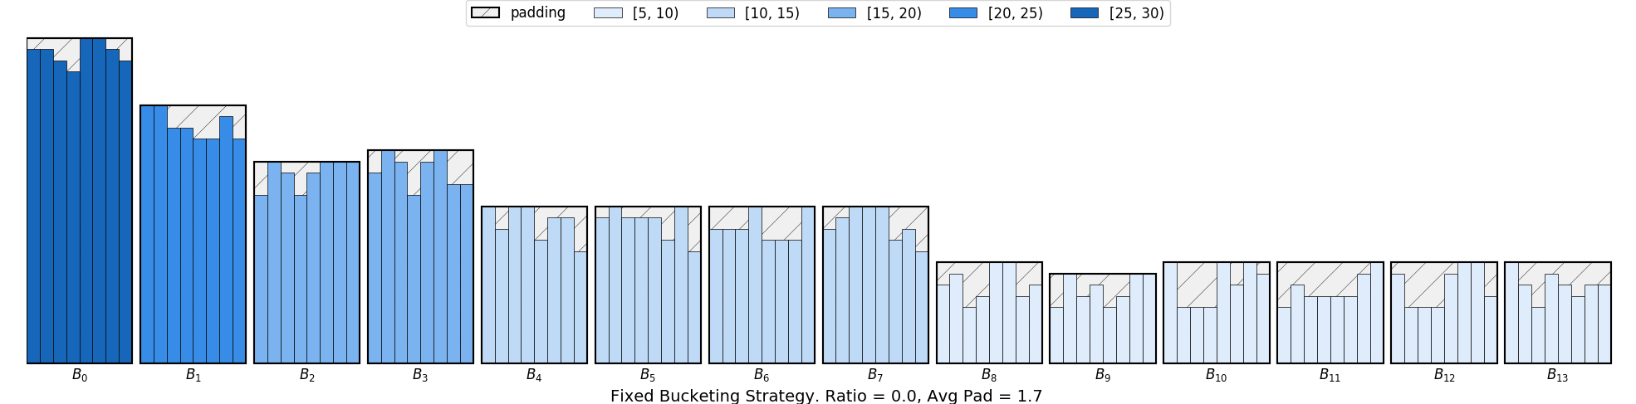
Fixed Bucketing
Average Padding = 1.7
Shorter sequences can have larger batch sizes.

Slide 22
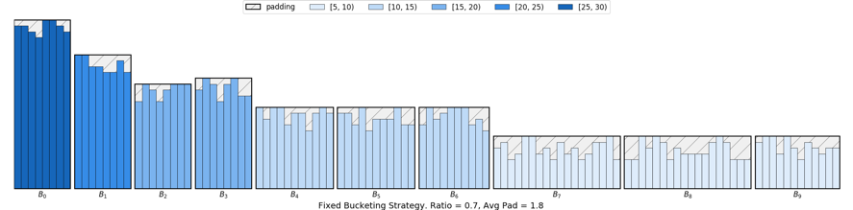

Fixed Bucketing
Average Padding = 1.8
Better throughput! ✌️
Length of the buckets
ratio

Slide 23
Features
Dataset
Many public datasets.
Streaming for very large datasets.
Text data processing
Vocabulary
Tokenization
Bucketing
Modeling
Attention
Beam Search
Weight Drop
State-of-the-art models
Pre-trained Word Embeddings
Embedding training and evaluation
Examples friendly to users that are new to the task
Reproducible training scripts

Slide 24
gluon-nlp.mxnet.io

Slide 25
