Slide 1
Multivariate Time Series
Cyrus Vahid - Principal Architect – AWS Deep Learning
Amazon Web Services

Slide 2
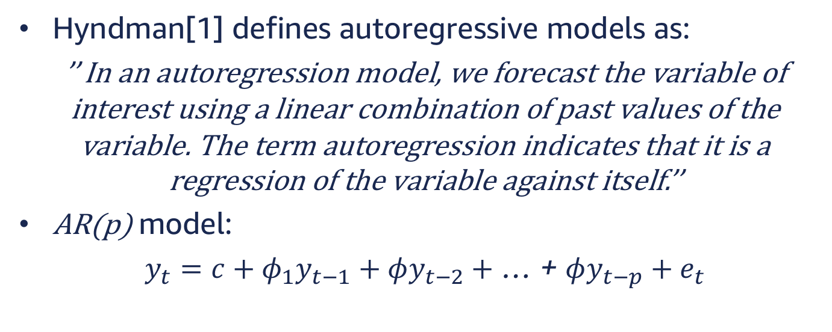
Autoregressive Models
Hyndman[1] defines autoregressive models as:
’’ In an autoregression model, we forecast the variable of interest using a linear combination of past values of the variable. The term autoregression indicates that it is a regression of the variable against itself.’’
AR(p) model:
$y_{t}=c+φ_{1}y_{t−1}+φy_{t−2}+$ … + $φy_{t−p}+e_{t}$

Slide 3



Auto Regressive Models
Autoregressive models are remarkably flexible at handling a wide range of different time series patterns.
$$y_{t}=18−0.8y_{t−1}+e_{t}$$
$$y_{t}=8+1.3y_{t}−1 −0.7 y_{t−2 }−2+e_{t}$$
$$ref:Hyndman [1]$$

Slide 4
Challenges faced by existing models
Most methods are designed to forecasting individual series or small groups. New set of problems have emerged:
Forecasting a large number of individual or grouped time series.
Trying to learn a global model facing the difficulty of dealing with scale of different time-series that would otherwise be related.
Many older models cannot account for environmental inputs.
Cold start problem for new items to be included in the forecast.

Slide 5
Goal
Ability to learn and generalized from similar series provides us with the ability to learn more complex models without overfitting.

Slide 6
DeepAR

Slide 7
Solution
DeepAR is a forecasting model based on autoregressive RNNs, which learns a global model from historical data of all time series in all datasets.[2]

Slide 8
DeepAR Advantages
Minimal manual feature engineering
Ability to provide forecast for series with little or no history.
Ability to incorporate a wide range of likelihood models.
Provides consistent estimates for subgroups.

Slide 9
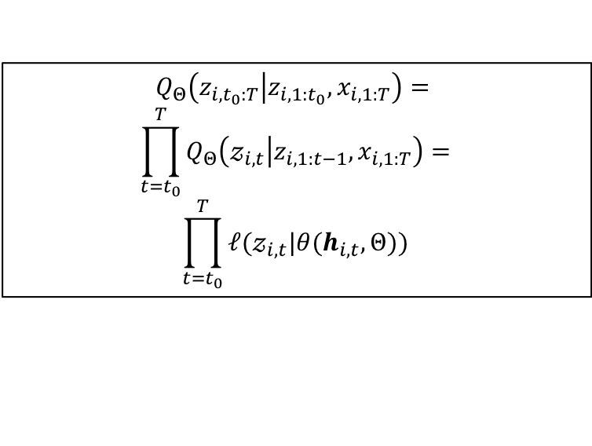

DeepAR Model
Goal: Given observed values of a series $i$ for $t$ time-steps, estimating probability distribution of next $T$ steps; more formally, modeling the below conditional distribution is the goal: $P\left(z_{i,t_{0}:T} | z_{i,{1:t}_{0}}, x_{i, 1:T}\right)$
Parameterized by output of an AR RNN.
$$Q_{Θ}\left(z_{i,t_{0}:T} | z_{i,{1:t}_{0}}, x_{i, 1:T}\right)=$$
$$\prod_{t=t_{0}}^{T}{Q_{Θ}\left(𝓏_{i,t} | z_{i,1:t−1}, x_{i,1:T}\right)=}$$
$$\prod_{t=t_{0}}^{T}{ℓ(𝓏_{i,t}|θ(h_{i,t}, Θ))}$$
$$h_{i,t}=h(h_{i,t−1},𝓏_{i,t−1},x_{i,t},Θ)$$

Slide 10
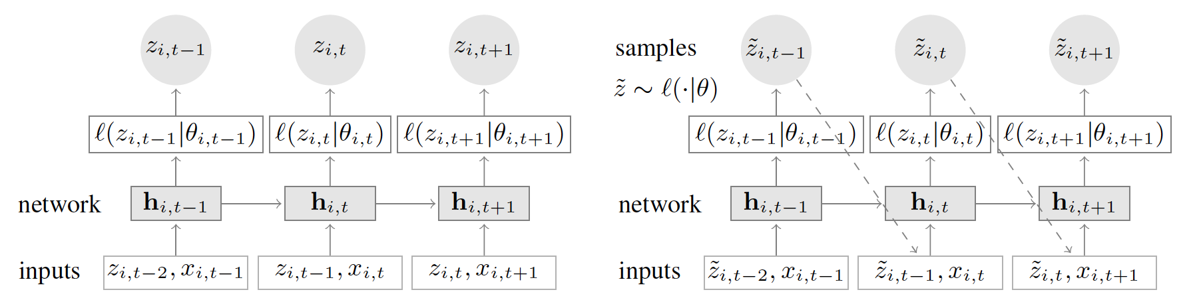
DeepAR Architecture
DeepAR is an encoder decode architecture, taking a number of input steps, output from encoder, and covariates, and predicts for the number of steps indicated as horizon.

Slide 11

Likelihood Model – Gaussian
Gaussian likelihood for real-valued Data
$$ℓ_{G}\left(𝓏 | μ,σ\right)={\left(2πσ^{2}\right)}^{−\frac{1}{2}}e^{\left(−\frac{{\left(𝓏−μ\right)}^{2}}{2σ^{2}}\right)}$$
$$μ\left(h_{i,t}\right)=w_{μ}^{T}h_{i,t}+b_{μ}$$
$$σ\left(h_{i,t}\right)=\log\left(1+e^{\left(w_{μ}^{T}h_{i,t}+b_{σ}\right)}\right)$$
Network output
Softplus activation

Slide 12
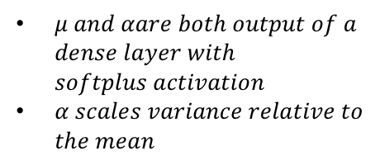

Likelihood Model – Negative Bionomial
Negative-binomial likelihood for positive count data. The Negative Binomial distribution is the distribution that underlies the stochasticity in over-dispersed count data.[3]
$$ℓ_{NB}\left(𝓏 | μ,α\right)=\frac{Γ\left(𝓏+\frac{1}{α}\right)}{Γ\left(𝓏+1\right)Γ\left(\frac{1}{α}\right)}{\left(\frac{1}{1+αμ}\right)}^{\frac{1}{α}}{\left(\frac{αμ}{1+αμ}\right)}^{𝓏}$$
$$μ\left(h_{i,t}\right)=\log\left(1+e^{\left(w_{μ}^{T}h_{i,t}+b_{μ}\right)}\right)$$
$$α\left(h_{i,t}\right)=\log\left(1+e^{\left(w_{α}^{T}h_{i,t}+b_{α}\right)}\right)$$
$μ and αare both output of a$ $dense layer with$ $softplus activation$
$α scales variance relative to$ $the mean$

Slide 13
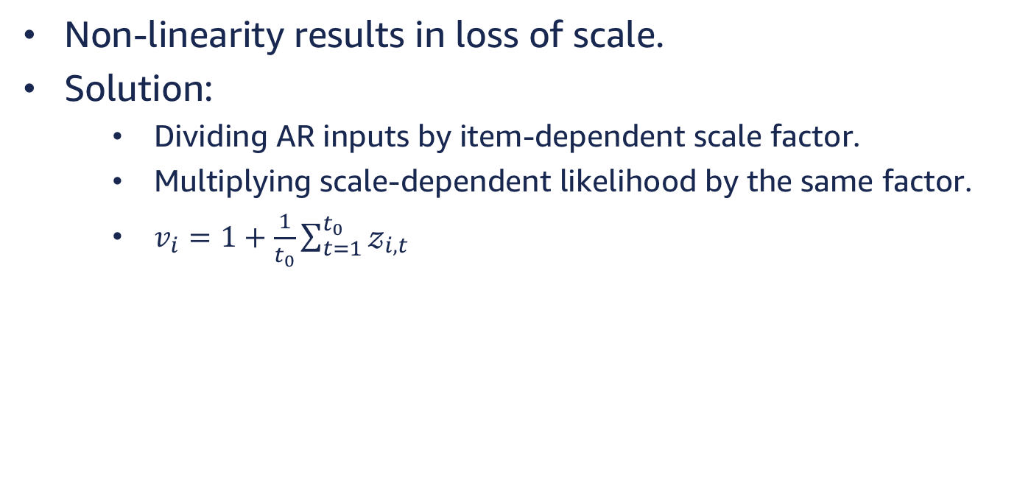
Scaling
Non-linearity results in loss of scale.
Solution:
Dividing AR inputs by item-dependent scale factor.
Multiplying scale-dependent likelihood by the same factor.
$v_{i}=1+\frac{1}{t_{0}}\sum_{t=1}^{t_{0}}{𝓏_{i,t}}$

Slide 14
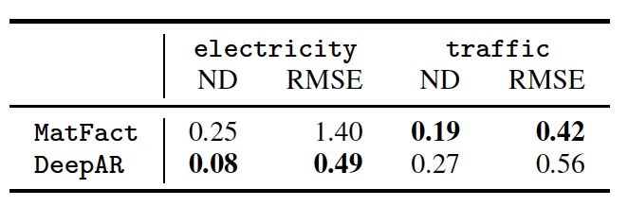
Comparison

Slide 15
LSTNet

Slide 16
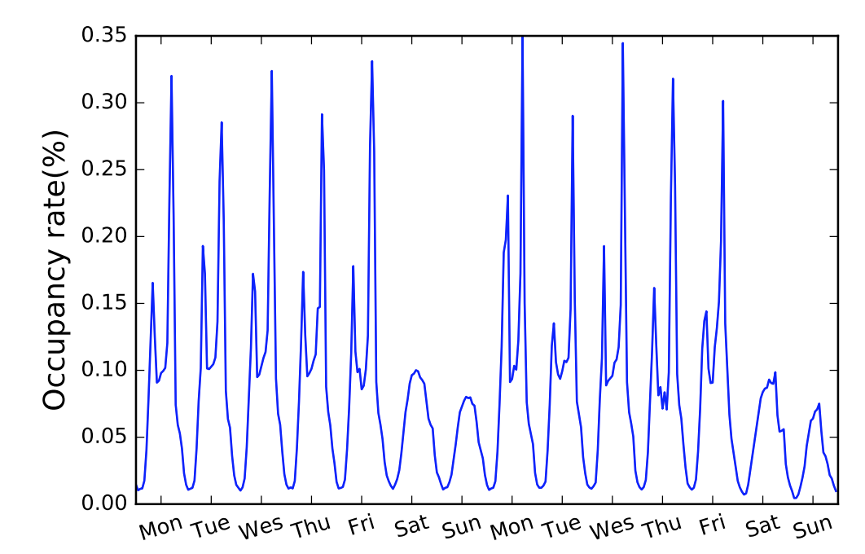
Challenge
Autoregressive models may fail to capture mixture of long and short term patterns.
``````````````
````````

Slide 17
Solution – LSTNet[4]
Long and Short Terms Time-series Networks is designed to capture mix long- and short-term patterns in data for multivariate time-series.

Slide 18
Concept
Using CNN to discover local dependencies
RNNs to capture long-term dependencies
Autoregressive model to handle scale.

Slide 19
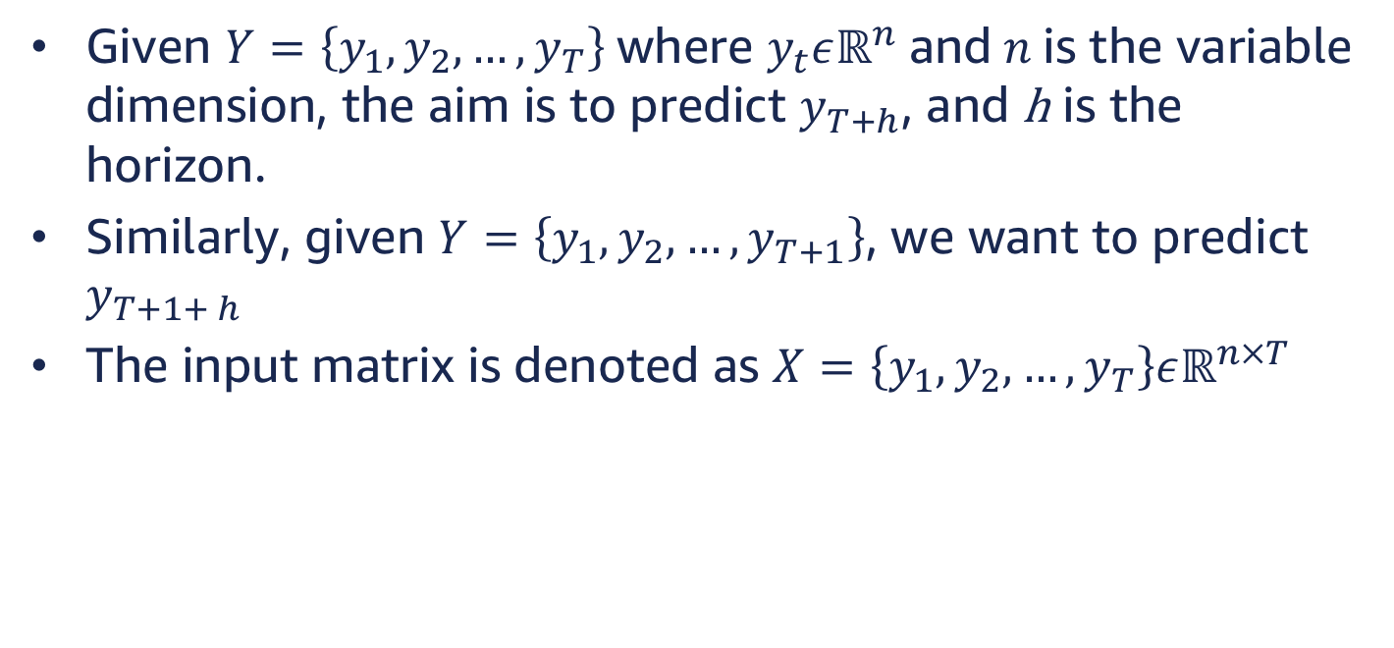
Problem Formulation
Given $Y=\left\{y_{1}, y_{2},…, y_{T}\right\}$where $y_{t}εℝ^{n}$ and $n$ is the variable dimension, the aim is to predict $y_{T+h}$, and h is the horizon.
Similarly, given $Y=\left\{y_{1}, y_{2},…, y_{T+1}\right\}$, we want to predict $y_{T+1+ h}$
The input matrix is denoted as $X=\left\{y_{1}, y_{2},…, y_{T}\right\}εℝ^{n×T}$

Slide 20
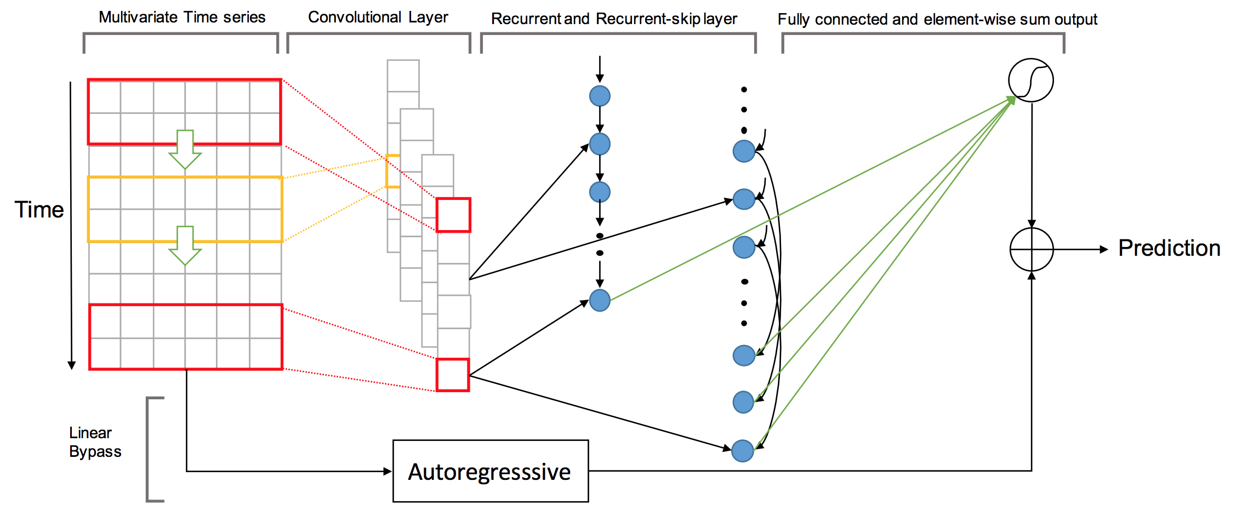
Architecture

Slide 21

Convolutional Component
Extract short-term patterns in the time dimension as well as local dependencies between variables.
Multiple filters of width $ω$ and height $n=num_var$
$h_{k}=RELU(W_{k}∗X+b_{k})$

Slide 22
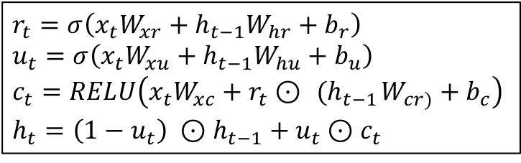
Recurrent Component
The output of the Conv layer is simultaneously fed to Recurrent and Recurrent-skip layers (next slide).
RNN component is GRU layer with RELU activation.*
$$r_{t}=σ\left(x_{t}W_{xr}+h_{t−1}W_{hr}+b_{r}\right)$$
$$u_{t}=σ\left(x_{t}W_{xu}+h_{t−1}W_{hu}+b_{u}\right)$$
$$c_{t}=RELU\left(x_{t}W_{xc}+r_{t}⊙{ (h}_{t−1}W_{cr)}+b_{c}\right)$$
$$h_{t}=\left(1−u_{t}\right) ⊙h_{t−1}+u_{t}⊙c_{t}$$
* The implementation of the paper is using tanh, but the authors claim is that RELU performs better than tanh

Slide 23
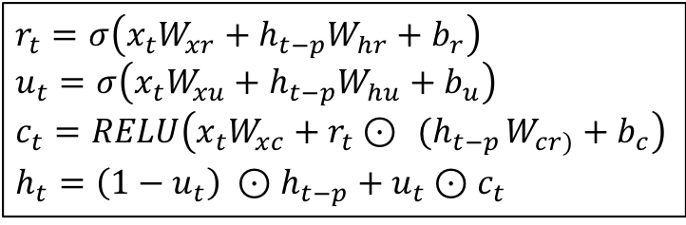
Recurrent-skip Component
Recurrent skip component is a recurrent layer that captures lagged long-term dependencies according to the appropriate lag. For instance hourly electricity consumption would have a lag of 24 time steps.
$$r_{t}=σ\left(x_{t}W_{xr}+h_{t−p}W_{hr}+b_{r}\right)$$
$$u_{t}=σ\left(x_{t}W_{xu}+h_{t−p}W_{hu}+b_{u}\right)$$
$$c_{t}=RELU\left(x_{t}W_{xc}+r_{t}⊙{ (h}_{t−p}W_{cr)}+b_{c}\right)$$
$$h_{t}=\left(1−u_{t}\right) ⊙h_{t−p}+u_{t}⊙c_{t}$$

Slide 24
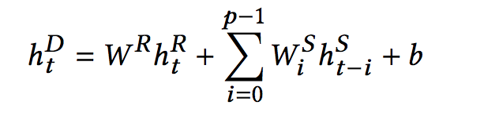
Combining Recurrent and Recurrent-skip Outputs
A Dense layer combines the output from recurrent layers.

Slide 25
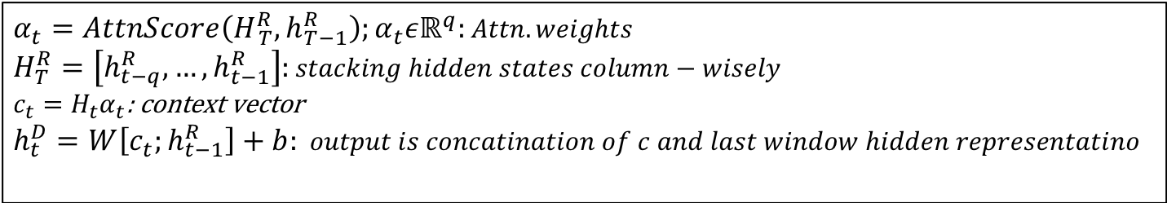
Temporal Attention Layer
In case of non-seasonal data skip step p is not useful.
In such cases an attention mechanism is used, which learns the weighted combination of hidden representations at each window position of the input matrix.
$$α_{t}=AttnScore\left(H_{ T}^{R}, h_{T−1}^{R}\right);α_{t}εℝ^{q}:Attn. weights$$
$$H_{T}^{R}=\left[h_{t−q}^{R}, …,h_{t−1}^{R}\right]:stacking hidden states column−wisely$$
$c_{t}=H_{t}α_{t}$: context vector
$$h_{t}^{D}=W\left[c_{t};h_{t−1}^{R}\right]+b: output is concatination of c and last window hidden representatino$$

Slide 26
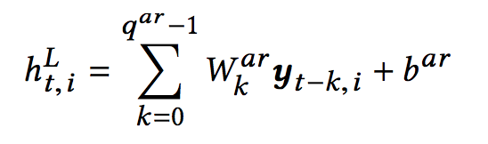
Autoregressive Component
ARC overcomes loss of scale, cased by DNN non-linearity.
ARC is a linear AR.

Slide 27

Final Output
Final output is obtained by integrating AR and DNN outputs.
$${\hat{Y}}_{t}=h_{t}^{D}+h_{t}^{L}$$

Slide 28
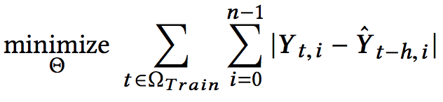
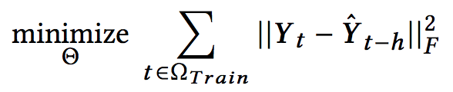
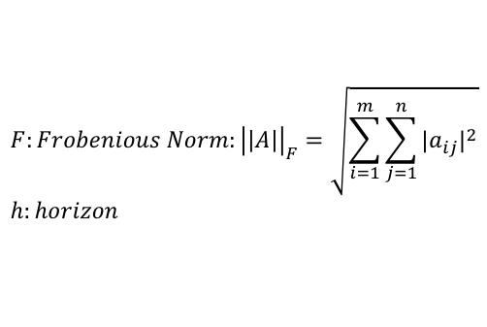
Objective Function
The paper suggests using either L1 or L2 loss function.
$$F:Frobenious Norm:{\left|\left|A\right|\right|}_{F}=\sqrt{\sum_{i=1}^{m}{\sum_{j=1}^{n}{{|a_{ij}|}^{2}}}}$$
$$h:horizon$$

Slide 29
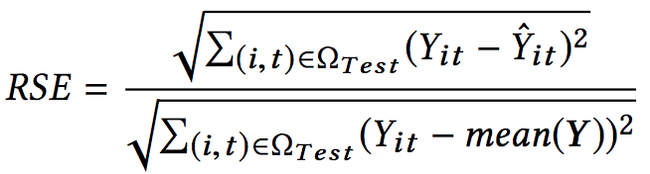
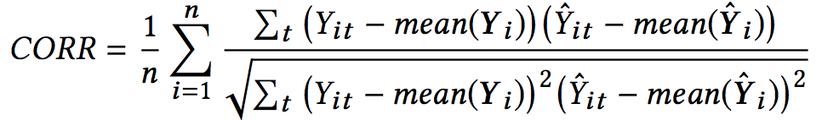
Metrics
Root Relative Squared Error (RSE): We want lower error.
Empirical Correlation Coefficient (CORR): We want higher correlation.

Slide 30
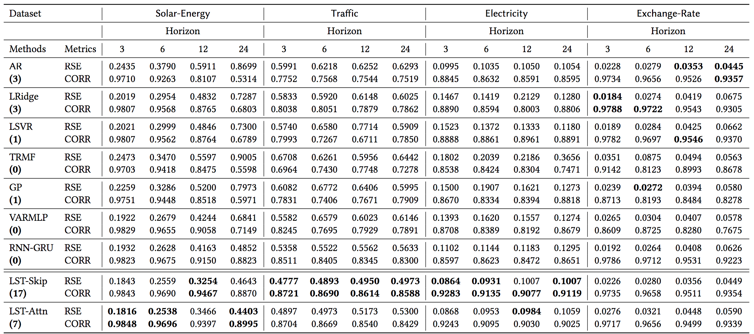
Comparison

Slide 31
References
Forecasting: Principles and Practice – Rob J Hyndman, George Athana­sopou­los https://www.otexts.org/fpp/8/3
DeepAR: Probabilistic Forecasting with Autoregressive Recurrent Networks - Valentin Flunkert , David Salinas , Jan Gasthaus. https://arxiv.org/abs/1704.04110
http://sherrytowers.com/2014/07/11/negative-binomial-likelihood/
Modeling Long- and Short-Term Temporal Patterns with Deep Neural Networks, Guokun Lai et. Al https://arxiv.org/pdf/1703.07015.pdf

