Slide 1
AWS Deep Learning AMI
Christian Petters, Solutions Architect
Saturday, July 28, 2018
Notes:
Challenges:
Having ML models doesn’t make an AI company
ML needs to be integrated in infrastructure ecosystem and business processes
ML code is only a small part of an overall ML production system
Old and new challenges for development and support processes
Operational requirements around model governance and auditability

Slide 2
AWS Deep Learning AMI
Multiple choice options, some mutual exclusive
Type: Conda AMI vs. Base AMI vs. Source AMI
Platform: CUDA 8 vs. CUDA 9
Operating system: Ubuntu vs. Amazon Linux vs. Windows 2016

Slide 3
AWS Deep Learning AMI
Conda AMI
Anaconda virtual environments
Apache MXNet, Caffe, Caffe2, Chainer, CNTK, Keras, PyTorch, TensorFlow and Theano
Most recent formal releases, no release candidates
Base AMI:
CUDA 8 or CUDA 9 pre-installed
No Framework components
Not available in Windows 2016
Source AMI:
Frameworks in single Python environment – Python 2.7 and 3.5
Includes source of frameworks

Slide 4
AWS Deep Learning AMI
CUDA 9 variant
Support for Apache MXNet, Caffe2, PyTorch, TensorFlow only
CUDA 8 variant:
Apache MXNet, Caffe, Caffe2, Chainer, CNTK, Keras, PyTorch, TensorFlow and Theano

Slide 5
AWS Deep Learning AMI
Framework and tools details
Consult release notes for each AMI type for details
https://amzn.to/2uWgPlV

Slide 6
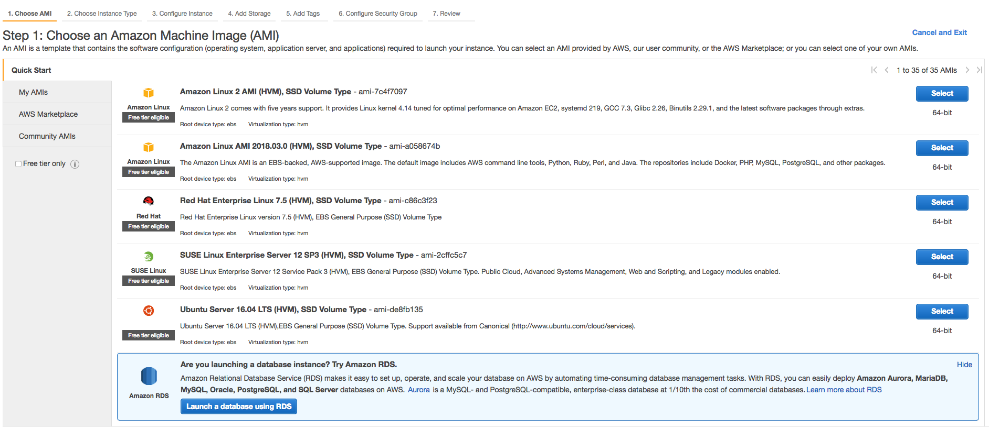
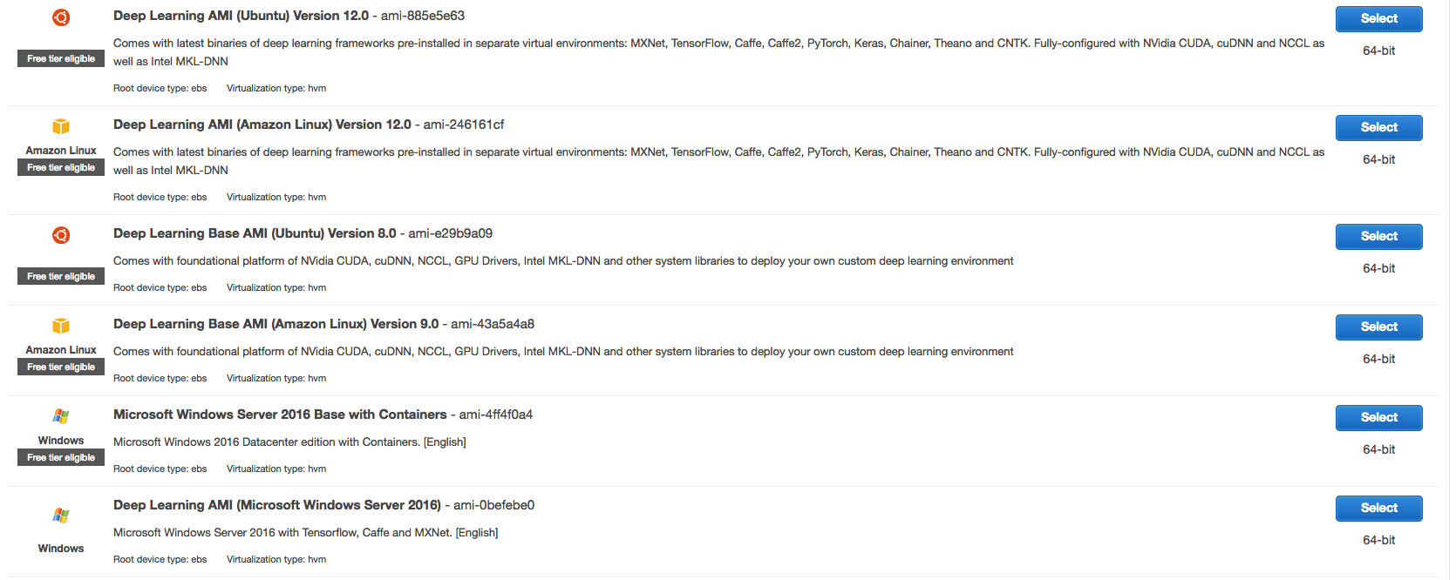
Getting started

Slide 7
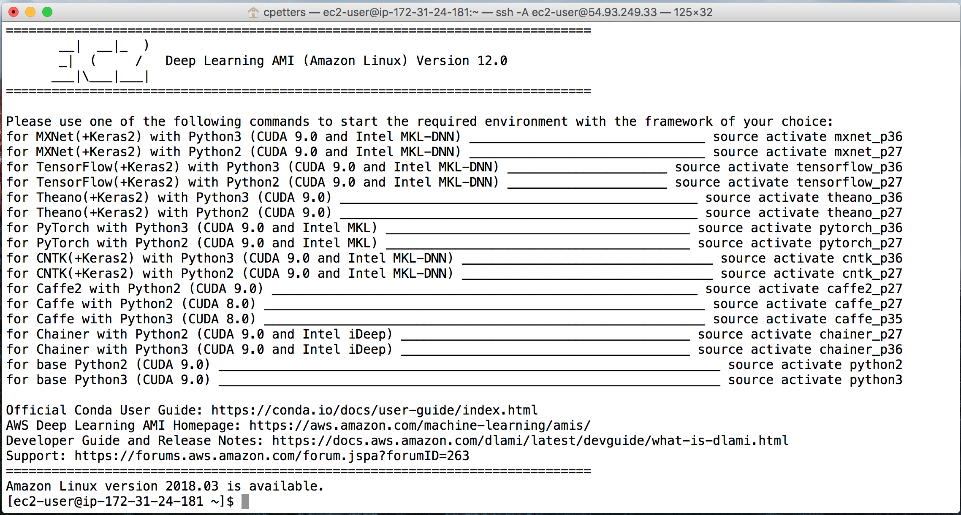
Getting started

Slide 8
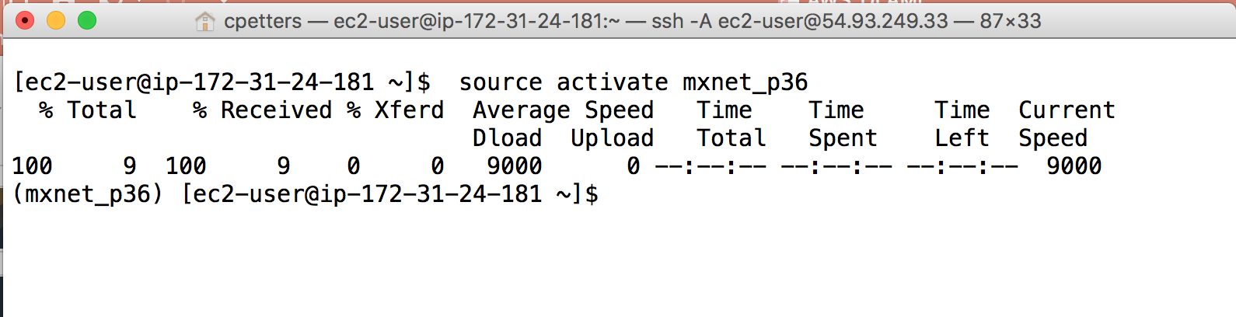
Getting started
Notes:
The Deep Learning AMI with Conda automatically installs the most optimized version of the framework for your EC2 instance upon the framework's first activation.

Slide 9
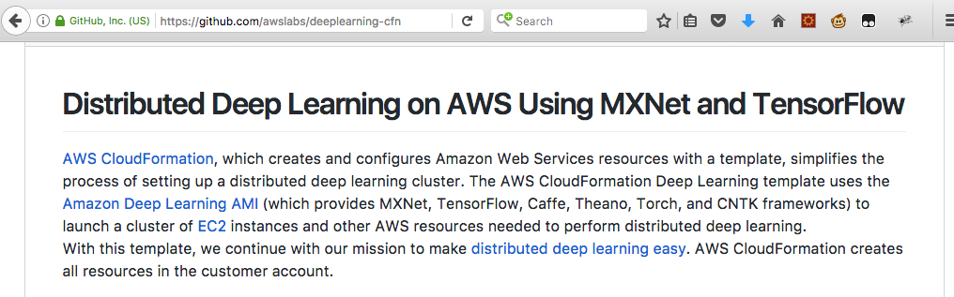
Distributed Deep Learning with Deep Learning AMI

