Slide 1
Amazon SageMaker
DevOps with Amazon SageMaker
Christian Petters, Solutions Architect
Friday, July 27, 2018
Notes:
Challenges:
Having ML models doesn’t make an AI company
ML needs to be integrated in infrastructure ecosystem and business processes
ML code is only a small part of an overall ML production system
Old and new challenges for development and support processes
Operational requirements around model governance and auditability

Slide 2
Amazon SageMaker
Build
Pre-built notebook instances
Fully-managed hosting at scale
Highly-optimized machine learning algorithms
Deploy
Train
Deployment without engineering effort
One-click training for ML, DL, and custom algorithms
CHAINER
Easier training with hyperparameter optimization
Notes:
DEPLOY
Deployment without Engineering Effort
After training, SageMaker provides the model artifacts and scoring images to you for deployment to Amazon EC2 or anywhere else. When you’re ready to deploy your model, you can launch into a secure and elastically scalable environment, with one-click deployment from the SageMaker console.
Fully Managed
Amazon SageMaker handles all of the compute infrastructure on your behalf, with built-in Amazon CloudWatch monitoring and logging, to perform health checks, apply security patches, and other routine maintenance, as well as ensure updates to the supported deep learning frameworks as they become available.

Slide 3
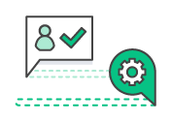
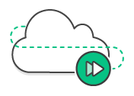
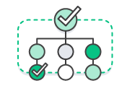


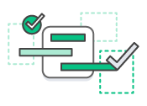
Why DevOps
Improved Collaboration
Rapid Delivery
Reliability
Security
Scale
Speed
Notes:
Teams work more efficiently and effectively, more nimble and agile
Using automation to work efficiently and release software more rapidly
You bake reliability and security into your automated practices to ensure your service is always running and infrastructure is in compliance
When you’re growing quickly and moving fast, you need IaC to help you manage your infrastructure at scale. Repeatable processes
Ultimately helps your organization increase its speed and velocity. The end goal is to innovate for your customers faster and become a better business

Slide 4




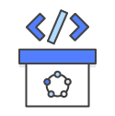
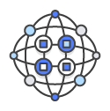
DevOps Practices
Social Coding
Infrastructure
as Code
Continuous
Integration
Monitoring
& Logging
Continuous
Delivery
Microservices

Slide 5
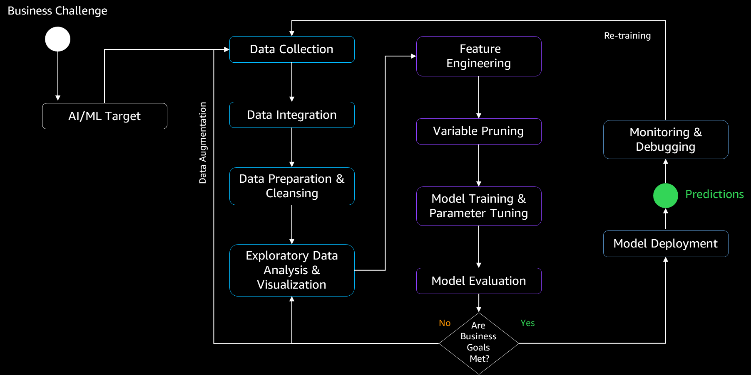
Machine Learning process

Slide 6
Machine Learning process
Amazon Glue
Amazon Athena
Amazon Quicksight

Slide 7
Machine Learning process
Amazon SageMaker

Slide 8
Machine Learning process
Amazon SageMaker
Amazon Batch
Amazon Lambda
Amazon CloudWatch
Amazon EC2 Container Services
Amazon Greengrass

Slide 9
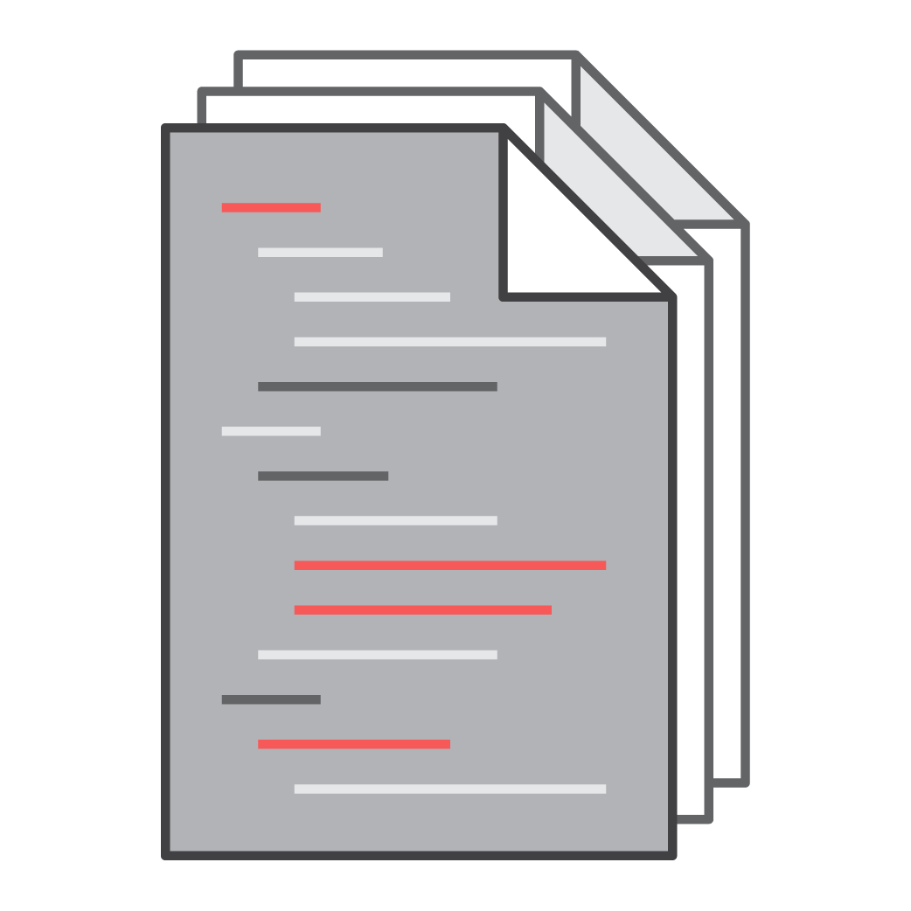
Training code
Amazon SageMaker
Amazon ECR

Slide 10


Client application
Amazon SageMaker API
CreateTrainingJob
Amazon SageMaker SDK
MXNet.estimator.fit
Training data
Training code
Helper code
Training code
Model Training (on EC2)
Amazon SageMaker
Amazon ECR

Slide 11
Client application
Amazon SageMaker API
CreateTrainingJob
Amazon SageMaker SDK
MXNet.estimator.fit
Inference code
Model artifacts
Training data
Training code
Helper code
Training code
Model Training (on EC2)
Amazon SageMaker
Amazon ECR

Slide 12
Client application
Amazon SageMaker API
CreateEndpointConfig + CreateEndpoint
Amazon SageMaker SDK
MXNet.estimator.deploy
Inference code
Helper code
Inference code
Model Hosting (on EC2)
Model artifacts
Training data
Training code
Helper code
Training code
Model Training (on EC2)
Amazon SageMaker
Amazon ECR

Slide 13

Client application
Inference response
Inference request
Amazon SageMaker API
Inference Endpoint
CreateEndpointConfig + CreateEndpoint
Amazon SageMaker SDK
MXNet.estimator.deploy
Inference code
Helper code
Inference code
Model Hosting (on EC2)
Model artifacts
Training data
Training code
Helper code
Training code
Model Training (on EC2)
Amazon SageMaker
Amazon ECR

Slide 14
Client application
Inference response
Inference request
Inference Endpoint
Inference code
Helper code
Inference code
Model Hosting (on EC2)
Training code
Amazon SageMaker
Amazon ECR

Slide 15
Client application
Inference response
Inference request
Amazon SageMaker API
Inference Endpoint
UpdateEndpoint or UpdateEndpoint_ WeightsAndCapacities
Ground Truth
Amazon SageMaker SDK
MXNet.estimator.deploy
Inference code
Helper code
Inference code
Model Hosting (on EC2)
Model artifacts
Training data
Training code
Helper code
Training code
Model Training (on EC2)
Amazon SageMaker
Amazon ECR

Slide 16
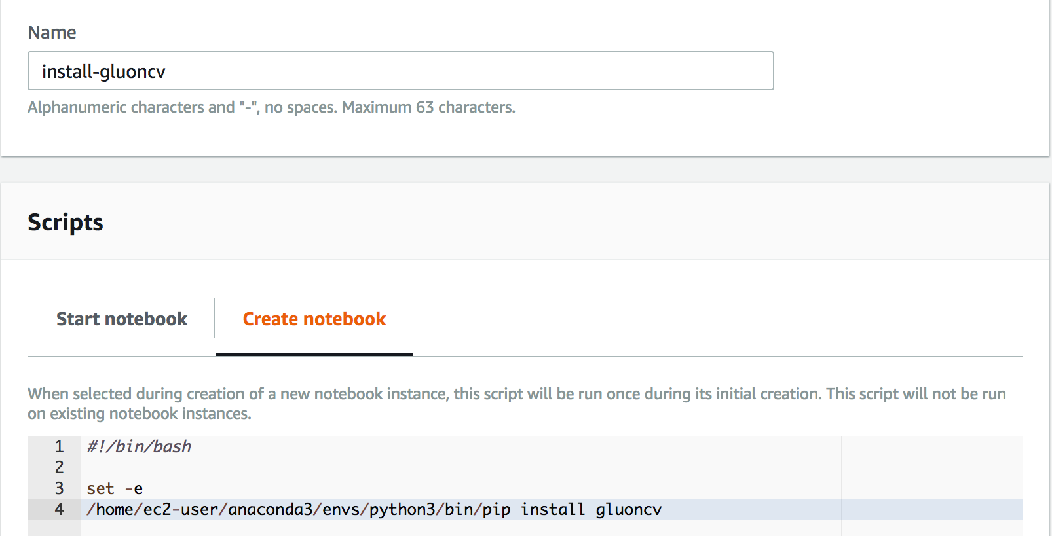
SageMaker environment configuration

Slide 17
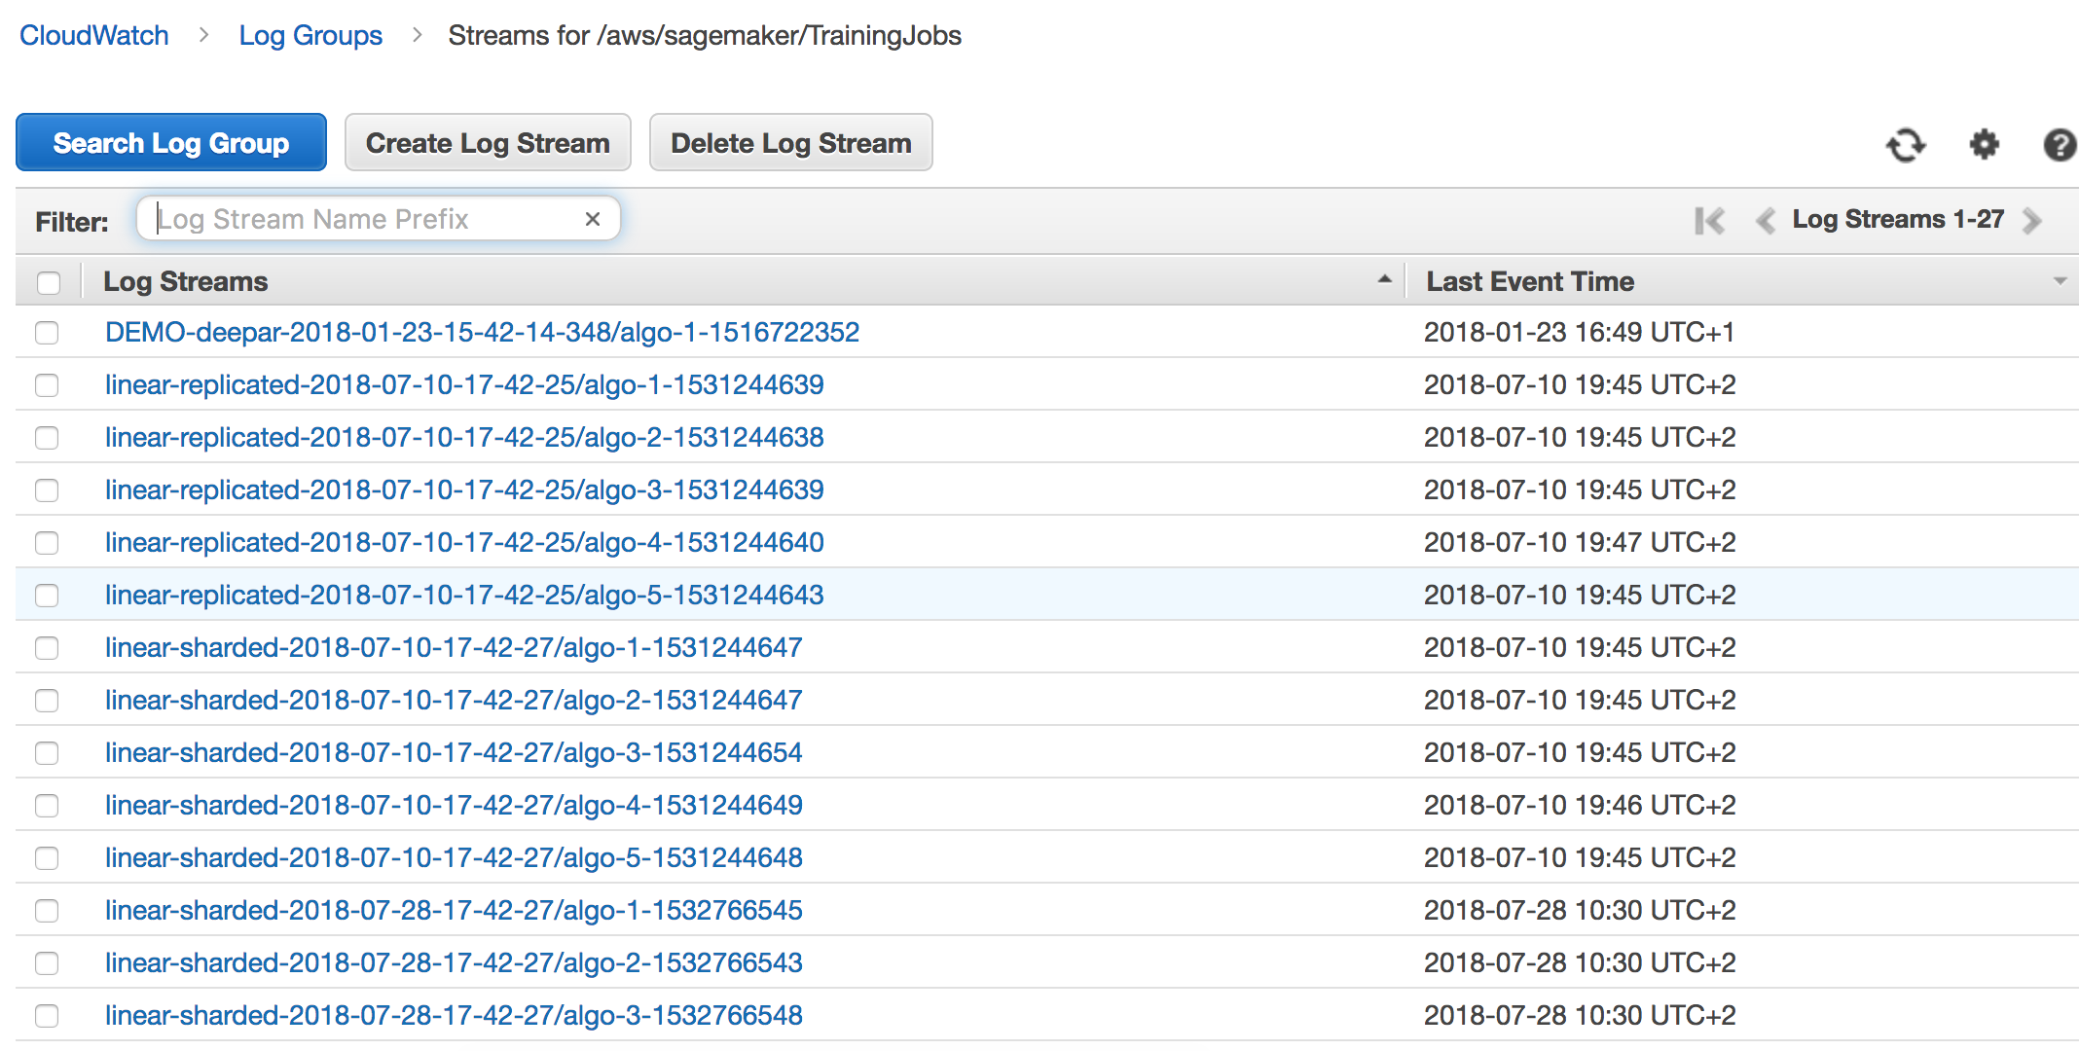
SageMaker monitoring

Slide 18
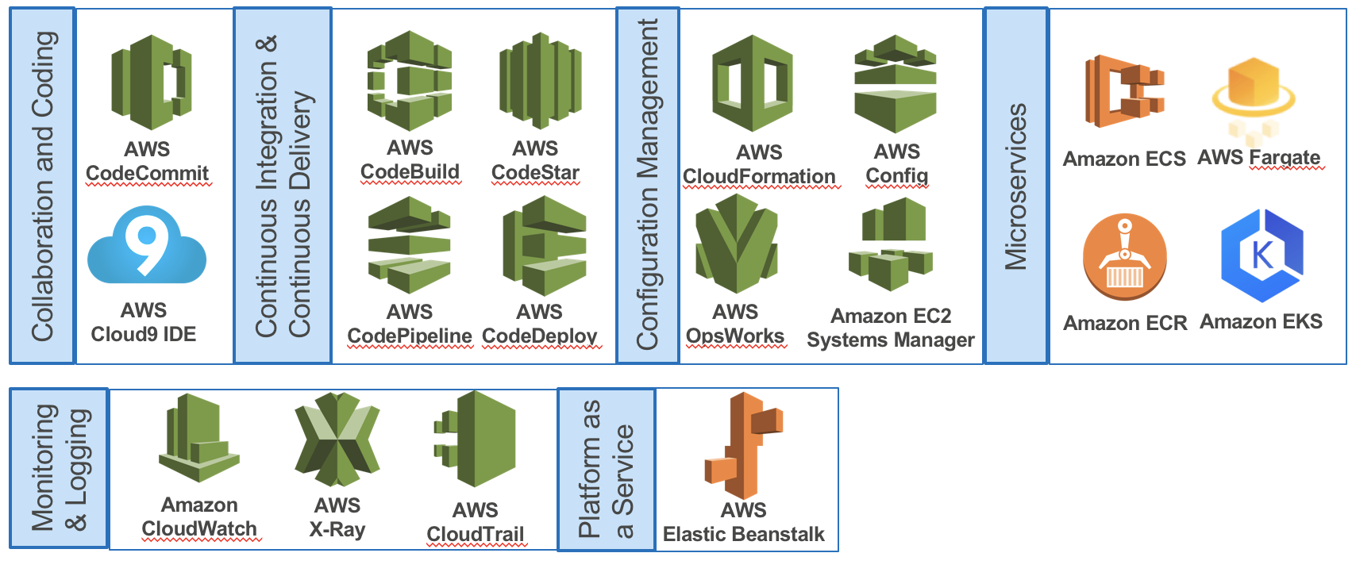
AWS DevOps services overview
Notes:
Tenets:
Design for scalability, elasticity and stability
Treat data with the same rigor as code
Automate as much as possible
Implement consistency by design
Enable full transparency and auditability
Foster collaboration through standardized configurations and feature sharing
Be framework agnostic

Slide 19
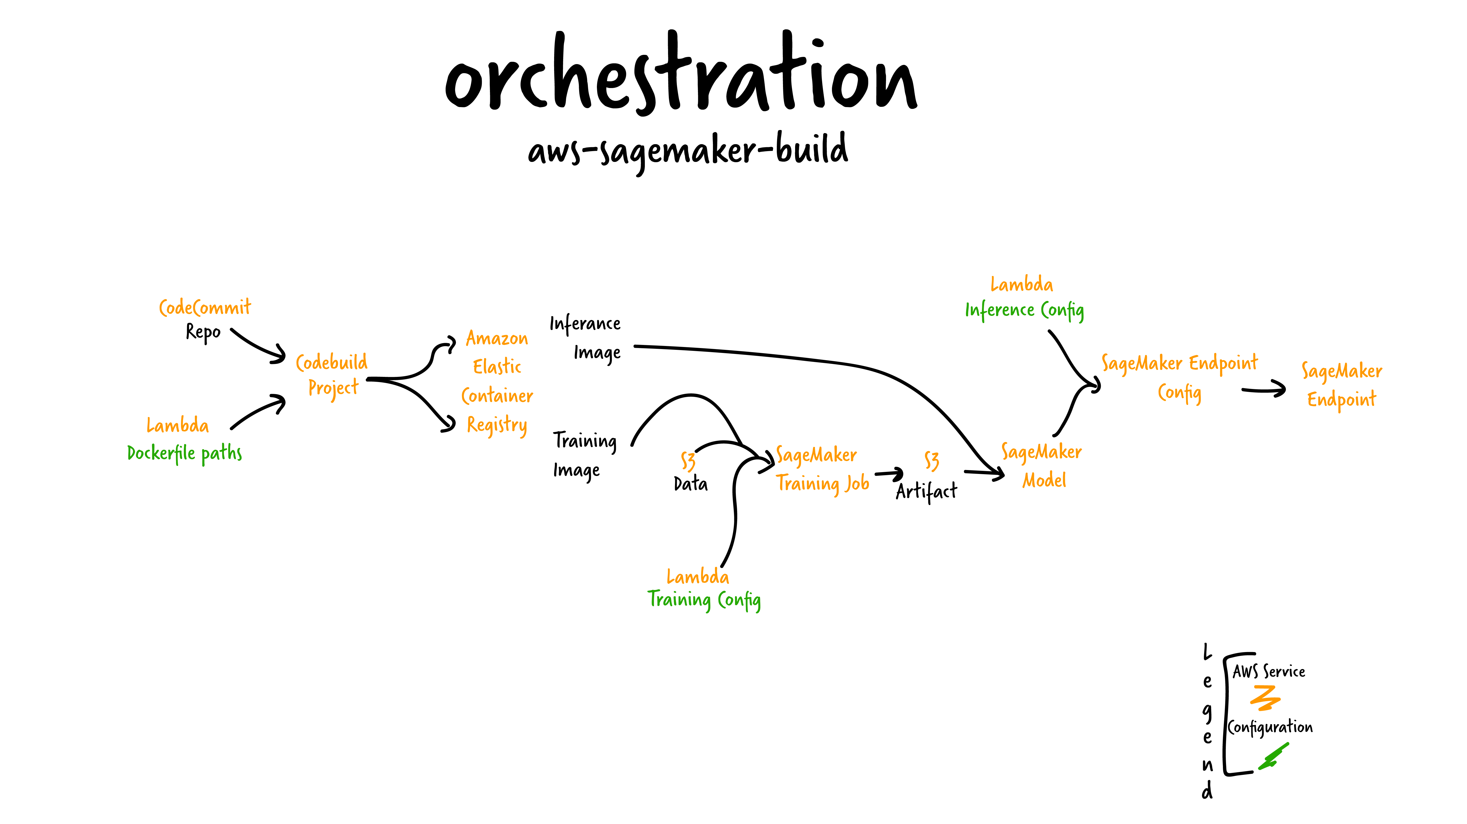

Slide 20
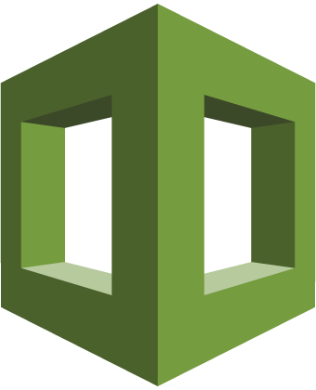
AWS CloudFormation
Simplified way to create and manage a collection of AWS resources
Enables orderly and predictable provisioning and updating of resources
Enables version control of your AWS infrastructure
Deploy and update stacks using the AWS Management Console, the AWS Command Line Interface (CLI), or the AWS API

Slide 21


Infrastructure as code
Single source of truth to deploy the whole stack
Infrastructure that you can replicate, re-deploy, and re-purpose
Control versioning on your infrastructure and your application together
Service rolls back to the last good state on failures
Build your infrastructure and run it through your CI/CD pipeline
Template
Stack
Stack
Stack
Notes:
Codifying your infrastructure allows you to treat your infrastructure as just code. You can author it with any code editor, check it into a version control system, and review the files with team members before deploying into production
The transactional nature of CloudFormation is one of it's biggest draws from a customer perspective. CloudFormation is Transactional -- Service will rollback to the last good state on failures”.

Slide 22
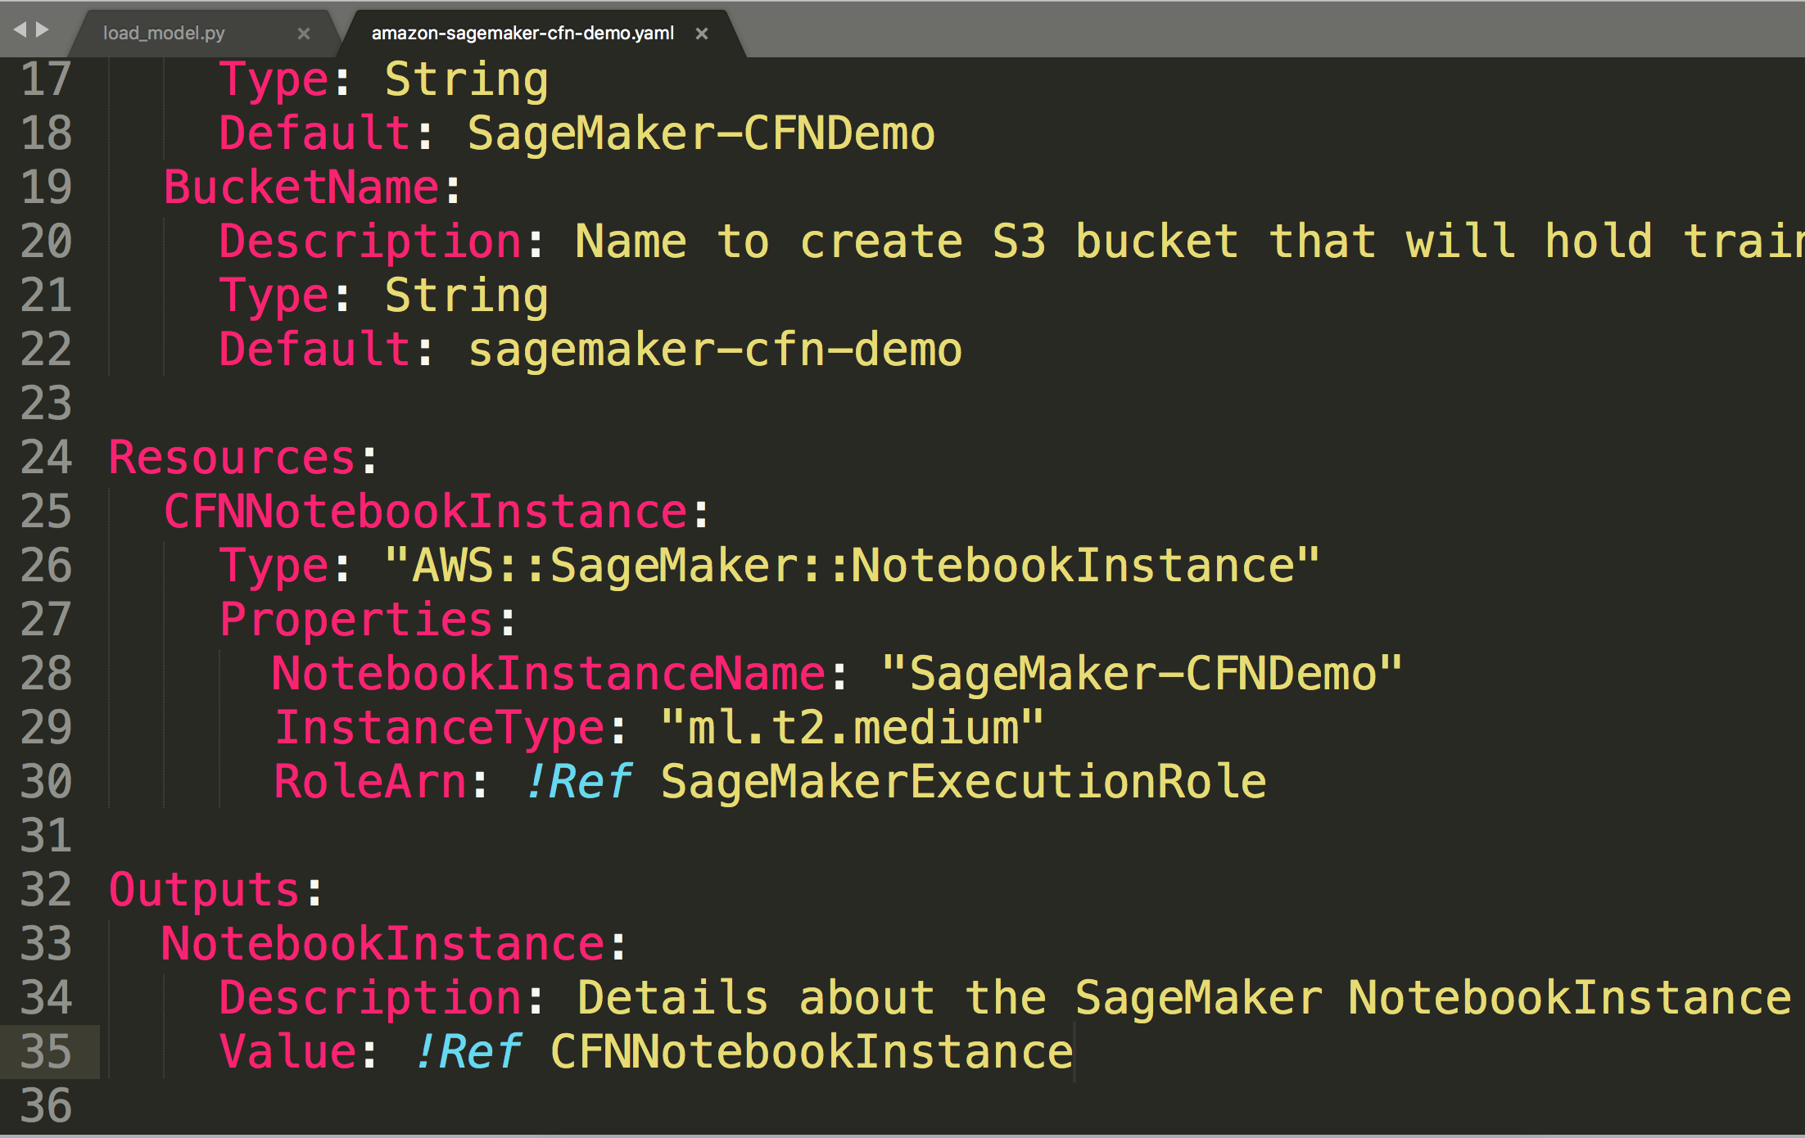
Stack creation
You use a template to create and manage a stack
A stack is a collection of AWS resources that you can manage as a single unit
AWS CloudFormation ensures all stack resources are created or deleted as appropriate
Notes:
AWS CloudFormation ensures all stack resources are created or deleted as appropriate. Because AWS CloudFormation treats the stack resources as a single unit, they must all be created or deleted successfully for the stack to be created or deleted. If a resource cannot be created, AWS CloudFormation rolls the stack back and automatically deletes any resources that were created. If a resource cannot be deleted, any remaining resources are retained until the stack can be successfully deleted.

