Slide 1
GENDER PREDICTION
ISHMAM-UR-RAHMAN
ID: 2020-1-60-241
SECTION: 02
COURSE: CSE 366
SUBMITTED TO,
MD. ASHRAFUL ISLAM

Slide 2
DATASET USED
CONTINUOUS | DISCRETE
AGE | GENDER
CREDIT_SCORE | RACE
ANNUAL_MILEAGE | DRIVING_EXPERIENCE
SPEEDING_VIOLATIONS | EDUCATION
DUIS | INCOME
PAST_ACCIDENTS | VEHICLE_OWNERSHIP
_ | VEHICLE_YEAR
_ | MARRIED
_ | CHILDREN
_ | POSTAL_CODE
_ | VEHICLE_TYPE
Car Insurance Data
TARGET COLUMN : GENDER

Slide 3
BAYES
PERCEPTRON

Slide 4
BAYES
THEOREM
P(Class | Features) = (P(Features | Class) * P(Class)) / P(Features) P(Class | Features): Posterior probability P(Features | Class): Likelihood P(Class): Prior probability

Slide 5
Bayes Classifier
Bayes' theorem is a fundamental principle in probability theory.
It provides a way to update beliefs or probabilities based on new evidence or information.
In the context of classification, Bayes' theorem is used to calculate the probability of a data point belonging to a specific class given its features.
The theorem is expressed as P(Class | Features) = (P(Features | Class) * P(Class)) / P(Features).
P(Features) is the probability of observing the given features, regardless of the class.
By applying Bayes' theorem, we can calculate the probability of a data point belonging to each class and assign it to the class with the highest probability.
Bayes' theorem is particularly useful in classification tasks as it incorporates prior knowledge and evidence to make informed decisions.

Slide 6
Naive Bayes
Naive Bayes classifier is a probabilistic machine learning algorithm for classification tasks.
It utilizes Bayes' theorem to calculate the probability of a data point belonging to a specific class given its features.
The classifier assumes feature independence given the class, simplifying the calculations.
During training, the classifier estimates prior probabilities of each class based on the frequency of class occurrences.
It also estimates the likelihood of observing each feature given a specific class.
When classifying a new data point, the classifier applies Bayes' theorem to calculate the posterior probabilities of each class.
The class with the highest posterior probability is assigned to the data point.
Despite its assumption of feature independence, Naive Bayes classifiers often perform well, especially in high-dimensional and large-scale applications.
They are computationally efficient and can handle large datasets efficiently.

Slide 7
PERCEPTRON
Linear Binary Classifier
Artificial Neuron Model
Weighted Sum Calculation
Activation Function Application
Error-Based Learning
Decision Boundary Determination
Decision-Making with Simplicity and Power

Slide 8
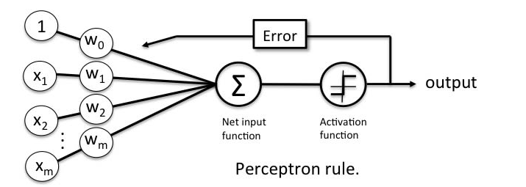

Slide 9
THANK YOU ~

