Slide 1
Variational Quantum Eigensolver to find the lowest eigenvalue of a hamiltonian matrix
Shah Ishmam Mohtashim
4th year, Department of Chemistry, University of Dhaka
Project link: https://github.com/IshmamShah/QSOF-TASK-4-SCREENING-/blob/master/QSOF%20TASK%204(Screening%20Assigenment).ipynb

Slide 2
VQE
Uses Variational Principle
Near term quantum algorithm
Hybrid algorithm - uses both classical and quantum computation. Classical part for optimization of parameters

Slide 3



Variational Principle
Hamiltonian:
Energy value:
Variational principle

Slide 4
Components
Hamiltonian
Ansatz
Circuit
Measurement of Expectation values

Slide 5
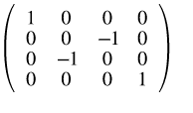
Hamiltonian
Matrix for this project:

Slide 6

Decomposition of Matrix into sum of tensor products of Pauli Matrices
Pauli matrices:

Slide 7

Decomposition Function
Mathematical Theory

Slide 8
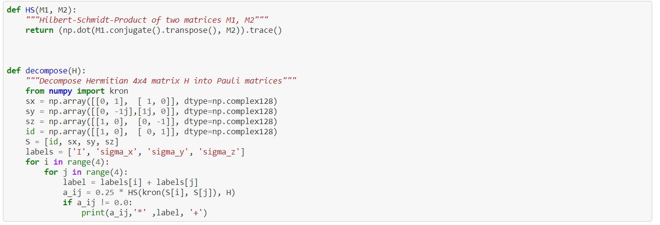
Decompostion function in code

Slide 9

Decomposed matrix
The decomposed matrix is

Slide 10
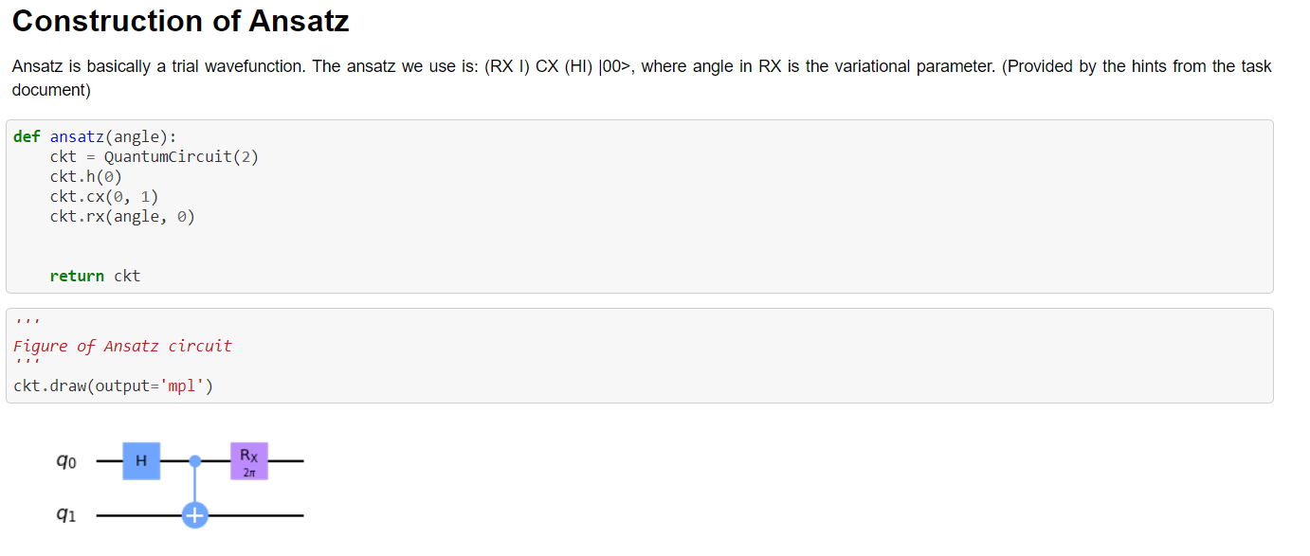
Construction of Ansatz

Slide 11
Gates as guiding mechanism to determine the basis of measurement
The gates work as guiding mechanisms for ansatz to conduct the measurements in a particular basis. For this project I had three basis
XX
YY
ZZ
II is added as a constant

Slide 12
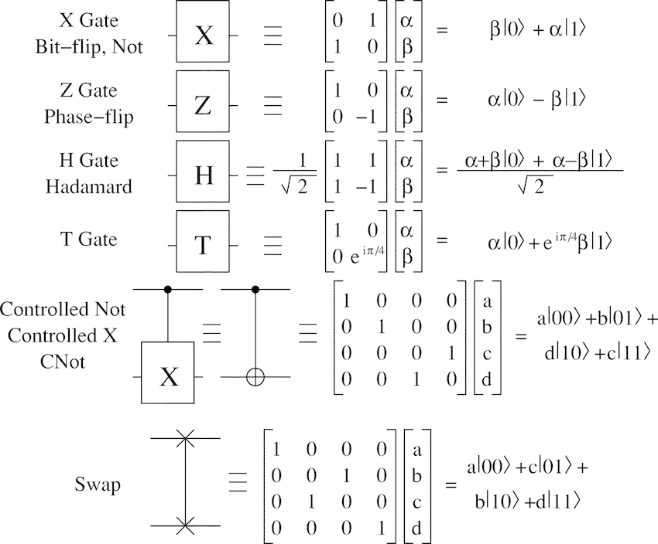
Quantum Gates

Slide 13
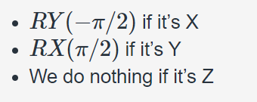
Conversion to Z basis

Slide 14
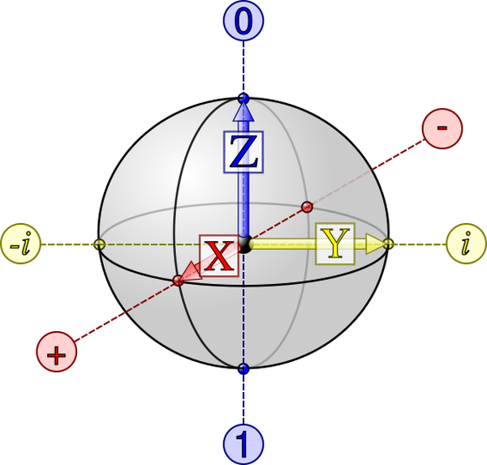
Bloch sphere

Slide 15
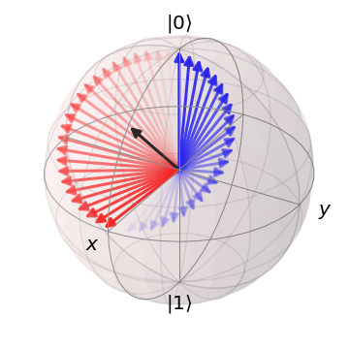
Rotation within Bloch sphere
Example:

Slide 16
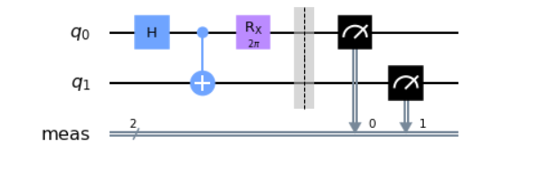
ZZ circuit preparation

Slide 17
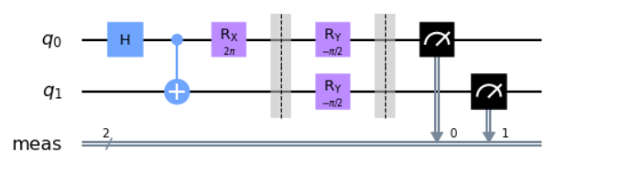
XX circuit preparation

Slide 18
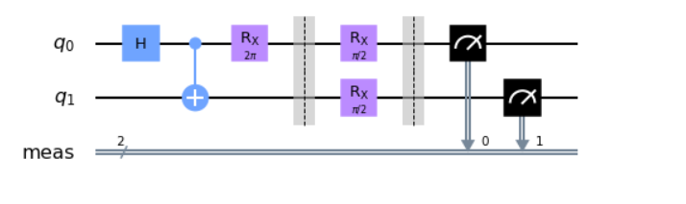
YY circuit Preparation

Slide 19
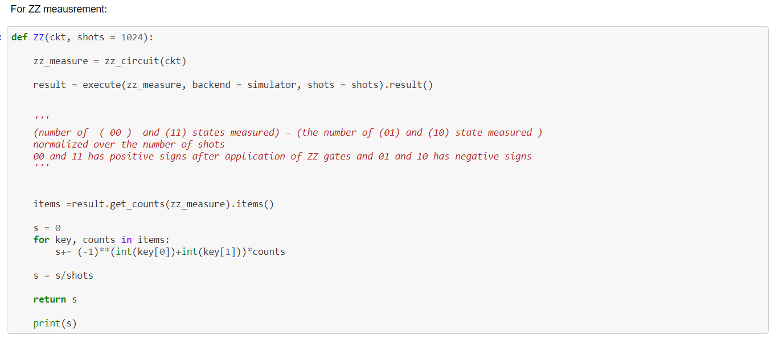
Meausement of expectation values

Slide 20
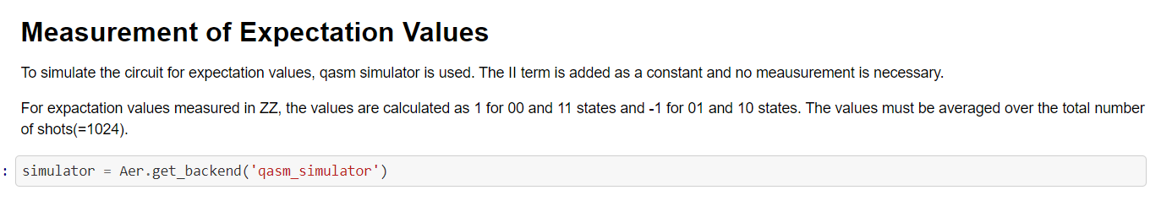
Simulator and why we got the previous values

Slide 21
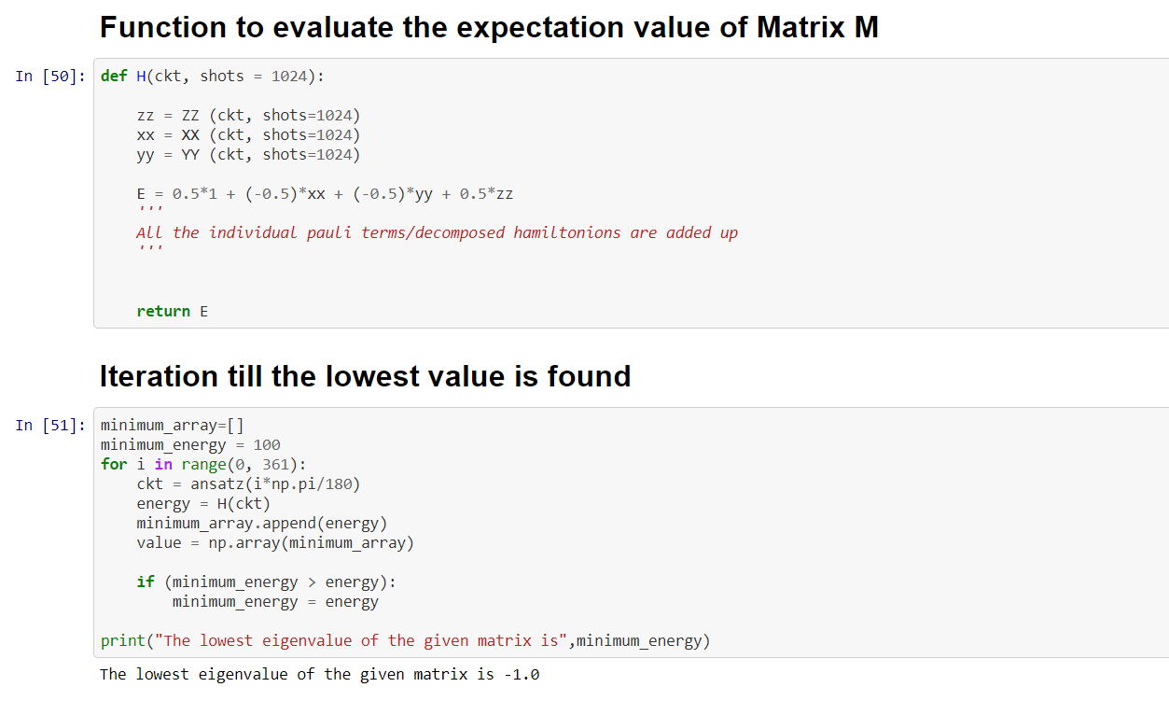

Slide 22
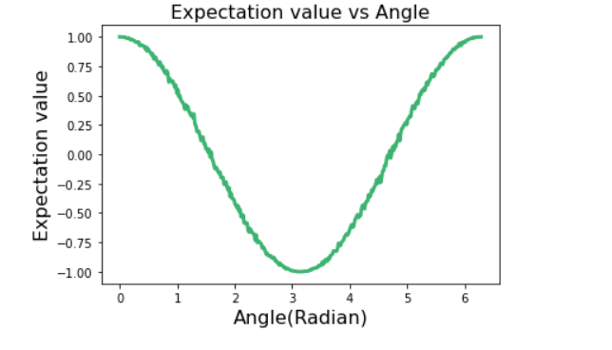
Plot of the values

