Slide 1
InfernoRDN (previously DAnTE)
Ashoka Polpitiya

Slide 2

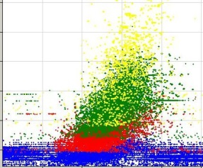
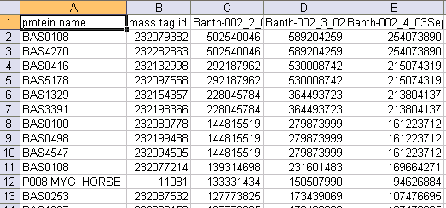
Where does InfernoRDN fit in?
Normalize raw abundances and rollup to proteins using RRollup, QRollup, and ZRollup
AMT Pipeline (LC-MS)
Biological Conclusions
Multialign
InfernoRDN
QRollup
Other CSV
files
(microarray)

Slide 3
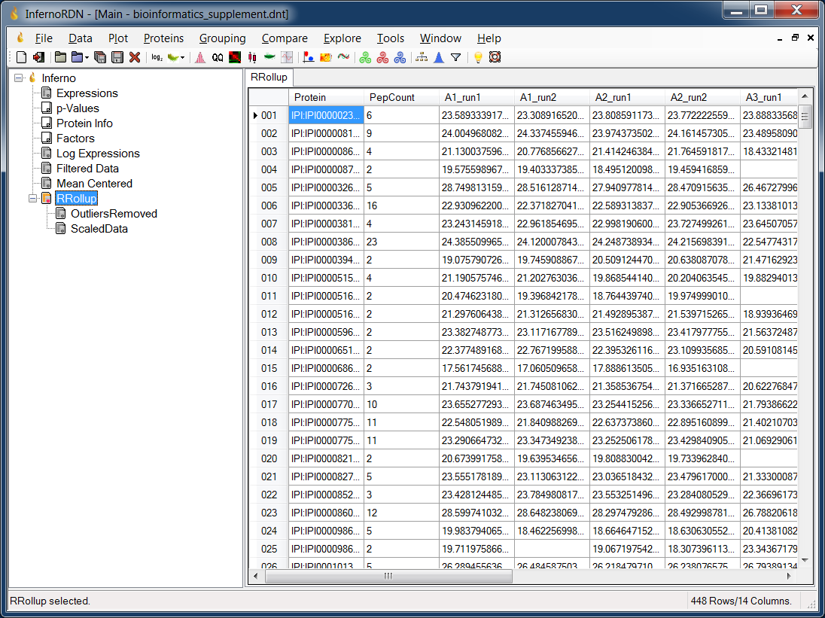
InfernoRDN

Slide 4
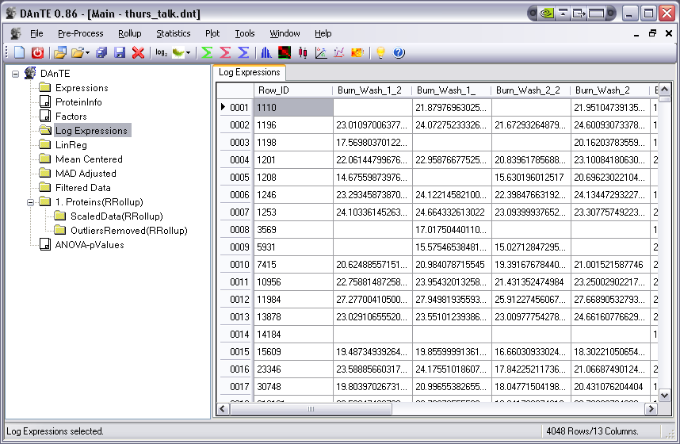
InfernoRDN is simply DAnTE re-branded
This screenshot shows the workspace after extensive data analysis

Slide 5
Analysis Flow in InfernoRDN
Statistical Tests
ANOVA
Mix Models
Data Loading
Peptide abundance
Peptide-Protein relations
Factors
Rollup
RRollup
ZRollup
QRollup
Rollup Plots
Misc Analytical Methods
PCA
PLS
Heatmaps (kmeans, hierachical)
Variance Stabilization
log2 or log10
Bias (additive/multiplicative)
Global Normalization
Central tendency
Median absolute Deviation (MAD)
Impute Missing
Substitute
Average
KNNimpute
SVDimpute etc.
Investigative Plots
Histograms
Boxplots
Correlation diagrams
MA Plots
Replicate Normalization
Linear Regression
Loess
Quantile
Other Features
Filter ANOVA results
Save session

Slide 6
Goals of a downstream tool in Proteomics
Identify problematic datasets
Normalize
Remove systematic bias and variation due to technical artifacts
Rolling up to proteins
Hypothesis testing and feature discovery
Fixed effects (treatment)
Random effects (different LC columns, Batch)
Unbalanced data (due to missing)
PCA / PLS
Clustering (Hierarchical / K-means)

Slide 7
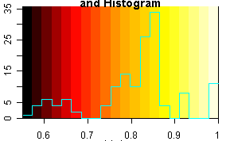
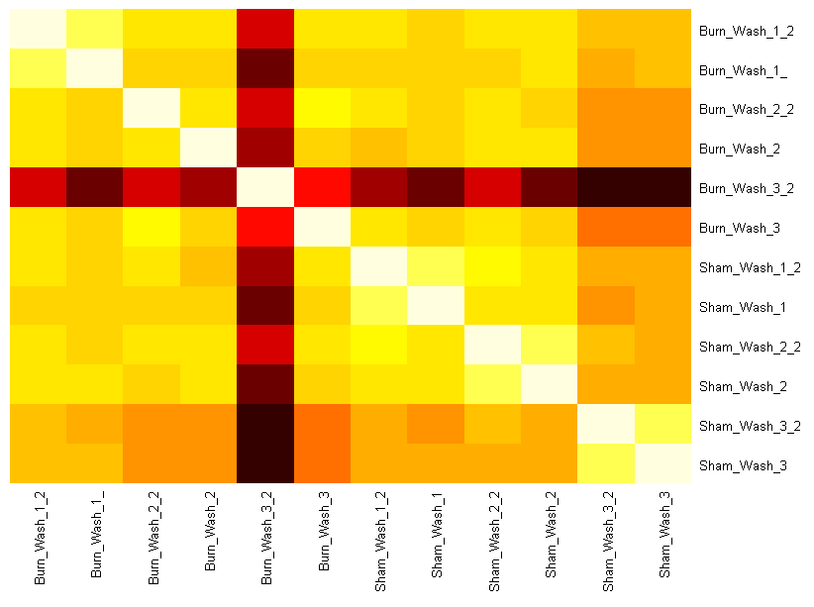
Goals of a downstream tool in Proteomics
Identify problematic datasets
Correlation Plots
Outlier dataset
Color legend with overlaid histogram of correlation values
Dataset Names
Dataset Names

Slide 8
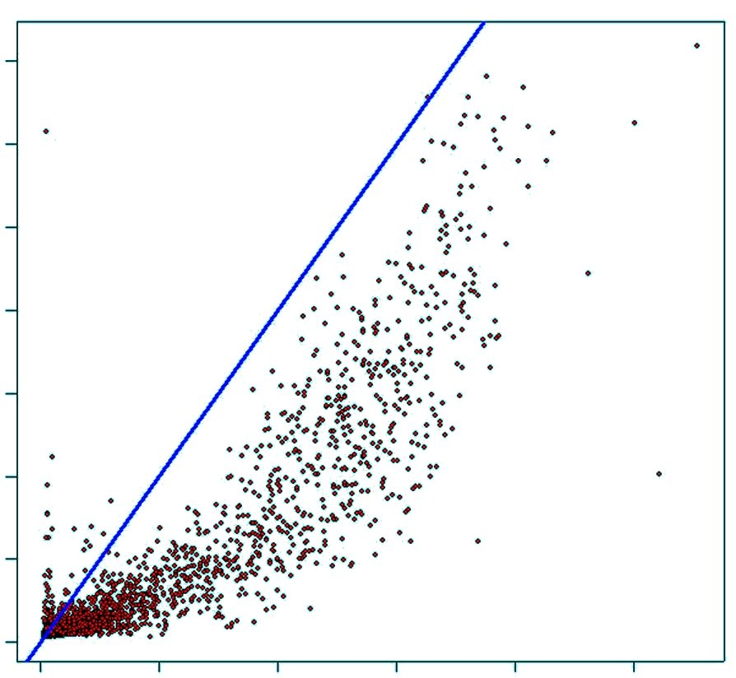
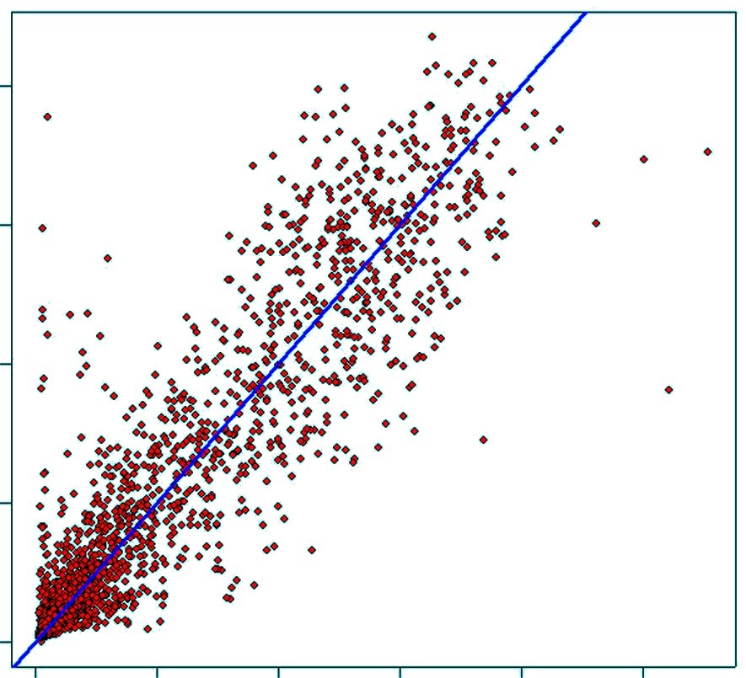
Goals of a downstream tool in Proteomics
Identify problematic datasets
Normalize
Remove systematic bias and variation due to technical artifacts
Dataset 2
Raw
Normalized
Dataset 1
Dataset 1

Slide 9
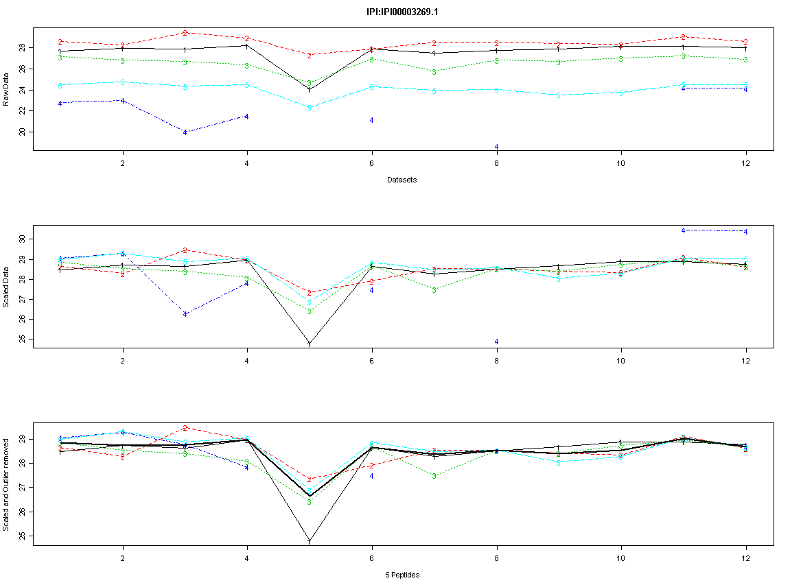
Goals of a downstream tool in Proteomics
Identify problematic datasets
Normalize
Remove systematic bias and variation due to technical artifacts
Rolling up to proteins
Raw
Scaled
Datasets

Slide 10
Example dataset
3 Burn (human) samples and 3 Control samples.
Each sample was run in duplicates, therefore 12 datasets.
Burn
Sham
(control)

Slide 11
Example dataset
Group datasets using “Factors”
Gender
Sample type
Technical replicate
Biological Replicate
Factors for Burn data
Condition: Burn / Sham
Replicates: 1,1,2,2,3,3,4,4,5,5,6,6
Burn
Sham
(control)
1
1
2
2
3
3
4
4
5
5
6
6
6
6

Slide 12
Outline of the Analysis of Data
Load data
Initial diagnosis with plots
Define factors
Normalize
Within a Factor
Linear regression
Loess
Quantile
Global
MAD
Mean Centering
Rollup
ANOVA

Slide 13
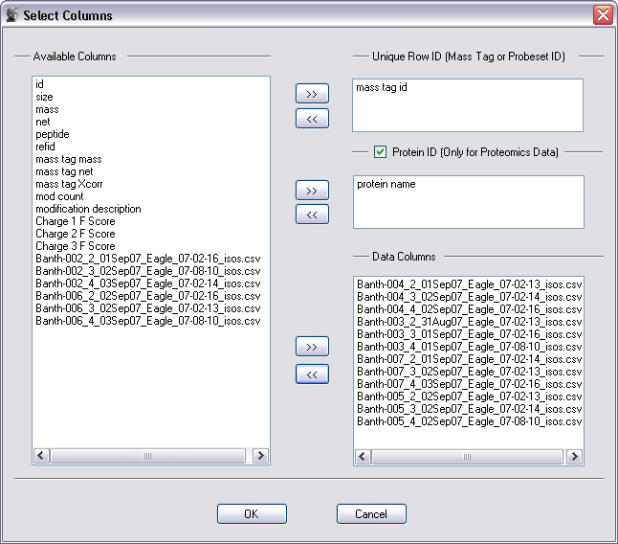
Data loading example

Slide 14


Correlations
Outlier dataset
Color legend with overlaid histogram of correlation values
Dataset Names
Dataset Names

Slide 15
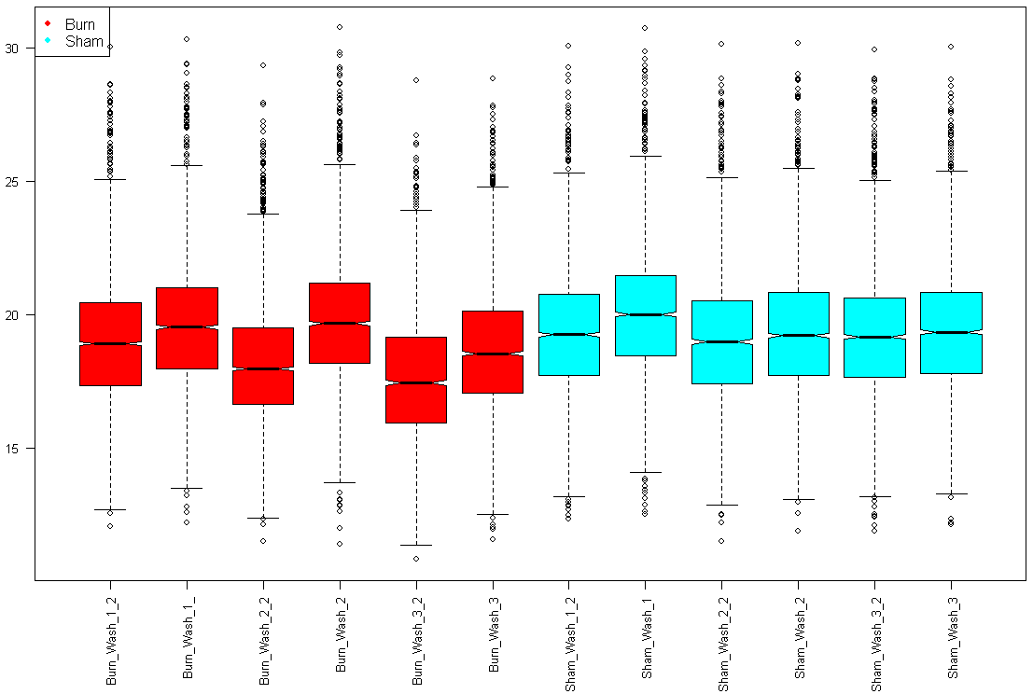
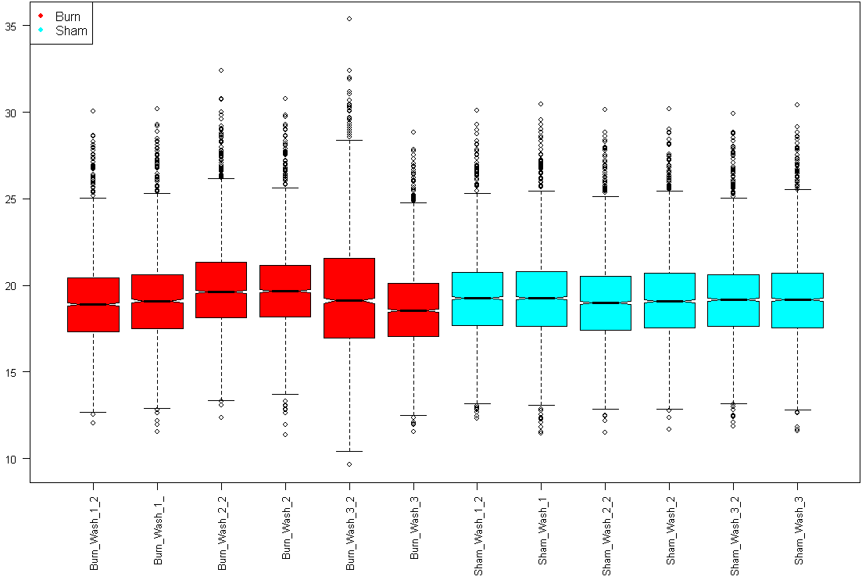
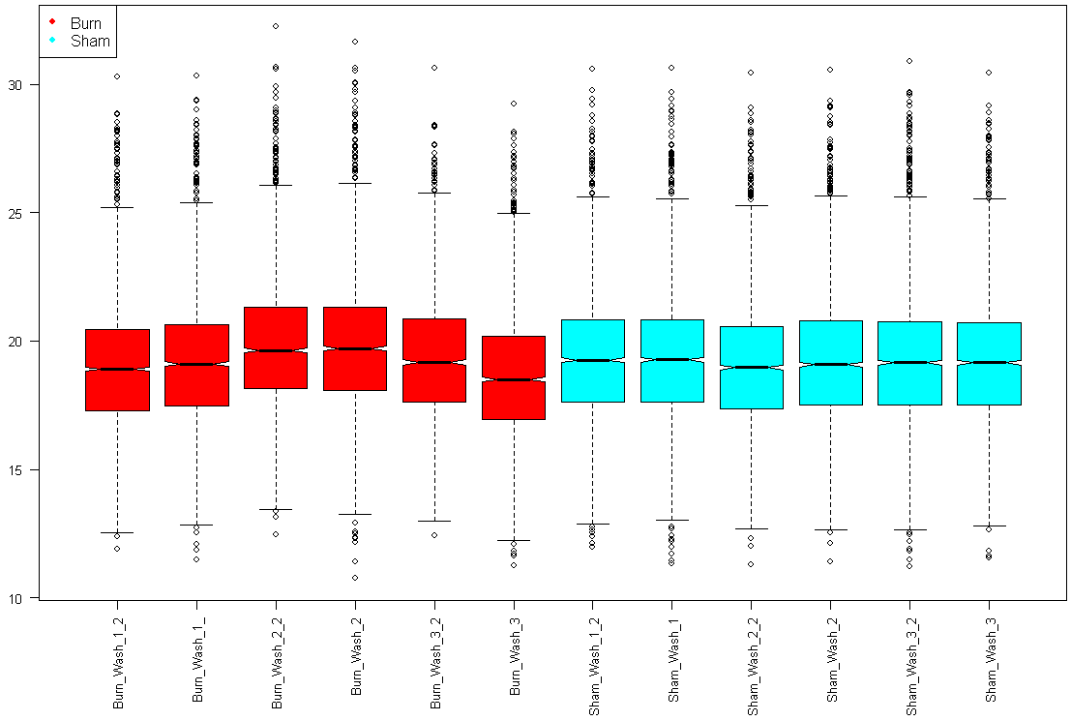
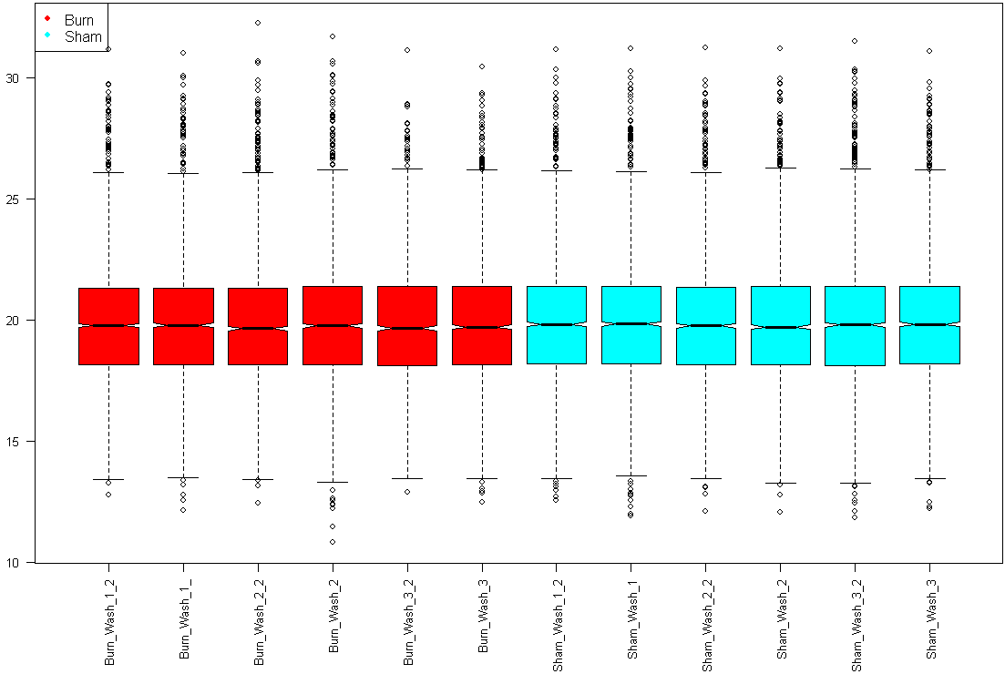
Normalizing - Box Plot Views
Abundance
Raw
Lin. Reg.
Dataset Names
MAD
Mean Center

Slide 16
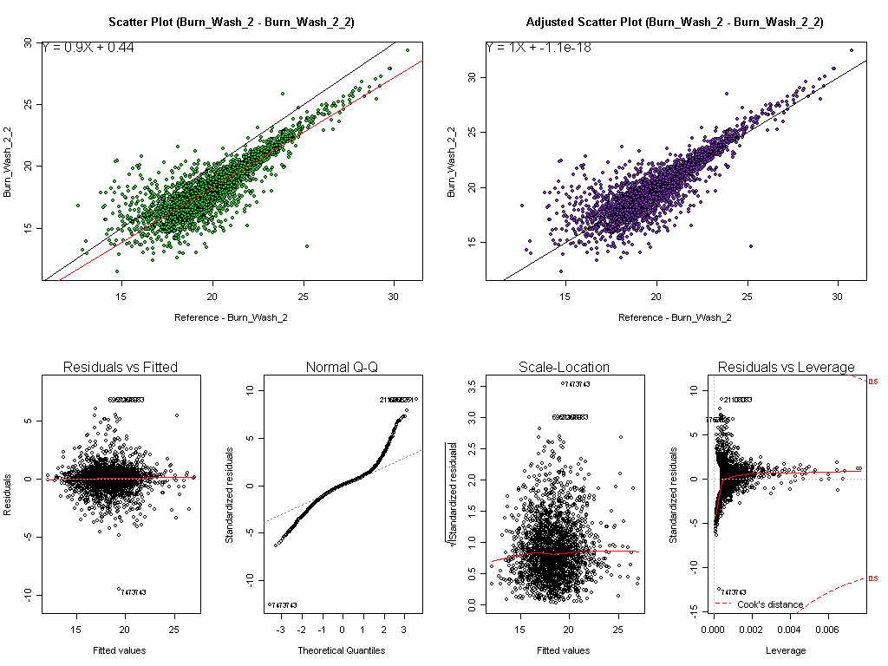
Diagnostic plots for Linear Regression
Raw
After regression
Regressing one dataset vs. second dataset

Slide 17

Rolling Up Peptides to Protein Abundance
Raw peptide abundances vs. dataset (for 1 protein)
Burn
Sham
Scaled peptide abundances for this protein’s 5 peptides
Burn
Sham
Scaled abun., outliers removed with Grubb’s test
Burn
Sham
Median protein abundance (dark black line)

Slide 18
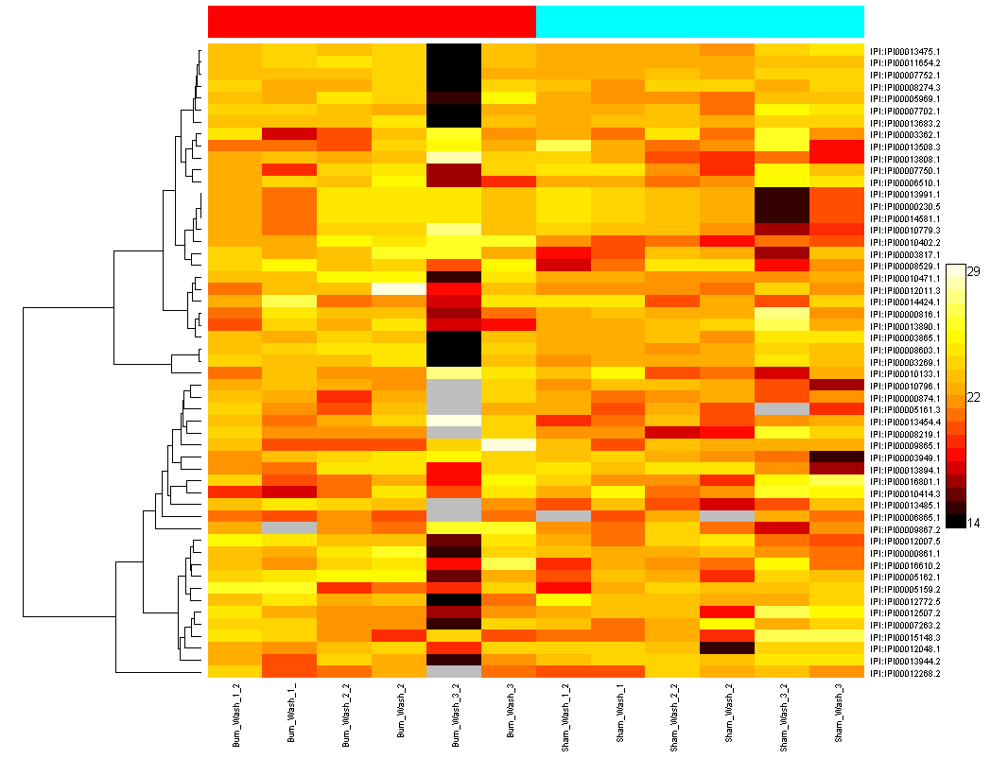
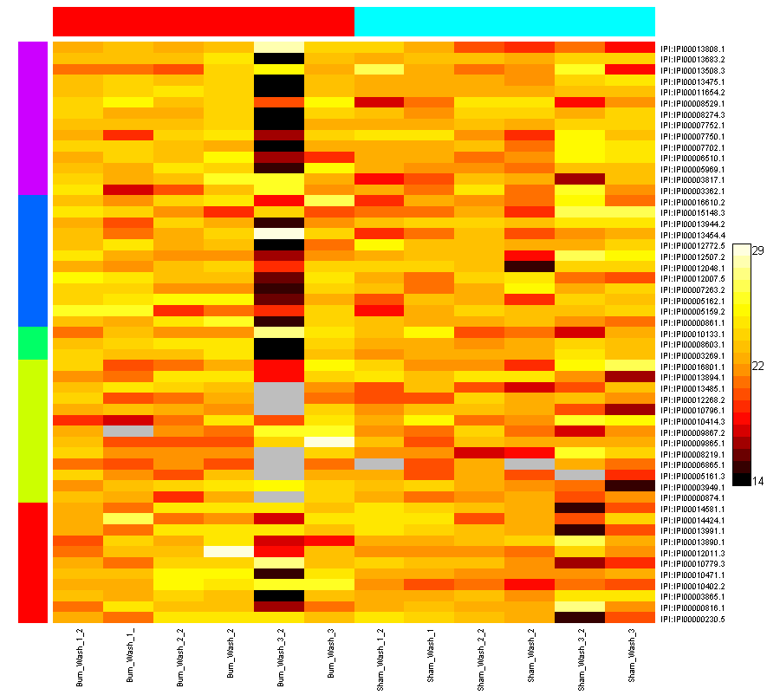
Heatmaps of Protein Abundance
Hierarchical clustering of rows
K-means clustering of rows (using 5 clusters)
Burn
Sham
Burn
Sham
Proteins
Datasets
Datasets

Slide 19
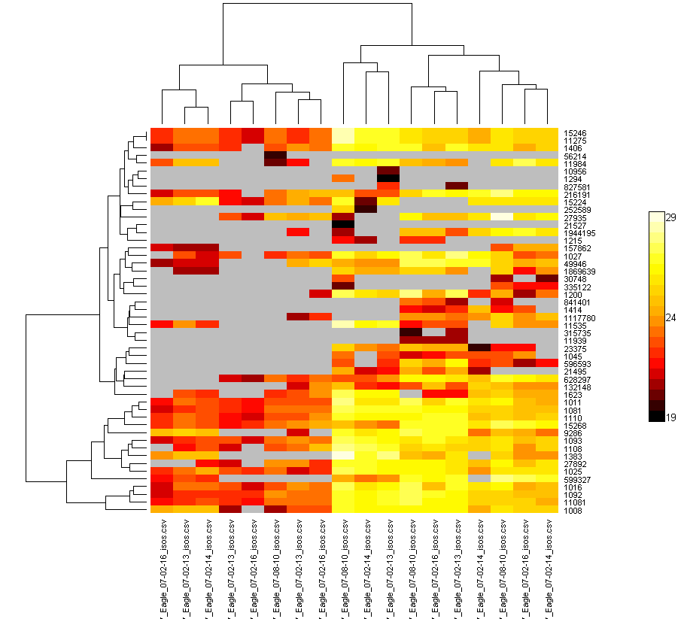
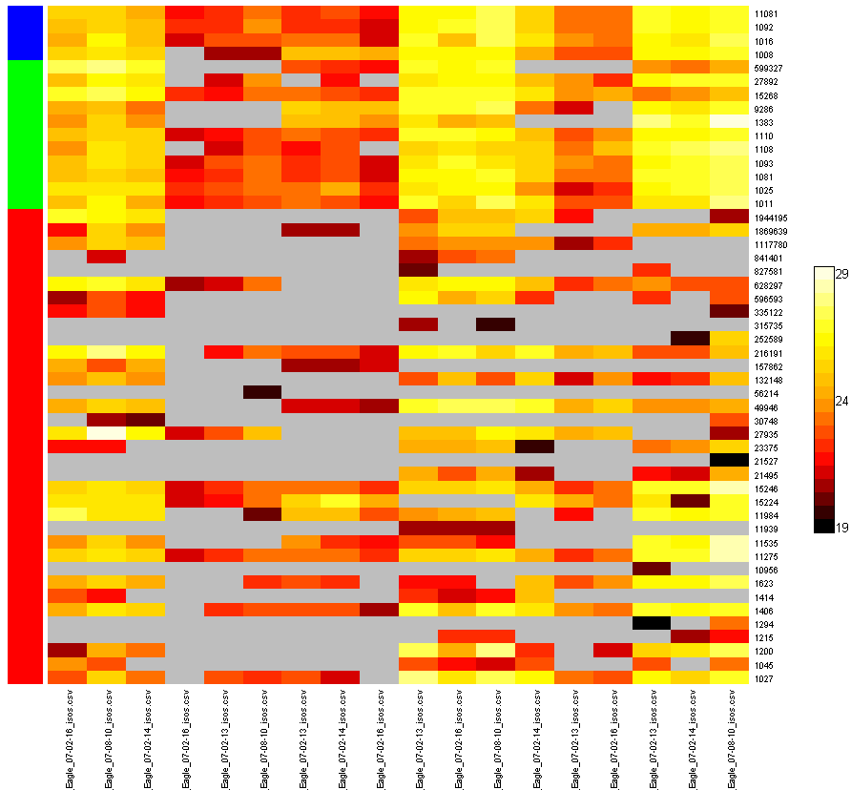
Heatmaps of Peptide Abundance
Hierarchical clustering of rows and columns
Various conditions ??

Slide 20
Complete InfernoRDN Feature List
Data loading with peptide-protein group information
Log transform
Factor Definitions
Normalization
Linear Regression
Loess
Quantile normalization
Median Absolute Deviation (MAD) Adj.
Mean Centering
Missing Value Imputation
Simple
mean/median of the sample
Substitute a constant
Advance
Row mean within a factor
kNN method
SVDimpute
Save tables / factors / session

Slide 21
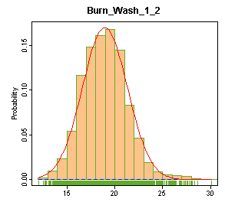
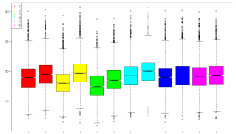
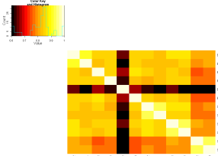
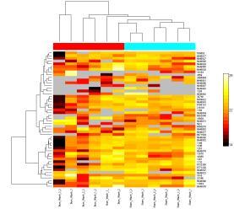
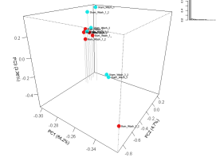
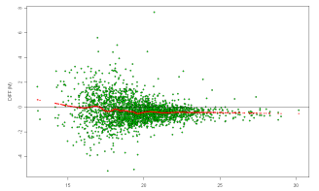
Complete InfernoRDN Feature List
Plots
Histograms
Boxplots
Correlation plots
MA plots
PCA/PLS plots
Protein rollup plots
Heatmaps
Rolling up to Proteins
Reference peptide based scaling (RRollup)
Z-score averaging (ZRollup)
QRollup
Statistics
ANOVA
Simple 1-way
N-Way (provisions for unbalanced data)
Random effects (multi level) models (REML)
Q-values
Filters
http://omics.pnl.gov/software/InfernoRDN
\\floyd\Software\Inferno

Slide 22
To be added…
Tests for normality, Nonparametric tests, post-hoc tests
Incorporating an interactive heatmap control
SMART-AMT, peptide prophet
Protein Quality metrics
Improve rollup methods to cluster and differentiate protein isoforms
Alan Dabney’s work
Network algorithms / Cytoscape

Slide 23
Acknowledgements
Weijun Qian
Deep Jaitly
Vlad Petyuk
Josh Adkins
Tom Metz
Stephen Callister
Brian LaMarche
Ken Auberry
Matt Monroe
and the rest of the informatics group
Joel Pounds
Susan Varnum
Bobbie-Jo Webb-Robertson
Active users!
Kim Hixson
Josh Turse
Charles Ansong
Feng Yang
Bryan Ham
Christina Sorensen
Angela Norbeck
Sam Purvine
Nathan Manes
Jon Jacobs
Gordon Anderson
Dick Smith
… and the group.

