Slide 1
Instructions to Run a sample dataset in InfernoRDN (previously DAnTE)
Ashoka Polpitiya

Slide 2
Data
Two conditions – A and B
Each condition has three samples run in duplicates.
This results in 12 runs in the dataset.

Slide 3
Related files
MT_AbundanceData.csv : MassTags (peptides) and their abundance values.
ProtInfo.csv : MassTags to Protein relationships.
bioinformatics_supplement.dnt : Session file saved with the resulting data.

Slide 4
Summary of analysis
Data loading
Factor definitions
Log transform
Correlation plot
Normalization
Central tendency adjustment
Rollup to proteins
Plot rollup results
ANOVA on proteins
Filter proteins with p < 0.05
Cluster heatmap

Slide 5
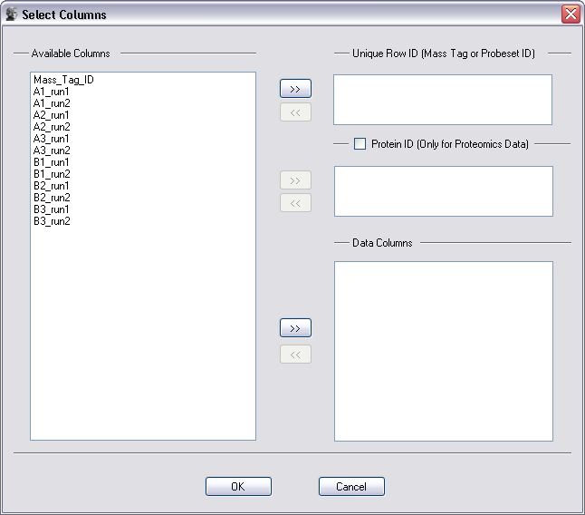
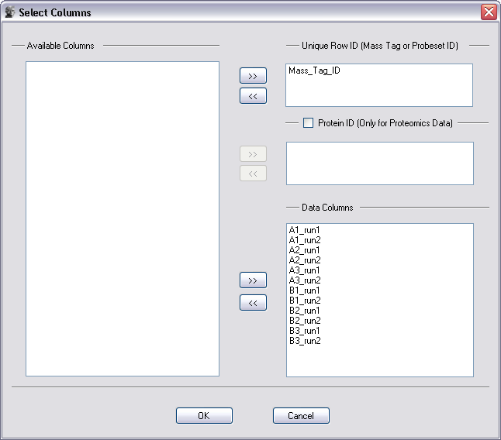
Data loading
Menu: File → Open → Expression File
Step 1
Step 2

Slide 6
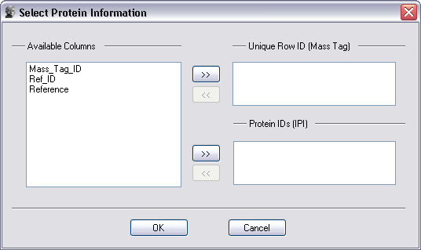
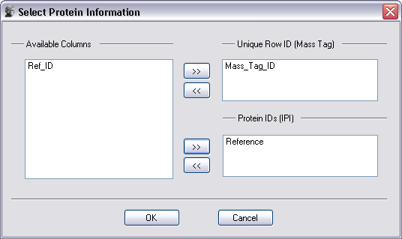
Data loading
Menu: File → Open → MassTag -Protein File
Step 1
Step 2

Slide 7
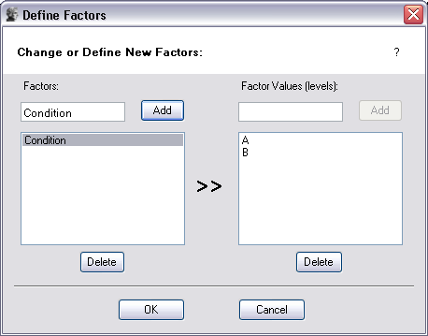
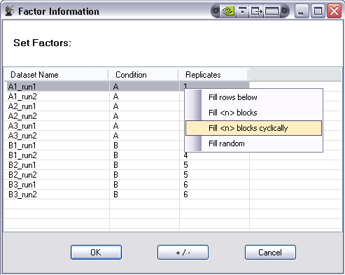
Factor definitions
Menu: Statistics → Define Factors
Define two factors
Condition with two levels (A and B)
Replicates with 6 levels (1 … 6, each corresponds to a sample)

Slide 8
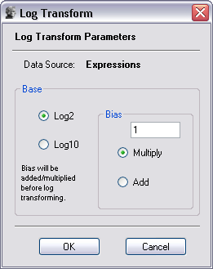
Log transform
Select the ‘Expressions’ table
Menu: Pre-Process → Log Transform

Slide 9
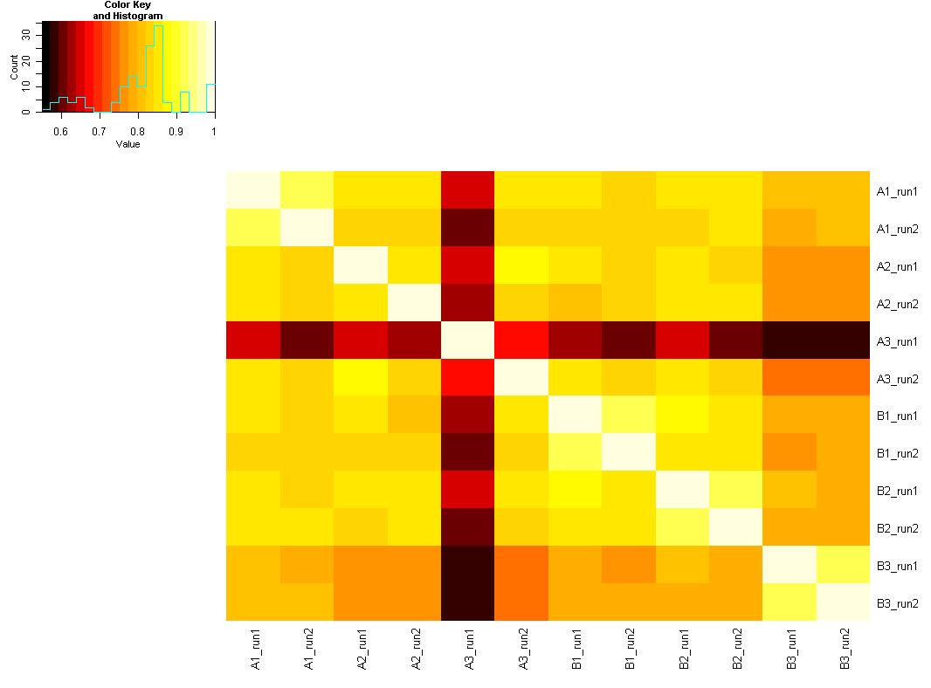
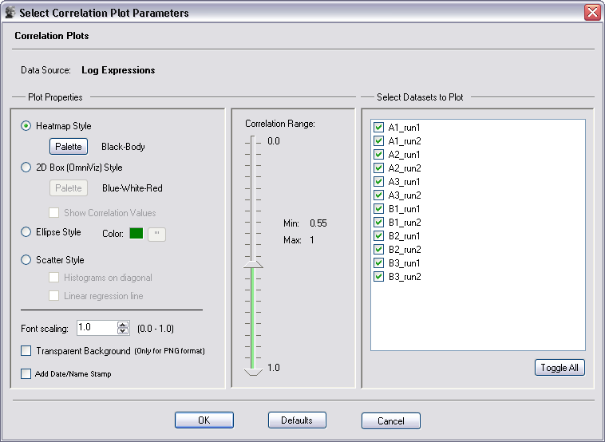
Correlation plot
Menu: Plot → Correlation
Possible outlier

Slide 10
Other plots
Q-Q plots (Menu: Plot → Q-Q Plot)
Histograms (Menu: Plot → Histograms)
Boxplots (Menu: Plot → Boxplots)
… etc.

Slide 11
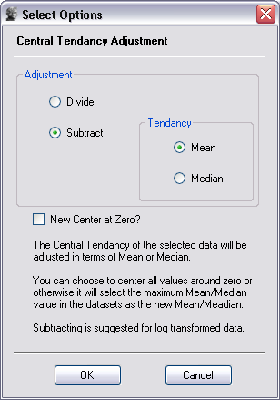
Normalization
Lets perform a central tendency adjustment
Menu: Pre-Process → Central Tendency

Slide 12
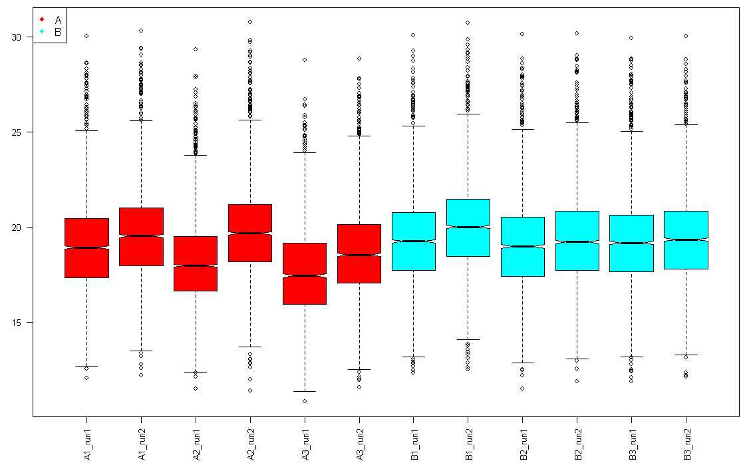
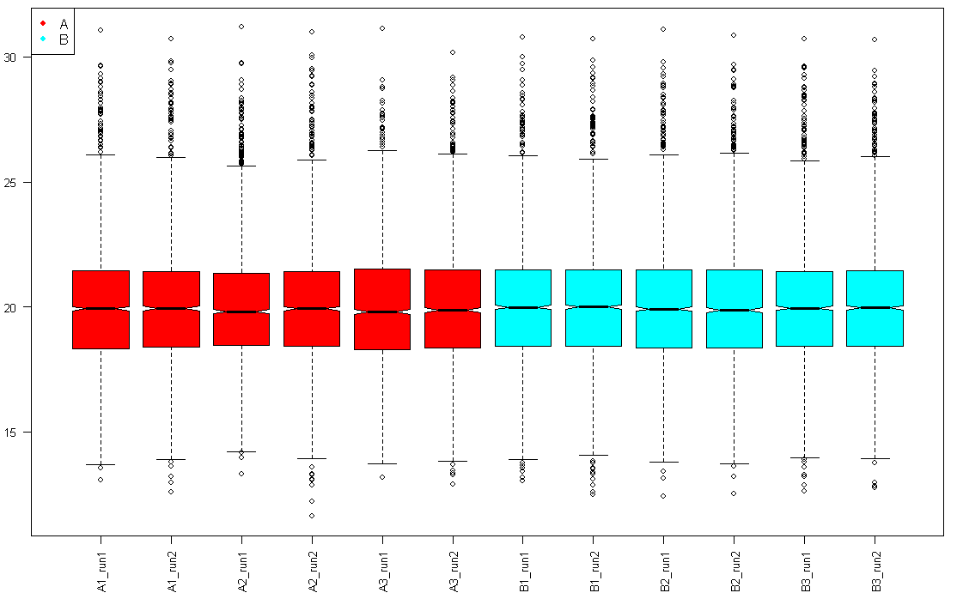
Normalization
Before
After

Slide 13
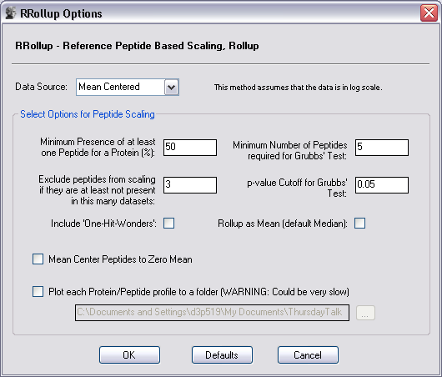
Rollup to proteins
Menu: Rollup → RRollup

Slide 14
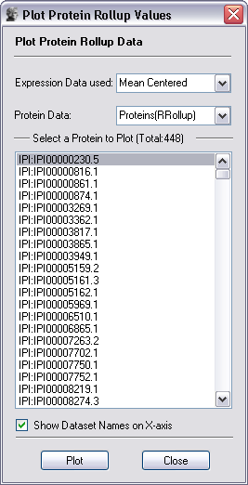
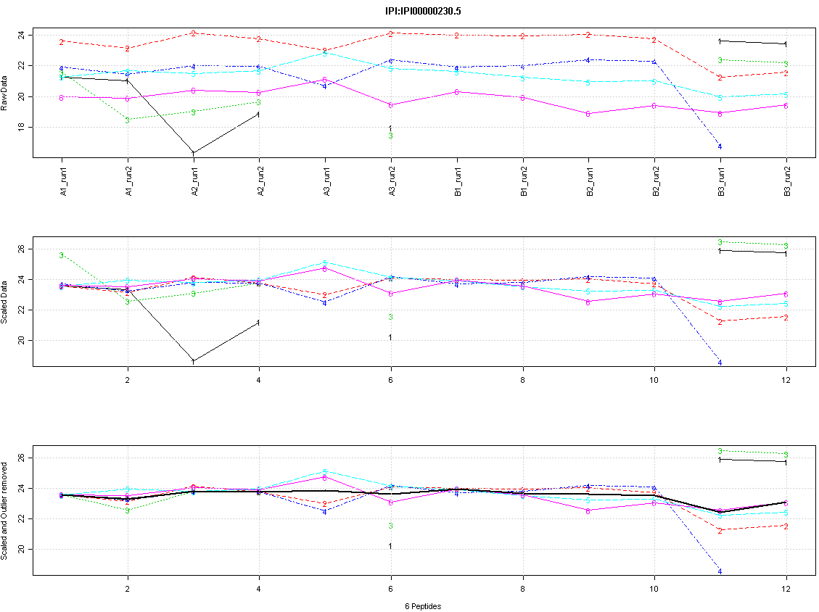
Plot rollup results
Menu: Plot → Protein Rollup

Slide 15
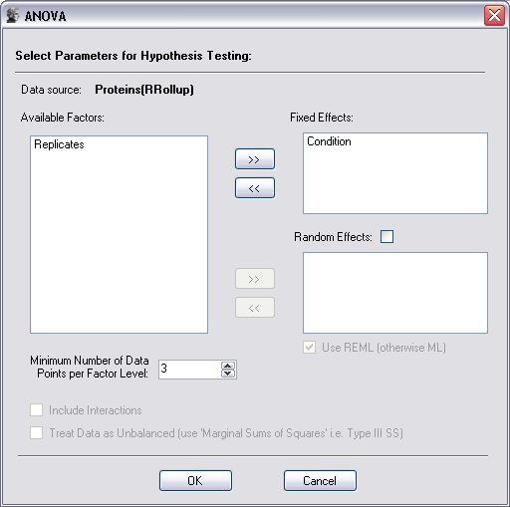
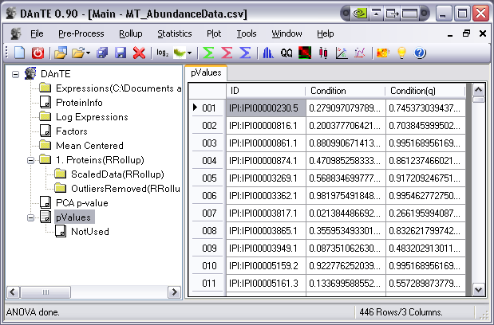
ANOVA
Menu: Statistics → ANOVA
Results – p and q values
Note: ANOVA results are similar to t-test in this case since there are only two conditions

Slide 16
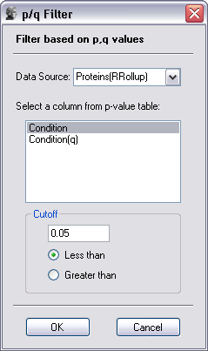
Filter based on p-value
Menu: Tools → p/q-value Filter
→ results in 59 proteins

Slide 17
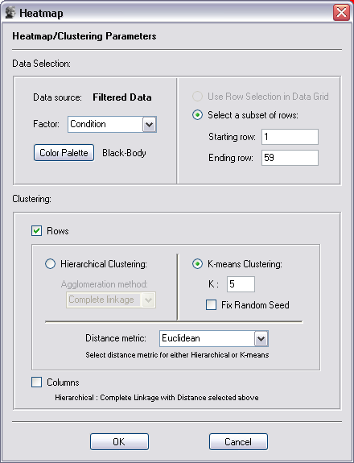
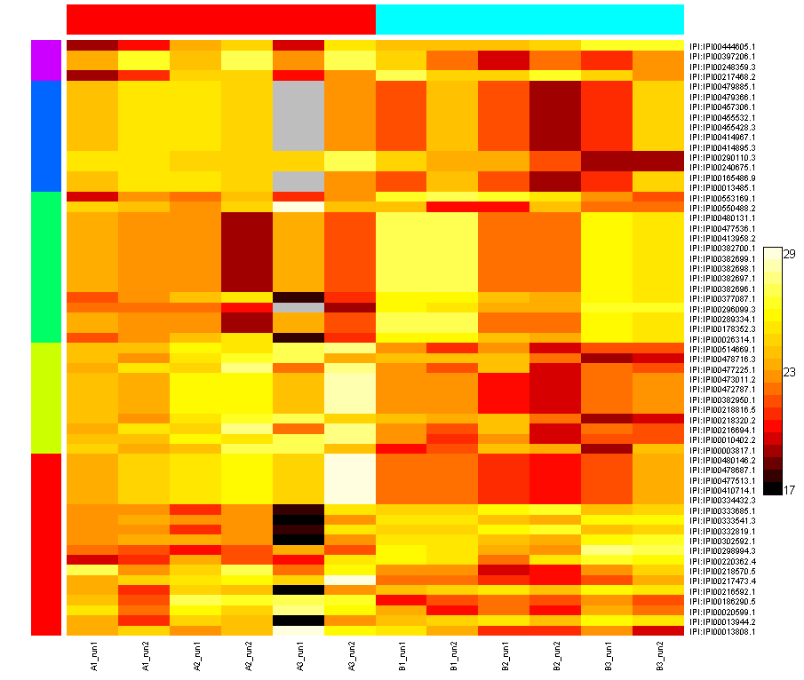
Cluster heatmap
Select ‘Filtered Data’
Menu: Plot → Heatmap
K-means cluster heatmap of 59 significant proteins

