Slide 1
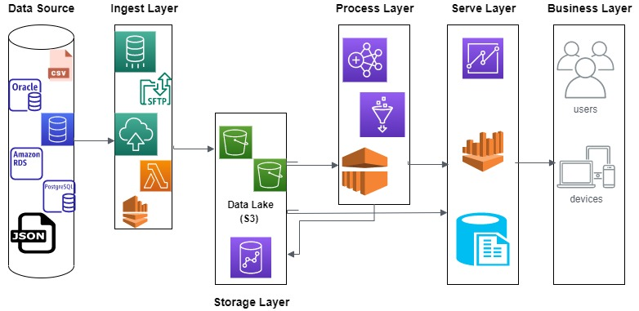
Case Study Architecture

