Slide 1
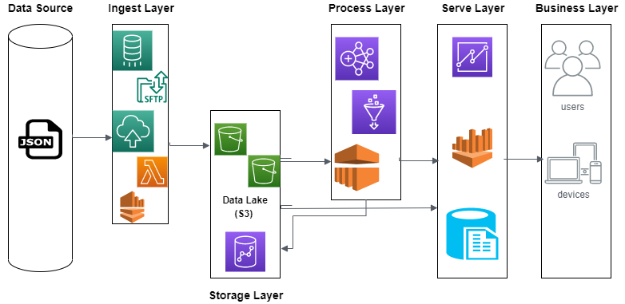
Case Study Architecture

Slide 2
Testing Approach
Integrating Testing with CI/CD Pipeline
CI pipeline will have automated unit test cases that can be run quickly. This gives the first level of feedback to developers if their code has broken any of the unit test cases.
The CI pipeline can also contain automated integrations tests that look at API based integrations between modules of the system and/or API based integration of the system with surrounding applications. These API based integration tests may use test stubs for surrounding applications. This gives the second level of feedback to developers if their code has broken any of the integration tests.

Slide 3
Handling Data Merge
Maintain Stage and Target Layers
Merge records from Staging to Target- Delete by using Inner Join and then Insert new rows from Staging tables.

Slide 4
Alerts and Monitoring
Data Quality Controls
Custom Scripts/ AWS CloudWatch

