Slide 1
Multi Objective Prioritized Workflow Scheduling Using Deep Reinforcement Based Learning in Cloud Computing
CSE 400 - Paper reading and presentation
May, 2025

Slide 2
Topic Breakdown
Cloud Computing & Cloud Services
Heavy computation works -
analysis of complex images
hosting globally accessible web apps
We take them as service from others through cloud (the vast network).
Cloud Service Providers (CSP)

Slide 3
Topic Breakdown
Servers & VMs
Servers are hardware devices capable of providing services
VMs are run inside servers to provide mutual exclusion and protection, along with abstraction.

Slide 4
Topic Breakdown
Cloud Services & Tasks
Infrastructure / Platform / Software
We ask the CSP to do the tasks for us in their highly capable machines
Workflow → Series of tasks

Slide 5
Topic Breakdown
Task Scheduling
Multiple clients send their tasks to CSP
Tasks are assigned to available VMs → Task Scheduling
VMs are not necessarily dedicated to clients → Distributed Systems

Slide 6
Reasoning
Task Scheduling Optimization
Minimum average turnaround time (wait time)
Makespan → The less, the better
VM energy consumption
In this paper, these are our judging criteria as well

Slide 7
Paper Title Breakdown
Multi Objective Prioritized Workflow Scheduling Using Deep Reinforcement Based Learning in Cloud Computing
Multi Objective → Tasks from different clients/sources to different CSPs
Task priorities & Dependencies
Optimized Scheduling through reinforcement learning

Slide 8
Compare Against
HEFT
Heterogeneous Earliest Finishing Time
Heterogeneous -> Tasks & VMs are not necessarily similar
CSO
Cat Swarm Optimization
Tracing & Hunting

Slide 9
Compare Against
ACO
Ant Colony Optimization
Stores rewards in memory
Similar to pheromone
PSO
Particle Swarm Optimization
Iterative improvements

Slide 10
Used in this Paper
DQN
Reinforcement Learning (reward / penalty based on action)
Deep-Q Neural Network ( Multi-layer)
Estimates best action → here, optimized schedule

Slide 11
Related Works
Adaptive Task Scheduling
Task durations can be dynamic
Minimizing completion time of dynamic tasks
Hybridization of HEFT & ACO
Q-learning with Markov game learning approach

Slide 12
Related Works
Automated Task Scheduling
Embedded Neural Network
Hybridizations
Q-learning, Bee colony algorithms with load balancers to distribute tasks.
Evaluated over - MOCS (Crow Search), MOPS)

Slide 13
Related Works
Strict Deadlines
Three variants of HEFT used in phases
Monetary Constraints
Divide and Conquer to make schedule paths linear
SLA and Availability Constraints
Hybridization of quality upgrading techniques

Slide 14
Problem Formulation
Tasks
T = { T1, T2, T3, ... ... }
Hosts ( Physical Servers)
H = { H1, H2, H3, ... ... }
VMs (Virtual Machines)
V = { V1, V2, V3, ... ... }

Slide 15
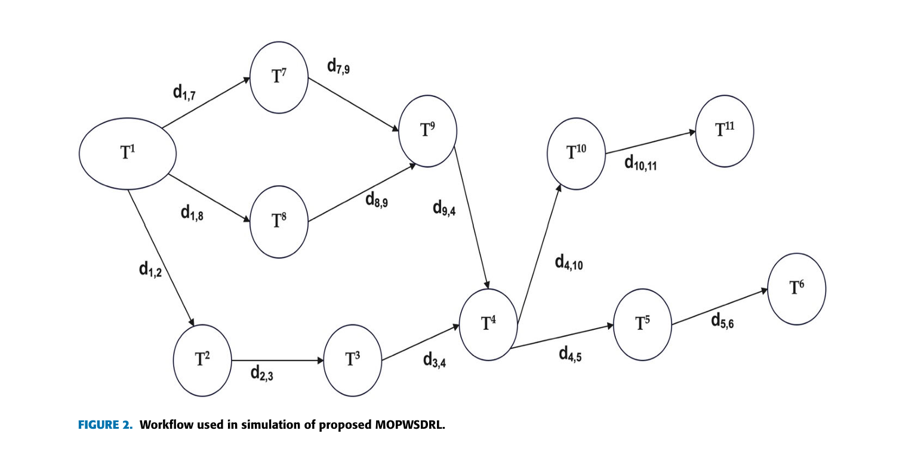
Problem Formulation
Workflow with Task Dependencies

Slide 16
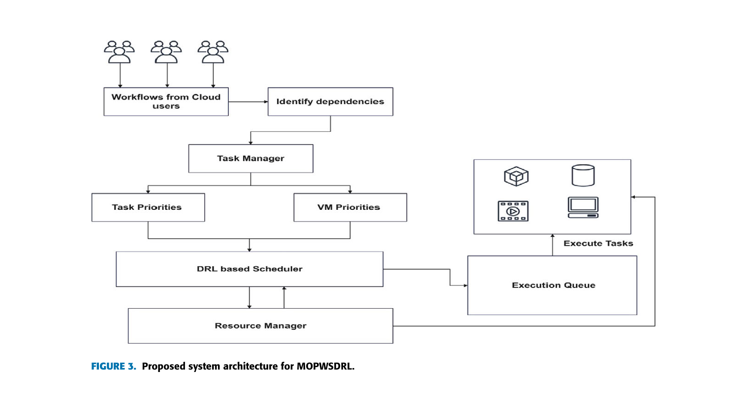
System Architecture

Slide 17
Mathematical Modelling
Formulas proposed to calculate -
Task priorities: Task length, Complexity, Dependencies
VM priorities: Computation power, Energy consumption
Support equations -
Task execution time, Task finishing time
Makespan, Energy consumption ← Judging criteria

Slide 18
METHODOLOGY USED
Uses a Deep Q-Network (DQN) to learn task scheduling automatically.
Starts by generating random schedules based on task dependencies, task/VM priorities, and deadlines.
The DQN agent evaluates each schedule and gives a positive reward if it improves time or energy metrics, or a negative reward otherwise.
Rewards are stored in a Q-table as Q(state, action) entries.

Slide 19
METHODOLOGY USED
On each new step, the agent consults the Q-table and past rewards to choose better scheduling actions.
Over many iterations, the agent’s policy converges to schedules that balance makespan and energy use.
The state space includes task dependencies and priorities; the action space is the choice of VM for each task.

Slide 20
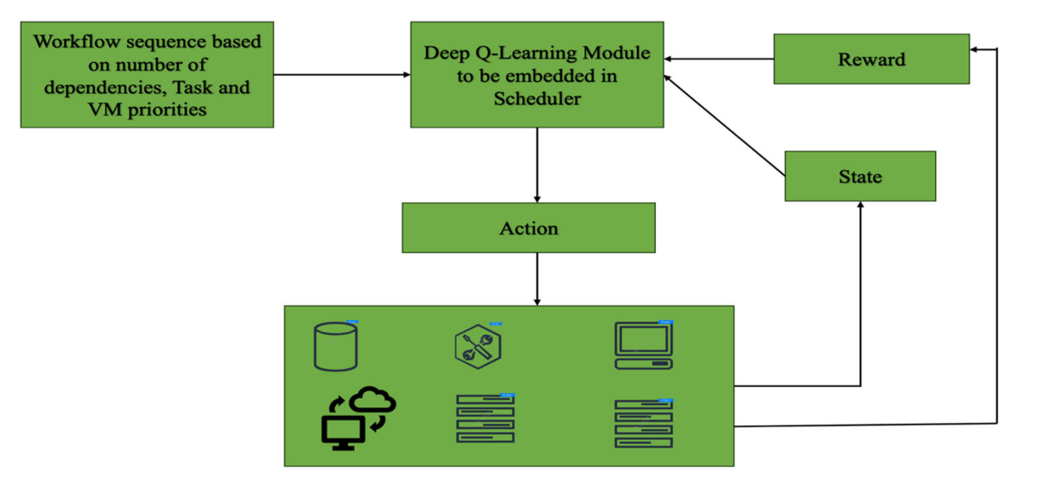
Proposed MOPWSDRL Model
Working of deep reinforcement approach for MOPWSDRL

Slide 21
Simulation Setup
Platform used: Workflowsim simulator on a macOS host (32 GB RAM, M1 chip)
WorkflowSim is an open-source software platform built on top of CloudSim (a widely used simulation toolkit for cloud computing). It is specifically designed to simulate the execution of scientific workflows in distributed or cloud-based environments.
Infrastructure:
5 hosts nodes
50 VMs running on those hosts
100 to 1000 tasks

Slide 22
Workflows Tested
Four real scientific workflows:
Montage (astronomy image assembly)
Cybershake (earthquake simulation)
Epigenomics (genome sequencing)
LIGO (gravitational-wave analysis)

Slide 23
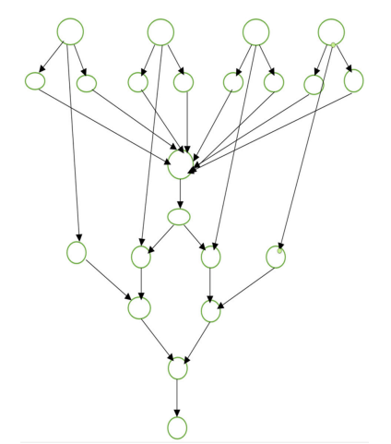
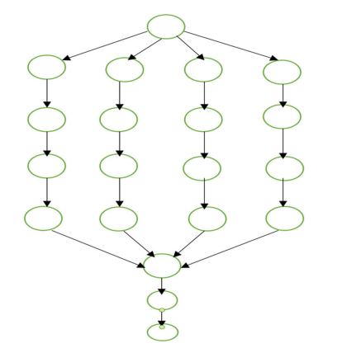
Montage workflow
Epigenomics workflow

Slide 24
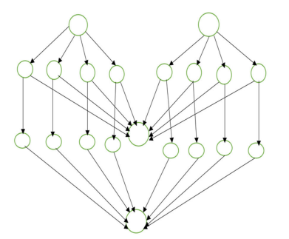
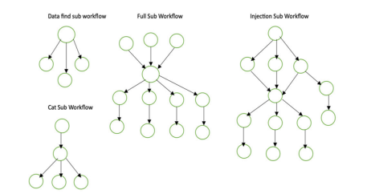
Cybershake workflow
Ligo workflow

Slide 25
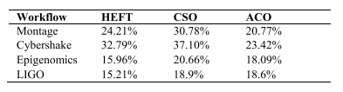
Makespan Results
Improvement of makespan for MOPWSDRL over existing mechanisms

Slide 26
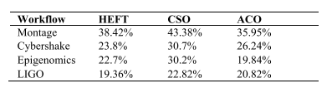
Energy Consumption Results
Improvement of energy consumption for MOPWSDRL over existing mechanisms.

Slide 27
Result Analysis
Why MOPWSDRL Outperforms HEFT, CSO & ACO :
Dependency- and Priority-Aware Scheduling
MOPWSDRL looks at how tasks depend on each other and combines two priorities—task size vs. VM speed and VM power cost—when choosing where to run each task. HEFT, CSO, and ACO use fixed rules and miss some of these important details.
Adaptive, Reward-Driven Learning
MOPWSDRL treats scheduling as a learning game: it gets good or bad “points” for each decision and uses past experiences to improve.

Slide 28
Conclusions
Summary:
Integrating task/VM priorities into a DQN scheduler dramatically cuts makespan and energy use across diverse workflows
Outperforms classic metaheuristics in both speed and “greenness”
Current Limitations:
Edge cases: very large workflows (like LIGO) still leave room for further gains
Training time & simulation overhead in real-time environments

Slide 29
Thank you

