Slide 1

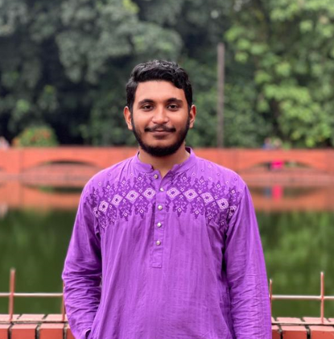
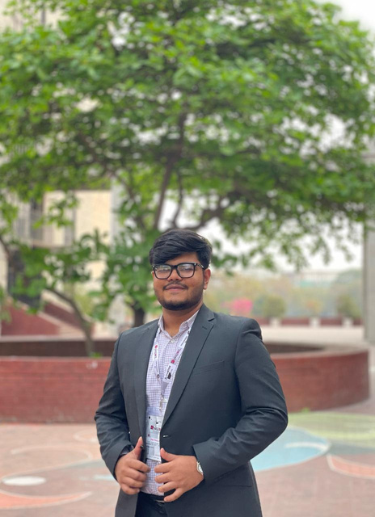
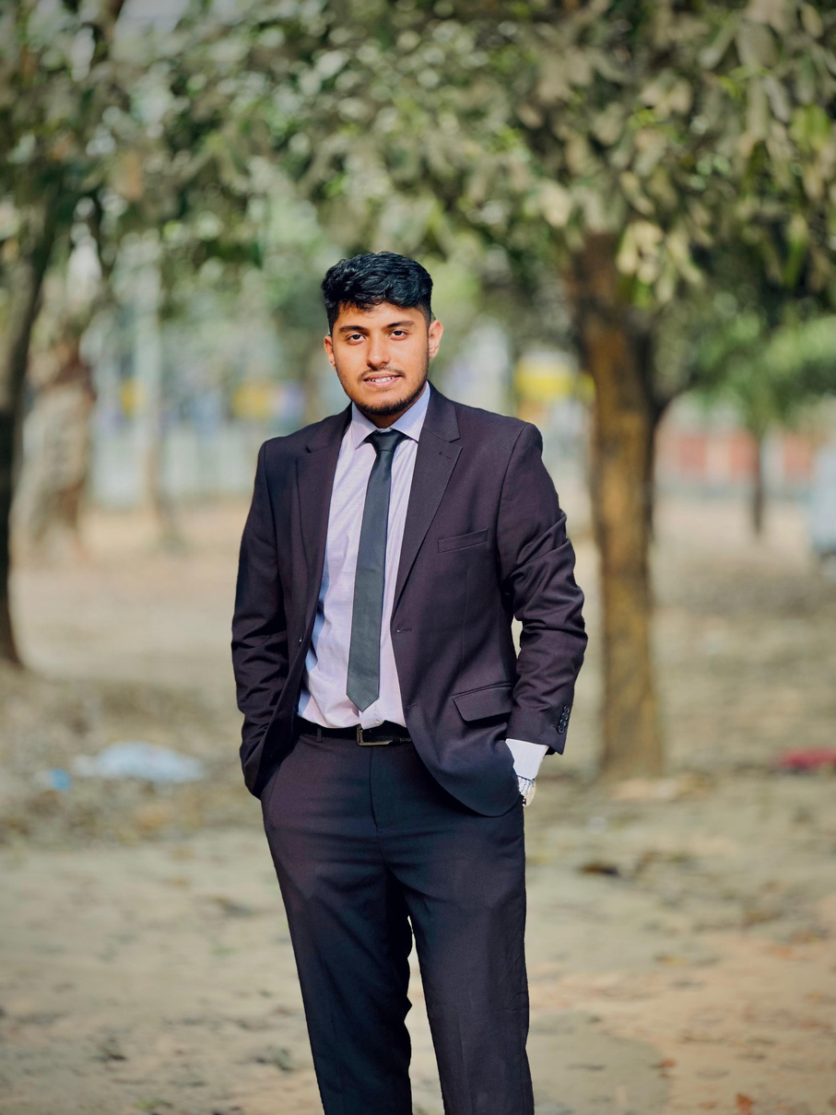
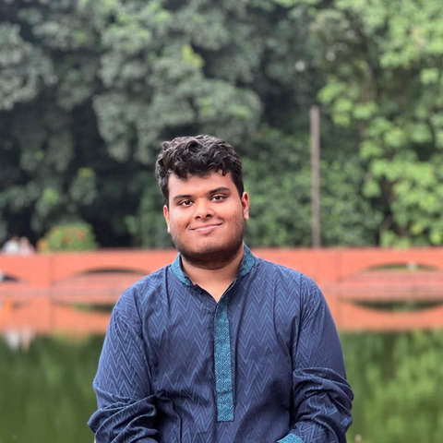
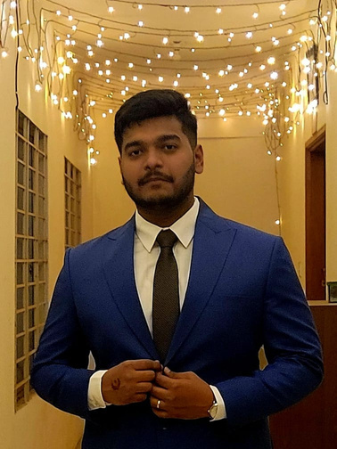
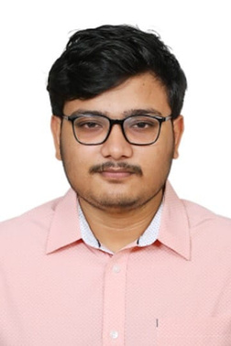
FINAL PROJECT DEMONESTRATION
EEE 4518: ELECTRICAL AND ELECTRONIC WORKSHOP
PROJECT TITLE: ENHANCEMENT OF BATTERY-POWERED RICKSHAW
Submitted by – Team Murubb_EEE
AR RAFI ISHRAQ
210021330
ISHRAK ANAN
210021212
TAUFEEQ HASSAN OMIO
210021214
ASHFIQ UL RAHMAN
210021342
TAHSIK ISLAM SAMPAD
210021318
BAYZID MOHAMMED SAKIB
210021250
Creating Global Citizens Rooted with Islamic Values

Slide 2

OUTLINE
  ABSTRACT
  PROBLEM STATEMENTS AND PROPOSED SOLUTIONS
  DESIGN
  IMPLEMENTATION
  ANALYSIS AND EVOLUTION
  REFLECTION OF INDIVIDUAL AND TEAMWORK
  REFERENCES
3
2
Creating Global Citizens Rooted with Islamic Values

Slide 3
ABSTRACT
We, team Murubbeee, aim to work on enhancing battery-run rickshaws in Bangladesh. Battery rickshaws have become a common urban transportation in Bangladesh, especially in busy cities like Dhaka, and Chittagong. According to Dhaka Tribune’s report on May 24, 2024, almost 60 lakh battery rickshaws are operating on the streets of Bangladesh. These rickshaws provide us with the benefits of fast transportation as compared to their counterpart, human-powered rickshaws. However, these benefits come with a price. Battery rickshaws are the major reasons for accidents, excessive electricity usage, and traffic-related issues. To address these issues and also upgrade these battery-run rickshaws for more efficient results, we propose our newly modified battery rickshaws.
3
3
Creating Global Citizens Rooted with Islamic Values

Slide 4
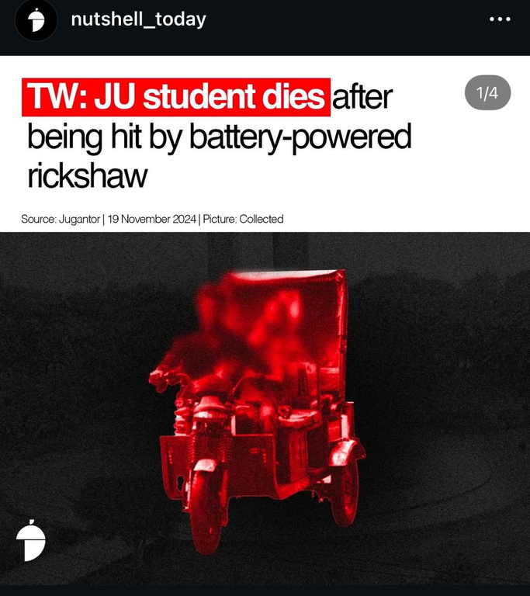
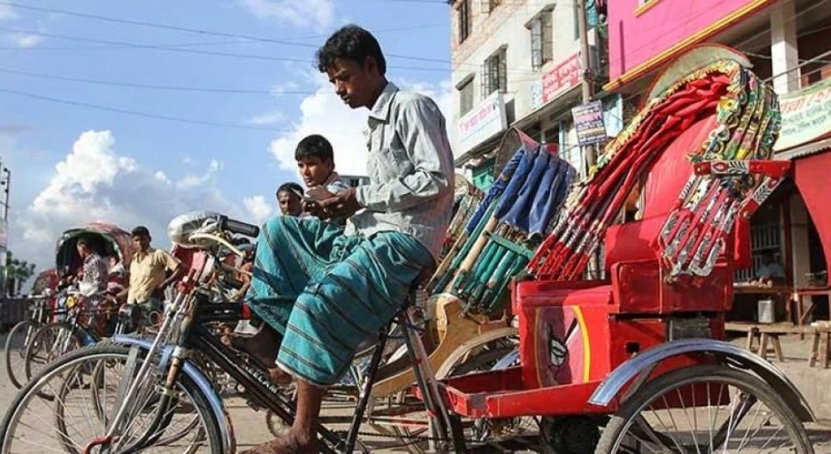
PROBLEM STATEMENTS
1. Unnecessary speeding of battery rickshaws.
2. Collisions that lead to minor or severe injuries and life threats
3. Excessive use of electricity for charging the battery-run rickshaws
4. Lack of safety measurements in the rickshaws
5. Absence of an information system in the rickshaw.
4
4
Creating Global Citizens Rooted with Islamic Values

Slide 5
PROPOSED SOLUTIONS
  Solar panel installation on the top of rickshaw hoods
  Speed sensors to detect the speed of the rickshaw
  Obstacle detector to be installed at the front portion
  A system that can respond to overspeed and reduce chances of collisions by controlling the power supply to motor.
  Addition of indicator lamps and headlamps
  Information system (LED display) to show necessary data (speed, charge, etc.)
5

Slide 6
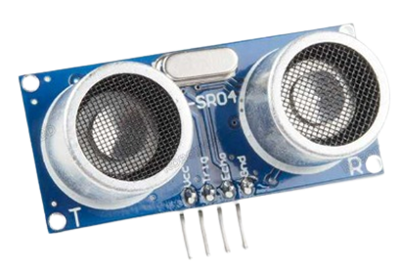
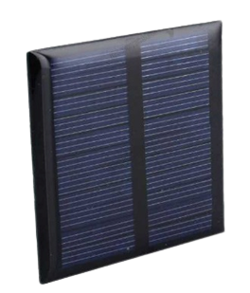
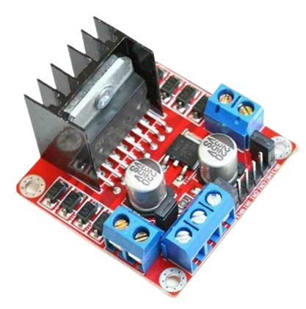
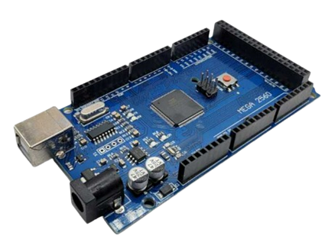
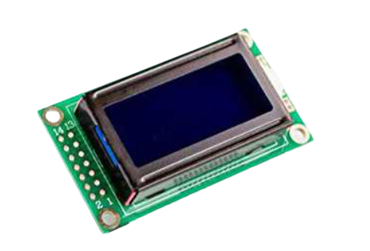

3.1 DESIGN: METHODS
Components Used in the prototype:
  ARDUINO
  400 RPM motors
  Dual Motor Drivers
  Solar Panel
  Speed Measuring Module
  LCD Panels
  SONAR sensor
  LED indicators
Microcontroller Used: ATmega328
Code implemented by: Arduino IDE
5
6
Creating Global Citizens Rooted with Islamic Values

Slide 7
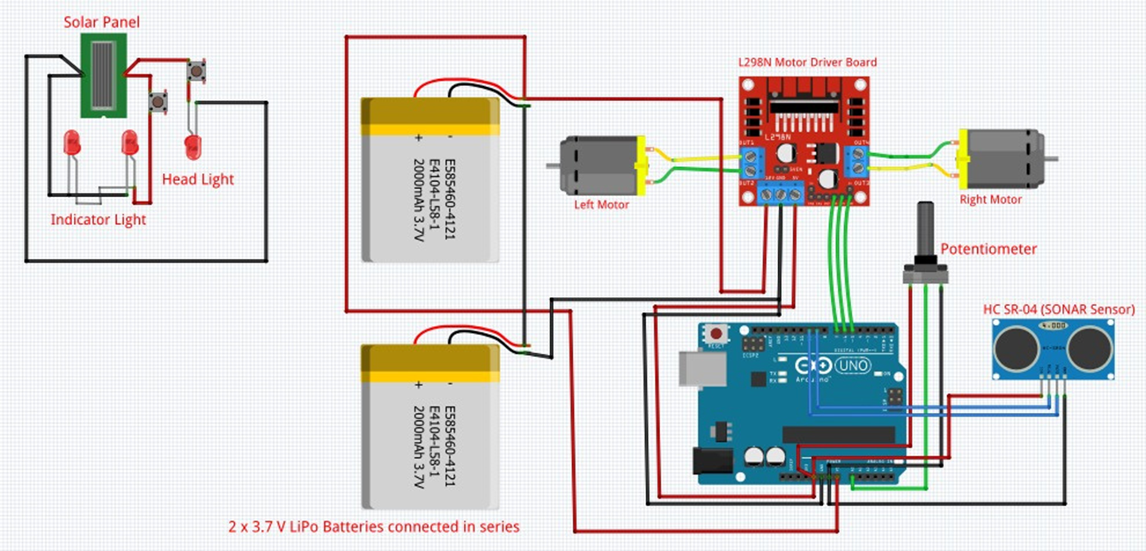
3.2 DESIGN: CIRCUIT DIAGRAM
5
7
Creating Global Citizens Rooted with Islamic Values

Slide 8
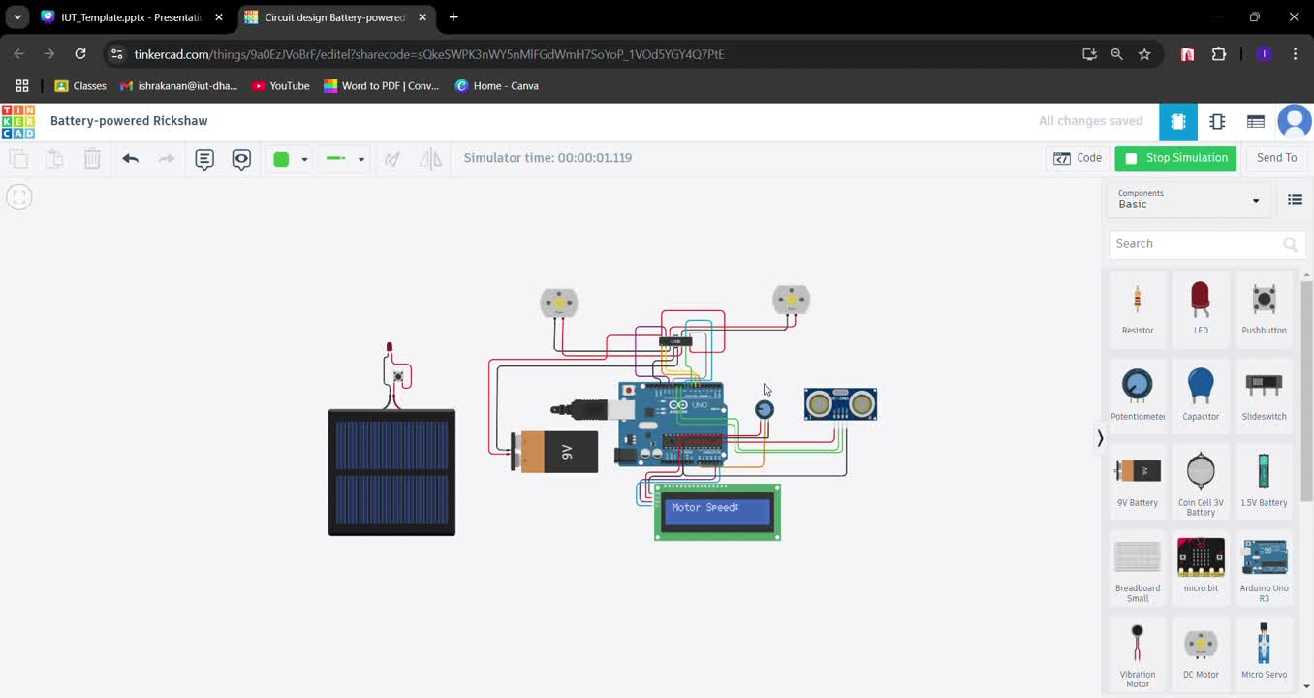
3.3 DESIGN: SIMULATION
5
8
Creating Global Citizens Rooted with Islamic Values

Slide 9
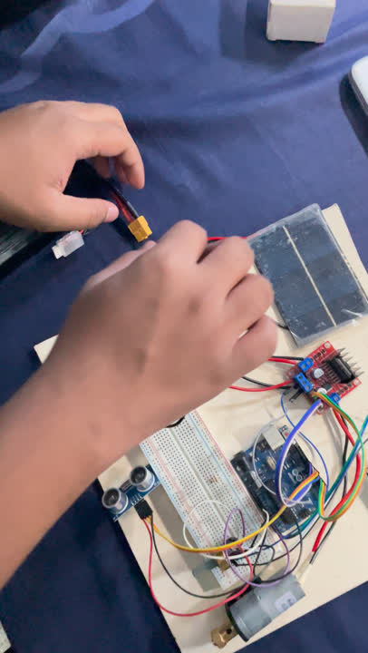
4. IMPLEMENTATION:
DEMONSTRATION
5
9
Creating Global Citizens Rooted with Islamic Values

Slide 10
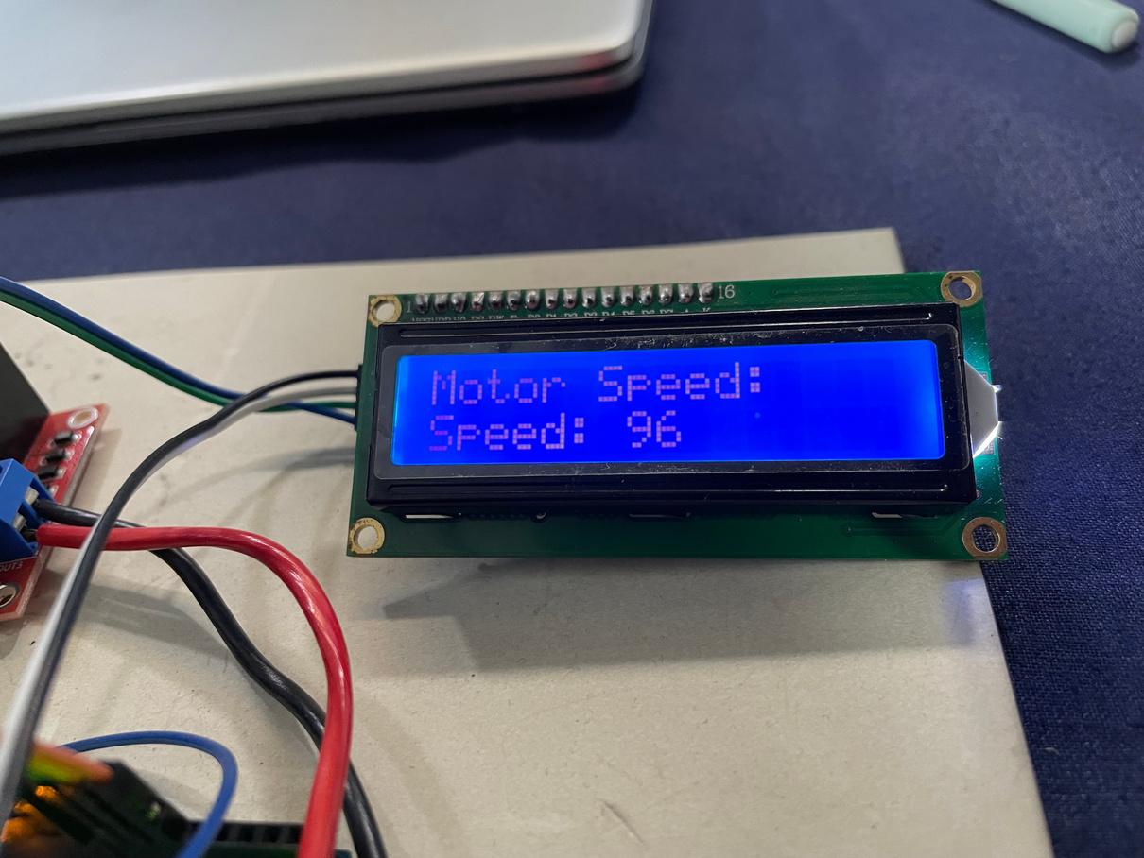
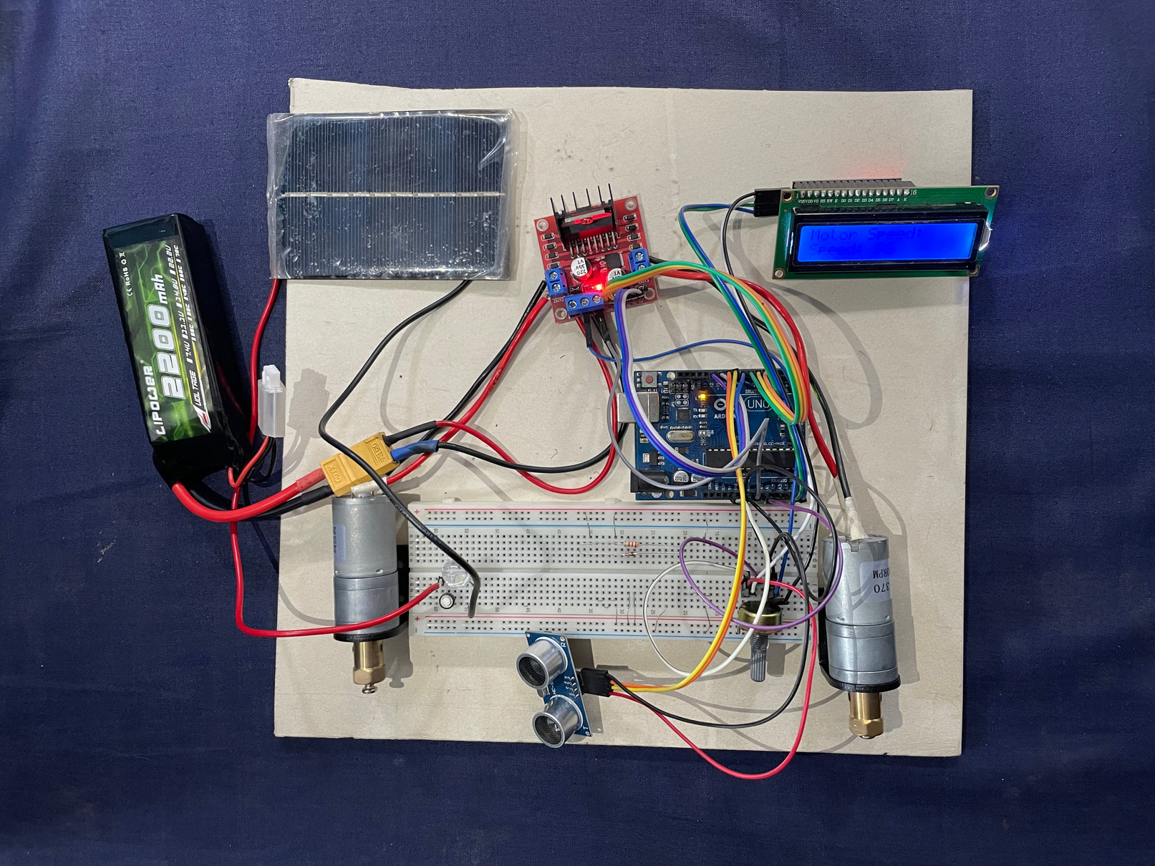
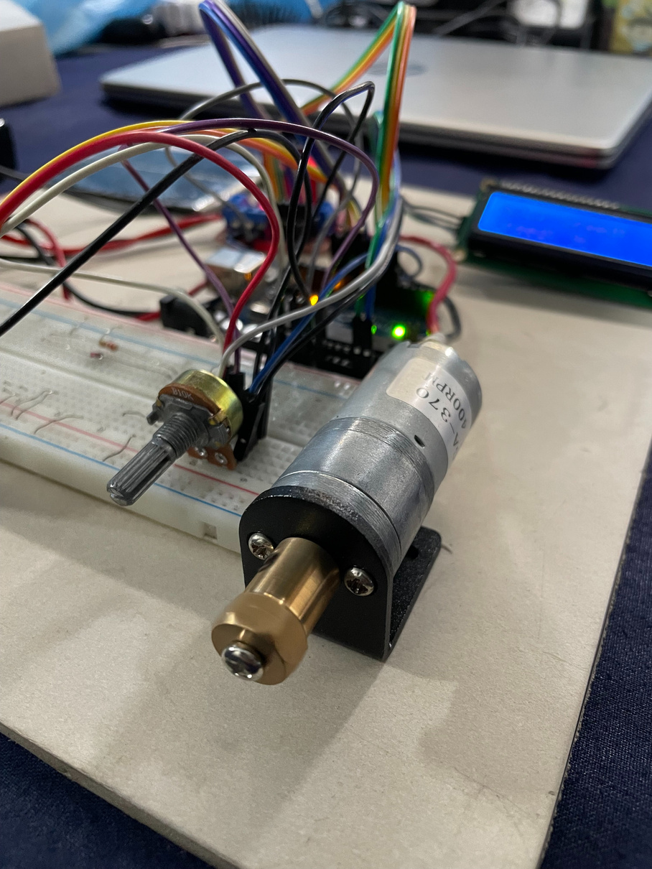
4.1 IMPLEMENTATION: PHOTO GALLERY
5
10
Creating Global Citizens Rooted with Islamic Values

Slide 11



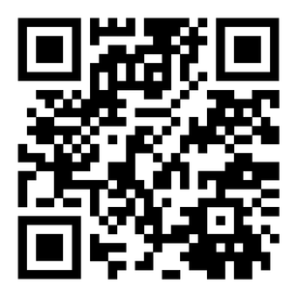

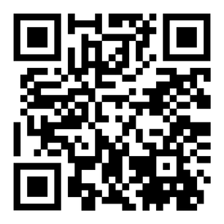
4.2 IMPLEMENTATION:
EXTERNAL LINKS
https://youtube.com/shorts/Rr9jDDKW8tM?si=Zxs3Y1whMCS7SmcW
https://drive.google.com/file/d/10qWkcPVF2pdNtCMIhrEbjjUucbQbvRDR/view?usp=drive_link
https://youtu.be/czvA3kF8Too
5
11
Creating Global Citizens Rooted with Islamic Values

Slide 12
5. ANALYSIS AND EVALUATION
5.1 Novelty
5.2 Project Management and Cost Analysis
5.3 Practical Considerations of the Design
5.4 Assessment of the Impact of the Project
5.5 Evaluation of the Sustainability
5
12
Creating Global Citizens Rooted with Islamic Values

Slide 13





5.1 NOVELTY
Our project introduces several innovative enhancements to existing battery-run rickshaws, aiming to improve safety, efficiency, and sustainability.
INTELLIGENT SPEED CONTROL SYSTEM
OBSTACLE DETECTION
UNIQUENESS
ENHANCED SAFETY FEATURES
ENERGY SAVING FEATURES
DATA-DRIVEN MONITORING SYSTEM
5
13
Creating Global Citizens Rooted with Islamic Values

Slide 14

5.2 PROJECT MANAGEMENT & COST ANALYSIS
Component Name
Quantity
Price
Component Name
Quantity
Price
Arduino UNO (R3)
1
995/-
Solar Panel
(RYO 474)
1
160/-
Motor Driver
(L298N)
LED Indicators
1
10/-
1
120/-
Potentiometer (10K)
2
30/-
Display
1
90/-
SONAR sensor (HC SR-04)
1
60/-
Adapter Module
1
90/-
LiPo Battery 11V
1
1600/-
Jumper wire + Hexa connector
1 set
260/-
Motor
(25GA 370 400 RPM)
2
800/-
Soldering Kit
1 Set
400/-
5
14
Creating Global Citizens Rooted with Islamic Values

Slide 15
5.3 PRACTICAL CONSIDERATIONS
PRACTICAL CONSIDERATIONS
Public Health & Safety
Cultural & Societal Needs
Environment
  Collision Detection ensures passenger safety
  Speed control system ensures safe journey
  Enhanced safety measures like indicators ensure safety on roads
  Energy saving features like Solar Panel
  Reduces charging time, saving excess use of electricity and fossil fuels
  Zero carbon emission
  Rickshaw represents the cultural tradition in Bangladesh
  Source of income for low-income people
  Easier mode of communication for people earning less.
5
15
Creating Global Citizens Rooted with Islamic Values

Slide 16
5.4 ASSESSMENT OF THE IMPACT
SOCIETAL ISSUES
  Reducing Accidents
  Lowering electricity demands
  Enhancing Public Perception
  Reducing the risk of high-speed collisions
  Prevents accidents involving pedestrians, other vehicles and roadside structures
  Improces visibility at night and in adverse weather conditions
HEALTH & SAFETY ISSUES
IMPACT
ASSESSMENT
LEGAL ISSUES
  Unauthorized road usage
  Illegal electricity connections
  Lack of standasrdization
CULTURAL ISSUES
  Preserving the role of rickshaws in urban transport
  Improving public image of rickshaws
  Supporting rickshaw pullers and owners
5
16
Creating Global Citizens Rooted with Islamic Values

Slide 17
5.5 EVALUATION OF THE SUSTAINABILITY
Sustainability
Societal Context
  Enhanced Safety
  Job security and opportunities
  Improved Public Perception
  Inclusion and accessibility
  Reduction in traffic incidents
  Reduction in carbon footprint
  Decreased electronic waste
  Lower energy wastage
  Noise pollution reduction
  Sustainable urban mobility
Environmental
Context
5
  Energy Efficiency
  Reduction in electricity Demand
  Long-term economic viability
  Durability and maintenance
  Environmental footprint
17
Creating Global Citizens Rooted with Islamic Values

Slide 18
6. REFELCTION ON INDIVIDUAL AND TEAMWORK
6.1 Individual Contribution of Each Team Member
6.2 Mode of Teamwork
6.3 Diversity Statement of Team
6.4 Assessment of the Impact of the Project
5
18
Creating Global Citizens Rooted with Islamic Values

Slide 19
6.1 INDIVIDUAL CONTRIBUTION OF EACH TEAM MEMBER
AR-RAFI ISHRAQ
ASHFIQ UL RAHMAN
  Research on component selection
  Purchasing components
  Hardware implementation (wiring, soldering)
  Code for individual Module
  Debugging
  Research on component selection
  Purchasing components
  Research on project feasibility and impact
  Hardware implementation (wiring, soldering)
  Report writing
  Debugging
ISHRAK ANAN
TAHSIK ISLAM SAMPAD
  Research on component selection
  Purchasing components
  Hardware implementation (wiring, soldering)
  Debugging
  Preparing presentation
  Purchasing components
  Budget designing
  Research on project feasibility and impact
  Hardware implementation (wiring, soldering)
TAUFEEQ HASSAN OMIO
BAYZID MOHAMMED SAKIB
  Research on component selection
  Research on project feasibility and impact
  Hardware implementation (wiring, soldering)
  Report writing
  Preparing presentation
  Purchasing components
  Budget designing
  Hardware implementation (wiring, soldering)
  Documentation
5
19
Creating Global Citizens Rooted with Islamic Values

Slide 20
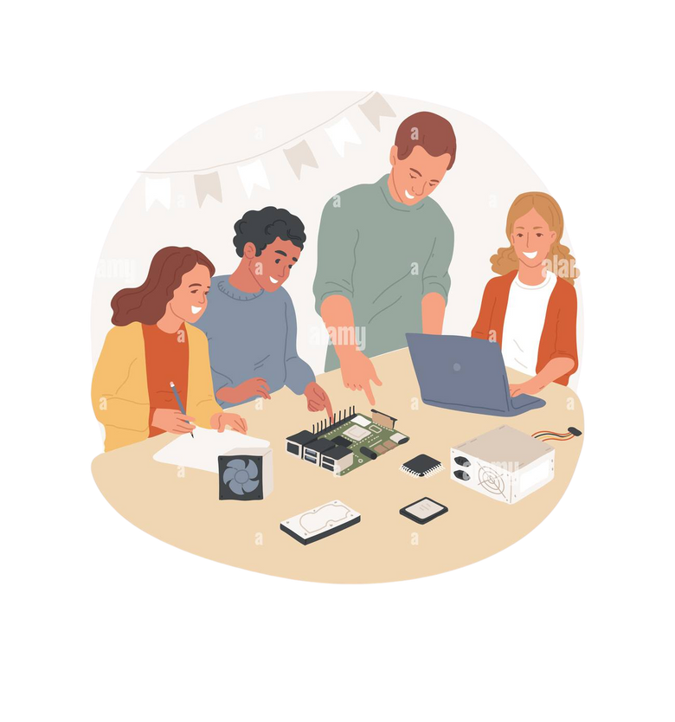



6.2 MODE OF TEAMWORK
TEAM COLLABORATION
BRAINSTORMING AND GROUP DISCUSSIONS
PROTOTYPING AND TESTING
ROLE BASED TASK ALLOCATION
5
20
Creating Global Citizens Rooted with Islamic Values

Slide 21
6.3 DIVERSITY STATEMENT OF TEAM
  ROLE BASED TASK ALLOCATION
  INCLUSIVE AND COLLABORATIVE ENVIRONMENT
  ADAPTIBILTY AND LEARNING
  COMMITMENT TO ENVIRONMENTAL AND SOCIAL IMPACT
5
21
Creating Global Citizens Rooted with Islamic Values

Slide 22


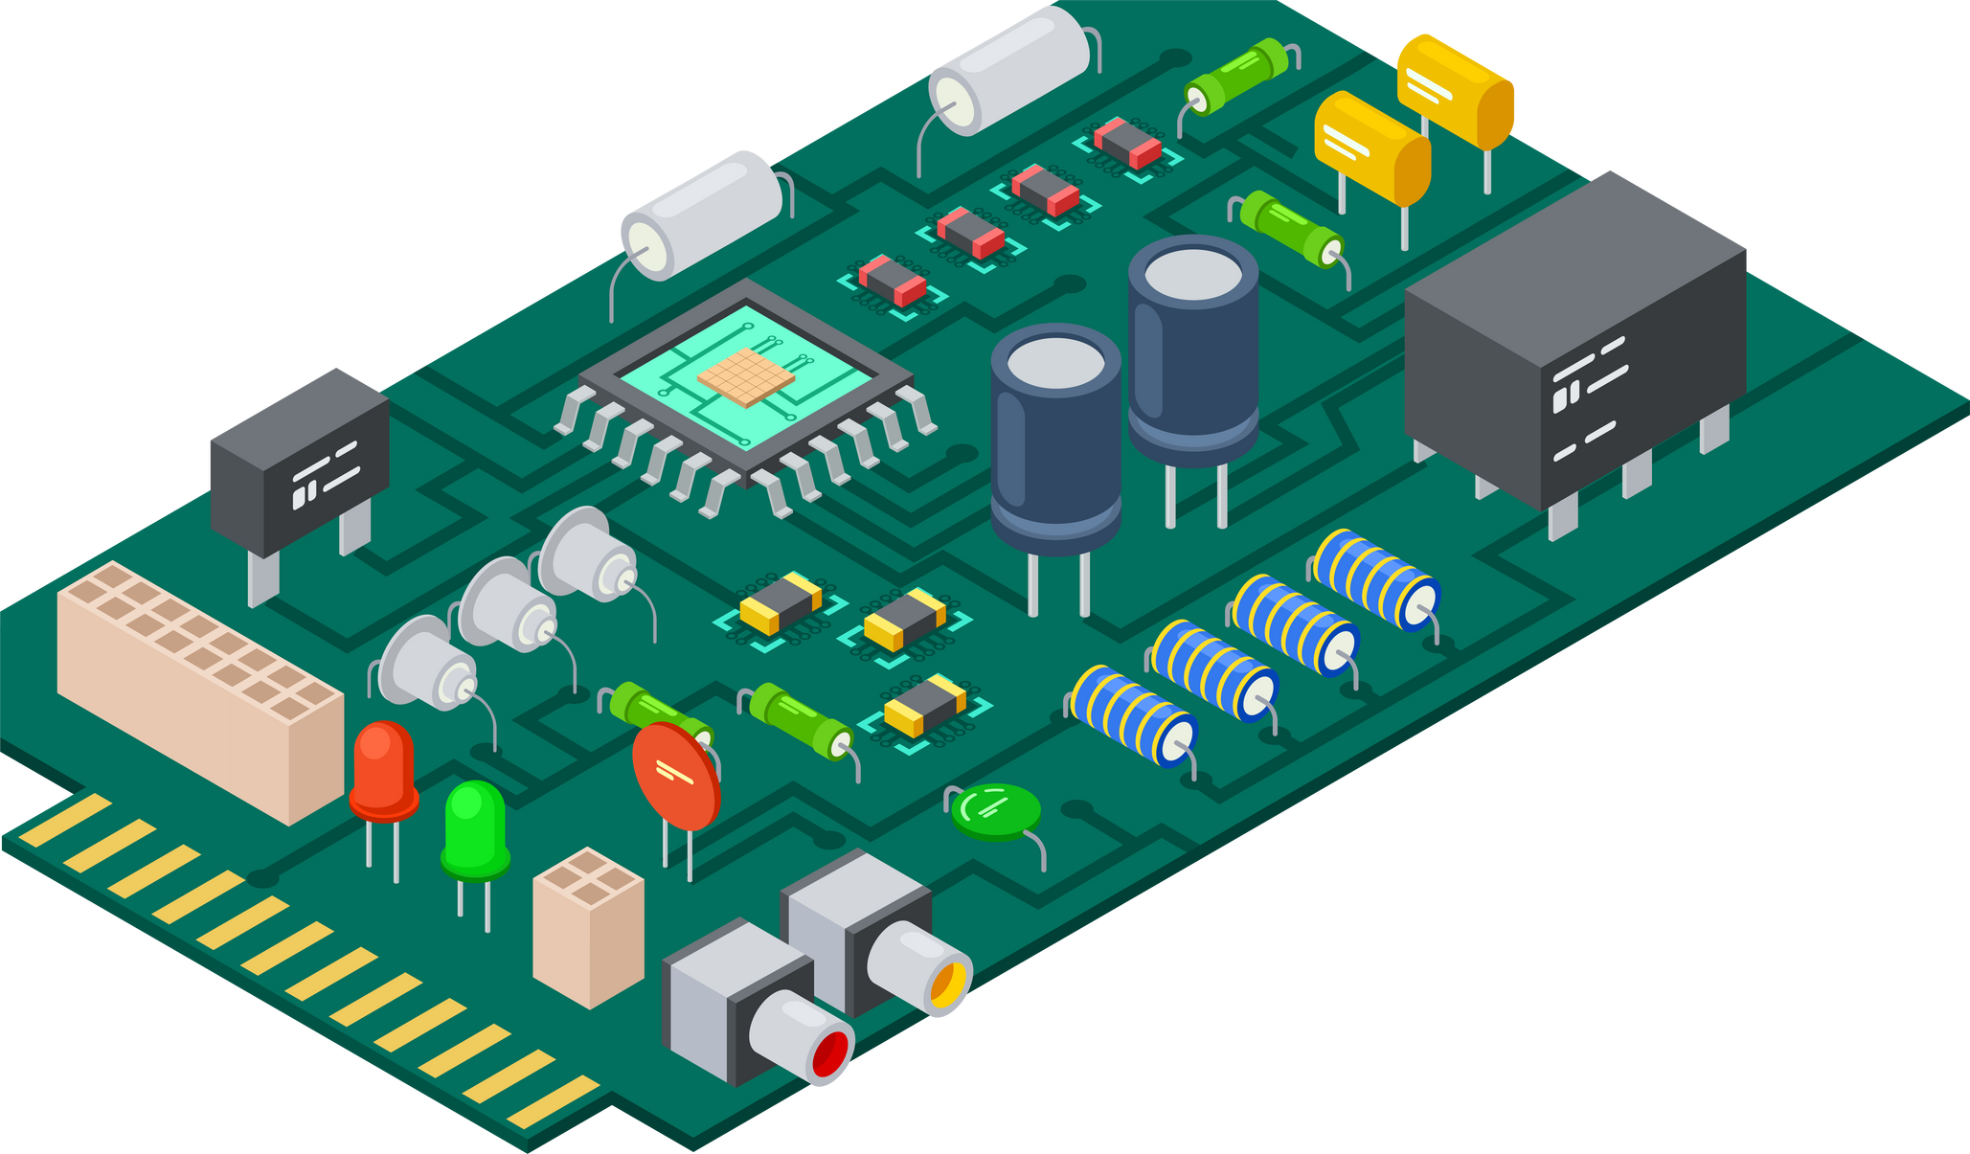

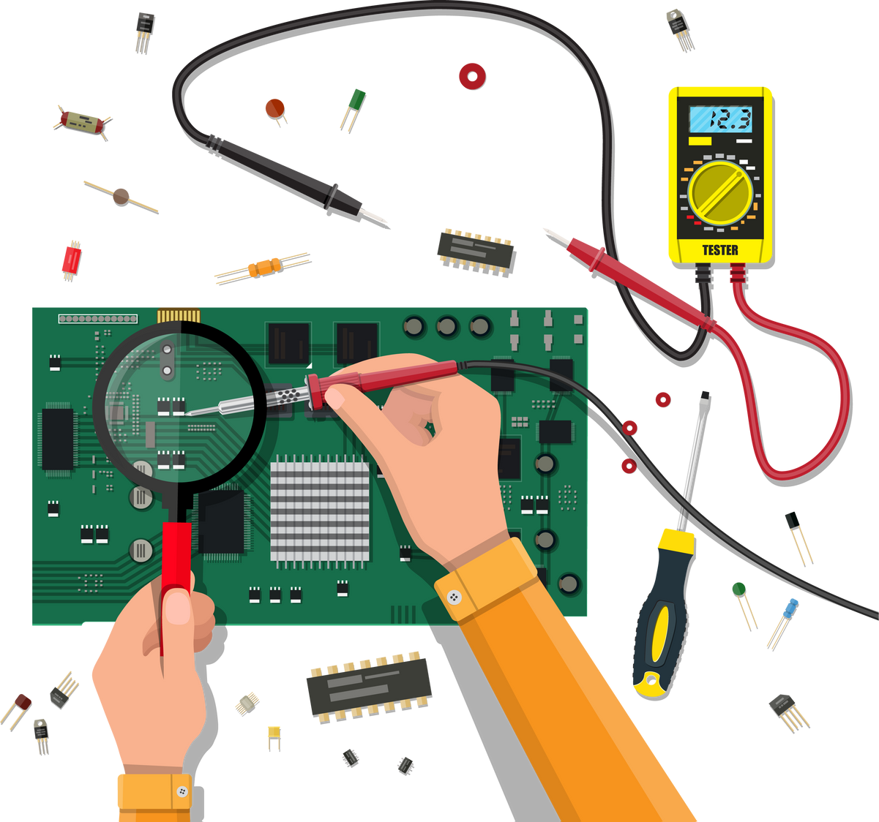

6.4 LOG BOOK OF PROJECT IMPLEMENTATION
Q2
Q4
Q6
Q1
COMPONENT SELECTION AND PROCUREMENT
Q3
CODING AND DEBUGGING
Q5
PRESENTATION
IDEATION AND RESEARCH
HARWARE IMPLEMENTATION
DOCUMENTATION
5
22
Creating Global Citizens Rooted with Islamic Values

Slide 23
THANK YOU
5
23
Creating Global Citizens Rooted with Islamic Values

