Slide 1
Cryo-EM structures of apo- APC/C and APC/C and insight into thier regulation
Anna Höfler, Jun Yu, Jing Yang, Leifu Chang
Published in: Nature Communications, 2025
Presented by Ishrak Hasin

Slide 2
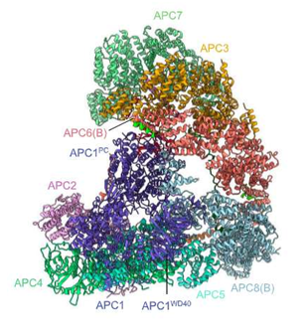
Overall structure of APC/C ternary complex and catalytic function
Anaphrase promiting complex/ cyclosome APC/C is a E3 ubiquitin ligase
It controls the cell cycle by marking mitotic cyclin and related proteins for degradation.
The catalytic site composed of APC2 cullin domain and APC2 RING domain
APC11 provides the primary recruitment surface for the E2 enzymes
For the E2 to bind and start work, a coactivator (CDC20 or CDH1) must first bind to the APC/C
EMI1 block the E2 binding site on APC2
Notes:
• The Auto-Inhibitory Segment (APC1AI): In the unphosphorylated apo-state, a specific part of the APC1 subunit called the auto-inhibitory segment binds to the "C-box receptor" site on APC8. This physically blocks coactivators (like CDC20 or CDH1) from binding. In the active or bound states, this segment must be displaced
APC11 provides the primary recruitment surface for the E2 enzymes
APC11 provides the primary recruitment surface for the E2 enzymes
APC2: The C-terminal domain (APC2CTD) contains a specialized LRRL-binding site
It creates steric hindrance that prevents UBCH10 from reaching the RING domain of APC11 during S and G2 phrase allowing cell to divide and commit to DNA replication

Slide 3
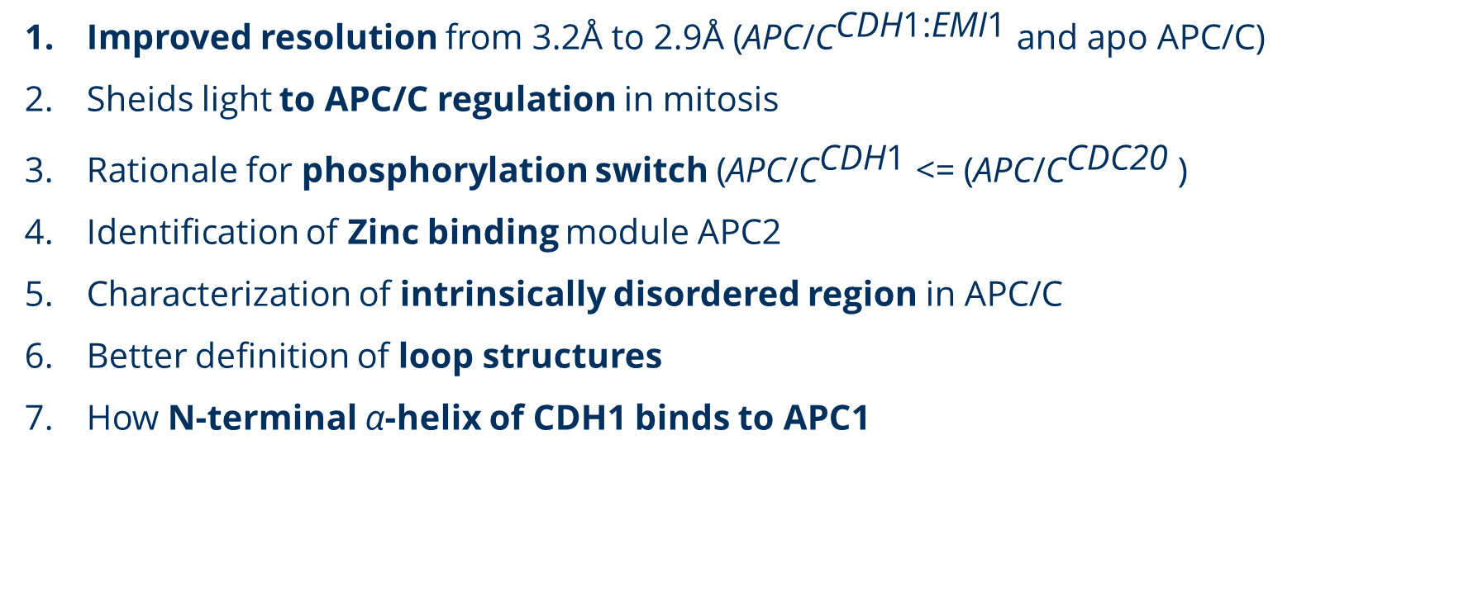
Contribution
Improved resolution from 3.2Å to 2.9Å ${\text{(}\text{APC}\text{/}\text{C}}^{\text{CDH}\text{1:}\text{EMI}\text{1}}$ and apo APC/C)
Sheids light to APC/C regulation in mitosis
Rationale for phosphorylation switch ${\text{(}\text{APC}\text{/}\text{C}}^{\text{CDH}\text{1}}$ <= ${\text{(}\text{APC}\text{/}\text{C}}^{\text{C}\text{DC}\text{20}}$ )
Identification of Zinc binding module APC2
Characterization of intrinsically disordered region in APC/C
Better definition of loop structures
How N-terminal α-helix of CDH1 binds to APC1
Notes:
APC2 is a core cullin-domain subunit

Slide 4
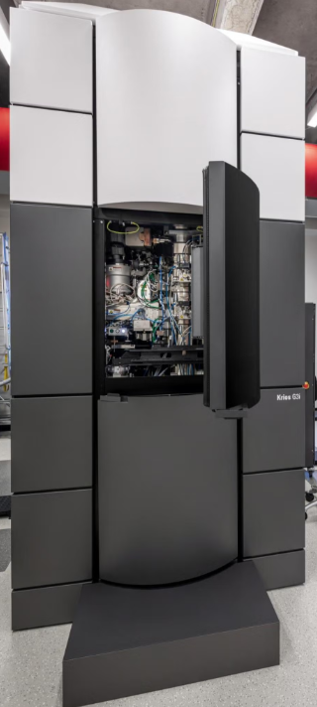
What they used
Improved Cryo EM hardware
Polara EM + Falcon 2 detector => Titan EM + Falcon 3 detector
2. Better software and methods(covered later) with :
a. Currently existing APC/C model
b. Alpha fold prediction
Titan Kiros EM

Slide 5
Some background: Cryo EM density
Experimental 3D volume or "map" generated from thousands of 2D electron microscopy images of vitrified (frozen) samples
This density represents the actual physical space occupied by the atoms of the protein complex being studied, such as the APC/C
Researchers take the "blobs" of density seen in the map and manually fit protein chains, amino acids, and side chains into them using software like COOT

Slide 6
Cryo-EM mapping
Refinement is based on multi body approach
3D classification generated 8 classes
The ternary complex map was divided into 3 masks for particle subtraction and focused 3D refinement
This process improved cryoEM densities in peripheral and flexible region from previous 3.6Å PDB 4U19.
Besides improving loops and fitting side chain and residue assignment
They de novo made or remade 4 biologically important regions.
Notes:
Particle subtraction allows for the segmentation of flexible large complexes into rigid body domains. Because the APC/C is a massive multi-subunit assembly, different parts of it can move independently. If the whole complex is refined at once, these moving parts become blurred. Subtraction mathematically removes the "signal" (the electron density) of the unwanted parts of the complex from the raw experimental images, leaving only the region of interest for independent alignment and refinement
2. Application to the Ternary Complex
The researchers divided the ternary APC/CCDH1:EMI1 map into three specific masks to handle this flexibility:
• Mask 1 (Catalytic Domain): Particle subtraction was performed prior to local refinement to better resolve the catalytic module.
• Mask 2 (TPR Lobe): Used for focused 3D refinement of the structural core.
• Mask 3 (CDH1): Particle subtraction was used here to "further improve the density of CDH1 and the KEN box of EMI1".
3. The Workflow
The sources describe a specific sequence for this operation:
1. Masking: A "soft mask" is applied to the region of interest (e.g., the catalytic module or the CDH1 subunit).
2. Subtraction: The software (RELION or cryoSPARC) subtracts the density of everything outside that mask from the original particle images.
3. Focused Refinement: The resulting "subtracted particles" are then subjected to another round of 3D classification and local refinement. This allowed the team to reach high resolutions, such as 2.85 Å for the TPR lobe and 3.05 Å for the CDH1 subunit.

Slide 7
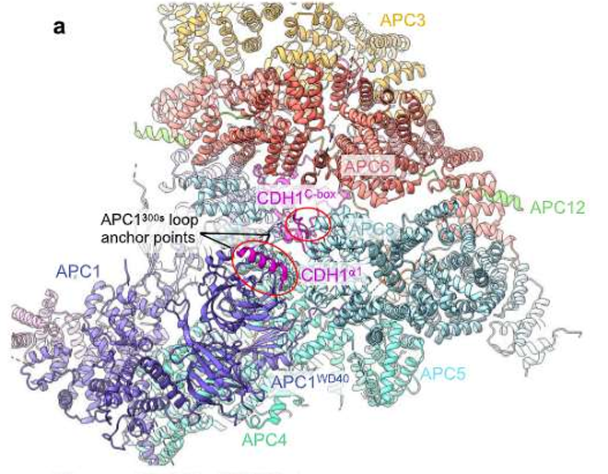
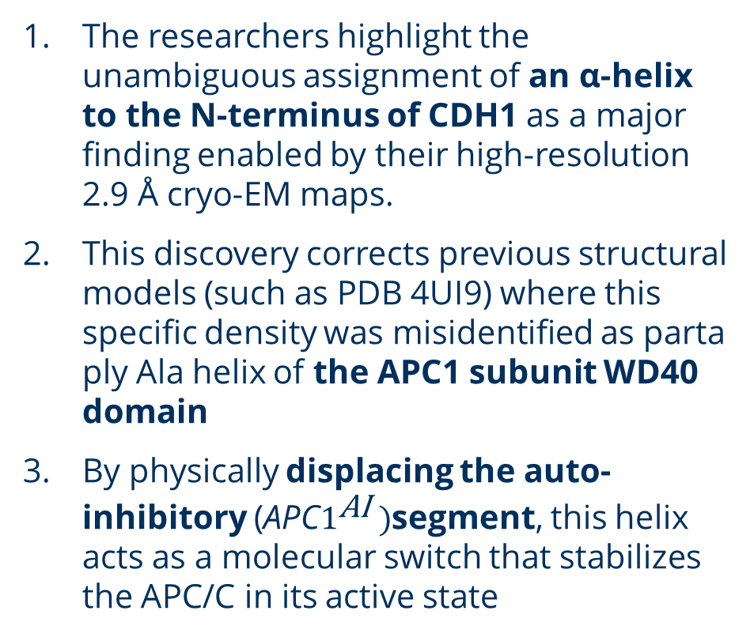
unambiguous assignment of an α-helix to the N-terminus of CDH1
The researchers highlight the unambiguous assignment of an α-helix to the N-terminus of CDH1 as a major finding enabled by their high-resolution 2.9 Å cryo-EM maps.
This discovery corrects previous structural models (such as PDB 4UI9) where this specific density was misidentified as parta ply Ala helix of the APC1 subunit WD40 domain
By physically displacing the auto-inhibitory ${\text{(}\text{APC}1}^{\text{AI}} )$segment, this helix acts as a molecular switch that stabilizes the APC/C in its active state
Notes:
Its robust interactions explain why CDH1 has a significantly higher affinity for unphosphorylated APC/C than the coactivator CDC20
Their current density does not fit APC1 sequence but N terminus of CDH1 N terminus
Secondary structure prediction with AlphaFold from Human CDH1 sequence confirms to form a helix

Slide 8
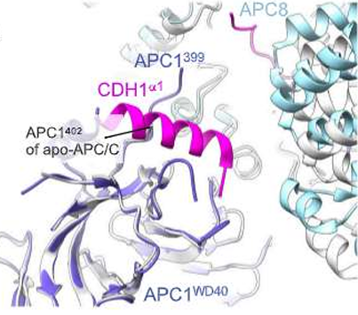
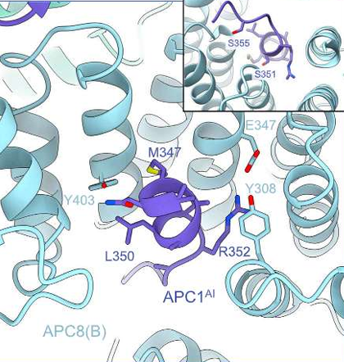
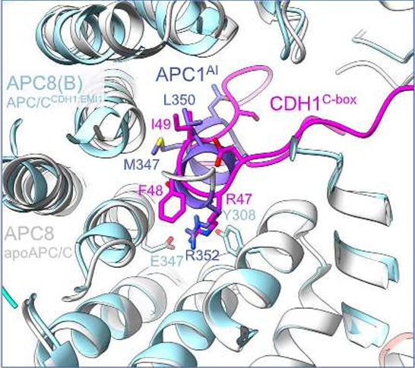
unambiguous assignment of an α-helix to the N-terminus of CDH1
Notes:
• Figure 2a: This provides an overview of the CDH1α1:APC1WD40 interactions, showing how the CDH1 polypeptide chain "threads through a fenestra" at the interface of APC1 and APC8.
• Figure 2b: This offers a detailed view of the CDH1α1 helix interacting with the APC1WD40 domain.
• Figure 2c: This is the actual cryo-EM density map for the CDH1α1 helix, which provided the high-resolution evidence needed to match the density to the N-terminal sequence of CDH1 (residues 1–19) rather than APC1.
• Figure 2e: This shows a superimposition of the APC/CCDH1:EMI1 complex onto the apo-APC/C structure, illustrating how the CDH1α1 helix physically overlaps with and displaces the APC1300s loop (the auto-inhibitory segment)

Slide 9
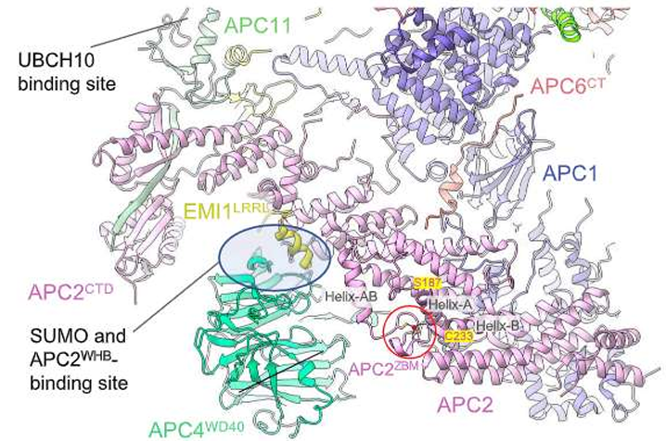
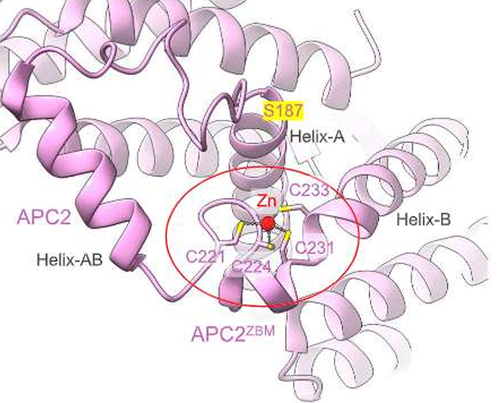
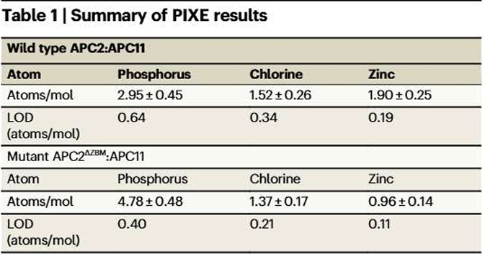
Discovery of the Metazoan Zinc-Binding Module (${\text{(}\text{APC}\text{2}}^{ZBM}$)
• The Module: Researchers identified a previously unknown highly conserved zinc-binding module located within the second cullin repeat (CR2) of the APC2 subunit.
• Structure: It consists of a 45-residue insert coordinated by a single zinc ion held by four highly conserved cysteine residues (Cys221, Cys224, Cys231, and Cys233)
Experimental Validation (PIXE): The presence of zinc was confirmed using proton-induced X-ray emission (PIXE) spectroscopy, which detected approximately two zinc ions per complex.
Notes:
Conservation: This feature is absolutely conserved across metazoans (from humans to C. elegans) but is notably absent in budding yeast, suggesting it is an evolved structural stabilizer for higher organisms
How it was discovered:
• High-Resolution Cryo-EM: Using advanced 2.9 Å resolution maps, the team observed well-defined electron density for the module, which had been previously built as an unassigned poly-alanine chain in lower-resolution models.
• Computational Prediction: AlphaFold2 models of human APC2 independently predicted the existence and fold of this zinc-binding module, which perfectly matched the experimental cryo-EM density.
• Experimental Validation (PIXE): The presence of zinc was confirmed using proton-induced X-ray emission (PIXE) spectroscopy, which detected approximately two zinc ions per APC2:APC11 complex.
• Mutagenesis: Researchers created a mutant (APC2ΔZBM) by swapping the four coordinating cysteines for alanines; PIXE analysis showed this mutant lost its zinc content, proving those specific residues are responsible for binding the metal ion

Slide 10
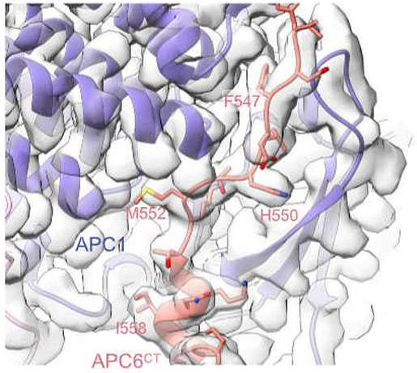
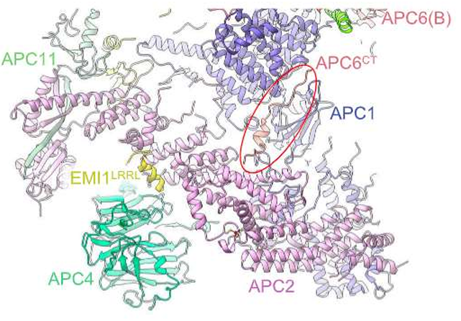
Extension of APC6 C terminus and intrinsically disordered region

Slide 11
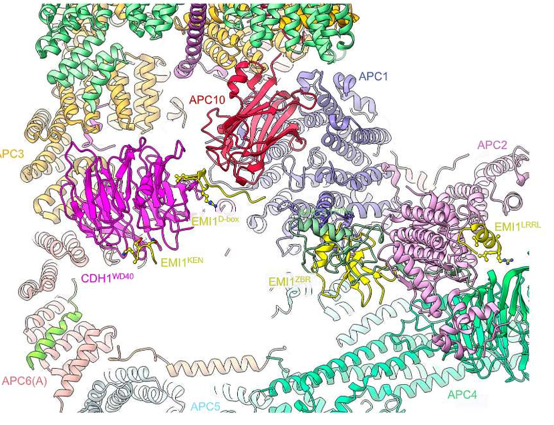
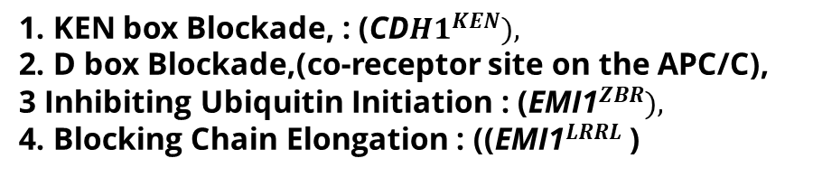
primary inhibitory mechanisms used by EMI1
1. KEN box Blockade, : ${\text{(}\text{CD}H1}^{KEN}),$
2. D box Blockade,(co-receptor site on the APC/C),
3 Inhibiting Ubiquitin Initiation : ${\text{(}\text{EMI}\text{1}}^{ZBR}),$
4. Blocking Chain Elongation : (${\text{(}\text{EMI}\text{1}}^{LRRL}$ )
Notes:
• Pseudo-substrate Mimicry (Degron Receptor Blockade)
◦ KEN-box Blockade: EMI1 uses a consensus KEN-motif (residues 117–121) to bind the receptor on the CDH1WD40 domain, preventing the recruitment of other KEN-box substrates.
◦ D-box Blockade: A pseudo-substrate D-box sequence in EMI1 (residues 322–330) blocks the D-box co-receptor site on the APC/C.
• Physical Blockage of E2 Enzymes (Steric Hindrance)
◦ Inhibiting Ubiquitin Initiation: The Zinc-Binding Region (EMI1ZBR) binds to the APC11 RING domain, physically obstructing the E2 enzyme UBCH10 (UBE2C) from binding the catalytic core.
◦ Blocking Chain Elongation: EMI1’s C-terminal LRRL motif (residues 433–447) is identical to the C-terminus of the E2 enzyme UBE2S.
◦ Direct Competition: EMI1 competes with UBE2S for the same binding site at the APC2:APC4 interface, effectively halting the elongation of ubiquitin chain

Slide 12
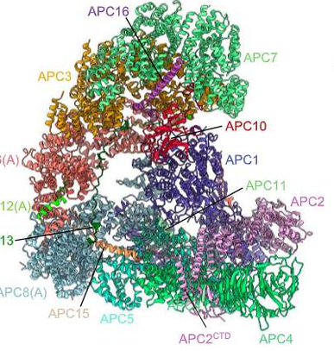
Discovery of a Conformational "Switch“:
.1.This apo state physically blocks the E2 enzyme (UBCH10) from binding to its site, effectively keeping the complex inactive.
2. CDH1 binding triggers the module to move into an "open" position, enabling catalytic activity.

Slide 13
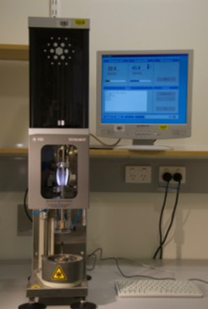
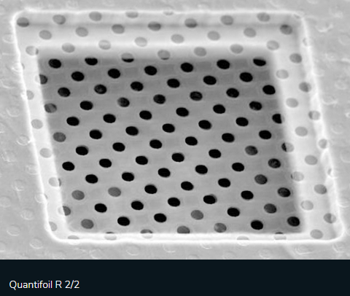
Cloning, Expression, and Purification and Cryo-EM Data Collection
Cloning, Expression, and Purification recombinant human APC/C, EMI1, CDH1, and CDC20 mutants using a modified MultiBac system
The purified ternary APC/CCDH1:EMI1 complex was applied to Quantifoil R2/2 grids coated with a thin layer of carbon.
The grids were vitrified by plunging them into liquid ethane using an FEI Vitrobot.
High-resolution data were collected on a Titan Krios microscope equipped with Falcon 3 direct electron detectors. Capture over 8,000 micrographs
Notes:
Today we are going to talk about synthetic biology and pattern formation.
Lets start with pattern formation.
A hallmark of coordinated cell behavior in single and multicellular organisms.
Relies on cell-cell communication and intracellular signaling to create organized spatial structures.
Everybody knows what a pattern is, but to show you a naturally occurring one, that is also resembling the goal pattern of today, I choose this one ( rings from tree)
Today the main goal is to create such pattern on a petri dish by using genetically modified e. coli.

Slide 14
Image Processing and 3D Reconstruction
The data were processed using cryoSPARC and RELION software. The workflow included:
Pre-processing: Motion correction via MotionCor2 and CTF estimation
Particle Picking: Automated picking was performed using the Topaz neural network
Refinement: 2D and 3D classifications were used to sort particles.
Techniques such as particle subtraction and focused refinement were applied to specific flexible regions, like the catalytic module,
Achieving final resolutions of 2.9 Å for the ternary complex and 3.2 Å for the apo-APC/C
Notes:
MotionCor2
MotionCor2 is a software tool used for motion-correction of the "movies" (sets of frames) captured by the electron detector. When an electron beam hits a vitrified sample, it causes the sample to move slightly; MotionCor2 performs an anisotropic correction of this beam-induced motion, essentially aligning the frames to remove blur and preserve high-resolution detail.
CTF (Contrast Transfer Function)
CTF estimation is a mathematical process used to determine and refine parameters related to the physics of the microscope's lens system. The researchers used patch-based CTF estimation to account for variations across the image. Accurately estimating the CTF is vital for correcting image distortions caused by the microscope, allowing the researchers to achieve the precise 2.9 Å and 3.2 Å resolutions reported in the study
Topaz
Topaz is an AI-driven tool—specifically a positive-unlabeled convolutional neural network—used for automated particle picking.
• How it was used: The researchers first manually identified (picked) particles of the APC/C complex in a small subset of images.
• The Result: They used those manual picks to train the Topaz neural network, which then automatically identified and extracted the APC/C particles from the thousands of remaining micrographs in the entire data set
1. Presence of Binding Partners
• Apo-APC/C: This is the "naked" or baseline state of the complex. It is defined as the APC/C without its coactivator (CDH1) or its inhibitor (EMI1).
• Human APC/CCDH1:EMI1: This is a ternary complex, meaning it consists of the APC/C core bound to both the coactivator CDH1 and the early mitotic inhibitor 1 (EMI1).

Slide 15
Initial Fitting of Existing Models
The process began by taking previously determined structures of the APC/C and using them as a starting template:
Ternary Complex: compared with (PDB: 4UI9) and fitted it into the new cryo-EM maps using Chimera.
Apo-APC/C: used PDB: 8PKP as the starting point
2. Manual Rebuilding and Ab Initio Modeling
Using the software COOT, the team manually rebuilt the protein subunits atom-by-atom to match the new, higher-resolution density.
• Refinement based on Density: Regions that were poorly defined in older models were adjusted to fit the current map's superior detail.
• Ab Initio Building: For previously unassigned or "invisible" regions of the complex, the researchers built new atomic chains from scratch (ab initio) directly into the density

Slide 16
Model Building
Initial atomic models were based on previous structures and fitted into the new maps using Chimera and COOT
For regions that were previously unassigned or disordered, the researchers integrated AlphaFold2 and RosettaFold predictions
AI-generated models were then manually refined into the cryo-EM density and validated using PHENIX and MolProbity to ensure accuracy
Notes:
Chimera (and ChimeraX)
Chimera (specifically UCSF Chimera and its successor ChimeraX) is an integrated system for visualizing and analyzing molecular structures.
• Initial Fitting: The researchers used Chimera to take previously known structures (such as PDB: 4UI9) and perform the initial "fitting" of these models into the new, higher-resolution cryo-EM maps.
• Final Output: Once the models were complete, the software was used to visualize the density maps and models and to generate the figures seen in the final publication.
COOT
COOT (Crystallographic Object-Oriented Toolkit) is a software package specifically designed for manual model building and refinement.
• Precision Rebuilding: While Chimera is used for broad fitting, COOT allowed the researchers to manually build or rebuild specific parts of the APC/C complex atom-by-atom based on the high-resolution density.
• Integrating AI Predictions: COOT was used to take AlphaFold predictions for difficult-to-interpret regions (like the APC1AI or the EMI1 KEN-box) and refine them manually to ensure they perfectly matched the experimental density map.
• Ab Initio Modeling: For regions of the protein that had never been seen before and were previously unassigned, the researchers used COOT to build these structures from scratch (ab initio
Topaz
Topaz is an AI-driven tool—specifically a positive-unlabeled convolutional neural network—used for automated particle picking.
• How it was used: The researchers first manually identified (picked) particles of the APC/C complex in a small subset of images.
• The Result: They used those manual picks to train the Topaz neural network, which then automatically identified and extracted the APC/C particles from the thousands of remaining micrographs in the entire data set
1. Presence of Binding Partners
• Apo-APC/C: This is the "naked" or baseline state of the complex. It is defined as the APC/C without its coactivator (CDH1) or its inhibitor (EMI1).
• Human APC/CCDH1:EMI1: This is a ternary complex, meaning it consists of the APC/C core bound to both the coactivator CDH1 and the early mitotic inhibitor 1 (EMI1).

Slide 17

AlphaFold Prediction
${\text{APC}\text{1}}^{\text{AI}}$: APC1 residue from 201 to 400
APC8: full length of APC8
${\text{CD}H1}^{WD40}$and ${\text{EMI}\text{1}}^{KEN}$ full length of CDH1 and EMI1
Prediction are fitted to density map and refined with COOT

Slide 18
Validation : chemical and Functional Assays
1. Phosphorylation:
2. Ubiquitination:
3. Proton-Induced X-ray Emission (PIXE)
4. SUMOylation
Notes:
• Phosphorylation: Purified APC/C was phosphorylated using CDK2–cyclin A3–CKS2 and PLK1 kinases at 30 °C to simulate mitotic conditions.
• Ubiquitination: Assays were conducted using E1 (UBA1), E2 (UBCH10 or UBE2S), and coactivators to measure the complex's ligase activity.
• SUMOylation: Experiments used E1 (Uba2-Aos1) and E2 (Ubc9) enzymes with SUMO-1 or SUMO-2 to assess the role of specific subunits in the SUMO pathway
Release from Checkpoint Inhibition: The primary importance of SUMOylation, as noted in the sources' references, is its role in the release of the APC/C from spindle assembly checkpoint (SAC) inhibition. This process is essential for allowing the cell cycle to progress once chromosomes are properly aligned. It was hypothesized that the APC2ZBM might serve as a binding interface for the E2 enzyme UBC9.
: Biochemical assays demonstrated that while the module is structurally close to the modification sites, it is not required for SUMOylation
Proton-Induced X-ray Emission (PIXE): APC2:APC11 complexes were dialyzed against a chloride-free buffer and bombarded with a 2.5 MeV proton beam

Slide 19
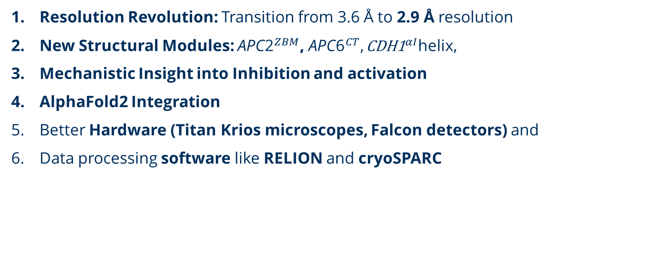
Discussion
Resolution Revolution: Transition from 3.6 Å to 2.9 Å resolution
New Structural Modules: ${\text{APC}\text{2}}^{ZBM}$, ${\text{APC}\text{6}}^{CT},{\text{CDH}\text{1}}^{αI}$helix,
Mechanistic Insight into Inhibition and activation
AlphaFold2 Integration
Better Hardware (Titan Krios microscopes, Falcon detectors) and
Data processing software like RELION and cryoSPARC

