Slide 1
Presentation by:
Ishrak Saleh Chowdhury
232-134-034
Shakif Niaz
232-134-040

Slide 2

PHARMACY
DATABASE MANAGEMENT SYSTEM
WITH PYTHON
01
Streamline Pharmacy Operations
02
Optimize Inventory Management
03
Enhance Customer Experience
03
Expand Accessibility

Slide 3
OBJECTIVES
OUTLINE
01
Streamline Pharmacy Operations
01
04
INTRODUCTION
METHODOLOGY
02
Optimize Inventory Management
02
05
OBJECTIVE
FUTURE WORK
03
Enhance Customer Experience
03
SQL & TKINTER
03
Expand Accessibility

Slide 4
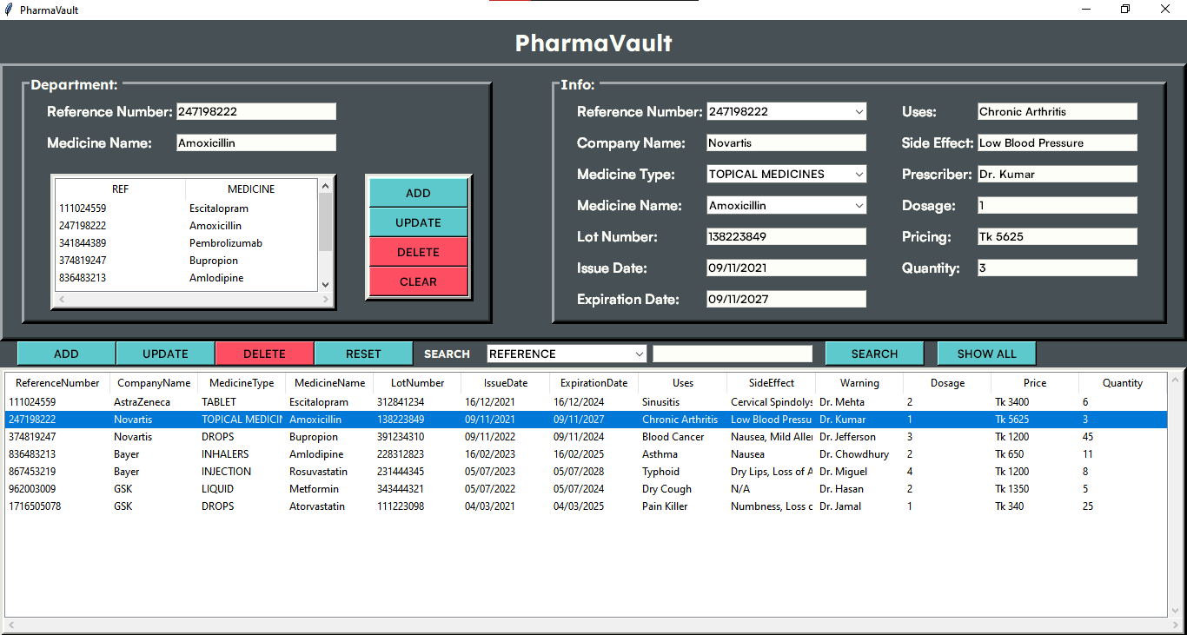
OBJECTIVES
OUTLINE
01
Streamline Pharmacy Operations
01
04
INTRODUCTION
OBJECTIVE
02
Optimize Inventory Management
02
05
OBJECTIVE
MATERIALS
03
Enhance Customer Experience
03
PROGRAMMING
04
Expand Accessibility
WITH PYTHON

Slide 5
OBJECTIVES
01
Streamline Pharmacy Operations
02
Optimize Inventory Management
03
Enhance Customer Experience
03
Expand Accessibility
INTERFACE
Tkinter
01
Standard GUI Library
02
Creating front end interface
03
Design and Navigation

Slide 6
INTERFACE
Tkinter
01
Standard GUI Library
02
Creating front end interface
03
Design and Navigation

Slide 7

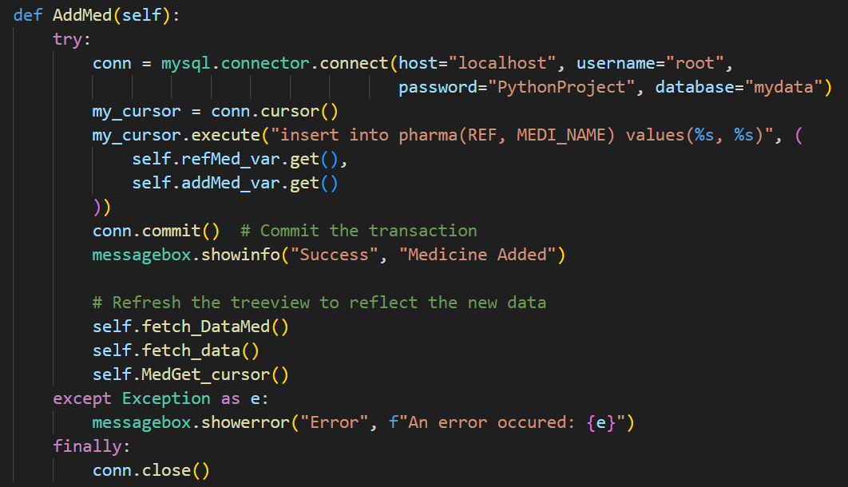
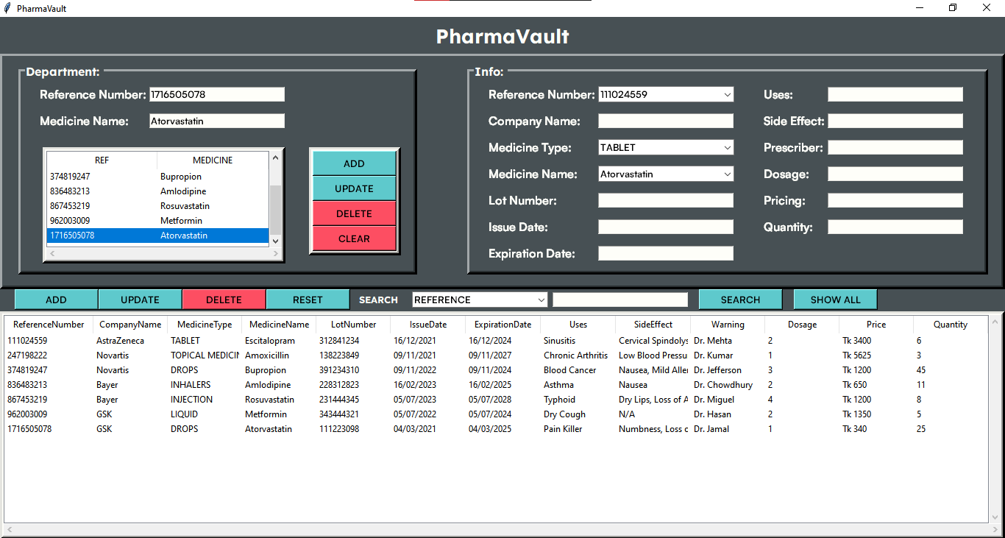
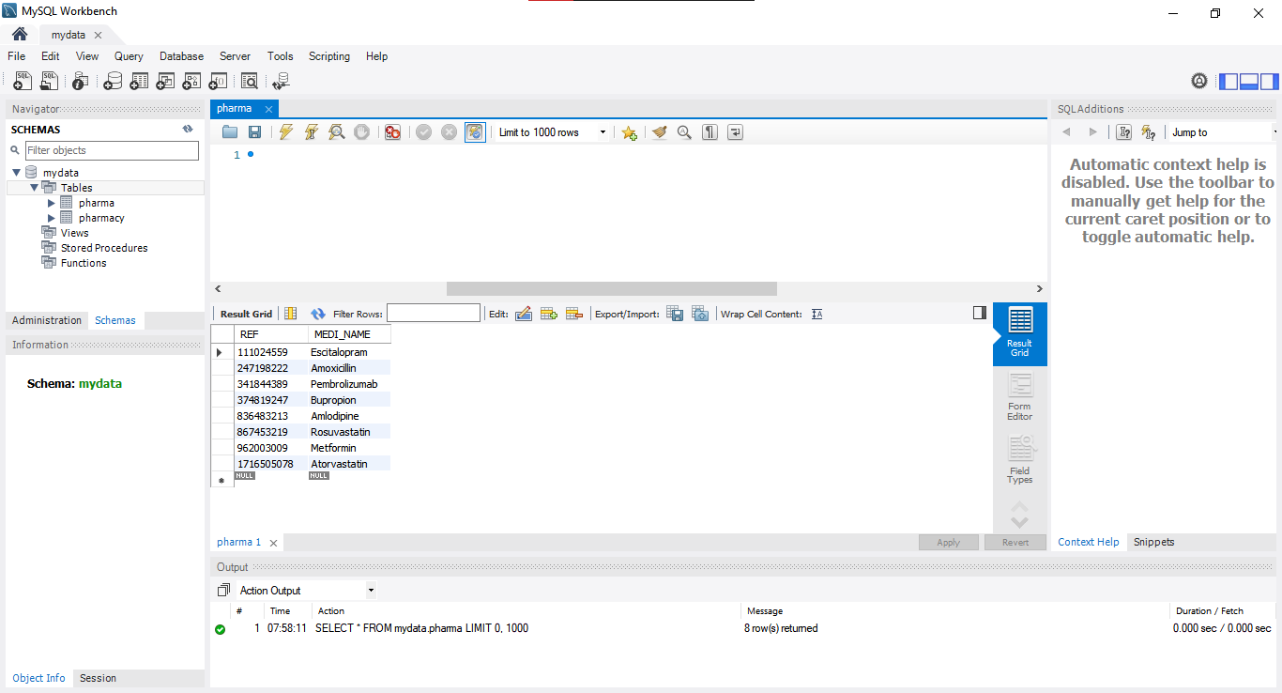
01
Database Management System
02
Uses SQL to access and manage Database
03
Store, fetch and display Pharmacy Data

Slide 9
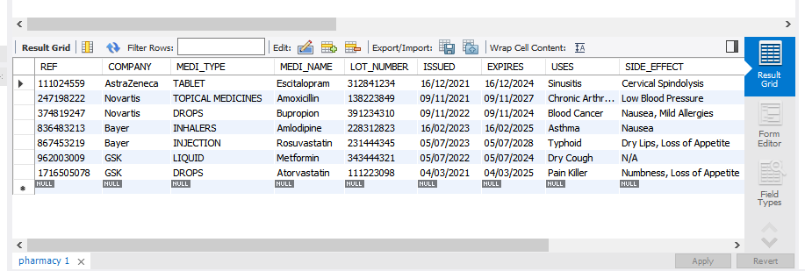

Slide 11
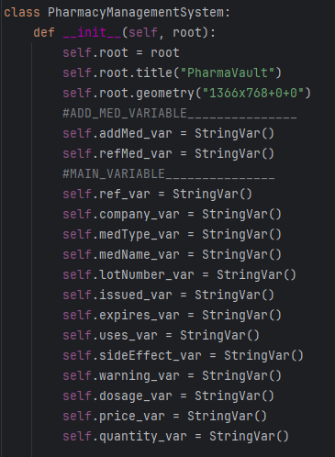
Calling Variables: For Easy Access

Slide 12
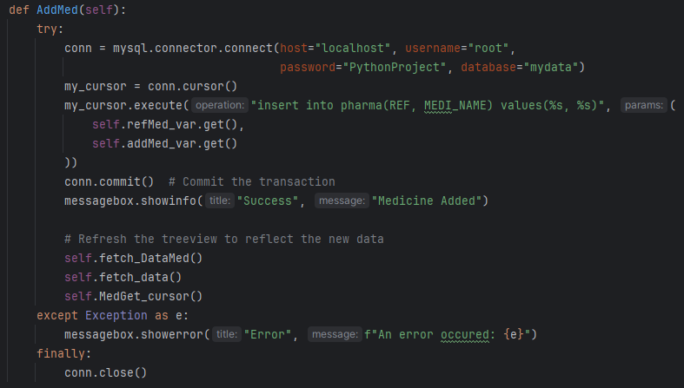
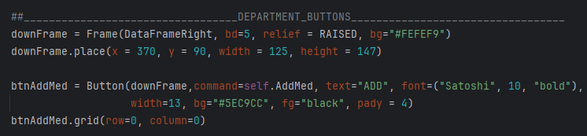
Creating Functions & Function Call

Slide 13
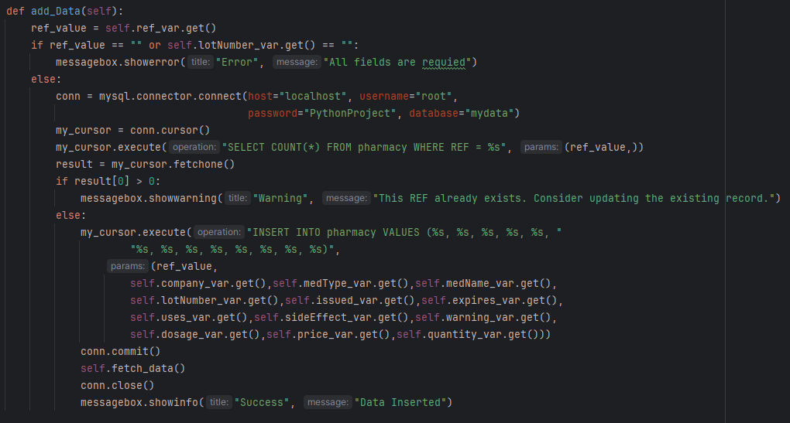

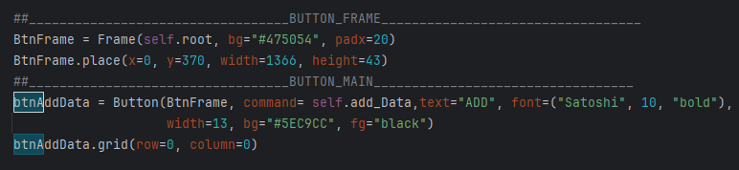
How They Work:
Using Similar Approach
For Multiple Functions

Slide 14
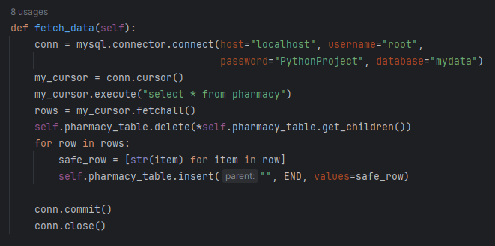
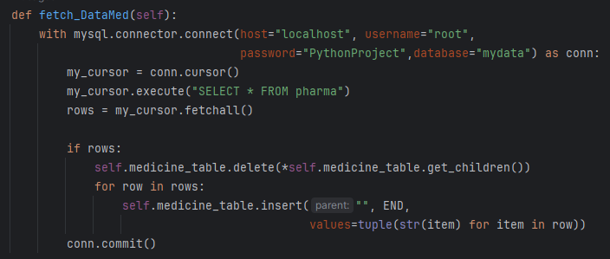
Functions To Refresh Data On Display

Slide 15
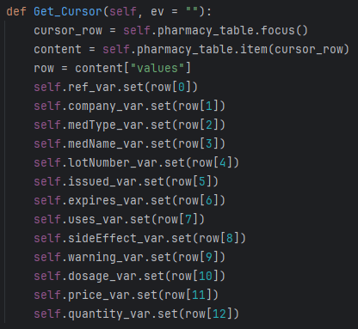
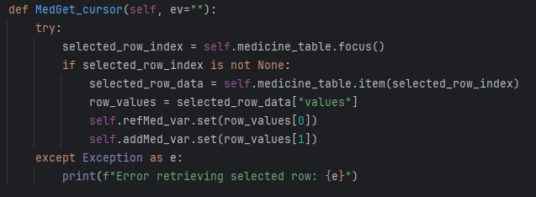
Filling Entry Fields: addMed_var & refMed_var

Slide 16
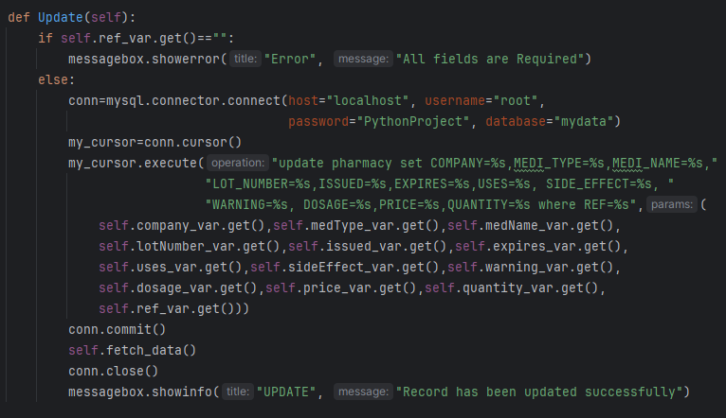
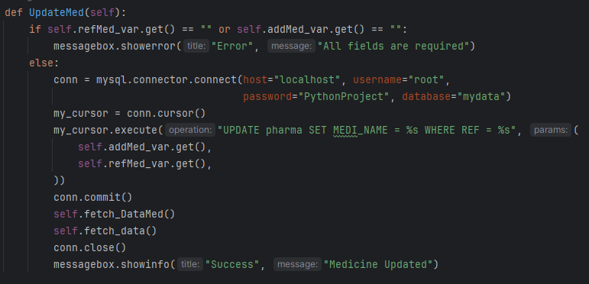
Update Functions

Slide 17
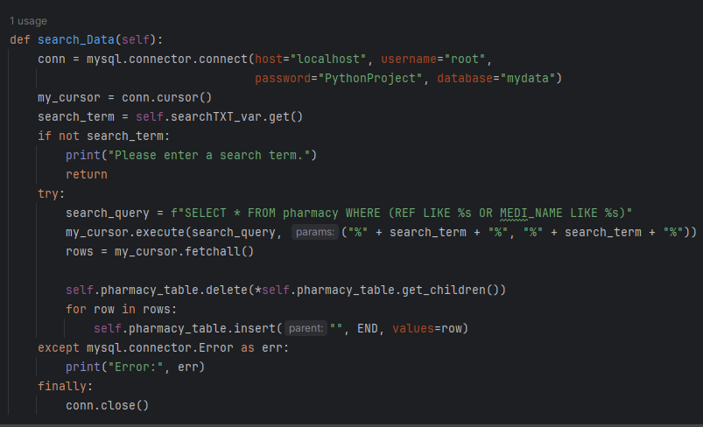
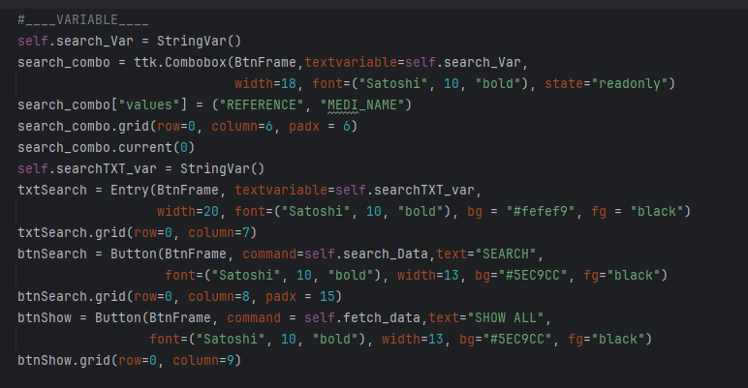
Data Search

Slide 18
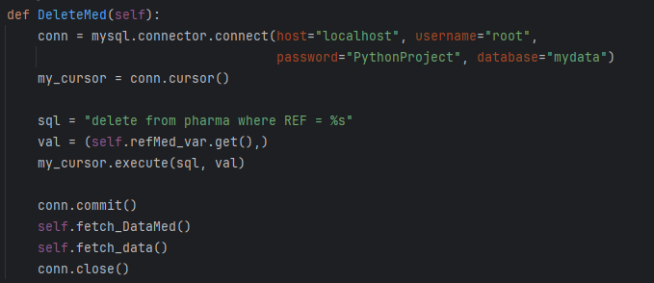

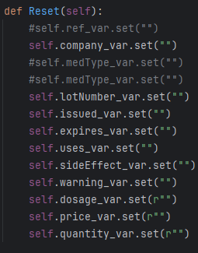
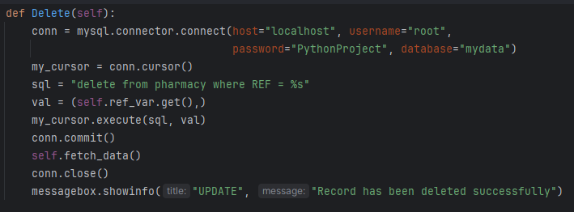
Ways To Erase Data:
Methods

Slide 19
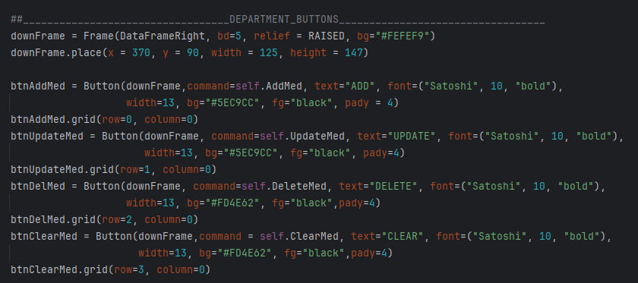
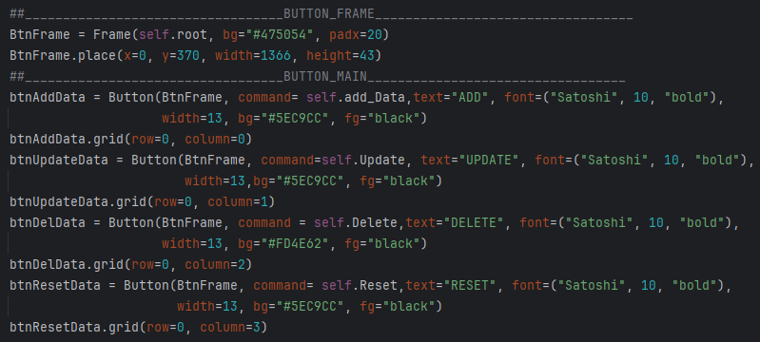
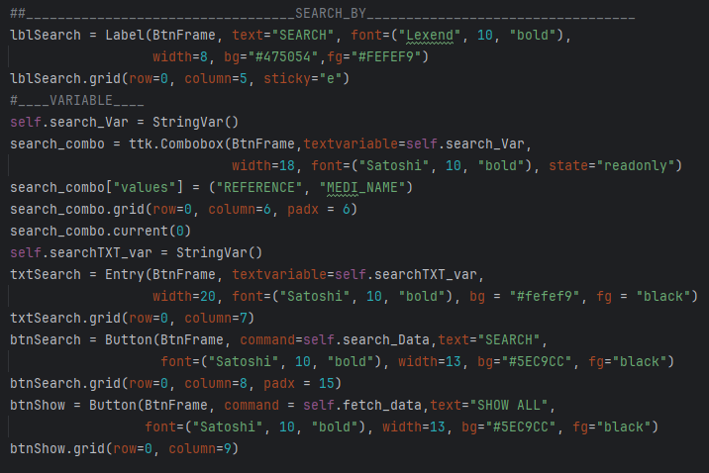
Buttons & Labeling

Slide 20
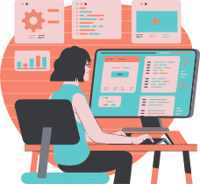
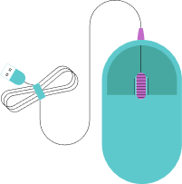














Future Work: Where To Improve
Log In System
Price Management System
Receipt System
UI Overhaul
Optimization

