Slide 1
Design and Implementation of a Laboratory Variable DC Power Supply
Presented by
Kazi Ishrak Ahmed – 1706077
Utsab Saha – 1706084
Monir Hossain- 1706091
Tasnim Nishat Islam – 1706092
Tahsin Saad - 1706095
Submitted to
Munia Ferdoushi
Satyaki Banik

Slide 2
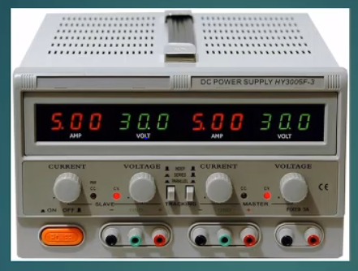
A variable DC power supply is a device where we can easily change the output voltage and also supply enough current to the load. The voltage is regulated irrespective of load & line variation.
This is a typical laboratory dc supply which can supply upto 30V & maximum current rating is 30 A.

Slide 3
Flowchart
Step Down Transformer
Current Limiter
Rectifier & Filter
PI Controller
Output
Buck Boost Converter
Feedback loop

Slide 4
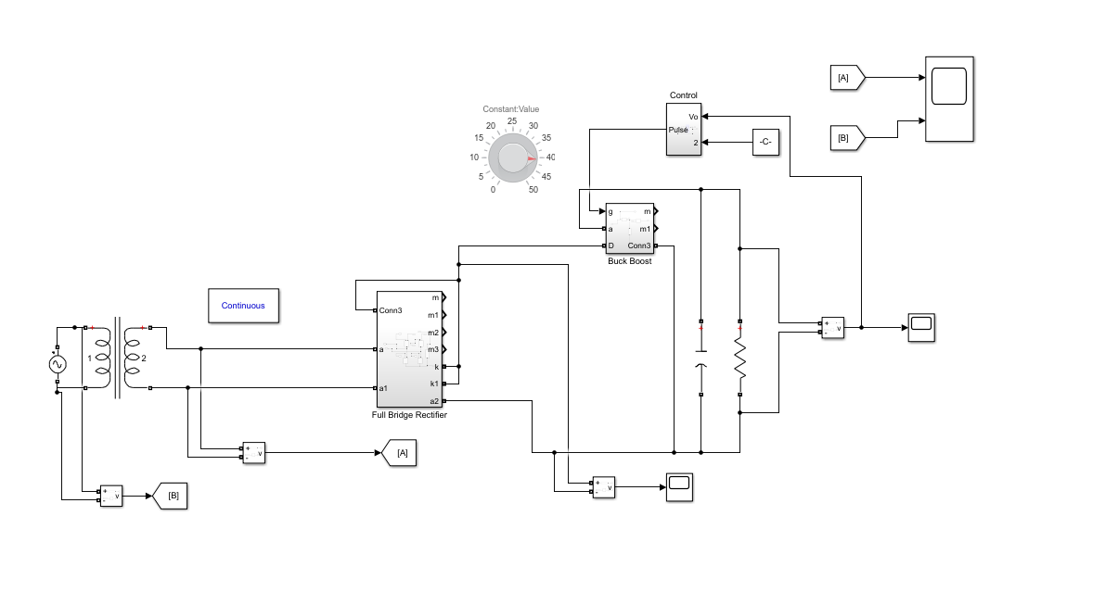
Circuit Diagram

Slide 5
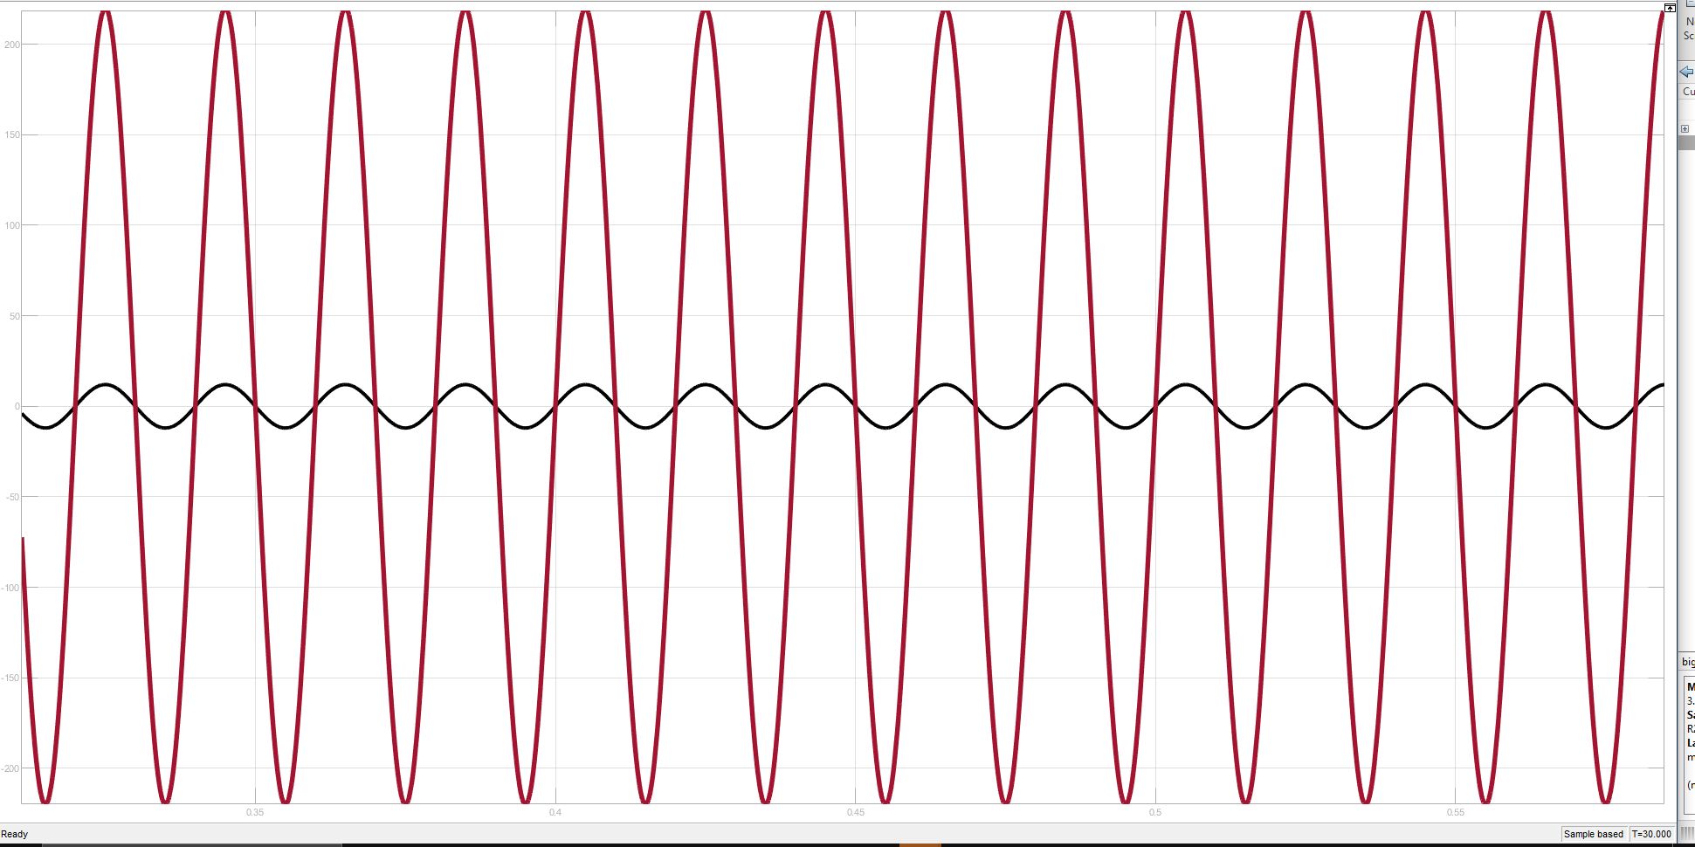
Step Down Transformer Output

Slide 6
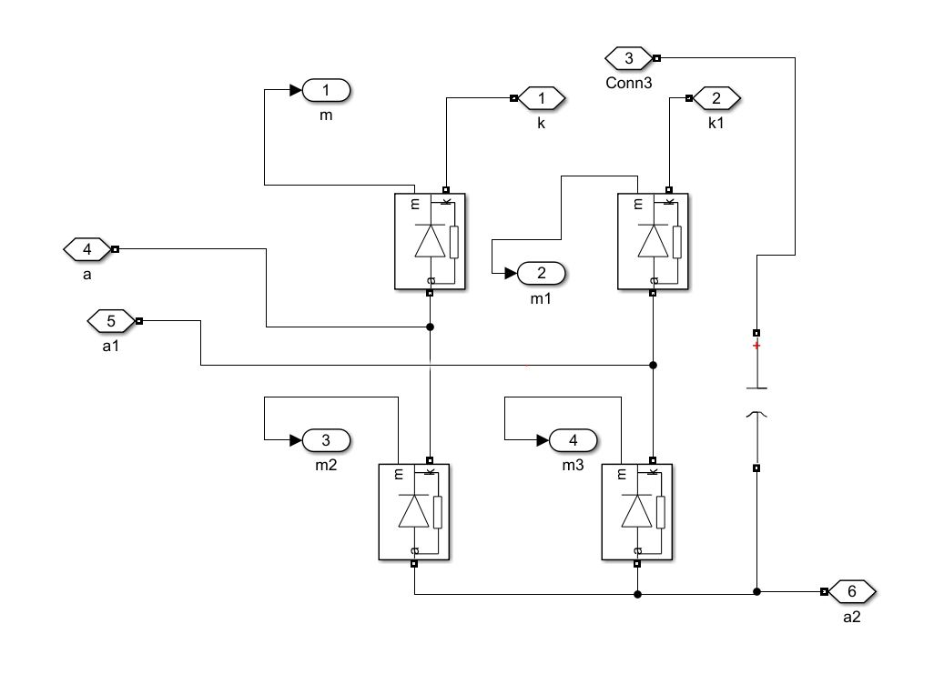
Full Bridge Rectifier

Slide 7
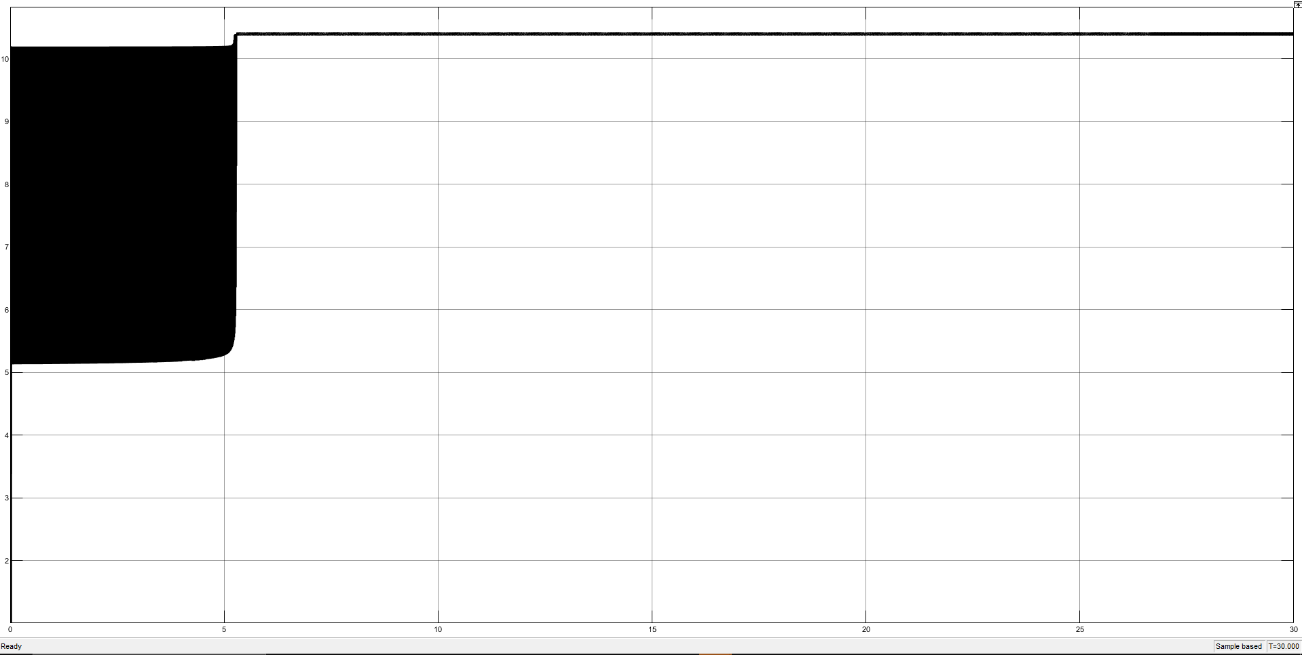
Rectification output

Slide 8
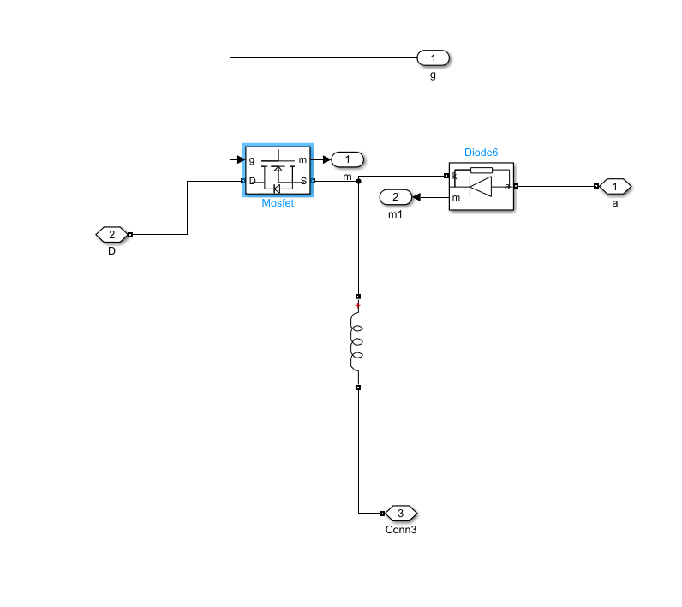
Buck Boost Configuration

Slide 9
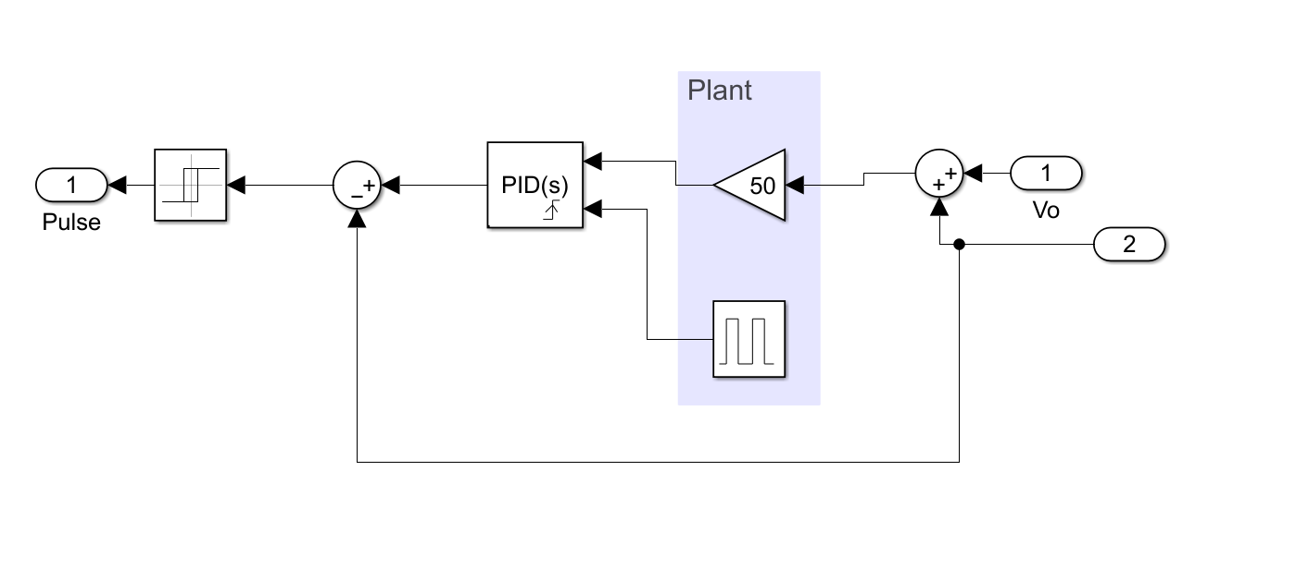
CONTROLLER

Slide 10
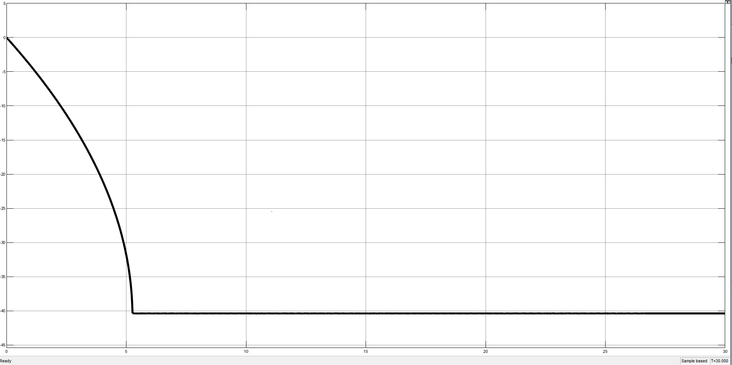
Final Output through Load

Slide 11
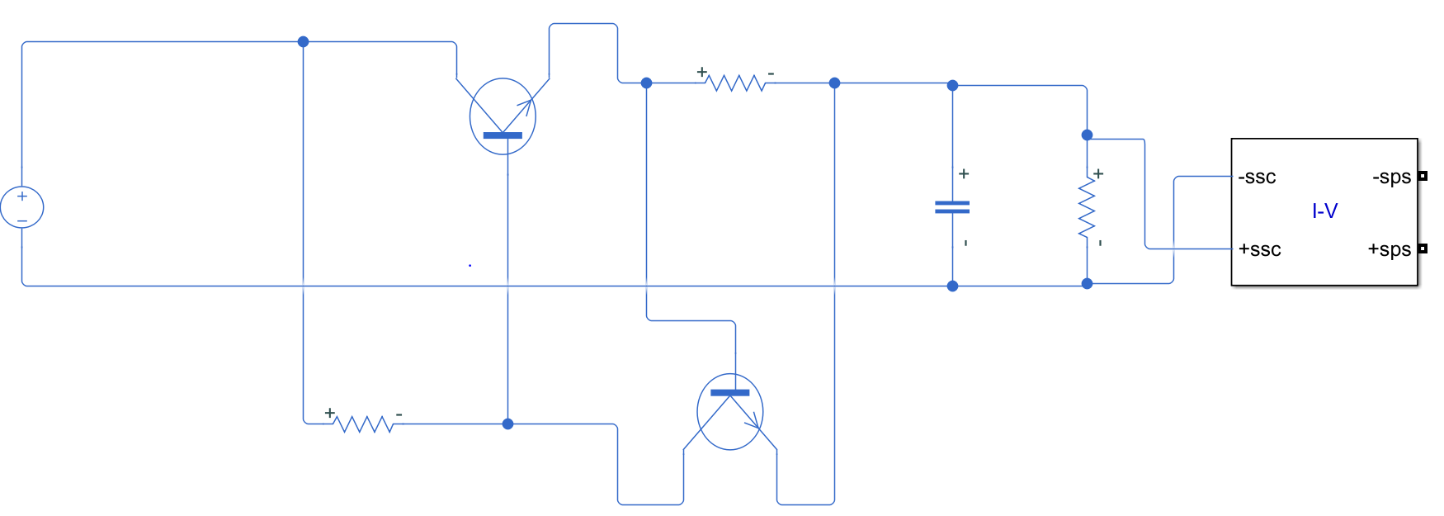
Current Limiter

Slide 12
LIMITATIONS
No voltage regulating IC’s in Simulink
Integration between simscape & non-simscape elements
Op-amps and transistors are not available in physical module
PID couldn’t be tuned automatically

Slide 13
Application of Variable DC Supply
Regulation range of output voltage
Stability Degree
Ripple Voltage control
Overcurrent Protection

Slide 14

THANK YOU

