Slide 1

Course No: EEE 412
Course Title : Power System II Sessional
Project Title:
Optimal Placement and Size of Distributed Generator for Voltage and Power Profile Improvement
Group 1
1706009 Jahid Hasan Tushar
1706015 Mir Jubaier Hassan
1706033 Azazul Islam
1706056 S. M. Manzarul Hoque Chowdhury
1706077 Kazi Ishrak Ahmed
1706089 Istiak Hasan Arnab
1706130 Abu Bakar Mohammad Abdullah

Slide 2
Objectives
Optimal Placement of Distributed Generator (DG)
Finding out optimized size of DG
Improving the voltage profile of the system
Reducing the real power loss
Reducing the reactive power loss

Slide 3
Load Flow Method
Load flow of the radial distribution system is performed in forward-backward sweep power flow method.
Reasons of using Forward-Backward method
Unidirectional power flow in radial system.
High R/X ratio of radial system.
Poor convergence of typical methods like Gauss-Seidel and Newton-Raphson method.

Slide 4
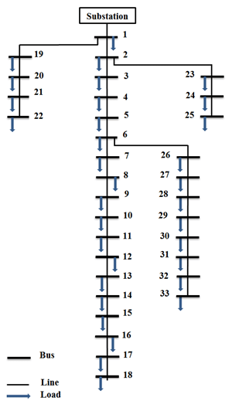
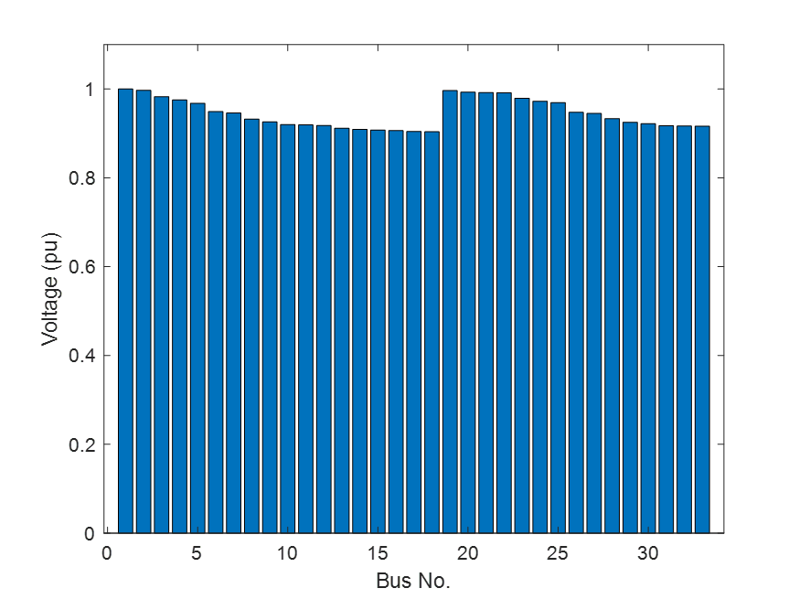
IEEE 33-Bus Radial System
Voltage Profile
Total Real Power Loss= 211 kW
Total Reactive Power Loss = 143 kVar
Sum(Abs(1-voltage_pu)) =1.8045pu
Bus 13 has lowest voltage 0.9037772pu
Total Real Power Load (P) = 3.715 MW
Total Reactive Power Load (Q) = 2.3 MVar
Base kV = 12.66 kV
Base power = 1 MVA

Slide 5
Distributed Generator (DG)
Distributed Generator – Small scale source, connected near the customer side as a backup or to meet the local demand by supporting grid.
DG Types
P type DG: Can only provide active power (P) to the grid.
Q type DG: Can only provide reactive power (Q) to the grid.
Delivering both P and Q: This type of DG can provide both active and reactive power to the grid.
Delivering P, consuming Q: This DG can provide active power but consume reactive power.
The DG that is used for this project > Can supply both Pand Q. It is modelled as a negative load for the respective bus.

Slide 6
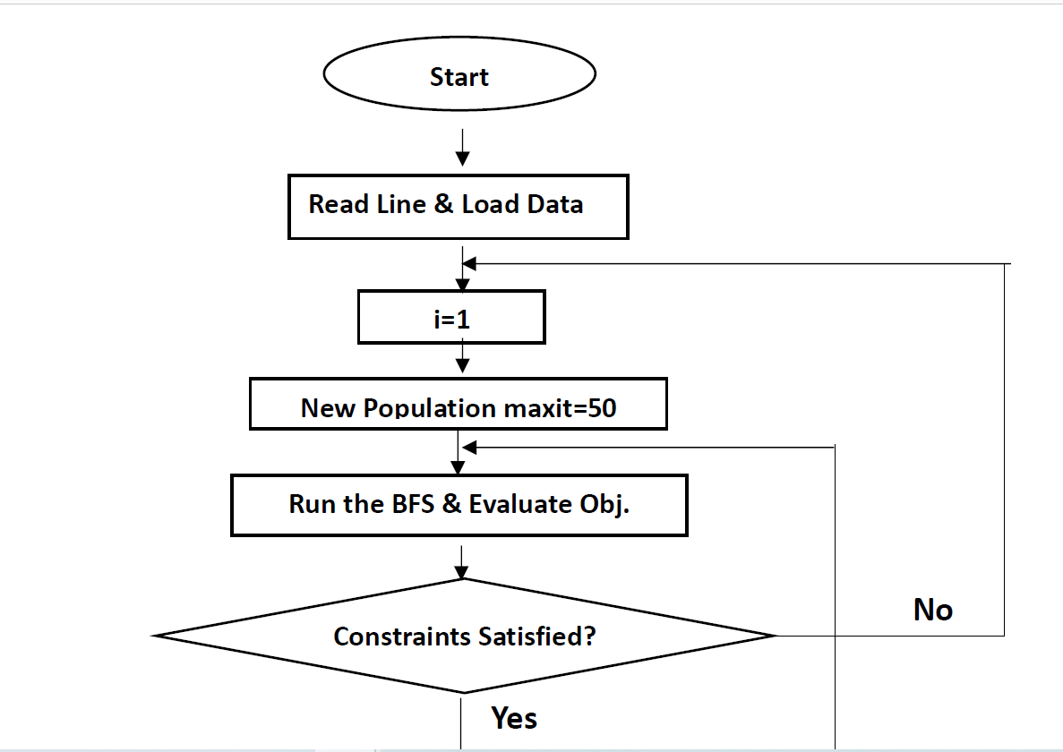
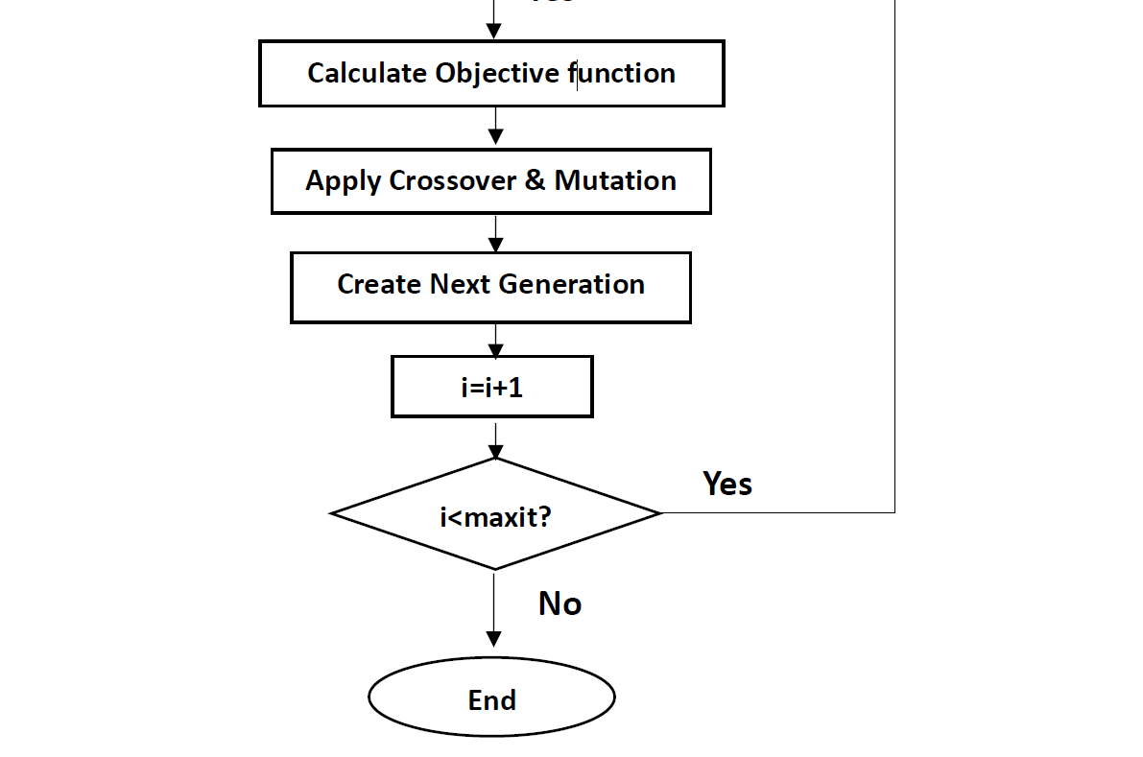
WORKFLOW

Slide 7
OBJECTIVE FUNCTION
F = w1*f1 +w2*f2 +w3*f3
The parameters
f1 = $\sum_{1}^{33}{I_{i}^{2}∗R_{i}}$ ;
f1 = ∑1_1^33▒〖𝐼_𝑖^2∗𝑅_𝑖 〗 ;
f2 = $\sum_{2}^{33}{\frac{{|V}_{i }−V_{rated}|}{V_{rated}}}$ ;
f2 = ∑2_2^33▒(〖|𝑉〗_(𝑖 )−𝑉_𝑟𝑎𝑡𝑒𝑑 |)/𝑉_𝑟𝑎𝑡𝑒𝑑 ;
f3 = $\sum_{1}^{33}{I_{i}^{2}∗X_{i}}$
f3 = ∑1_1^33▒〖𝐼_𝑖^2∗𝑋_𝑖 〗
Assumptions: Weights are linearly distributed. So w1=w2=w3=0.33.

Slide 8
Results(for single dg placement):
Dg Placement | Bus 8
Dg Size | 2 MW
Percentage of the total load | 53.835%
Power Factor | 0.85
Real power loss | 83.9411 kW
Reactive power loss | 64.2178 kVAR
Real power loss improvement | 60.217%
Reactive power loss improvement | 55.092%

Slide 9
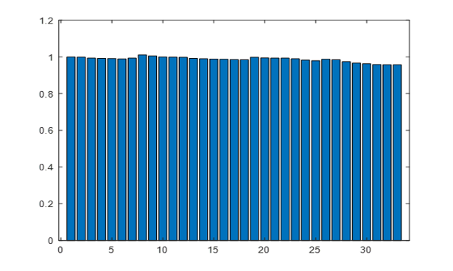
Results(for single dg placement):
The summation of all the 33 absolute bus voltages deviations from the 1pu voltage was found to be 0.4535pu averaging 0.0137pu for a single bus.
The lowest voltage was found in bus 33 and the value was 0.957579pu. So, the lowest voltage was found in the range of 0.95pu-1.05pu.
Voltage Profile

Slide 10
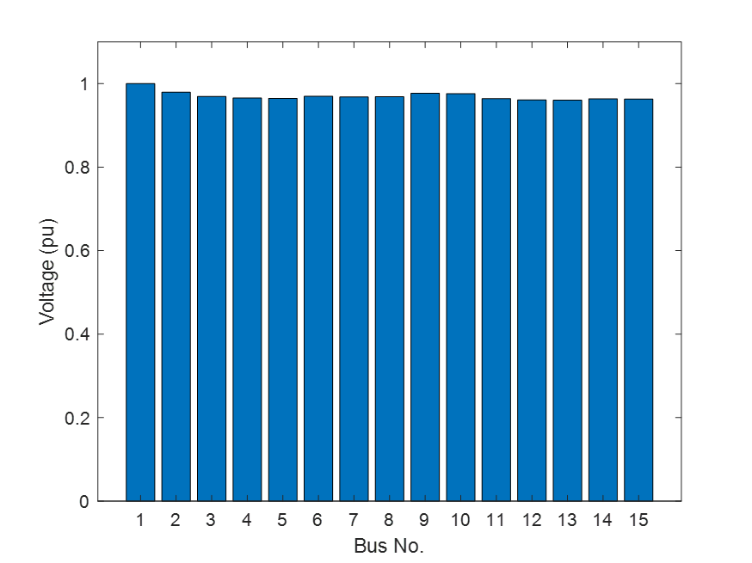
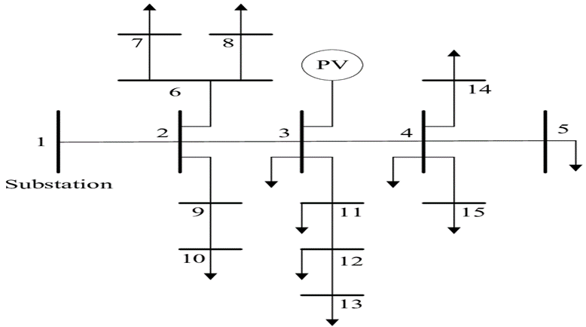
IEEE 15-Bus Radial System
Voltage Profile
Total Real Power Load (P) = 1.1265 MW
Total Reactive Power Load (Q) = 1.251182 MVar
Base kV = 12.66 kV
Base power = 1 MVA
Total Real Power Loss= 42 kW
Total Reactive Power Loss = 38.57 kVar
Sum(Abs(1-voltage_pu)) = 0.4476
Bus 13 has lowest voltage 0.960348 pu

Slide 11
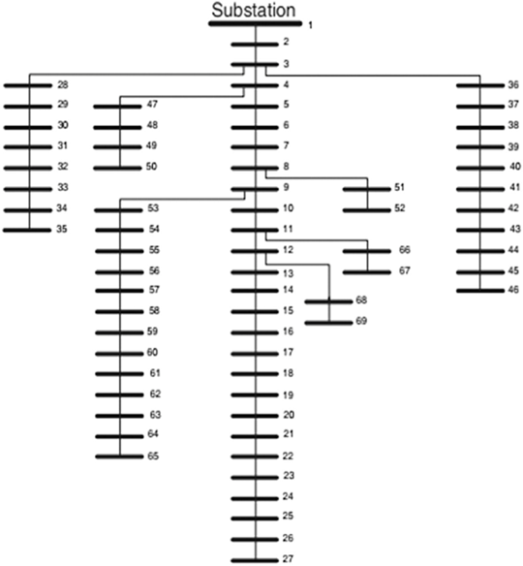
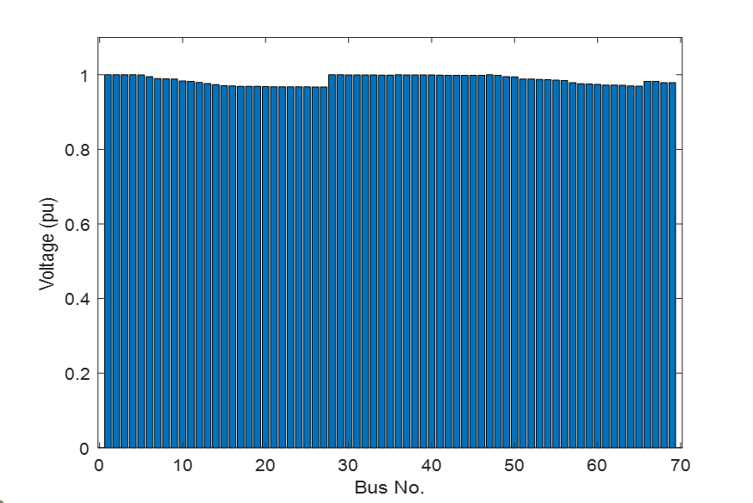
IEEE 69-Bus Radial System
Voltage Profile
Total Real Power Load (P) = 3.802 MW
Total Reactive Power Load (Q) = 2.694 MVar
Base kV = 12.66 kV
Base power = 1 MVA
Total Real Power Loss = 42 kW
Total Total Reactive Power Loss = 38.57 kVar
Sum(Abs(1-voltage_pu)) = 0.9761
Bus 27 has lowest voltage 0.967458 pu

Slide 12
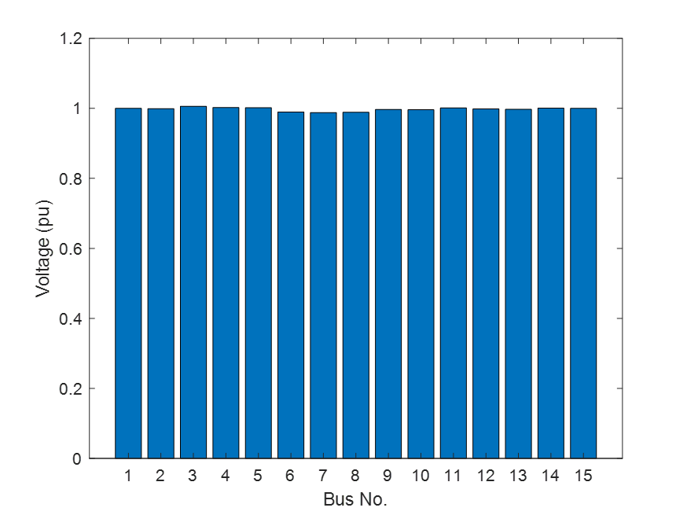
Results (After one DG placement) for IEEE 15 Bus Radial System
Voltage Profile
Optimal position of DG | Bus 3
Value of DG | 1.4218 MW
Power factor | 0.85
Total Real Power Loss | 15.38kW
Total Reactive Power Loss | 12.6565kVar
Sum of Voltage Deviation of all buses | 0.0581pu
Lowest voltage profile | Bus 7 (0.988059pu)

Slide 13
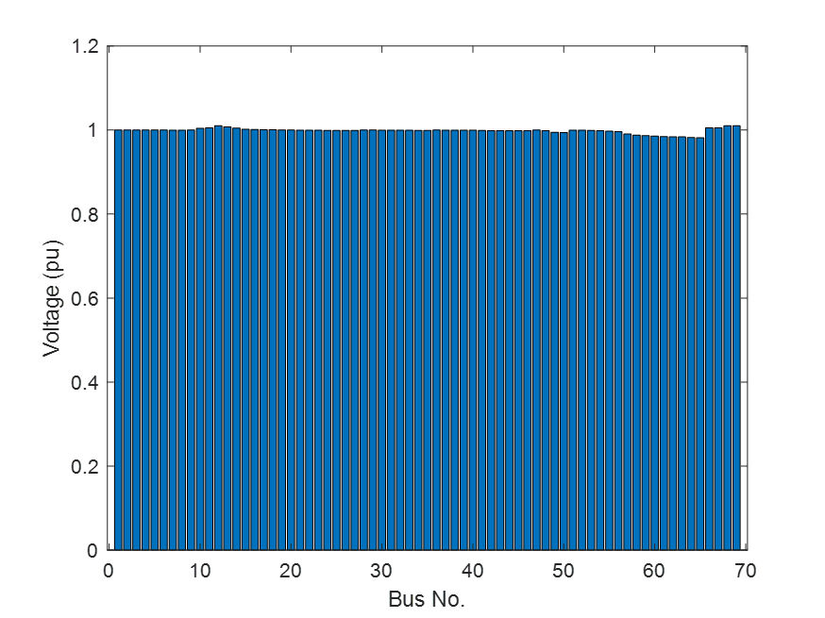
Results (After one DG placement) for IEEE 69 Bus Radial System
Voltage Profile
Optimal position of DG | Bus 12
Value of DG | 1.5131 MW
Power factor | 0.85
Total Real Power Loss | 25.7675kW
Total Reactive Power Loss | 14.3269kVar
Sum of Voltage Deviation of all buses | 0.2430pu
Lowest voltage profile | Bus 65 (0.9814pu)

Slide 14
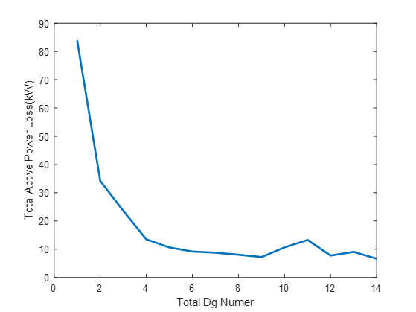
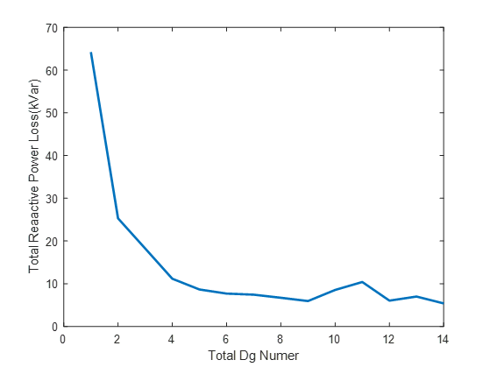
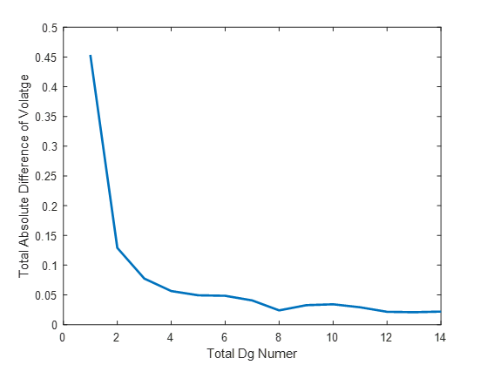
Maximum Effective DG Number Estimation
IEEE 33 BUS Test System
Deployed DG Number > 4 --> Improvement rate drastically falls
Deployed DG Number > 9 --> Fluctuation appears instead of improvement

Slide 15
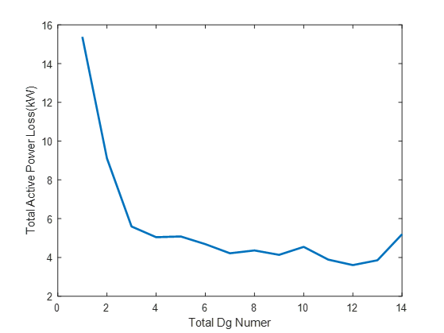
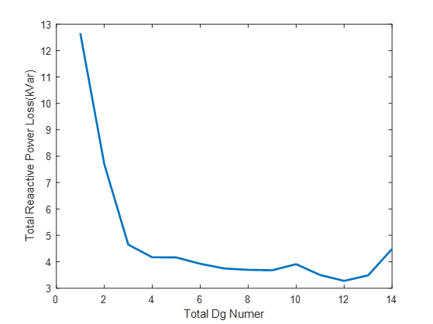
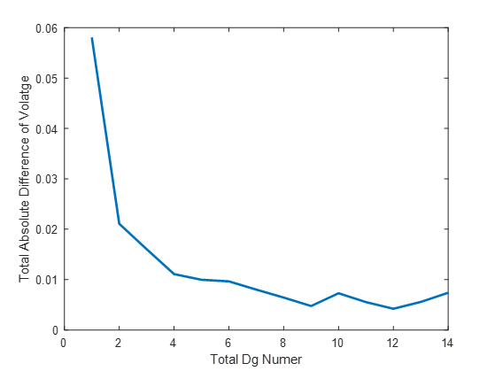
Maximum Effective DG Number Estimation
IEEE 15 BUS Test System
Deployed DG Number > 3 --> Improvement rate drastically falls
Deployed DG Number > 3 --> Fluctuation appears instead of improvement

Slide 16
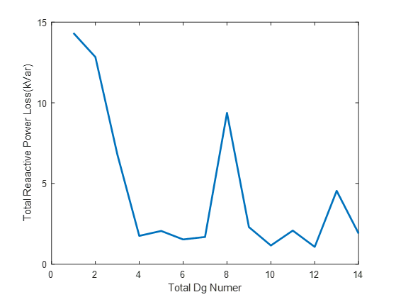
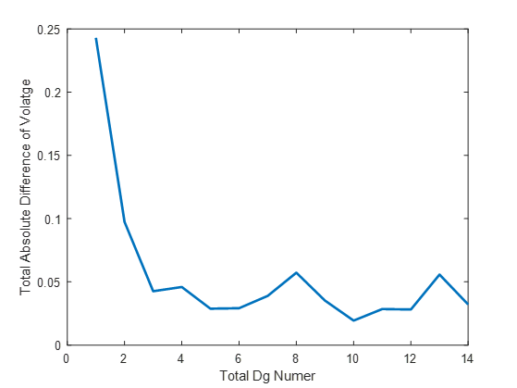
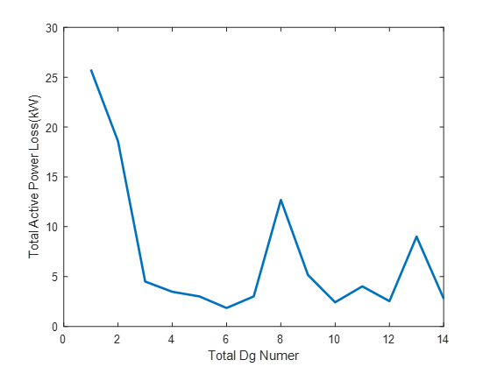
Maximum Effective DG Number Estimation
IEEE 69 BUS Test System
Deployed DG Number > 4 --> Improvement rate drastically falls
Deployed DG Number > 6 --> Fluctuation appears instead of improvement

Slide 17
Conclusion
Forward/backward Sweep Power Flow Method: Three different radial distribution systems are analyzed through forward backward power flow method.
Improvement in Voltage, Power Loss: With inclusion of optimum sized DG in optimum bus using Genetic Algorithm, voltage and power loss profile get improved.
Effective Total DG Number: For different system, effective DG number up to which improvement is satisfactory is evaluated.
Future Work
Optimization for transmission system.
Comparison between different type of dg source i.e fossil fuel, renewable energy etc.
Inclusion of cost in the objective function

Slide 18



