Slide 1
EEE 306 Project Title: Investigating the effect of HVDC connection and large industrial loads in IEEE 39-bus network
Submitted by
Md. Tahmid Kabir (1706072) Ahadur Rahman(1706075)
Bulbul Ahmed Joy (1706073) Khandaker Khairuzzaman(1706076)
Md. Sabbir Hossen Bijoy(1706074) Kazi Ishrak Ahmed(1706077)

Slide 2
Contribution of the Group Members In this Project
ID | CONTRIBUTION
1706072 | Line data input, SVC compensation
1706073 | Line data input, Shunt Capacitor compensation
1706074 | Line data input, HVDC connection
1706075 | Line data input, Induction Motor addition and Active generation Increase
1706076 | Bus, Generator, Transformer, Static Load data input
1706077 | Line data input, Distributed swing application

Slide 3
Load Flow Outputs

Slide 4
Bus Table Problems
Bus ID | kV Base | Vmin - [pu] | Vmax - [pu] | V sol - [pu] | Ang sol - [deg]
7 | 345 | 0.95 | 1.05 | 0.945 | -10.4
8 | 345 | 0.95 | 1.05 | 0.946 | -11
12 | 138 | 0.95 | 1.05 | 0.936 | -6.1
36 | 16.5 | 0.95 | 1.05 | 1.064 | 8.9
The bus voltages on Buses B12, B7, B8 are beyond the limit of 0.95. The voltage of those buses is lower than nominal operating conditions. Besides those, B36 bus is overloaded which is outside the limit 1.05 which is 1.064.

Slide 5
UNDERLOADED TRANSFORMERS (WITHIN 50%)
ID | Bus From | Bus To | Power Flow - [MVA] | Loading Limit - [MVA]
T01 | 12 | 11 | 41.992 | 150
T02 | 12 | 13 | 46.575 | 150
T10 | 2 | 30 | 291.817 | 500
T12 | 19 | 20 | 123.261 | 500
Here, T01 and T02 are under-loaded, T10 and T12 is loaded near to nominal operating region.

Slide 6
Summary
Summary Data | Active Power | Reactive Power
Total generation | 6150.978 | 1365.157
Spinning reserve | 9239.022
Static Load | 6097.1 | 1408.9
Total load | 6097.1 | 1408.9
Line / cable losses | 33.344 | -649.414
Transformer losses | 20.534 | 605.672
Total losses | 53.877 | -43.742
Total losses of the system in case of active power is 53.877 MW and in case of reactive power is -43.742 MVAR

Slide 7
Load Flow Output after adding HVDC

Slide 8
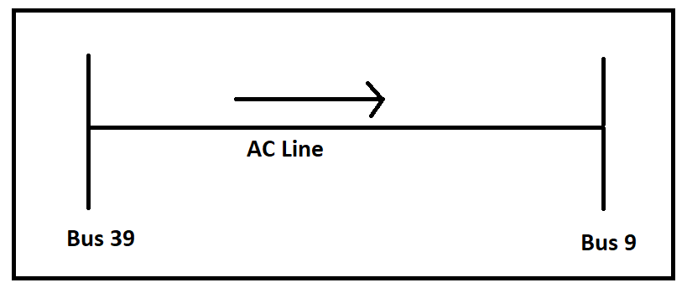

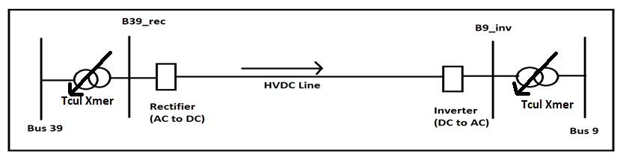

HVDC addition between BUS 39 and BUS 9

Slide 9
Bus Table Problems
Bus ID | kV Base | Vmin - [pu] | Vmax - [pu] | V sol - [pu] | Ang sol - [deg]
4 | 345 | 0.95 | 1.05 | 0.915 | -1.4
5 | 345 | 0.95 | 1.05 | 0.899 | -0.3
6 | 345 | 0.95 | 1.05 | 0.903 | 0
7 | 345 | 0.95 | 1.05 | 0.874 | -1.1
8 | 345 | 0.95 | 1.05 | 0.864 | -0.8
9 | 345 | 0.95 | 1.05 | 0.783 | 14.9
B9_INV | 100 | 0.95 | 1.05 | 0.772 | 18.3
10 | 345 | 0.95 | 1.05 | 0.928 | 3.2
11 | 345 | 0.95 | 1.05 | 0.919 | 2.2
12 | 138 | 0.95 | 1.05 | 0.901 | 2.3
13 | 345 | 0.95 | 1.05 | 0.926 | 2.5
14 | 345 | 0.95 | 1.05 | 0.928 | 0.8
15 | 345 | 0.95 | 1.05 | 0.949 | 0.8
36 | 16.5 | 0.95 | 1.05 | 1.064 | 17.7
We can see that the bus voltages on Buses B4,B5,B6,B7,B8,B9, B10,B11 B12,B13,B14,B15 and B9_INV are beyond limit of 0.95.The voltage of those buses is lower than nominal operating conditions.

Slide 10
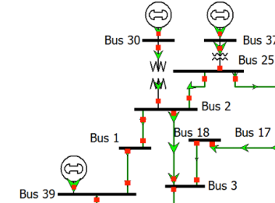
Bus 39 and buses close to it

Slide 11
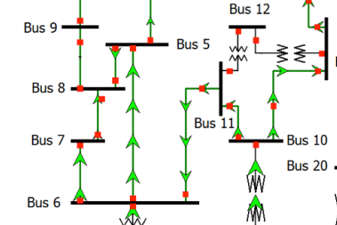
Bus 9 and buses close to it

Slide 12
Explanation
The maintenance of constant voltage at the two ends requires reactive power control as the line loading is increased. So there is a relative need of reactive power in the bus 9. Because of that buses near the bus 9 also feel scarcity of reactive power. Bus 39 and buses closer to it such as bus 1, bus 2 supply the reactive power. As a result their overall voltage rating remains closer to unity. But the reactive power is relatively being fed to the bus 9 and buses closer to them such as bus 5,6,7,8 etc. As a result their voltage decreased from unity and dropped down from nominal value of 0.95 pu. Although DC converter station requires reactive power related to the power transmitted, the DC line itself does not require any reactive power.

Slide 13
Comparison of voltage of the buses closure to BUS 9
Bus | V sol (pu) Before adding HVDC | V sol (pu) After adding HVDC
4 | 0.953 | 0.915
5 | 0.952 | 0.899
6 | 0.953 | 0.903
7 | 0.945 | 0.874
8 | 0.946 | 0.864
9 | 1.008 | 0.783
Voltage of bus 4 to 9 drops from 0.95 to lesser value. Most significant change has been found in BUS 9

Slide 14
Comparison of voltage of the buses closure to BUS 39
Bus | V sol (pu) Before adding HVDC | V sol (pu) After adding HVDC
1 | 1.036 | 1.006
2 | 1.018 | 1
39 | 1.03 | 1.03
Voltage of the buses close to BUS 39 increases

Slide 15
Branch Table Problems
ID | Bus From | Bus To | DBase ID | Type | kV Nominal | Length | P [MW] | Q [MVAR] | S [MVA] | P. Factor [%] | I [pu] | I angle [deg] | P losses [MW] | Q losses [MVAR]
L5 | 3 | 4 | L5 | Line | 345 | 142.8 | 123.62 | 217.73 | 250.37 | 49.4 | 2.591 | -60.3 | 0.94 | -4.23
L10 | 5 | 8 | L10 | Line | 345 | 75.1 | 84.1 | 266.08 | 279.05 | 30.1 | 3.105 | -72.8 | 0.81 | -0.23
L11 | 6 | 7 | L11 | Line | 345 | 61.7 | 185.35 | 274.22 | 330.99 | 56 | 3.664 | -55.9 | 0.82 | 3.71
L14 | 8 | 9 | L14 | Line | 345 | 243.3 | -488.18 | 280.4 | 562.98 | -86.7 | 6.515 | -151 | 9.96 | 132.14
L20 | 15 | 16 | L20 | Line | 345 | 63 | -327.04 | -228 | 398.67 | -82 | 4.203 | 145.9 | 1.56 | 0.44
Line no. 5,10, 11,14,20 are burdened with reactive power flow of more than 200 MVAR

Slide 16
DC Line Table
ID | Bus From | Bus To | DBase ID | DC Current | Commut. X (Rectifier) | Commut. X (Inverter)
DC1 | B39_REC | B9_INV | DC1 | 1000 | 2.83 | 2.83
ID | PF (Rectifier) | PF (Inverter) | DC Voltage (Rectifier) | DC Voltage (Inverter) | DC Power (Rectifier) | DC Power (Inverter) | AC Volt (Rectifier) | AC Volt (Inverter)
DC1 | 0.93 | 0.96 | 501 | 500 | 501 | 500 | 102 | 77.2
ID | P to Converter (Rectifier) | Q to Converter (Rectifier) | P to Converter (Inverter) | Q to Converter (Inverter) | P from Network (Rectifier) | Q from Network (Rectifier) | P from Network (Inverter) | Q from Network (Inverter)
DC1 | 501 | 177 | -499 | 117 | 502 | 196 | -498 | 148

Slide 17
UNDERLOADED TRANSFORMERS ( WITHIN 50 %)
ID | Bus From | Bus To | Power Flow - [MVA] | Loading Limit - [MVA]
T01 | 12 | 11 | 36.009 | 150
T02 | 12 | 13 | 52.878 | 150
T03 | 6 | 31 | 283.952 | 350
T12 | 19 | 20 | 122.585 | 500

Slide 18
Summary
Summary Data | Active Power | Reactive Power
Total generation | 6184.313 | 2362.987
Spinning reserve | 9205.688
Static Load | 6097.1 | 1408.9
Total load | 6097.1 | 1408.9
Line / cable losses | 60.508 | -72.786
Transformer losses | 24.676 | 732.904
Total losses | 86.184 | 954.119
Total losses of the system in case of active power is 86.184 MW and in case of reactive power is 954.119 MVAR

Slide 19
After INDUCTION MOTOR ADDITION
Bus Table
Bus ID | kV Base | Vmin - [pu] | Vmax - [pu] | V sol - [pu] | Ang sol - [deg]
3 | 345 | 0.95 | 1.05 | 0.874 | -31.2
4 | 345 | 0.95 | 1.05 | 0.828 | -23.4
5 | 345 | 0.95 | 1.05 | 0.817 | -16.4
6 | 345 | 0.95 | 1.05 | 0.827 | -14.9
7 | 345 | 0.95 | 1.05 | 0.787 | -16.6
8 | 345 | 0.95 | 1.05 | 0.773 | -16.5
9 | 345 | 0.95 | 1.05 | 0.651 | 4.9
B9_INV | 100 | 0.95 | 1.05 | 0.637 | 9.8
10 | 345 | 0.95 | 1.05 | 0.862 | -14.2

Slide 20
Bus Table
Bus ID | kV Base | Vmin - [pu] | Vmax - [pu] | V sol - [pu] | Ang sol - [deg]
11 | 345 | 0.95 | 1.05 | 0.849 | -14.5
12 | 138 | 0.95 | 1.05 | 0.83 | -15.3
13 | 345 | 0.95 | 1.05 | 0.857 | -16
14 | 345 | 0.95 | 1.05 | 0.854 | -20.4
15 | 345 | 0.95 | 1.05 | 0.898 | -24.6
16 | 345 | 0.95 | 1.05 | 0..935 | -24.3
17 | 345 | 0.95 | 1.05 | 0.924 | -27
18 | 345 | 0.95 | 1.05 | 0.903 | -29.1
24 | 345 | 0.95 | 1.05 | 0.948 | -24.2
27 | 345 | 0.95 | 1.05 | 0.945 | -27.9
From the table we can see that Bus No. 3,4,5,6,7,8,9,10,11,12,14,15,16,17,18, 24 and 27 are outside the voltage limit which is at Under Voltage condition.

Slide 21
Branch Table
ID | Bus From | Bus To | DBase ID | Type | kV Nominal | Length | P [MW] | Q [MVAR] | S [MVA] | P. Factor [%] | I [pu] | I angle [deg] | P losses [MW] | Q losses [MVAR]
L3 | 2 | 3 | L3 | Line | 345 | 101.2 | 456.37 | 515.43 | 688.43 | 66.3 | 7.163 | -75.4 | 6.82 | 57.8
L5 | 3 | 4 | L5 | Line | 345 | 142.8 | 442.34 | 239.26 | 502.9 | -88 | 5.751 | 177.2 | 4.37 | 55.55
L9 | 5 | 6 | L9 | Line | 345 | 17.4 | 687.67 | -243.03 | 729.35 | -94.3 | 8.924 | 144.2 | 1.59 | 17.74
L10 | 5 | 8 | L10 | Line | 345 | 75.1 | 40.23 | 316.89 | 319.43 | 12.6 | 3.908 | -99.1 | 1.27 | 8.3
L11 | 6 | 7 | L11 | Line | 345 | 61.7 | 236.67 | 342.17 | 416.04 | 56.9 | 5.031 | -70.2 | 1.54 | 16.28
L12 | 6 | 11 | L12 | Line | 345 | 55 | -81.59 | -220.99 | 235.58 | -34.6 | 2.849 | 95.4 | 0.55 | -3.35
L13 | 7 | 8 | L13 | Line | 345 | 30.8 | 1.33 | 241.89 | 241.89 | 0.5 | 3.073 | 106.3 | 0.38 | -0.31

Slide 22
Branch Table
ID | Bus From | Bus To | DBase ID | Type | kV Nominal | Length | P [MW] | Q [MVAR] | S [MVA] | P. Factor [%] | I [pu] | I angle [deg] | P losses [MW] | Q losses [MVAR]
L14 | 8 | 9 | L14 | Line | 345 | 243.3 | 482.09 | 374.79 | 610.64 | -78.9 | 7.901 | 158.7 | 14.61 | 212.43
L16 | 10 | 11 | L16 | Line | 345 | 28.8 | 107.3 | 253.31 | 275.09 | 39 | 3.19 | -81.2 | 0.41 | -0.88
L20 | 15 | 16 | L20 | Line | 345 | 63 | -76.94 | -349.81 | 358.17 | -21.5 | 3.987 | 77.8 | 1.38 | 0.02
L24 | 16 | 24 | L24 | Line | 345 | 39.5 | -41.11 | -205.37 | 209.44 | -19.6 | 2.24 | 77 | 0.15 | -3.15
L25 | 17 | 18 | L25 | Line | 345 | 55 | 390.88 | 206.44 | 442.04 | 88.4 | 4.784 | -54.8 | 1.62 | 7.99
L27 | 21 | 22 | L27 | Line | 345 | 93 | 601.84 | -249.74 | 651.6 | -92.4 | 6.807 | 135.9 | 3.61 | 39.07
From the branch table we can see that Line No. 3,5,9,10,11,12,13,14,16,20,24,25,27 gives the passage of reactive power of more than 200 MVAR.

Slide 23
Transformer Table
OVERLOADED TRANSFORMERS (WITHIN 100 %)
ID | Bus From | Bus To | Power Flow - [MVA] | Loading Limit - [MVA] | Emergency Loading Limit - [MVA]
T03 | 6 | 31 | 926.699 | 700 | 1050
UNDERLOADED TRANSFORMERS (WITHIN 50 %)
ID | Bus From | Bus To | Power Flow - [MVA] | Loading Limit - [MVA]
T01 | 12 | 11 | 43.143 | 150
T02 | 12 | 13 | 55.37 | 150
T12 | 19 | 20 | 128.996 | 500
Here,we can see that Transformer T03 is at overloaded condition and T01,T02 and T12 is at underloaded condition

Slide 24
Generator Table
ID | Bus From | P Gen - [MW] | Q Gen - [MVAR] | Q Min - [MVAR] | Q Max - [MVAR]
G3 | 32 | 650 | 448.06 | -192 | 448
From the above table,we can see that the reactive power of Generator G03 is 448.06 MVAR which is outside the reactive power limit.

Slide 25
Summary
Summary Data | Active Power | Reactive Power
Total generation | 7031.604 | 3680.44
Spinning reserve | 8358.396
Static Load | 6097.1 | 1408.9
Motor loads | 800 | 387.458
Total load | 6897.1 | 1796.358
Line / cable losses | 96.047 | 458.08
Transformer losses | 35.378 | 1132.419
Total losses | 132.422 | 1884.499

Slide 26
Explanation behind the increasing of active generation
Transformer no. 3(T03) is overloaded dangerously as the real power flowing through it is about 144.33 MW higher than its rating (700 MVA). T03 is directly connected to Swing Generator bus (BUS NO. 31). And at BUS 31 only T03 is connected and no other element except the swing generator is connected. Therefore, the real power imbalances supplied by the swing generator is directly flowing through the Transformer 03(T03). Therefore, we have planned to increase the active GENERATION of the remaining 9 generators so that real power imbalance (844.33 MW) supplied by the swing generator will be less than before. And thereby, T03 will not be overloaded. Therefore, we have decided to increase the active generation of each generator (except the swing generator) by 15 MW.

Slide 27
After Active Generation Increase Bus table
Bus ID | Zone | kV Base | Vmin - [pu] | Vmax - [pu] | V sol - [pu]
3 | 0 | 345 | 0.95 | 1.05 | 0.886
4 | 0 | 345 | 0.95 | 1.05 | 0.851
5 | 0 | 345 | 0.95 | 1.05 | 0.844
6 | 0 | 345 | 0.95 | 1.05 | 0.853
7 | 0 | 345 | 0.95 | 1.05 | 0.817
8 | 0 | 345 | 0.95 | 1.05 | 0.804
9 | 0 | 345 | 0.95 | 1.05 | 0.701
B9_INV | 0 | 100 | 0.95 | 1.05 | 0.688

Slide 28
Bus table
Bus ID | Zone | kV Base | Vmin - [pu] | Vmax - [pu] | V sol - [pu]
10 | 0 | 345 | 0.95 | 1.05 | 0.886
11 | 0 | 345 | 0.95 | 1.05 | 0.874
12 | 0 | 138 | 0.95 | 1.05 | 0.855
13 | 0 | 345 | 0.95 | 1.05 | 0.881
14 | 0 | 345 | 0.95 | 1.05 | 0.876
15 | 0 | 345 | 0.95 | 1.05 | 0.91
16 | 0 | 345 | 0.95 | 1.05 | 0.942
17 | 0 | 345 | 0.95 | 1.05 | 0.931
18 | 0 | 345 | 0.95 | 1.05 | 0.912
Here, we can notice that Bus No. 3,4,5,6,7,8,9,10,11,12,14,15,16,17 and 18 are outside the voltage limit which is at Under Voltage condition and the Bus No. 36 is at Over Voltage condition.

Slide 29
Branch Table
ID | Bus From | Bus To | DBase ID | Type | kV Nominal | Length | P [MW] | Q [MVAR] | S [MVA] | P. Factor [%] | I [pu] | I angle [deg] | P losses [MW] | Q losses [MVAR]
L3 | 2 | 3 | L3 | Line | 345 | 101.2 | 501.87 | 473.05 | 689.67 | 72.8 | 7.142 | -63.6 | 6.77 | 56.79
L9 | 5 | 6 | L9 | Line | 345 | 17.4 | 609.36 | -232.93 | 652.36 | -93.4 | 7.729 | 146.2 | 1.19 | 12.38
L10 | 5 | 8 | L10 | Line | 345 | 75.1 | 45.93 | 290.6 | 294.21 | 15.6 | 3.486 | -93.9 | 1.01 | 4.06
L11 | 6 | 7 | L11 | Line | 345 | 61.7 | 227.67 | 316.7 | 390.04 | 58.4 | 4.574 | -66 | 1.27 | 11.7
L12 | 6 | 11 | L12 | Line | 345 | 55 | 151.82 | -208.25 | 257.71 | -58.9 | 3.022 | 114.4 | 0.62 | -3.1
L14 | 8 | 9 | L14 | Line | 345 | 243.3 | 484.78 | 333.21 | 588.25 | -82.4 | 7.313 | 158.6 | 12.53 | 177.17
L16 | 10 | 11 | L16 | Line | 345 | 28.8 | 172.16 | 241.77 | 296.8 | 58 | 3.349 | -64.9 | 0.46 | -0.75
L20 | 15 | 16 | L20 | Line | 345 | 63 | 144.28 | -300.3 | 333.16 | -43.3 | 3.661 | 97.1 | 1.16 | -2.53
L27 | 21 | 22 | L27 | Line | 345 | 93 | 619.29 | -233.12 | 661.72 | -93.6 | 6.881 | 144.4 | 3.7 | 40.38
Here,Line No. 3,9,10,11,12,14,16,20,27 gives the passage of reactive power of more than 200 MVAR.

Slide 30
Transformer
OVERLOADED TRANSFORMERS (WITHIN 100 %)
ID | Bus From | Bus To | Power Flow - [MVA] | Loading Limit - [MVA] | Emergency Loading Limit - [MVA]
T03 | 6 | 31 | 772.205 | 700 | 1050
UNDERLOADED TRANSFORMERS (WITHIN 50 %)
ID | Bus From | Bus To | Power Flow - [MVA] | Loading Limit - [MVA]
T01 | 12 | 11 | 41.127 | 150
T02 | 12 | 13 | 52.957 | 150
T12 | 19 | 20 | 98.217 | 500
Here Transformer T03 is at overloaded condition and T01,T02 and T12 is at underloaded condition.

Slide 31
Dc Line Report
ID | Bus From | Bus To | D Base ID | DC Current | Commut. X (Rectifier) | Commut. X (Inverter) | PF (Rectifier) | PF (Inverter) | DC Voltage (Rectifier) | DC Voltage (Inverter) | DC Power (Rectifier) | DC Power (Inverter)
DC1 | B39_REC | B9_INV | DC1 | 999 | 2.83 | 2.83 | 0.93 | 0.95 | 502 | 501 | 501 | 500
From the above DC Line Report we can see that he DC bus voltages are 502(at rectifier), 501(at inverter), DC power flow 501(at rectifier), 500(at inverter).

Slide 32
Dc Line Report
ID | Bus From | Bus To | D Base ID | AC Volt (Rectifier) | AC Volt (Inverter) | P to Converter (Rectifier) | Q to Converter (Rectifier) | P to Converter (Inverter) | Q to Converter (Inverter) | P from Network (Rectifier) | Q from Network (Rectifier) | P from Network (Inverter) | Q from Network (Inverter)
DC1 | B39_REC | B9_INV | DC1 | 102 | 68.8 | 501 | 177 | -498 | 117 | 502 | 196 | -497 | 156
Here the power to converter (at rectifier) is 501, power to converter (at inverter) is -498, power from network (at rectifier) is 502, power from network( at inverter) is -497.

Slide 33
Summary
Summary Data | Active Power | Reactive Power
Total generation | 7020.881 | 3442.946
Spinning reserve | 8369.119
Static Load | 6097.1 | 1408.9
Motor loads | 800 | 387.458
Total load | 6897.1 | 1796.358
Line / cable losses | 88.161 | 322.072
Transformer losses | 32.977 | 1030.774
Total losses | 122.135 | 1646.846

Slide 34
DISTRIBUTED SWING
The operating strategy traditionally has been to allow one generation to deviate from the schedule to improve the resulting operation. This generation is called the swing generation. Allotting this excess power to a single generator can prove unacceptable if the deviation from the desired value is large.

Slide 35
BUS VOLTAGE IMPROVEMENT COMPARISON
Bus ID | Voltage Before Distributed Swing(p.u) | Voltage After Distributed Swing(p.u)
10 | 0.886 | 0.896
11 | 0.874 | 0.884
12 | 0.855 | 0.865
13 | 0.881 | 0.891
14 | 0.876 | 0.885
15 | 0.91 | 0.915
16 | 0.942 | 0.944
17 | 0.931 | 0.934
18 | 0.912 | 0.915
3 | 0.886 | 0.891
4 | 0.851 | 0.861
5 | 0.844 | 0.855
6 | 0.853 | 0.864
7 | 0.817 | 0.829
8 | 0.804 | 0.817
9 | 0.701 | 0.719
9_INV | 0.688 | 0.707
36 | 1.064 | 1.064

Slide 36
Generator
ID | Bus ID | DBase ID | Rated S [MVA] | kV Nominal | Generator Type | P [MW] | Q [MVAR] | S [MVA] | P. Factor [%] | I [pu] | Q max. [MVAR] | Q min. [MVAR] | Ctrled BusID | Ctrld Bus/V [pu]
G2 | 31 | G2 | 700 | 16.5 | SW | 0 | 500.56 | 500.56 | 0 | 5.097 | 392 | -168 | 31 | 0.982
Previously, the swing generator was supplying real power more than its rated value. Now If Pgen=0 MW is entered at a swing bus, then the program will reschedule its generation.

Slide 37
Distributed Swing Report
ID | P Desired [MW] | P calculated [MW]
G10 | 815 | 830.29
G3 | 665 | 677.48
G4 | 647 | 659.14
G5 | 269 | 548.09
G6 | 665 | 677.48
G7 | 575 | 585.79
G8 | 555 | 565.41
G9 | 845 | 860.86
G1 | 1015 | 1034.05
Large values are input to reflect the large power capacity of the swing bus.

Slide 38
Line Loading
UNDERLOADED LINES & CABLES ( WITHIN 50 %)
ID | Bus From | Bus To | Power Flow - [pu] | Loading Limit - [pu]
L10 | 5 | 8 | 3.353 | 4.482
L20 | 15 | 16 | 3.68 | 4.482
L30 | 25 | 26 | 0.257 | 4.482
L11 | 6 | 7 | 4.392 | 4.482
L31 | 26 | 27 | 2.964 | 4.482
L12 | 6 | 11 | 3.312 | 4.482
L32 | 26 | 28 | 1.689 | 4.482
L13 | 7 | 8 | 2.589 | 4.482
L23 | 16 | 21 | 3.971 | 4.482
L33 | 26 | 29 | 2.166 | 4.482
L24 | 16 | 24 | 2.103 | 4.482
L34 | 28 | 29 | 3.637 | 4.482
L16 | 10 | 11 | 3.604 | 4.482
L26 | 17 | 27 | 1.323 | 4.482
L28 | 22 | 23 | 0.387 | 4.482
L19 | 14 | 15 | 2.171 | 4.482
L29 | 23 | 24 | 3.91 | 4.482
L4 | 2 | 25 | 3.225 | 4.482
L5 | 3 | 4 | 3.962 | 4.482
L6 | 3 | 18 | 3.381 | 4.482
L8 | 4 | 14 | 4.12 | 4.482
So here we can’t say any improvement or degradation in current flowing, rather it just distributed accordingly to rated apparent power and calculated real power.

Slide 39
STATIC VAR COMPENSATION: STEP-1(SVC-1 at Bus No. 3 Addition):
From the standpoint of logical intuition, it is decided to append a static VAR compensator element to bus 3 where 10 industrial induction motor loads are already attached.
The industrial induction motor loads are at 0.9 lagging power factor and with a 90 percent efficiency level. Therefore, they consume a considerable amount of reactive power and thereby play a vital role in increasing the reactive current component in the power system network line.
As, we know the effect of line loss and line voltage drop are rendered severe due to this reactive current component in the lines of the power network, it is imperative that this lagging reactive power flow and flow of reactive component of the current in the lines be mitigated with great care.

Slide 40
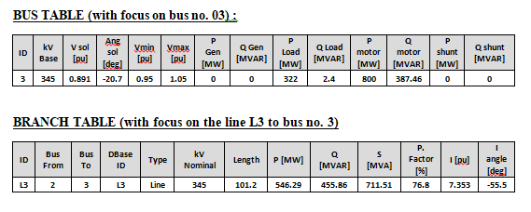
STATIC VAR COMPENSATION: STEP-1(SVC-1 at Bus No. 3 Addition):
we have noticed that the per unit voltage level at bus no. 3 is 0.891 and line no. 3 (L3) has gone into bus 3.
The Reactive power flowing through the line is 455.86 MVAR.
So, we have appended a STATIC VAR COMPENSATOR with Q-max of 456 and Q-min of -456 MVAR at bus 3.

Slide 41
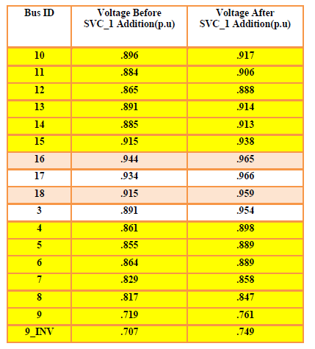
STATIC VAR COMPENSATION: STEP-1(SVC-1 at Bus No. 3 Addition):
Bus voltage improvement after SVC-1 Addition:

Slide 42
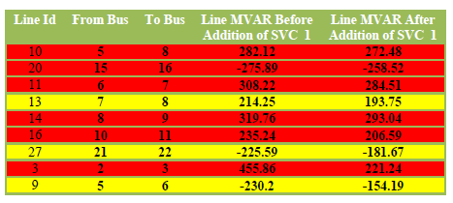
STATIC VAR COMPENSATION: STEP-1(SVC-1 at Bus No. 3 Addition):
LINE MVAR IMPROVEMENT COMPARISION (AFTER SVC_1 ADDITION)
We can see line MVAR is reduced in those line mentioned in the table above.
->The lines L9,L13,L27 which are highlighted with yellow color are improved in terms of their MVAR and they are now within limit.
->And the other lines L3,L10,L11,L14,L16,L20 which are highlighted with red color are improved in terms of MVAR but they are still outside limit.

Slide 43
STATIC VAR COMPENSATION: STEP-1(SVC-1 at Bus No. 3 Addition):
After the inclusion of SVC1.
No transformer was overloaded .
No generator was at reactive limit and overloaded .
No line was burdened with current limit violation.

Slide 44
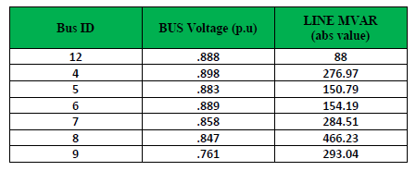
STEP-2(SVC-2 at Bus No. 9 Addition):
From the above table,
-> we can see that bus no. 9 is heavily affected by line losses and voltage drop in the lines due to reactive current component.
-> Though bus no. 8 is burdened by more line MVAR, its voltage is not as bad as that of bus no. 9
-> It is because bus no. 8 is absorbing 466.23 MVAR as well as giving away 293.04 MVAR to bus no. 9. So our focus is on bus no. 9.
-> So, we have appended a STATIC VAR COMPENSATOR (SVC_2) with Q-max of 294 and Q-min of -294 MVAR at bus no. 9.

Slide 45
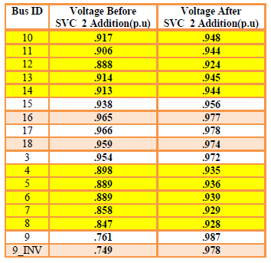
STEP-2(SVC-2 at Bus No. 9 Addition):
BUS VOLTAGE IMPROVEMENT COMPARISON (AFTER SVC_2 ADDITION)

Slide 46
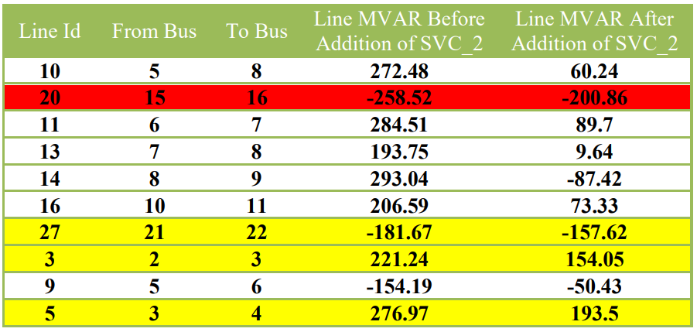
STEP-2(SVC-2 at Bus No. 9 Addition):
LINE MVAR IMPROVEMENT COMPARISION (AFTER SVC_2 ADDITION)
After addition of second Static VAR Compensator at bus no. 9, we can see ->line MVAR is reduced in those line mentioned above in the table.
->The lines L3,L5,L27 which are highlighted with yellow color are improved in terms of their MVAR and they are now within limit.
->The line L20 which are highlighted with red color are improved in terms of MVAR but they are still outside limit.
-> And the MVARs are heavily reduced in the rest of the lines mentioned above in the table.

Slide 47
STEP-2(SVC-2 at Bus No. 9 Addition):
After the inclusion of SVC2.
No transformer was overloaded .
No generator was at reactive limit and overloaded .
No line was burdened with current limit violation.

Slide 48
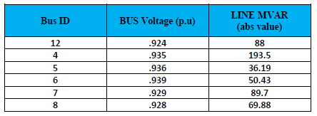
STEP-3(SVC-3 at Bus No. 4 Addition):
From the above table, it is noticed that
->bus no. 12 has the lowest per unit voltage but the lines associated with it are carrying 88 MVAR reactive powers. But bus no. 4 is not far good than bus no. 12
-> additionally the line associated with it is carrying 193.5 MVAR reactive power which is roughly 2 times higher than case in bus no. 12.
->This relatively high MVAR is essentially affecting the voltages of adjacent buses of bus no. 4 (i.e. bus no. 5, 6, 7, 8) in an adverse way.
-> So, we have appended a STATIC VAR COMPENSATOR (SVC_3) with Q-max of 194 and Q-min of -194 MVAR at bus no. 4.

Slide 49
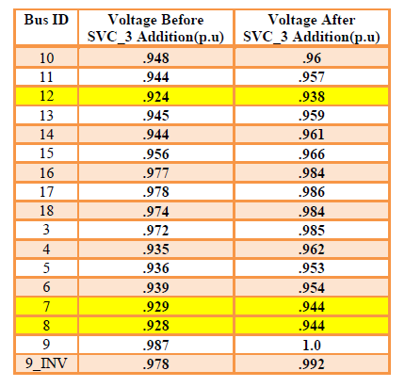
STEP-3(SVC-3 at Bus No. 4 Addition):
BUS VOLTAGE IMPROVEMENT COMPARISON (AFTER SVC3 ADDITION)

Slide 50
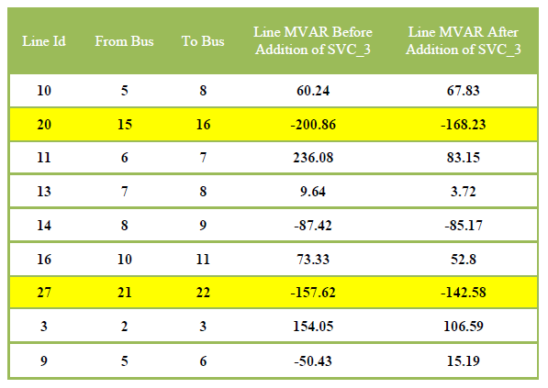
STEP-3(SVC-3 at Bus No. 4 Addition):
LINE MVAR IMPROVEMENT COMPARISION (AFTER SVC3 ADDITION)
After addition of third Static VAR Compensator at bus no. 4, we can see
-> line MVAR is reduced in those line mentioned above in the table.
->The lines L20,,L27 which are highlighted with yellow color are improved in terms of their MVAR and they are now within limit
-> No line is outside limit.

Slide 51
STEP-3(SVC-3 at Bus No. 4 Addition):
After the inclusion of SVC3.
No transformer was overloaded .
No generator was at reactive limit and overloaded .
No line was burdened with current limit violation.

Slide 52
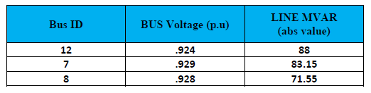
STEP-4 (SVC-4 at Bus No. 12 Addition):
Here we can observe that
->bus no. 12 has the lowest voltage in per unit and the lines associated with it are carrying the highest MVAR of 88.
->So the next target should be bus 12.
->Therefore, we have decided to append the next static VAR compensator SVC_4 at bus 12 with Q-max of 88 and Q-min of -88 MVAR.

Slide 53
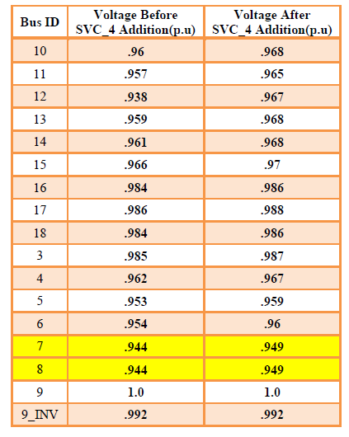
STEP-4 (SVC-4 at Bus No. 12 Addition):
BUS VOLTAGE IMPROVEMENT COMPARISON (AFTER SVC_4 ADDITION)

Slide 54
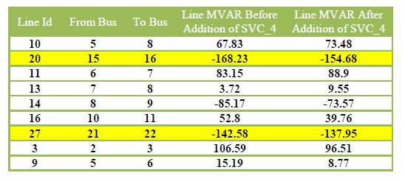
STEP-4 (SVC-4 at Bus No. 12 Addition):
LINE MVAR IMPROVEMENT COMPARISION (AFTER SVC_4 ADDITION)
After addition of fourth Static VAR Compensator at bus no. 12, we can see ->line MVAR is reduced in those line mentioned above in the table.
->The lines L20,L27 which are highlighted with yellow color are improved in terms of their MVAR but their MVARs are greater than 150.
-> And the MVARs are less than 100 in the rest of the lines mentioned above in the table.

Slide 55
STEP-4 (SVC-4 at Bus No. 12 Addition):
After the inclusion of SVC4.
No transformer was overloaded .
No generator was at reactive limit and overloaded .
No line was burdened with current limit violation.

Slide 56
STEP-5 (SVC_3 and SVC_4 ADJUSTMENT)
After appending SVC_4 at bus 12,
->we have noticed that the voltages at bus 7 and 8 are yet to be within the safe voltage limit. Literally they are at a stone’s throw from the desired voltage limit namely both are with 0.949 per unit.
->So adding another SVC would seem less efficient and costly. Therefore we have decided to increase the positive and negative reactive limits of the existing static VAR compensators by a necessary amount. Here we have followed some randomized guessing.
->And finally we have increased the Q-max and Q-min of SVC_3 to +215 and -215 MVAR. Likewise, we have also increased the Q-max and Q-min of SVC_4 to +90 and -90 MVAR.

Slide 57
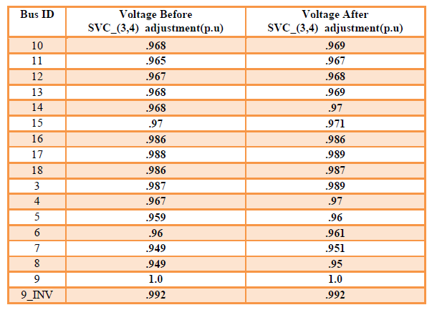
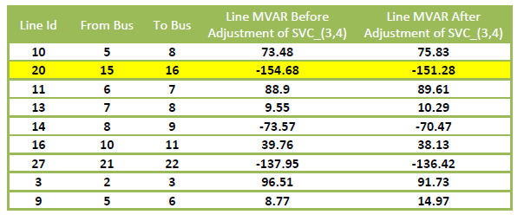
STEP-5 (SVC_3 and SVC_4 ADJUSTMENT):
BUS VOLTAGE IMPROVEMENT
LINE MVAR IMPROVEMENT

Slide 58
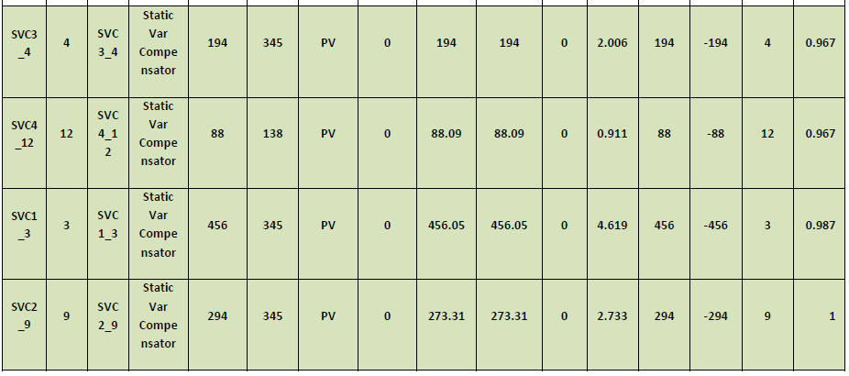
STATIC VAR COMPENSATION ALL THE SVCs SHOWN TOGETHER

Slide 59
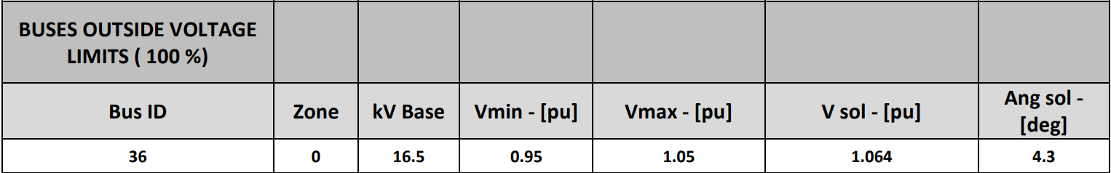
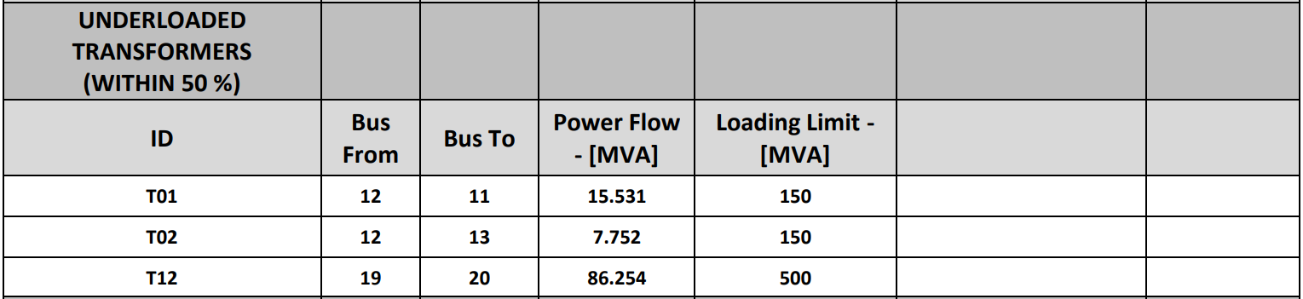
ABNORMAL REPORT

Slide 60
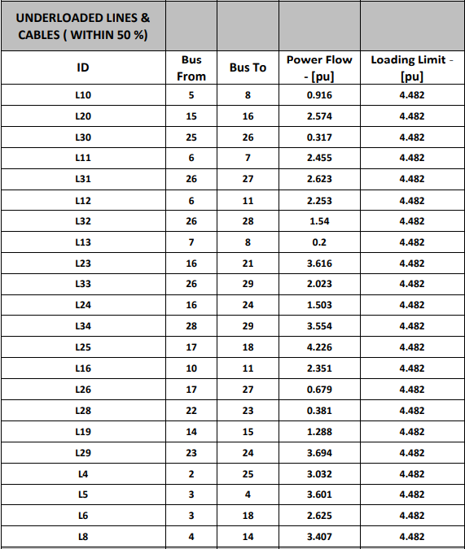
ABNORMAL REPORT

Slide 61
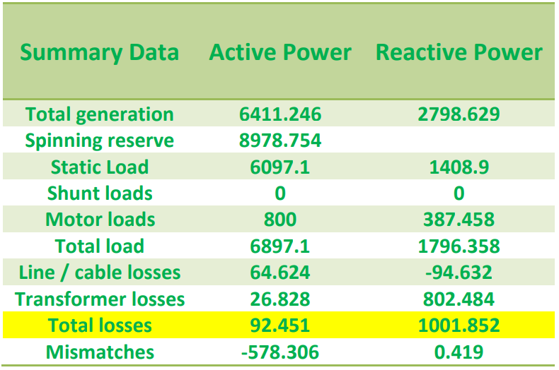
STATIC VAR COMPENSATION SUMMARY REPORT

Slide 62
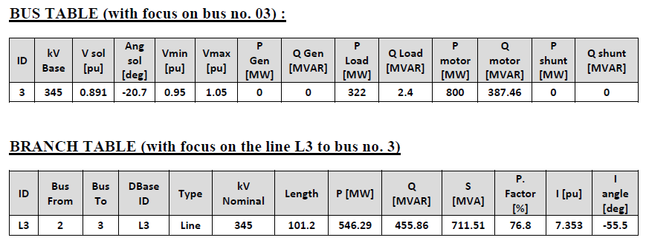
SHUNT CAPACITOR COMPENSATION: STEP-1(SC-1 at Bus No. 3 Addition):
From the aforementioned extracted sections of our previous informative tables in the point of distributed swing application, we have noticed that
-> the per unit voltage level at bus no. 3 is 0.891 and line no. 3 (L3) has gone into bus 3.
->The Reactive power flowing through the line is 455.86 MVAR. So, we have appended a SHUNT CAPACITOR with Q-RATING of 456 MVAR

Slide 63
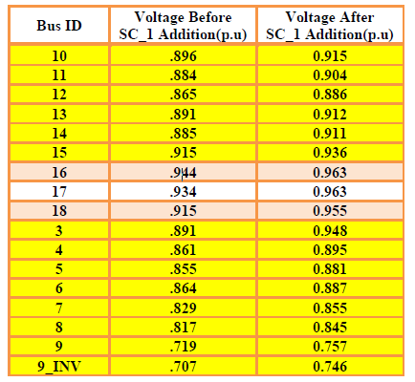
SHUNT CAPACITOR COMPENSATION: STEP-1(SC-1 at Bus No. 3 Addition):
BUS VOLTAGE IMPROVEMENT COMPARISON (AFTER SC_1 ADDITION)

Slide 64
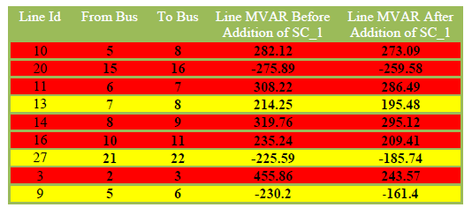
SHUNT CAPACITOR COMPENSATION: STEP-1(SC-1 at Bus No. 3 Addition):
LINE MVAR IMPROVEMENT COMPARISION (AFTER SC_1 ADDITION)
After addition of first Shunt Capacitor at bus no. 3, we can see
-> line MVAR is reduced in those line mentioned in the table above.
->The lines L9,L13,L27 which are highlighted with yellow color are improved in terms of their MVAR and they are now within limit.
-> And the other lines L3,L10,L11,L14,L16,L20 which are highlighted with red color are improved in terms of MVAR but they are still outside limit.

Slide 65
STEP-1(SC-1 at Bus No. 3 Addition):
After the inclusion of SC1.
No transformer was overloaded .
No generator was at reactive limit and overloaded .
No line was burdened with current limit violation.

Slide 66
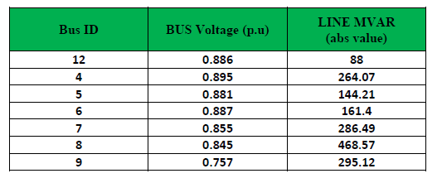
STEP-2(SC-2 at Bus No. 9 Addition):
From the above table, we can see that
-> bus no. 9 is heavily affected by line losses and voltage drop in the lines due to reactive current component.
-> Though bus no. 8 is burdened by more line MVAR, its voltage is not as bad as that of bus no. 9.
-> It is because bus no. 8 is absorbing 468.57 MVAR as well as giving away 295.12 MVAR to bus no. 9.
-> So our focus is on bus no. 9. So, we have appended a SHUNT CAPACITOR (SC_2) with Q-RATING of 296 MVAR at bus no. 9.

Slide 67
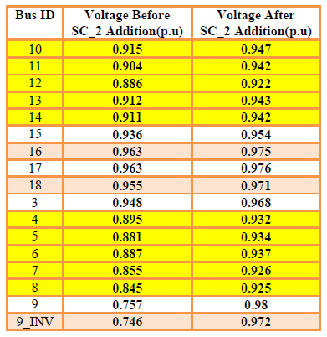
STEP-2(SC-2 at Bus No. 9 Addition):
BUS VOLTAGE IMPROVEMENT COMPARISON (AFTER SC_2 ADDITION)

Slide 68
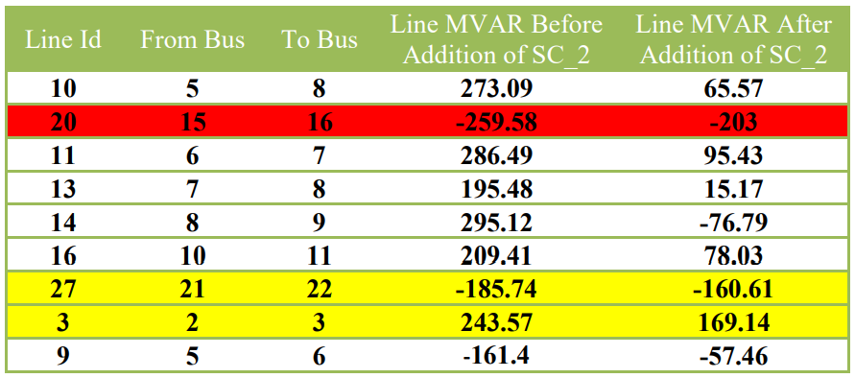
STEP-2(SC-2 at Bus No. 9 Addition):
LINE MVAR IMPROVEMENT COMPARISION (AFTER SC_2 ADDITION)
After addition of second Shunt Capacitor at bus no. 9, we can see
-> line MVAR is reduced in those line mentioned in the table above.
->The lines L3,L27 which are highlighted with yellow color are improved in terms of their MVAR and they are now within limit but their MVAR is greater than 150.
->The other lines are heavily improved in terms of their MVARs and their value is less than 100.

Slide 69
STEP-2(SC-2 at Bus No. 9 Addition):
After the inclusion of SC2.
No transformer was overloaded .
No generator was at reactive limit and overloaded .
No line was burdened with current limit violation.

Slide 70
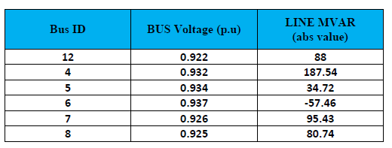
STEP-3(SC-3 at Bus No. 4 Addition):
From the above table, it is noticed that
-> bus no. 12 has the lowest per unit voltage but the lines associated with it are carrying 88 MVAR reactive powers.
->But bus no. 4 is not far good than bus no. 12 and additionally the line associated with it is carrying 187.54 MVAR reactive power which is roughly 2 times higher than the case in bus no. 12.
->This relatively high MVAR is essentially affecting the voltages of adjacent buses of bus no. 4 (i.e. bus no. 5, 6, 7, 8) in an adverse way.
->So, we have appended a SHUNT CAPACITOR (SC_3) with Q-RATING of 188 MVAR at bus no. 4.

Slide 71
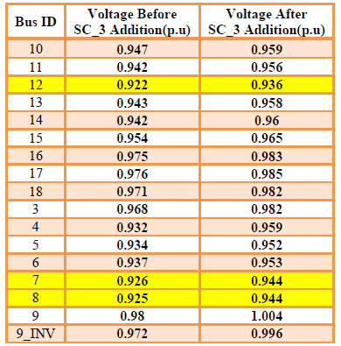
STEP-3(SC-3 at Bus No. 4 Addition):
BUS VOLTAGE IMPROVEMENT COMPARISON (AFTER SC_3 ADDITION)

Slide 72
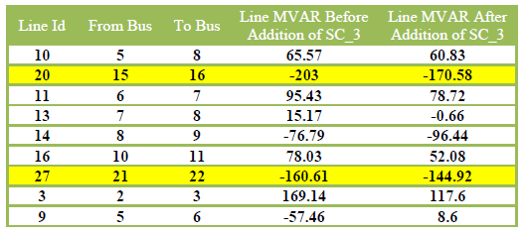
STEP-3(SC-3 at Bus No. 4 Addition):
LINE MVAR IMPROVEMENT COMPARISION (AFTER SC_3 ADDITION)
After addition of third Static VAR Compensator at bus no. 4, we can see
-> line MVAR is reduced in those line mentioned in the table above.
->The lines L20,L27 which are highlighted with yellow color are improved in terms of their MVAR and they are now within limit.
-> And the other lines which are not highlighted but we are focusing are within limit and their value is less than 150.

Slide 73
STEP-3(SC-3 at Bus No. 4 Addition):
After the inclusion of SC3.
No transformer was overloaded .
No generator was at reactive limit and overloaded .
No line was burdened with current limit violation.

Slide 74
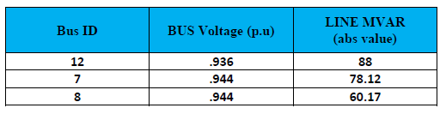
STEP-4 (SC-4 at Bus No. 12 Addition):
Here we can observe that
-> bus no. 12 has the lowest voltage in per unit and the lines associated with it are carrying the highest MVAR of 88.
->So the next target should be bus 12.
->Therefore, we have decided to append the next SHUNT CAPACITOR SC_4 at bus 12 with Q-RATING of 88 MVAR.

Slide 75
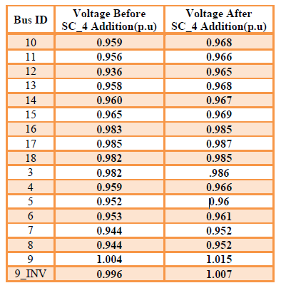
STEP-4 (SC-4 at Bus No. 12 Addition):
BUS VOLTAGE IMPROVEMENT COMPARISON (AFTER SC_4 ADDITION)

Slide 76
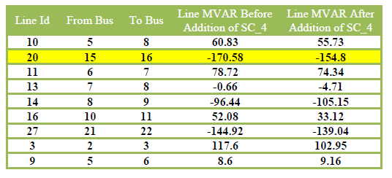
STEP-4 (SC-4 at Bus No. 12 Addition):
LINE MVAR IMPROVEMENT COMPARISION (AFTER SC_4 ADDITION)
After addition of fourth Shunt Capacitor at bus no. 12, we can see
-> line MVAR is reduced in those line mentioned in the table above.
->The line L20 which is highlighted with yellow color is improved in terms of its MVAR and it is within limit but greater than 150.
-> And the other lines which are not highlighted but focused are within limit.

Slide 77
STEP-4 (SC-4 at Bus No. 12 Addition):
After the inclusion of SC4.
No transformer was overloaded .
No generator was at reactive limit and overloaded .
No line was burdened with current limit violation.

Slide 78
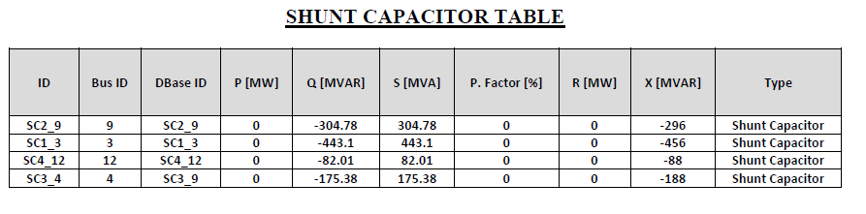
STEP-4 (SC-4 at Bus No. 12 Addition): ALL SHUNT CAPACITORS SHOWN TOGETHER

Slide 79
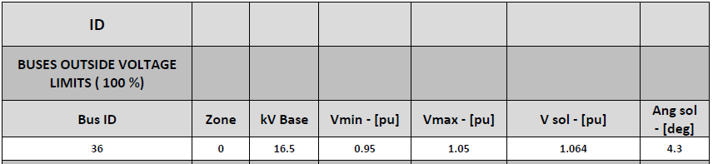
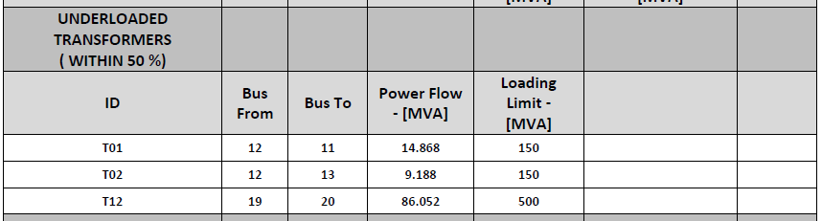
STEP-4 (SC-4 at Bus No. 12 Addition): ABORMAL REPORT

Slide 80
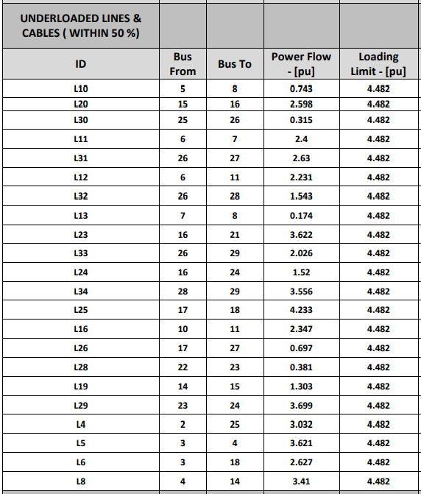
STEP-4 (SC-4 at Bus No. 12 Addition): ABORMAL REPORT

Slide 81
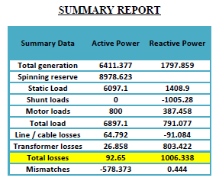
STEP-4 (SC-4 at Bus No. 12 Addition):

Slide 82
Thank You

