Slide 1
Plant Disease Detection using Deep Neural Network
Group Member:
Kazi Ishrak Ahmed (1706077)
Tushar Talukder Showrav (1706087)
Monir Hossain (1706091)
Sajib Bain (1706094)

Slide 2
Datasets We have used
Plant Village Dataset
IPM Dataset
Bing Dataset

Slide 3
Dataset 1: Plant Village
This dataset has total 54305 different images of different plant leaves
Total 38 classes of plant leaves
24 classes of diseases & 14 classes of healthy crops
14 types of crops species
We have divided the images at multiple ratios for training and testing
We have used both color and grayscale version of images
We have resized the images as per the CNN architecture needs

Slide 4
Class | Plant Common Name | Disease Common Name | Disease Scientific Name | Total Images
C1 C2 C3 C4 C5 C6 C7 C8 C9 C10 C11 C12 C13 C14 C15 C16 C17 C18 C19 C20 C21 C22 C23 C24 C25 C26 C27 C28 C29 C30 C31 C32 C33 C34 C35 C36 C37 C38 Total | Apple Apple Apple Apple Blueberry Cherry(Including Sour) Cherry(Including Sour) Corn(Maize) Corn(Maize) Corn(Maize) Corn(Maize) Grape Grape Grape Grape Orange Peach Peach Pepper Bell Pepper Bell Potato Potato Potato Raspberry Soybean Squash Strawberry Strawberry Tomato Tomato Tomato Tomato Tomato Tomato Tomato Tomato Tomato Tomato 14 Crop Species | Apple Scab Black Rot Cedar Apple Rust Healthy Healthy Powdery Mildew Healthy Cerespora Leaf Spot Gray Leaf Spot Common Rust Northern Leaf Blight Healthy Black Rot Esca (Black Measles) Leaf Blight (Isariopsis Leaf Spot) Healthy Haunglongbin (Citrus Greening) Bacterial Spot Healthy Bacterial Spot Healthy Early Blight Late Blight Healthy Healthy Healthy Powdery Mildew Leaf Scorch Healthy Bacterial Spot Early Blight Late Blight Leaf Mold Septoria Leaf Spot Spider Mites Two-Spotted Spider Mite Target Spot Tomato Yellow Leaf Curl Virus Tomato Mosaic Virus Healthy 21 Disease Classes | Venturia Inaequalis Diplodia Seriata Gymnosporangium Juniperi-Virginianae - - Podosphaera Clandestine - Cercospora Zeae-Maydis Puccinia Sorghi Setosphaeria Turcica - Guignardia Bidwellii Togninia Minima Pseudocercospora Vitis - Liberibacter Asiaticus Xanthomonas Arboricola - Xanthomonas Campestris - Alternaria Solani Phytophthora Infestans - - - Podosphaera Xanthii Diplocarpon Earlianum - Xanthomonas Campestris Alternaria Solani Phytophthora Infestans Mycovellosiella Fulva Septoria Lycopersici Tetranychidae Spp. Corynespora Cassiicola TYLCV Tomv - | 630 621 275 1645 1502 1052 854 512 1192 985 1162 1180 1383 1076 423 5507 2297 360 997 1478 1000 1000 152 371 5090 1835 1109 456 2127 1000 1909 952 1771 1676 1404 5357 373 1591 54305

Slide 5
Dataset 2: IPM Dataset
This dataset has total 118 different images of different plant leaves
Total 19 classes of diseases and healthy crops
Dataset 3: Bing Dataset
This dataset has total 55 different images of different plant leaves
Total 24 classes of diseases and healthy crops

Slide 6
Bing Dataset
IPM Dataset
Class | Plant Common Name | Disease Common Name | Total Images
C1 C2 C3 C4 C7 C8 C9 C10 C11 C16 C18 C19 C21 C22 C24 C28 C29 C30 C32 C33 C34 C35 C36 C38 Total | Apple Apple Apple Apple Cherry (including sour) Corn (maize) Corn (maize) Corn (maize) Corn (maize) Orange Peach Pepper bell Potato Potato Raspberry Strawberry Tomato Tomato Tomato Tomato Tomato Tomato Tomato Tomato | Apple scab Black rot Cedar apple rust Healthy Healthy Cerespora leaf spot gray leaf spot Common rust Northern Leaf Blight Healthy Haunglongbing (Citrus greening) Healthy Bacterial Spot Early blight Late blight Healthy Healthy Bacterial Spot Early blight Leaf mold Septoria Leaf spot Spider mites Target Spot Tomato yellow Leaf Curl Virus Healthy | 2 3 1 1 1 3 3 2 1 2 1 1 1 3 1 2 1 5 6 4 1 5 1 4 55
Class | Plant Common Name | Disease Common Name | Total Images
C1 C2 C3 C6 C8 C9 C10 C12 C14 C16 C17 C19 C21 C27 C29 C30 C31 C32 C33 Total | Apple Apple Apple Cherry (including sour) Corn (maize) Corn (maize) Corn (maize) Grape Grape Orange Peach Pepper bell Potato Strawberry Tomato Tomato Tomato Tomato Tomato | Apple scab Black rot Cedar apple rust Powdery mildew Cerespora leaf spot gray leaf spot Common rust Northern Leaf blight Black rot Leaf blight (Isariopsis Leaf Spot) Haunglongbin (Citrus greening) Bacterial spot Bacterial spot Early blight Leaf scorch Bacterial spot Early blight Late blight Leaf Mold Septoria Leaf Spot | 2 2 3 2 10 20 8 8 2 13 12 2 5 5 5 7 4 4 4 118

Slide 7
Methodology
Comparison between different learning configurations
Testing with PV Dataset
Testing with IPM and Bing Dataset
Disease identification based on common names of disease
Retesting IPM and Bing Dataset by using new approach
Evaluate our model on completely unseen crops
Evaluate our model to classify healthy and unhealthy plants

Slide 8
CNN architectures:
NASNetLarge (Parameters 88,949,818)
VGG16 (Parameters 22,910,480)
EfficientNetB0 (Parameters 5,330,571)
InceptionResNetV2 (Parameters 55,873,736)

Slide 9
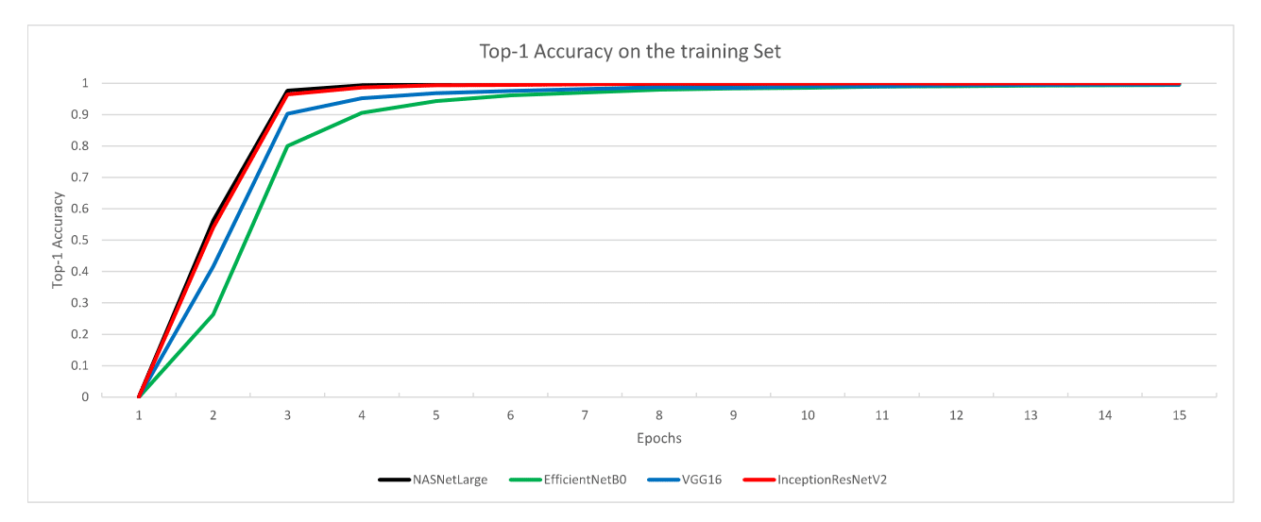

Slide 10
Comparison of Different Architectures
Architectures | Training Accuracy | Validation Accuracy | IPM | Bing
NasNetLarge | 99.93 | 99.55 | 36.98 | 20.00
VGG16 | 99.50 | 99.35 | 35.29 | 20.00
EfficientNetB0 | 99.43 | 99.60 | 30.25 | 18.18
InceptionResNetV2 | 99.94 | 99.00 | 44.54 | 10.91

Slide 11
Disease identification based on common names of disease
 | Healthy | Apple Scab | Black Rot | Ceder Apple Rust | Powdery Mildew | Cercospora | Common rust | Northern leaf blight | Esca | Leaf blight | Huangglongbing | Bacterial spot
Apple | 1645 | 630 | 621 | 275
Blueberry | 1502
Cherry | 854 |  |  |  | 1052
Corn | 1162 |  |  |  |  | 513 | 1192 | 985
Grape | 423 |  | 1180 |  |  |  |  |  | 1383 | 1076
Orange |  |  |  |  |  |  |  |  |  |  | 5507
Peach | 360 |  |  |  |  |  |  |  |  |  |  | 2297
Pepper Bell | 1478 |  |  |  |  |  |  |  |  |  |  | 997
Potato | 152
Raspberry | 371
Soybean | 5090
Squash |  |  |  |  | 1835
Strawberry | 456
Tomato | 1591
Total | 15084 | 630 | 1801 | 275 | 2887 | 513 | 1192 | 985 | 1383 | 1076 | 5507 | 5421
Early Blight | Late Blight | Leaf Scorch | Leaf Mold | Septoria Leaf Spot | Spider Mites | Target Spot | Curl Virus | TMV | Total
 |  |  |  |  |  |  |  |  | 3171
 |  |  |  |  |  |  |  |  | 1502
 |  |  |  |  |  |  |  |  | 1906
 |  |  |  |  |  |  |  |  | 3852
 |  |  |  |  |  |  |  |  | 4062
 |  |  |  |  |  |  |  |  | 5507
 |  |  |  |  |  |  |  |  | 2657
 |  |  |  |  |  |  |  |  | 2475
1000 | 1000 |  |  |  |  |  |  |  | 2152
 |  |  |  |  |  |  |  |  | 371
 |  |  |  |  |  |  |  |  | 5090
 |  |  |  |  |  |  |  |  | 1835
 |  | 1109 |  |  |  |  |  |  | 1565
1000 | 1909 |  | 952 | 1771 | 1676 | 1404 | 5357 | 373 | 18160
2000 | 2909 | 1109 | 952 | 1771 | 1676 | 1404 | 5357 | 373 | 54305

Slide 12
Retesting IPM and Bing Dataset by using new approach
Architectures | IPM | Bing
NASNetLarge | 46.61 | 41.82
VGG16 | 35.29 | 40.00
EfficientNetB0 | 33.89 | 30.91
InceptionResNetV2 | 37.29 | 38.18

Slide 13
Evaluate our model on completely unseen crops
At first we removed “Pepper Bell Healthy” and “Pepper Bell Bacterial Spot” classes from our modified PV dataset
Then we trained our models with this new modified PV dataset
Then we evaluated the predictions of detecting images of the two excluded classes, where these 2 classes were completely unknown to our models

Slide 14
Performance of our models on completely unseen crops
Architectures | Pepper bell healthy | Pepper bell bacterial spot
NASNetLarge | 90.93 | 30.19
VGG16 | 98.78 | 55.97
InceptionResNetV2 | 97.56 | 25.98

Slide 15
Evaluate our model to classify Unseen healthy or unhealthy plants
Architectures | Healthy | Unhealthy | Average
NASNetLarge | 94.18 | 96.99 | 95.31
VGG16 | 94.45 | 96.59 | 95.31
InceptionResNetV2 | 97.84 | 97.29 | 97.61

Slide 16
Difficulties
No experience about Python Coding
Zero knowledge on Machine Learning
No experience working on Kaggle
Acquisition of IPM and Bing Dataset
Hardware limitations

Slide 17
Future Plans
Removing different more crop classes from the PV dataset and testing with these unseen images to our models
Too further improve performance on IPM and Bing images detection

Slide 18
THANK YOU!

