Slide 1
AGE ESTIMATION FROM FACE IMAGE LEVERAGING CONCATENATED FEATURES OF VISION TRANSFORMER ALONG WITH RESNET-50
Ishra Naznin
ID: 18701069
Supervisor: Dr. Md. Mahbubul Islam
Department of Computer Science and Engineering
University of Chittagong
24th August, 2023

Slide 2
01
Problem statement
02
Literature Review
03
Proposed Methods
Presentation
Outlines
04
Experimental Results
05
Conclusion & Future Work
06
References

Slide 3



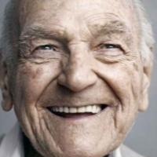
Problem statement
Age Estimation
“Estimate the age of a person from facial image”
1 year
Age Estimator
Output
Input
10 year
100 year

Slide 4
Motivation
Variations in facial shape and texture are brought on by aging.
Aging is inevitable and uncontrollable , cant be avoided, advanced, or delayed it with slow and irreversible.
Aging patterns are personalized.
Facial variations caused by aging are temporary .
Age estimation aids areas are: drug prevention, forensics, access control , recommendation, security control.
Imprecise data collection and labeling leads to imbalanced by age
Objective
To find out aging patterns and variations in facial appearance with an automated way to estimate age.
To investigate the applicability of machine learning(HOG) and deep learning algorithm (deep features) for age estimation.
To propose a effective hybrid model for estimate age from facial appearance.

Slide 5
Related work
Age Estimation with CNN-based VGG16 architecture in UTKFace, FG-NET dataset (K. ELKarazleet. Intell. Autom. Soft Comput, vol. 34, pp. 105–118, 2022)
Age Estimation with transfer learning CNNs (VGG, Res-Net, Google-Net, Alex-Net) in FG-NET, MORPH dataset.(I. Dagher et. Multimedia Tools and Applications, 2021)
Age Estimation with combination of CNN and SVR method in FG-Net and MORPH-II datasets(O. Sendik et. Signal Processing: Image Communication, 2019).
Automated age estimation using Recurrent Neural Network (RNN) in Images of Groups and Gallagher collection person datasets (Rizwan et. Computers, Materials and Continua, 2022).
A CNN-based EfficientNet architecture for age estimation in UTKface and Adience datasets (I. Aruleba et. Springer, 2021).
A fine-grained age estimation utilizing LSTM units and residual networks (ResNets) on IMDB-WIKI-101, FG-NET, MORPH II datasets.(K. Zhang et. IEEE Transactions on Circuits and Systems for Video Technology, vol. 30, no. 9, pp. 3140–3152, 2019).

Slide 6
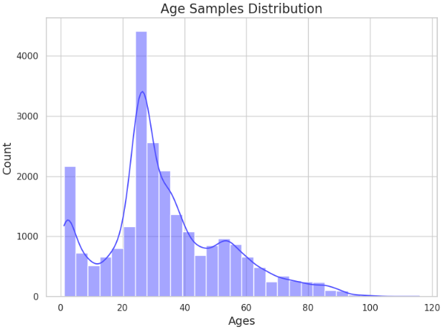
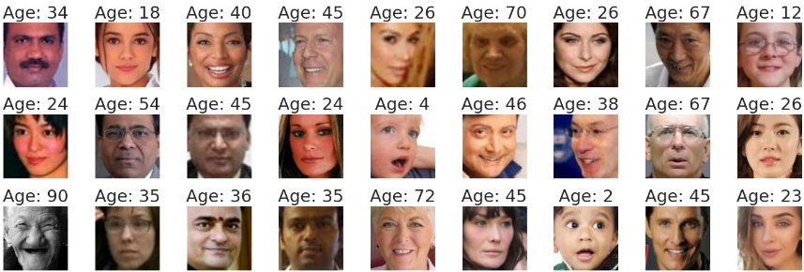
Dataset
UTKFace[2] dataset : 23708 samples
Training data: 15172
Testing data: 4742 samples
Validation data: 3794 samples
6

Slide 7

Image Pre-Processing
01
Face Detection (test case)
02
Methodology
Feature Extraction
03
04
Classification / Regression

Slide 8

Workflow
Feature Extraction
*
Face Image dataset
ResNet50
Vision Transformer
Data augmentation
Concatenate Features
Image preprocessing
(Resize, RGB color conversion, array of images and ages)
Training data
Validation data
Train Model
Test data
Evaluate
Real time image or camera
Extract face
Age

Slide 9
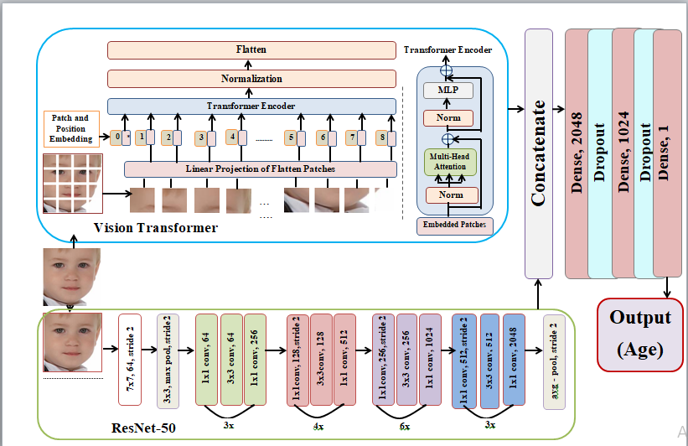
Proposed Model

Slide 10
Experimental Results
Features | Regression( Best) |  | Classification through Regression ( Best)
 | Alg. name | MAE | Alg. name | MAE
HOG | DNN | 7.085 | DNN | 8.125
CNN | ResNet50 | 5.021 | RestNet50 | 18.058
ViT | --- | 7.870 | --- | 9.705
HOG * ResNet50 | DNN | 6.082 | DNN | 6.104
HOG * ResNet50 * ViT | DNN | 5.812 | DNN | 5.541
ViT * ResNet50 | Proposed hybrid model | 4.886 | Proposed hybrid model | 6.057

Slide 11
Experimental Results(Cont.)
Comparative performance on proposed hybrid model:

Slide 12
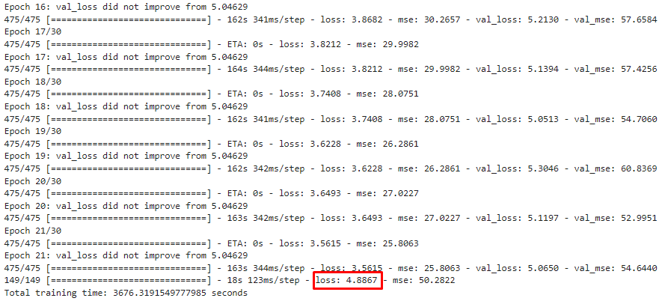
Experimental Results(Cont.)
Different Results on different epoch

Slide 13
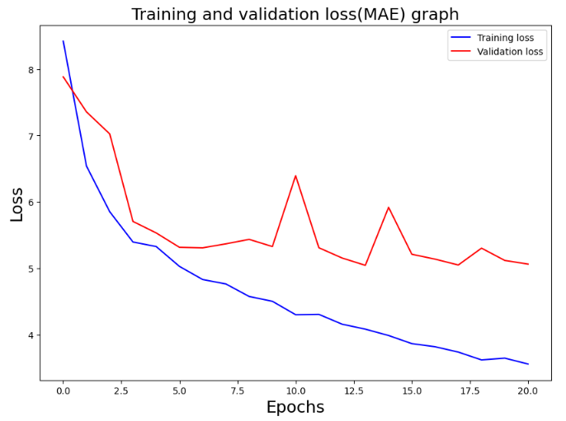
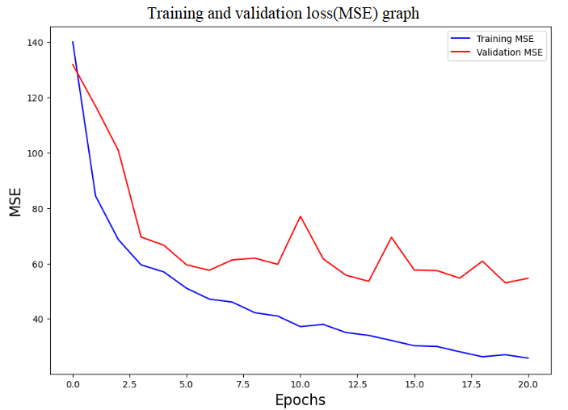
Experimental Results(Cont.)
Training & validation
Fig: Graph of training and validation of proposed hybrid model

Slide 14
Experimental Results(Cont.)
Comparison with others’ work on UTKFace dataset
Method | Age Estimation(MAE)
ResNet50 [1] | 9.66
ResNeXt-50(32x4d) [3] | 7.21
Inceptionv3 [1] | 9.50
DenseNet [1] | 9.19
Custom CNN [4] | 5.67
CORAL [5] | 5.39
Our proposed hybrid model | 4.88

Slide 15
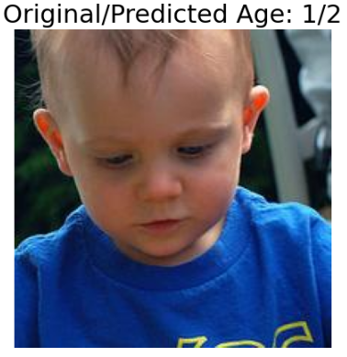
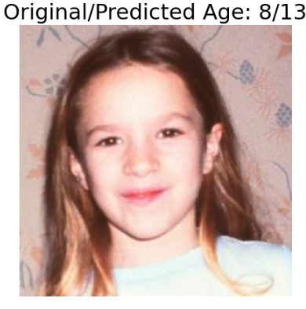
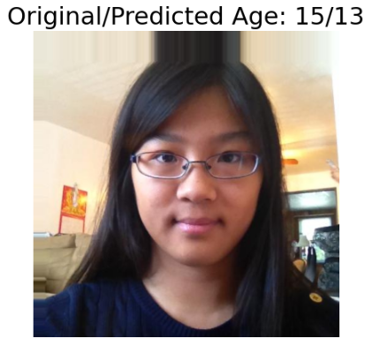
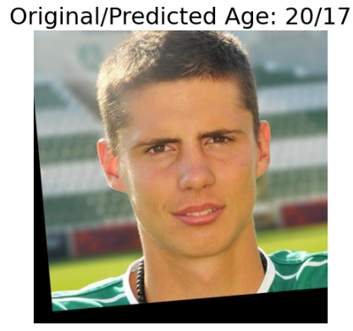
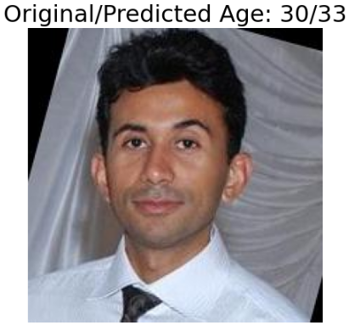
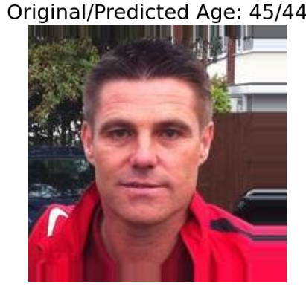
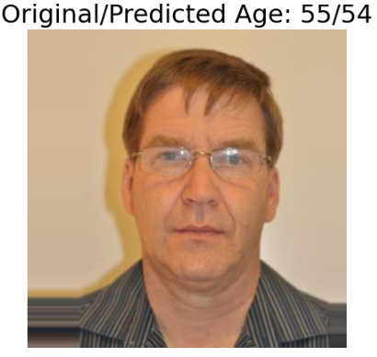
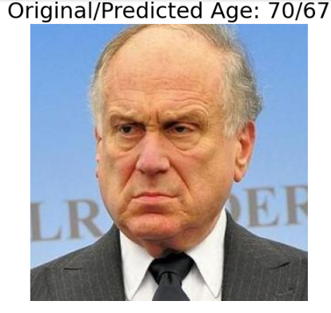
Experimental Results(Cont.)
Fig: Predicted age of some test images using our proposed hybrid model

Slide 16
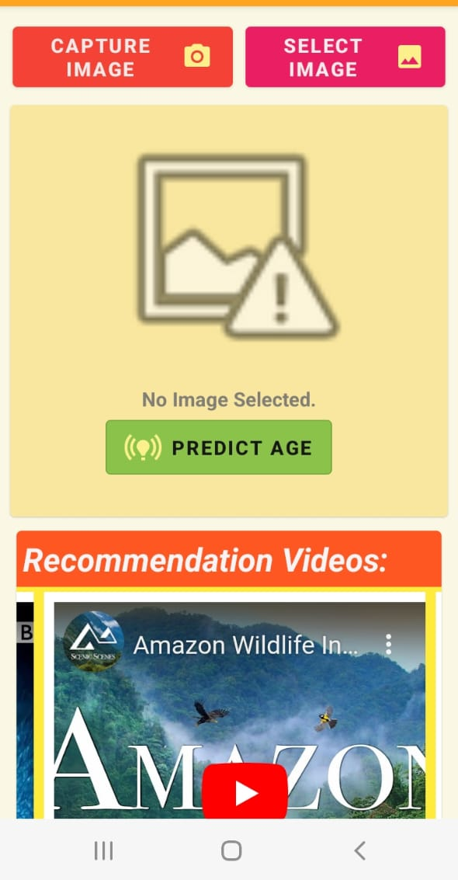
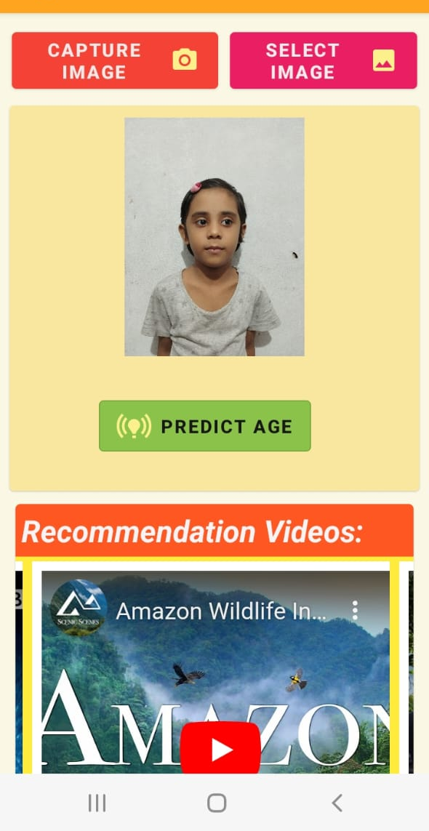
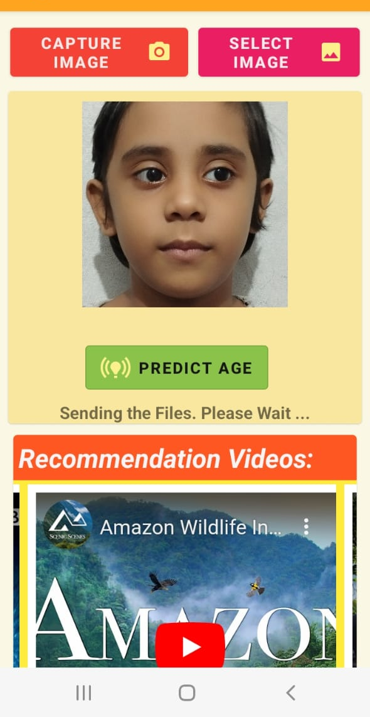
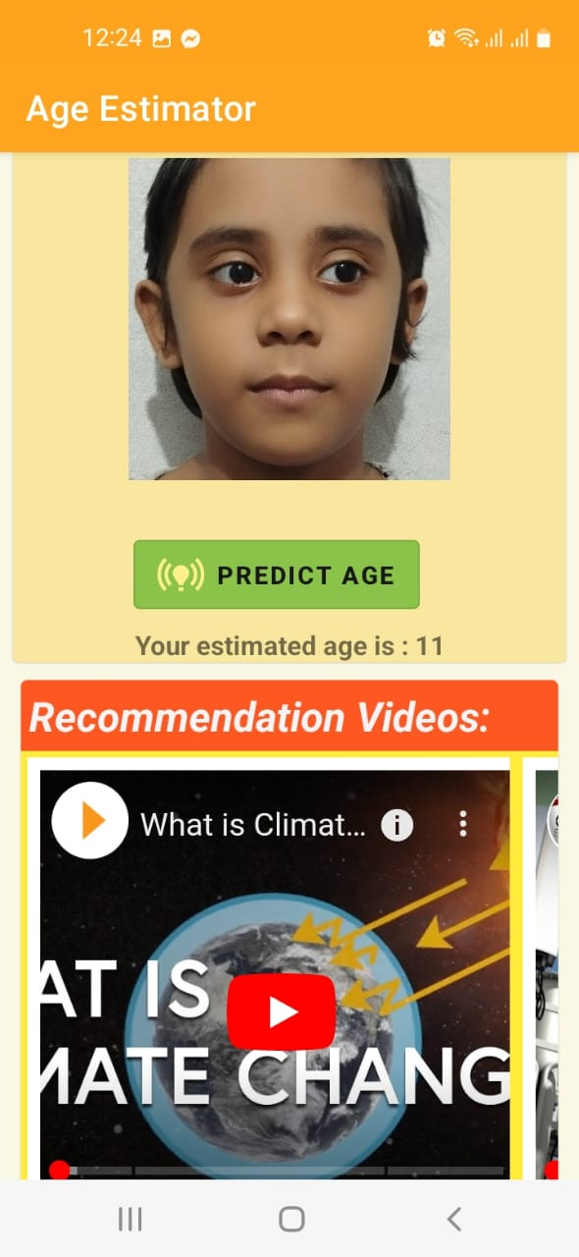
Implementation
A deep learning founded recommendation solution for YouTube video suggestions.
Figure 3. The proposed age based recommendation system.

Slide 17
Conclusion and Future work
Conclusion:
Proposed a hybrid model by concatenated features of CNN-based ResNet50 and Vision transformer for age estimation.
Proposed model demonstrated well behavior with 4.88 as MAE.
Experiment on UTKFace dataset demonstrated the efficiency of our method in terms of other types of deep features combination.
Evaluate our approach on both deep learning and machine learning approaches on different features vectors.
Future work:
Cross dataset experiment to leverage more knowledge to estimate age.
Effect of gender and ethnicity to estimate age from facial image.
Improve the effectiveness of our proposed model by more hyper tuning.

Slide 18
References:
M. Akhand et al., “Human age prediction from facial image using transfer learning in deep convolutional neural networks,” in Proceedings of International Joint Conference on Computational Intelligence: IJCCI 2019, pp. 217–229, Springer, 2020.[1]
https://susanqq.github.io/UTKFace/ [2]
A. Fariza et al., “Age estimation system using deep residual network classification method,” in 2019 International Electronics Symposium (IES), pp. 607–611, IEEE, 2019.[3]
V. Sheoran et al., “Age and gender prediction using deep cnns and transfer learning,” in Computer Vision and Image Processing: 5th International Conference, CVIP 2020, Prayagraj, India, December 4-6, 2020, Revised Selected Papers, Part II 5, pp. 293–304, Springer, 2021.[4]
W. Cao et al., “Rank consistent ordinal regression for neural networks with application to age estimation,” Pattern Recognition Letters, vol. 140, pp. 325–331, 2020. [5]

Slide 19
Appendix:
Network Name | Number of Layer | Number of Parameters (Millions) | Size (MB) | Default Input Size (Height × Width)
ResNet50 | 50 | 25.6M | 98 | 224x224
VGG16 | 16 | 138.4M | 528 | 224x224
Xception | 71 | 22.9M | 88 | 299x299
InceptionV3 | 48 | 23.9M | 92 | 299x 299
MobileNet | 27 | 4.3M | 16 | 224x224
DenseNet | 121 | 8.1M | 33 | 224,x224

Slide 20
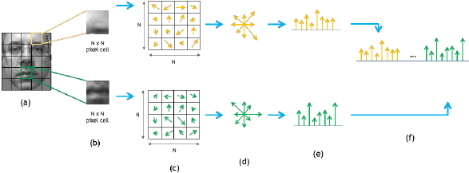
HOG features
Represents an image’s gradient or edge orientation patterns as a histogram.
Fig: HOG features extraction process: image is divided in cells of size N×N pixels. The orientation of all pixels is computed and accumulated in an M-bins histogram of orientations. Finally, all cell histograms are concatenated in order to construct the ﬁnal features vector. The example reports a cell size of 4 pixels and 8 orientation bins for the cell histograms
Notes:
The gradient magnitude represents how strong the change in intensity is at that pixel,
while the gradient orientation indicates the direction in which the intensity change is maximal.

Slide 21
Experimental evolution
Comparative performance on HOG features:
Regression |  | Classification through Regression
Model name | MAE | Model name | MAE
Linear Regression | 12.5767 | SGD Classifier | 19.4309
Ridge | 12.4374 | K Neighbors Classifier | 21.9073
 |  | Extra Trees Classifier | 17.8818
Lasso | 15.3758
 |  | Random Forest Classifier | 17.9018
Bayesian Ridge | 9.4603 | SVC | 17.9012
 |  | Gaussian Naive Bayes | 22.5889
DNN | 7.0853 | MLP Classifier | 14.9582
 |  | DNN | 8.12555

Slide 22
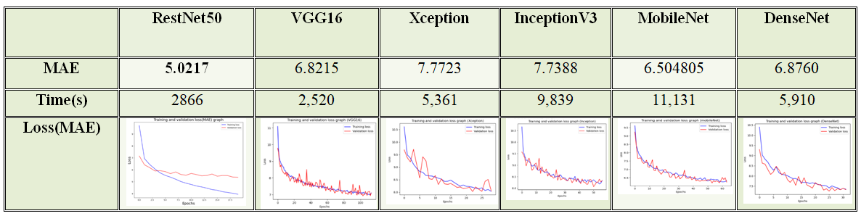
Experimental evolution(Cont.)
Comparative performance on different CNN-based models:

Slide 23
Experimental evolution(Cont.)
Comparative performance on Resnet50 features:
Regression |  | Classification through Regression
Model name | MAE | Model name | MAE
Linear Regression | 8.0613 | SGD Classifier | 19.7642
Ridge | 8.04629 | K Neighbors Classifier | 19.5022
 |  | Extra Trees Classifier | 18.2312
Lasso | 9.6754
 |  | Random Forest Classifier | 18.471
Bayesian Ridge | 7.6504 | SVC | 19.1610
 |  | Gaussian Naive Bayes | 23.3440
RestNet50 | 5.0217 | MLP Classifier | 14.9582
 |  | RestNet50 | 18.058

Slide 24
Experimental evolution(Cont.)
Comparative performance on ViT features:
Regression |  | Classification through Regression
Model name | MAE | Model name | MAE
Linear Regression | 11.4764 | SGD Classifier | 23.5066
Ridge | 11.0581 | K Neighbors Classifier | 22.1384
 |  | Extra Trees Classifier | 17.8851
Lasso | 15.1519
 |  | Random Forest Classifier | 17.9437
Bayesian Ridge | 10.7546 | SVC | 16.7182
 |  | Gaussian Naive Bayes | 25.158
ViT | 7.8707 | MLP Classifier | 14.9582
 |  | ViT | 9.70504

Slide 25
Experimental evolution(Cont.)
Comparative performance on combined HOG and CNN features:
Regression |  | Classification through Regression
Model name | MAE | Model name | MAE
Linear Regression | 10.94734 | SGD Classifier | 19.5348
Ridge | 10.6915 | K Neighbors Classifier | 19.8690
 |  | Extra Trees Classifier | 17.6181
Lasso | 9.67540
 |  | Random Forest Classifier | 17.9018
Bayesian Ridge | 7.27642 | SVC | 19.140
 |  | Gaussian Naive Bayes | 22.28518
DNN | 6.0821 | MLP Classifier | 19.5494
 |  | DNN | 6.104

Slide 26
Experimental evolution(Cont.)
Comparative performance on combined HOG, CNN, ViT features:
Regression |  | Classification through Regression
Model name | MAE | Model name | MAE
Linear Regression | 12.8466 | SGD Classifier | 20.1594
Ridge | 12.1714 | K Neighbors Classifier | 19.4462
 |  | Extra Trees Classifier | 17.6488
Lasso | 9.5369
 |  | Random Forest Classifier | 17.9855
Bayesian Ridge | 7.1699 | SVC | 18.505
 |  | Gaussian Naive Bayes | 22.3712
DNN | 5.8121 | MLP Classifier | 14.958
 |  | DNN | 5.5413

Slide 27
Experimental evolution(Cont.)
Comparative performance on combined CNN, ViT features :
Regression |  | Classification through Regression
Model name | MAE | Model name | MAE
Linear Regression | 8.6695 | SGD Classifier | 20.0067
Ridge | 8.6138 | K Neighbors Classifier | 20.2688
 |  | Extra Trees Classifier | 18.1557
Lasso | 10.1495
 |  | Random Forest Classifier | 18.3650
Bayesian Ridge | 7.7216 | SVC | 18.1399
 |  | Gaussian Naive Bayes | 23.4580
Proposed hybrid model | 4.886 | MLP Classifier | 19.355
 |  | Proposed hybrid model | 6.057

Slide 28
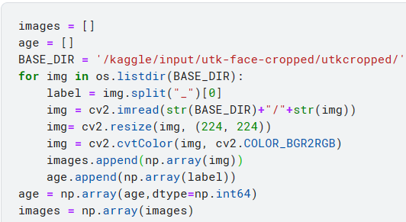
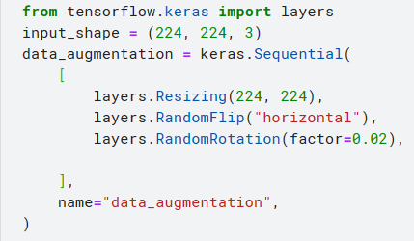
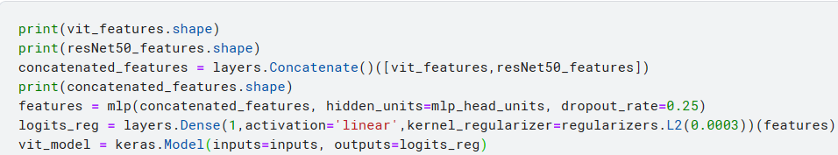
Code screenshot(part 1):

Slide 29
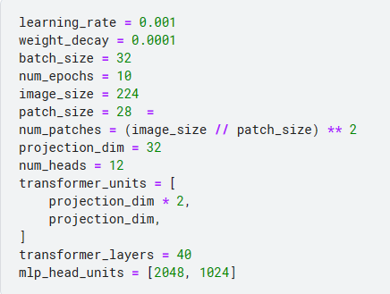
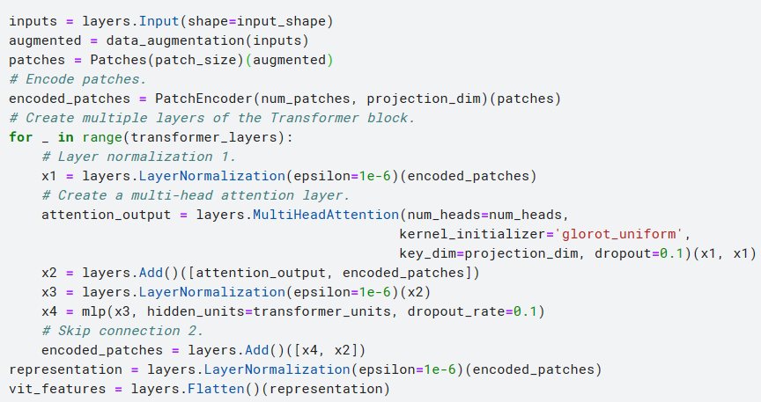
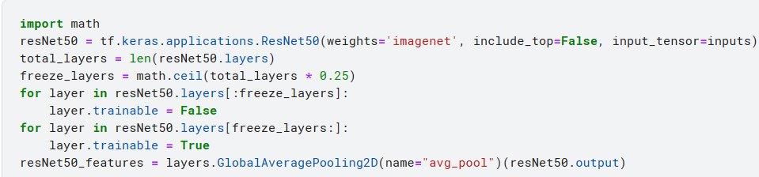
Code screenshot(part 2):

Slide 30


Slide 31
Thank you

