Slide 1
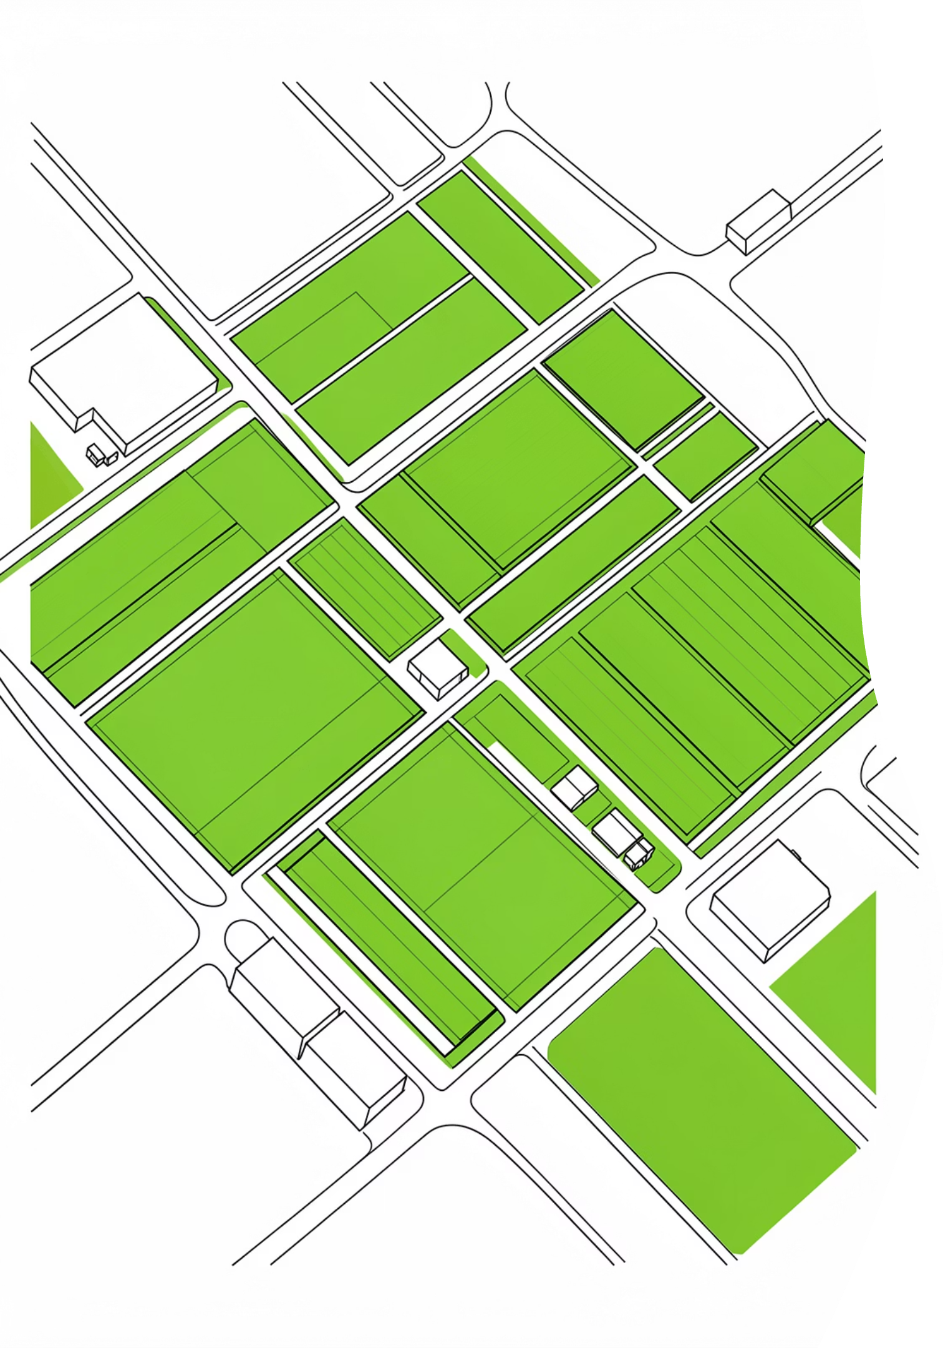

FieldMind
AI-Powered Research Farm Manager
ISHRAT JANDU

Slide 2
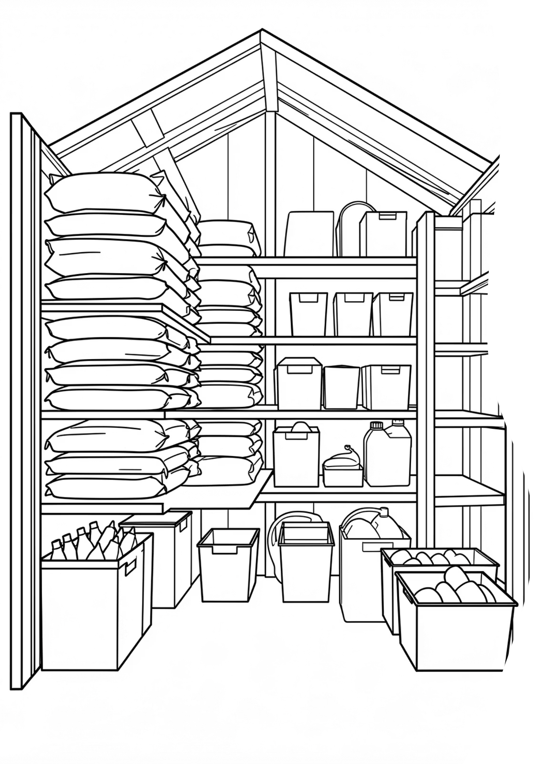
Research Farms Run Experiments, Not Crops
Sixteen plots. Eight varieties. Forty treatments. One storage shed. Three systemic failures.
Stockouts Kill Experiments
Running out of fertilizer the day before an application compromises an entire replicate and the data is lost.
Manual Estimation Is Bad Estimation
Humans guess burn rates. Over a season, that's thousands of dollars wasted and irrecoverable data gaps.
Institutional Memory Walks Out
When a grad student graduates, their tracking system and all its tacit knowledge away goes with them.

Slide 3
System Architecture
A full-stack web application with an AI agent at its core purpose-built for research farm operations.
Frontend
Jinja templates · Tailwind CSS · Vanilla JS · Plotly charts
Backend
Flask routes · SQLAlchemy ORM · Role-based auth · CSRF protection
AI Layer
Google Gemini
Database
SQLite · 13 tables — users, plots, varieties, treatments, logs

Slide 4
Agentic AI Design
A five-step closed loop with tools, memory, and guardrails LLM for nuance, rules for safety.
1
2
3
Observe
Reason
Act
Stock levels, 30-day usage, scheduled treatments, equipment burn rates.
Gemini predicts rates, stockouts, confidence, severity, and quantity.
Writes notification and displays on website interface.
4
5
Approve
Learn
Human manager approves, dismisses, or corrects every suggestion.
Corrections persisted and injected into the next prompt cycle.

Slide 5
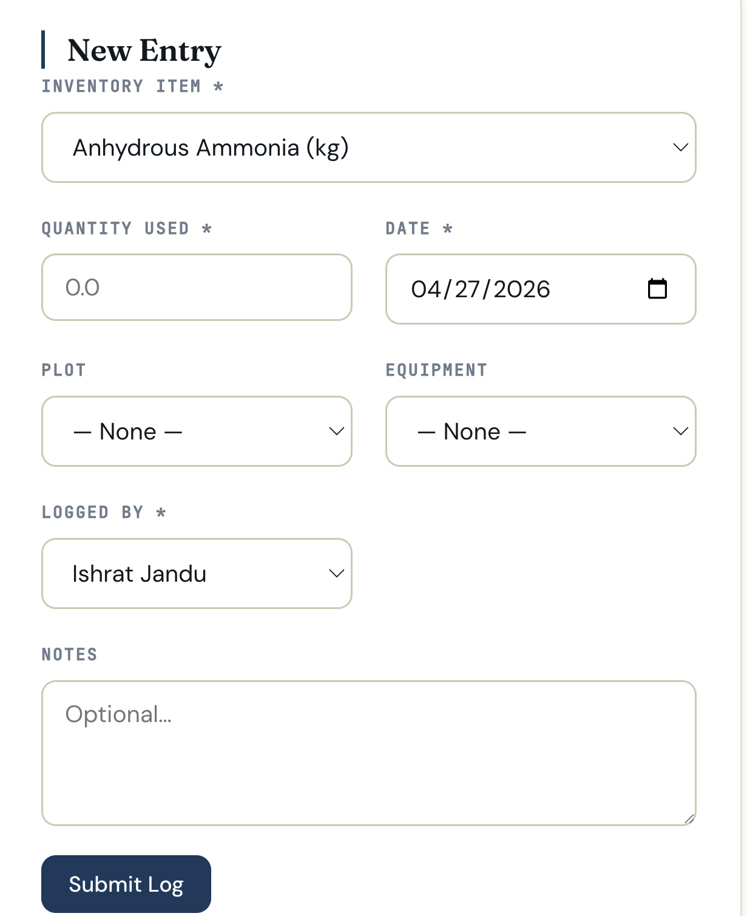
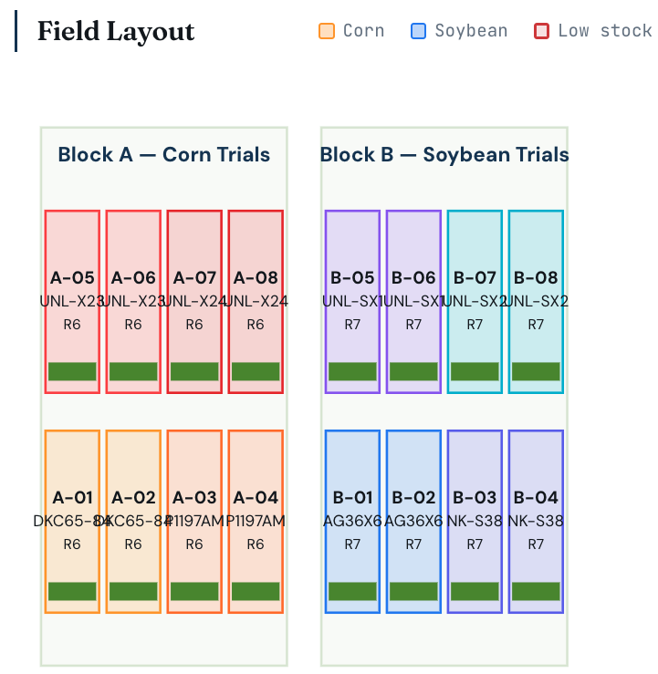
Live View
What FieldMind looks like in practice four core interfaces.
Farm Map
Log Usage
Block A corn, Block B soybean
Treatment progress overlaid.
Single-page entry with inventory, plot, and equipment selectors.

Slide 6
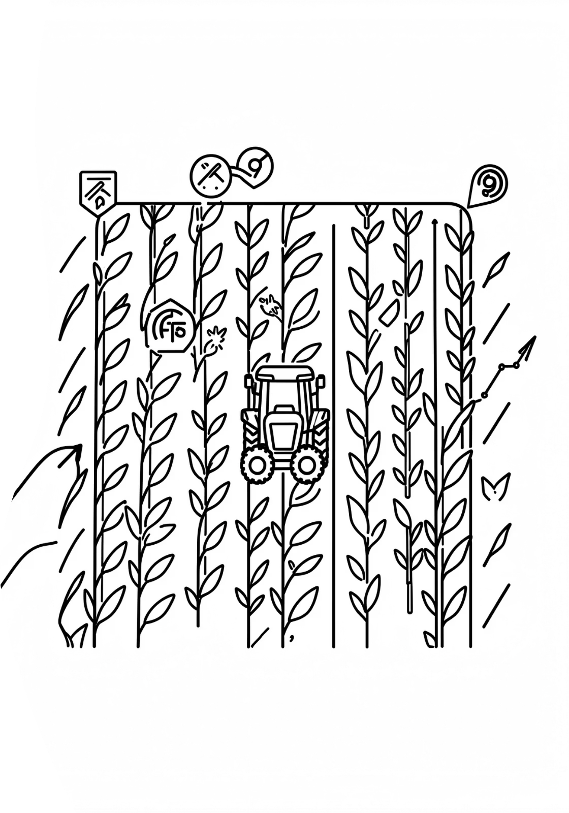
What Makes FieldMind Different
1
Hybrid AI
Gemini reasons over messy farm data; reorder_ai.py provides a defensible deterministic fallback. Every suggestion carries a full audit trail.
2
Correction Loop
When a manager corrects a burn rate, that fact persists and shapes future predictions. A genuinely closed loop where most ag-tech tools stop at the suggestion.
3
GIS-Aware
Most farm software is row-based. FieldMind reads shapefiles, knows plot geometry, and computes treatment quantities from rate × actual polygon area — precision for replicated experiments.

Slide 7




Responsible AI
Specific commitments enforced in the schema — not aspirational, structural.
Human-in-the-Loop
Transparency
Agent never auto-orders. Every draft requires explicit approve-or-dismiss. draft_order_sent defaults to false.
Every alert ships with a reasoning string and confidence score. Uncertain predictions say so explicitly.
Bounded Autonomy
Privacy & Access
Order quantities hard-capped at 5× the configured reorder threshold. AI cannot run away with a bad prediction.
Auth-gated to UNL email. Three roles: admin / manager / viewer. Activity logs on every state change. No personal data leaves the institution.

Slide 8
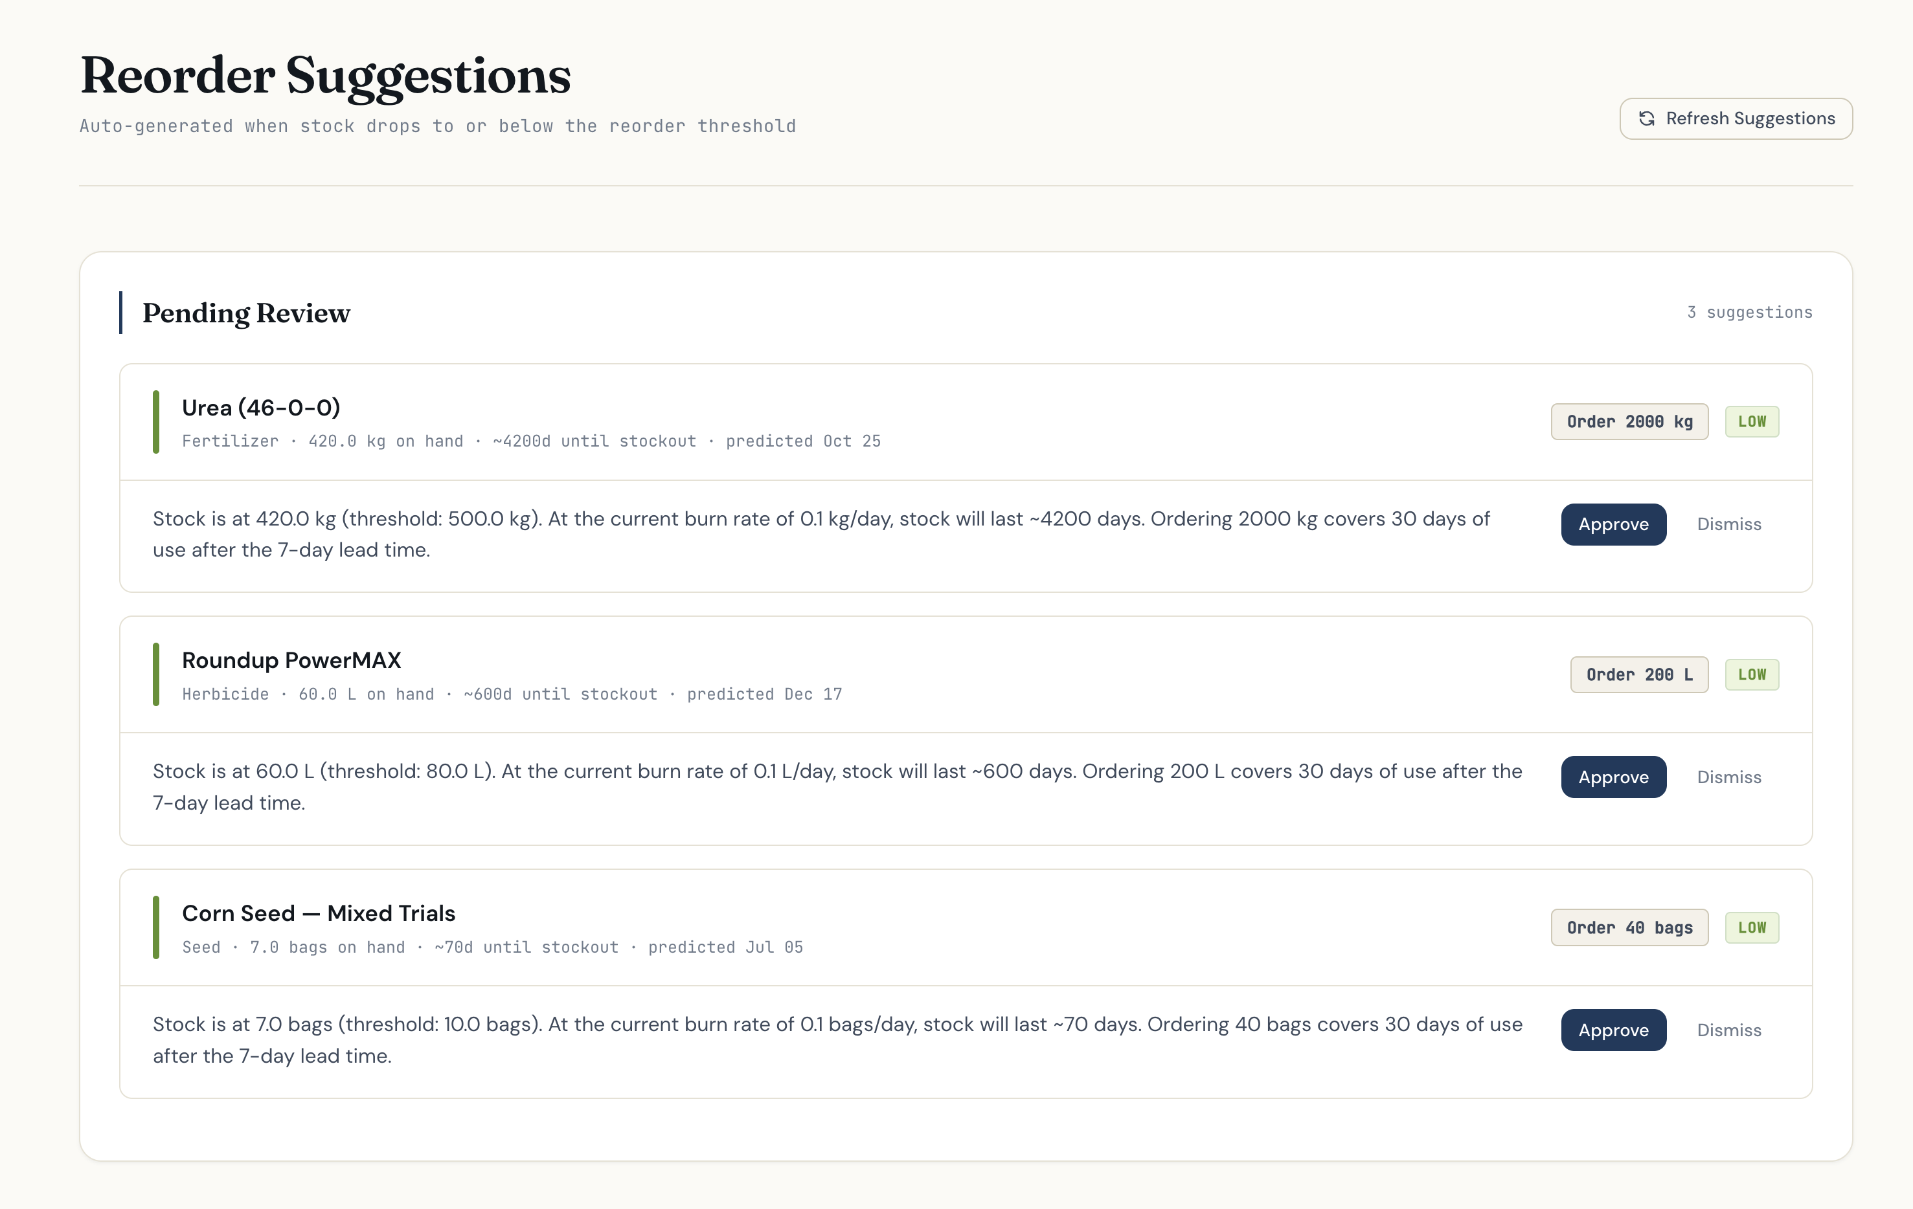

Slide 9
UX & Documentation
Built for the field. Documented for the team.
Usability
Documentation
Big touch targets for field tablets
Single-page log entry with smart selectors
Inline sparkline trends not buried tables
Plain-English AI alerts on the dashboard
Tested with seeded planting-day data
Structured README with architecture diagram and Mermaid flowcharts
Step-by-step fix logs under docs/
Database schema reference
claude.md documenting design rules
pytest suite for the reorder agent

Slide 10

FieldMind Closes the Gap Between the Spreadsheet and the Soil
Presenter
Ishrat Jandu
UNL Biological Systems Engineering
Github Repo
github.com/Ishrat2110/fieldmind

