Slide 1

B108 Data Governance, Security and Ethics Individual Final Presentation GH1019648
Notes:
Good [afternoon] Sir.
My name is [Ishrat Shaikh], and I have been hired as a security consultant to assess and address the information security and governance concerns within the organization.
Today, I will be presenting the findings of our security assessment

Slide 2
Agenda
Introduction
Summary of Findings
Scope of the Security Assessment
Risks and Consequences
Risk Assessment
Security Plan Overview
Security Culture and Awareness
System Reliability
Strengthening Physical and Technical Security Controls
Enhancing Policies and Procedures
Conclusion
Notes:
These are the topics we will focus in today’s presentation.

Slide 3

Introduction SmartCart Online Shop is a well-known and reliable online merchant that caters to customers in many countries. As a company they deals with a lot of private information about their clients, including financial and identity-related data.
Notes:
SmartCart Online Shop is a trusted global online merchant that prioritizes customer satisfaction by offering a wide range of products while handling sensitive personal information with utmost care.

Slide 4

Problem
Data breaches
Unauthorised price modification
Website Downtime Due to Hardware Failure
Insufficient Security Controls
Lack of Security Culture and Awareness
Notes:
The organisation has experienced several security issues in the past, that require immediate attention.
Data Breaches:
1) Instances of data breaches and unauthorized access to customer information were identified, highlighting potential lapses in data protection mechanisms.
Unauthorized Price Modifications:
1) The system showed evidence of unauthorized price modifications for expensive products, leading to financial losses for the company.
Website Downtime Due to Hardware Failure:
1) The website was down for a whole day which disrupted business operations and affected customer experience.
Insufficient Security Controls:
1) Insufficient security controls were identified, which increased the risk of unauthorized access and data breaches.
Lack of Security Culture and Awareness:
1) The assessment highlighted a lack of security culture and awareness among employees, potentially contributing to the overall security posture.

Slide 5
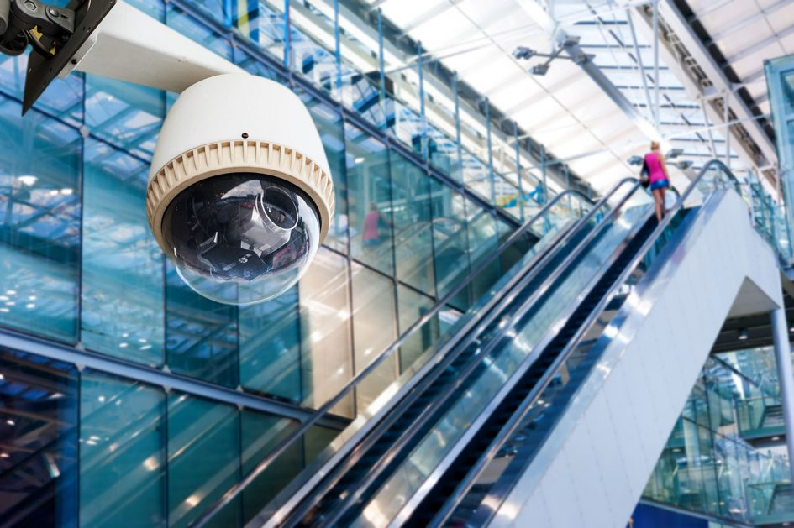

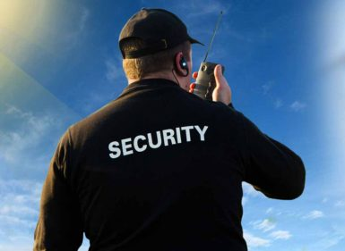
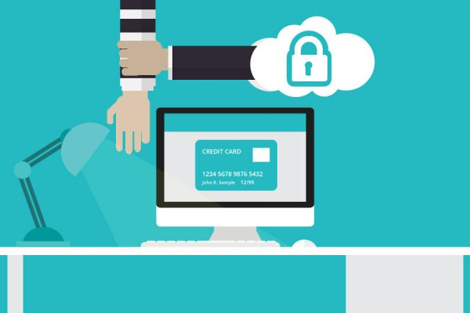
Scope of the security assessment
Policies and procedures
Physical Security
Technical Security
Security Culture and Awareness
Notes:
The security assessment performed for the SmartCart online store included an in-depth evaluation of many factors important for information security and governance.
Policies and Procedures:
Include policies and procedures in security assessments to identify vulnerabilities, assess risks, and establish necessary security measures.
Physical Security:
Enhance physical security through assessments of access controls, surveillance systems, and visitor management to reduce risks, detect vulnerabilities, and improve security measures.
Technical Security:
Analyse and evaluate technical security measures to safeguard an organization's IT infrastructure, systems, and data effectively.
Security Culture and Awareness:
Assess security culture and staff awareness to evaluate the overall security posture of the organization.

Slide 6
Risks and Consequences
Legal Consequences
Financial Consequences
Customer Trust and Reputation
Business Continuity
Notes:
The risks that have been identified could have a negative impact on SmartCart Online Shop's reputation, customer trust, and ability to continue operating.
Legal Consequences:
Failure to prevent unauthorized access and data breaches can result in government fines, legal action from affected customers, and significant legal consequences for non-compliance with data privacy laws like GDPR (General Data Protection Regulation) and CCPA (California Consumer Privacy Act).
Financial Consequences:
Unauthorized price modifications and data breaches can cause financial losses, reputation damage, costly remediation efforts, investigations, and the need for credit monitoring services.
Customer Trust and Reputation:
Security breaches damage customer trust and reputation, leading to customer attrition and diminished business prospects for ShieldTech Online Shop.
Business Continuity:
Hardware issues and security breaches causing downtime not only impact business operations, revenue, and customer satisfaction but also pose a long-term threat to business continuity and sustainability.

Slide 7
Risk assessment
Problem | Risk Category | Impact Level | Likelihood Level | Solution
Data breaches | Customer Data | High | High to Medium | Strengthening physical and technical security safeguards, putting encryption into place, performing routine security audits and assessments
Unauthorized price modification | Financial Impact | High | High to Medium | Implement strong monitoring and authorization mechanisms, and routinely train staff on security awareness and access controls
Website Downtime Due to Hardware Failure | Operational Disruption | High to medium | Medium | Regular maintenance and monitoring, disaster recovery strategy, redundant systems
Insufficient Security Controls | Financial Impact | High to Medium | Medium | Implement and enforce strong access rules, conduct simulated phishing exercises, and conduct routine security assessments and audits.
Lack of Security Culture and Awareness | Reputation | High | Medium | Implementing a reporting mechanism for security events, training employees on best practices for security, and awareness campaigns on new dangers
Notes:
During the risk assessment I have evaluated some categories of risks which could impact SmartCart.
Financial, Reputation, Customer Data, Operational Disruption, Compliance, and Legal risks pose significant impacts to SmartCart Online Shop, with varying likelihoods, including unauthorized access, reputation damage, customer data compromise, operational disruptions, non-compliance, and legal issues.

Slide 8

Security Plan Overview
Policies and Procedures
Physical Security Controls
Technical Security Controls
Security Awareness and Culture
Notes:
Based on the results of the security assessment, we have created a thorough security strategy for the SmartCart online store. To improve the organization's overall security posture, this plan intends to address the risks and vulnerabilities found.
Policies and Procedures:
Ensure robust security measures by strengthening security policies and processes to comply with industry best practices and relevant laws, while implementing a comprehensive data classification and access control structure to protect sensitive client data.
Physical Security Controls:
Strengthen physical security by implementing access control systems, and conducting regular risk assessments to ensure proper response procedures are in place.
Technical Security Controls:
Ensure comprehensive data protection by implementing robust firewall configurations, and a vulnerability management program to safeguard data integrity, confidentiality, and address system vulnerabilities continuously.
Security Awareness and Culture:
Develop a comprehensive security awareness program to educate staff on responsibilities and best practices, fostering a culture of awareness through training, simulations, and reporting channels.

Slide 9

Security Culture
Employee Training
Awareness Campaigns
Reporting Mechanism
Simulated Phishing Exercises
Notes:
To ensure information security at SmartCart online shop, a solid security culture and employee awareness-raising are essential. I advise the following suggestions:
Employee Training:
1) Provide comprehensive security training covering best practices, legal requirements, data management, password protection, social engineering awareness, and phishing prevention.
Awareness Campaigns:
1) Staff members are regularly updated on emerging risks and attack techniques through security awareness programs that use a variety of communication channels.
Reporting Mechanism:
1) In order to allow staff members to report security events, shady activities, and policy violations, implement an open and confidential reporting process that encourages early identification and prompt reaction.
Simulated Phishing Exercises:
1) Regularly carry out simulated phishing exercises to identify employee susceptibility, and make use of these occasions to give training on spotting and dealing with phishing efforts.

Slide 10
System reliability
Redundancy and Fault tolerance
Include redundant devices, such as servers, power supplies, and storage devices, to guarantee system availability even in the event of hardware failures.
Regular Maintenance and Monitoring
Perform routine health checks, firmware updates, and performance improvements to prevent hardware failures caused by outdated or damaged components.
Disaster Recovery Plan
Create an in-depth disaster recovery strategy with steps for handling hardware problems, including backup and restoration procedures.
Notes:
Because the company has suffered from hardware failure in the past years following are the steps we can do to improve the system reliability of the company: -
Redundancy and fault tolerance: -
To ensure system availability even in the event of hardware failures, we can Enhance system availability and reliability by implementing redundant hardware components, fault tolerance mechanisms like RAID(Redundant Array of Independent Disks), and workload distribution through load balancing or clustering techniques.
•Regular Maintenance and Monitoring: -
Ensure hardware reliability by conducting routine health checks, performing firmware updates, and implementing performance enhancements, while installing reliable monitoring tools for immediate access to performance and health information, enabling early detection and timely resolution of issues.
Disaster Recovery Planning: -
Ensure effective disaster recovery by regularly testing the plan, creating a comprehensive strategy for handling hardware problems with backup and restoration procedures, and considering off-site backups or cloud-based solutions for data protection and swift recovery.

Slide 11
Strengthening Physical and Technical Security Controls
Physical Security Controls | Technical Security Controls
Implement access control systems, such as key cards or biometric authentication, to restrict unauthorized physical access to sensitive areas. Deploy surveillance systems, including CCTV cameras, at critical locations to monitor and record activities. | Implement network segmentation to isolate critical systems and restrict unauthorized lateral movement within the network. Deploy robust firewall configurations to filter and control incoming and outgoing network traffic.
Notes:
To strengthen the entire security posture of SmartCart online business, improved physical and technical security controls are important We advise the following suggestions:
Physical Security Controls:
Secure sensitive areas by implementing access control systems, such as key cards or biometric authentication, while deploying surveillance systems, including CCTV cameras, to monitor and restrict unauthorized physical access.
Technical Security Controls:
Enhance network security by deploying robust firewall configurations, encryption mechanisms, and intrusion detection/prevention systems to control network traffic, protect data in transit, and detect/respond to unauthorized activity.

Slide 12
Enhancing Policies and Procedures
What?
Why?
Data Classification
To safeguard data against illegal access and misuse.
To safeguard private information, including client information.
Helps to reduce damage, speed up recovery, resume commercial operations, and cut costs.
Must let their clients and other parties know about the violation
Access Controls
Incident Response
Data Breach Notification
Notes:
Improving the SmartCart online shop's overall information security and governance structure requires strengthening policies and procedures. The following specific recommendations are suggested:
Data Classification:
Why we need data classification?
Implement a comprehensive data categorization framework and train staff on handling sensitive data based on its sensitivity and criticality.
Access Controls:
Why we need data Access controls?
Enforce least privilege and strengthen authentication with MFA to restrict unauthorized access to data and platforms.
Incident Response:
Why we need data Incident Response
Develop and test an incident response plan for effective and coordinated response to security incidents and data breaches.
Data Breach Notification:
Why we need data data breach notification?
Implement a precise and compliant data breach notification procedure to inform stakeholders, maintaining transparency and trust.

Slide 13

Conclusion
To reduce risks, safeguard consumer data, and ensure regulatory compliance, the security plan must be put into action.
For continuous protection against changing threats, ongoing monitoring, recurring security assessments, and changes to security measures are crucial.
By proactively making investments in information security and governance, ABC online shop can increase customer confidence, protect its reputation, and guarantee company continuity.
Notes:
In Conclusion,
Implementing the security plan is vital to mitigate risks, protect customer information and ensure regulatory compliance.
Continuous monitoring, periodic security assessments, and updates to security measures are essential for sustained protection against evolving threats.
By proactively investing in information security and governance, SmartCart online shop can enhance customer trust, safeguard its reputation, and ensure business continuity.

Slide 14
References
Access Control: - Security. (n.d.). What is Access Control? [online] Available at: https://www.techtarget.com/searchsecurity/definition/access-control#:~:text=Access%20control%20is%20a%20fundamental [Accessed 12 Jun. 2023].
Heimdal Security Blog. (2023). What Is Broken Access Control and How to Keep Your Organization Safe? [online] Available at: https://heimdalsecurity.com/blog/what-is-broken-access-control/#:~:text=Access%20control%20is%20an%20important [Accessed 12 Jun. 2023].
www.alibabacloud.com. (n.d.). Who Is Responsible For Data Categorization And Security - Alibaba Cloud. [online] Available at: https://www.alibabacloud.com/topic-center/data-management/ggb2cl567k-who-is-responsible-for-data-categorization-and-security#:~:text=The%20data%20must%20be%20properly [Accessed 12 Jun. 2023].
CybSafe (2023) 7 reasons why security awareness training is important in 2023, CybSafe. Available at: https://www.cybsafe.com/blog/7-reasons-why-security-awareness-training-is-important/ (Accessed: 14 June 2023).
Security culture: NPSA (no date) National Protective Security Authority. Available at: https://www.npsa.gov.uk/security-culture (Accessed: 14 June 2023).

