Slide 1
The Third Eye : Smart Glasses for the Blind without Arduino
A presentation On
Ohahidur zaman Utsho (1902034)
Mocaddache Tuya(1902055)
Rokaiya Tasnim (1902056)
Ishrat Jahan (1902060)
Al Mahmud Siam (1902062)

Slide 2
Outline of our Project
Introduction
Objectives
Features
Architecture
Technologies requirements
System model
Project Design
Benefits
Limitations
Future Goals
Conclusion
Reference

Slide 3
Introduction
This project is mainly used for blind people who are not able to see anything in the world but we want them to feel normal and guide them as much as we can. There are Blind people in every country but we start this project in our country.
This smart glasses can assist them while walking alone in new environments by taking inputs through an ultrasonic sensor and when it gets any obstacles in front of the sensor then it provide feedback to the person through buzzer.
The background of our project is physics and we learned some physics in the activities of this project.

Slide 4
Objectives
The main objective of this project is to help blind people to inform the existence of objects in front of them, and make their life a little bit easier.
To help them to detect the distance of the objects in front of them.
To make a device which is lightweight, Portable & easy to use.
To Compute the distance between the person and each object.
Another objectives is to convert the information to sound.
GPS tracker used to find the location for easy tracking.
Can able to detect any accidental risk.

Slide 5
Features
Can able to recognize the object front of them using a sound.
Can identify the location of the blind person their guardian
Implement GPS and inertial sensors for turn-by-turn navigation guidance.
Allow users to customize sensor sensitivity and adjust feedback preferences.
Utilize computer vision technology to identify and describe objects in the user's environment.
Design the smart glasses to be lightweight and comfortable for extended use.

Slide 6
Working process
An ultrasonic sensor is an instrument that measures the distance to an object using ultrasonic sound waves. An ultrasonic sensor uses a transducer to send and receive ultrasonic pulses that relay back information about an object's proximity
Here an ultrasonic sensor senses the distance of the object by ultrasonic waves and sends this information to NE 555 timer circuit. The timer circuit then sends this information to buzzer .
The buzzer is activated with the help of battery.

Slide 7
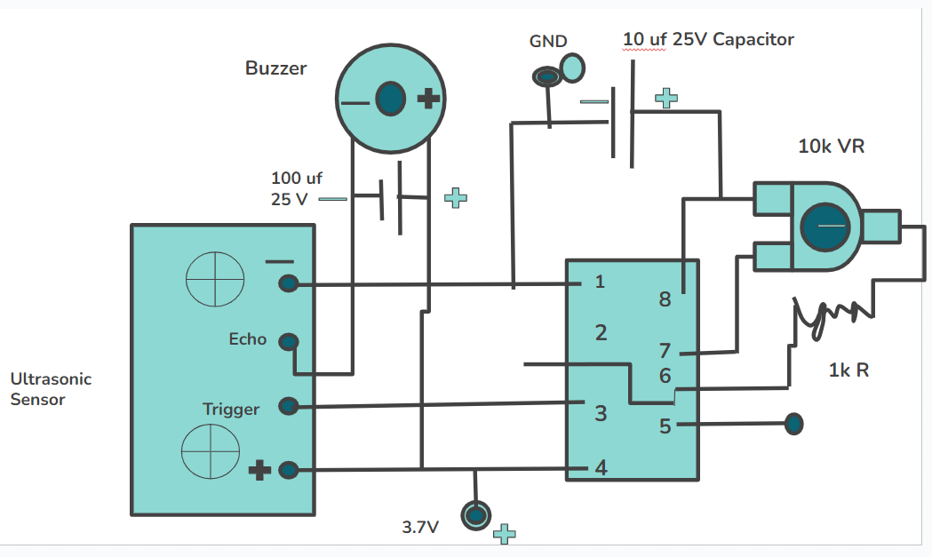
Architecture of Components

Slide 8
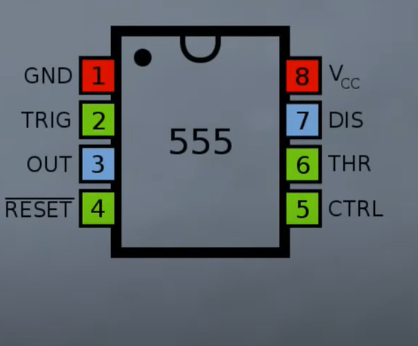
Project Design Process
At first take a NE 555 ic which is also known as a timer circuit. The figure of NE 555 ic is given below . Now connect the 2nd + 6th pin together and also connect the 4th and 8th pin together .

Slide 9
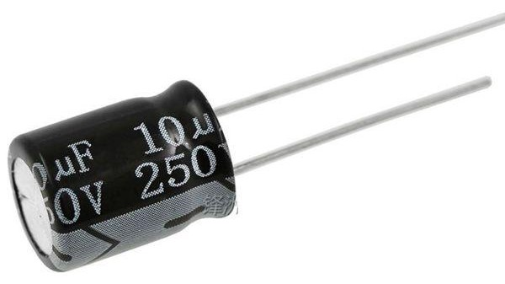
Project Design Process
2. Then take a capacitor of 10uf 25v and then connect capacitor’s positive pin with 1st pin of NE 555 ic and connect capacitor’s negative pin with 8th pin of NE 555 ic.

Slide 10
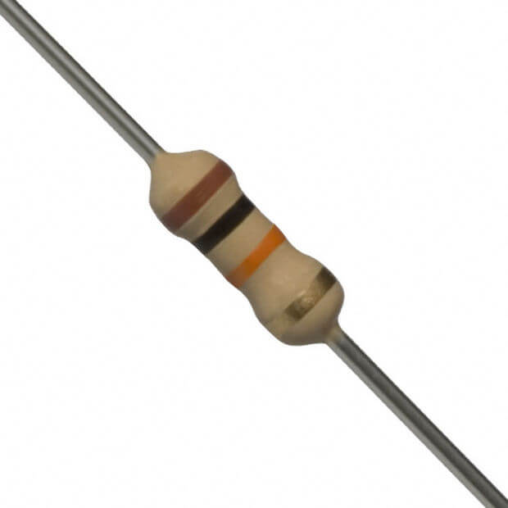
Project Design Process
3. Now take a preset of 10k ohm and connect it with the 7th and 8th pin of the NE 555 ic .

Slide 11
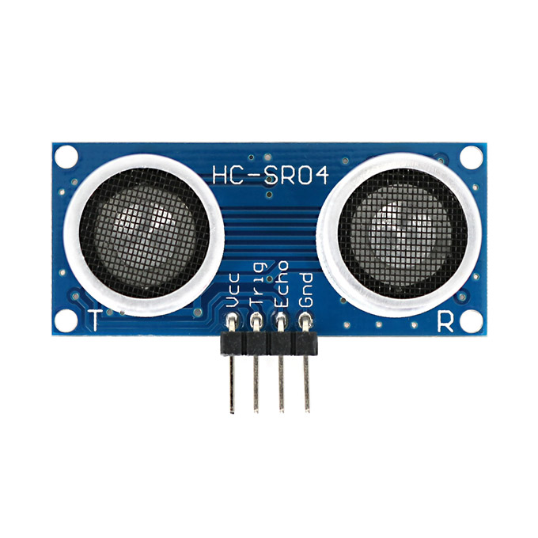
Project Design Process
4. Then take a 10k ohm resistor and connect it with the 5 the pin of NE 555 ic and connect another point with the upper pin of the preset.
5. Now take an ultrasonic sensor and connect its ground pin with the 1st pin of NE 555 ic also connect ic pin 3 with ultrasonic sensors trigger pin . And connect ic pin 4 with ultrasonic sensors VCC pin.

Slide 12
Project Design Process
6. Take a 10 uF, 25v capacitor and connect:
Negative pin with ultrasonic sensors echo pin.
Positive pin with ultrasonic sensors vcc pin.
7. Take a battery and connect:
Take a positive pin with vcc.
Negative pin with Gr.

Slide 13
Technologies requirements
Ultrasonic sensor
NE 555 IC
Capacitor 10 micro F
Resistor 1K
Battery
Switch
Buzzer
Eye glass

Slide 14
Benefits
It can make blind people life easier.
It has a GPS tracker so that if he get lost his path then we can easily locate him.
It is low cost.
It is light weight so easily carry it.
Its installation system is very easy any one can easily use it.
As it is a portable a device so it has no complexity to connect wire.

Slide 15
Limitations
It has no impact for the color blind people.
If there has any obstacles behind the blind people then it can’t give any solution.

Slide 16
Future Plan
In future it can be improved for blind people and people who have vision difficulties by adding new technologies.
Direction and warning messages to prevent expected accidents.
Message to tell the user about the battery level.
Video detection to provide a full healthy life for people with vision difficulties.
Develop mobile application to control “Smart Glasses”.
Use 270 cameras to have more wider view angle.

Slide 17
Result
The smart blind glasses will be used by blind people which will give than to walk freely like any normal person as well as it also allow them to find the best route.
GPS tracker help to identify their location when the get lost their path.

Slide 18
Conclusion
Technology offers us a lot of significant solutions to our problems and disapplies.This Smart Glasses technology played an important role in the blind people life.They use it almost everywhere and every time for their daily life to daily work.
Our role is to use it properly to reach the success level that benefits individual, society and whole country as well.

