Slide 1



E-book Summary Extraction along with
sentiment analysis
P-101 TEAM 3
Mentors- Kartik & Pallavi
6 Team members:
Ishrath Jahaan Didagur
Sarika Walake
Muhammed Sahal Asharaf
Mrunal Sunil Chaudhari
Mohammed Mubarizuddin
Prathik Mohan

Slide 2
Business Objective :
To extract E-books of your choice and extract summary ,categorize summary as positive, negative or neutral. Build a NLP model to achieve the said objective with accepted accuracy of 75% and above.

Slide 3
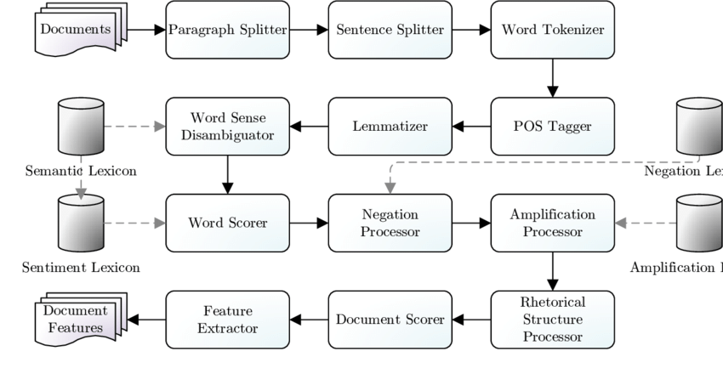
Sentiment Analysis

Slide 4
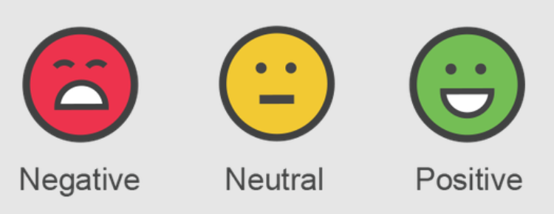
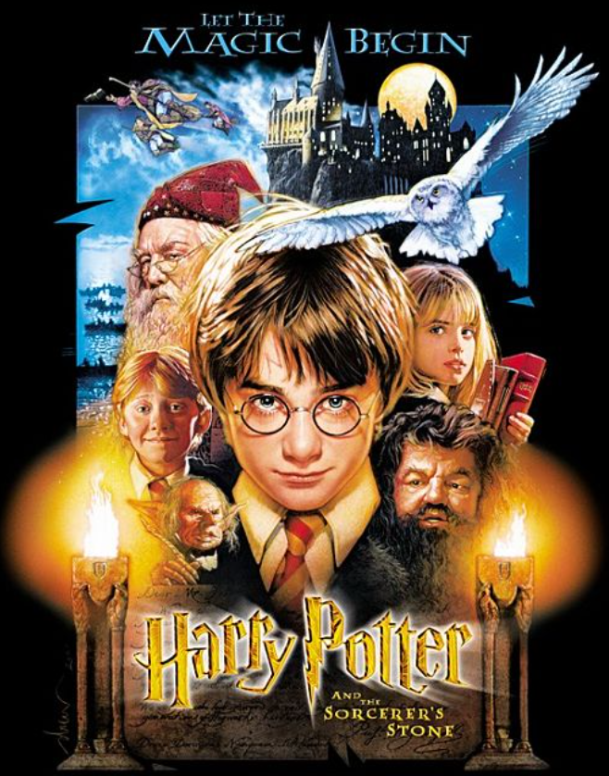

Extracting/Scraping Data from
e-book (PDF)
Data: e-book → Happy Potter Series
Part One e-book → Harry Potter and the Sorcerer's Stone
Goal: Complete HP Series → Extract Summary then
Most e-books in PDF or EPUB
First task → Convert PDF/EPUB to editable information
Framework: PyPDF2
Language: Python 3

Slide 5
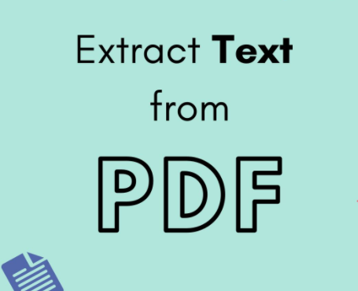
PyPDF2
Pure-python PDF toolkit originating from the pyPdf project currently maintained by Phaseit, Inc.
What can it do?
PyPDF2 can extract data from PDF files, or manipulate existing PDFs to produce a new file. PyPDF2 is compatible with Python versions 2.6, 2.7, and 3.2 - 3.5.
Web: https://pythonhosted.org/PyPDF2/
!pip install PyPDF2
import PyPDF2 as pdf
Class: PdfFileReader

Slide 6
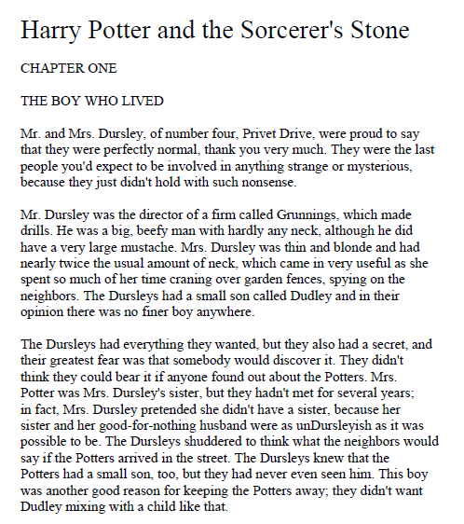
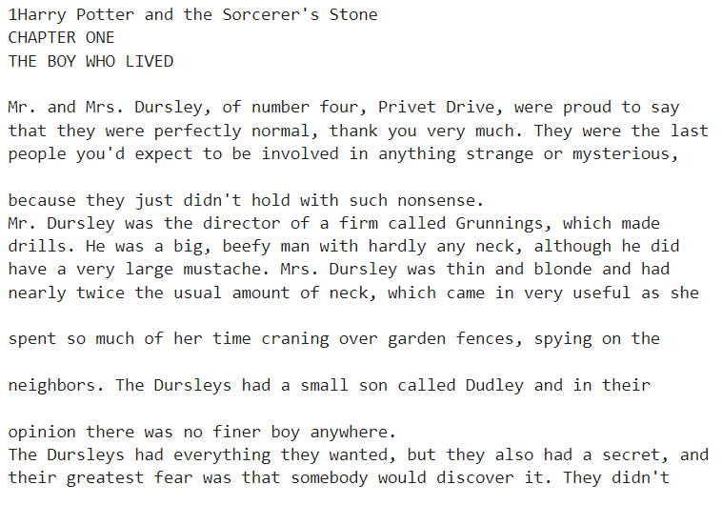
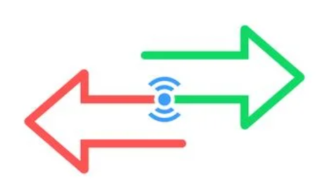
Part 1 - Sample Text Extraction Result
Harry Potter and the Sorcerer's Stone e-book Page 02

Slide 7
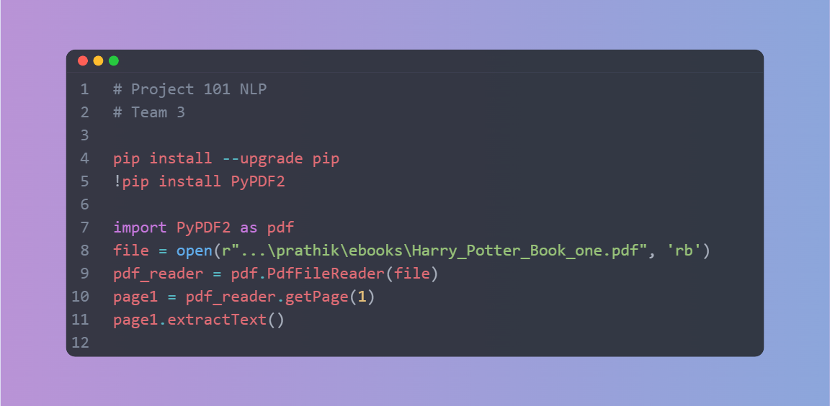
Sample Extraction Code Snippet

Slide 8
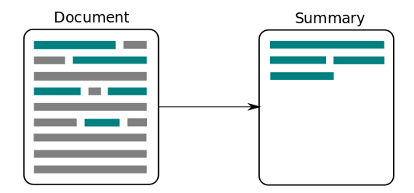
Part 2 – Clean and Summarize the Input information
Cleaning → Involves – removing unwanted characters, encoding in proper format, tokenization (splitting string into words or sentences), removing stop-words & punctuation etc.
Why Cleaning? preparing text for NLP.
Summarization → Picking only important info from complete information
Why Summarization? Makes selection process easier, increases chance to process multiple books at once for NLP etc.

Slide 9
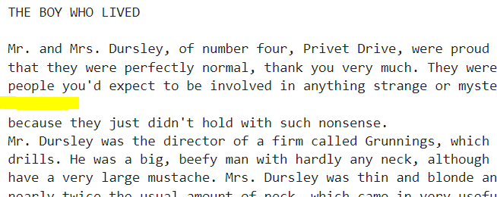
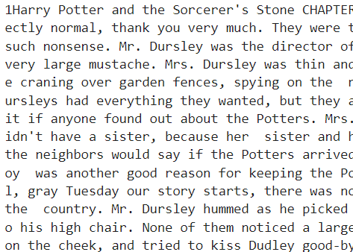
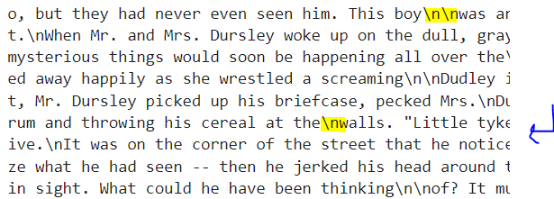
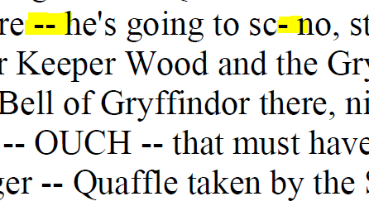
Cleaning Process
Methods used in Python coding:
.split()
.replace()
List to String custom function

Slide 10
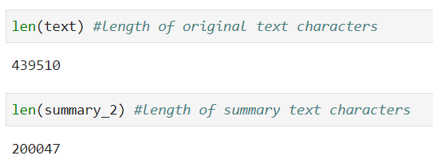
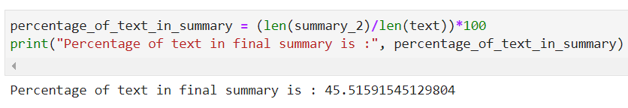
Summarization Process
1. Do word tokenization,
2. Calculate word frequency,
3. Get the normalized word frequencies of each word,
4. Then do sentence tokenization,
give sentence a score based on the normalized word frequency present in each sentence,
5. Finally get 30% of the sentences based on the maximum score (importance) of each sentence.
Libraries/Methods used in Python coding:
nltk, spacy, string, heapq
STOP_WORDS, punctuation

Slide 11
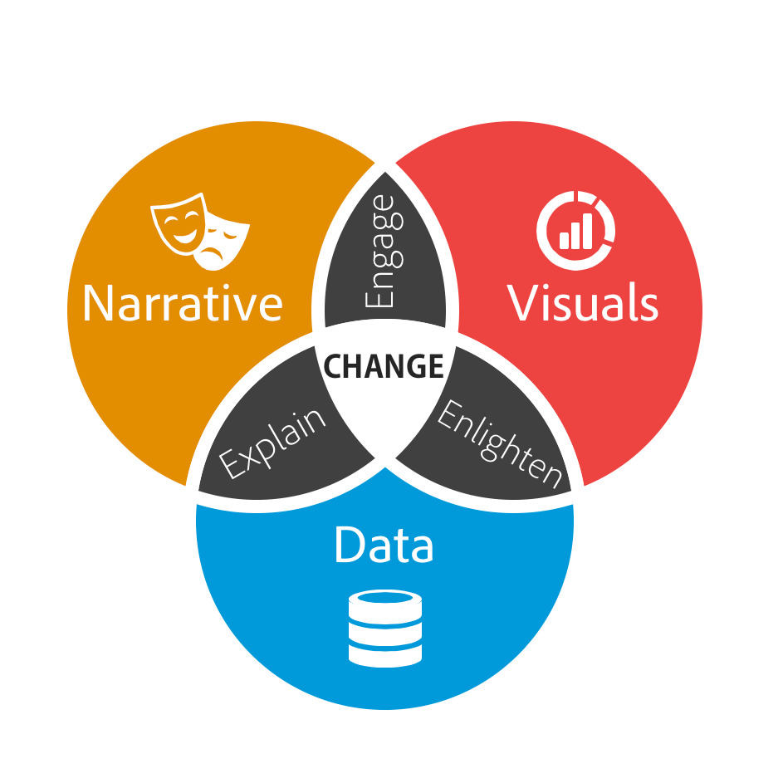
EDA – Org text vs Summarized text
Information/Paragraph Slide

Slide 12
EDA – Org text vs Summarized text
Information/Paragraph Slide

Slide 13
EDA – Org text vs Summarized text
Information/Paragraph Slide

Slide 14
EDA – Org text vs Summarized text
Information/Paragraph Slide

Slide 15
EDA – Org text vs Summarized text
Information/Paragraph Slide

Slide 16


