Slide 1
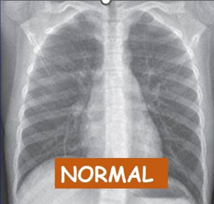
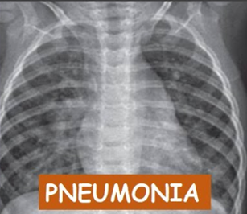
PneumoniaMNISTIsh
For Project Research Scientist position , titled An endoscopic ultrasound image-based Prediction and Risk Observation System for chronic Pancreatitis Evaluation using Convolutional neural network Technique (PROSPECT)” under Dr. Kamal Kishore Department of Biostatistics, Nehru Hospital, PGIMER-Chandigarh.
Assignment by Ishsirjan Kaur Chandok
MTech at IIT Hyderabad
ishsirjanchandokiskc@gmail.com
+91 7987106408 https://github.com/Ishsirjan/PneumoniaMNISTIsh

Slide 2
Problem Statement & Solution
• Detect pneumonia in chest X-rays using deep learning.
• Dataset: PneumoniaMNIST (28x28 grayscale images).
• Challenge: Subtle features and class imbalance.
• Solution: Transfer learning + Focal Loss + Balanced Sampling.

Slide 3
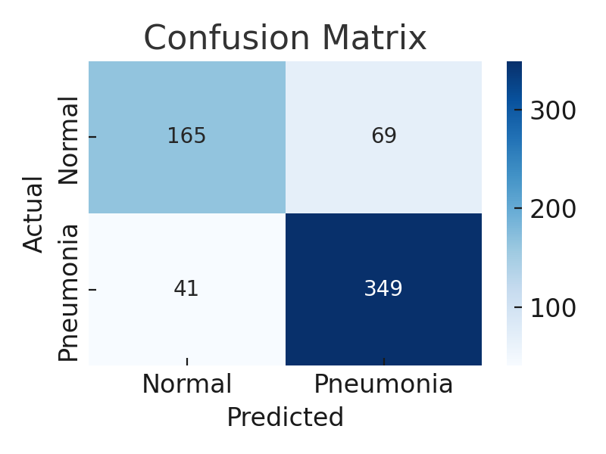
Model Architecture & Workflow
• Input: 28x28 grayscale → 224x224 RGB
• Backbone: Pretrained ResNet-50
• Fine-tuned top 50 layers • Loss: Focal Loss • 2-phase training strategy

Slide 4
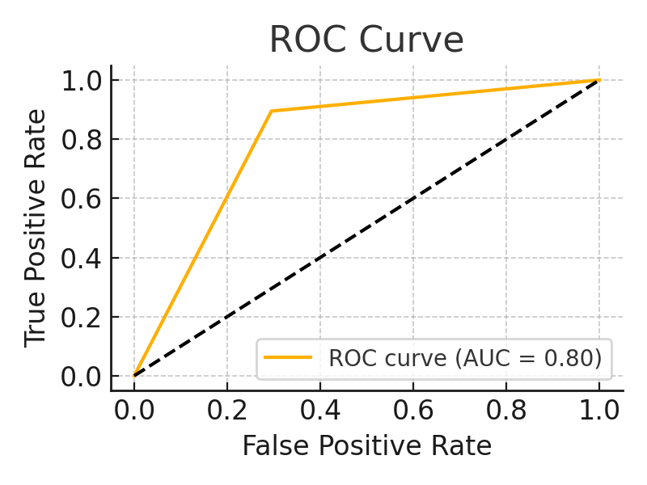
Evaluation & Insights
• Test Accuracy: 82.2%, Precision: 87.2%, Recall: 83.9%
• ROC AUC: 0.91 shows strong diagnostic capability • Few false negatives; high clinical relevance • Next: Add attention-based models

Slide 5

Looking forward to hearing back from you

