Slide 1
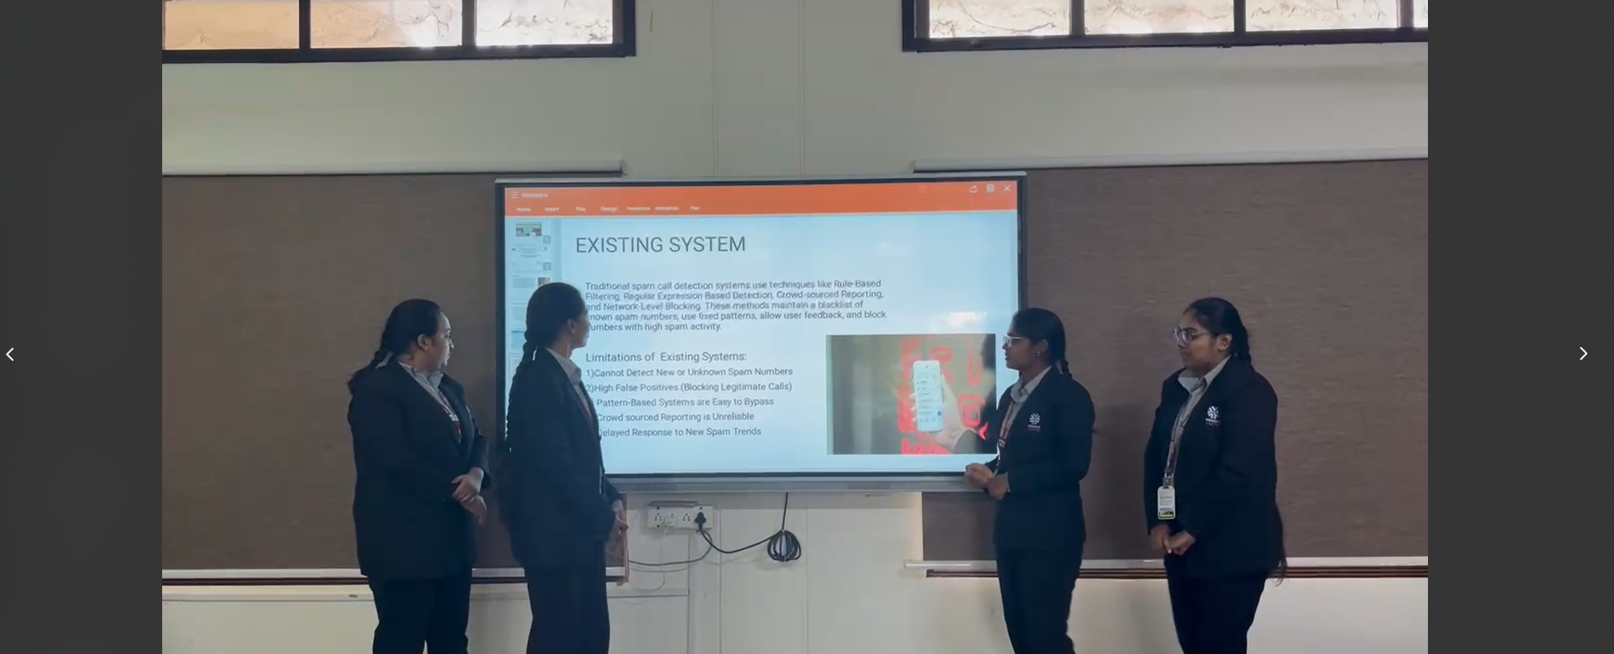
AI-Driven Spam Call Detection for Enhanced Security
PRESENTED BY:
D.NIKHITHA(22UP1A7216)
V.ISHTA(22UP1A7260)
P.SRI SAI MANASWINI(22UP1A7247)
G.VEENA(23UP5A7202)

Slide 2

DEPARTMENT OF AI&DS AI-Driven Spam Call Detection for Enhanced Security De
PRESENTED BY:
D.NIKHITHA(22UP1A7216)
V.ISHTA(22UP1A7260)
P.SRI SAI MANASWINI(22UP1A7247)
G.VEENA(23UP5A7202)
INTERNAL GUIDE :
Mrs. A. Eenaja
Assistant professor
Department of IT

Slide 3
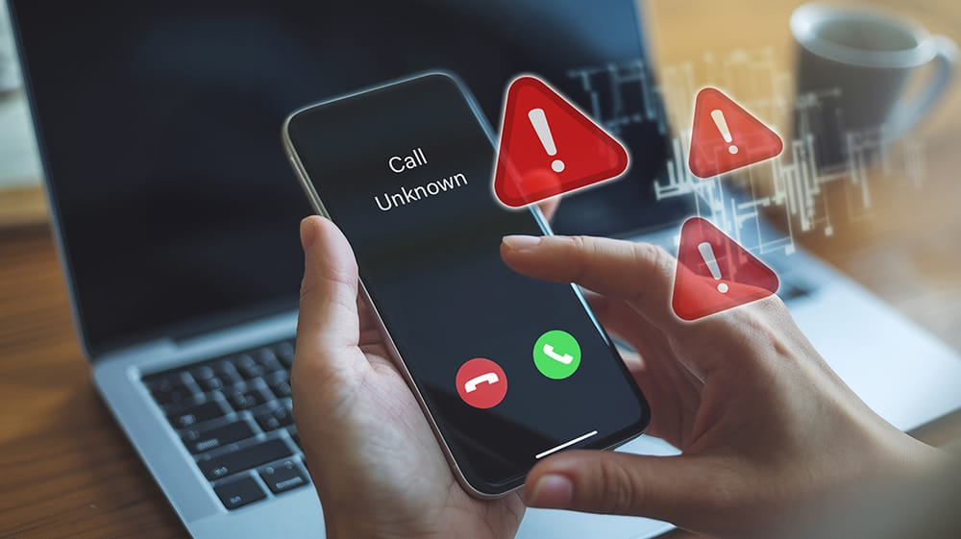
ABSTRACT
Spam call Detection tool aims to address the growing issue of spam calls from fraudsters, telemarketers, and robocalls. An intelligent Spam Call Detection Tool is proposed to analyze phone numbers and classify them as spam or safe. It uses static detection and pattern-based analysis to identify suspicious patterns. The tool can be extended with Machine Learning for real-time caller identification .This tool helps users avoid fraud and disturbances by flagging suspicious calls before answering .Future improvements could include AI-driven spam classification, real-time databases, and automatic call blocking features.

Slide 4

INTRODUCTION:
Spam call detection is a technology used to identify and block unwanted phone calls. These calls often come from telemarketers, scammers, or robocallers trying to sell products, trick people, or steal personal information .With the rise of mobile phones, spam calls have increased, making it essential to have systems that can detect and prevent them. Spam call detection works by analyzing call patterns, checking caller IDs against spam databases, and using artificial intelligence to identify suspicious calls. Many smartphones, telecom providers, and third-party apps now offer built-in spam protection to help users avoid these unwanted calls. The goal of spam call detection is to reduce disturbances, protect personal information, and prevent fraud, making phone communication safer and more efficient for everyone.

Slide 5
LITERATURE TABLE:
Paper title | Paper published year | Author(s) | Methodology | Findings | Limitations
AI-powered real-time spam detection Machine learning for spam call detection. Rule based spam call detection using blacklists. | 2023 2019 2018 | Google AI team Lee & Kumar Smith (et al) And others | Used neural networks and NLP to analyzes voice patterns. Used random forest and SVM for call classification. Maintained a static blacklist of known spam Numbers. | Achieved 96% accuracy with real-time spam call detection. Achieved 90% accuracy in predicting spam calls. Detected known spam calls with 85% accuracy. | Required constant model updates to stay effective. Required large labelled datasets. Could not detect new spam numbers.

Slide 6
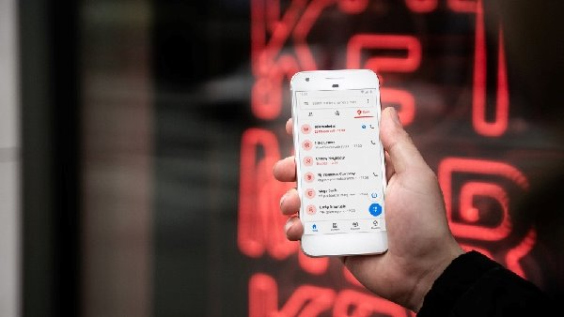
EXISTING SYSTEM
Traditional spam call detection systems use techniques like Rule-Based Filtering, Regular Expression Based Detection, Crowd-sourced Reporting, and Network-Level Blocking. These methods maintain a blacklist of known spam numbers, use fixed patterns, allow user feedback, and block numbers with high spam activity.
Limitations of Existing Systems:
1)Cannot Detect New or Unknown Spam Numbers
2)High False Positives (Blocking Legitimate Calls)
3) Pattern-Based Systems are Easy to Bypass
4) Crowd sourced Reporting is Unreliable
5) Delayed Response to New Spam Trends

Slide 7
PROPOSED SYSTEM
The proposed system aims to identify and warn users about spam or fraudulent calls using a phone number database and pattern-matching algorithms. This system enhances user security by analyzing phone numbers and categorizing them as safe, suspicious, or spam based on predefined rules and external databases.
Dynamic Spam Detection, Machine Learning Integration, Hybrid Approach, User-Defined Spam Reporting with Validation etc.
✅ How the Proposed System Works:
1️⃣ User Inputs a Phone Number :The user enters a phone number into the system.
2️⃣ Database and Pattern Check :The system checks the number against a predefined spam database. It also uses pattern-matching algorithms (Regex) to detect suspicious numbers.
3️⃣ Machine Learning (Optional Enhancement):If implemented, AI-based models can analyze call history and behavior to improve spam detection accuracy.
4️⃣ Result Display: The system categorizes the number as Safe, Suspicious, or Spam Call. It provides warnings if the number is flagged in known spam reports.

Slide 8
Advantages of the Proposed System
✔ Real-time Detection: Instantly identifies spam calls before the user picks up.
✔ Pattern-Based Detection: Even if a number is not in the database, it can be flagged based on suspicious patterns.
✔ User-Friendly Interface: Simple and easy-to-use web or mobile UI for checking numbers.
✔ Customizable Database: Can be updated with new spam numbers for better accuracy.
✔ Prevention of Financial Fraud: Helps users avoid scam calls that attempt to steal personal information.
✔ Lightweight and Fast: The system does not require high processing power, making it efficient for all devices.
✔ Integration with APIs (Optional): Can be linked to third-party spam call databases for wider coverage.

Slide 9
SOFTWARE REQUIREMENTS
1.Operating System: Windows 10/11, macOS, or Linux
2.Programming Language: Python 3.x
3. Framework: Flask (for backend development)
4. IDE/Text Editor: VS Code / PyCharm / Sublime Text
5.Web Technologies: HTML, CSS (for frontend design)
6. Database (Optional): SQLite / MySQL (if spam numbers need to be stored)
7. Required Python Libraries: pip install flask
(Additional libraries may be required for database and API integration.)

Slide 10
HARDWARE REQUIREMENTS
1. Processor: Intel i3 (or higher) / AMD Ryzen 3 (or higher)
2.RAM: Minimum 4GB (Recommended: 8GB+ for better performance)
3.Storage: At least 10GB free space
4.Display: Standard HD Display (1366x768) or higher
5.Network:Internet connection (for external API integration, if needed)

Slide 11
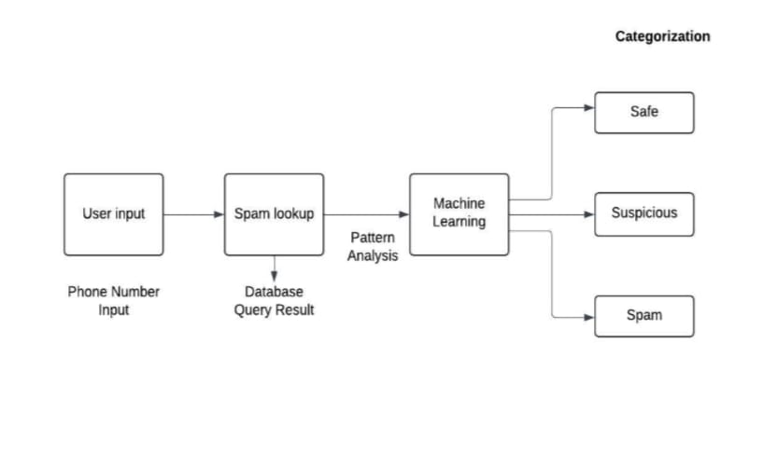
SYSTEM ARCHITECTURE

Slide 12
MODULES
1.Input & Collection – Gathers messages, calls, and metadata from users or external sources.
2.Processing & Detection – Cleans data, applies rules (blacklists, keywords), and uses machine learning to detect spam.
3.Decision Making – Assigns a spam score and determines if a message is spam or not.
4.User Interaction – Alerts users, blocks spam, and allows feedback to improve detection.
5.Storage & Integration – Logs spam data, maintains blacklists, and connects with external services.

Slide 13
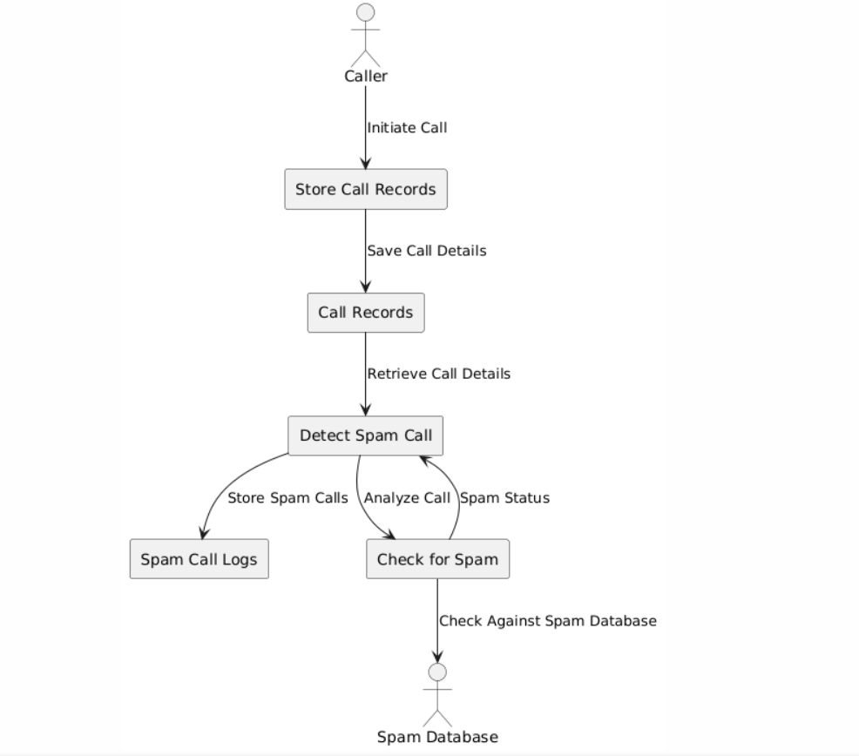
DATA FLOW DIAGRAM

Slide 14
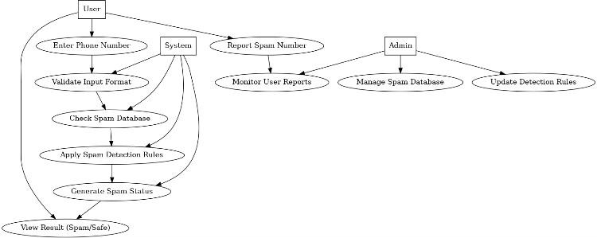
USECASE DIAGRAM

Slide 15
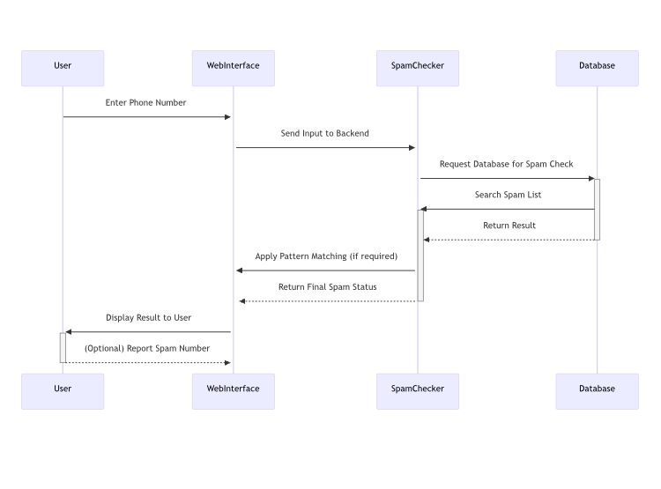
SEQUENCE DIAGRAM

Slide 16
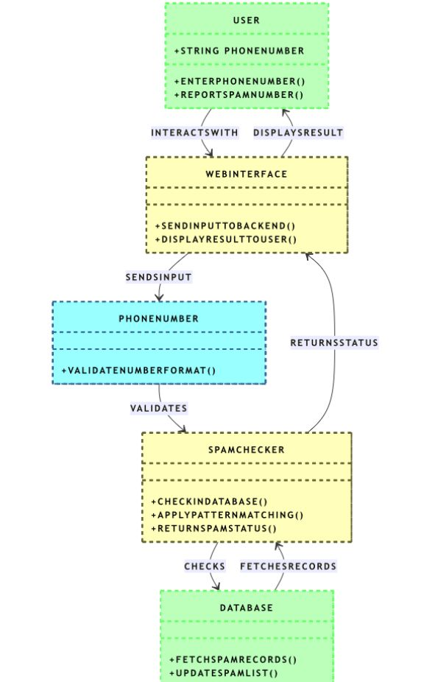
CLASS DIAGRAM

Slide 17
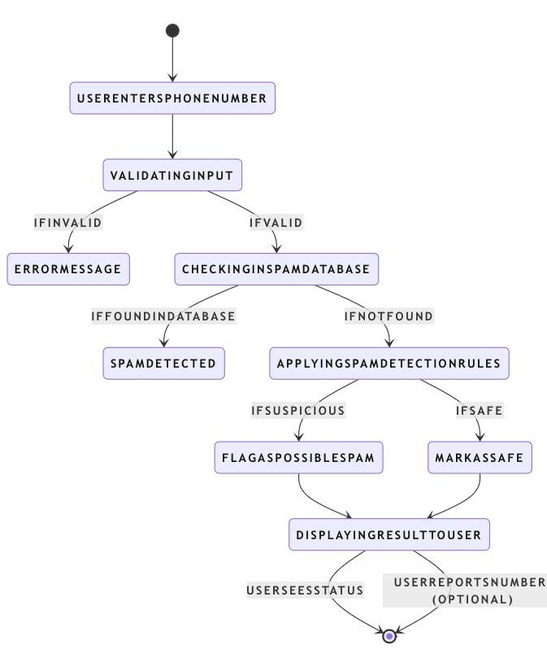
STATE CHART DIAGRAM

Slide 18
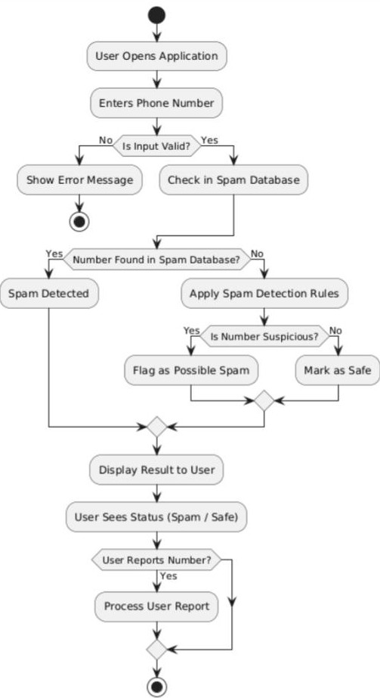
ACTIVITY DIAGRAM

Slide 19
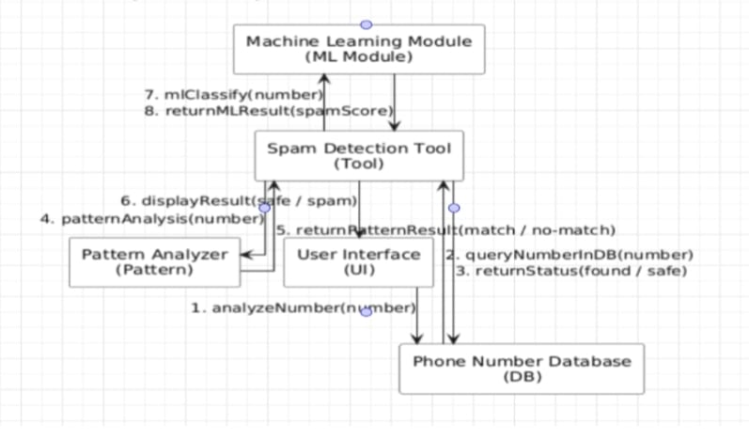
COLLABORATION DIAGRAM

Slide 20
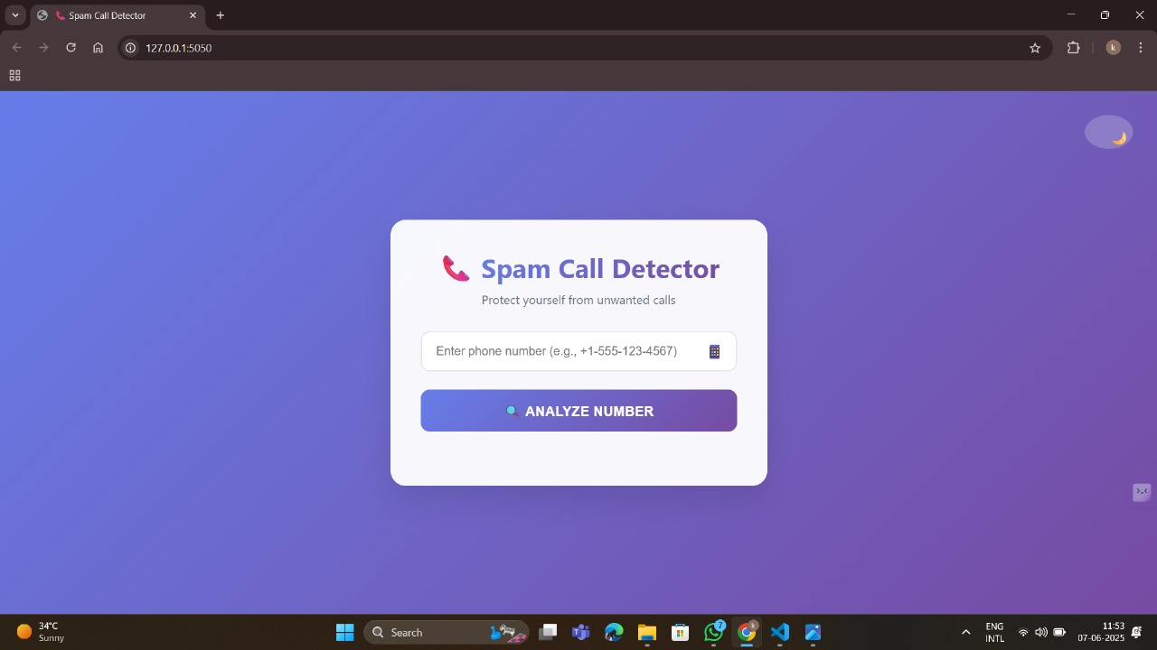
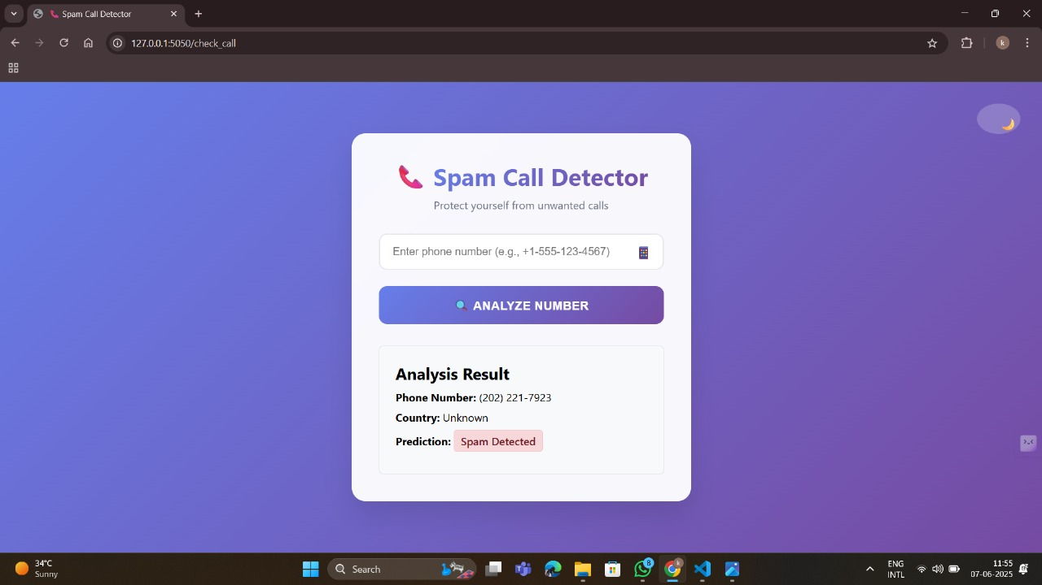
OUTPUT

Slide 21
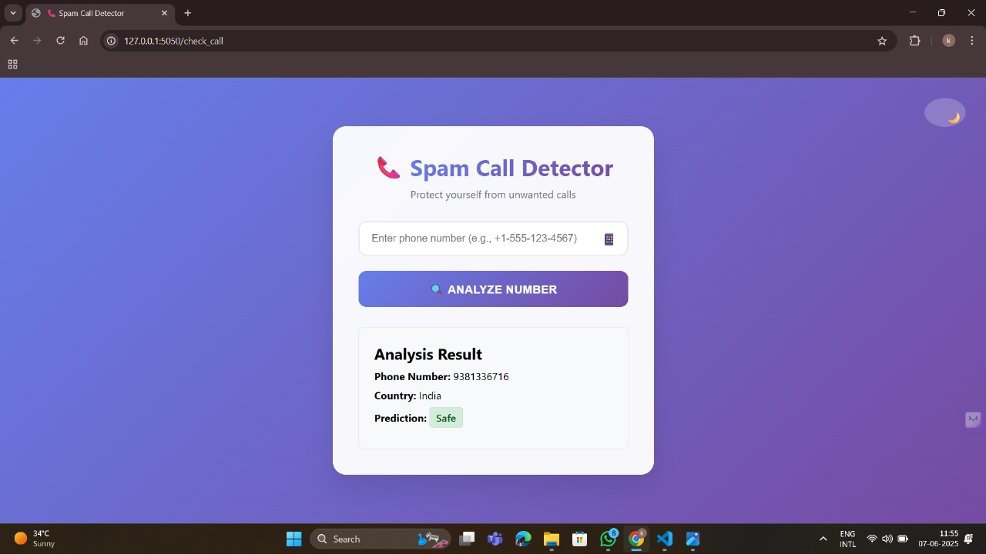
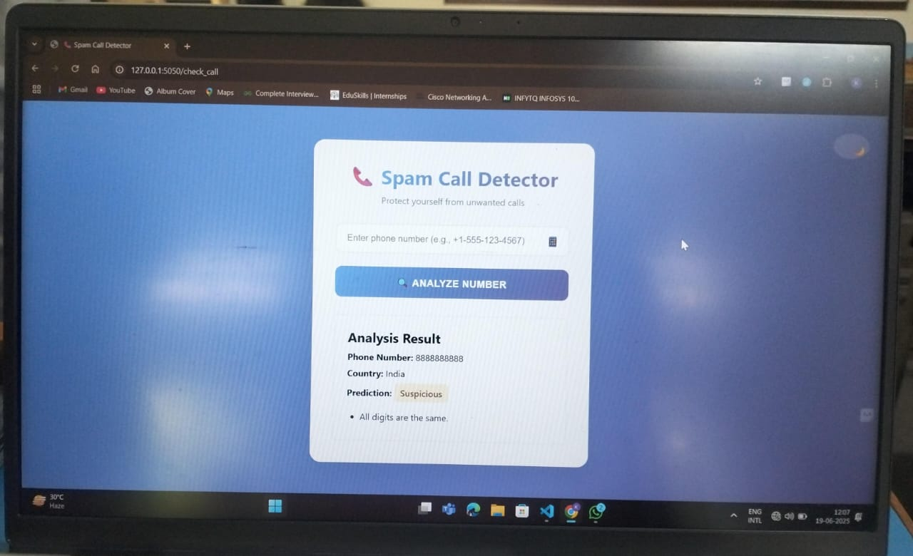

Slide 22
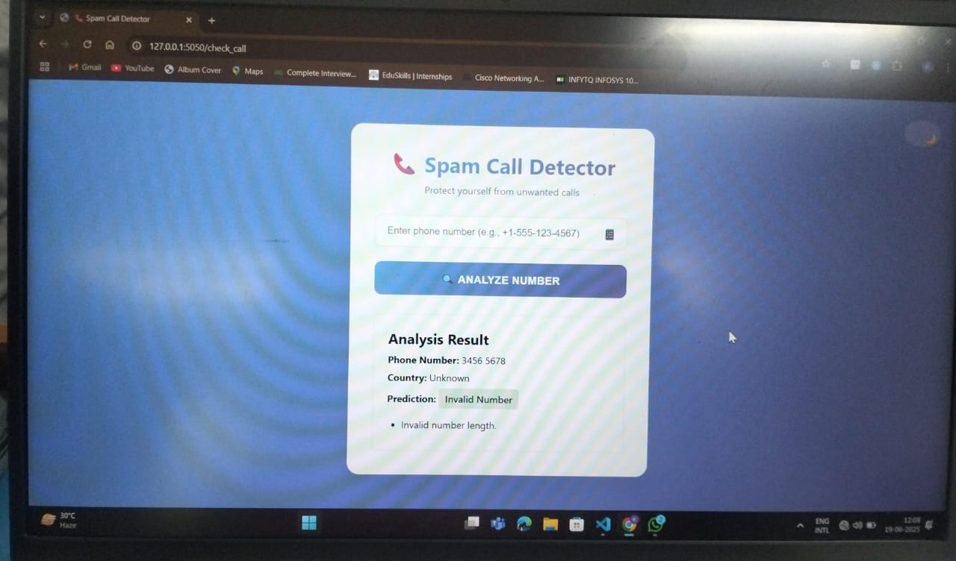

Slide 23
CONCLUSION
Spam calls have become a significant issue in the modern era of mobile communication, posing threats to user privacy, security, and productivity. Traditional rule-based or manual filtering techniques have proven inadequate in handling the volume and evolving nature of spam calls. To overcome these limitations, our project demonstrates how Machine Learning (ML) can be effectively utilized to build an intelligent, adaptive system for spam call detection.
By analyzing historical call patterns and extracting meaningful features, we trained and evaluated classification models capable of accurately distinguishing between spam and legitimate calls. Our approach not only automates the detection process but also offers the flexibility to learn and adapt from new data, making it robust against evolving spam strategies.

Slide 24
THANK YOU

