Slide 1
DIU LANDTECH INNOVATION HACKATHON 2026 · PROBLEM P3
🛡️ TrueDeed (LA-72)
Algorithmic Land Fraud & Double-Selling Prevention Platform
A National Decision-Support System for Sub-Registry Pre-Registration Title Verification
Team Leader: Ishtiak Ahmed (ID: 0242310005101006) | Member: Ashfikur Rahman Mahi
Faculty Mentor: Md. Jubayar Alam Rafi (Asst. Prof, CSE, DIU) | Industry Mentor: MD Zafor Iqbal
Live Prototype: https://frontend-five-sage-86.vercel.app

Slide 2
PROBLEM STATEMENT (P3)
The 3.5 Million Land Dispute Crisis in Bangladesh
Institutional Void
• Ministry of Law (Sub-Registry) registers deeds without live khatian mutation visibility.
• Ministry of Land (AC Land) updates e-Namjari separately.
• This disconnected silo allows forged deeds to register before mutations are detected.
Core Fraud Vectors
• Inheritance Overclaiming: Sellers claiming 22 shatak when Quranic Farayez entitles only 14.
• Broken Chain-of-Title: Fake intermediate deeds with non-existent mutation DCR orders.
• Double-Selling Scams: Same plot sold to multiple buyers across neighboring sub-registries.
Socio-Economic Damage
• Over 70% of all civil court litigations in Bangladesh stem from land fraud.
• 3.5 Million pending cases paralyzing district and civil courts.
• BDT Thousands of Crores in frozen capital and non-performing mortgage loans for banks.

Slide 3
THE INNOVATION
TrueDeed: Automated Pre-Registration Interception Layer
How TrueDeed Solves P3
• Pre-Registration Gatekeeper: Validates land title in sub-second time (3.8s) BEFORE stamp registration.
• Deterministic Trust Score (0-100%): Explainable mathematical rating backed by strict hard vetoes.
• Instant Hard Veto Block: Automatically cancels registration upon detecting Order 39 CPC court injunctions or broken chains.
• Tamper-Proof Proof: Cryptographic SHA-256 Merkle root & dynamic QR verification certificate.
3 Pillars of Protection
• 1. Farayez Statutory Quota Interceptor: Quranic inheritance calculation (Muslim Family Laws 1961).
• 2. 25-Year Baya DAG Lineage Tracer: Directed Acyclic Graph tracking ownership from CS 1921 to 2026.
• 3. 45-Day Concurrency Plot Lock: Real-time mutex lock across all Sub-Registries during mutation window.

Slide 4
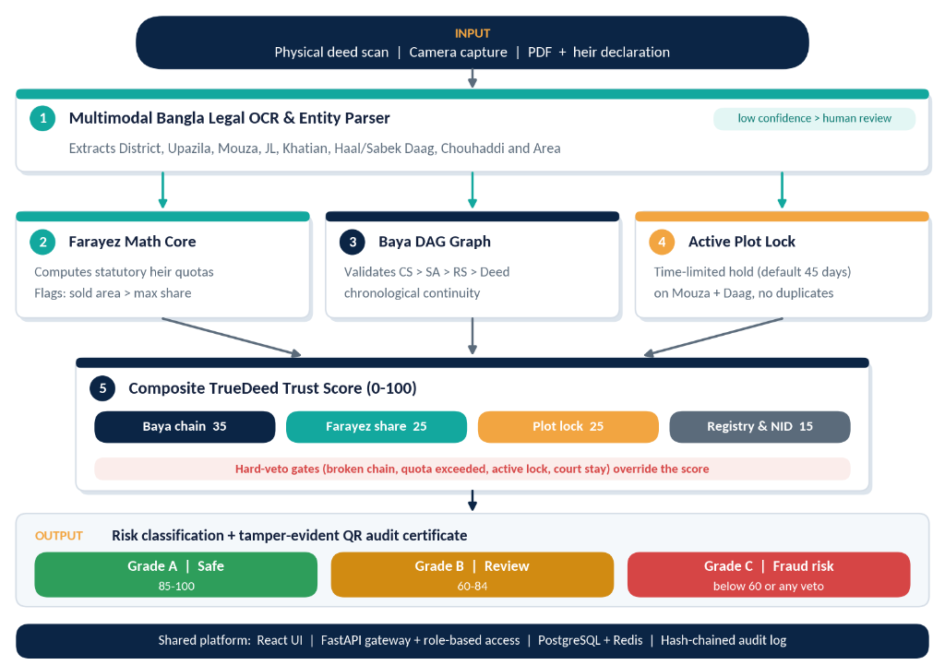
TECHNICAL BLUEPRINT
End-to-End System Architecture

Slide 5
LIVE USER EXPERIENCE
The 3-Page Interactive Prototype Suite
1. Verification Cockpit
• Deed Intake with OpenCV bounding boxes.
• Normalized bilingual entity extraction (District, Upazila, Daag, Acreage, NID).
• Interactive Deed Upload & Case Switcher (Test Clean, Overclaim, or Locked deeds).
• Hard Veto alert and dynamic digital certificate generation.
2. Baya DAG Lineage Tracer
• 5-Node Directed Acyclic Graph (CS 1921 -> SA 1962 -> RS 1987 -> Deed 2009 -> Seller 2026).
• Interactive Node Inspector: Reveals record room volumes, gazettes and map sheets.
• Area Conservation Math: 120 -> 60 -> 40 Shatak.
• 1-Click Baya Chain Audit Dossier (PDF Download).
3. Farayez Calculator Sandbox
• Hanafi Legal Math Engine implementing Zawil Furood, Asaba & Aul doctrine.
• Tactile Heirs Stepper (+/-) with live SVG Donut.
• Bidirectional Cockpit Sync: Inject sandbox calculations directly into active deed verification.

Slide 6
STAKEHOLDER ECOSYSTEM
Tailored Governance for 3 Core Personas
🏛️ Sub-Registrar Desk
• Statutory registration authority under Registration Act 1908.
• Automated Section 22A compliance check.
• Instant Hard Veto: Stops fake registration before ink touches deed stamp.
• Issues QR-signed Digital Title Certificate.
🏦 Commercial Bank Desk
• Mortgage collateral clearance for BDT 45 Lakh Home Loan.
• Duplicate Lien & CIB Record check across national registries.
• Zero-Lien Title Clearance Certificate generation for Credit Risk approvals.
🛡️ Citizen & NRB Portal
• Buyer Due-Diligence portal for general citizens and expatriate Bangladeshis.
• Pre-purchase title fraud shield: Prevents buying disputed or co-heir burdened land.
• Direct integration with Land Ministry Hotline (16122) & Legal Aid (16430).

Slide 7
COMPETITIVE ADVANTAGE
Why TrueDeed Wins (Comparative Benchmark)
Traditional Land System vs TrueDeed
• Traditional: Manual visual deed inspection taking 15-30 days → TrueDeed: 3.8s automated algorithmic check.
• Traditional: No live link between Sub-Registry & AC Land → TrueDeed: 45-day atomic plot concurrency lock.
• Traditional: Inheritance fraud discovered years after sale → TrueDeed: Pre-registration Quranic Farayez quota quota block.
• Traditional: Unverified deed chains → TrueDeed: 100-year cryptographic DAG lineage proof.
Prototype Maturity & Deliverables
• ✓ Live 24/7 Production Prototype hosted on Vercel: frontend-five-sage-86.vercel.app
• ✓ Pure 100% Bilingual localization (Authentic Bengali & English terminology).
• ✓ Tested locally and in cloud with 0 cold-start latency.
• ✓ Complete 4-Page Concept Note, 10 Vector Blueprints & Video demonstration ready.

Slide 8
VISION & IMPACT
Execution Roadmap & National Scale-Up
Implementation Milestones
• Phase 1 (Hackathon MVP): Completed End-to-end prototype, Farayez sandbox & DAG engine.
• Phase 2 (Pilot Sandbox): Direct webhook integration with Ministry of Land e-Mutation & e-Porcha APIs.
• Phase 3 (National Rollout): Deployment across 500+ Sub-Registry offices under Ministry of Law.
• Projected Impact: Eliminates over 80% of new land litigation at the point of registration.
Summary & Team TrueDeed (LA-72)
• TrueDeed transforms Bangladesh land governance from reactive litigation to proactive algorithmic prevention.
• Project Repo: https://github.com/Ishtiak-Ahmed886/TrueDeed
• Live Demo: https://frontend-five-sage-86.vercel.app
• Thank you to our Mentors, Organizers, and Esteemed Judges!

