Slide 1
Airline Passenger and Luggage Management System
by

Slide 2
Scenario::
Design and implement a Airline Passenger and Luggage Management System application with the following features:
Create a base class Passenger that represents a passenger in the system. It should have attributes like passenger ID , name, age, gender, nationality, and ticketNumber . Implement constructors, accessors , and mutators as needed.
Create derived classes Economy Passenger and Business Passenger that inherit from the Passenger class. Each derived class should have its own unique attributes and methods. For example, an Economy Passenger may have additional attributes like seat Number, meal Preference, and baggage Allowance, while a Business Passenger may include attributes like priority Boarding, lounge Access, and additional Services.
Implement dynamic binding and polymorphism by defining virtual functions in the base class and overriding them in the derived classes. For example, create a virtual function displayDetails() that displays the passenger details based on their type (economy or business class).

Slide 3
create a class luggage to represent luggage information. it should have attributes like luggageld, passengerid (to associate luggage with passengers), weight, size, and contents. implement appropriate constructors, accessors, and mutators.
implement exception handling to manage runtime errors. for example, handle exceptions when a passenger attempts to exceed luggage weight limit, add duplicate luggage id, or if the passenger details are invalid.
develop a file handling system to store and retrieve passenger and luggage information securely. implement encryption and decryption mechanisms for data storage. create functions for saving the passenger and luggage details to a file and loading data from a file, ensuring data remains encrypted.

Slide 4
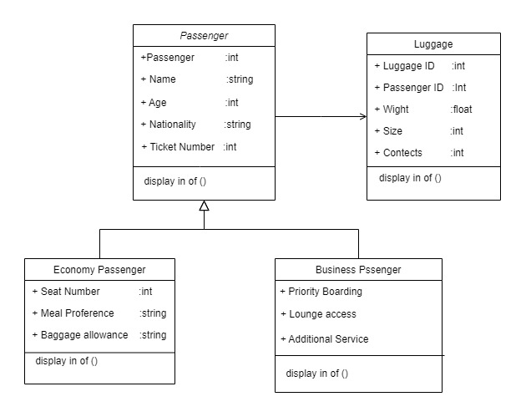
Class diagram:

Slide 5
Use case diagram

Slide 7
THANK you

